Slide 1



KM3NeT-INFRADEV2
WP5:
Sustainability and Socio-economic impact
Christos Markou, NCSR Demokritos
March 27th, 2023
Funded by the European Union. Views and opinions expressed are however those of the author(s) only and do not necessarily reflect those of the European Research Agency (REA). Neither the European Union nor the REA can be held responsible for them.

Slide 2


WP5 : Members
Christos Markou: Director, Institute of Nuclear and Particle Physics, NCSR “Demokritos”, Athens, Greece
Member of the KM3NeT Management Team
Chair of the Conference Committee
Member of the Publication and Outreach committees
Chair of the KM3NeT Institution Board (2016 – 2020)
Coordinator of WP10 on “Zero Carbon footprint” of KM3NeT-INFRADEV -1 project (2017-2020)
Membership list (incomplete) of WP5 : Victoria Ciarlet, Giacomo Cuttone, Paolo Piattelli, Marco Romano,
Piera Sapienza, Rosa Coniglione, Paco Salesa, Ekaterini Tazamariudaki,
Evangelia Drakopoulou, NWO-I, FAU and CNRS people.
Also, 1 (possibly 2) new hire(s) to be completed soon.

Slide 3
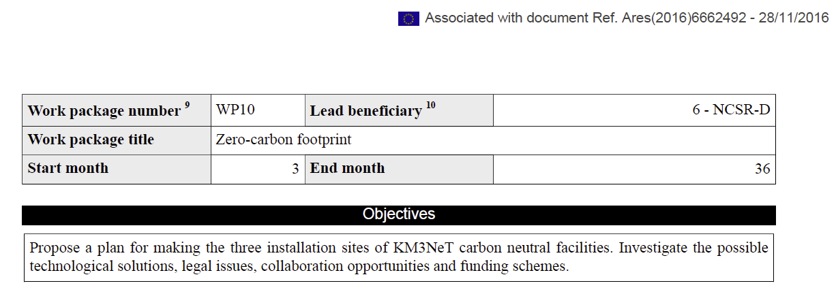
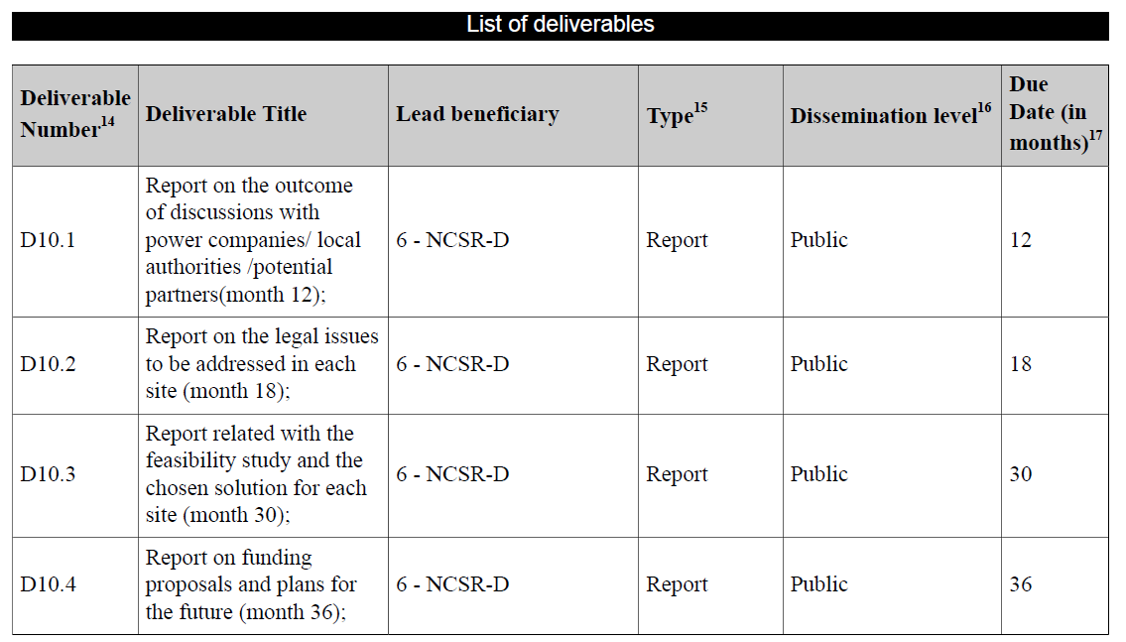
WP5 : A bit of History
WP10 of KM3NeT – INFRADEV-1 project :

Slide 4
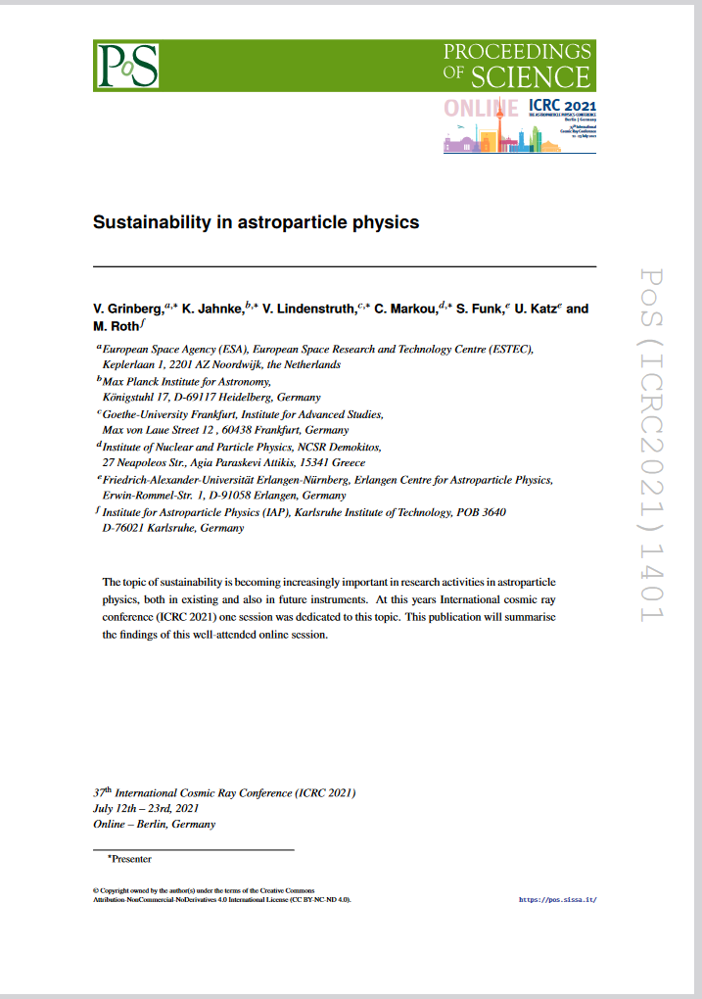
WP5 : A bit of History
Growing sensitivity and awareness of our community towards issues concerning the sustainability and environmental impact of large scale scientific efforts.

Slide 5
WP5 : Objectives
Expand the scope of measures and policies in KM3NeT to our members and activities during the lifetime of KM3NeT in a sustainable and environmental friendly manner:
Investigate possible solutions and identify procedures for transforming the daily activities of the KM3NeT community to a sustainable configuration.
Investigate the potential impact of the KM3NeT decommissioning on the environment and define procedures for eliminating adverse issues.
Define recycling schemes of the KM3NeT infrastructure at the end of the project lifetime.
Study the expected socio-economic impact of the KM3NeT infrastructure operation in the installation sites.
Expand and showcase contacts with industry for the development of new technologies.

Slide 6
WP5 : Tasks and deliverables
Task 5.1 - Procedures for sustainable travel and mobility
Task 5.2 - Green computing
Task 5.3 - Decommissioning and recycling procedures
Task 5.4 - Socio-economic impact study
Task 5.5 - Promotion of technology developments
D5.1 Report on the proposed procedures for sustainable travel and mobility
D5.2 Report on the proposed transformation to green computing
D5.3 Report on the decommissioning and recycling procedures
D5.4 Socio-economic impact study for France and Greece
D5.5 Report on the promotion of technology developments

Slide 7
WP5 – Concluding…
The environmental impact of large research infrastructures has become a strong focus of political
attention and concern of scientists alike.
WP5 will extend investigations in the INFRADEV-1 project on the carbon-neutral operation of KM3NeT to additional activities, such as travelling of Collaboration members and computing, and will derive methods and recommendations for increasing sustainability.
In addition, environment-friendly methods for KM3NeT decommissioning will be worked out.
The socio-economic impact of KM3NeT and the French and Greek sites will be studied,
and
Showcase documentations of cooperation with industry collected.
The main impact of WP5 will be the demonstration of KM3NeT as a role model for a research
infrastructure with high sustainability standards and societal and environmental awareness.

Slide 8
WP5
Thank you !
Questions / remarks ?

