Slide 1
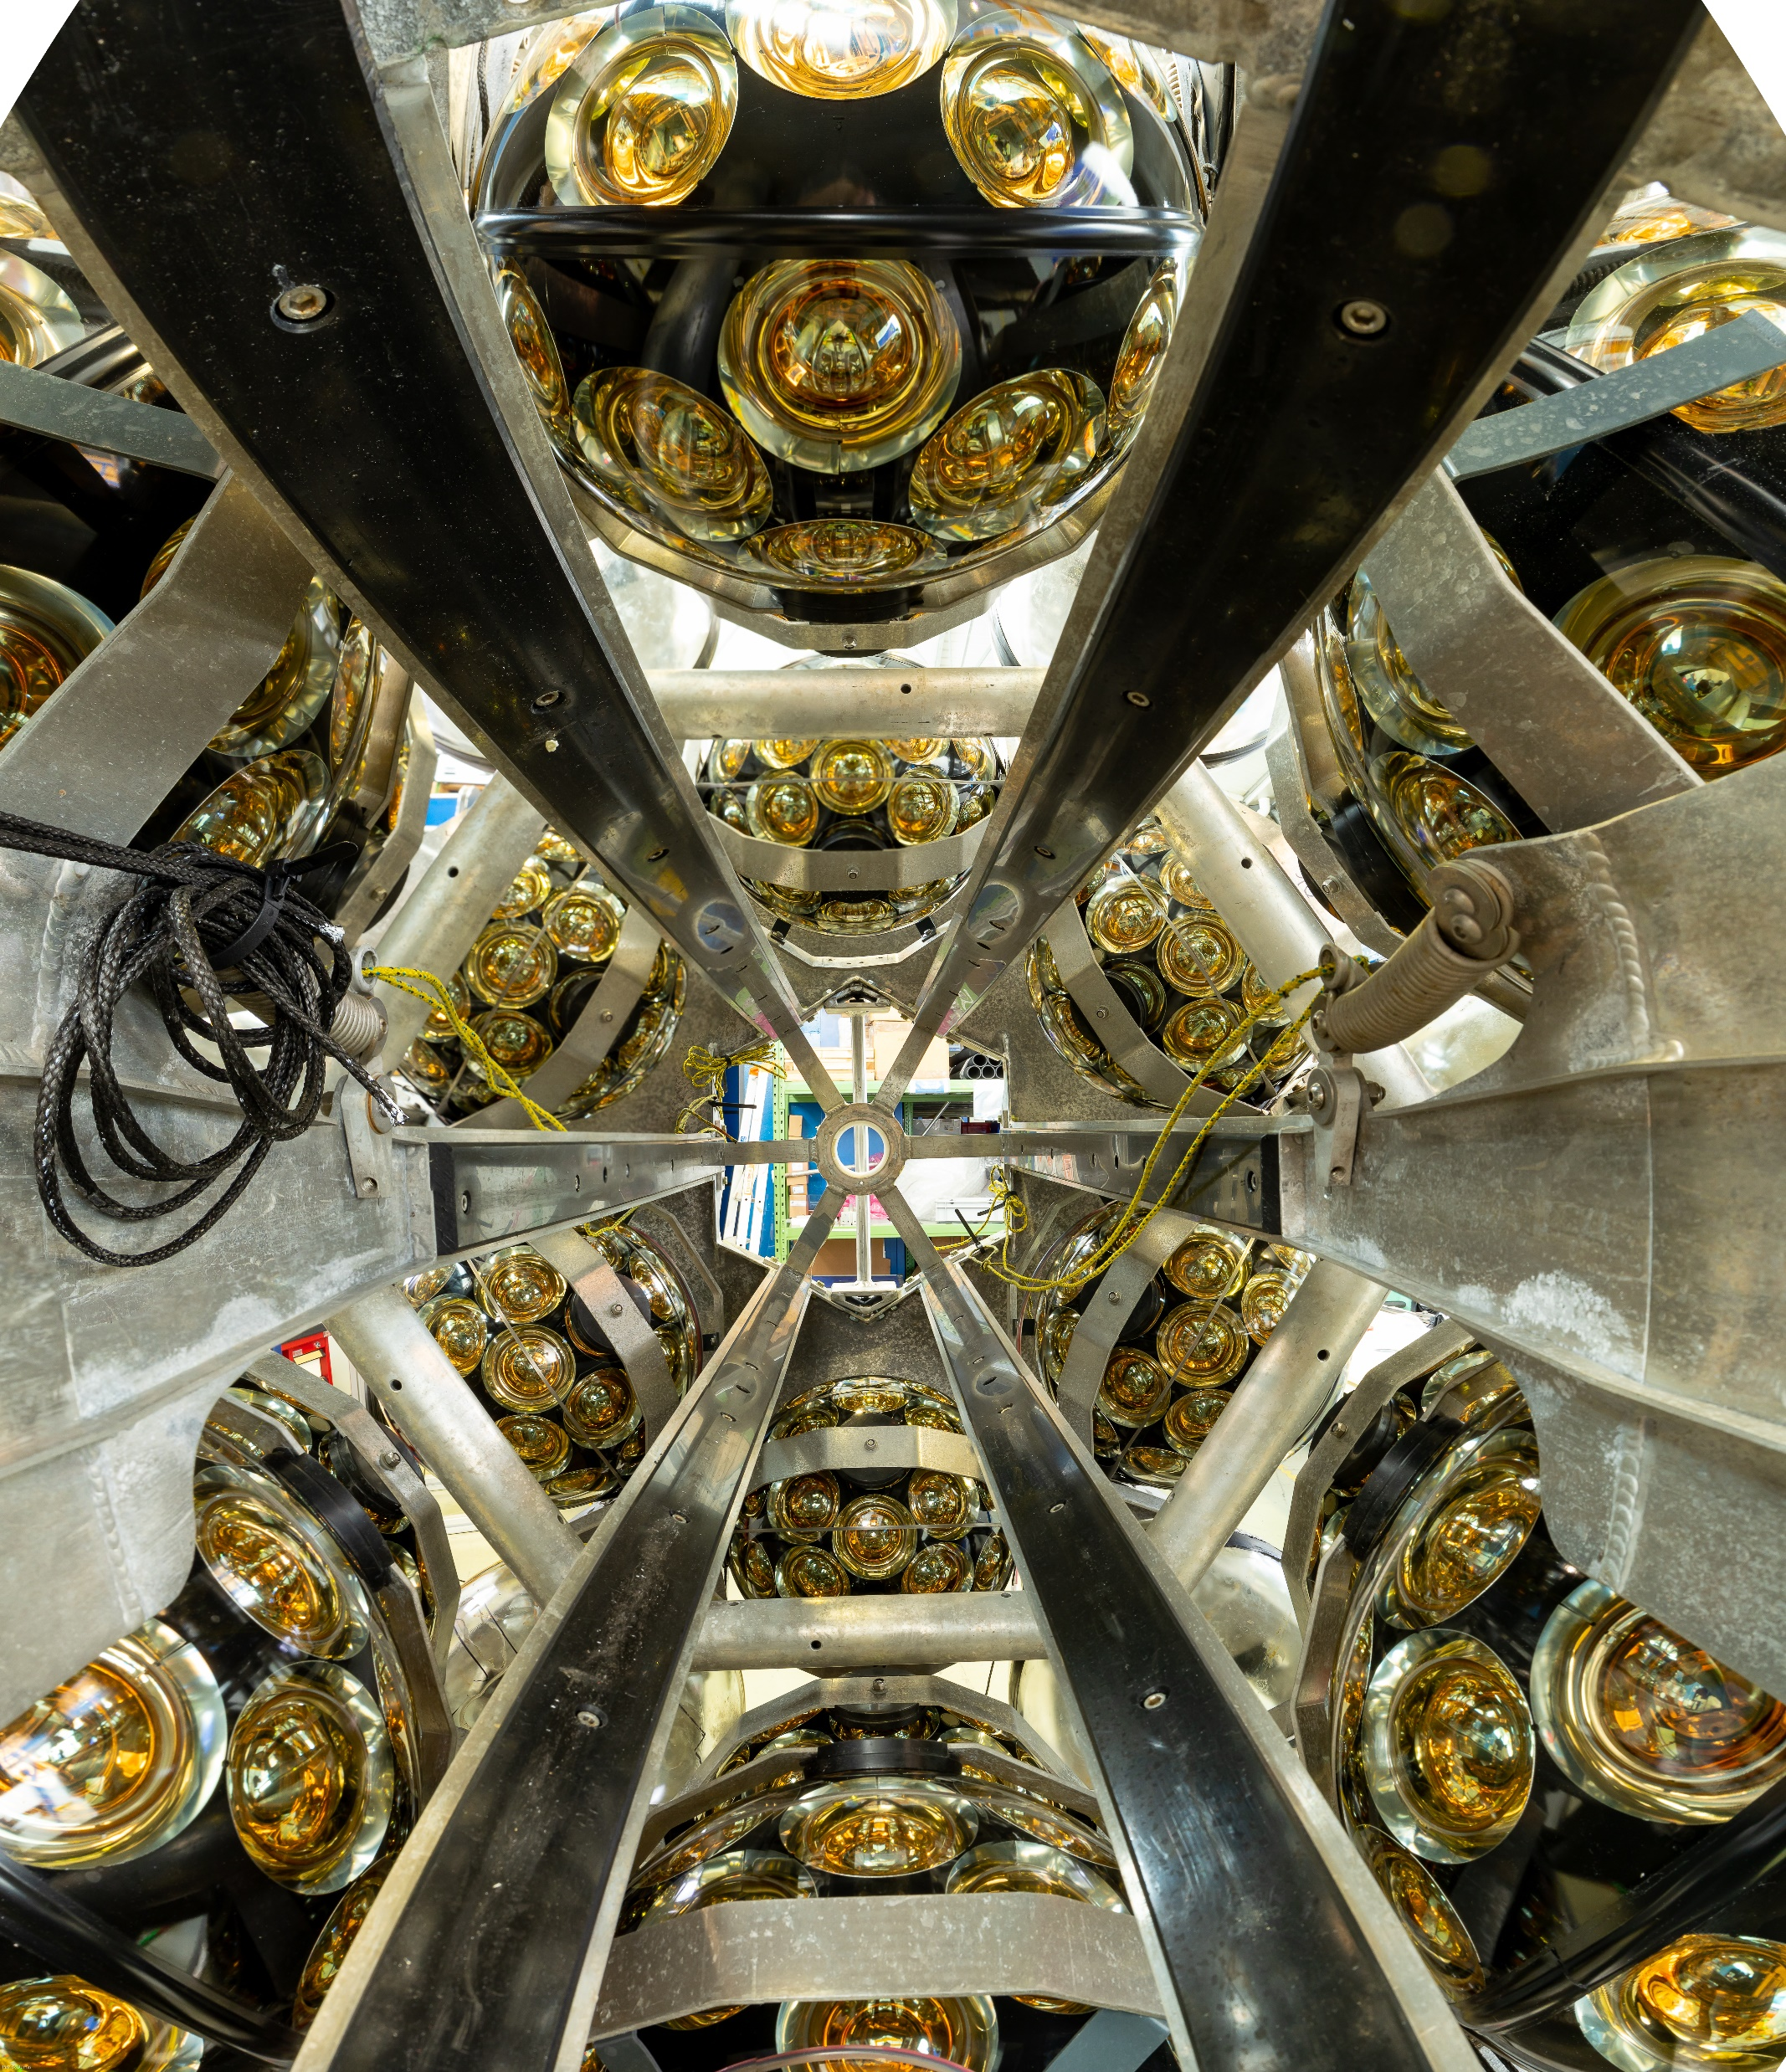

PART II
© Patrick Dumas, CNRS Images - 2019
ORGANISATIONAL WORKSHOP
Led by Paschal Coyle & Victoria Ciarlet Thaon

Slide 2
1. Confirmation of the WP members
Is someone missing ?
Do you plan on recruiting / adding someone else ? (who, when and on which task ?)
WP2 – Piera Sapienza (INFN)
Victoria Ciarlet
Paschal Coyle
Mathieu Perrin-Terrin
Paul de Jong
Hans Chang
Aart Heijoboer
Juande Zornoza
Uli Katz
Giacomo Cuttone
Veronica Buccheri
Laura Barracco
Attilio Sequi
Marco Romano
Marco Pallavicini
WP3 – Miles Lindsey Clark (CNRS)
Victoria Ciarlet
Paschal Coyle
Nick Lumb
Tommaso Chiarusi
Rosa Coniglione
Marco Circella
Stéphane Colonges
2 new comers :
Procurement Officer
RAMS Officer(s)
+ 1 PhD student
WP4 – Jutta Schnabel & Kay Graf (FAU)
Victoria Ciarlet
Paschal Coyle
Mieke Bouwhuis
Francisco Vazquez de Sola Fernandez
Uli Katz
Paco Salesa
Vincent Cecchini
Damien Dornic
Tamas Gal
Giorgio Riccobene
Salvatore Viola
Rosa Coniglione
Dimitris Stavropoulos
Evangelia Drakopoulou
WP5 – Christos Markou (NCSR D)
Victoria Ciarlet
Paschal Coyle
Giacomo Cuttone
Paolo Piattelli
Marco Romano
Piera Sapienza
Rosa Coniglione
Paco Salesa
Nick Lumb
Uli Katz
Miles Lindsey Clark
Ekaterini Tzamariudaki
Evangelia Drakopoulou

Slide 3
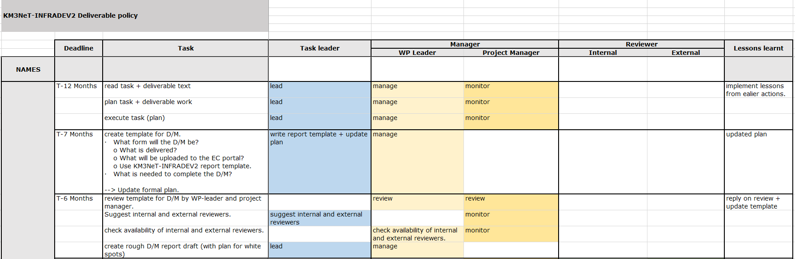
2. Deliverable Policy
Available on Google Drive to adapt for each deliverable.

Slide 4
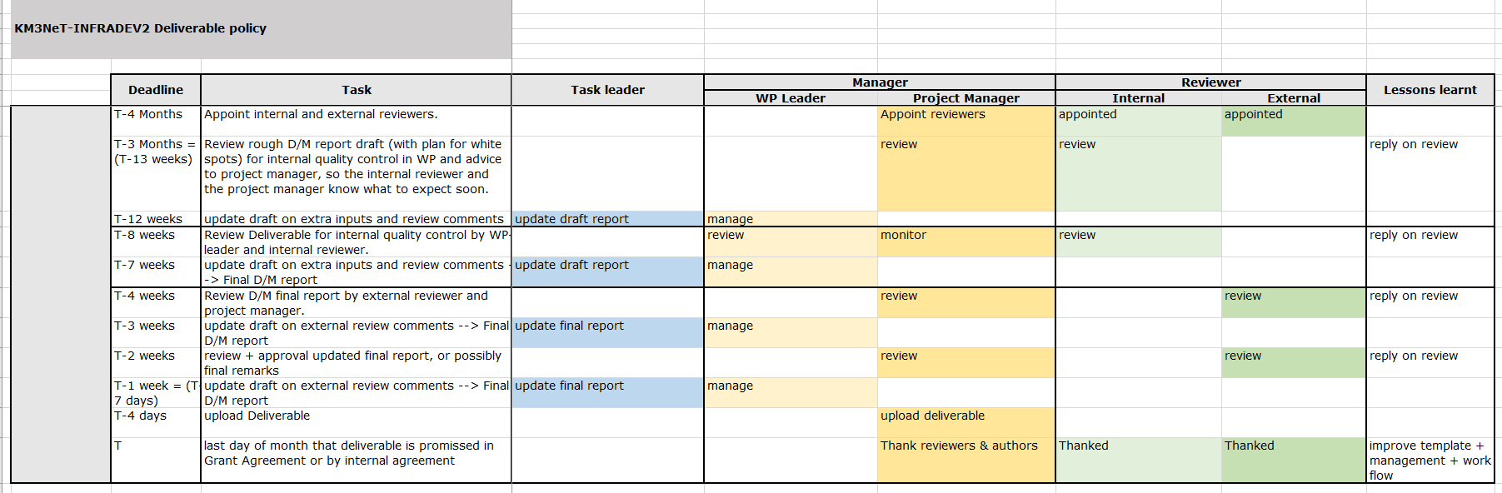
2. Deliverable Policy
Available on Google Drive to adapt for each deliverable.

Slide 5
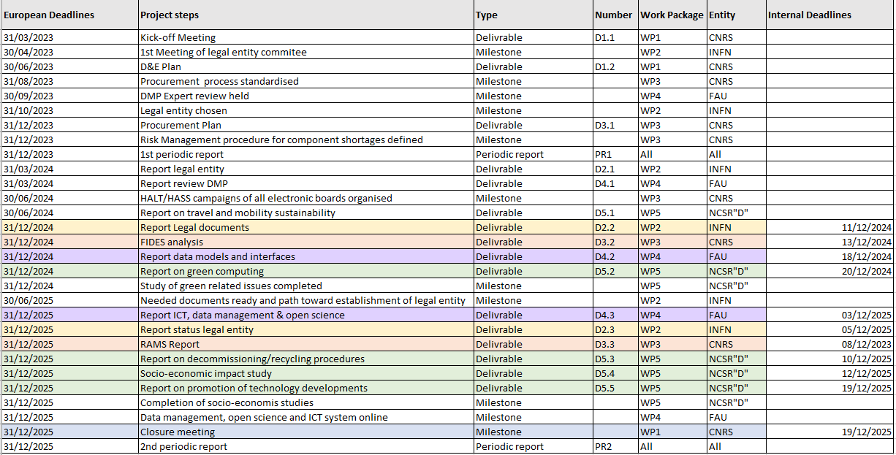
3. Planning discussion
For 31 Dec 2024:
WP2: 11 Dec
WP3: 13 Dec
WP4: 18 Dec
WP5: 20 Dec
For 31 Dec 2025:
WP4: 3 Dec
WP2: 5 Dec
WP3: 8 Dec
WP5: 10 Dec
WP5: 12 Dec
WP5: 19 Dec

Slide 6

4. Improvement of the project management
Communication tools:
Mailing: Miles suggested to use the KM3NeT Mailing tags
For example: [INFRADEV2-WP1]
Meetings: Don’t forget to use Indico for your meetings (or to inform me so I will create an Indico event)
Creation of progress planning by year to keep track on each task
Any other idea or suggestion ?

Slide 7
5. Planification of next steps & meetings
WP Coordination meetings
Coordination:
PMB: Bi or Tri monthly meetings
- Next one : beginning of May ?
WP Coordination meetings: WP2, 3 & 5
- 30min meeting in April
Next milestones & deliverables:
WP 2 Legal Entity Committee first meeting: Agenda and minutes for 30 April
D&E Plan: 30 June
- Socio economic aspects meeting
- Open Science aspects meeting
Legal Entity Committee
PMB meeting
D&E Plan content meetings

Slide 8

CONCLUSION
Any remark or suggestion about today’s event?
Few words by Paschal Coyle

Slide 9







Funded by the European Union. Views and opinions expressed are however those of the author(s) only and do not necessarily reflect those of the European Research Agency (REA). Neither the European Union nor the REA can be held responsible for them.
Thank you!
Merci, Danke, Grazie, Σας ευχαριστώ, Bedankt, Gracias

