Slide 1




Muon Collider
D. Schulte
for the International Muon Collider Collaboration
JUAS 2023
February 2023

Slide 2
Motivation and Goal
Previous studies in US (now very strong interest again), experimental programme in UK and alternatives studies by INFN
New strong interest in high-energy, high-luminosity lepton collider
Combines precision physics and discovery reach
Muon collider promises sustainable approach to the energy frontier
limited power consumption, cost and land use
Technology and design advances in past years
review did not find any showstoppers
Goal is
10+ TeV collider
potential initial energy stage (e.g. 3 TeV)
higher energies to be explored later
2

Slide 3
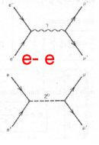
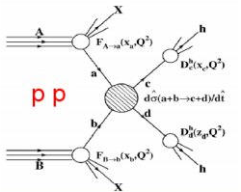
Physics Goals
Energy for discovery reach
10-14 TeV lepton collisions comparable to 100-200 TeV proton collisions
Leptons make the full energy available for particle production, protons only a fraction
Theorists defined goals:
Yields constant number of events in the s-channel
Luminosity must increase as E_{cm}² as production cross sections decrease
3

Slide 4
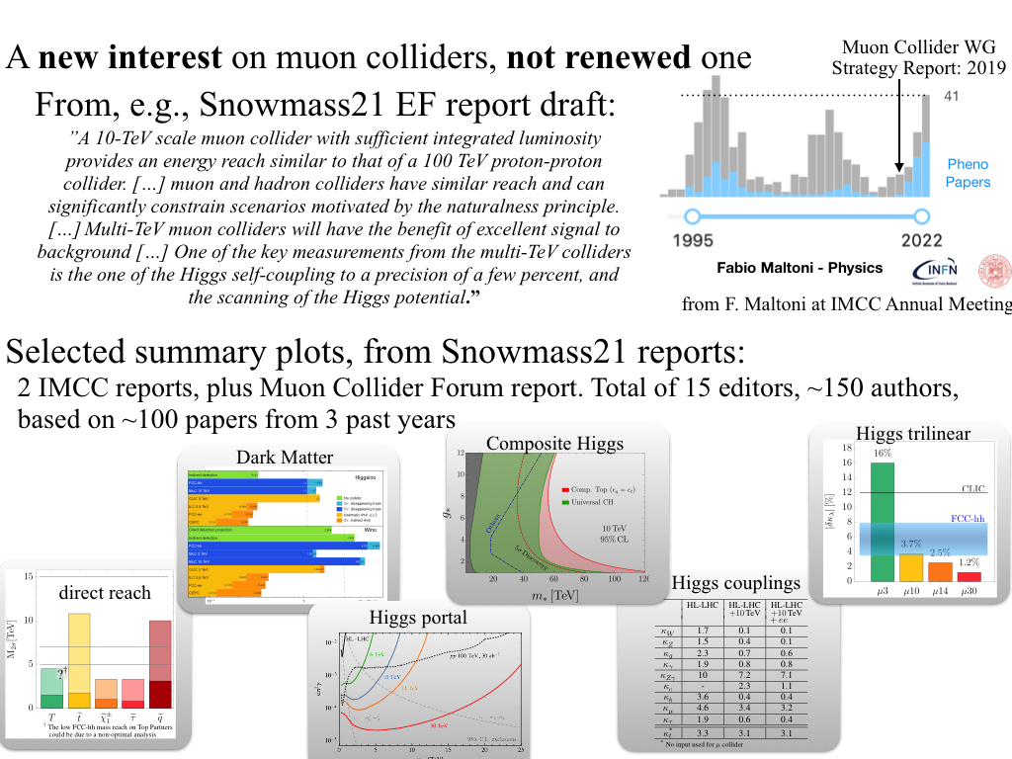
A new Interest in Muon Colliders
A. Wulzer, F. Maltoni, P. Meade et al.
O(150) authors, 15 editors, 100 papers
Strong US involvement starting with Muon Smasher’s Guide
and in Muon Collider Forum

Slide 5
High-energy Colliders
accelerating cavities
Electron-positron rings are multi-pass colliders limited by synchrotron radiation due to small electron mass of 0.511MeV: LEP, FCC-ee, CEPC
Hence proton rings are energy frontier: LHC, FCC-hh, SppC
N
N
S
S
Electron-positron linear colliders avoid synchrotron radiation, but single pass: SLC, ILC, CLIC
Typically cost proportional to energy and power proportional to luminosity,
Novel approach: muon collider (the first of its kind)
Large mass of 105.7 MeV suppresses synchrotron radiation => multi-pass
Fundamental particle requires less energy than protons
But lifetime at rest only 2.2 μs
Proportional to energy γ x 2.2 μs => accelerate rapidly collider in small ring

Slide 6
Muon Collider Overview
Would be easy if the muons did not decay
Lifetime is τ = γ x 2.2 μs
Short, intense proton bunch
Ionisation cooling of muon in matter
Acceleration to collision energy
Collision
Protons produce pions which decay into muons
muons are captured
6

Slide 7
Cost and Sustainability
CLIC is highest energy proposal with CDR
No obvious way to further improve linear colliders (decades of R&D)
Cost 18 GCHF, power approx. 500 MW
Rough rule of thumb:
cost proportional to energy
power proportional to luminosity
Muon Collider goals (10 TeV), challenging but reasonable:
Much more luminosity than CLIC at 3 TeV (L=20x10³⁴, CLIC: L=2x10³⁴/6x10³⁴)
Lower power consumption than CLIC at 3 TeV (P_{beam,MC}=0.5P_{beam,CLIC})
Lower cost
Staging is possible
Synergies exist (neutrino/higgs)
Unique opportunity for a high-energy, high-luminosity lepton collider
7

Slide 8
Accelerator R&D Roadmap
On CERN Council request Laboratory Directors Group developed Accelerator R&D Roadmap
global community participated, a global roadmap
No insurmountable obstacle found for the muon collider
but important need for R&D
developed two funding scenarios
Full scenario deliverables by next ESPPU/other processes
Project Evaluation Report
R&D Plan that describes a path towards the collider;
Allows to make informed decisions
Council asked for implementation plan
do not yet have the resources of the reduced scenario
Scenario | FTEy | M MCHF
Full scenario | 445.9 | 11.9
Reduced scenario | 193 | 2.45
http://arxiv.org/abs/2201.07895
8

Slide 9

Muon Collider Community
Formed collaboration to implement and R&D Roadmap for CERN Council
EU Design Study approved this summer, 32 partners, O(3+4 MEUR)
(EU+Switzerland+UK and partners)
50+ partner institutions
30+ already signed formal agreement
US Snowmass has strong support
to contribute to R&D
as a collider in the US
Now waiting for P5
Plan to apply in 2024 for HORIZON-INFRA-2024-TECH Goal: prepare experimental programme, e.g. demonstrator, prototypes, …

Slide 10
Technically Limited Timeline
To be reviewed considering progress, funding and decisions
Muon collider important in the long term
Prudently explore if MuC can be option as next project
e.g. in Europe if higgs factory built elsewhere
sufficient funding required now
very strong ramp-up required after 2026
might require compromises on initial scope and performance
  3 TeV
Evaluation+decision
Evaluation+decision
10

Slide 11
Initial Target Parameters
Target integrated luminosities
Note: currently focus on 10 TeV, also explore 3 TeV
Tentative parameters based on MAP study, might add margins
Achieve goal in 5 years
FCC-hh to operate for 25 years
Aim to have two detectors
Parameter | Unit | 3 TeV | 10 TeV | 14 TeV
L | 10³⁴ cm⁻²s⁻¹ | 1.8 | 20 | 40
N | 10¹² | 2.2 | 1.8 | 1.8
f_{r} | Hz | 5 | 5 | 5
P_{beam} | MW | 5.3 | 14.4 | 20
C | km | 4.5 | 10 | 14
<B> | T | 7 | 10.5 | 10.5
ε_{L} | MeV m | 7.5 | 7.5 | 7.5
σ_{E} / E | % | 0.1 | 0.1 | 0.1
σ_{z} | mm | 5 | 1.5 | 1.07
β | mm | 5 | 1.5 | 1.07
ε | μm | 25 | 25 | 25
σ_{x,y} | μm | 3.0 | 0.9 | 0.63
CLIC at 3 TeV
2 (6)
28
11

Slide 12
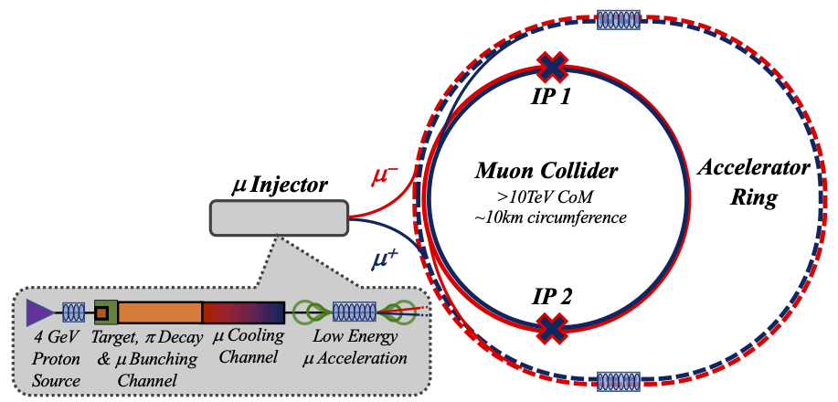
Key Challenges
0) Physics case
4) Drives the beam quality
MAP put much effort in design
optimise as much as possible
2) Beam-induced background
1) Dense neutrino flux
mitigated by mover system and site selection
3) Cost and power consumption limit energy reach
e.g. 35 km accelerator for 10 TeV, 10 km collider ring
Also impacts beam quality
12

Slide 13
Key Technology Challenges
RCS
- Beam dynamics
- Ramping magnets
- Power converter
- Superconducting RF system
Target
- High-power Target
- Superconducting solenoid
Cooling channel
- Channel design
- Superconducting solenoids
- Normal-conducting RF in magnetic field
- Absorbers and windows
- Integration
Collider ring
- Optics
- Superconducting magnets
- Neutrino flux
- Detector background
Proton complex
- Compressing protons to few bunches
13

Slide 14
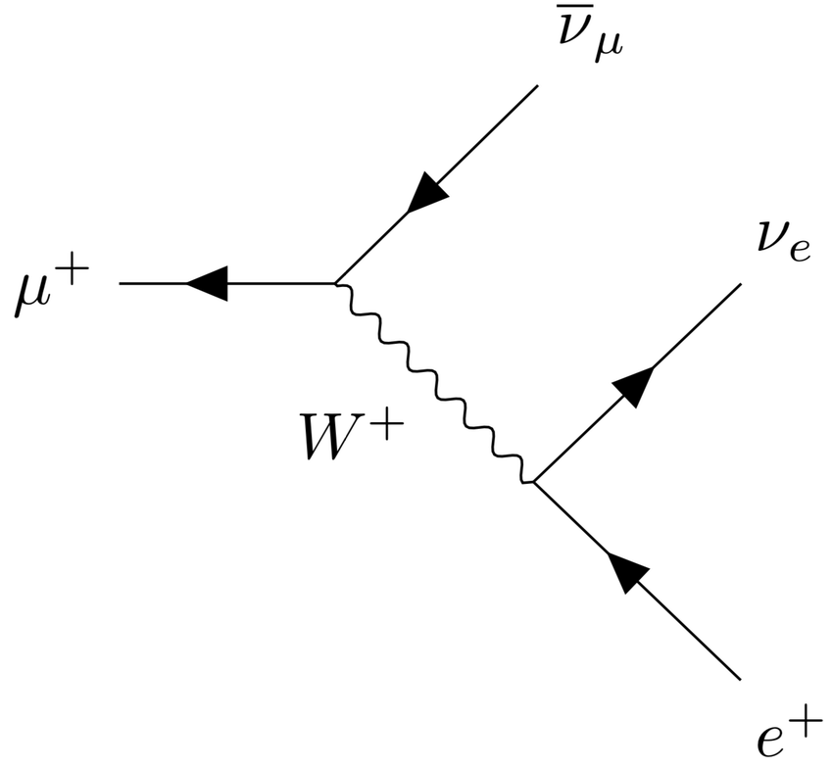
Muon Decay
Muons decay produces neutrinos, electrons and positrons
Electrons/positrons carry on average 1/3 of the muon energy
They will be lost in the machine
Need to protect machine and detector
Muon decays per bunch passage decreases with energy
235,000 m⁻¹ at 3 TeV
58,000 m⁻¹ at 10 TeV
14

Slide 15
Muon Decay and Detector Background
15

Slide 16
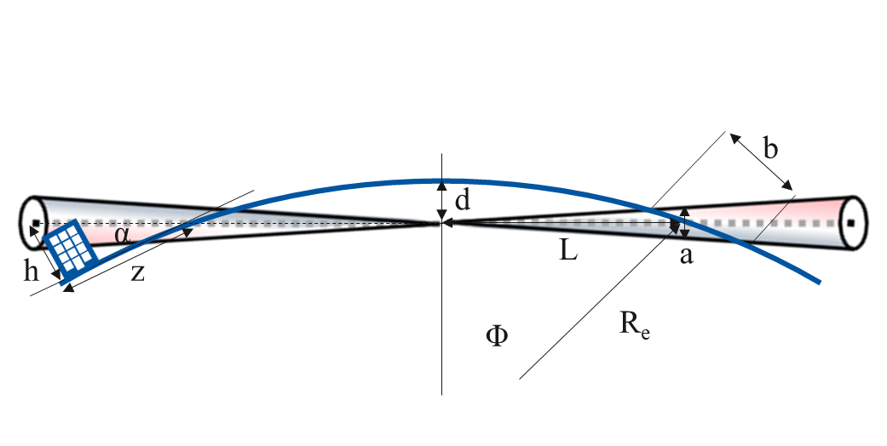
Neutrino Flux
~2 x 600 m
16

Slide 17
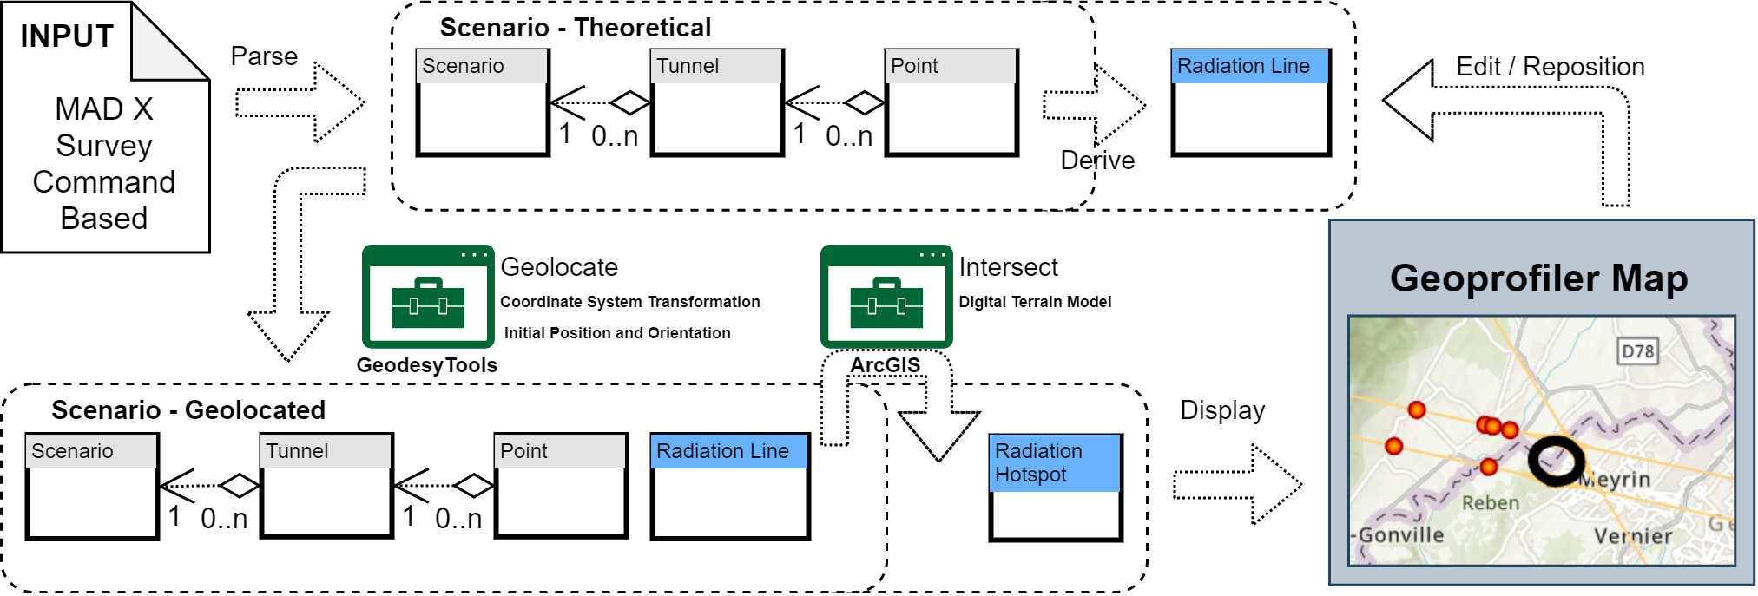
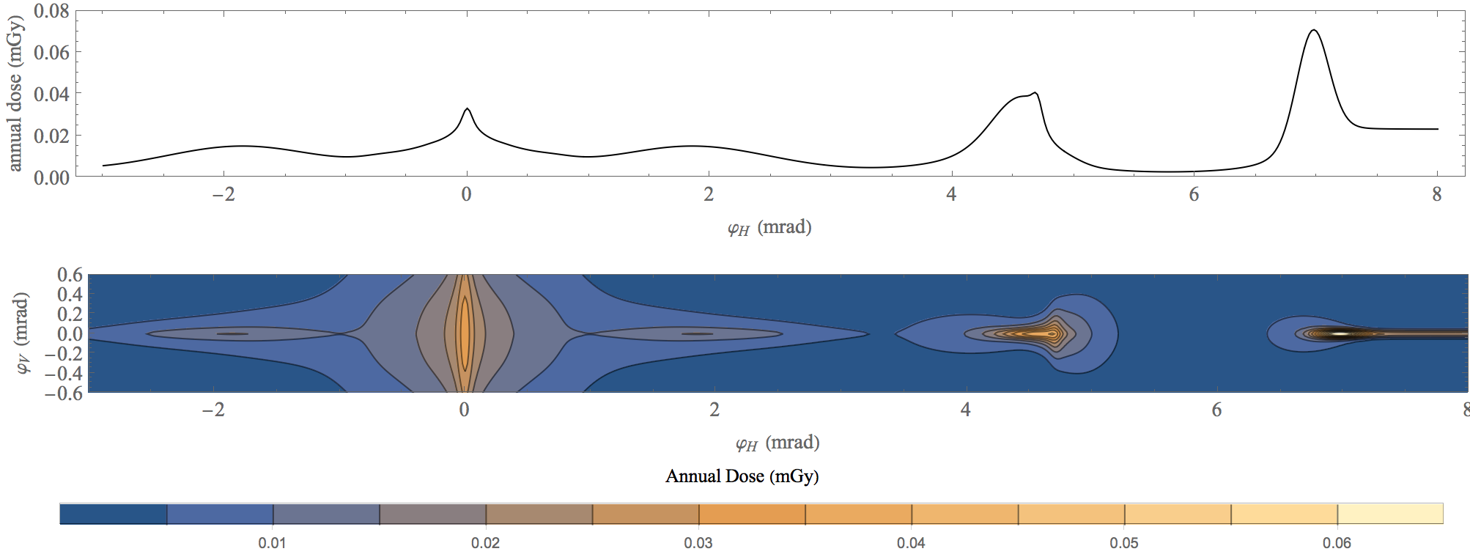
Neutrino Flux Mitigation
Goal: similar to LHC: limit neutrino flux to have negligible impact, “fully optimised” (10% of MAP goal)
Verify performance of concept to be good for 14 TeV
Mover and support system
FLUKA dose studies
Conformity Verification Scheme
F. Bertinelli et al. (CERN, Riga)
G. Lerner, D. Calzolari, A. Lechner, C. Ahdida
G. Lacerda, Y. Robert, N. Guilhaudin (CERN)
C. Ahdida, P. Vojtyla, M. Widorski, H. Vincke
Flux direction map / lattice design / mover impact on beam
Mitigation:
Site choice tool
C. Carli, K. Skoufaris (CERN)
17

Slide 18
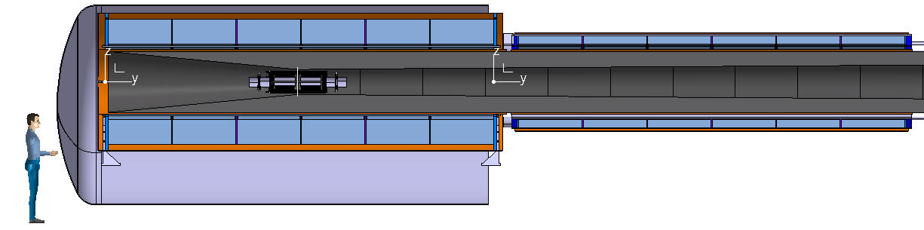
Proton Complex and Target Area
2 MW Proton beam power is no issue
some challenges in H- source and accumulator and combiner complex
Thick shielding of superconducting solenoid
Large aperture superconducting solenoid to guide pions/muons

Slide 19
Target Design
5 x 10¹⁴ protons/pulse, 5 GeV (0.4 MJ), 5 Hz
graphite rod with 15 mm radius
or liquid lead
or fluidised tungsten
CNGS
Thick shielding around target to protect solenoid from radiation and neutrons
CNGS target
3.5 x 10¹³ protons/pulse, 400 GeV (2.2 MJ), 1/6 Hz

Slide 20
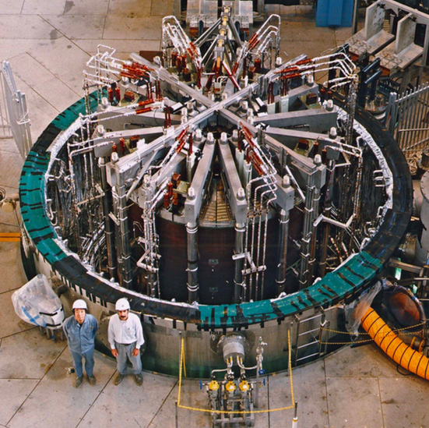
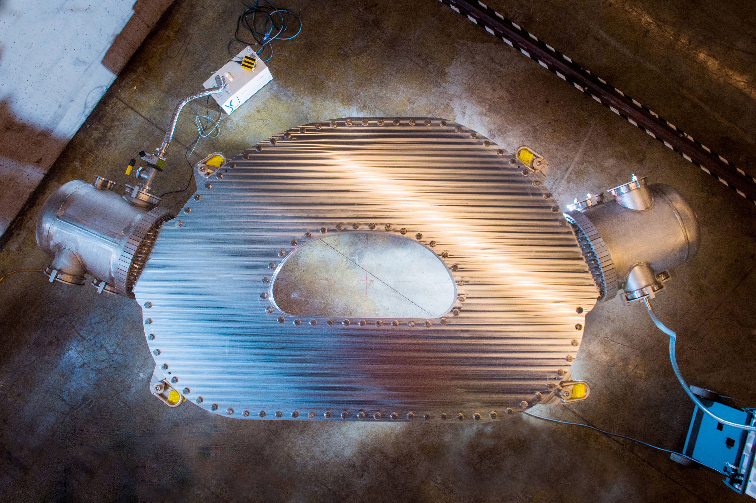
Capture Solenoid
Solenoid can guide positive and negative pions
Goal: Capture field at target: 20 T, 150 mm aperture
Two approaches:
15 T Nb₃Sn with resistive insert
  similar to ITER central solenoid
20 T HTS
  Relevant for advanced fusion reactors
Challenge: shielding of debris of 2 MW proton beam
thick tungsten layer required
1-2 m large aperture of superconducting solenoid
Two limitations:
radiation dose
displacement of atoms due to neutrons
ITER Central Solenoid Model Coil
13 T in 1.7 m (LTS)
MIT/CFS SPARC TF Coil prototype
20 T at 20 K (HTS)

Slide 21
Final Cooling Principle
High field solenoids minimise beta-function and impact of multiple scattering
Energy loss = cooling
Multiple scattering = heating

Slide 22
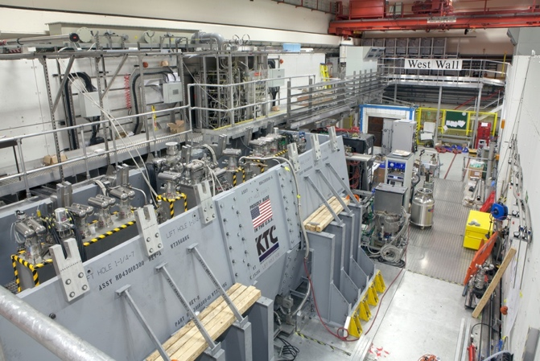
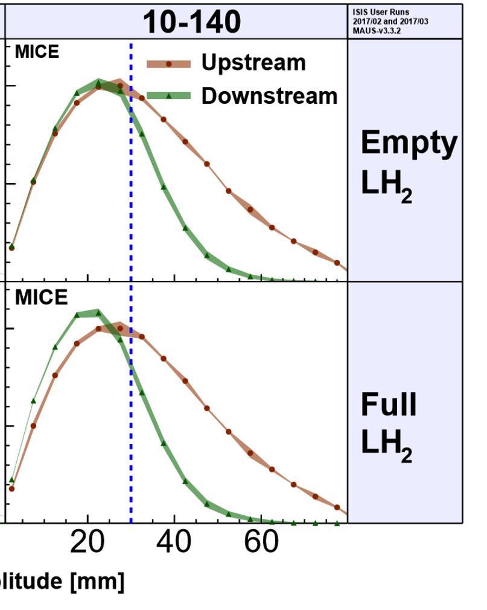
MICE: Cooling Demonstration
More particles at smaller amplitude after absorber is put in place
Nature vol. 578, p. 53-59 (2020)
More complete experiment with higher statistics, more than one stage required
Integration of magnets, RF, absorbers, vacuum is engineering challenge
Principle of ionisation cooling has been demonstrated
Use of data for benchmarking is still ongoing
22

Slide 23
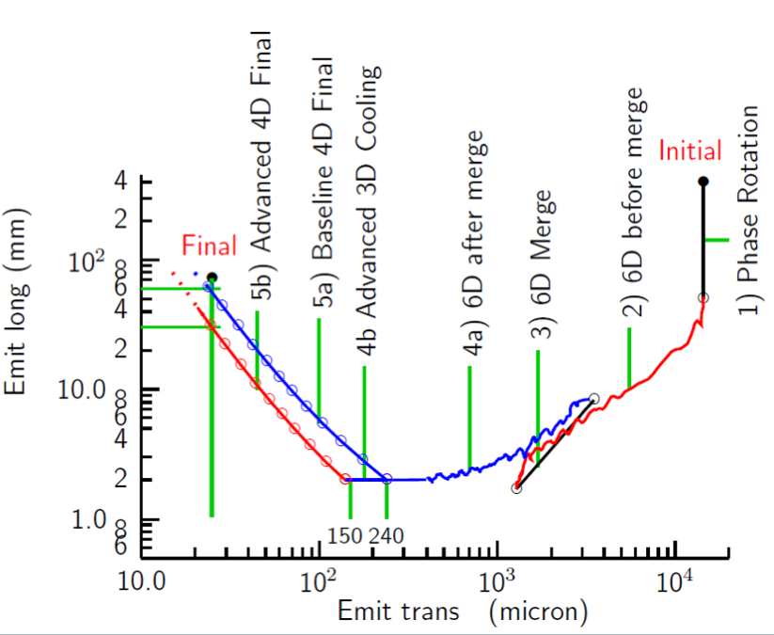
Cooling: The System Chain
Target
Y
Specification
•
•
•
For acceleration to
multi-TeV collider
Front End
For acceleration to NuMAX (325MHz injector acceptance 3mm,24mm)
Phase
Rotator
Exit Front End
(15mm,45mm)
Longitudinal Emittance (mm)
Final
Cooling
pre-merge
6D Cooling
post-merge 6D cooling
bunch merge
Transverse Emittance (microns)
MAP collaboration

Slide 24
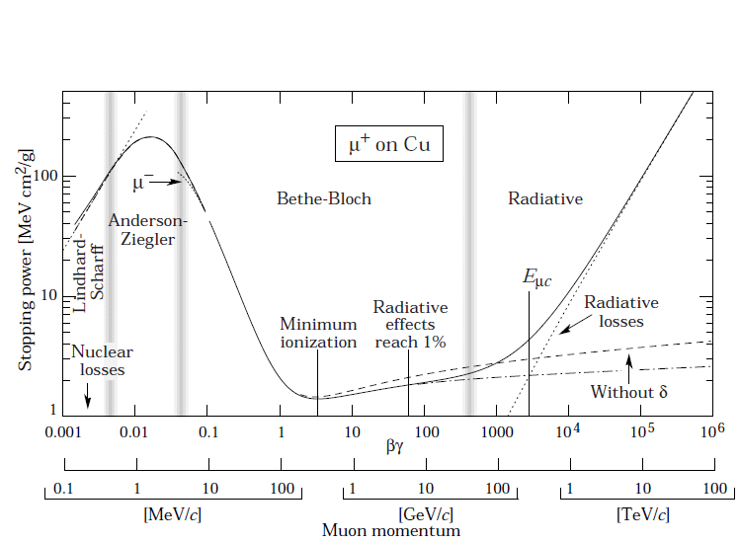
Equilibrium Emittance, Material and Energy
Strong solenoid field helps
Hard stochastic losses
Most of cooling is done here
Material property
best is hydrogen
Lithium hydride is good solid material
best at low energies
but rapidly increasing energy spread
use for final cooling

Slide 25
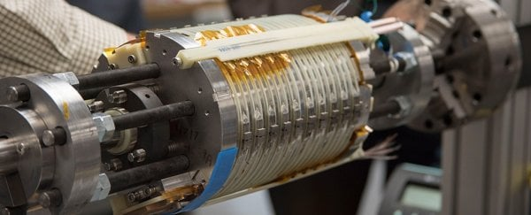
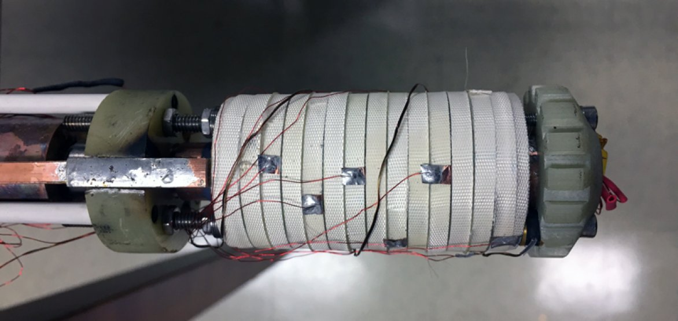
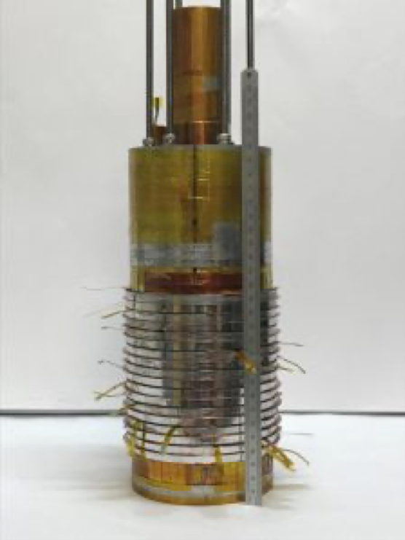
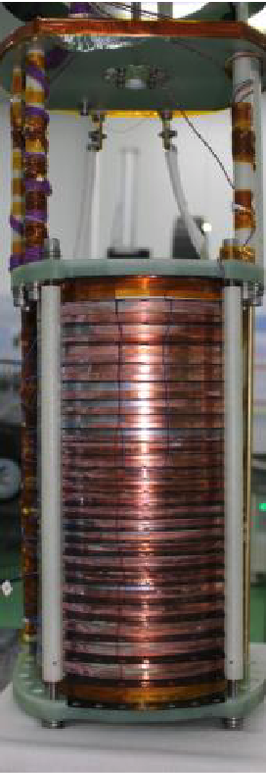
Solenoid Fields
Luca Bottura
HTS insert of NHMFL all SC 32 T
32 T in 40 mm (15 T LTS + 17 T HTS)
NHMFL HTS Little Big Coil
45.5 T in 14 mm (14.5 T HTS + 31 T resistive)
LNCMI/CEA Nougat
HTS insert
32.5 T in 50 mm
(12. 5 T HTS + 20 T resistive)
Sunam NI one-body
HTS magnet
26.4 T in 35 mm
Solenoids with >30 T and aperture of 50 mm exist for high magnetic field science
The limit is the stress in the HTS
Even 60 T might be possible
but important R&D required to see how far we can push

Slide 26
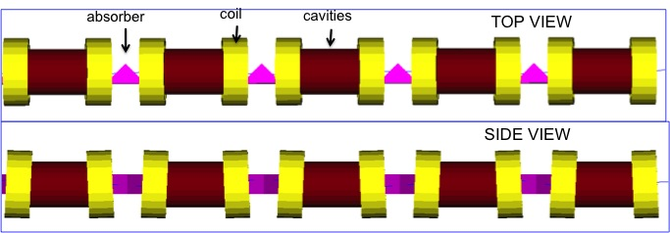
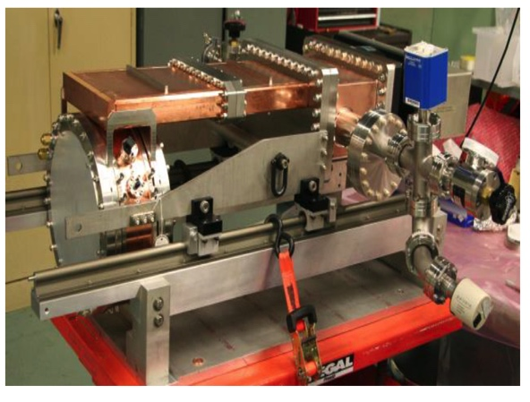
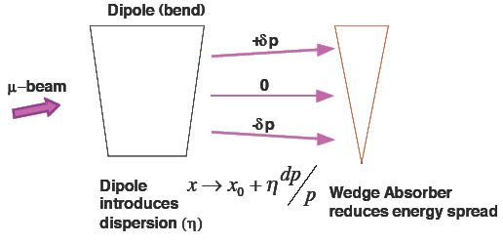
6D Cooling Cell Design
Initial 6D cooling
MuCool: >50 MV/m in 5 T
Two solutions
H2-filled copper cavities
Cavities with Be end caps
2.2 T
High-gradient cavities in high magnetic field
Tight integration of solenoids, RF, absorbers, instrumentation, cooling, vacuum, alignment, …
Slight bending separates energies and allows longitudinal cooling

Slide 27
RF Cavity Challenge
Magnetic field concentrates electron emitted from surface
Solution 1:
Beryllium cavity
Experiment (MUCOOL):
Cavity in 3 T: 50 MV/m with 30 μs RF pulse
Solution 2:
Hydrogen-filled cavity
Experiment (MUCOOL):
Cavity in 3 T:
65 MV/m ,5 g/l H₂
Gradient
Sorry, could not find better figure
Density

Slide 28
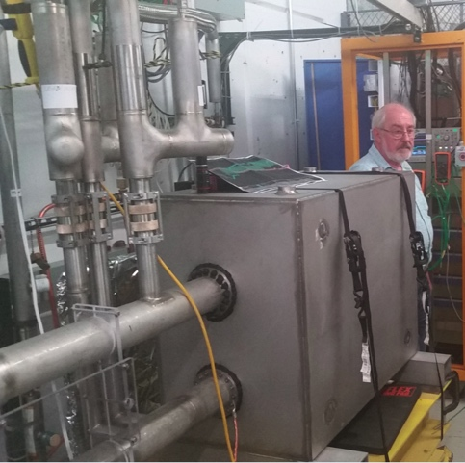
Acceleration Complex
Core of baseline is sequence of pulsed synchrotron (0.4-11 ms)
Important cost and power consumption
Started
Integrated design of RCS
  lattice with realistic hardware specifications
  collective effects
Concept of key components
  Fast-ramping normal magnets
  HTS alternative
  Efficient power converters
  RF with transient beam loading
Alternative FFA
A. Chance et al. (CEA)
E. Metral et al. (CERN)
L. Bottura et al. (LNCMI, Darmstadt, Bologna, Twente)
F. Boattini et al.
EMMA proof of FFA principle
Nature Physics 8, 243–247 (2012)
H. Damerell, F. Batsch, U. van Rienen, A. Grudiev et al. (Rostock, Milano, CERN)
FNAL 300 T/s HTS magnet
S. Machida et al. (RAL)

Slide 29
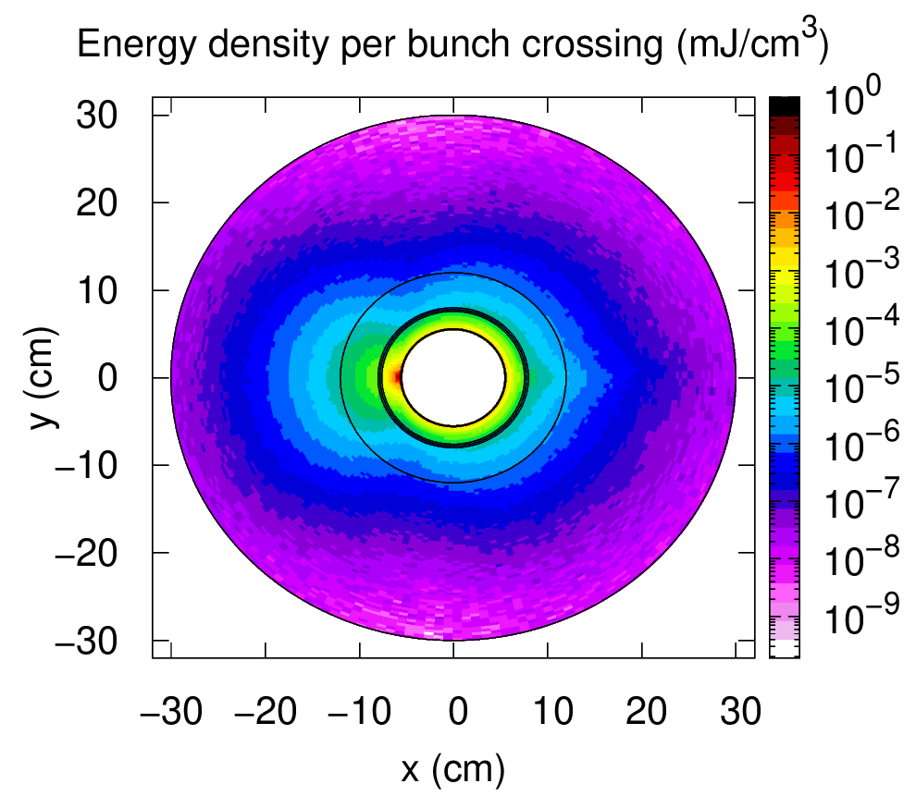
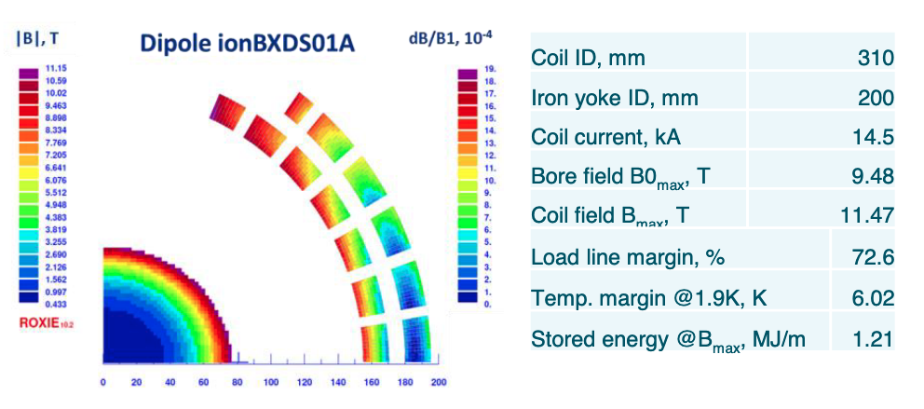
Collider Ring
High field = small circumference = high luminosity
Shielding
MAP developed 4.5 km ring for 3 TeV with Nb₃Sn
magnet specifications in the HL-LHC range
A. Lechner
D. Calzolari (CERN)
Working on 10 km ring for 10 TeV collider ring
around 16 T Nb₃Sn or HTS dipoles
final focus based on HTS
Coil
C. Carli, K. Skoufaris (CERN)
500 W/m due to muon decay
Need thick shielding
150 mm aperture
stress managed magnets
29

Slide 30
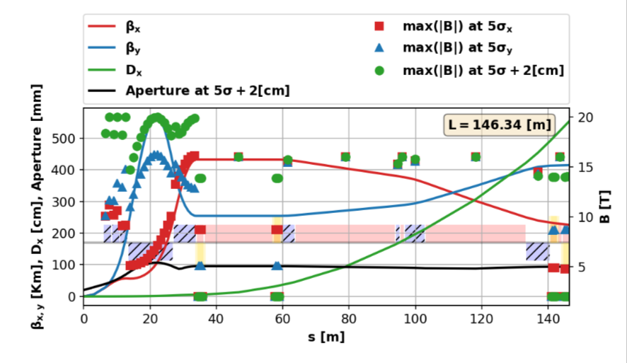
Collider Ring: Final Focus
Beta-function should be small
Divergence of beam is large
=> challenging optics and magnet design
Beam divergence (angles) is the same at all energies
more difficult to make optics
becomes long
and difficult to correct chromatic effects

Slide 31
CDR Phase
To be reviewed considering progress, funding and decisions
Will contain component prototypes, beam tests and facilities with beam
a muon production and cooling demonstrator is important components
targets
hybrid RCS
…
Can be distributed world-wide
Evaluation+decision
Evaluation+decision
31

Slide 32
Test Facility Dimensions
Downstream diagnostics area, 5 m
Collimation and upstream diagnostics area, 10 m
Target
+ horn (1st phase) /
+ superconducting solenoid (2nd phase)
Cooling area, 50 m
Momentum selection chicane, 10 m
Look for an existing proton beam with significant power
Different sites are being considered
CERN, FNAL, ESS are being discussed
J-PARC also interesting as option
C. Rogers

Slide 33
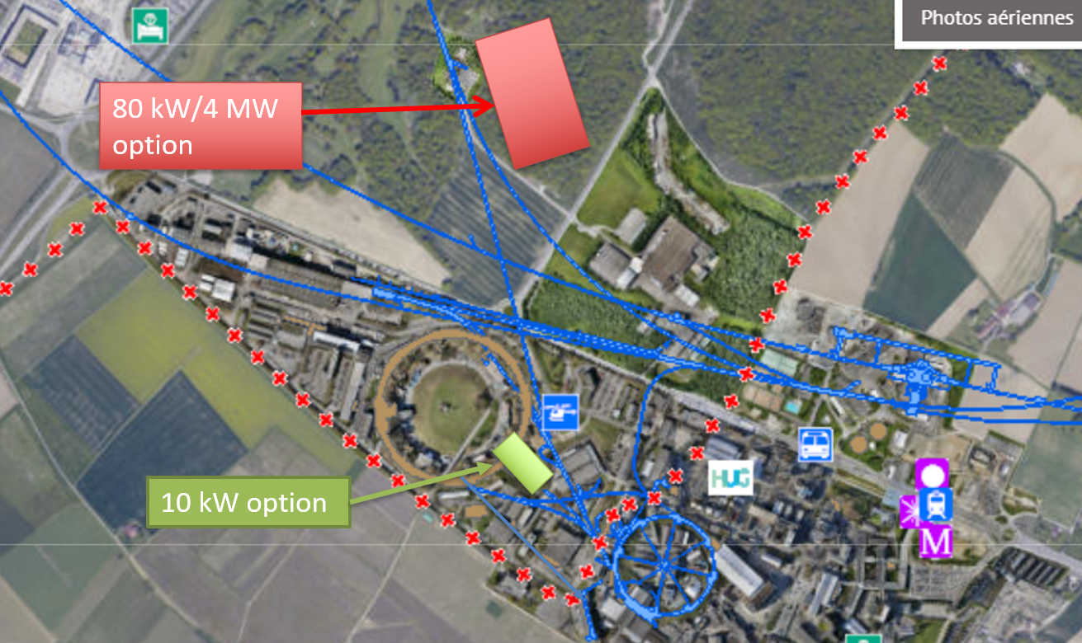
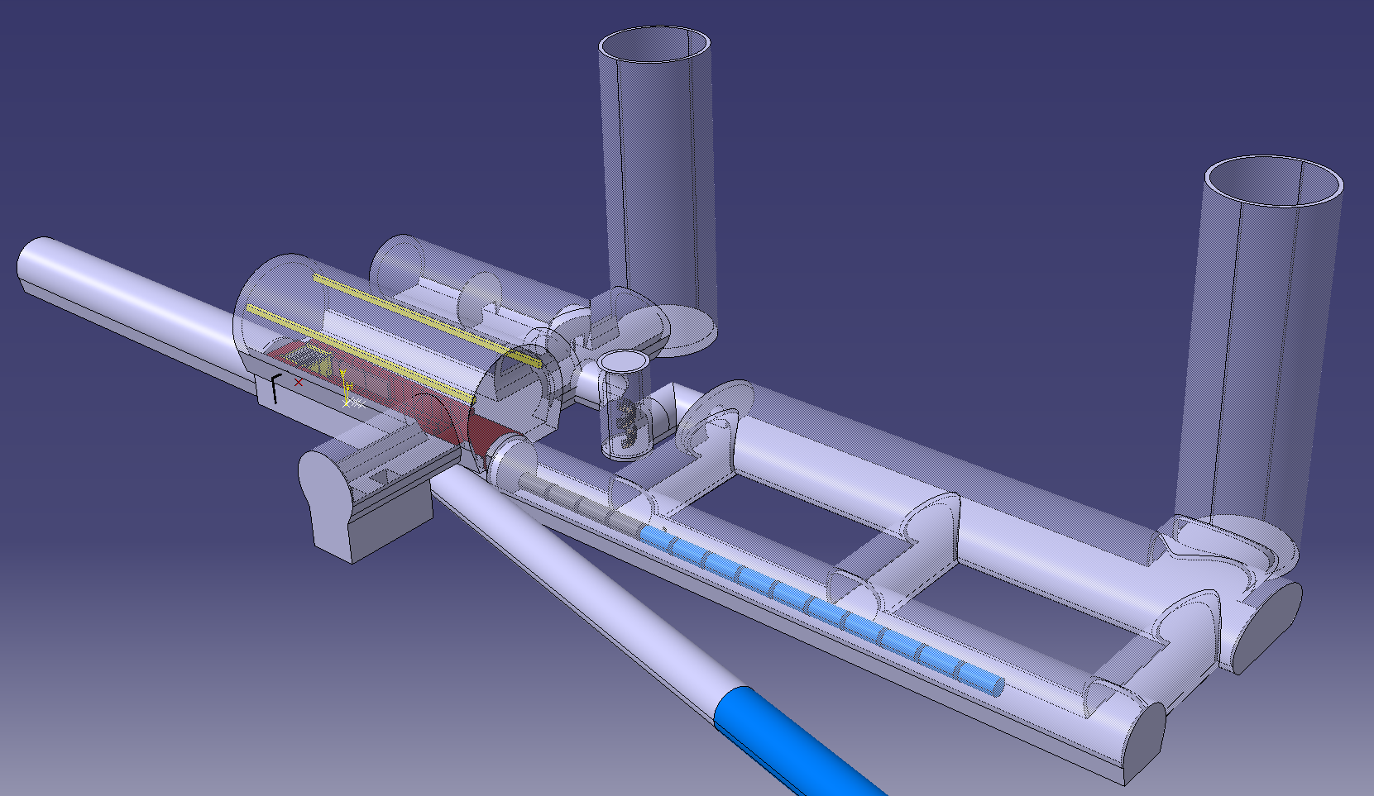
Possible CERN Locations
Consider nTOF-like beam from PS for cooling experiment:
1 pulse of 10¹³ p at 20 GeV per 1.2 s, i.e. 27 kW
maybe O(100kW) possible
If SPL were, installed could use its beam, e.g. 5 GeV, 4 MW
M. Calviani

Slide 34
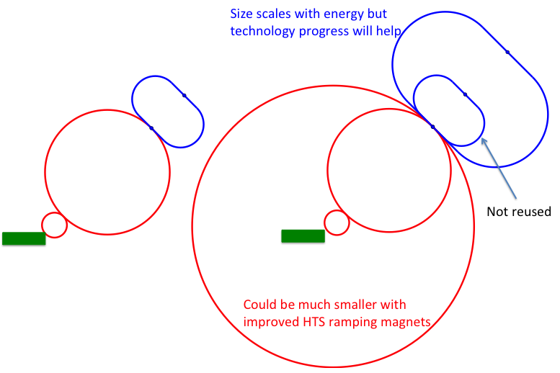
Staging
Ideally would like full energy right away, but
staging could lead to faster implementation
Substantially less cost for a first stage
Can make technical compromises
  e.g. 8 T NbTi magnets would increase collider ring from 4.5 to 6 km and reduce luminosity by 25%
Timeline might be more consistent with human lifespan
Upgrade adds one more accelerator and new collider ring
only first collider ring is not being reused

Slide 35
Conclusion
Muon collider is unique opportunity for high-energy, high-luminosity lepton collider
  Less mature than other options
  But promises compactness, cost and power efficiency
  Mainly technological challenges
Currently two different options considered
  Goal of 10+ TeV, potential 3 TeV intermediate stage explored
  Deliverables for next strategies: Project Evaluation Report and R&D Plan
Addressing key challenges
  Very motivated team
  Synergy with applications for society, e.g. HTS solenoids
  More funding required for full results by next strategy processes
http://muoncollider.web.cern.ch
To join contact
muon.collider.secretariat@cern.ch
35

Slide 36
Reserve

Slide 37
Muon Collider Luminosity Scaling
Fundamental limitation
Requires emittance preservation and advanced lattice design
Applies to MAP scheme
Large energy acceptance
High beam power
High energy
Dense beam
High field in collider ring
Luminosity per power increases with energy
Provided technologies can be made available
Constant current for required luminosity scaling

Slide 38
Alternatives: The LEMMA Scheme
LEMMA scheme (INFN) P. Raimondi et al.
Note: New proposal by C. Curatolo and L. Serafini needs to be looked at
Uses Bethe-Heitler production with electrons
45 GeV positrons to produce muon pairs
Accumulate muons from several passages
Excellent idea, but nature is cruel
Detailed estimates of fundamental limits show that we require a very large positron bunch charge to reach the same luminosity as the proton-based scheme
Need same game changing invention

Slide 39
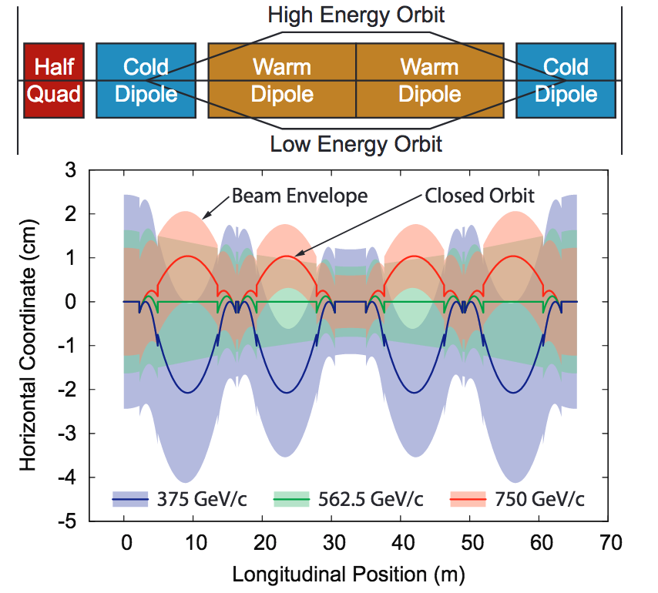
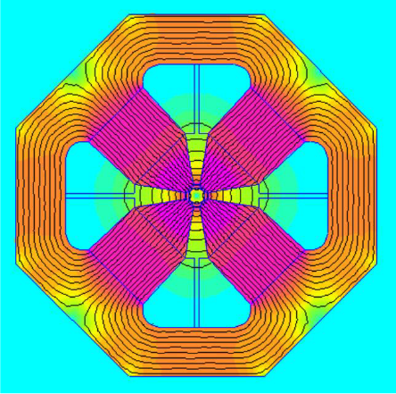
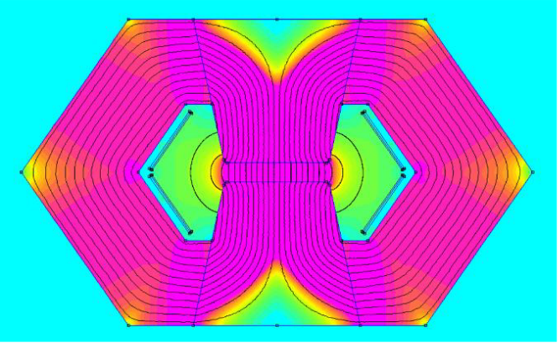
Acceleration
Sequence of
linac
two recirculating linacs
two to four rings
  baseline: pulsed synchrotron (RCS)
  alternative: FFA
J. Scott Berg, et al.
Hybrid RCS combine static superconducting magnets and fast-ramping normal-conducting magnets

Slide 40
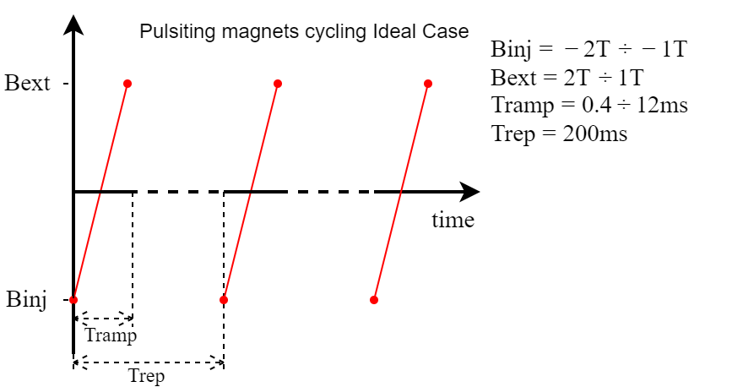
Magnet Powering
Parameter | unit | RCS 1 | RCS 2 | RCS 3
E₁ | GeV | 60 | 300 | 1500
E₂ | GeV | 300 | 1500 | 5000
<G> | MV/m | 2 | 2 | 1
N_{in} | 10¹² | 2.82 | 2.48 | 2.18
N_{out} | 10¹² | 2.48 | 2.18 | 1.8
L_{static} | km | 0.47 | 2.35 | 8.5
L_{ramp} | km | 1.26 | 6.28 | 18.3
L_{RF} | km | 0.28 | 1.38 | 1.9
C | km | 2.8 | 13.8 | 38
beam turns |  | 44 | 44 | 92
T_{ramp} | ms | 0.4 | 2 | 11.67
dB/dt | kT/s | 10 | 2 | 0.34
E_{ramp} | MJ | 16 | 80 | 234
P_{ramp} | GW | 64 | 64 | 32
Beam loss | W/m | 20 | 17.8 | 31.4
Move energy into magnets before beam
Take energy out
Put it back in with other sign
Take it out again after beam is gone
So total of 3.3 GJ go into the magnets each second
Need recovery on the 98% level

Slide 41
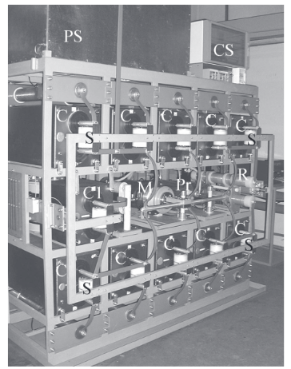
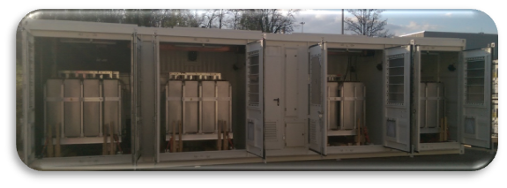
Power Converter
Total stored energy in MC: O(200 MJ), demonstrated
Peak power (all rings combined) 150 GW, demonstrated
But lifetime and average power is demanding (10⁹ pulses)
Also switch the voltage in the capacitors
Laser Mega Joule (France) 480 x CapacitorBankModule ≈ 400MJ
One CBM: 860kJ @ 24kV; 360us wide 240kA current pulse;
5.76 GW peak power
1 pulse every 25min; 2500 kg; total lifetime → 200’000 pulses (12h of the MC)
estimated price 70kCHF
Cost ≈ 0.09 CHF/Joule
POPS (CERN) 6 x CapacitorContainers ≈ 20MJ
One CC: 3.2MJ @ 5kV; 2ms wide 2kA current pulse;
10 MW peak power
1 pulse every 1.2s; 25000 kg;
total lifetime 120’000’000 pulses (1 year of the MC)
estimated price 500kCHF
Cost ≈ 0.15 CHF/Joule

Slide 42
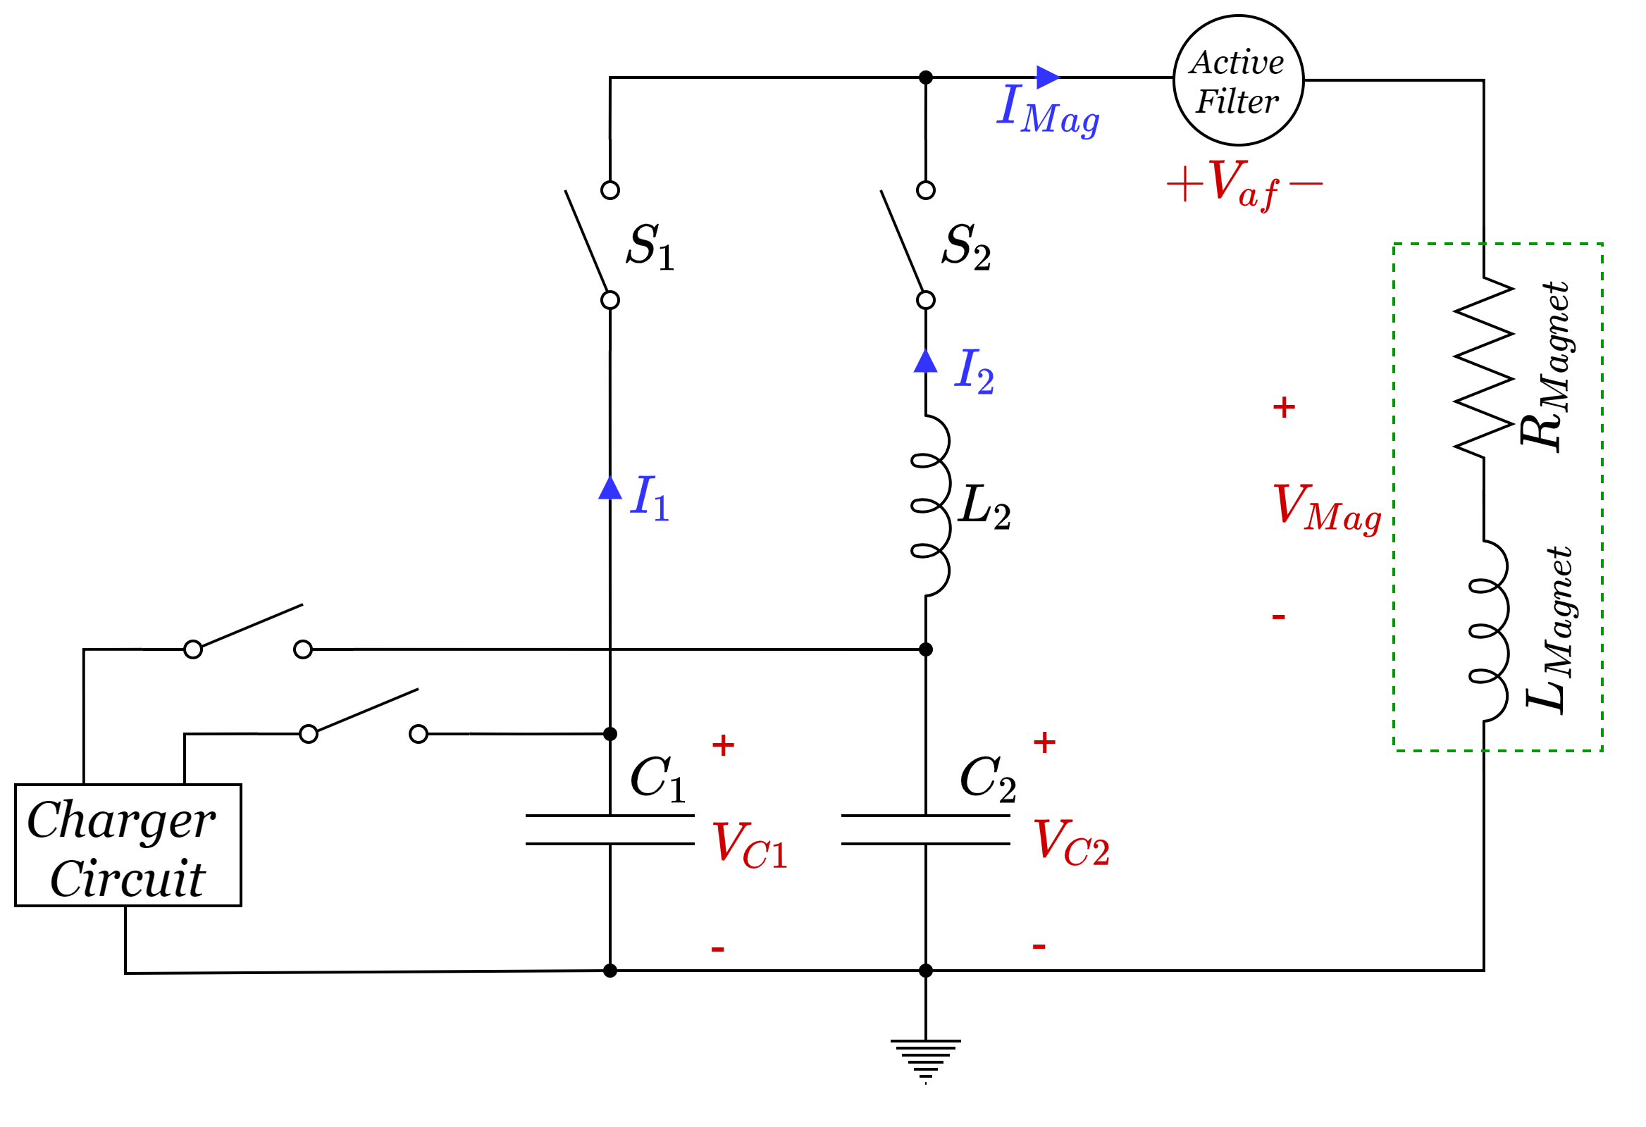
First Design
Initial design with two frequencies and active filter for linearisation
Cost of power converter is important
mainly active filters due to linear ramp
need iteration with beam dynamics
then will see for capacitors
Need to estimate power losses
Need optimisation in loop with magnet design, beam dynamics, RF, …
Power converter as project drivers
Synergy power grid applications

Slide 43
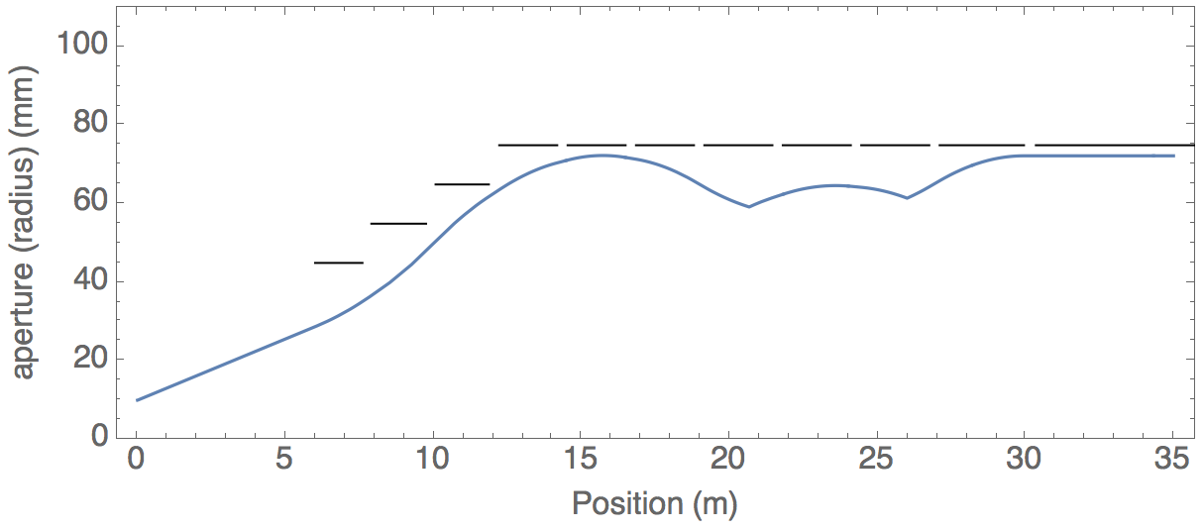
Final Focus Magnet Challenge
At 3 TeV:
Up to 12 T in aperture 150 mm
Similar to HL-LHC final focus magnets
Close to state of the art with Nb₃Sn
At 10+ TeV:
Aperture of 200+ mm
20 T field in aperture
Stress is significantly higher
Will need HTS
3 TeV FFS Design (MAP)
Parameter | Q1 | Q1 | Q3 | Q4
Aperture (mm) | 90 | 110 | 130 | 150
Gradients (T/m) | 267 | 218 | -154 | -133.5
Peak field (T) | 12 | 12 | 10+ | 10+
Dipole field (T) | 0 | 0 | 2.00 | 2.00
HTS magnet development is essential for 10 TeV

Slide 44
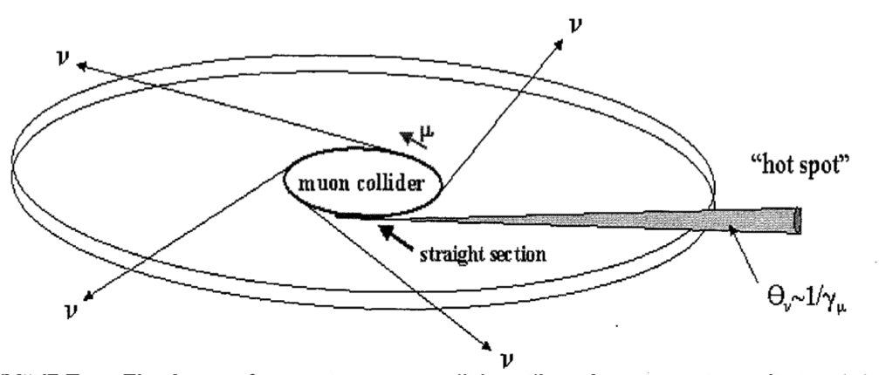
Neutrino Flux Mitigation
Use mover system to reduce neutrino flux and limit impact on environnement to lvel similar to LHC
Large stroke mover system with precision
High reliability
Alignment system with reference to the surface
Mechanical forces on tilted girders
Connections, e.g. cryogenics (helium)
Active mover system to reduce flux density
~2 x 600 m
t₁
angle
15 cm
s₁
neutrinos
t₂
time

Slide 45
Neutrino Flux
Dense neutrino flux cone can impact environment Challenge scales with E x L
Goal is to reduce to negligible level, similar to LHC
3 TeV, 200 m deep tunnel is about OK
Expand idea of Mokhov, Ginneken to move beam in aperture: move collider ring components, e.g. vertical bending with 1% of main field
14 TeV, in 200 m deep tunnel comparable to LHC case with +/- 1 mradian
scales with luminosity toward higher E
~2 x 600 m
Need to study mover system, magnet, connections and impact on beam
Working on different approaches for experimental insertion
Other optimisations are possible (magnetic field, emittance etc.)
45

Slide 46
Organisation
International Collaboration Board represents the partners
International Advisory Committee
Coordination Committee
executes the study
(only Study Leader in MoC)
Steering Board oversees study and links to regional supervision (addition to MoC)

Slide 47
Thanks
Muon Beam Panel: Daniel Schulte (CERN, chair), Mark Palmer (BNL, co-chair), Tabea Arndt (KIT), Antoine Chance (CEA/IRFU) Jean-Pierre Delahaye (retired), Angeles Faus-Golfe (IN2P3/IJClab), Simone Gilardoni (CERN), Philippe Lebrun (European Scientific Institute), Ken Long (Imperial College London), Elias Metral (CERN), Nadia Pastrone (INFN-Torino), Lionel Quettier (CEA/IRFU), Magnet Panel link, Tor Raubenheimer (SLAC), Chris Rogers (STFC-RAL), Mike Seidel (EPFL and PSI), Diktys Stratakis (FNAL), Akira Yamamoto (KEK and CERN) Contributors: Alexej Grudiev (CERN), Roberto Losito (CERN), Donatella Lucchesi (INFN)
Community conveners: Radio-Frequency (RF): Alexej Grudiev (CERN), Jean-Pierre Delahaye (CERN retiree), Derun Li (LBNL), Akira Yamamoto (KEK). Magnets: Lionel Quettier (CEA), Toru Ogitsu (KEK)‎, Soren Prestemon (LBNL), Sasha Zlobin (FNAL), Emanuela Barzi (FNAL). High-Energy Complex (HEC): Antoine Chance (CEA), J. Scott Berg (BNL), Alex Bogacz (JLAB), Christian Carli (CERN), Angeles Faus-Golfe (IJCLab), Eliana Gianfelice-Wendt (FNAL), Shinji Machida (RAL). Muon Production and Cooling (MPC): Chris Rogers (RAL), Marco Calviani (CERN), Chris Densham (RAL), Diktys Stratakis (FNAL), Akira Sato (Osaka University), Katsuya Yonehara (FNAL). Proton Complex (PC): Simone Gilardoni (CERN), Hannes Bartosik (CERN), Frank Gerigk (CERN), Natalia Milas (ESS). Beam Dynamics (BD): Elias Metral (CERN), Tor Raubenheimer (SLAC and Stanford University), Rob Ryne (LBNL). Radiation Protection (RP): Claudia Ahdida (CERN). Parameters, Power and Cost (PPC): Daniel Schulte (CERN), Mark Palmer (BNL), Jean-Pierre Delahaye (CERN retiree), Philippe Lebrun (CERN retiree and ESI), Mike Seidel (PSI), Vladimir Shiltsev (FNAL), Jingyu Tang (IHEP), Akira Yamamoto (KEK). Machine Detector Interface (MDI): Donatella Lucchesi (University of Padova), Christian Carli (CERN), Anton Lechner (CERN), Nicolai Mokhov (FNAL), Nadia Pastrone (INFN), Sergo R Jindariani (FNAL). Synergy: Kenneth Long (Imperial College), Roger Ruber (Uppsala University), Koichiro Shimomura (KEK). Test Facility (TF): Roberto Losito (CERN), Alan Bross (FNAL), Tord Ekelof (ESS,Uppsala University).
47
And the participants to the community meetings and the study

Slide 48
Roadmap
In aspirational scenario can make informed decisions:
Three main deliverables are foreseen:
a Project Evaluation Report for the next ESPPU will contain an assessment of whether the 10 TeV muon collider is a promising option and identify the required compromises to realise a 3 TeV option by 2045. In particular the questions below would be addressed.
  What is a realistic luminosity target?
  What are the background conditions in the detector?
  Can one consider implementing such a collider at CERN or other sites, and can it have one or two detectors?
  What are the key performance specifications of the components and what is the maturity of the technologies?
  What are the cost drivers and what is the cost scale of such a collider?
  What are the power drivers and what is the power consumption scale of the collider?
  What are the key risks of the project?
an R&D Plan that describes an R&D path towards the collider;
an Interim Report by the end of 2023 that documents progress and allows the wider community to update their view of the concept and to give feedback to the collaboration.
48

Slide 49
R&D Plan
The R&D plan will describe the R&D path toward the collider, in particular during the CDR phase, and will comprise the elements below.
An integrated concept of a muon cooling cell that will allow construction and testing of this key novel component.
A concept of the facility to provide the muon beam to test the cells.
An evaluation of whether this facility can be installed at CERN or another site.
A description of other R&D efforts required during the CDR phase including other demonstrators.
This R&D plan will allow the community to understand the technically limited timeline for the muoncollider development after the next ESPPU.

Slide 50
Minimal Scenario
Will allow partially informed decisions
No conceptual design of neutrino flux and alignment system
No alternative superconducting fast-ramping magnet system
Several collider systems would (almost) not be covered, in particular
  the linacs
  the target complex
  the proton complex
  engineering considerations of the muon cooling cells
  alternative designs for the final cooling system, acceleration, collider ring
No RF test stand would be constructed for the muon cooling accelerating cavities
No conceptual design of a muon cooling cell for the test programme
No conceptual design of a muon cooling demonstrator facility
No concept of RF power sources
No tests/models to develop solenoid technology.

Slide 51
Schedule
2023
Interim Report to gauge progress
Initial baseline defined
2025
Assessment Report
2025-2027
R&D plan will be refined
51

Slide 52
Coordination Committee Members
Physics | Andrea Wulzer
Detector and MDI | Donatella Lucchesi
US (detector) | Sergo Jindariani
US (accelerator) | Mark Palmer
Asia (China) | Jingyu Tang
Asia (Japan) | tbd
Protons | Natalia Milas
Muon production and cooling | Chris Rogers
Muon acceleration | Antoine Chance
Collider | Christian Carli
Magnets | Luca Bottura
RF | Alexej Grudiev, Claude Marchand
Beam-matter int. target systems | Anton Lechner
Collective effects | Elias Metral
A strengthening on the physics and detector side is planned
Cooling cell design | Lucio Rossi
Demonstrator | Roberto Losito

Slide 53
Key Technologies
Magnets
Superconducting solenoids for target and cooling profit from developments for society
  target solenoid comparable to ITER central solenoid fusion
  6D cooling solenoids similar and wind power generators, motors
  final cooling solenoids synergetic with high-field research, NMR
Collider ring magnets
  profit from developments for other colliders FCC-hh, stress-managed magnets
Fast-ramping normal-conducting magnet system
  HTS alternative, power converter
RF systems
superconducting RF, normal-conducting RF, efficient klystrons
Target, cooling absorbers, windows, shielding
Neutrino mitigation mover system, cooling cell integration, …
Detector

Slide 54
Key Technologies, cont.
RF systems
Normal-conducting cooling cavities in magnetic field
  profit from CLIC work
Superconducting accelerator RF
  profit from ILC, …
Efficient power sources
  profit from CLIC work
Beam-matter interaction
Proton target
Cooling absorbers
Shielding (accelerator and detector)
Mechanical system
Neutrino flux mitigation system
Muon cooling cell integration

Slide 55
Collaboration Vision
IMCC is an international collaboration and aims to
Enlarge the collaboration
  Physics interest in all regions, strong US contribution to the muon collider physics and detector, interest in Japan
  First US university have joined collaboration, try to see how to move forward, also with labs
Combine the R&D efforts for the design and its technologies
  Critical contributions in all relevant fields the US
Consider several sites for the collider
  CERN would be one, FNAL and others should also be considered
  A proposal with alternative sites is stronger for a single site
Consider several sites for the demonstrators
  E.g. Muon production and cooling demonstrator at CERN, FNAL, ESS, JPARC
  e.g. RCS at ESRF or elsewhere
  Target tests
  …

Slide 56
Collaboration Organisation
Collaboration Board (ICB)
  Chair: Nadia Pastrone
Steering Board (ISB)
  Chair Steinar Stapnes
  Reports to LDG but could add DOE
Advisory Committee (IAC)
  To be defined
Coordination committee (CC)
  Study Leader Daniel Schulte
  Deputies: Andrea Wulzer, Donatella Lucchesi, Chris Rogers
  Sergo Jindariani, Mark Palmer as US links
  Will strengthen physics and detectors

Slide 57
Muon Decay and Detector Background
Muons decay produces electrons and positrons
Loss per unit length almost independent of energy
Tools mostly ready to generate background
tentative beamline and mask, FLUKA
tentative beam-beam for muons (GUINEA-PIG)
Studies at 1.5 <and 3 TeV with concept based on CLIC detector
Radiation level in tracking detector similar to HL-LHC
Studies with beam-induced background in progress
some channels are not affected by background
some improvement required for other channels
Concept for 10 TeV in progress
Detector team
O(69) authors, O(150 signatories)
57

Slide 58
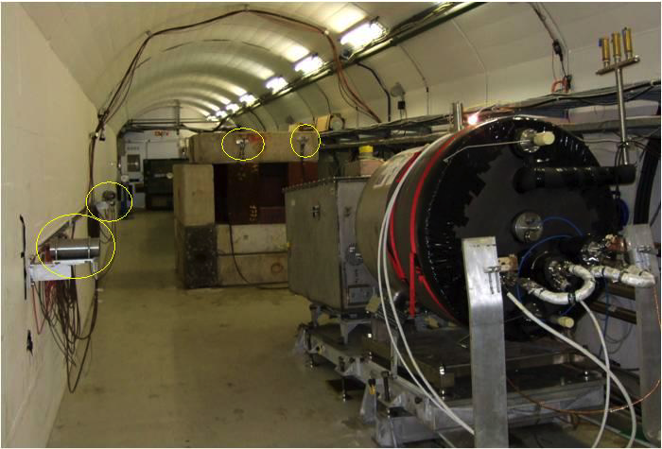
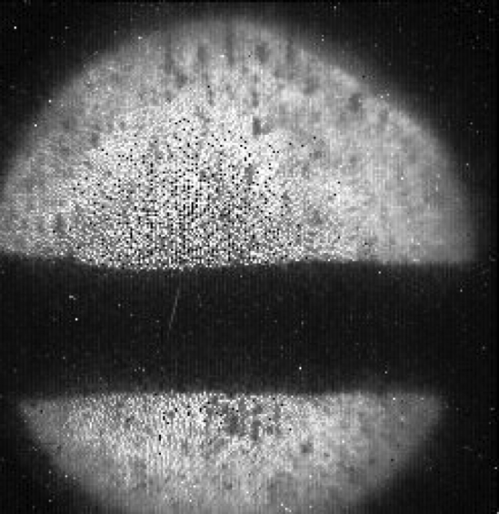
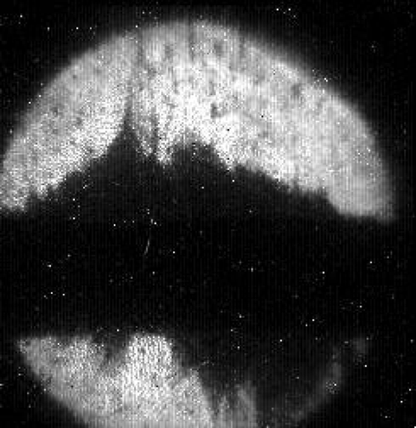
Note: Liquid Metal Target
Safety concerns prevent this in Europe
Other metals or dust stream are options
Tested with
30x10¹² protons with 24 GeV yield 9x10¹² muons
Almost enough (loose 90%)

Slide 59
Cooling Cell Technology
C. Marchand, Alexej Grudiev et al. (CEA, Milano, CERN, Tartu)
RF cavities in magnetic field
MAP demonstrated higher than goal gradient
Improve design based on theoretical understanding
Preparation of new test stand, but needs funding
Test stand at CEA (700 MHz, need funding)
Test at other frequencies in the UK considered
Use of CLIC breakdown experiment considered
MuCool demonstrated >50 MV/m in 5 T
H2-filled copper
Be end caps
Assessment of realistic goal for highest field solenoids
MAP demonstrated 30 T
now magnets aim for 40+ T
even more can be possible
synergy with high-field research
L. Bottura et al.
INFN (Task Leader), CEA, CERN, LNCMI, PSI, SOTON, UNIGE and TWENTE, in collaboration with KEK and US-MDP
Will develop example cooling cell integration
tight constraints
additional technologies (absorbers, instrumentation,…)
early preparation of demonstrator facility
L. Rossi et al. (INFN, Milano, STFC, CERN),
J. Ferreira Somoza et al.
59

Slide 60
RF Cavity Challenge
Gradient of normal-conducting RF cavities is typically limited by breakdown
Model:
electrons start at one emitter site
electrons are accelerated by cavity field and hit other side
In solenoid field:
electrons spiral around magnetic field line
they all hit one spot on the other site
this can heat spot above plastic deformation stress
and lead to breakdown
in any case electrons bounce back and forth between sites

Slide 61
RF Cavities: Approach 1
Reduce the time in which we have losses in the wall
shorter pulses
but requires to fill energy into the cavity more quickly
requires higher peak power from klystrons
this is more costly
Reduce the energy lost by the electrons in the cavity walls
e.g. replace copper with beryllium
  lower density, smaller Z
Experimental result (MUCOOL):
Beryllium cavity in 3 T: 50 MV/m with 30 μs RF pulse
To be studied: gradient in higher field

Slide 62
RF Cavities: Approach 2
Use high-pressure hydrogen gas inside of the cavity
the electrons will collide with the hydrogen and lose energy
condition: The mean free path of the electron must not allow it to gain more than O(15 eV), the ionisation energy of hydrogen
Sorry, I can only find this poor quality figure
Experimental results (MUCOOL):
Molybdenum cavity in 3 T: 65 MV/m
limited by gas density (gradient is proportional to density)
Some material dependence
Obviously different design of cooling system
cavities also serve as absorbers

