Slide 1
How can the Scientific Information Service help you?
Read books and articles, publish and preserve your work, and more!
Paulina Birtwistle, Sunje Dallmeier-Tiessen, Anne Gentil-Beccot, Lydia Pieper, Salome Rohr
13 June 2023

Slide 2
Agenda
1 SIS mission
Library services & collections
CERN bookshop
Make your work freely available
And your research data

Slide 3
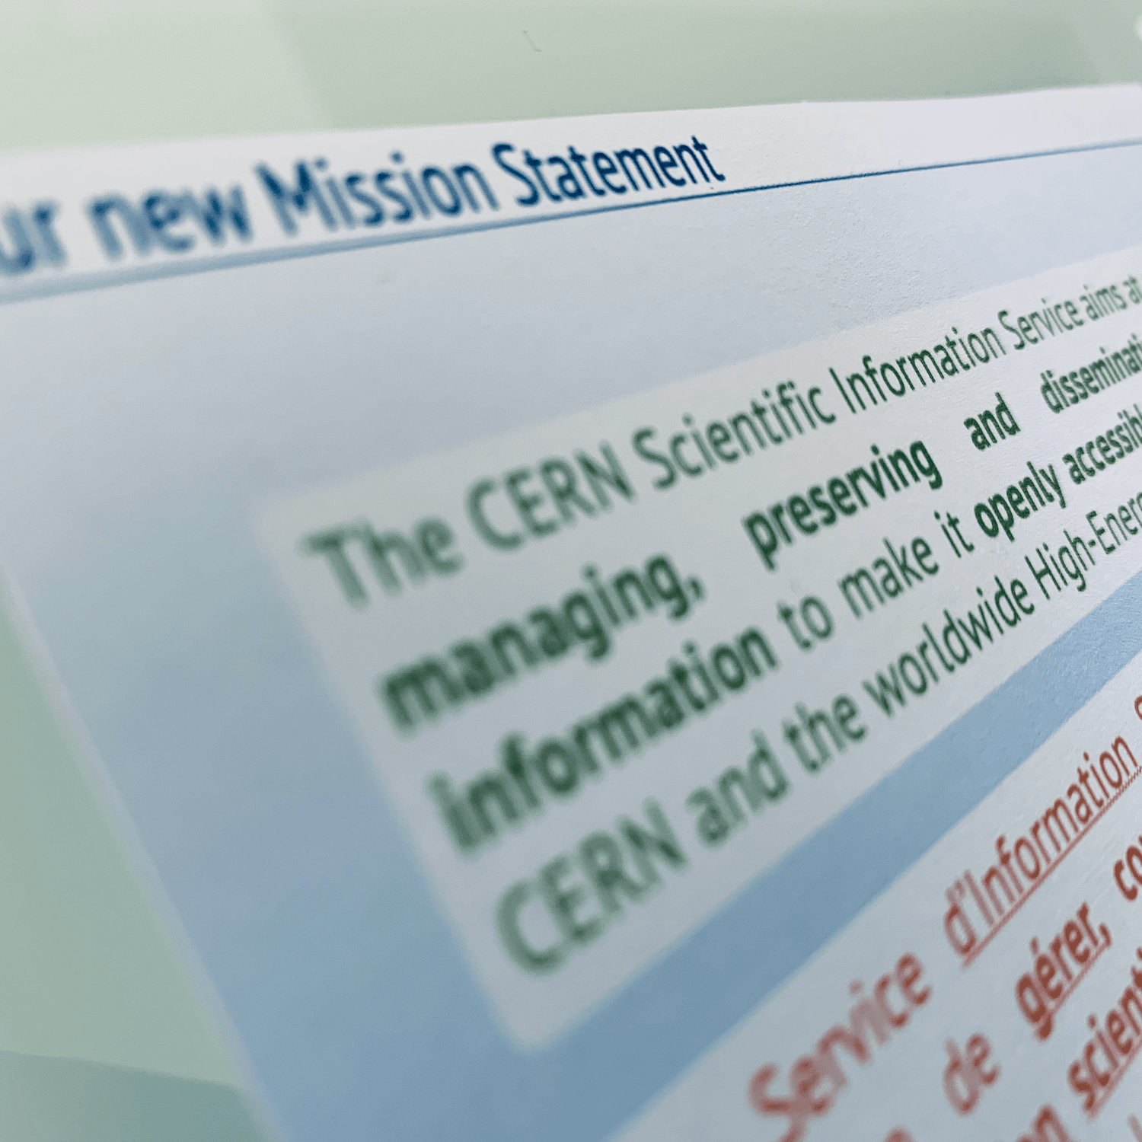
Scientific Information Service (SIS)
The CERN Scientific Information Service aims at efficiently managing, preserving and disseminating scientific information to make it openly accessible and reusable to CERN and the worldwide High-Energy Physics community.

Slide 4
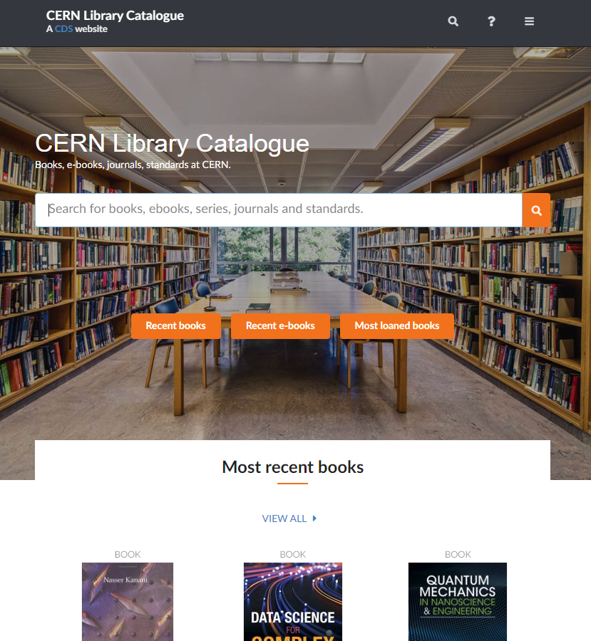
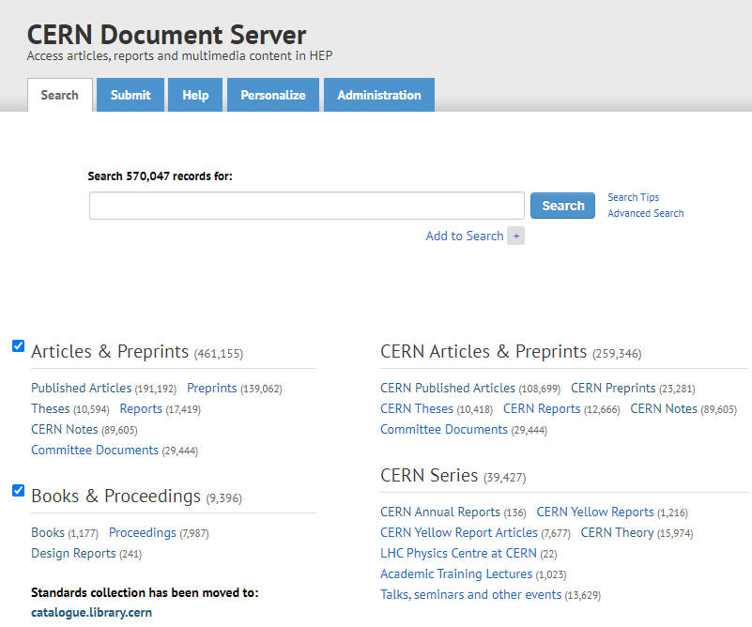
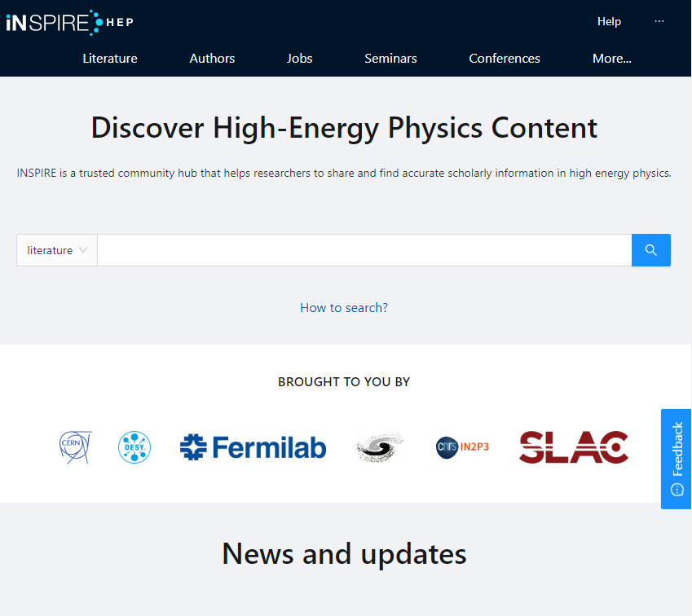
Collections
Library catalogue:
https://catalogue.library.cern/
Books, proceedings, journals, standards, in all fields of relevance to the Organisation
CERN Document Server (CDS):
http://cds.cern.ch/
CERN institutional repository which stores documents written by CERN authors and collaborations: CERN articles, reports, Yellow Reports, theses, photos, lectures, Archive collections… and much more!
INSPIRE:
https://inspirehep.net/​
High energy physics (HEP) content: interlinked database on literature, conferences, institutions, seminars, researchers, experiments, job

Slide 5
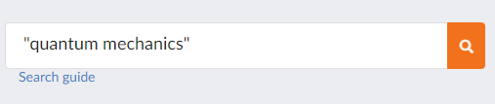
Library catalogue:
Searching, borrowing, accessing online resources
How to search: https://catalogue.library.cern
  If you are looking for a specific term or know part of the title, make sure to use the double quotation marks when searching
  Search guide: https://catalogue.library.cern/guide/search
How to borrow books and access resources:
    Majority of resources are electronic & e-books
    Paper copies and books: ‘Request loan’ (pick it up at the Library or have it delivered to your office)
    Extend your loan online via your profile: https://catalogue.library.cern/profile if it has not been requested in the meantime
Remote access to electronic resources: even if you are not at CERN, our EzProxy gives you access to the Library’s electronic resources

Slide 6
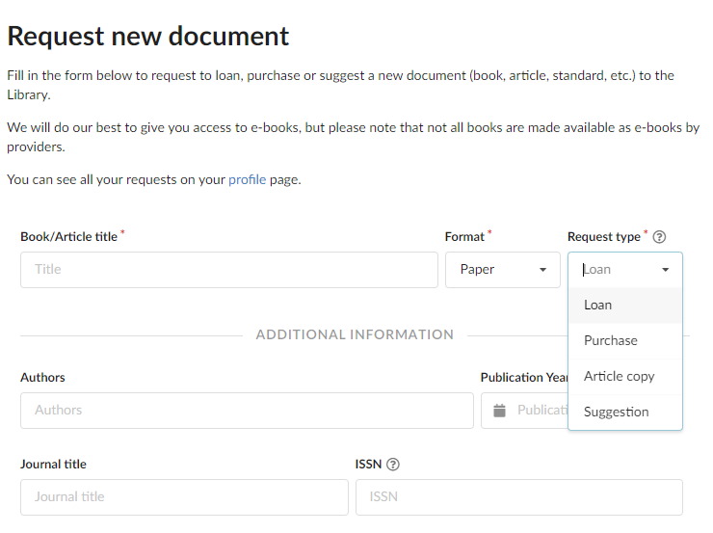
Library catalogue:
Cannot find what you're looking for?
Request what you cannot find in the CERN Library catalogue by submitting this form https://catalogue.library.cern/request:
    Loan: We can get books that we do not have in our catalogue – Usually delivered in 2-5 days
    Article copy: If you cannot access an article you would like to read online, we can deliver it within 24h
    Purchase: We can order books for you with payment by cash/card or budget code
    Suggestion: Let us know if an important document is missing in our collections – We can purchase it for the library

Slide 7
Online resources
Beside e-books and e-journals available in the catalogue, CERN SIS provides a wide range of online resources in various disciplines:
Dictionaries and reference books (e.g. Oxford English Dictionary, Oxford References, Grand Robert)
Online databases (E.g. Total Materia, Nucleonica)
Scientific writing references (e.g. Chicago Manual of Style, Oxford Style guide)
Online trainings and videos (O'reilly learning platform)
All resources available here: https://sis.web.cern.ch/search-and-read/online-resources

Slide 8
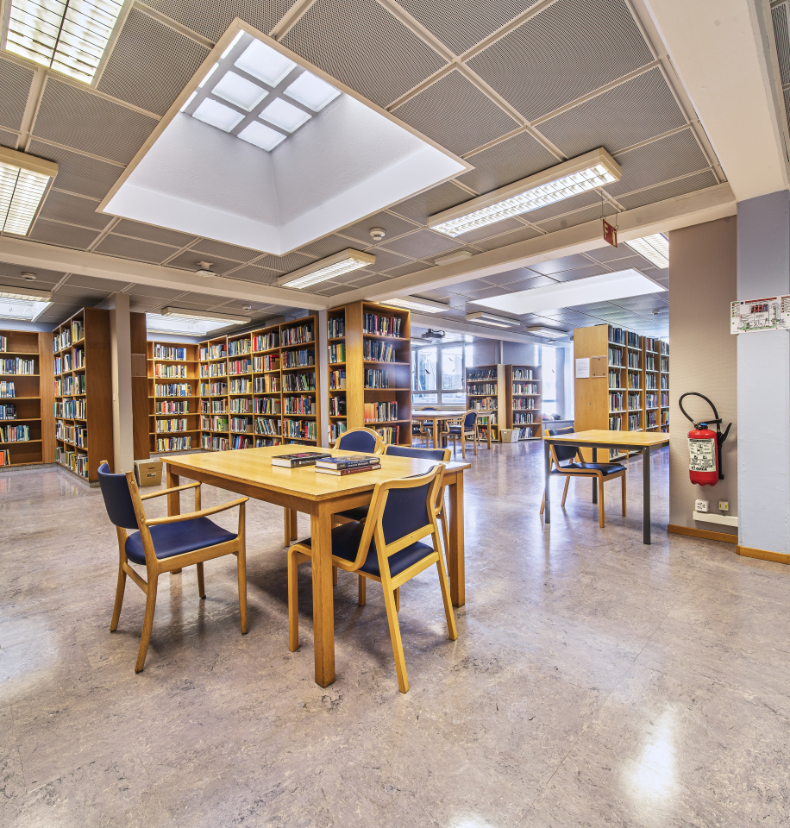
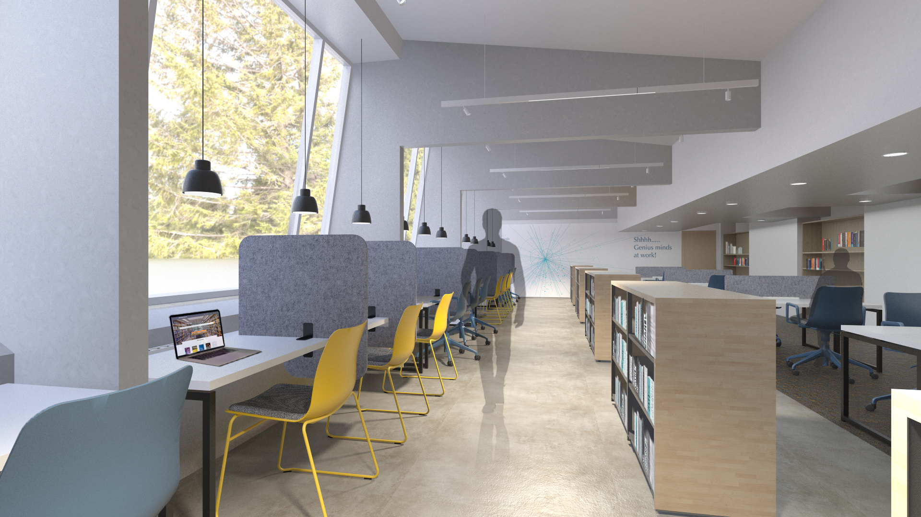

Library facilities
Library is undergoing renovation works until end of September 2023
A temporary library is open in
Bldg. 3/1-015, accessible 24/7
Librarians on duty at the library desk:
Monday-Friday: 9.00 AM – 5.00 PM
Around 1 500 books freely accessible 24/7
More than 42 000 books, proceedings, standards, journals in closed stacks available on request in our catalogue or at the desk in 3/1-015

Slide 9

CERN Bookshop
A Bookshop is part of the Library!
Bldg. 3/1-011
Opening hours:
Monday-Friday:
9.00 AM – 5.00 PM
Buy your favourite books or a souvenir
Browse the Bookshop catalogue

Slide 10


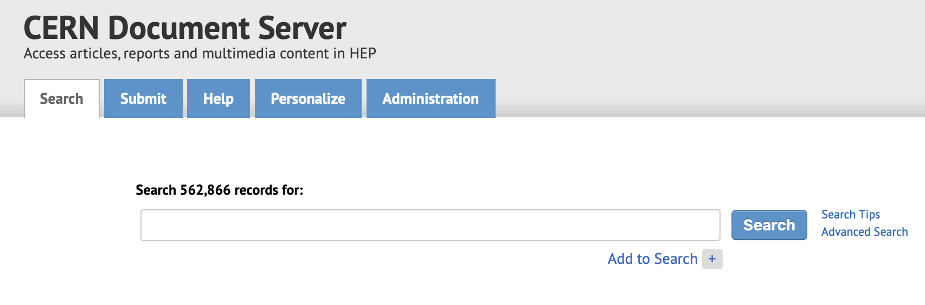
Make your work freely available
Operational Circular 6 requires that every CERN Author submits a copy of their scientific documents to the CERN Document Server (CDS)
Check our guidelines on how and where to submit your document and with your supervisor
Submit directly to CDS: https://cds.cern.ch/submit
Submit your preprint to arXiv and it will appear in CDS within 2 days automatically (via INSPIRE)
If you are unsure where to submit, please contact library.desk@cern.ch

Slide 11
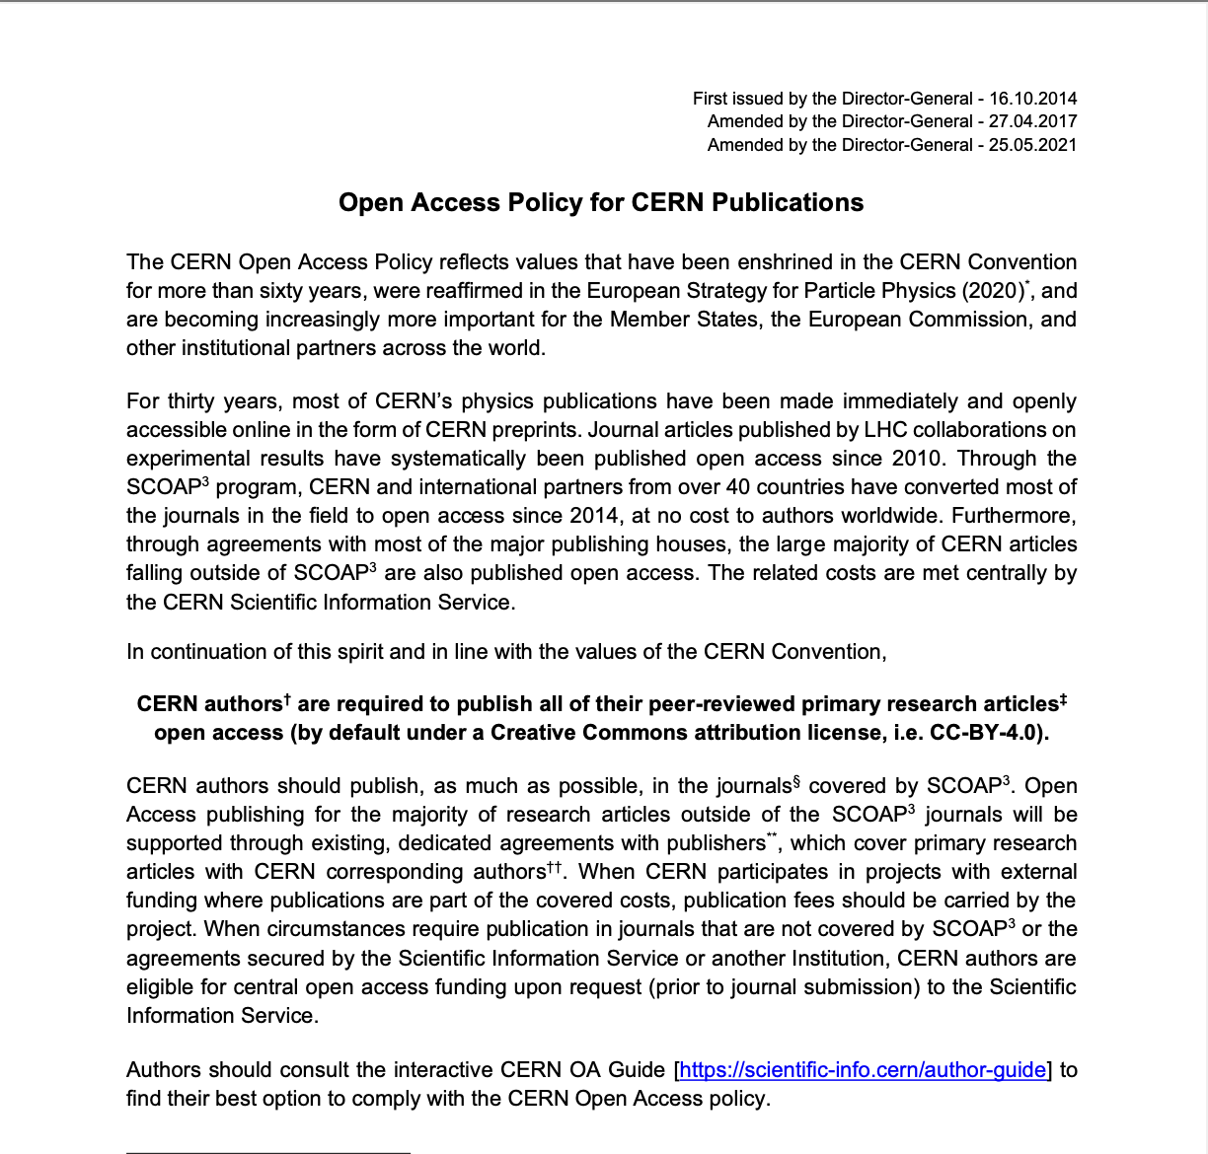
CERN Open Access policy
http://doi.org/10.17181/CERN.XDL3.FX3J
>> CERN authors & CERN collaborations (OC 6)
>> Research articles published in journals (conference papers excluded)
>> Immediate Open Access to the published article
>> Creative Commons Licence

Slide 12
Publish your work in Open Access
CERN supports many Open access initiatives (eg. SCOAP3..)
Agreements with publishers that cover 4000+ journals
More information:
  http://cern.ch/open-access
  CERN author guide: https://scientific-info.cern/cern-author-guide
  Includes info related to OA monographs and conference proceedings
We are here to support you!
  open-access-questions@cern.ch
  https://mattermost.web.cern.ch/sis-team/channels/open-access-publications

Slide 13
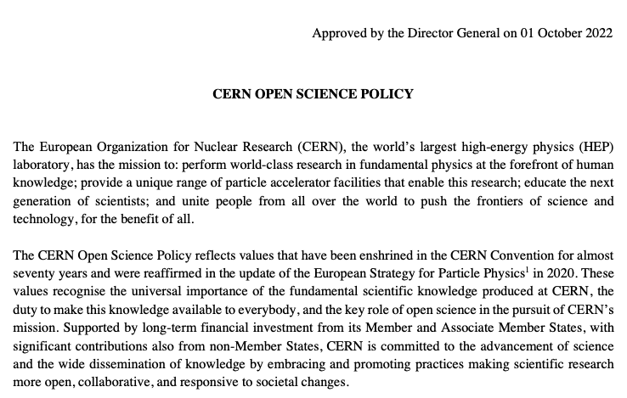
CERN Open Science policy
Since October 2022:
Requirements concerning:
Open Access
Open Data
Open Source Software
Open Hardware
Research Integrity and Reuse
Open Infrastructure
Research Assessment
Education and Outreach
Citizen Science
More info and contact:
https://openscience.web.cern.ch/
https://cds.cern.ch/record/2835057/files/CERN-OPEN-2022-013.pdf

Slide 14

Do you have an ORCID?
ORCID provides a persistent digital identifier that you own and control, and that distinguishes you from every other researcher.
https://orcid.org/register It takes less than 2 minutes to get one!
Some collaborations require you to create an ORCID account in order to be added to the author list. Add your ORCID to your CERN user profile: https://users-portal.web.cern.ch/

Slide 15
Contact the CERN Scientific Information Service
E-Mail:
  Library.desk@cern.ch
  Request books, articles, standards etc. for loan or purchase: https://catalogue.library.cern/request
  Open Access publications: open-access-questions@cern.ch
  Open Science and Data Management: sunje.dallmeier-tiessen@cern.ch
Ask informally via Mattermost chat:
  Library requests: https://mattermost.web.cern.ch/sis-team/channels/library-requests
  Open Access Publications: https://mattermost.web.cern.ch/sis-team/channels/open-access-publications
Come to the Library Desk or Bookshop:
  Library: Bldg. 3/1-015, open 24/7, librarian on desk duty Monday-Friday 9 AM – 5 PM
  Bookshop: Bldg. 3/1-011, open Monday-Friday 9AM – 5 PM
Check our website: http://scientific-info.cern/

Slide 17
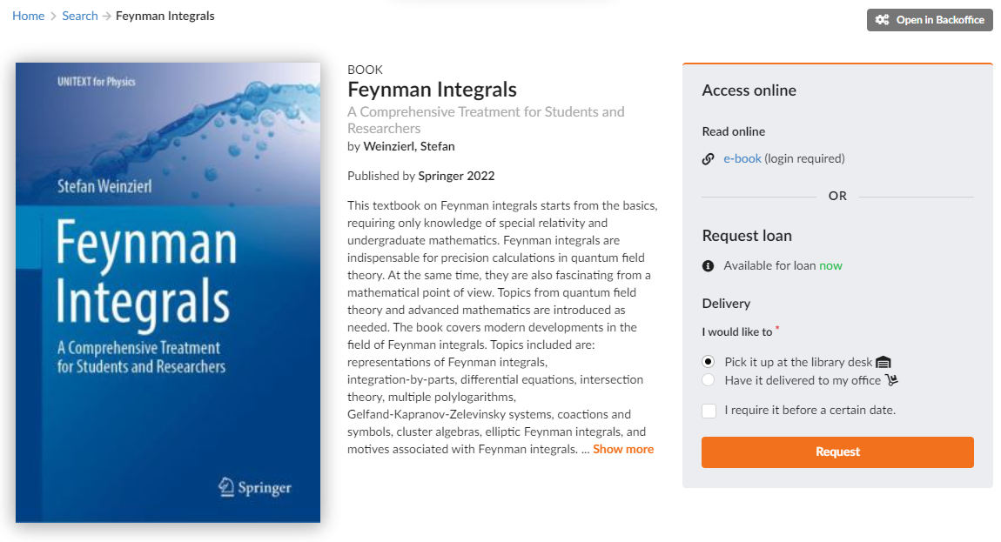
How to access e-books – Example 1
Directly from the library catalogue
For most publishers (e.g. Springer) access to e-books works directly via the e-book link from the library catalogue
You simply have to log in with your CERN credentials and can directly download the whole book or individual chapters
You can also access them from home as the EzProxy is already applied to the link from the catalogue (you do not have to be at CERN to gain access)

Slide 18
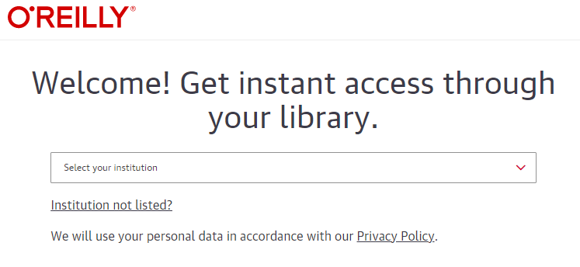
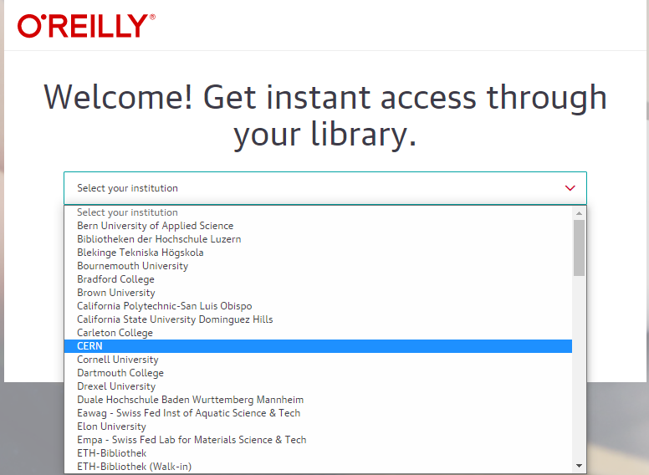
How to access e-books – Example 2
O'Reilly Platform
E-Books provided by O'Reilly require to select 'CERN' as your institution before you can gain access.

Slide 19
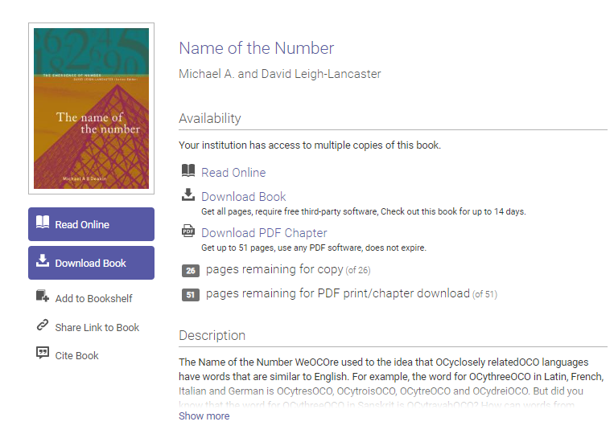
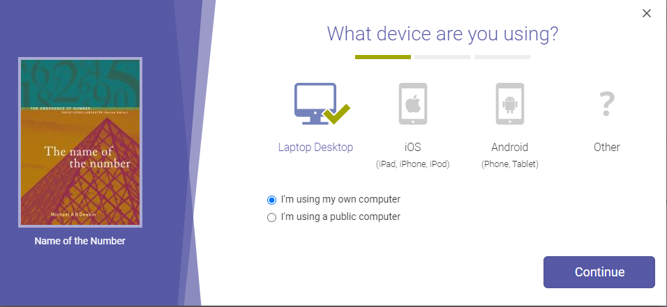
How to access e-books – Example 3
Ebook Central: Book is available for download
Less expensive e-books are available for download for 14 days, after that they disappear from your PC. You have to download Adobe Digital Editions in order to view them.

Slide 20
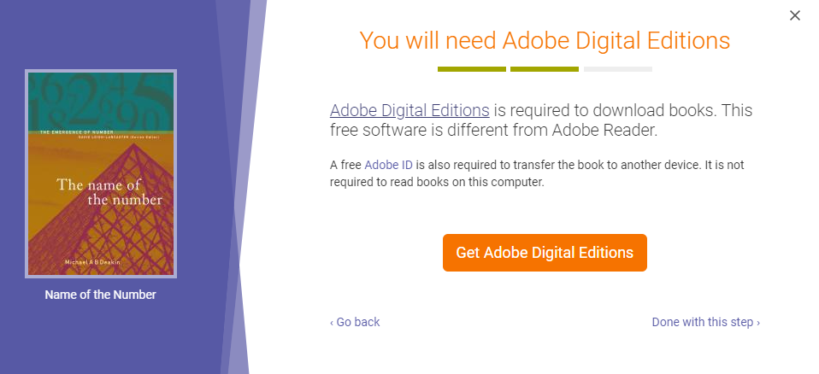
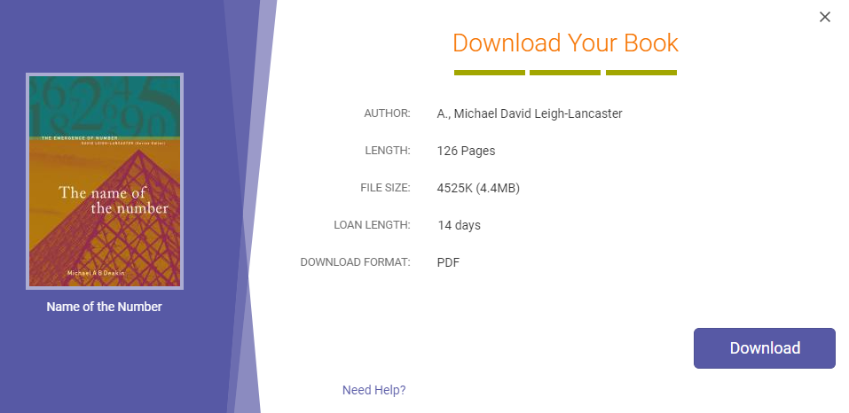
How to access e-books – Example 3
Ebook Central: Book is available for download

Slide 21
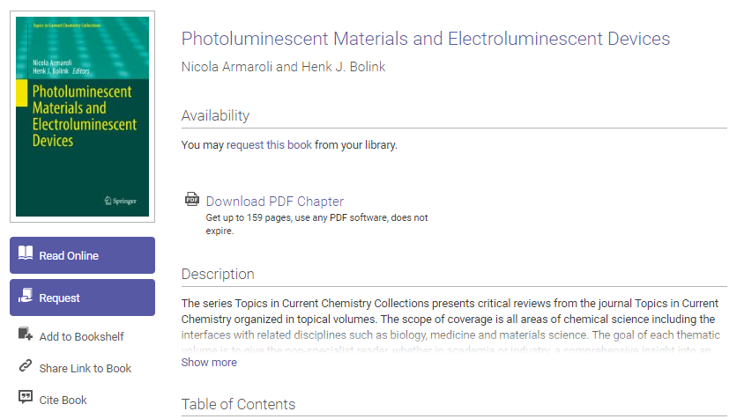
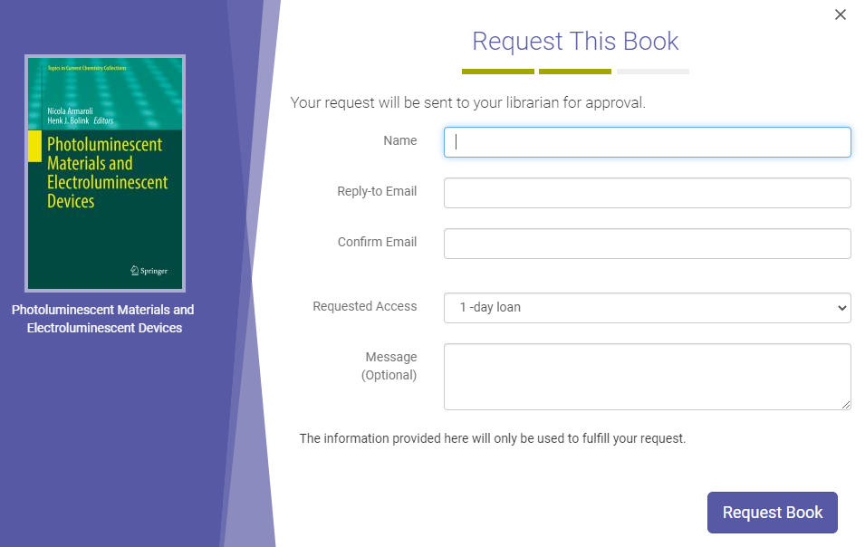
How to access e-books – Example 4
Ebook Central: e-book is on request
More expensive e-books are only available on request, which is evaluated by us. We will first check for less expensive alternatives (e.g. physical copy or interlibrary loan).
You can still read online for the first 5 minutes for free (for example if you only want to verify a reference).

Slide 22



Data management plans and research data management
Required or wish to make a data management plan?
Contact sunje.dallmeier-tiessen@cern.ch for support
Wish to deposit your data or code?
A range of services available serving your needs:
https://zenodo.org/
https://www.hepdata.net
http://opendata.cern.ch/

Slide 23
Where else can I look?
  EDMS: https://edms.cern.ch/
  Engineering & Equipment Data Management Service. Dedicated training courses available on LMS
  Indico: https://indico.cern.ch/
    Conference & meeting management tool. Dedicated training course available on LMS

