Slide 1

The vacuum control system at CERN
André Rocha (andre.rocha@cern.ch)
Interlocks, Controls and Monitoring Section, Vacuum Group
TE
Technology Department

Slide 2
Vacuum at CERN
Why accelerators need vacuum
Control System Architecture
How the vacuum control system is structured
Configuration Infrastructure
How we manage configuration and deploy our control system
Limitations to scalability
Is there any roadblock for a larger system ?
Trends and a Possible Future Architecture
What if we had to build FCC today ?
Conclusions
Key takeaways

Slide 3
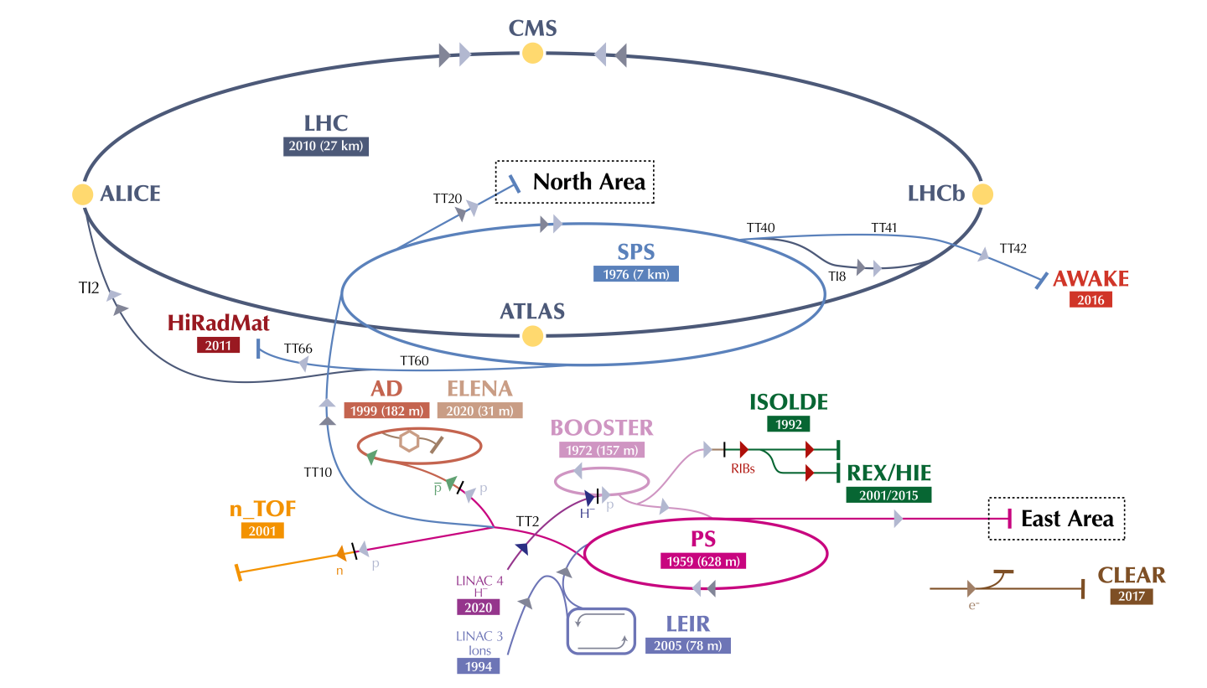

Vacuum at CERN
127 km of lines under vaccum
Pressures between ${10}^{−4}$ and ${10}^{−12}$ mbar
Notes:
No matter the installation, you will always find that the control system is based

Slide 4

Pressure on LHC beam lines is between ${10}^{−10}$ and ${10}^{−11}$ mbar
10 times less than the pressure on the moon

Slide 5
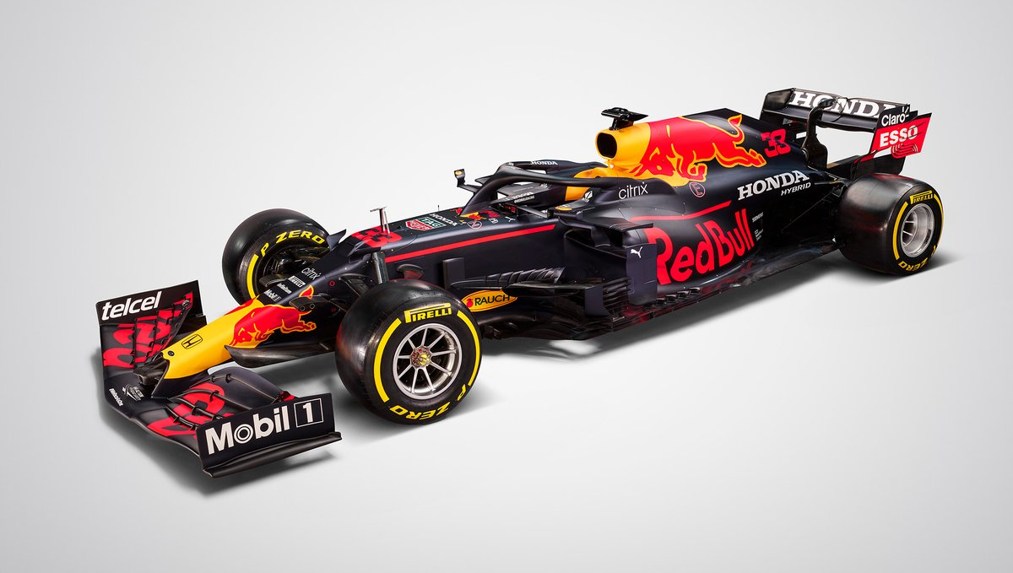
The Beam
Notes:
We can compare the beam to an F1 car that needs to accelerate through the tracks

Slide 6
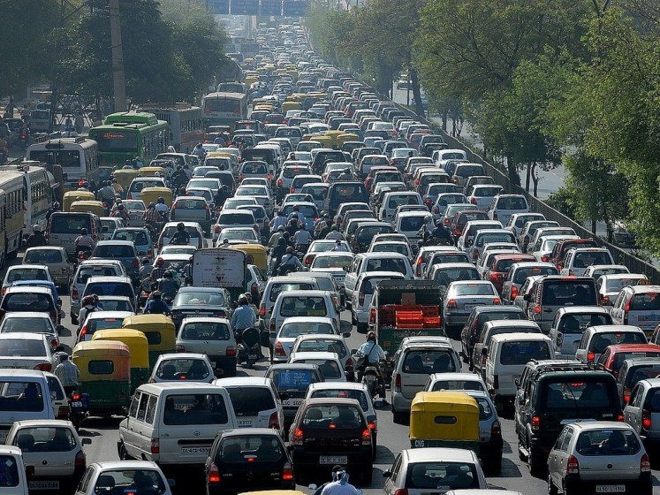
Gas Molecules

Slide 7

Beam in Vacuum

Slide 8
Increased Beam Lifetime
Beam Vacuum
Less particles lost at each turn
Increased Beam Stability
Less interference to beam dynamics
Objective:
Reduce the interaction between the beam and residual gas molecules
Increased Beam Luminosity
Better focused beam
Reduced Experiment Background noise
Less scattered particles

Slide 9
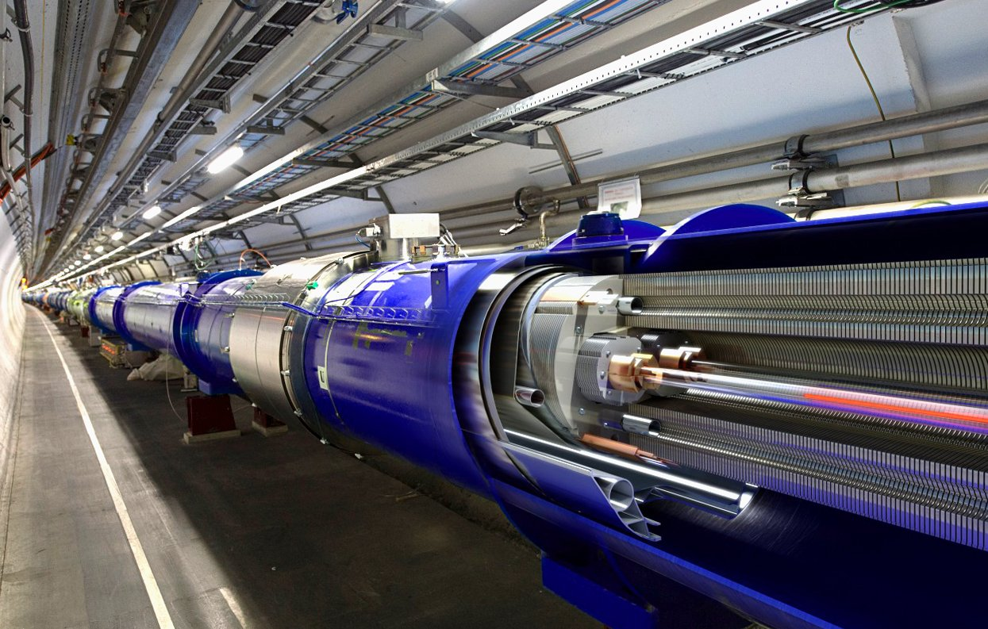
Insulation Vacuum
LHC Dipole
Objective:
Thermal insulation for magnets and helium distribution
To guide the beam, 1200 8T magnets are used
Current of 12kA
Superconductivity is necessary
  0 electrical resistivity
  Reduced size of conductors
Superconductivity achieved with liquid Helium
Vacuum is used as thermal insulator for magnets and helium distribution
Notes:
Any gas molecules in the magnet volume could cause unwanted heat transfer to the magnets, leading to a loss of superconductivity and subsequent damage to the magnets.

Slide 10
Process Equipment numbers
Vacuum is achieved and monitored by over 12000 pieces of control equipment

Slide 11

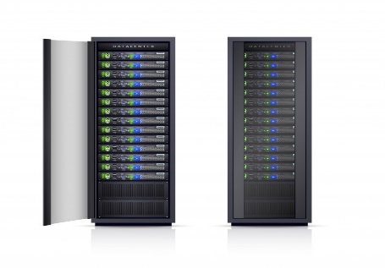
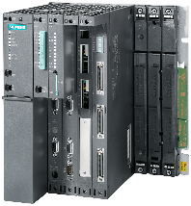
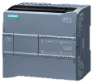
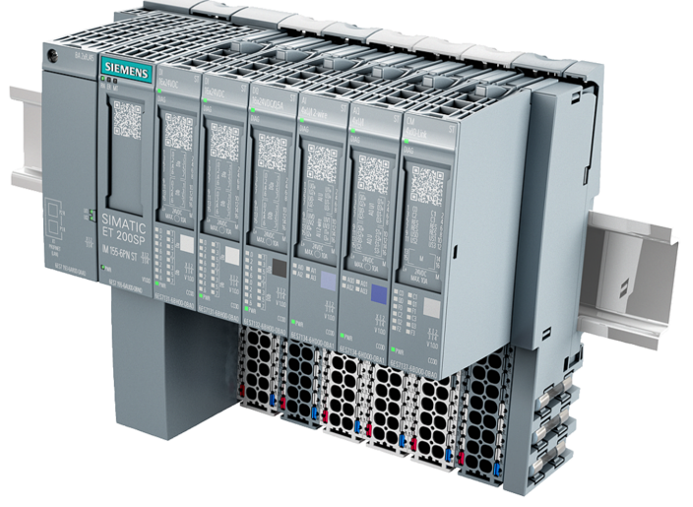
Control System Architecture
SCADA
Servers
WinCC-OA
General Purpose Network
User
Terminals
Terminal
Servers
Technical Network
Master PLC
(S7-400 x 35)
LSS Gauge
Reading PLC
(ET200-SP x 18)
Arc Gauge
Reading PLC
(ET200-SP x 16)
VPG PLC
(S7-1200 x 220)
Profibus (mobile)
Profibus (fixed)
Sector Valves
Mobile
Devices
Pumping
Group
LSS Insulation Vacuum Gauges
Arc Insulation Vacuum Gauges
Bypass
Valves
NEG + Ion Pumps
LSS Beam Gauges
Penning + Pirani Gauges
Cryogenic
Interlocks
Arc Beam Vacuum Gauges
Cryogenic
Interlocks
( … )

Slide 12












SCADA Applications
as of 2023
Notes:
No matter the installation, you will always find that the control system is based

Slide 13
Configuration settings numbers
LHC
SPS
CPS
617 632
147 315
100 783

Slide 14
Control Parameters
Attributes required to control devices
Alarms
Archiving
Alarm descriptions
Alarm hierarchies
What to archive. Which archive settings ? Archive duration
vacDB
Communication
Data Sharing
SCADA <-> PLC <-> Device
What to share to other systems ?
Display
The location of equipment in synoptics

Slide 15
Vacuum Databases
Master Database
For each device type:
Definition of Vacuum Equipment Types
Definition of Attributes
Definition of Default Attribute values
Definition of Communication block
Definition of SCADA datapoint type
Definition of alarms produced
Master DB
LHC
SPS
CPS
Machine Databases
Instantiation of equipment
Specification of equipment attributes
Specification of archiving settings
Specification of data sharing
Machine DBs

Slide 16
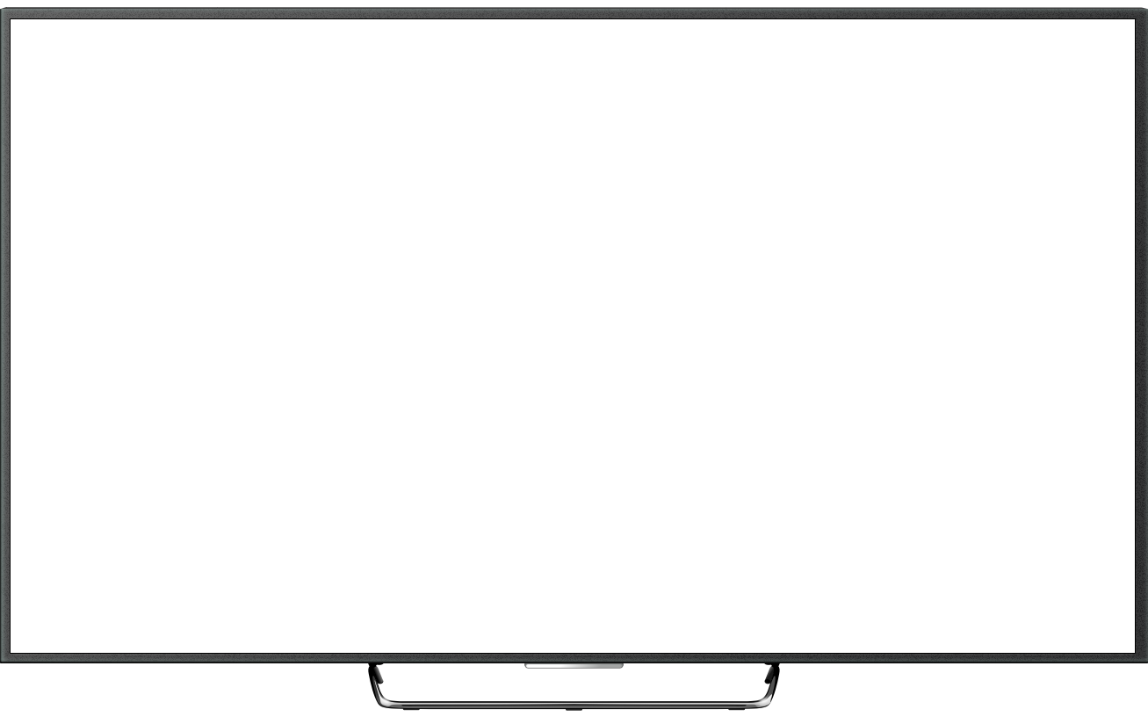
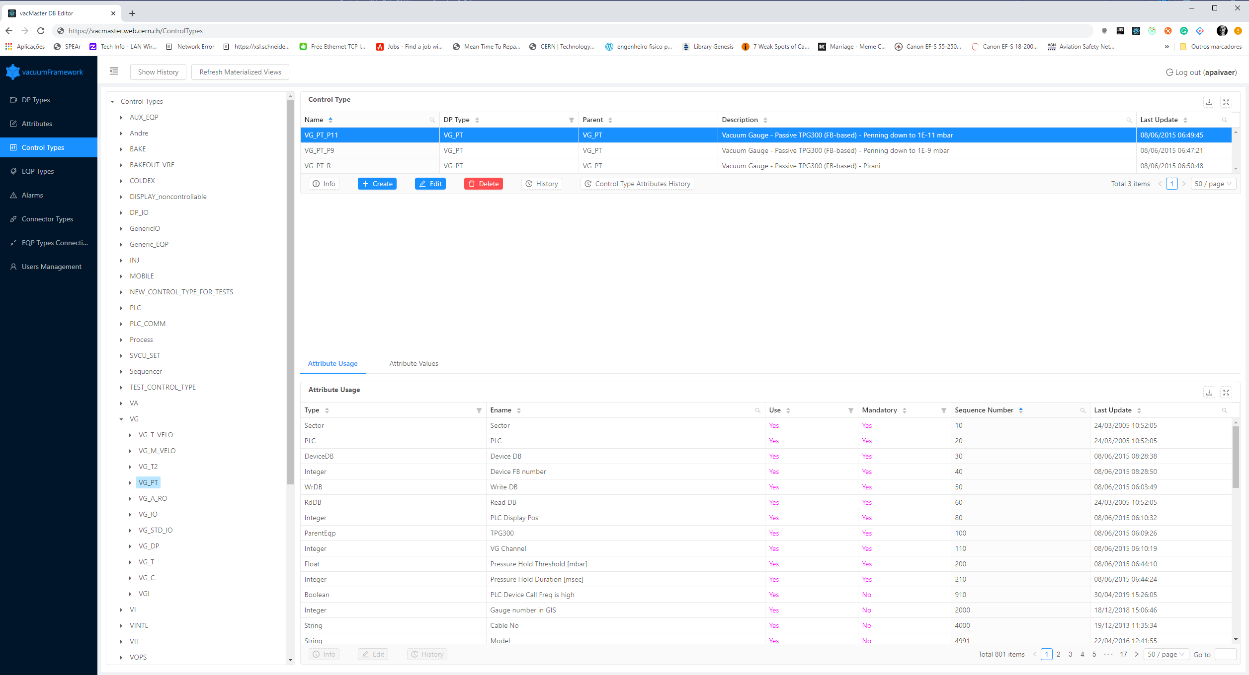
vacCC
Master
The metadata editor
Used by SCADA developers
Definition of defaults for each eqp type

Slide 17
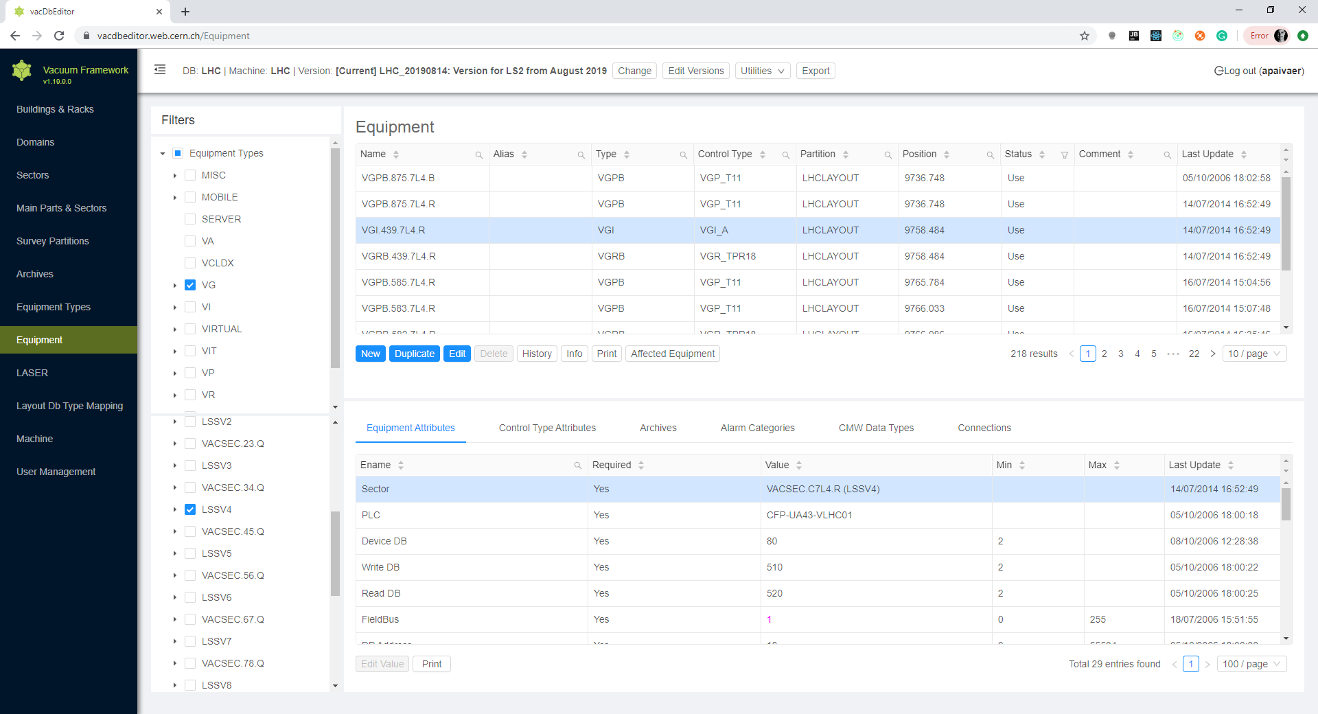
vacCC
Machine
The editor for the machine databases
Allows integration of equipment in the control system by non software experts
Full traceability

Slide 18
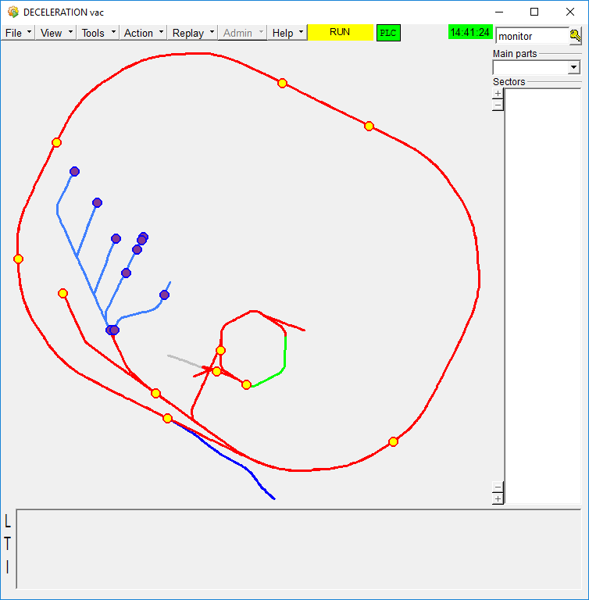
vacCC Master
Configuration
Architecture
MASTER
vacCC Master Backend
Data flow
LHC
SPS
CPS
SCADA
Import
SCADA Configuration
vacCC Machine Backend
Exporter Service
PLC Code
Vacuum Devices
vacCC Machine
Notes:
All

Slide 19
Advantages of Database-Driven Configuration Engineering Tools
Cross-layer consistency
  Changes of parameters are propagated to all relevant layers of the control system
Data integrity
  Configuration integrity and consistency done by defining rules for data validation and constraints
Assessibility
  Multiple people can work in the configuration of the control system at the same time
Versioning
  Have different versions of the control system ready in advance according to the needs of operations
History
  Log every change. Know what changed, when it changed and who changed what.

Slide 20
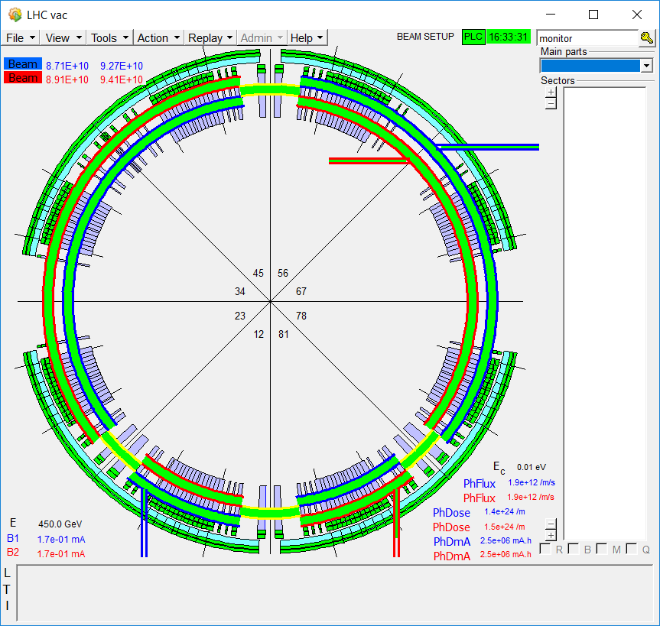
SCADA
User Interface

Slide 21
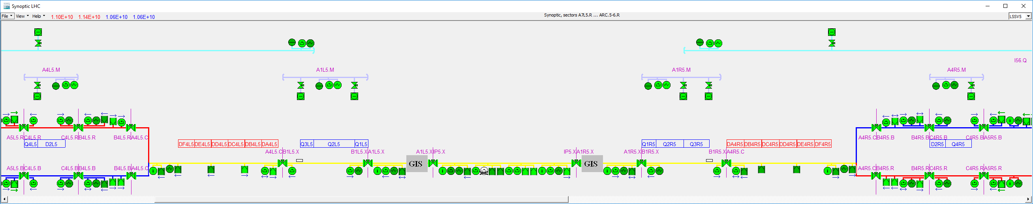
Automatic Synoptic Drawing

Slide 22
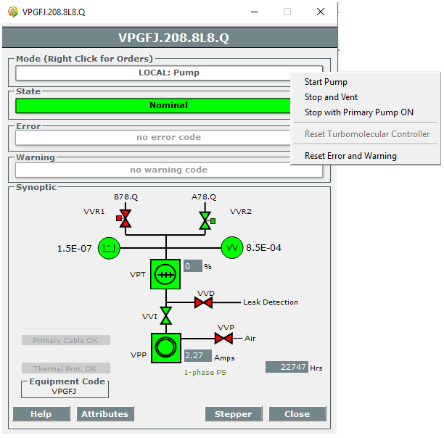
Equipment Details Panel

Slide 23
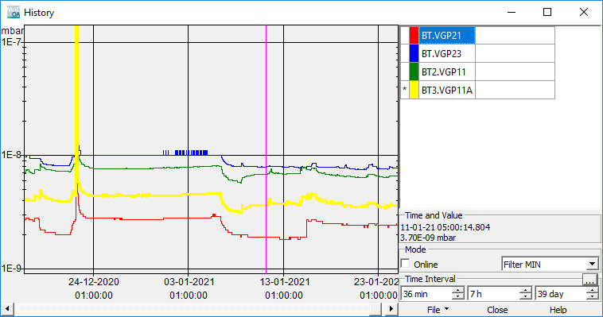
Archiving

Slide 24
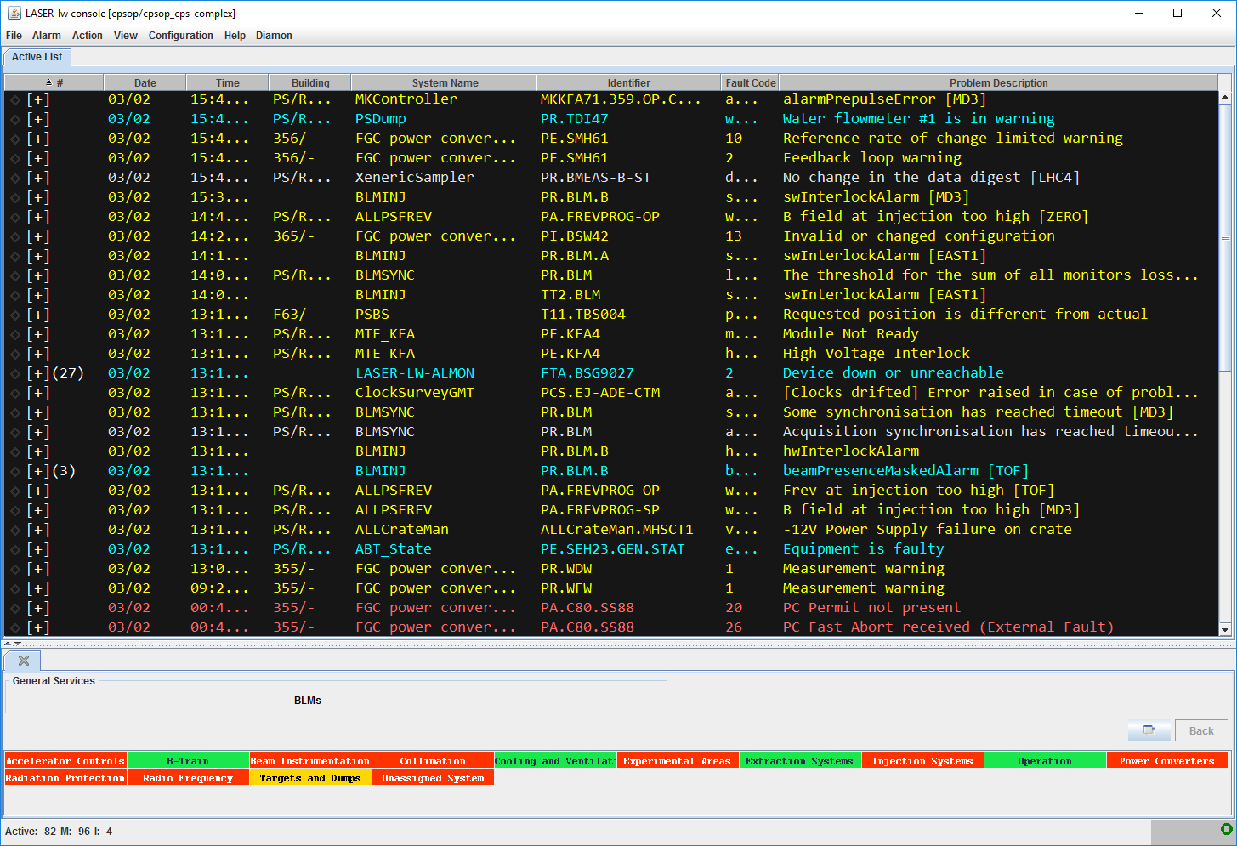
Alarms

Slide 25

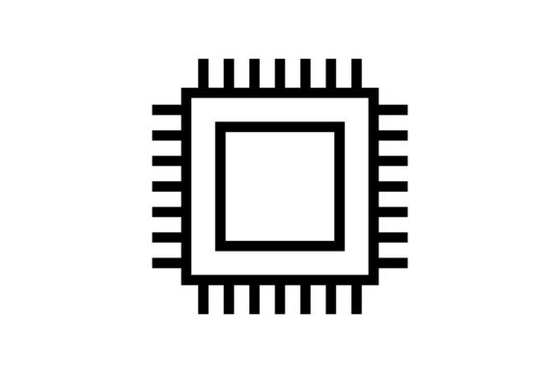
WinCC-OA Limitations to Scalability
(known) factors that may eventually limit our current architecture
Source: https://www.winccoa.com/documentation/WinCCOA/3.18/en_US/Installation/Operating_Conditions.html
Devices and datapoint elements
Maximum number of datapoint elements: ~16M
Implications on memory and CPU load
LHC: currently at 400.000
Memory and CPU
Average CPU load by event manager should be < 20%
Summarized average CPU of all WinCC-OA processes (drivers, event, data, ctrl) should be < 50 %
LHC Total CPU load < 3% / Event Manager Load 10% on single core
LHC currently at 14GB/256GB memory usage
Number of PLC Connections
Maximum number of 512 connections per system
LHC currently with 300 connections

Slide 26
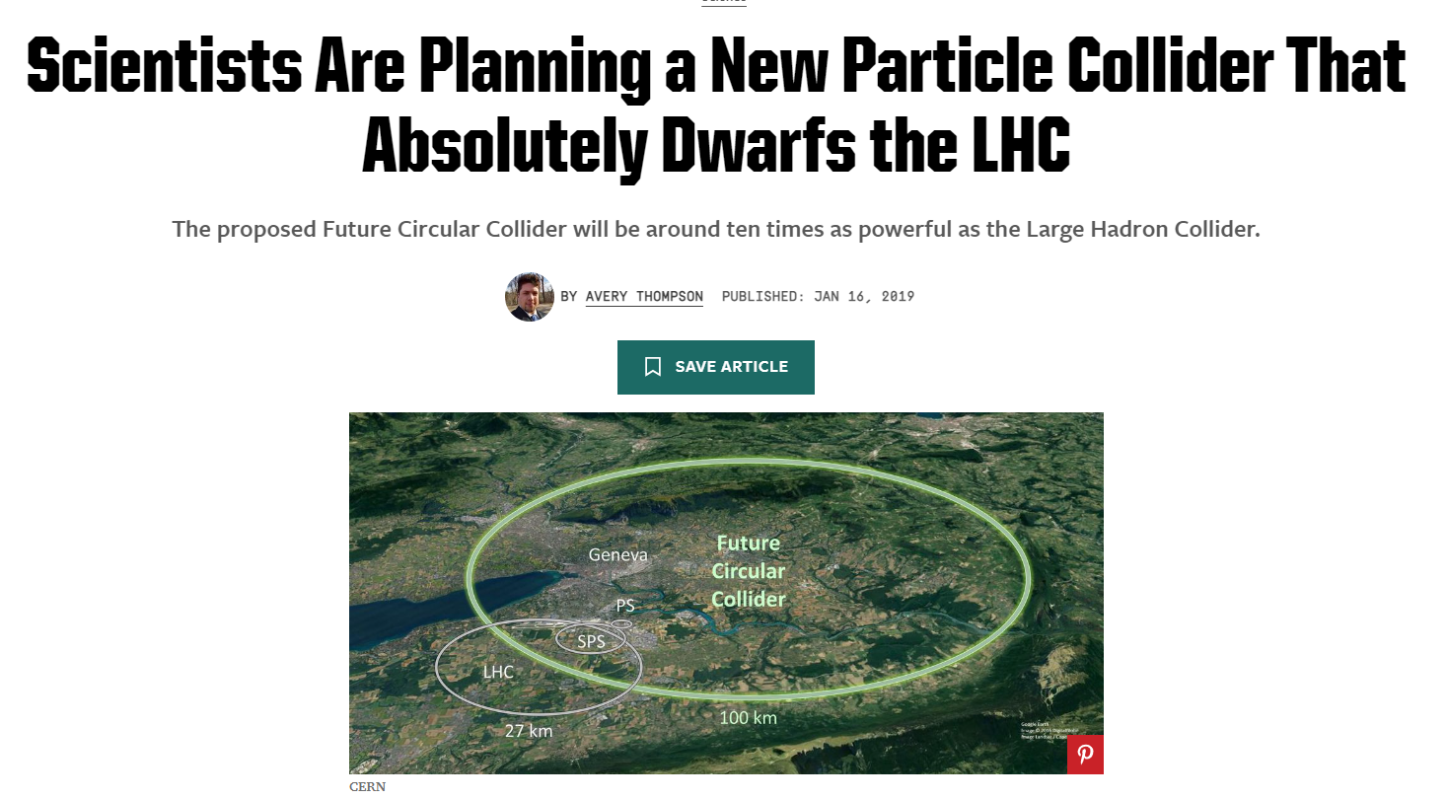

Slide 27
Scaling to FCC
Scaling our current architecture to an accelerator the size of FCC won’t work
  FCC planned size is roughly 4 times that of LHC
  WinCC-OA is limited to 512 PLC connections
    LHC has 300 PLCs x 4 = 1 200 PLCs – too many connections
(New) trends have to be considered for future control system architectures
  Integration of IOT devices
  Advanced real time data analytics – increasingly important on large scale systems with huge amounts of data to analyze
  Data pipelines – provide robust ways of moving large amounts of data between the different parts of the control system

Slide 28

Kafka
Distributed streaming platform
Publish/subscribe messaging system based on topics
High Throughput / Low latency
  Hundreds of thousands of messages per second on a single broker
Scalable without compromising performance
  Designed to scale horizontally by adding more brokers to the cluster
  Topic partitioning – distribute data across multiple brokers
Highly available and Fault-tolerant
  Automatic Failover
  Topic replication
Ecosystem of pre-made connectors, allowing to integrate kafka with a multitude of systems
  https://docs.confluent.io/kafka-connectors/self-managed/kafka_connectors.html#kafka-connectors
producer
producer
producer
producer
producer
producer
producer
producer
producer
Kafka broker
Kafka broker
Kafka broker
consumer
consumer
consumer
producer
producer
producer
producer
producer
producer

Slide 29
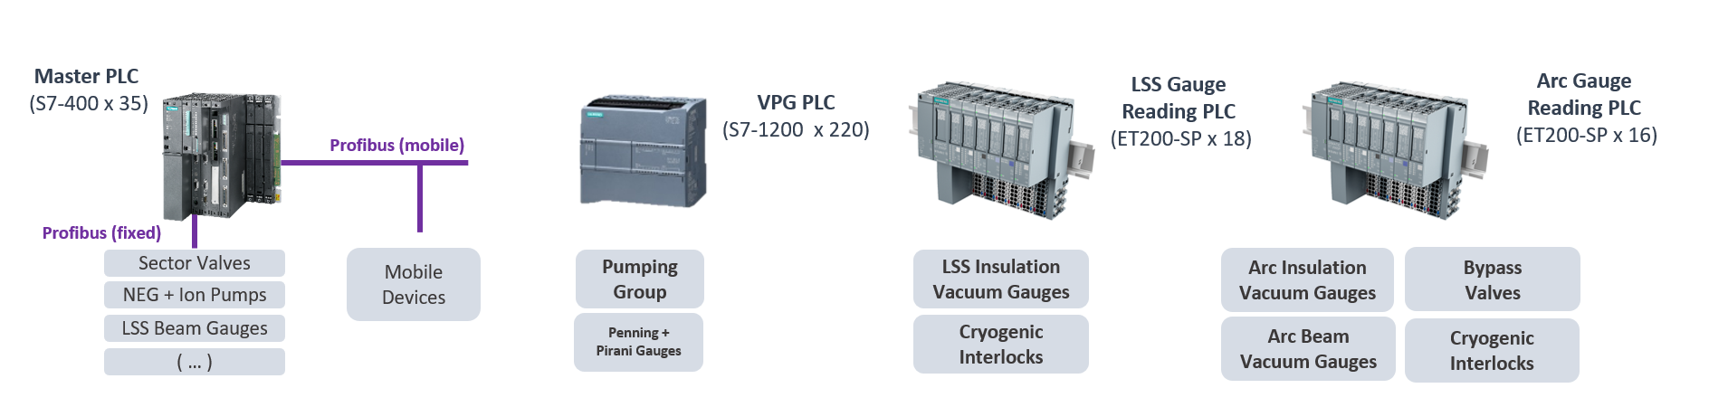

Control System Architecture
SCADA
Servers
General Purpose Network
Real Time Analytics
Processors
User
Terminals
Technical Network
Kafka Translators
Zone 1
Kafka Translators
Zone 2
Kafka Translators
Zone n
Zone 1
Zone 2
Zone n

Slide 30
Conclusion
Database-driven Configuration Engineering tools are essential to manage large-scale control systems:
  Provide a centralized location for storing and managing equipment configurations, making it easier to maintain and update control systems
  Allow for more efficient collaboration between multiple teams working on different aspects of a control system
  Improve the reliability and safety of control systems by ensuring that equipment configurations are consistent and correctly applied in the relevant layers
  Allows operators to track and monitor changes made to control system parameters, providing a clear audit trail of modifications
Distributed streaming technologies can help us evolve our control system architecture:
  Provide greater scalability, enabling control systems to handle larger and more complex deployments
  Enable real-time analytics, allowing for more proactive and predictive maintenance strategies
  Open up new possibilities for integrating different types of equipment and technologies, improving interoperability and reducing vendor lock-in

Slide 31
Thank you !

