Slide 1
Electrical Network Evolution
DNV Visit
Mario Parodi, with the important support of Stefano Bertolasi, Nuno Dos Santos, Dimitrios Katsanikos, Pablo Valdes, Eva Cano Gonzalez, Philippe Orlandi, Bruno Saint-Sulpice, George Podoleanu – EN/EL
2023-04-04

Slide 2
Content
Electrical grid in CERN region
Overview of CERN electrical network
Network evolution up to LS2
Roadmap for the future
Conclusions

Slide 3
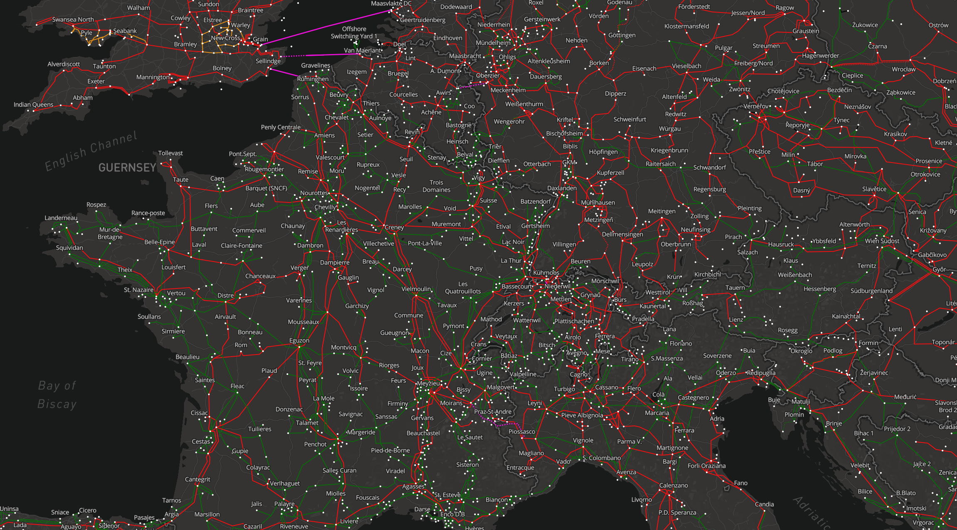
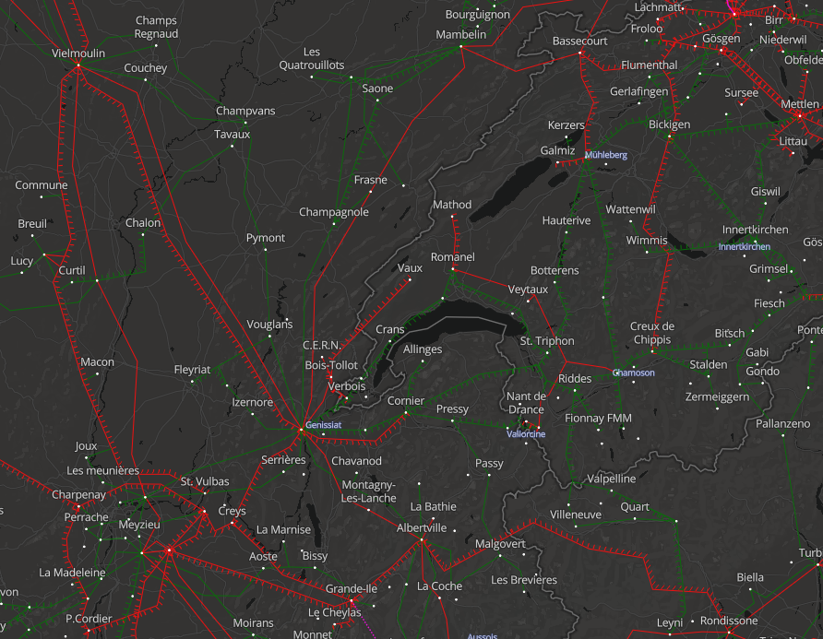
400 kV
220 kV

Slide 4
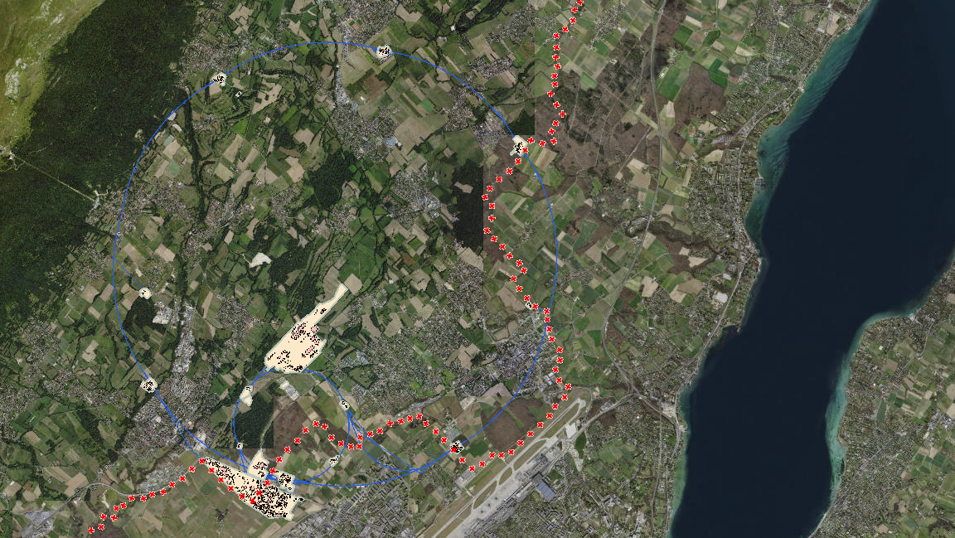
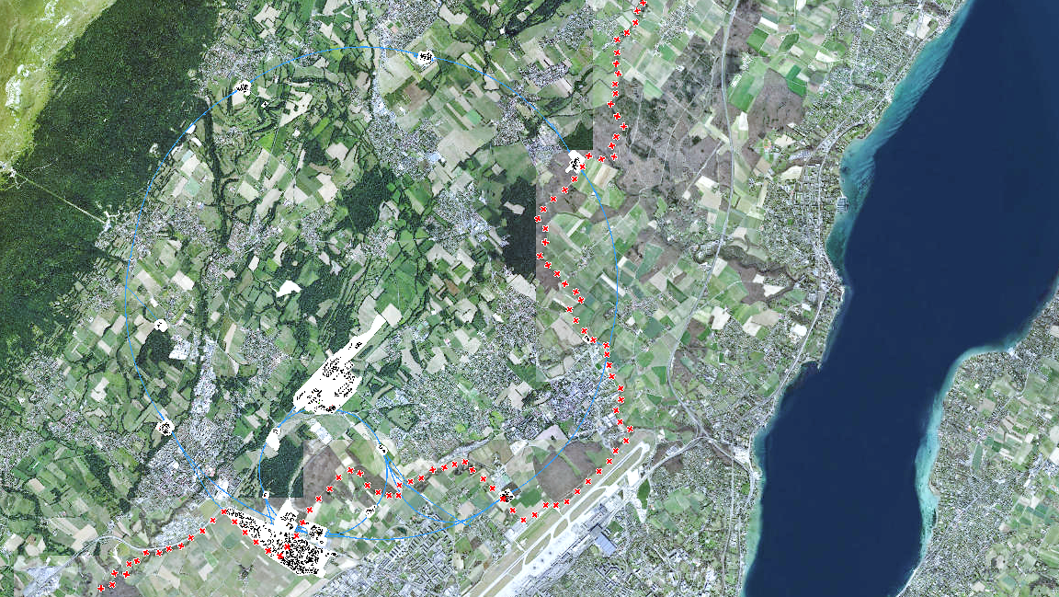


ROMANEL
CHAMOSON
RTE/Swissgrid 400 kV lines
RTE Bois-Tollot 400 kV substation
BE1 400/66/18 kV substation
BE2 400/66 kV substation
66 kV lines
66/18 kV substation
18 kV lines
18 kV substation
SIG 132 kV line
ME10 130/18 kV substation
ENEDIS 20 kV suppliles
B.T.
BE1
BE2
BE1
BE2
B.T.
GENISSIAT
VERBOIS

Slide 5
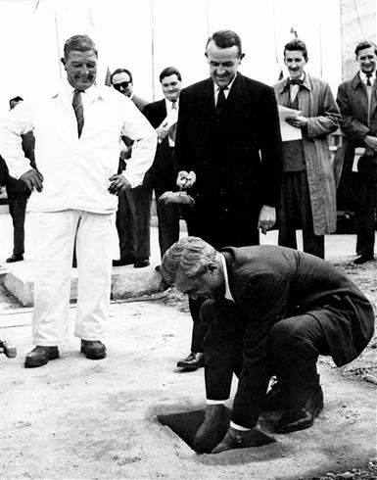
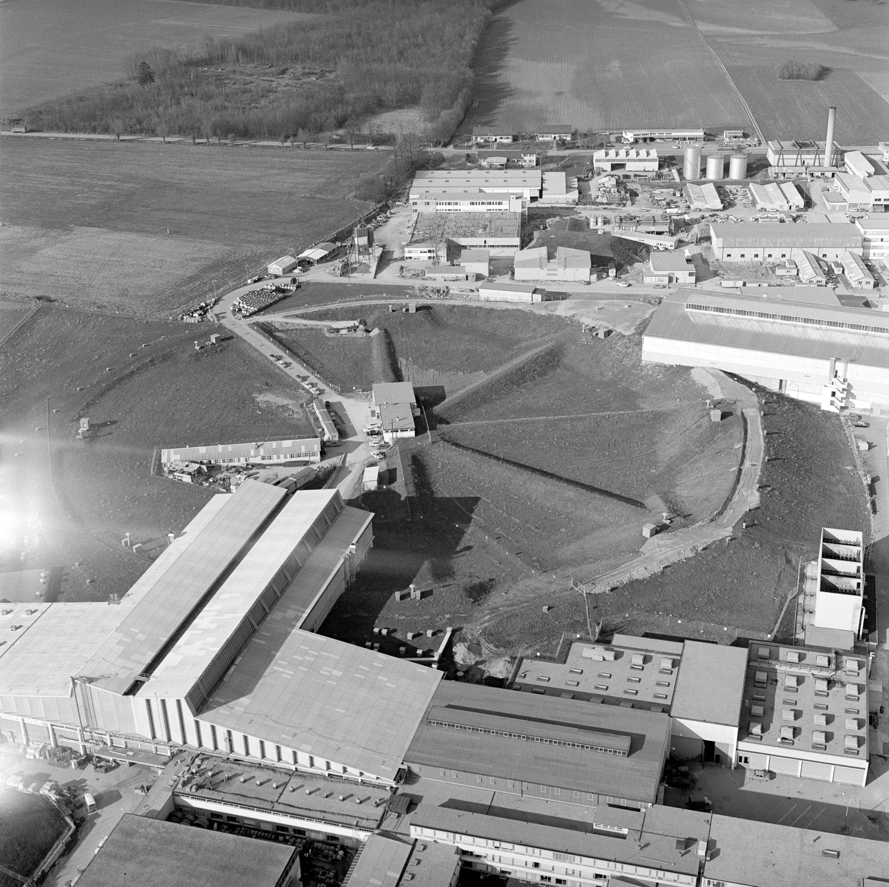
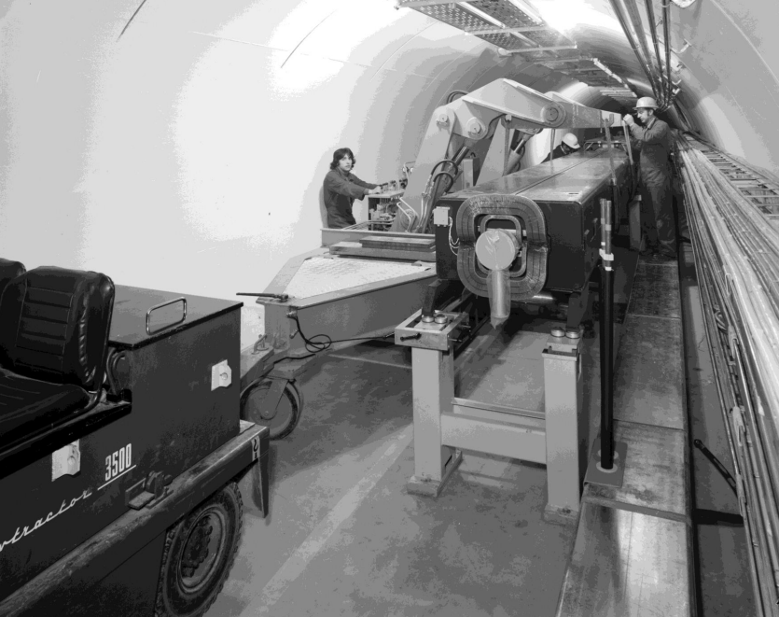
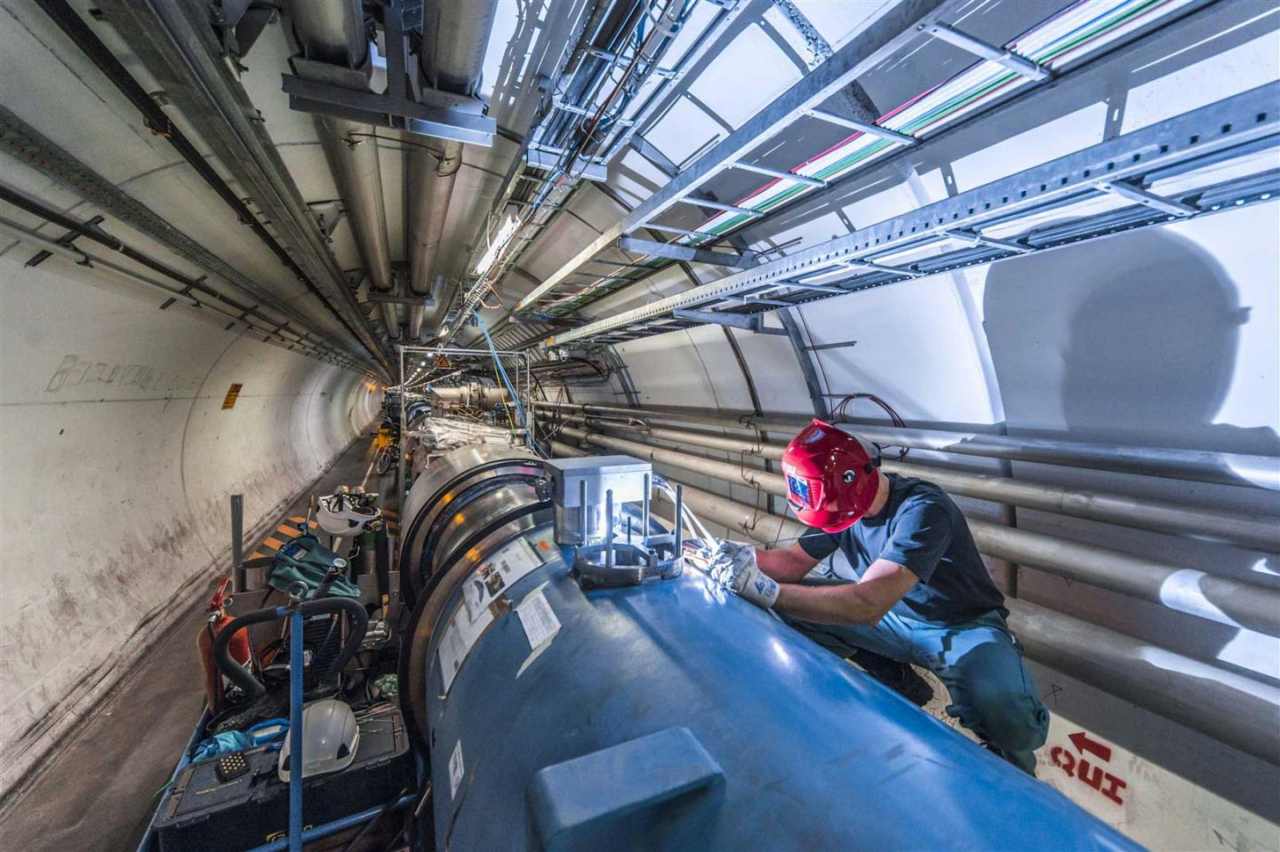
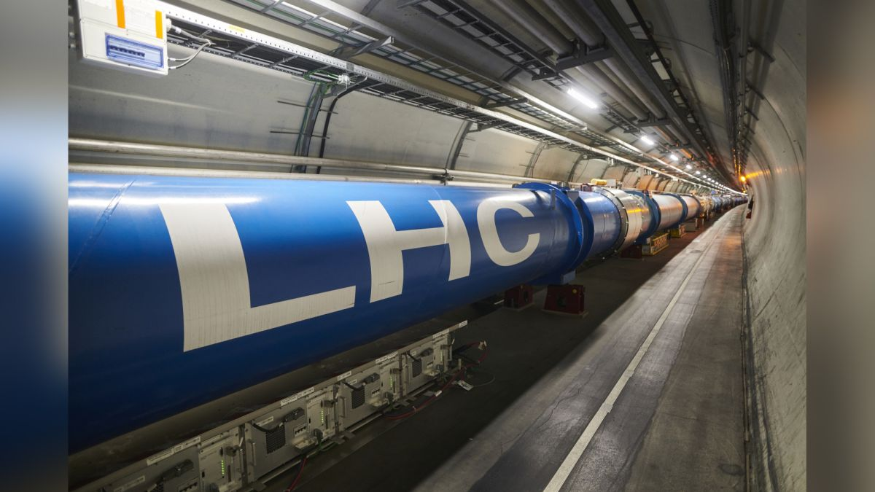
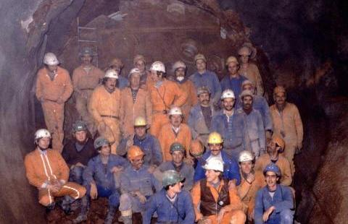
1954
1960
1970
1980
1990
2000
2010
2020
2021
LS1
RUN2+LS2

Slide 6
Roadmap for the future evolution
By the end of LS3:
LHC5-LHC6 66 kV upgrade
LHC5 18 kV upgrade
LHC1 18 kV upgrade
ME10 consolidation
Prevessin and PCC supply
North Area consolidation Phase 1
Future évolutions (under discussion)
North Area consolidation Phase 2
Upgrade of MP7 link
Separation of SPS and LHC networks
2022
2024
2026
2028
2030
2032
2034
2036
RUN3+LS3
RUN4+LS4

Slide 7
Conclusions
The CERN electrical infrastructure is a multi-layer network covering all sites of the complex.
The network has followed the evolution of the Organization.
Strong interface with the surrounding regional grids and their status.
Important results have been achieved until LS2, but the evolution will continue.
The Roadmap for the evolution of the network is set until LS3 and beyond, with interesting options >2028 already under assessment.
The evolution shall face future challenges for what concerns the energy market evolution, the flexibility required from the external grids, the electrical automotive development, and shall consider new technologies arising.
The higher the power demand, the more complex the upgrade: significative power requirements shall be announced in due time.

