Slide 1
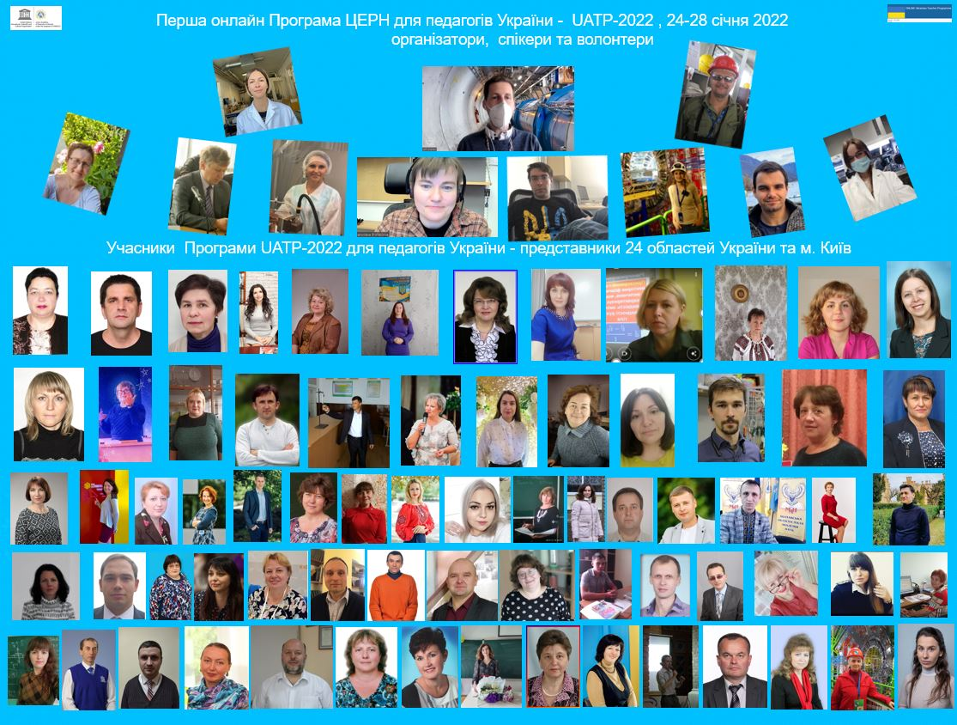
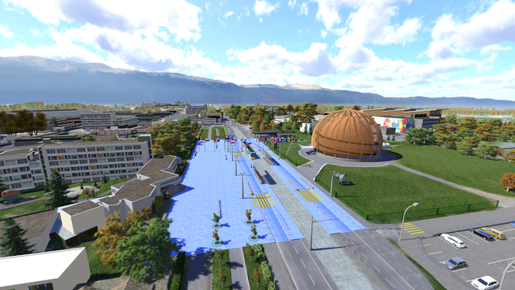
Teacher and student programmes
CERN, Geneva
Oksana Zhyvotova
March 2023

Slide 2
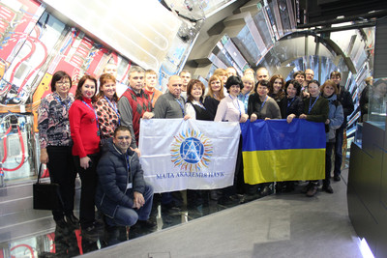
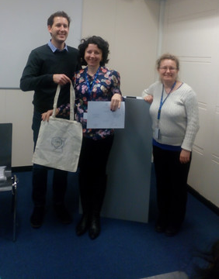
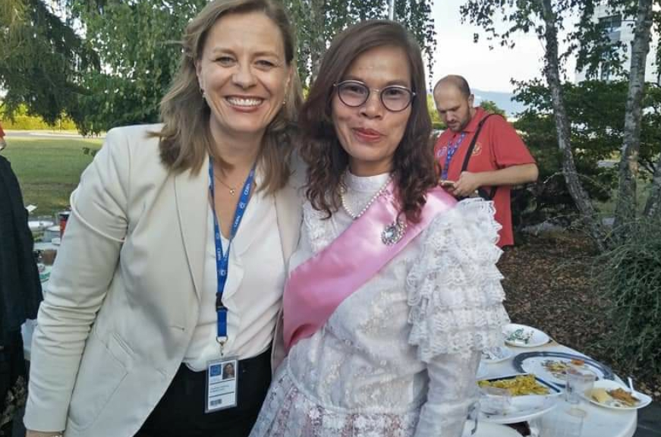
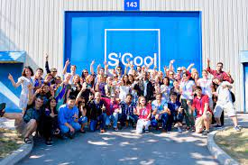
The importance of programmes for teachers
Hello, my name is Oksana Zhyvotova. I am a coordinator of online schools and programmes for teachers and students from Ukraine.
First, I want to explain the importance of the programmes for teachers.
When I was a young teacher, I learned about CERN thanks to the national programme for teachers in 2016. When it finished, I returned to Ukraine as a CERN ambassador and was able to actively share the acquired knowledge with students and colleagues. We began to organize all-Ukrainian online webinars so that as many people as possible could learn about CERN's research and its applications. Additionally, I shared information with colleagues on how to apply for the programmes at CERN. I find this an invaluable experience.
When I came here, at CERN, I met with the manager of the teacher programmes, Jeff Wiener, and the coordinator of programs for Ukrainian teachers: Tetiana Hryn’ova.
The next step for me was to participate in the international programme. These three weeks were very busy but wonderful! We were 44 teachers from 33 countries of the world and even though the programme is over, we continue to communicate on scientific topics within the group...

Slide 3
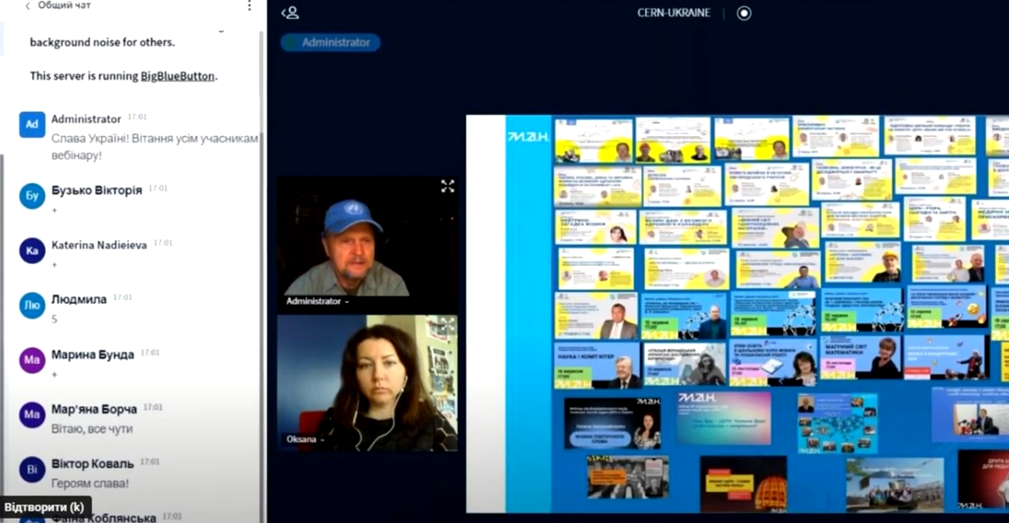
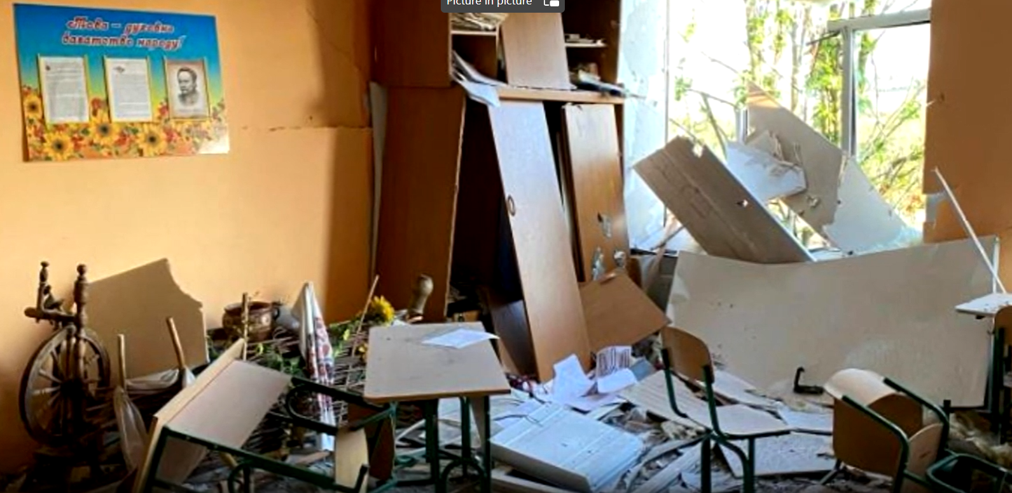
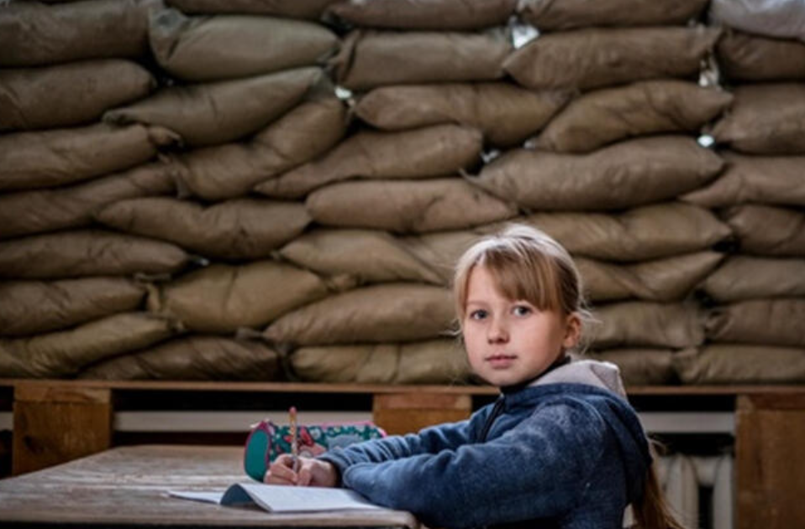
In Ukraine, the CERN Ambassadors Club is successfully functioning, the coordinator is a person who is always full of ideas - Oleksandr Yurov.
CERN provides many opportunities for Ukrainian teachers even now.
During the period January 2022 - March 2023 the following events were organized within the framework of CERN cooperation with Ukraine.
After pandemic, we, Ukrainian teachers, were very glad to have the First ONLINE Ukrainian Teacher Programme on January 2022. In this period teachers came back from the covid-break (156 participants).
Unfortunately, the next months, when the war began, were very difficult for all Ukrainian people. Of course, for the education process for Ukrainian teachers and students as well.

Slide 4
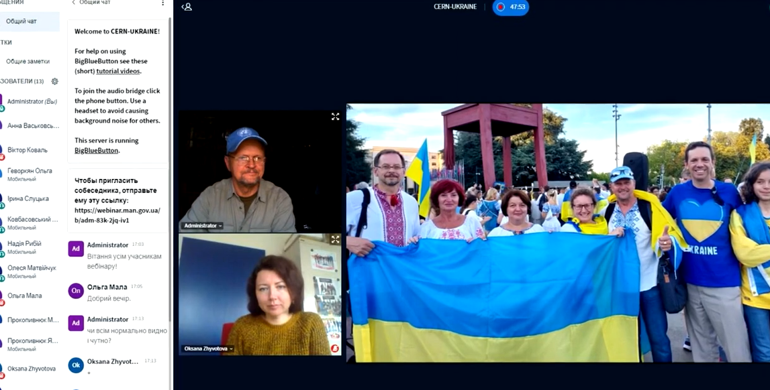
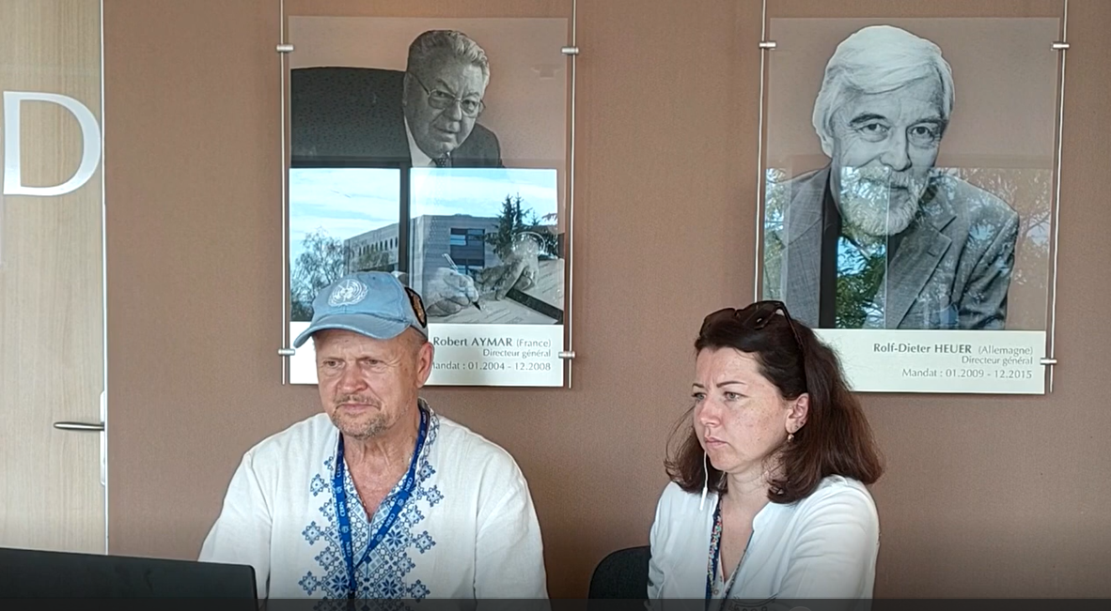
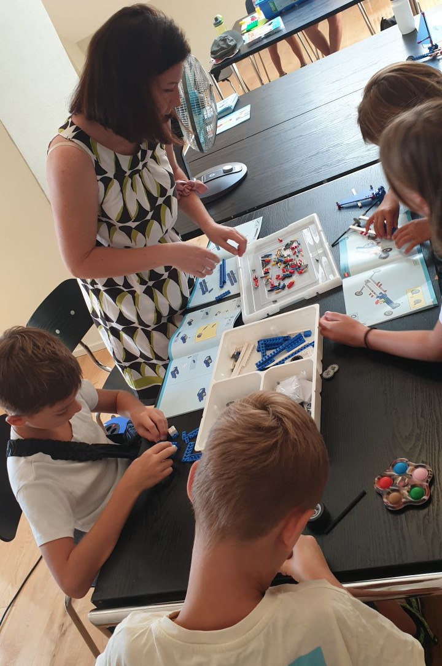
Last summer, my contract at CERN officially began. Now, one of the tasks I have is to organize and conduct online programmes, webinars and teleconferences for Ukrainian teachers and students.
The first step was to organize events within the framework of the summer camp for children of Ukrainian refugees, who are staying in Geneva and in French villages near the border of Switzerland and France (workshop ''Visible is not visible'', science show ''Fun Physics'' in the Globe and others events).
The next step was to manage the second online Ukrainian Teacher Programme. It took place in November, 2022 and included fantastic lectures, and many virtual visits at CERN facilities.
I have to say that despite the blackouts and the difficult situation in Ukraine, about 40 teacher and 7 students joined the programme (many of them from the occupied Marianka).
One of the participants, a student asked me if there were programmes at CERN for school students. The last programme for students had been in 2019... This question, the interest of students in knowledge, that motivated us to organize the first online Ukrainian Student programme (January-February 2023).
Ukrainian teachers hold the educational front professionally and bravely. We thank CERN for its support and for facilitating teacher and student programmes This is very important today!

Slide 5

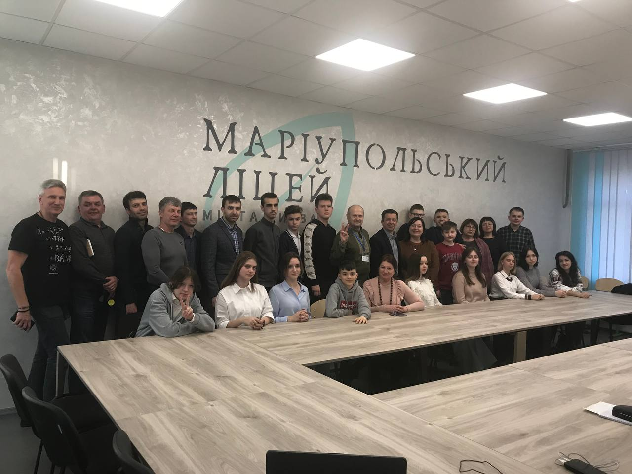
Plan for the future:
3rd ONLINE Ukrainian Teacher Programme
  24-28 April 2023
Teleconferences with school from unconquered cities of Ukraine:
  March 2023 - Mariupol Lyceum (location in Kyiv now)
  16 May 2023 - School from Bucha
  8 June 2023 - School from Irpin

Slide 6
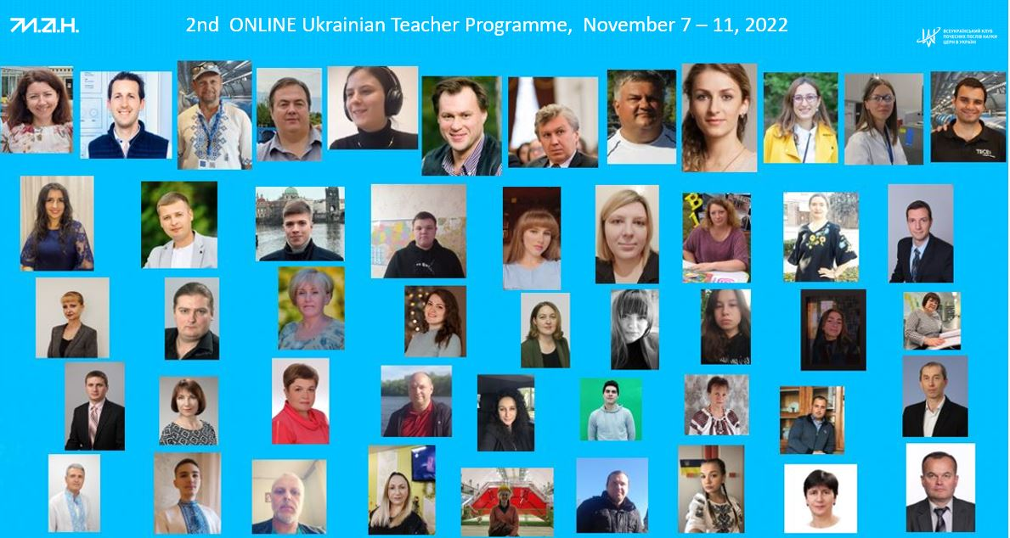
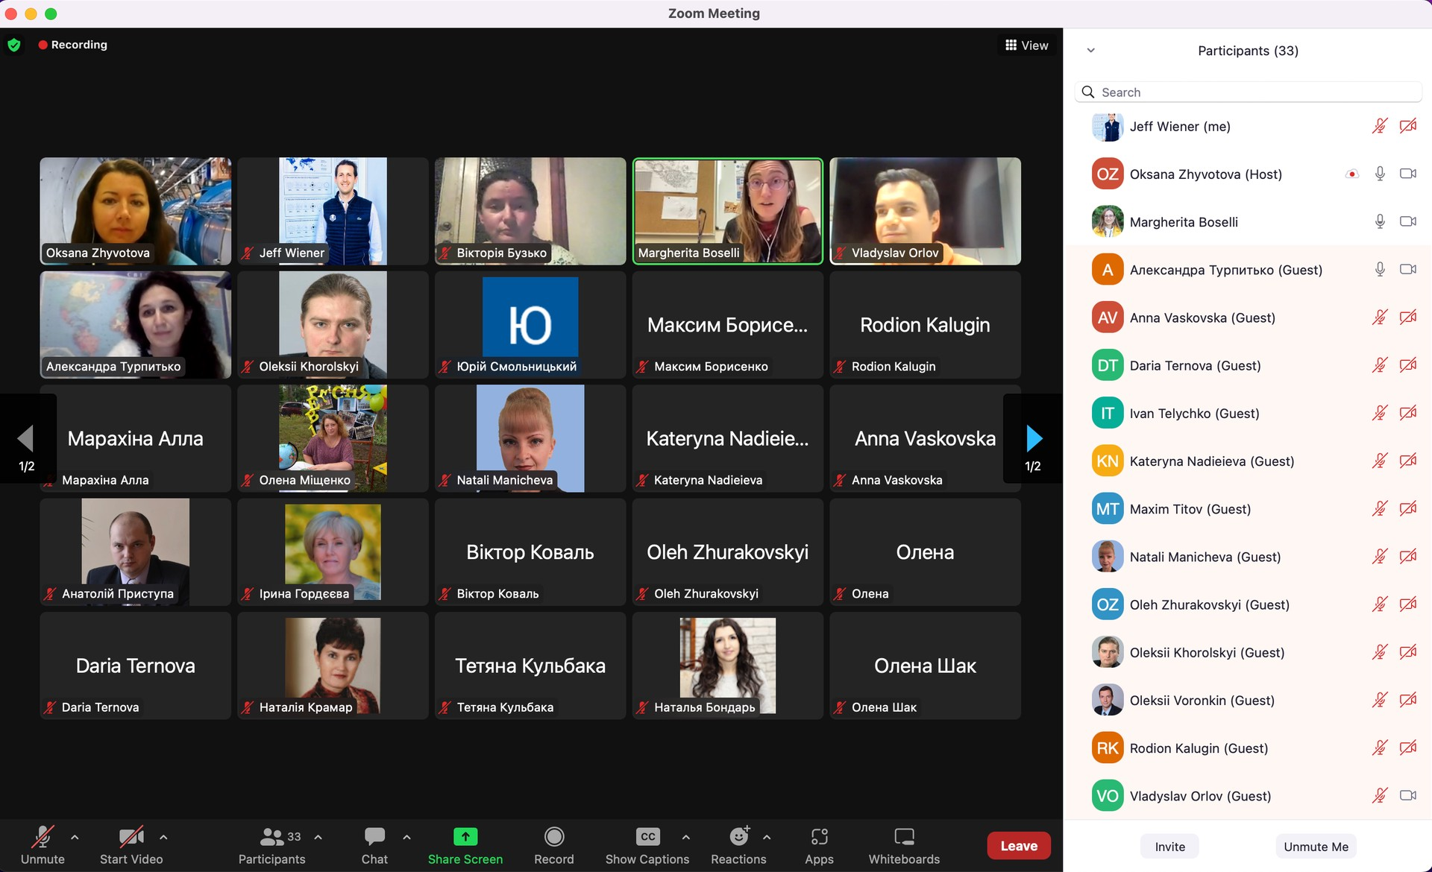
Many thanks to the leadership of CERN for the opportunity to conduct online schools for teachers and students.
I want to thank my supervisors Sascha Schmeling and Jeff Wiener who supported every idea of the Ukrainian coordinators.
I thank my Ukrainian colleagues coordinators Tetiana Hryn’ova, Oleksandr Yurov, Daria Ternova and speakers from the programmes: Boris Grynyov, Maksym Titov, Olena Karacheban, Pavlo Svirin, Vladyslav Orlov, Iaroslava Profatilova, Anna Vnuchenko, Dmytro Kovalskyi, Oleg Bezshyyko, Valeriia Lukashenko, Alexey Boyarsky, Anastasiia Lazuka, Ihor Olkhovskyi, Joni Pham, Volodymyr Rodin .
Also, many thanks to my team: Margherita Boselli, Patrick Georges Thill, Gernot Werner Scheerer and Paulina Emilia Nicinska for support in the Ukrainian programmes. It was fantastic workshops, science – shows, BL4S.
Thank you everyone for your contribution!

Slide 7
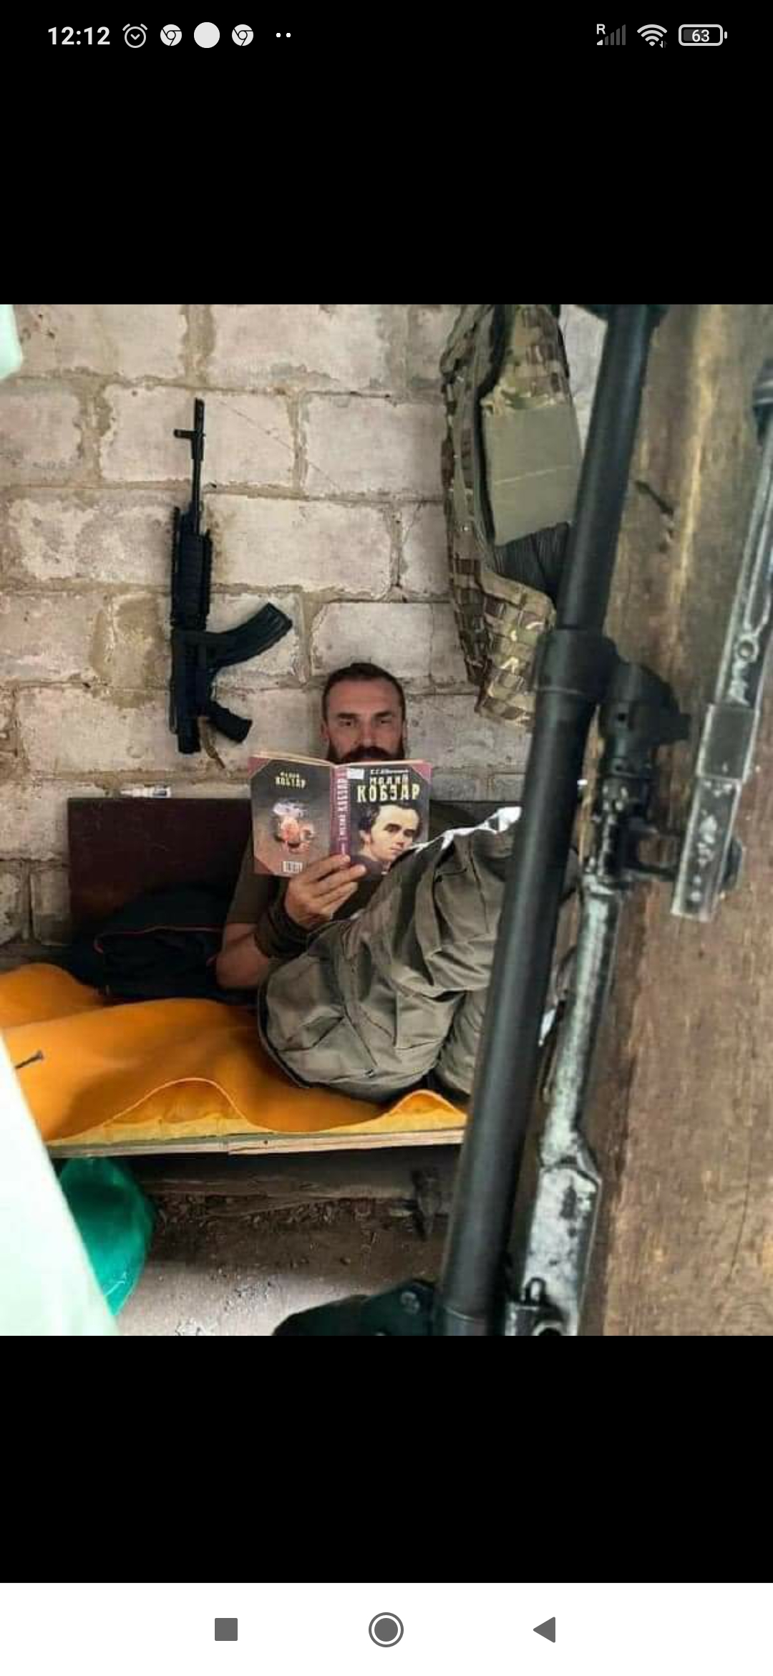
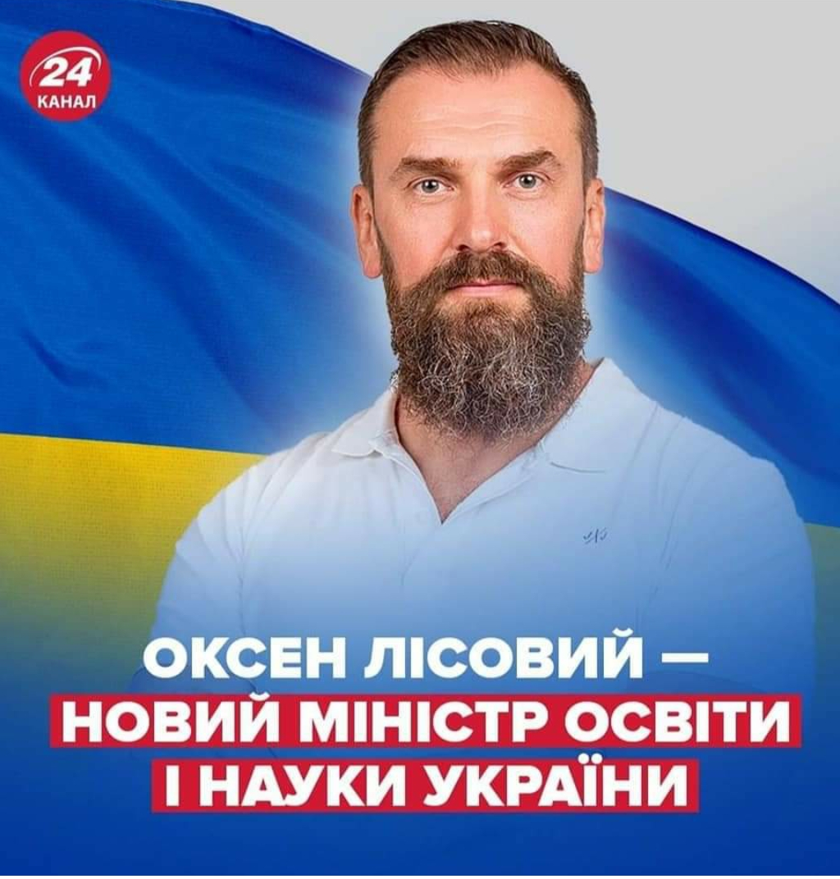
In conclusion, I want to say:
Last week I heard the news of the appointment of Oksen Lisovoy (head of the Junior Academy of Science) as Minister of Education and Science of Ukraine. This is the first great news for Ukraine during the last year!
It is important to say that he became a volunteer of the Ukrainian army at the beginning of the war. So, the Ukrainian education is in safe hands.
On this optimistic note, I do not say ''goodbye'', but I say ''see you in the upcoming teacher programmes!''. I hope the victory is close and the next programmes for teachers and students will be offline!
Thank you for your attention!

