Slide 1
Muon Collider and High Gradient RF challenges
Alexej Grudiev on behalf of IMCC

Slide 2
Outline
Introduction to Muon Collider
High Gradient acceleration in strong magnetic fields
  Needs
  Current understanding
Discussion

Slide 3
Muon collider schematic layout
Proton driven Muon Collider Concept (MAP collaboration)
RF
RF
RF
RF
RF
RF
RF
RF
RF
RF
RF
Proton driver complex produce high power (few MW) proton beam
Proton beam hit the target and produce muons
Muons are captured and cooled to produce low emittance muon beam
Muon beams are accelerated to high energy
Positive and negative muon beams collide

Slide 4
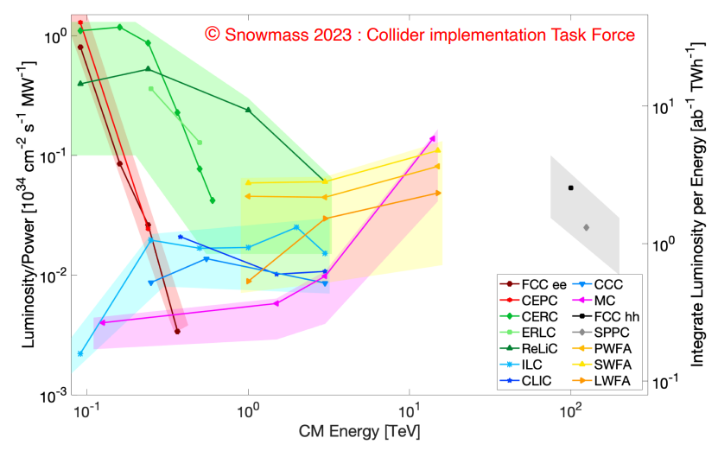
Muon Collider promises: Cost and Sustainability
Compactness promises cost effectiveness
And low CO₂ footprint for construction
Increasing luminosity per beam power promises power efficiency
Staging is possible
Unique opportunity for a high-energy, high-luminosity lepton collider
4

Slide 5
Muon collider and RF system challenges
Proton driven Muon Collider Concept (MAP collaboration)
RF
RF
RF
RF
RF
RF
RF
RF
RF
RF
RF
The main challenge of the Muon Collider is finite ~2us lifetime of the muons.
Normal conducting RF for capture and cooling
  High-gradient cavities in high magnetic field
  High charge, Huge beam size, Important beam losses
  Peak RF power
Everything must be fast ! ----------------------------------------→ High Gradient !!!

Slide 6
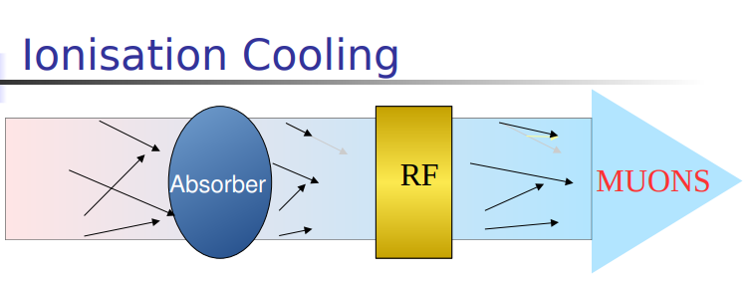
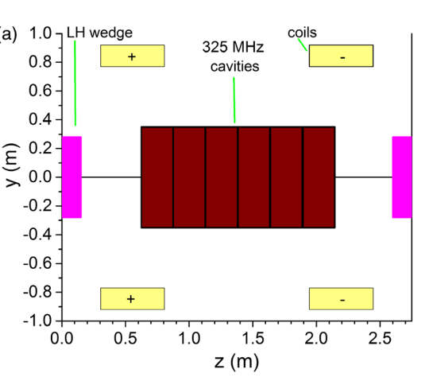
RF system for muon cooling (MAP design)
Summarized from:
David Neuffer
Chris Rogers
Region | Length [m] | N of cavities | Frequencies [MHz] | Gradient [MV/m] | Magnetic field [T] | Peak RF power [MW/cav.]
Buncher | 21 | 54 | 490 - 366 | 0 - 15 |  | 1.3
Rotator | 24 | 64 | 366 – 326 | 20 |  | 2.4
Initial Cooler | 126 | 360 | 325 | 25 | 2 | 3.7
Cooler 1 | 400 | 1605 x2 | 325, 650 | 22, 30 | 2-3, 4-6 | 4, 2
Bunch merge | 130 | 26 x2 | 108 - 1950 | ~ 10
Cooler 2 | 420 | 1746 x2 | 325, 650 | 22, 30 | 2-5, 8-13 | 4, 2
Final Cooling | 140 | 96 x2 | 325 - 20
Total | ~1300 | 7424 |  |  |  | => ~20GW
It is a very large and complex RF system with high peak power

Slide 7
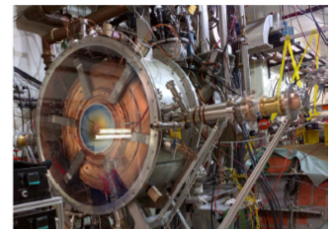
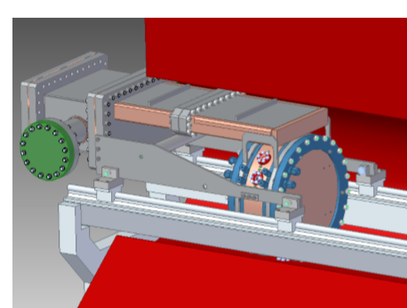
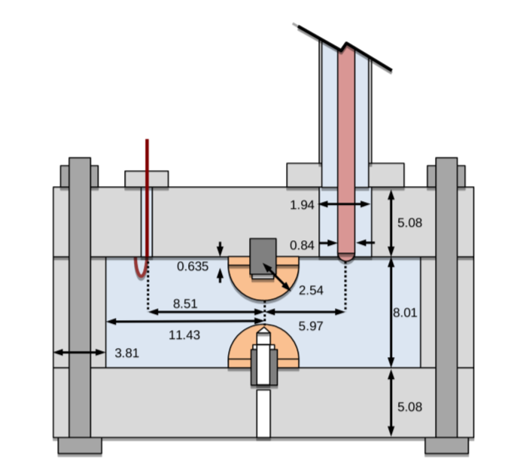
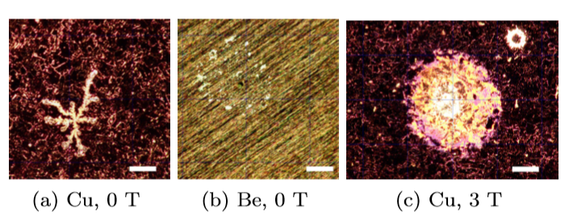
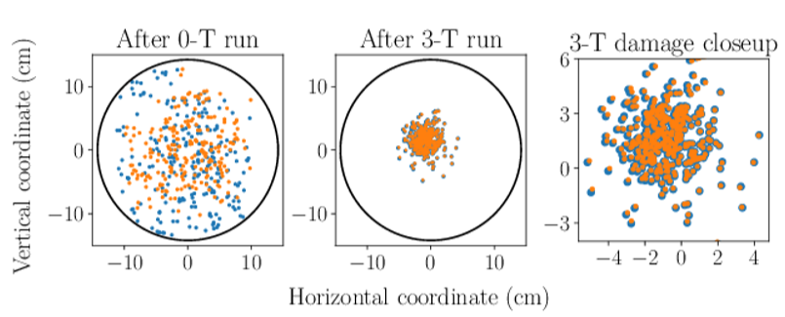
State-of-the-Art: RF cavities for muon cooling
Challenges:
High Gradient
High magnetic field
High radiation
Technology far from been common
---------------------
State of the art (not complete):
MICE 200 MHz RF module prototype: 4T, 10 MV/m, 1ms@1Hz
800 MHz beryllium cavity:
3T, 50 MV/m, 30us@10Hz
Gas filled RF cavity:
Small gap, 800 MHz, >50 MV/m

Slide 8
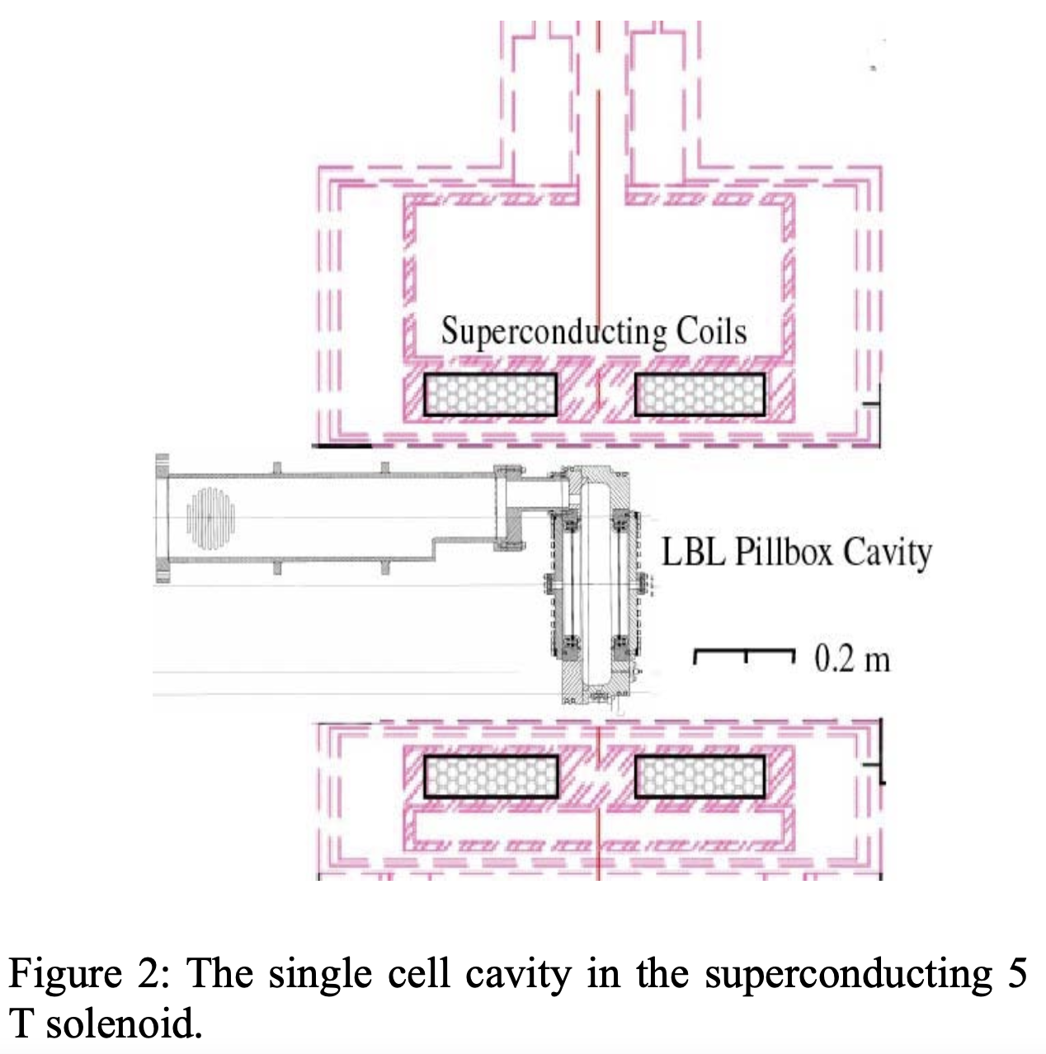
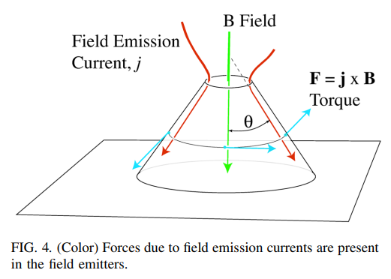
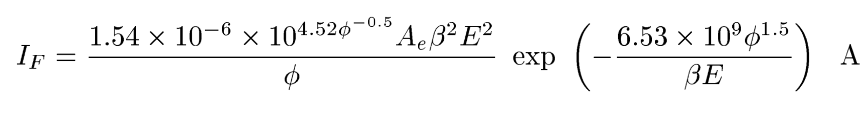
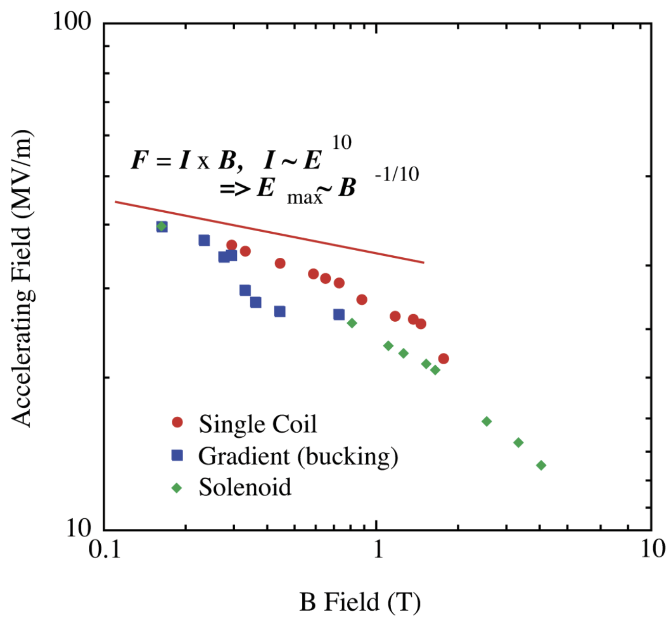
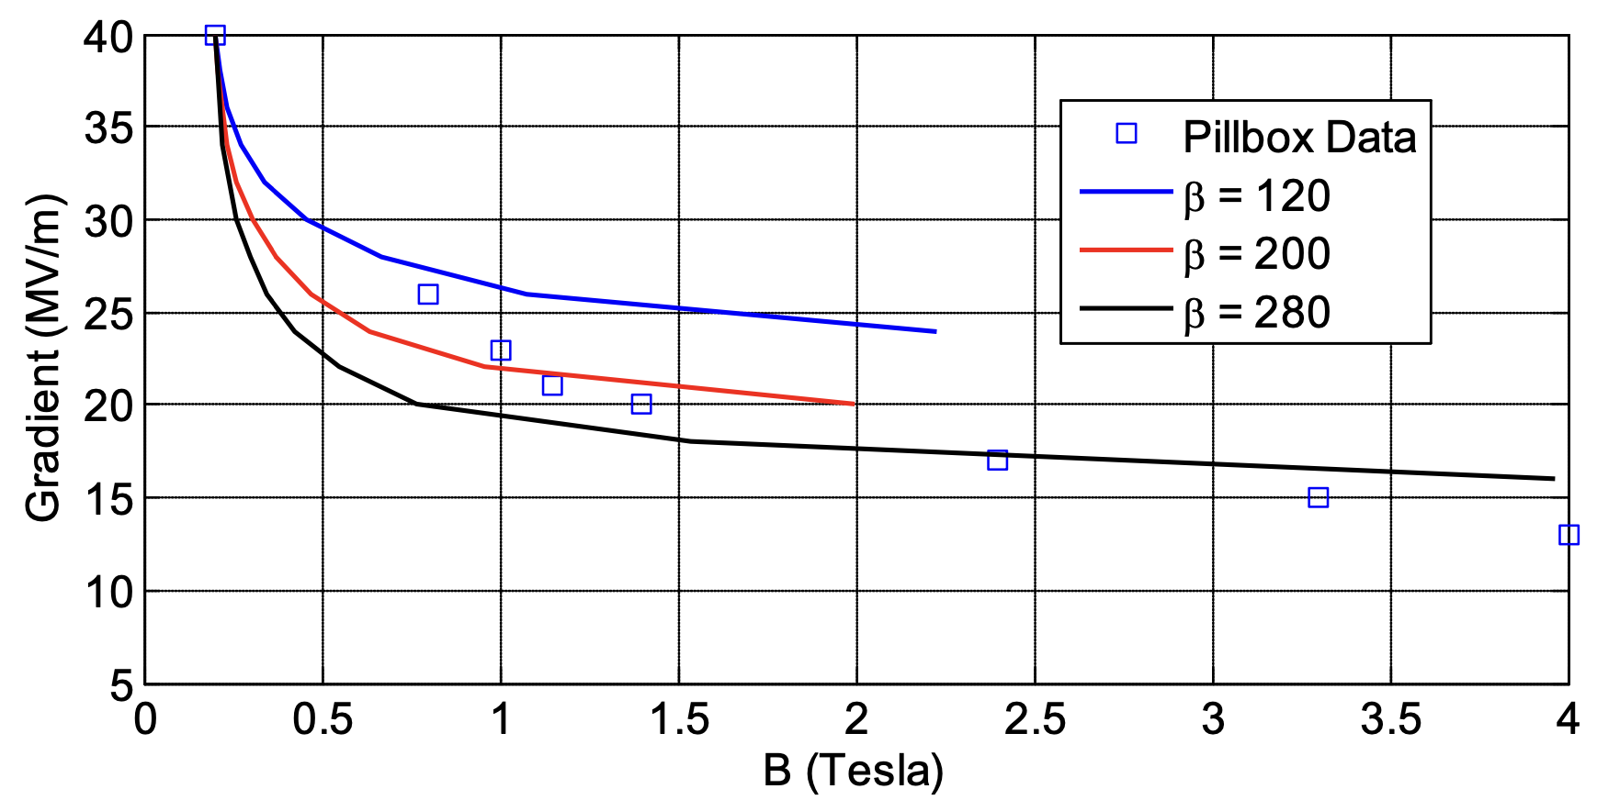
Initial results in 805 MHz pill box Cu cavity and a ‘local’ model
Moretti et al., Effects of high solenoidal magnetic fields on rf accelerating cavities, Phys.Rev.Acc.Beams 8, 072001 (2005)
Fowler-Nordheim Field Emission current:

Slide 9
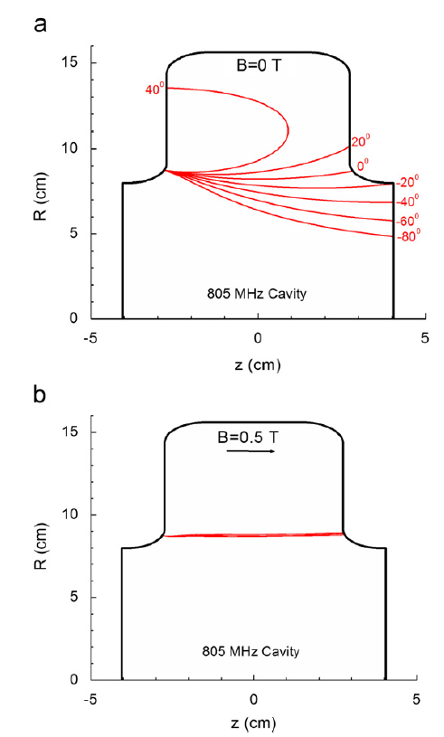
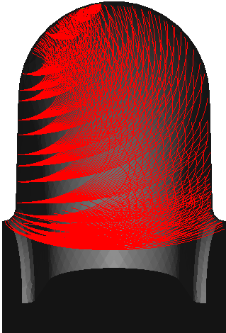
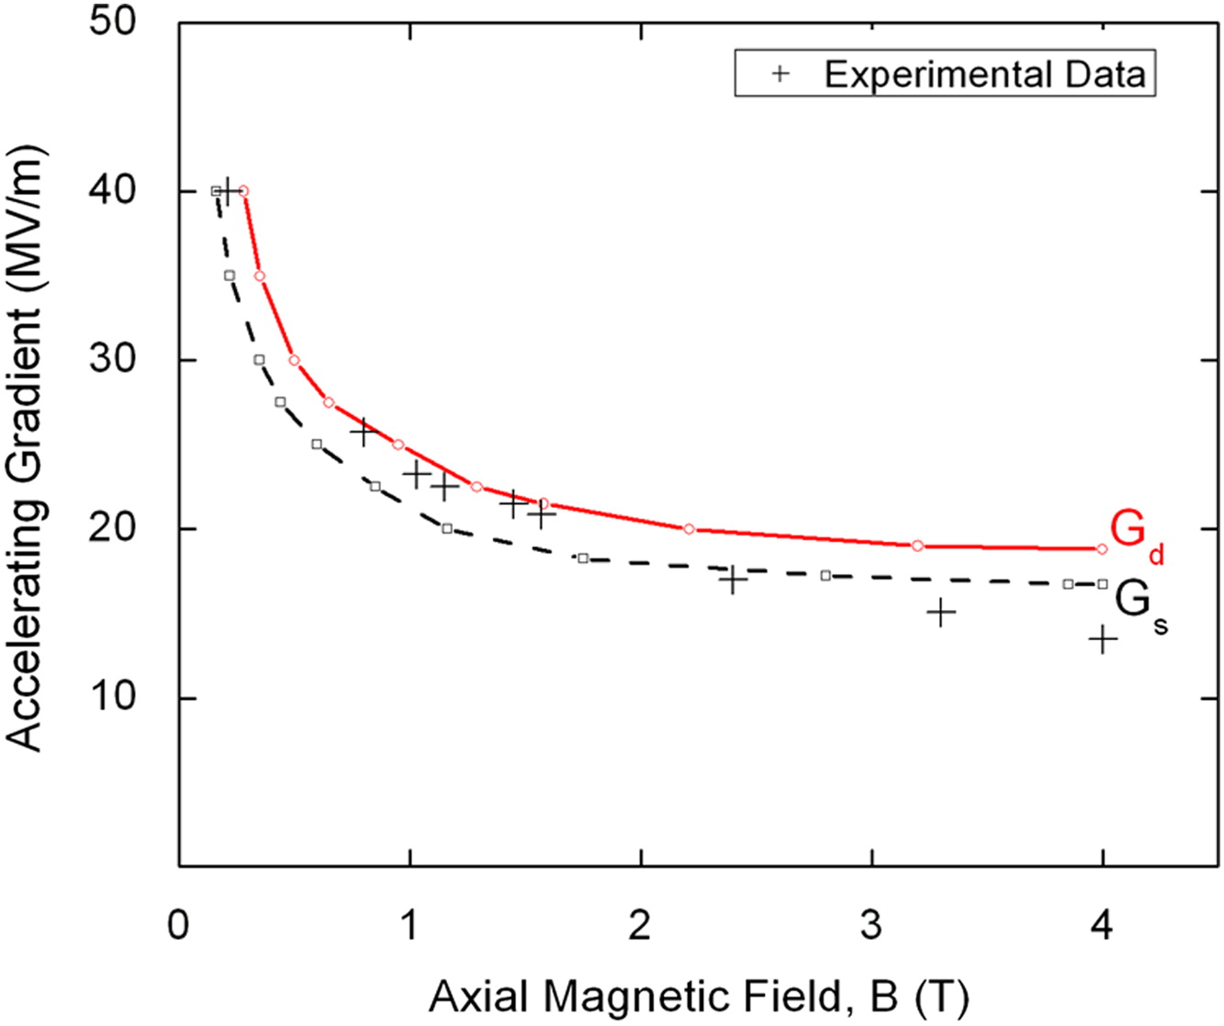
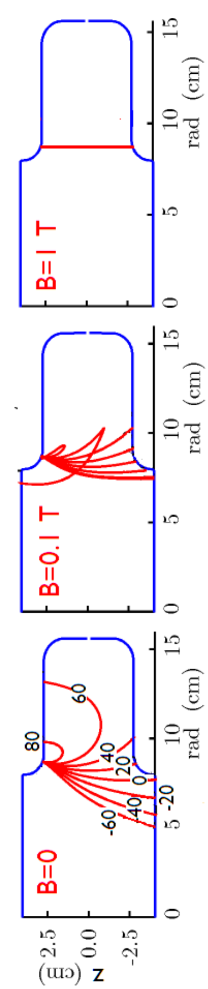
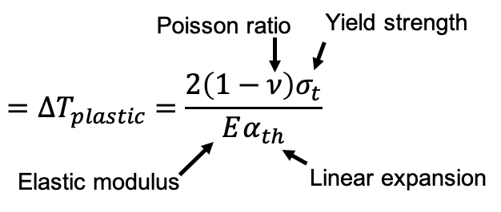
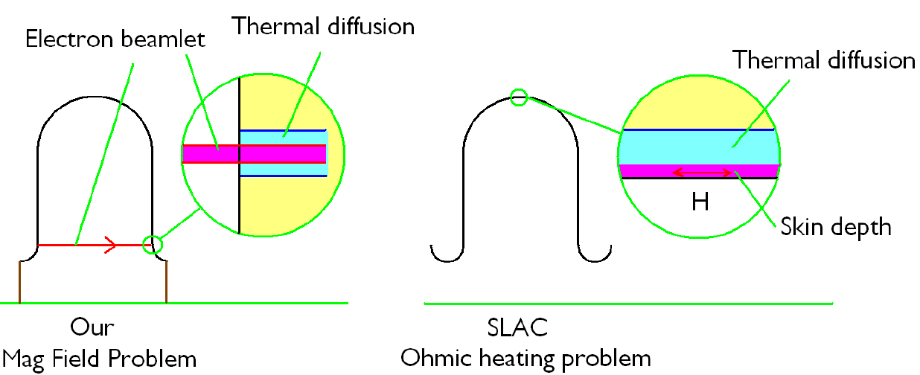
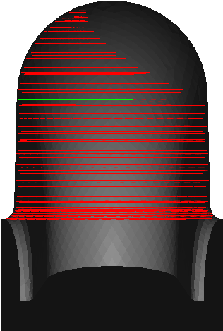
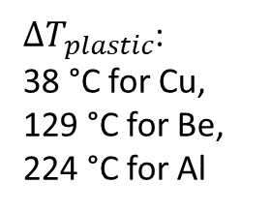
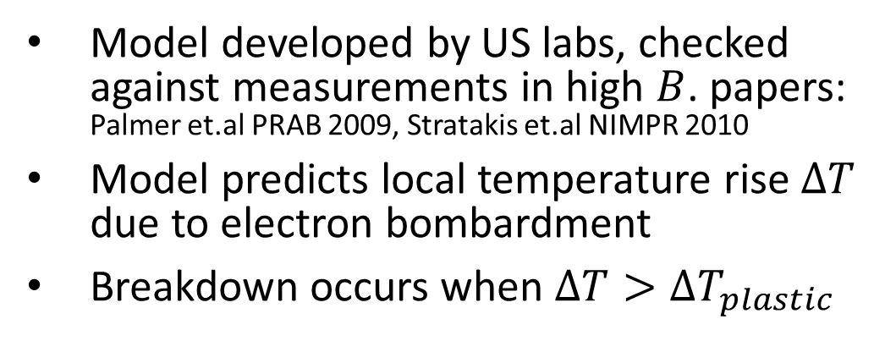
A ‘global’ model: beamlet focused by magnetic field
Numerical simulations showed trajectories of beamlets in the presence of the 805 MHz pillbox cavity
Model developed by US labs, checked against measurements in high $B$. papers: Palmer et.al PRAB 2009, Stratakis et.al NIMPR 2010
Model predicts local temperature rise $∆T$ due to electron bombardment
Breakdown occurs when $∆T>∆T_{plastic}$
Electron beamlet
Thermal diffusion
$∆T_{plastic}$:
38 °C for Cu,
129 °C for Be,
224 °C for Al
Heating due to electron bombardment

Slide 10
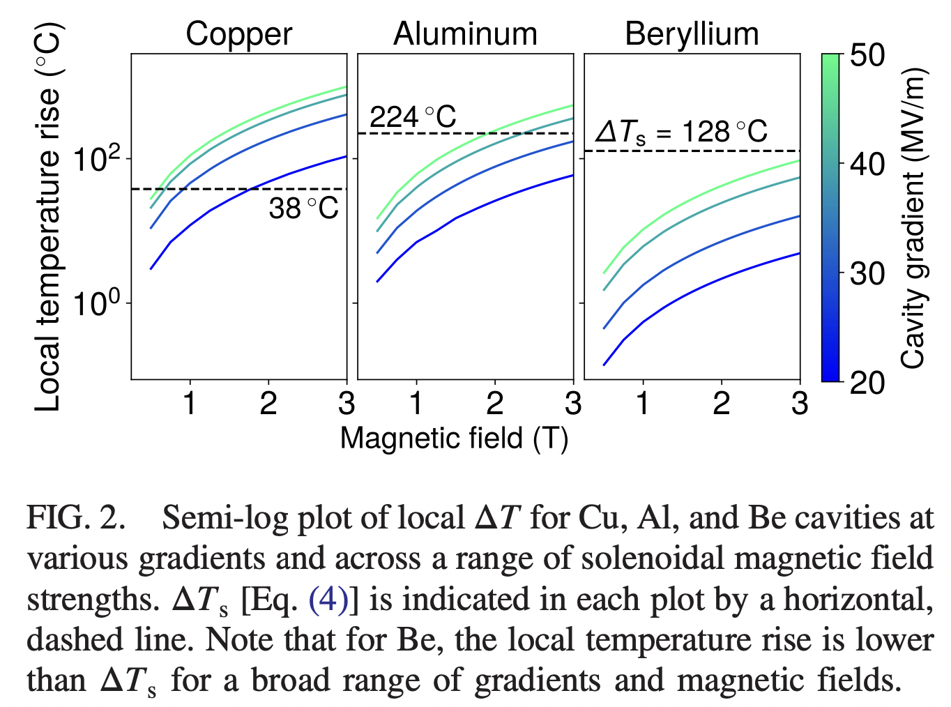
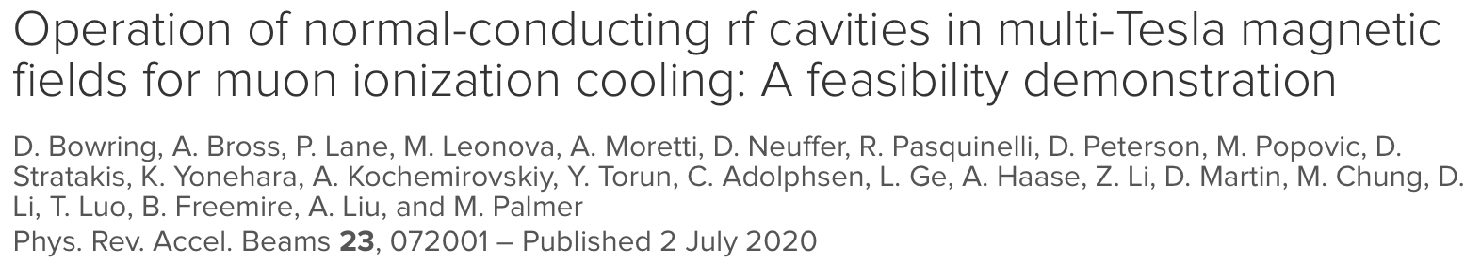
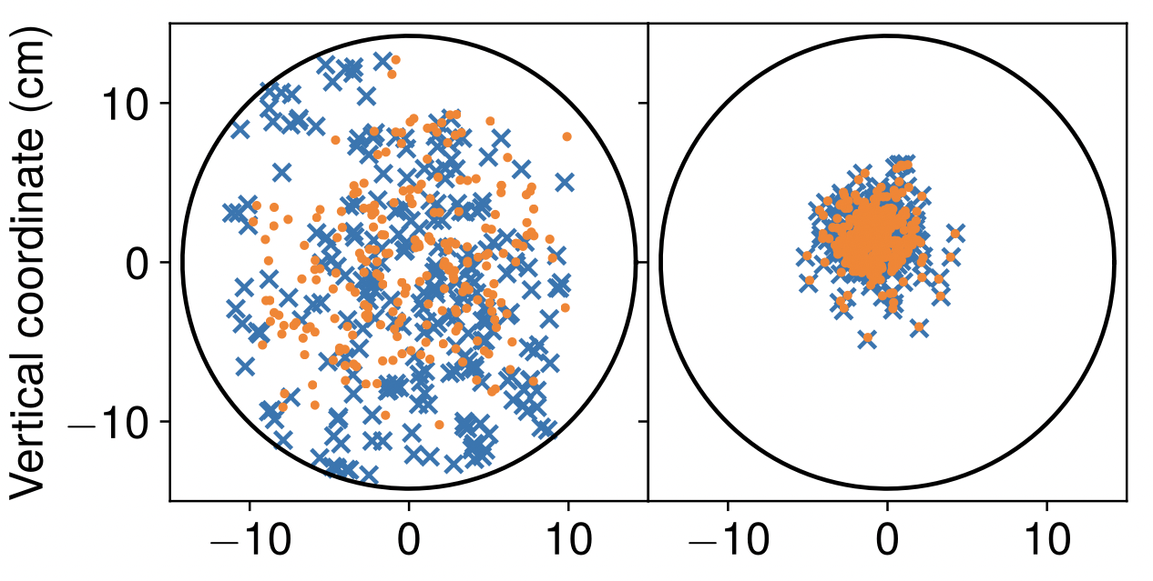
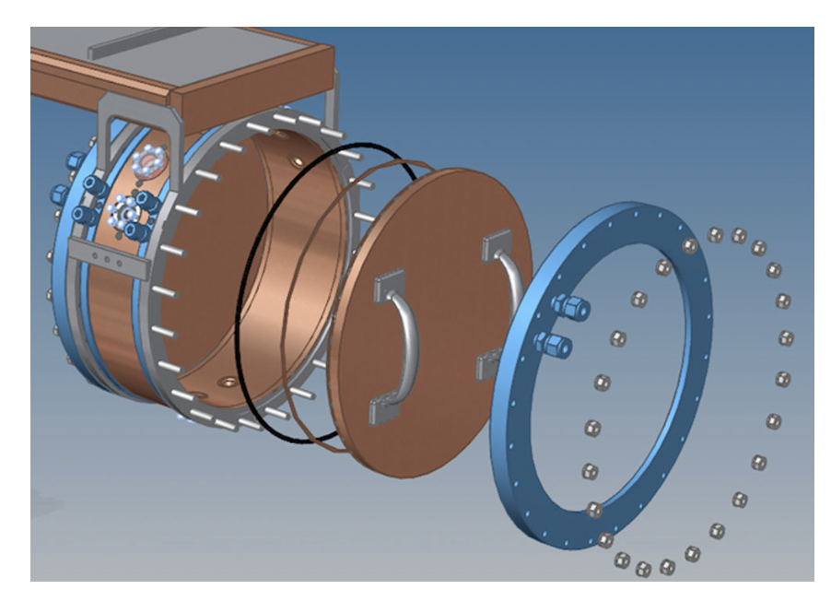
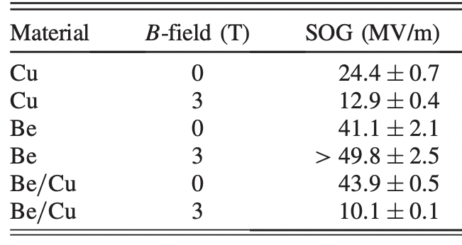
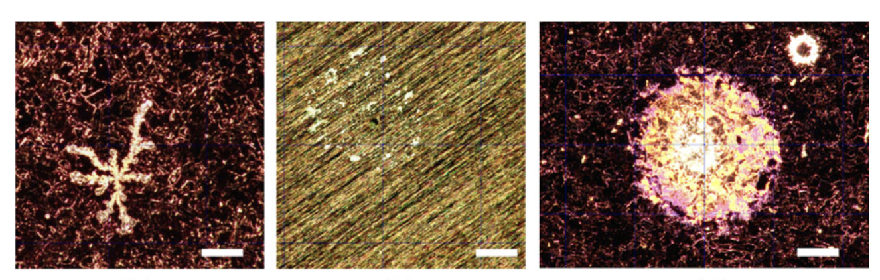
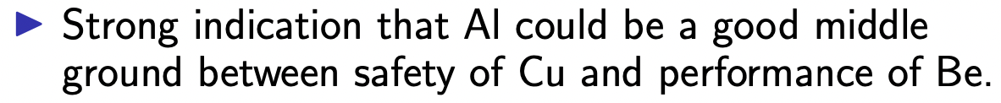
MuCool 805 MHz cavity test with modular plates
modular plate
Cu: 0 T
Cu: 3 T
Be: 0 & 3 T

Slide 11
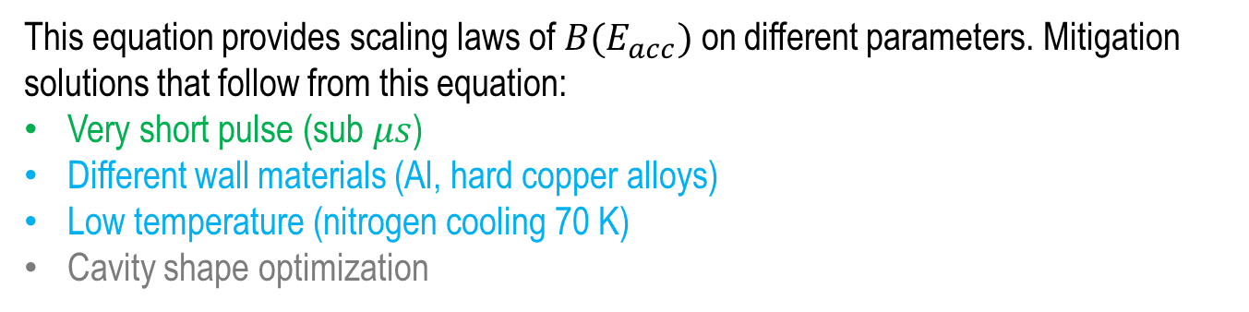



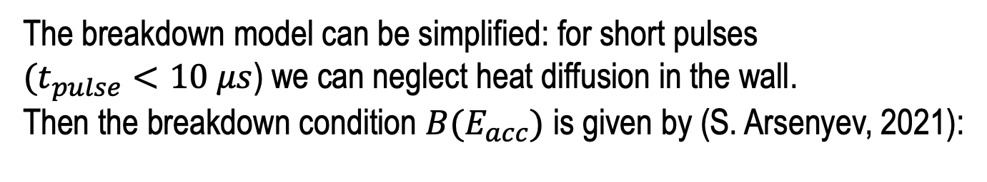
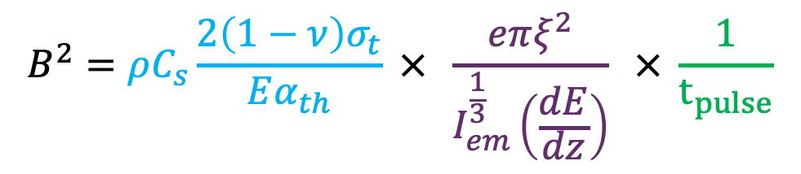

Scaling using no-diffusion beamlet model
The breakdown model can be simplified: for short pulses
$(t_{pulse}<10 μs$) we can neglect heat diffusion in the wall.
Then the breakdown condition $B(E_{acc})$ is given by (S. Arsenyev, 2021):
$$ΔT$$
Diffusion
ΔT_{plastic}
Cavity-dependent constant
$$B^{2}=ρC_{s}\frac{2\left(1−ν\right)σ_{t}}{Eα_{th}} × \frac{eπξ^{2}}{I_{em}^{\frac{1}{3}}\left(\frac{dE}{dz}\right)} × \frac{1}{t_{pulse}}$$
No diffusion
Pulse length
Magnetic field at breakdown
Wall material properties
$$\sim 10 μs$$
$$t_{pulse}$$
Electron energy loss
Field Emission current $I(E_{acc})$
This equation provides scaling laws of $B(E_{acc})$ on different parameters. Mitigation solutions that follow from this equation:
Very short pulse (sub $μs$)
Different wall materials (Al, hard copper alloys)
Low temperature (nitrogen cooling 70 K)
Cavity shape optimization
When combined, benefits from different solutions would multiply

Slide 12
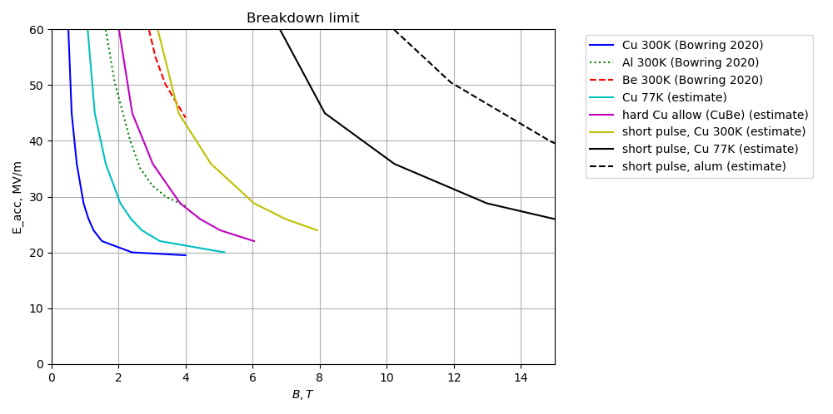
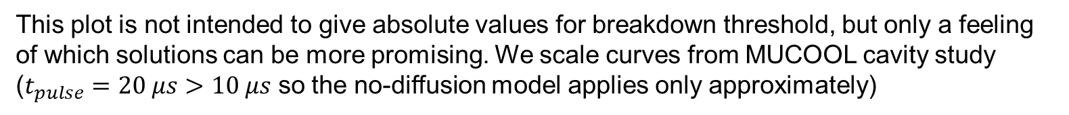
Comparing breakdown mitigation ideas
This plot is not intended to give absolute values for breakdown threshold, but only a feeling of which solutions can be more promising. We scale curves from MUCOOL cavity study ($t_{pulse}=20 μs$ $>10 μs$ so the no-diffusion model applies only approximately)
Scaled from the first 3 curves using the scaling model (slide 7)
Benefits of short pulse and aluminum multiply
Aluminum cavity with a short pulse looks very promising

Slide 13
R&D directions for NC RF cavities tests in high B field
Need high gradient RF test stand(s) with B field up to ~10T Test cavities for technology development
  Frequency: ideally 300 to 700 MHz range
    tests at higher frequencies useful, but need some rescaling to MCC f range
  Gradients from 25 to 50 MV/m
  Short RF pulses (~μs)
  Magnetic field: 0 – ~10T, different field configurations
  Different materials: Cu, Be, Al, …
  Different temperatures: 300K -> 70K ->…
  Different cavity shapes ?

Slide 14
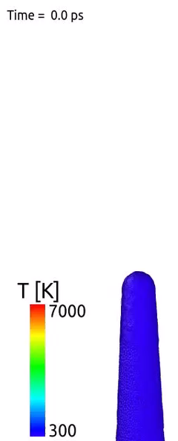
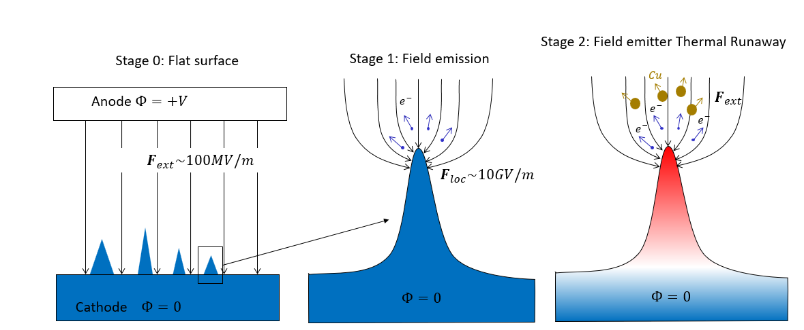
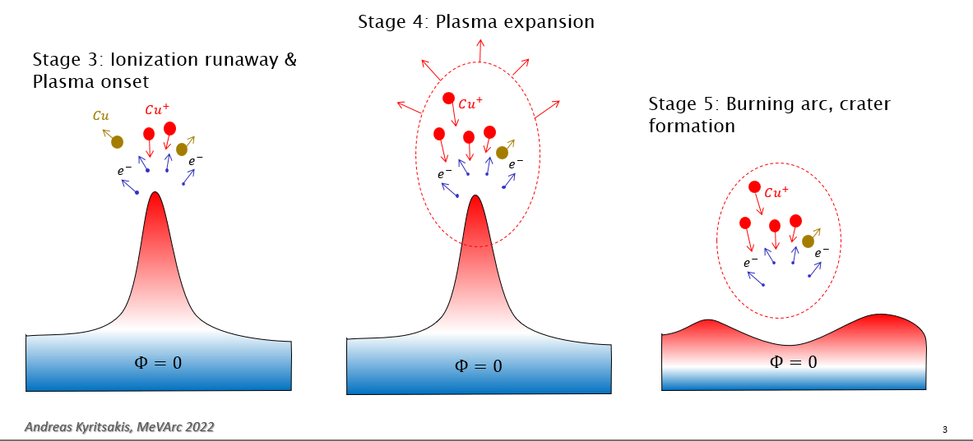
Other possible mechanisms ?
What happens to this picture if strong magnetic field is applied ?
Can we simulate this and make predictions?
Can we measure it in DC setups ?
  [A. Kyritsakis et. al., J. Phys. D: Appl. Phys. 51 225203 (2018)]

