Slide 1
Background to the Normal Conducting High-Gradient Survey that you will receive soon
Walter Wuensch
miniMeVArc
14/9/2023

Slide 2
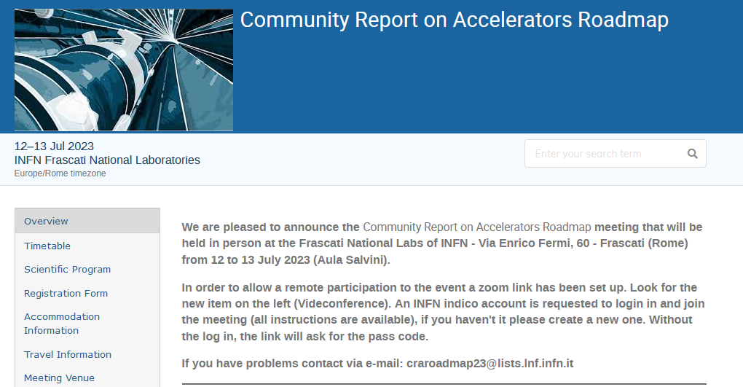
https://agenda.infn.it/event/35579/

Slide 3

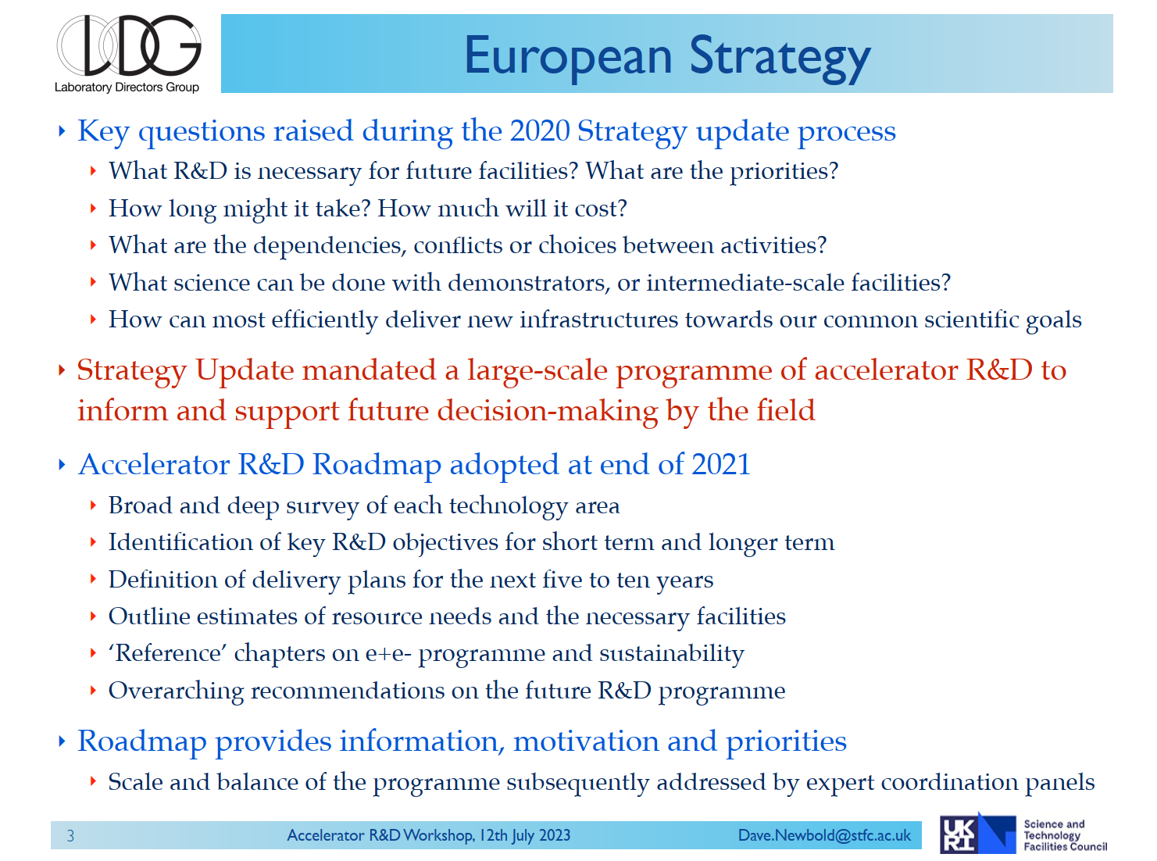

Slide 4
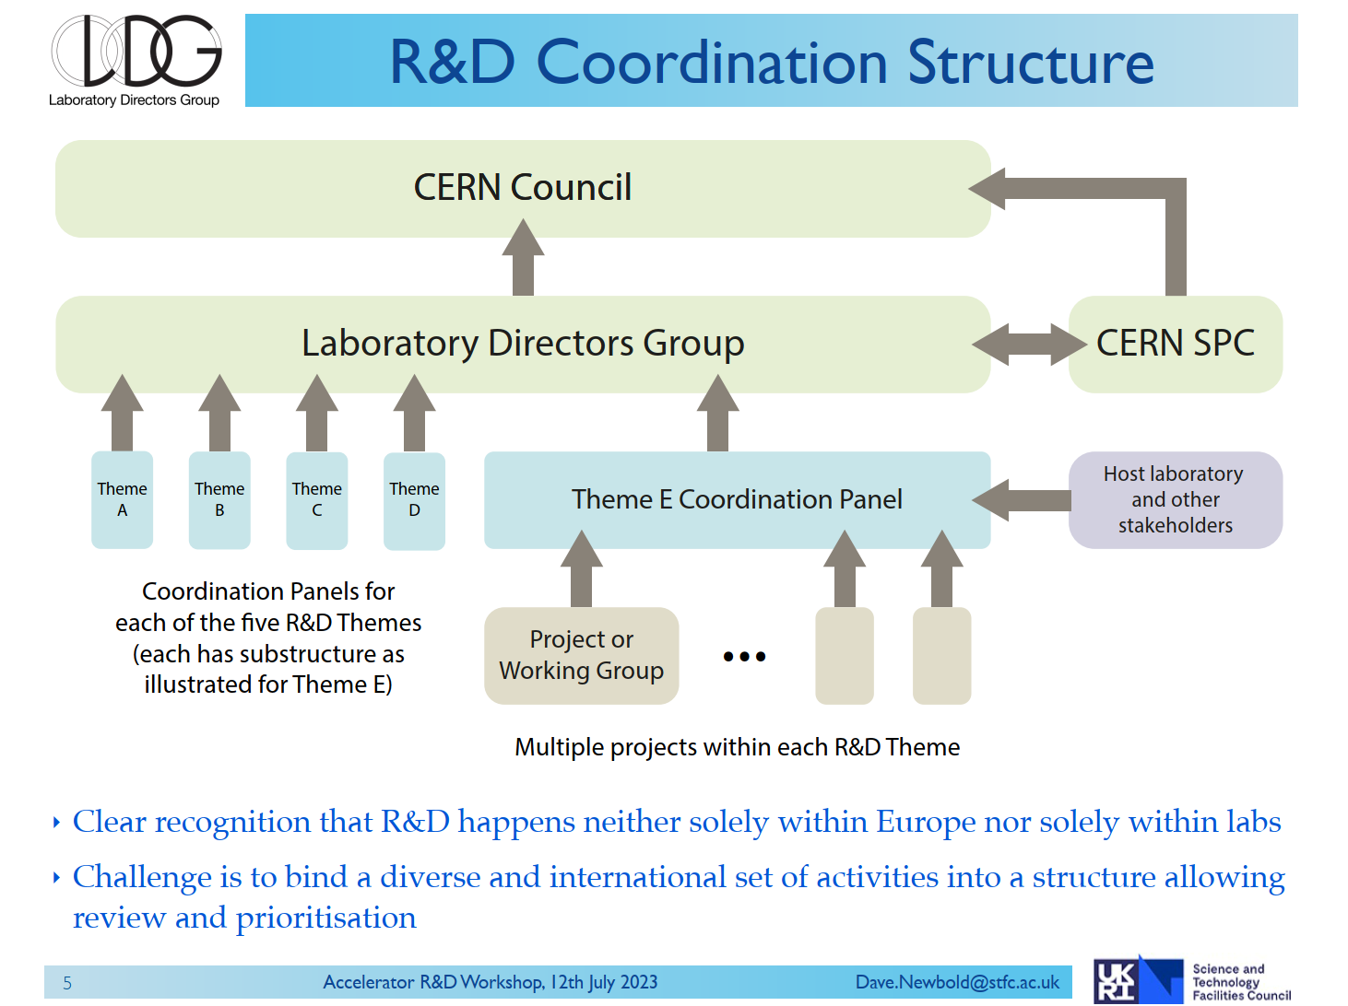
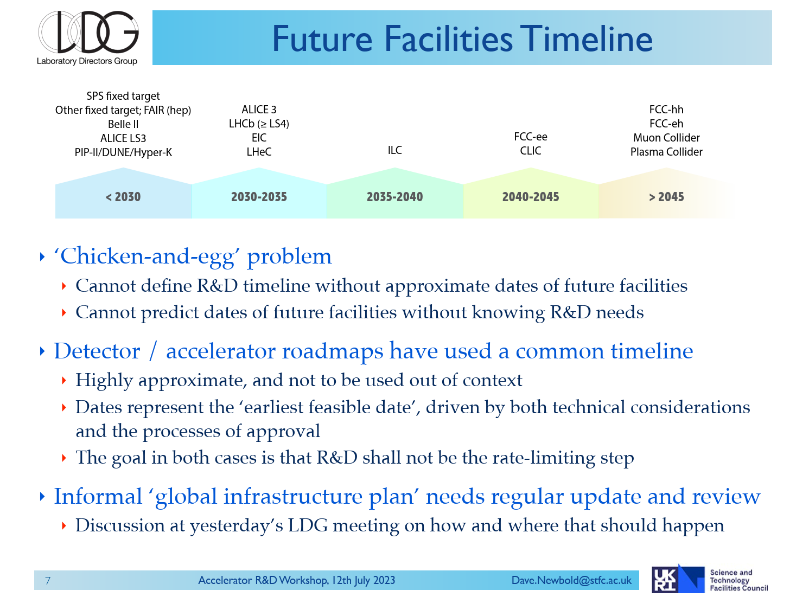

Slide 5

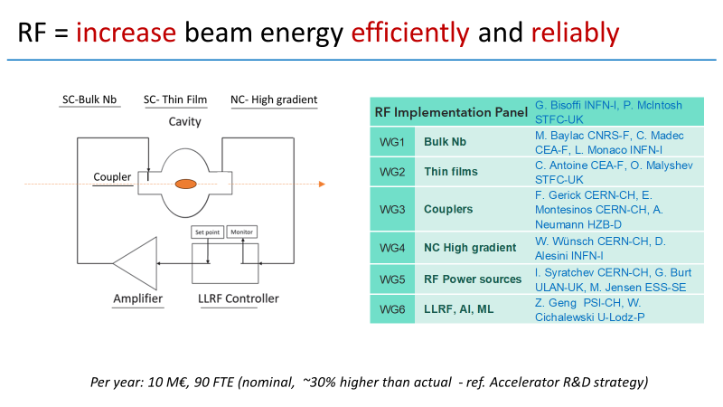

Slide 6
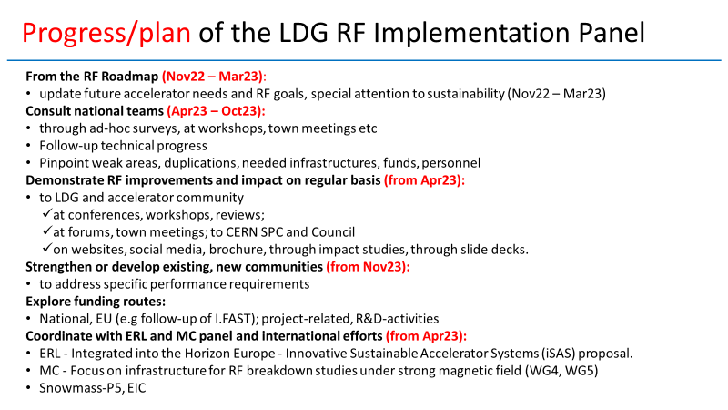
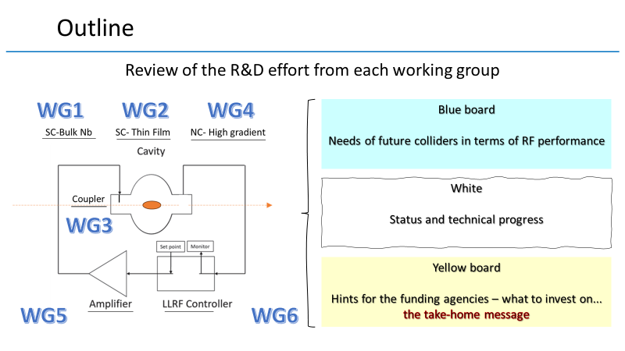

Slide 7
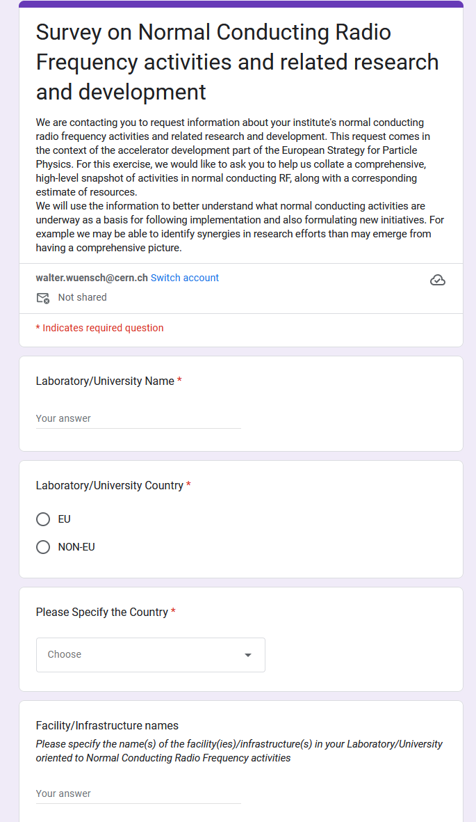
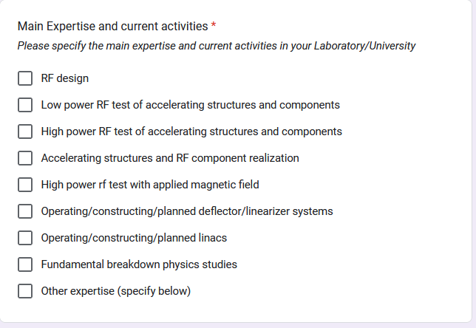
To provide basis for “implementation” and development of future proposals, David Alesini and I would like to start with composing a reasonably accurate picture of ongoing high-gradient activities.
We plan to do this through a survey. Each of your groups will be contacted soon.
https://forms.gle/8Pm3xwdTXAEofm7fA

Slide 8
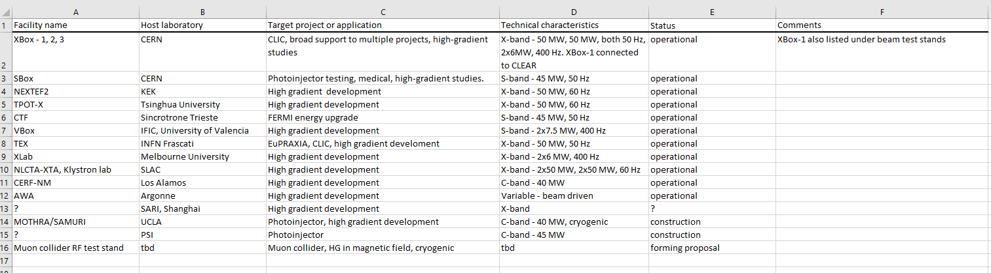
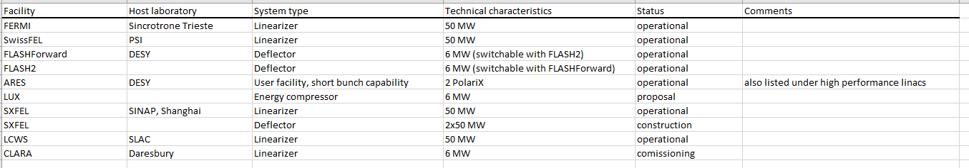
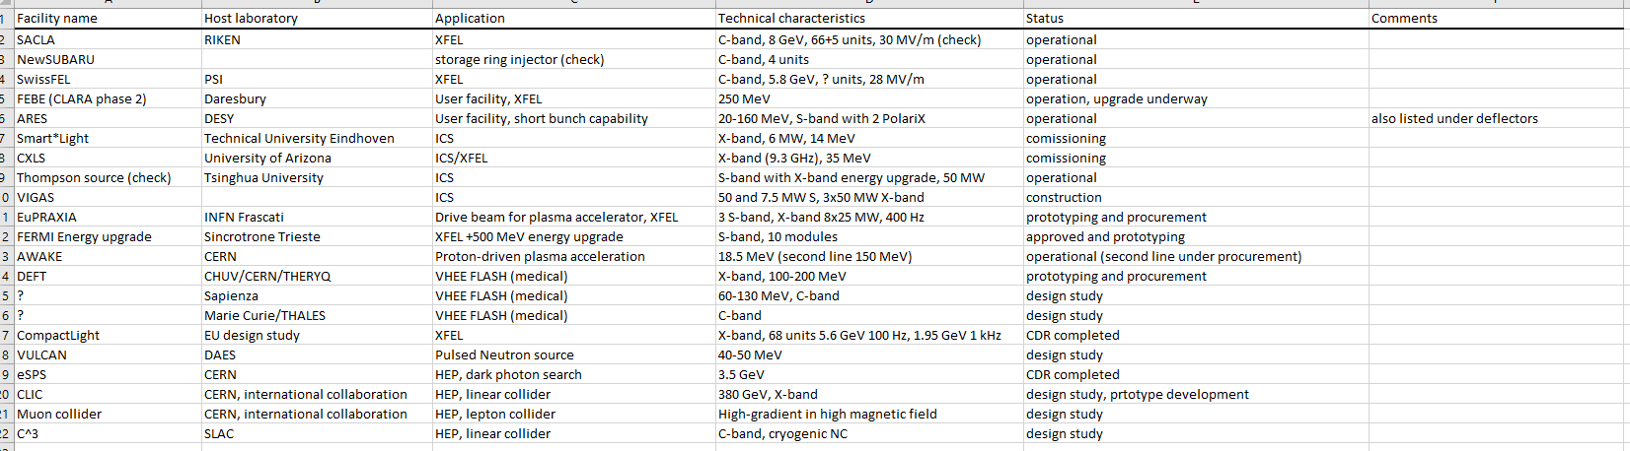
Test stands
Linearizers and deflectors
High-performance linacs

Slide 9
