Slide 1

Early History and the Search of VBD Zebras
Salvador Barranco Cárceles, Andreas Kyritsakis, Veronika Zadin,
Aquila Mavalankar, Ian Underwood
miniMeVArc, CERN, 2023

Slide 2
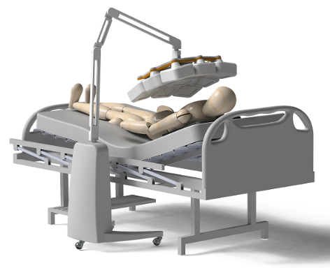
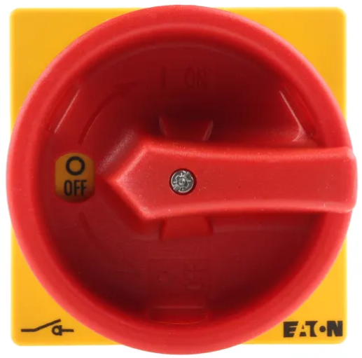
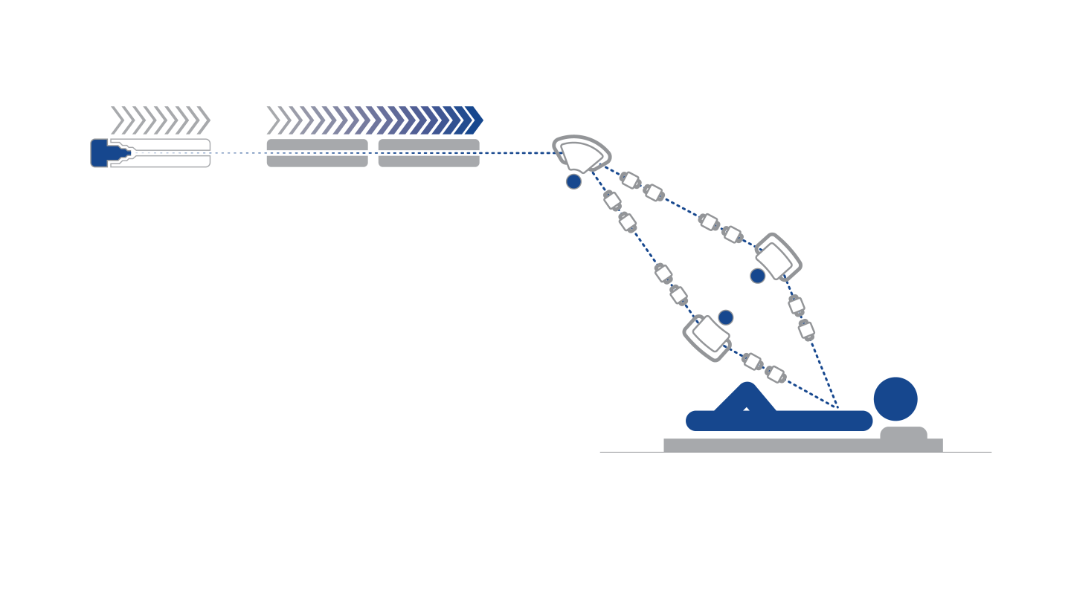
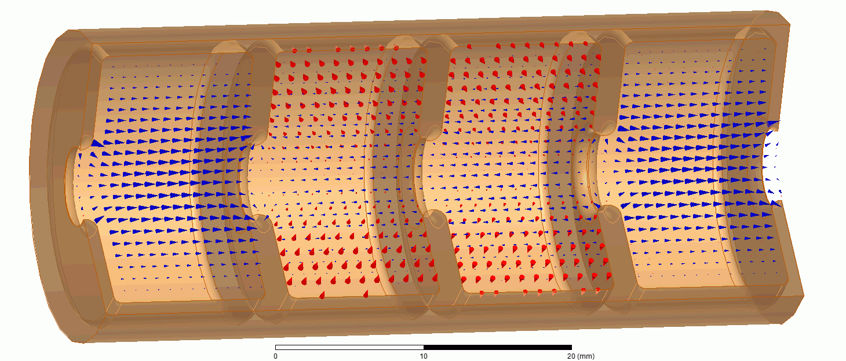

Enabled Technologies
Portable 3D Medical Imaging
Particle Accelerators
High Power Switching
Bending magnet
system
e⁻ source
Lin. Accelerator
Patient
Image: Adaptix Imaging Ltd.
Image: Walter Wuensch, CERN

Slide 3
Why Does VBD Occur?
Nano-Protrusions
Plasmons
Dislocations

Slide 4
My Surprise
“The initiation mechanism of this [VBD] phenomenon has been studied for many years and the contradictory experimental results led to contradictory theories. However, in the late 1960’s, the mystery was cleared up by the discovery of…”
Utsumi T., IEEE Trans. Elec. Dev, 1991

Slide 5
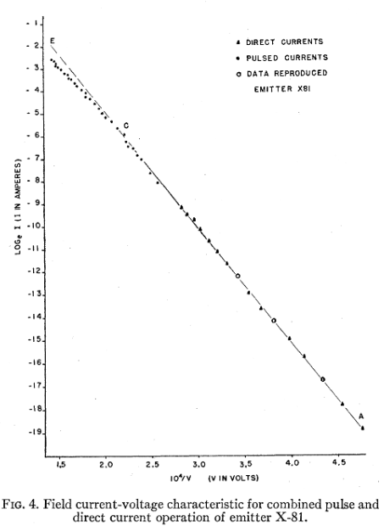
Cathode Vs Anode VBD
Cathode Induced VBD
Dyke, 1953
Point-to-plain set up using W
Linear FN. At high J deviation due to space charge. Then VBD
If pulsed emission they could extract 2 more order of magnitude of current
Current density, thus heat, is the main paremetre
W. P. Dyke. et al., Physical Review, 1953

Slide 6
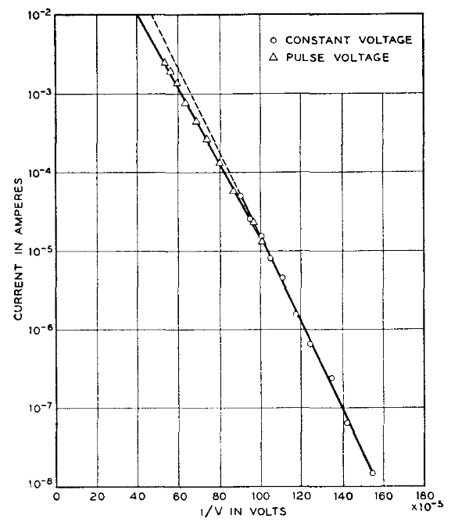
Cathode Vs Anode VBD
Anode Induced VBD
Boyle, 1955
2 crossed W wires
Linear FN. At high J deviation due to space charge. Then VBD
Power flux and heat dissipation
Space charge from electrons and ions
Their device had no resolution time resolution enough for further analysis
W. S. Boyle et al., Journal of Applied Physics, 1955

Slide 7
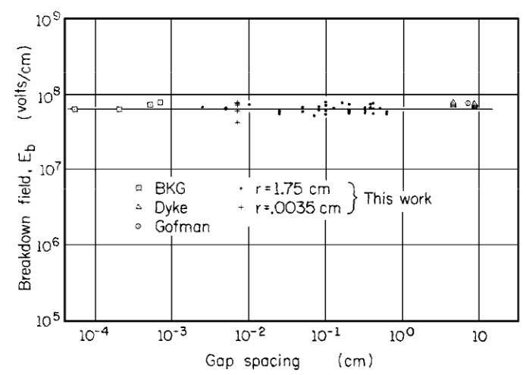
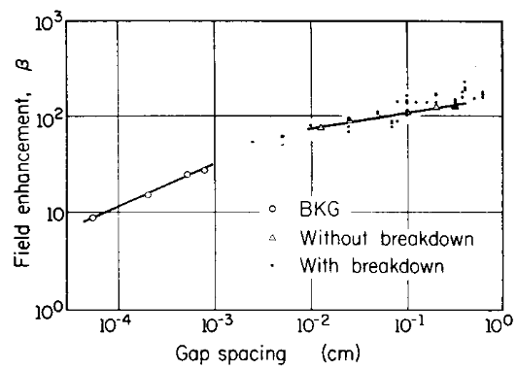
Follow Up Studies
Alpert, 1964
Plain-to-plain W electrodes
Estimated beta in the 100s, but is gap dependent
First mention the nanoprotrusion (NP)
Spots observed on phosphorus screen
Estimation of the NP to be 2 um long
D. Alpert et al., JVST, 1964

Slide 8
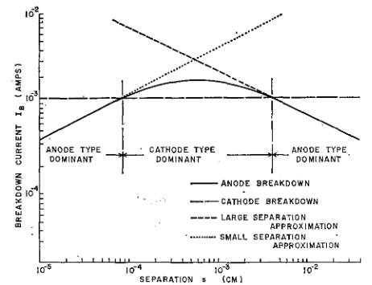
Follow Up Studies
Utsumi, 1967
Plain-to-plain W and Cu electrodes
Conditions for cathode or anode VBD determined
Calculated betas
  W 50-150
  Cu 150-300
Parabolic trajectory emitted electrons measured as function of anode/cathode distance
Basic calculations for current and power density made
T. Utsumi, Journal of Applied Physics, 1967

Slide 9
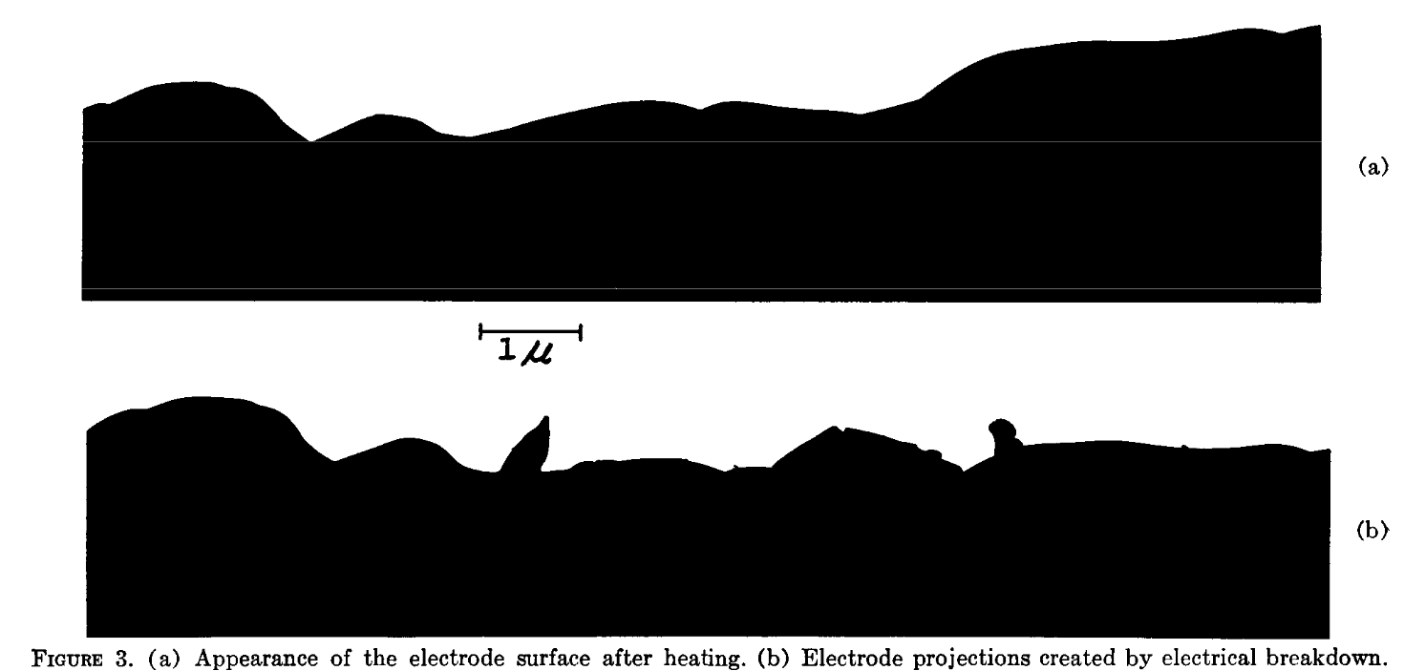
Nano-Protrusions
H. E. Tomaschke, JVST, 1967

Slide 10
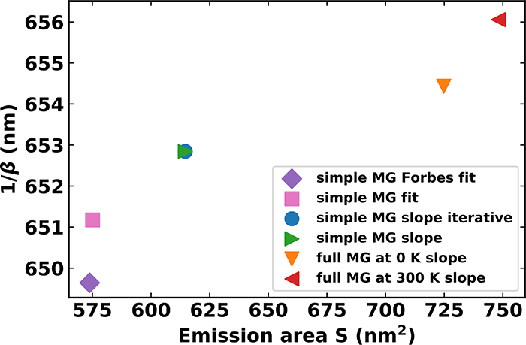
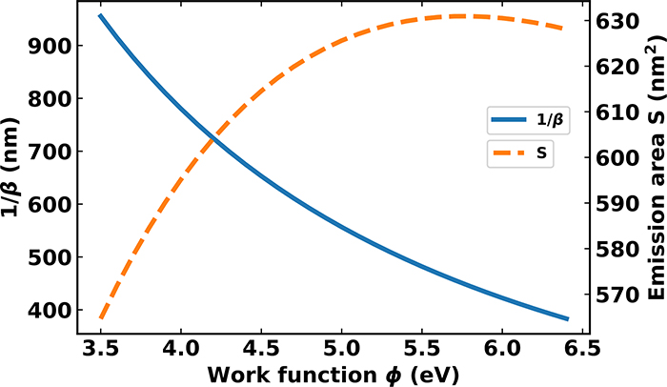
Word for Warning
FN is somewhere far far far away over there
All papers used FN theory, not MG theory (1953) for their analysis
Work function assumed
Nottingham heat, radiation loses, temperature dependence of electric and heat conductivity neglected
Analysis limited to 1D
No time dependent analysis
A. Ayari et al., JVSTB, 2023

Slide 11
Conclusions and Future Work
VBD can be cathode or anode induced
There is strong evidence for the nanoprotrusion hypothesis
Previous work needs to be reanalysed in light of modern theory and stated of art tool
  Murphy and Good theory for Field Emission
  GETELEC in combination of Multiphysics software
Modern observation of the nano-protrusion
Explanation for nano-protrusion growth

Slide 12






THANK YOU

Slide 13
References
Dyke, 1953 - DOI: 10.1103/PhysRev.89.799
Boyle, 1955 - DOI: 10.1063/1.1722078
Alpert, 1964 – DOI: 10.1116/1.1491722
Utsumi, 1967- DOI: 10.1063/1.1710038
Tomaschke, 1967 – DOI: 10.1116/1.1492545
Utsumi, 1991 – DOI: 10.1109/16.88510
Ayari, 2023 – DOI: 10.1116/6.0002338

Slide 14
Qs?

