Slide 1



Nanostructured photocathodes development
Overview and link to breakdown studies.

Slide 2
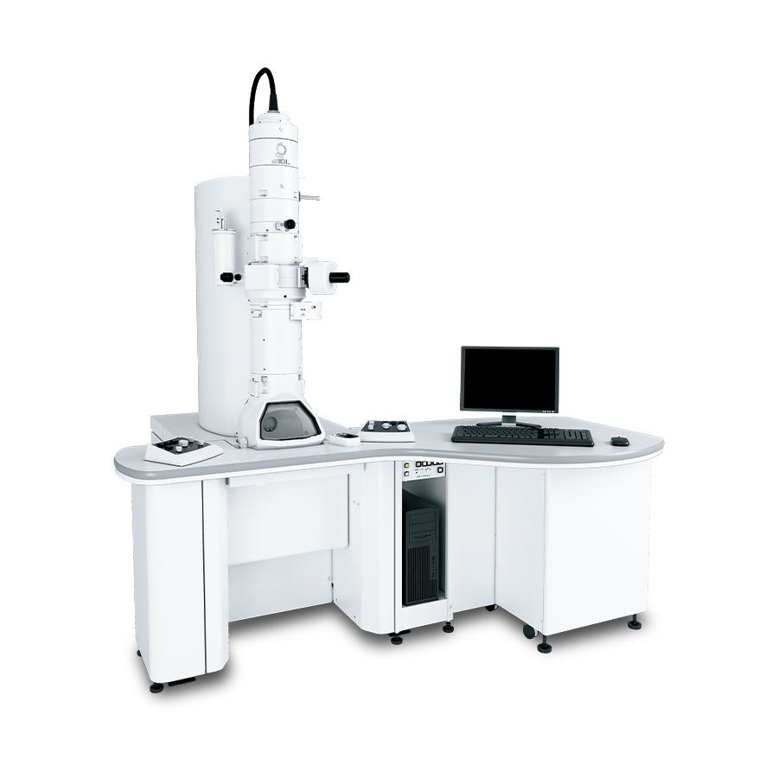

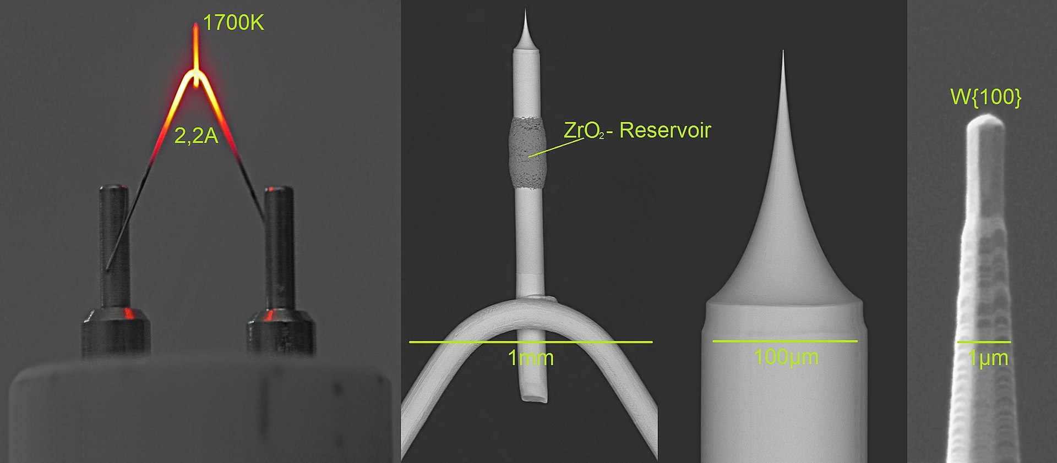
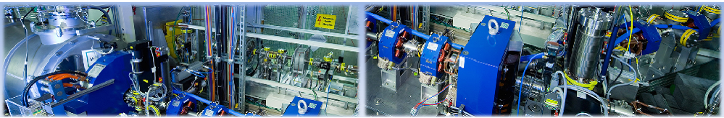
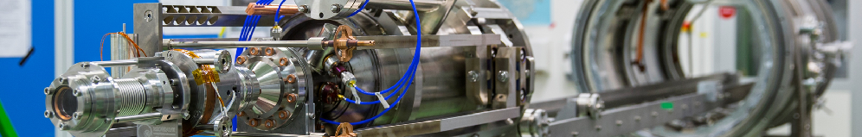
Electron Sources
Types of electron sources:
Thermionic emitter
Field emission gun
Photoemission cathodes
1
Notes:
Electron sources have become a common day application.
Used in every day application, such as a microwave oven, or in something complicated, like an accelerator!
There are essentially three main electron sources.
Thermionic, which requires the heating of a filament to release electrons and is a common source.
There is also field emitter, which you all are very farmiliar with already...
There is also photocathodes, which is the focus of this talk!

Slide 3
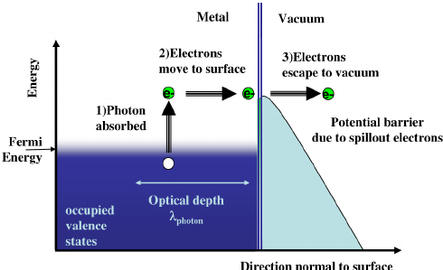
Basic Physics Behind Photoemission
Three step model:
Photon absorption
Electron migration
Potential barrier esape
Figurex : Taken from [1]
1
Notes:
Electrons are struck with a photon, giving them energy.
Thereafter, the electron has to move towards the surface without collision not to lose its additional energy
At the last step, it must have enough energy to escape the potential barrier it is facing.
Several other theories exist to this day, like Fowler Dubridge and also newer quantum mechanical models regarding photoemission.

Slide 4
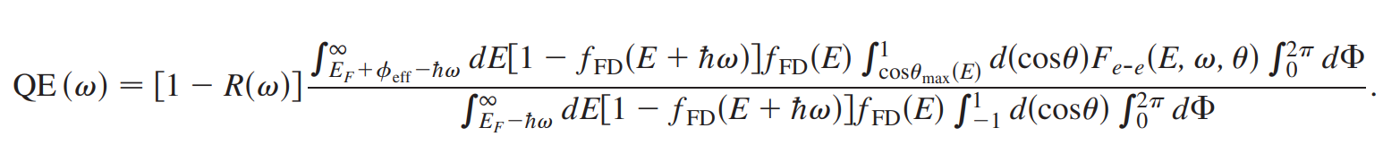
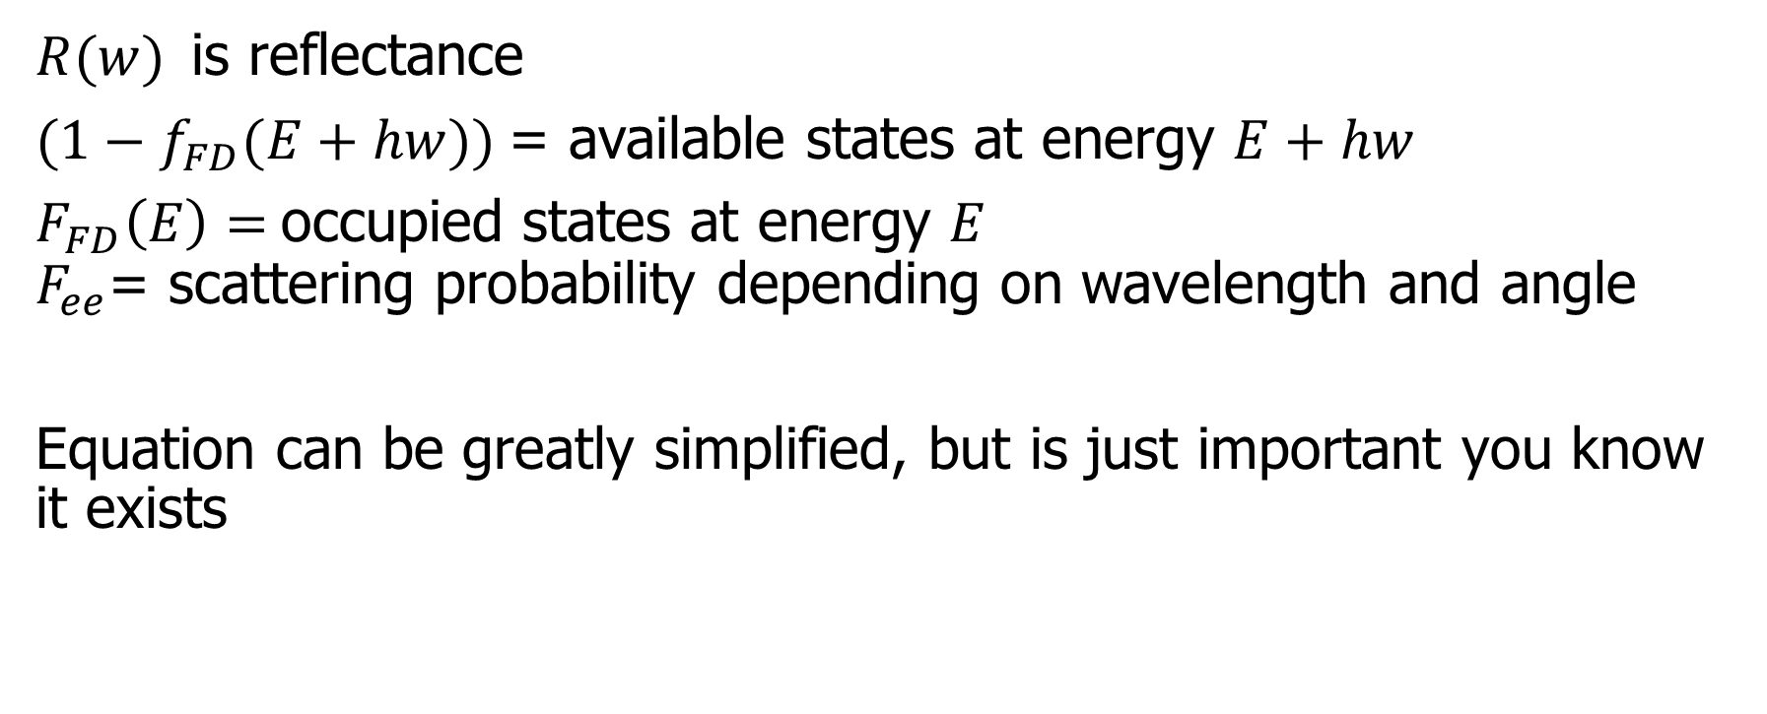
Basic Physics Behind Photoemission:
Three Step Model
$R(w)$is reflectance
$(1−f_{FD}(E+hw))$= available states at energy $E+hw$
$F_{FD}\left(E\right)=$occupied states at energy $E$
$F_{ee}$= scattering probability depending on wavelength and angle
Equation can be greatly simplified, but is just important you know it exists
1
Notes:
REMEMBER TO MENTION THE ASSUMPTION OF THE MODEL

Slide 5

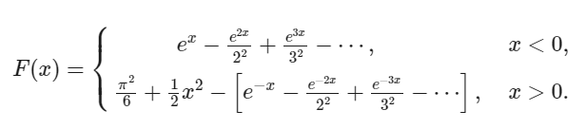
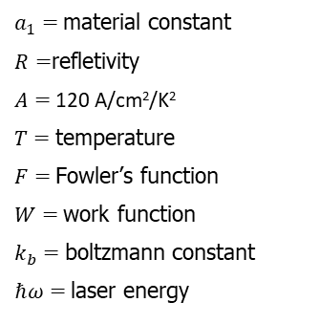
Basic Physics Behind Photoemission:
Fowler Dubridge
Fowler Dubridge assumptions:
Fermi-Dirac distribution
Uniform momentum space distribution
Photon absorption is independent on the electron’s initial energy state
Only the normal momentum is affected
Escape is possible if the normal momentum is larger than the work function
$a_{1}=$material constant
$R=$refletivity
$A=$120 A/cm²/K²
$T=$temperature
$F=$Fowler’s function
$W=$work function
$k_{b}=$boltzmann constant
$ℏω=$laser energy
1
Notes:
REMEMBER TO MENTION THE ASSUMPTIONS OF THE THEORY

Slide 6
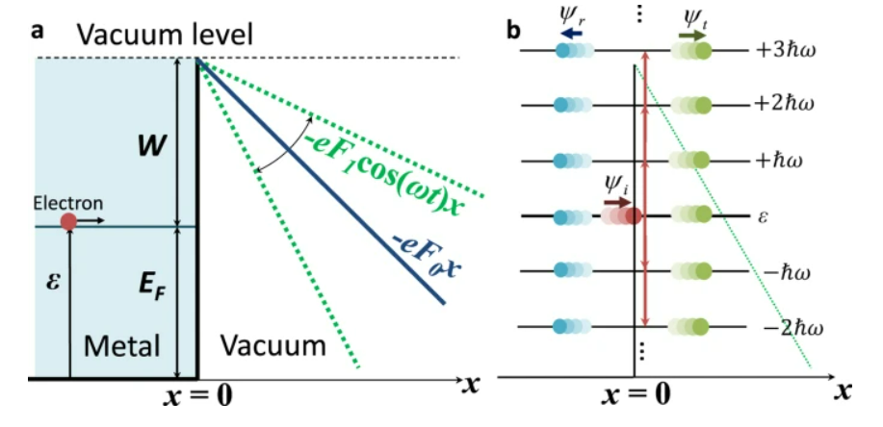
Basic Physics Behind Photoemission:
Quantum model
Interesting model trying to explain what happens in the limit between photoemission and field emission
The different electrons can tunnel or reflect when they hig the boundary
1
Notes:
Electrons are struck with a photon, giving them energy.
Thereafter, the electron has to move towards the surface without collision not to lose its additional energy
At the last step, it must have enough energy to escape the potential barrier it is facing.
Several other theories exist to this day, like Fowler Dubridge and also newer quantum mechanical models regarding photoemission.

Slide 7
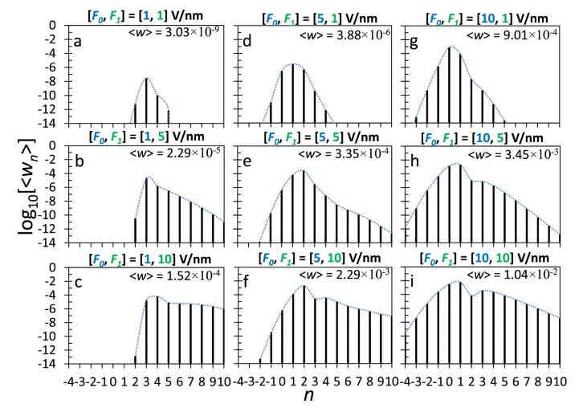
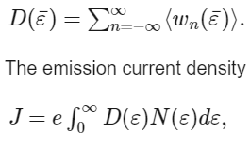
Basic Physics Behind Photoemission:
Quantum model
From this, different probabilities for processes can be found
0> multiphoton absorption
0= tunneling
0< n multiphoton emission
1
Notes:
Electrons are struck with a photon, giving them energy.
Thereafter, the electron has to move towards the surface without collision not to lose its additional energy
At the last step, it must have enough energy to escape the potential barrier it is facing.
Several other theories exist to this day, like Fowler Dubridge and also newer quantum mechanical models regarding photoemission.

Slide 8
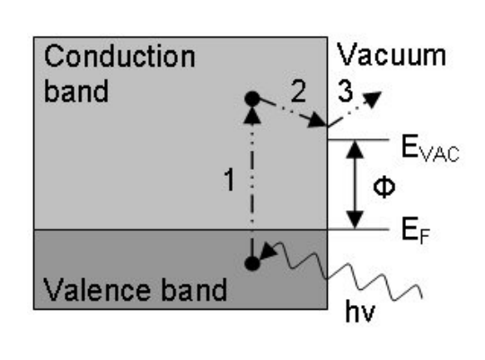
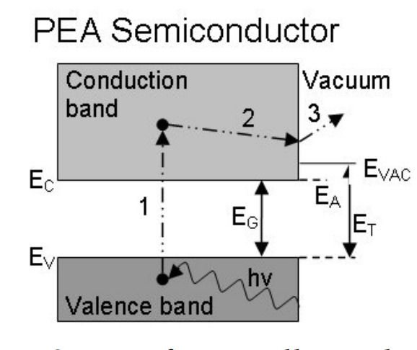
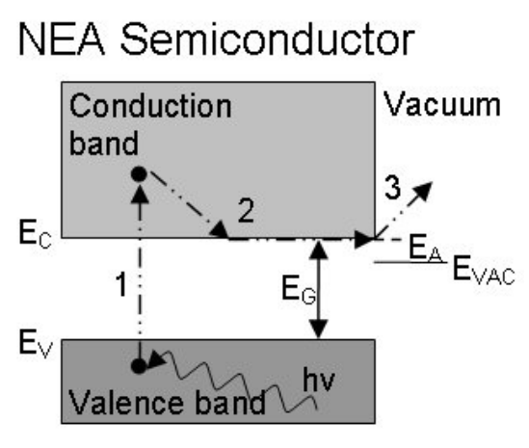
Basic Physics Behind Photoemission: Materials
Two main groups
Metal
Semiconductor
Positive Electron Affinity
Negative Electron Affinity
1
Notes:
Electrons are struck with a photon, giving them energy.
Thereafter, the electron has to move towards the surface without collision not to lose its additional energy
At the last step, it must have enough energy to escape the potential barrier it is facing.
Several other theories exist to this day, like Fowler Dubridge and also newer quantum mechanical models regarding photoemission.
Figures taken from [4]

Slide 9
Basic Physics Behind Photoemission
Two main groups
Metal
Semiconductor
Positive Electron Affinity
Materials:Cs2Te, K2CsSb,
Cs3Sb
Quantum Efficiency: High
Lifetime: Short
Wavelength: Visible
Emitance: High
Vaccum sensitive: Yes
Negative Electron Affinity
Materials: Cu, Mg
Quantum Efficiency: Low
Lifetime: Long
Wavelength: UV
Emitance: Low
Vaccum sensitive: No
Materials: GaAs, GaN,AlGaN
Quantum Efficiency: High
Lifetime: Short
Wavelength: Visible
Emitance: High
Vaccum sensitive: Yes
1
OBS! Needs an activation layer to lower the potential barrier!
Notes:
Electrons are struck with a photon, giving them energy.
Thereafter, the electron has to move towards the surface without collision not to lose its additional energy
At the last step, it must have enough energy to escape the potential barrier it is facing.
Several other theories exist to this day, like Fowler Dubridge and also newer quantum mechanical models regarding photoemission.

Slide 10
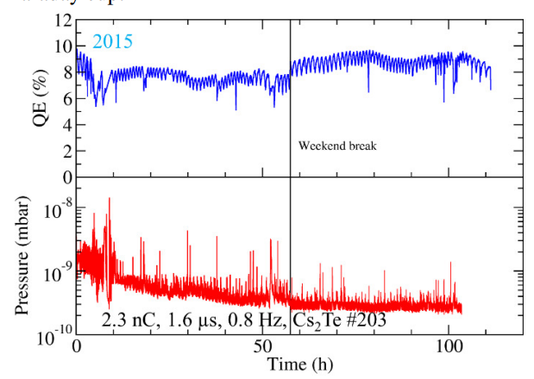
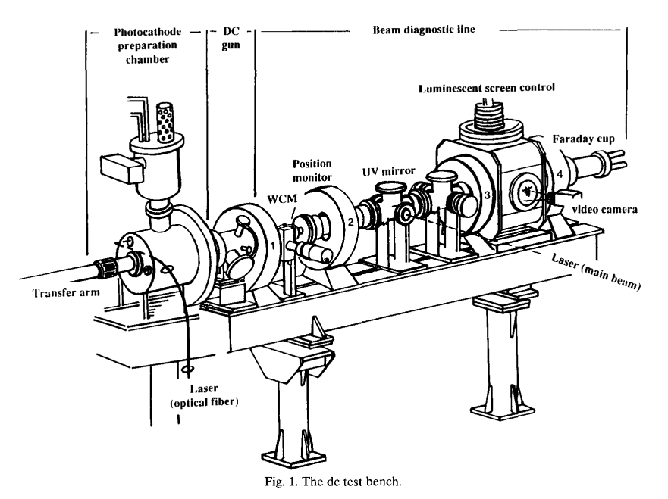
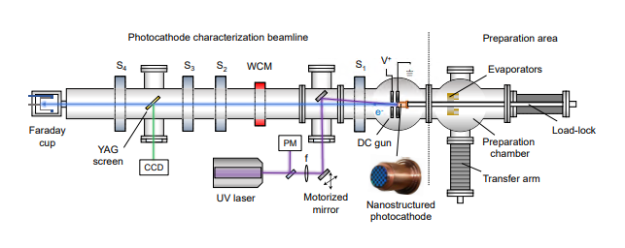
Photocathode used at CERN
At CERN: Cs2Te (PEA) photocathode.
Quantum efficienty of ~10%
Requires good vacuum and
Cannot be exposed to atmospheric conditions.
Want to move on to pure copper (metal) cathodes.
Figurex : Taken from [3] and [2] and [5]
1
Notes:
Electrons are struck with a photon, giving them energy.
Thereafter, the electron has to move towards the surface without collision not to lose its additional energy
At the last step, it must have enough energy to escape the potential barrier it is facing.
Several other theories exist to this day, like Fowler Dubridge and also newer quantum mechanical models regarding photoemission.

Slide 11
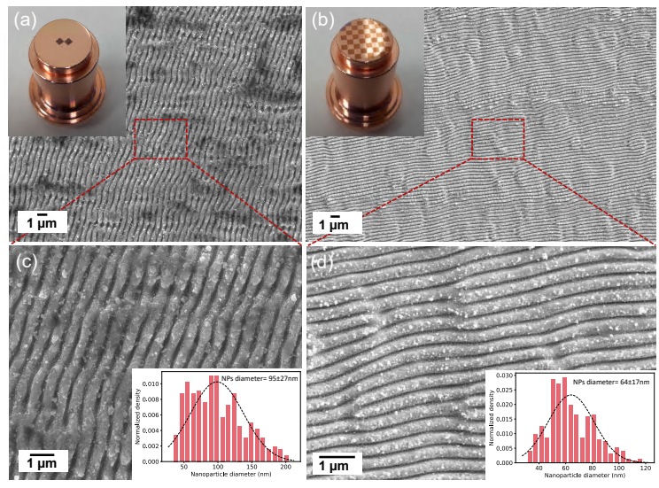
Laser Induced Periodic Surface Structure (LIPPS)
Ultra fast lasers
Surface plasmons
Surface structures
Increased QE
Not caused by LIPPS pattern!
Caused by nanospheres!
3
Notes:
By employing ultra fast lasers onto the surface of the metal, surface plasmons are induced, leading to periodic structures

Slide 12
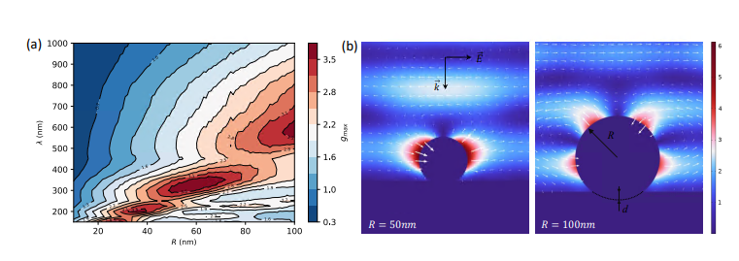
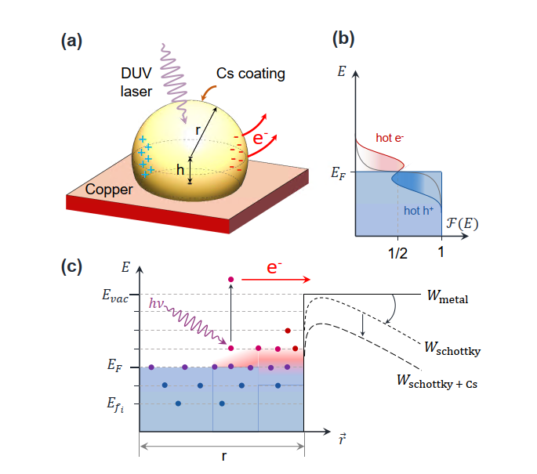
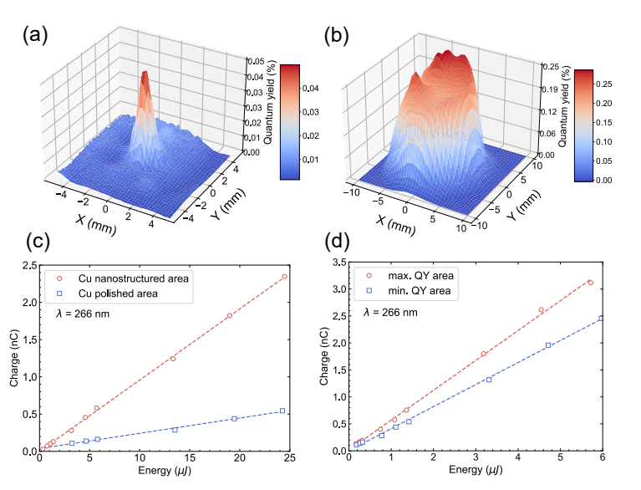
Laser Induced Periodic Surface Structure (LIPPS)
Small nanospheres occured as a bi- product.
Gives off a field enhancment generating hot electrons!
4

Slide 13



Laser Induced Periodic Surface Structure (LIPPS): Potential LES studies
Structuring LES cathode
Test field emission form nanospheres
Can make distinguish between photo and field emission
Exposure to high electric field (arrow) will they survive in real RF structure?
$$Anode$$
$$E_{field}$$
$$LIPPS Cathode$$
4

Slide 14
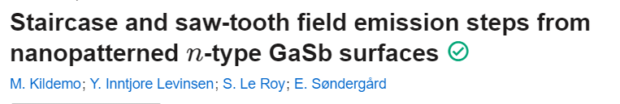
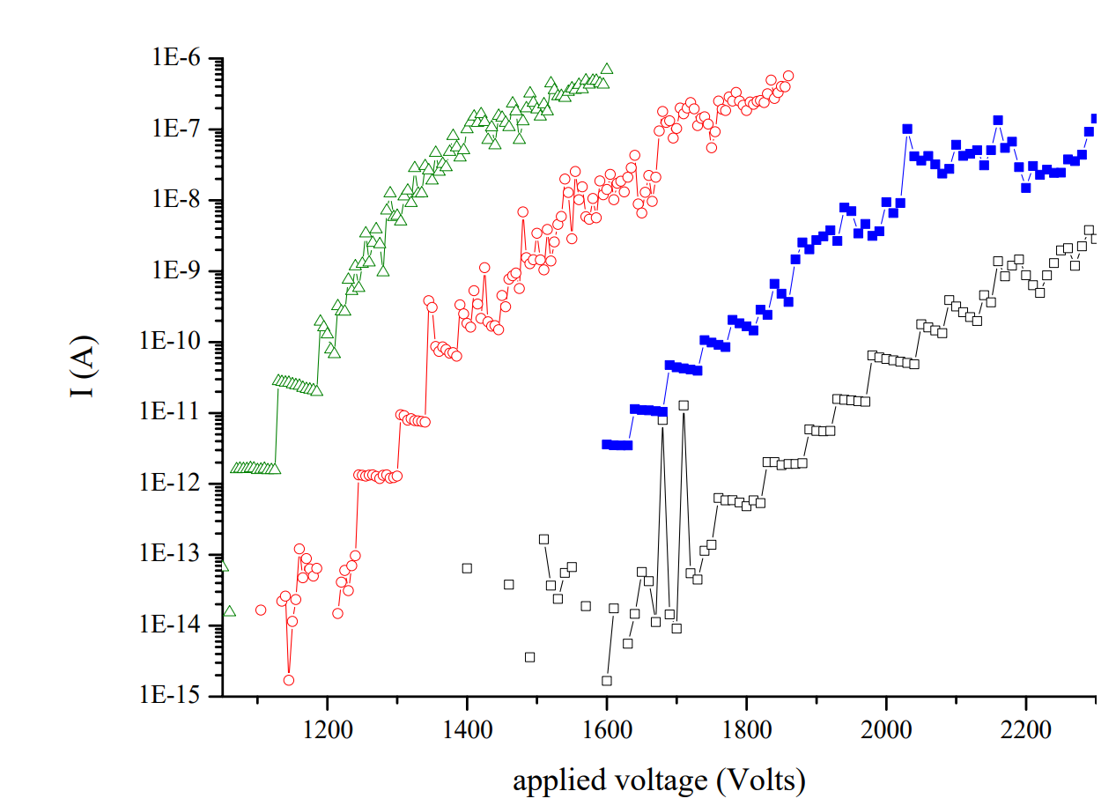
Nanopatterns into LES
Semiconductor nanostructures has been tested in the LES more than 10 years ago!
Data shows staircase steps in field emission
Caused by resonance tunneling? (likely not...)
Discrete distributions of beta
Only probing the high betas in an area
7
Notes:
There could be a rich Mo area on top of the pillars, leading to a resonance tunneling effect there.
Only probing the high betas in an area IS JUS LIKE THE LIGHT EMISSIONE XPERIMENT!!!!

Slide 15
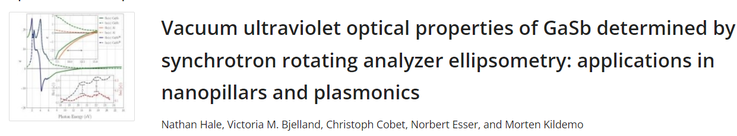
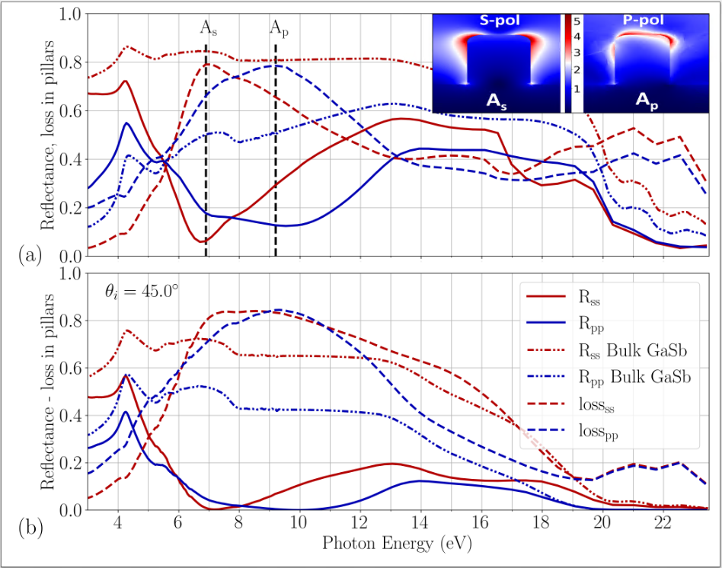
Semiconductor nanopillars: GaSb
Same nanopillars tested in the LES
Ellipsometry data recorded for the system
Simulations indicate much absorption in the UV range
Could be an interesting photocathode candidate
6

Slide 16
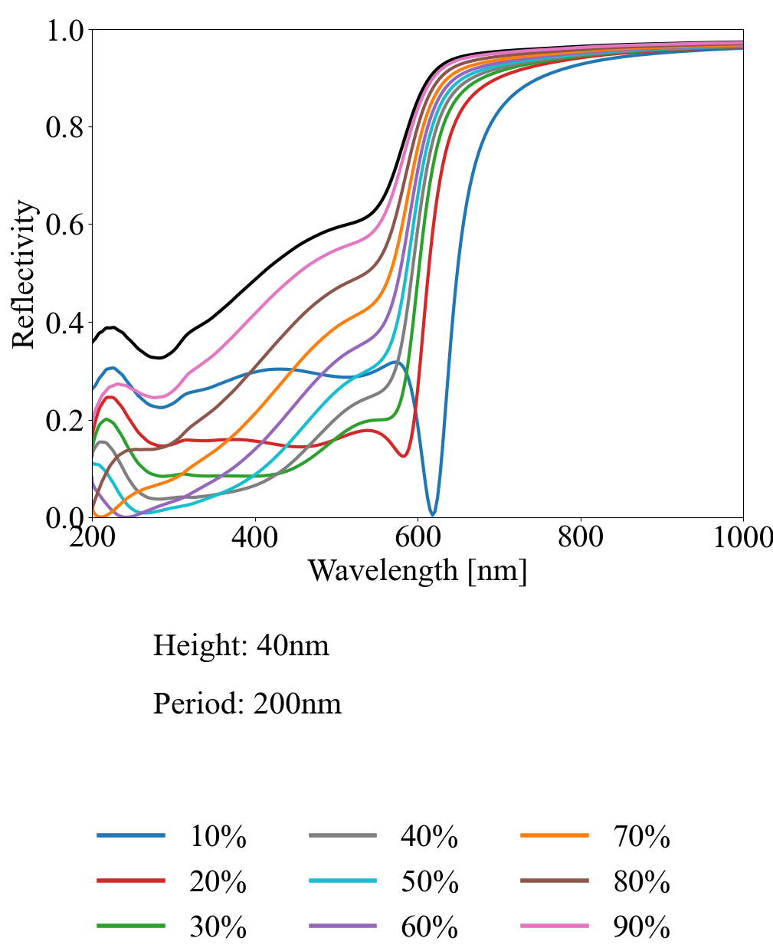
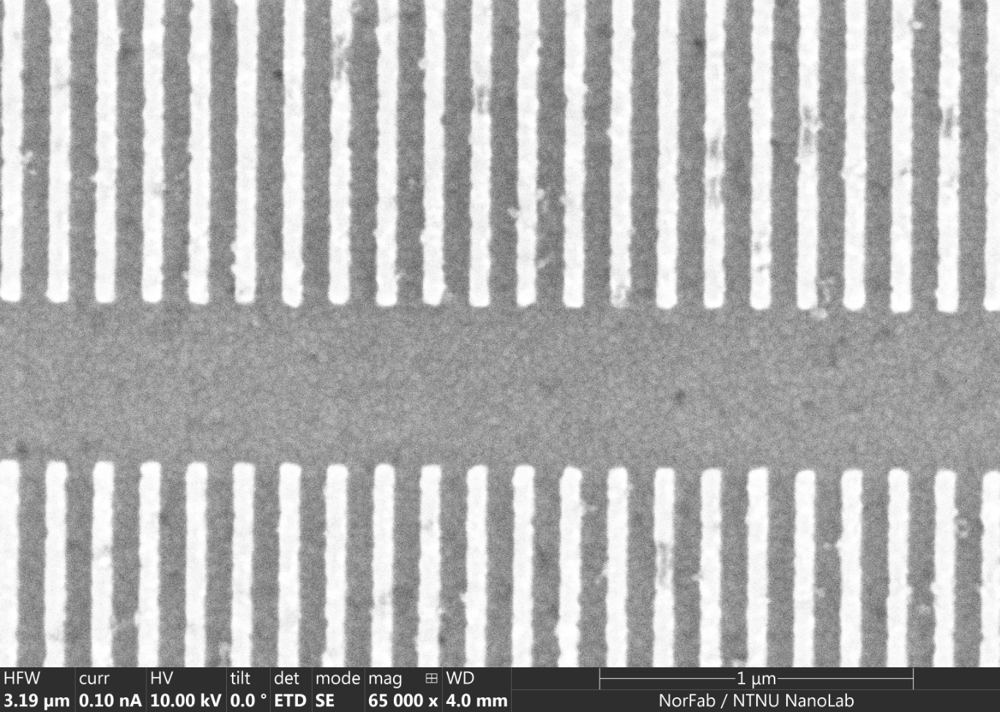
UV Low Reflectance Copper
Nanostructured metallic photocathodes
Low UV reflectance.
Potential metamaterial effect!
Height h
Period p
Width w
Fill factor f = w/p
8

Slide 17
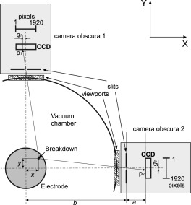
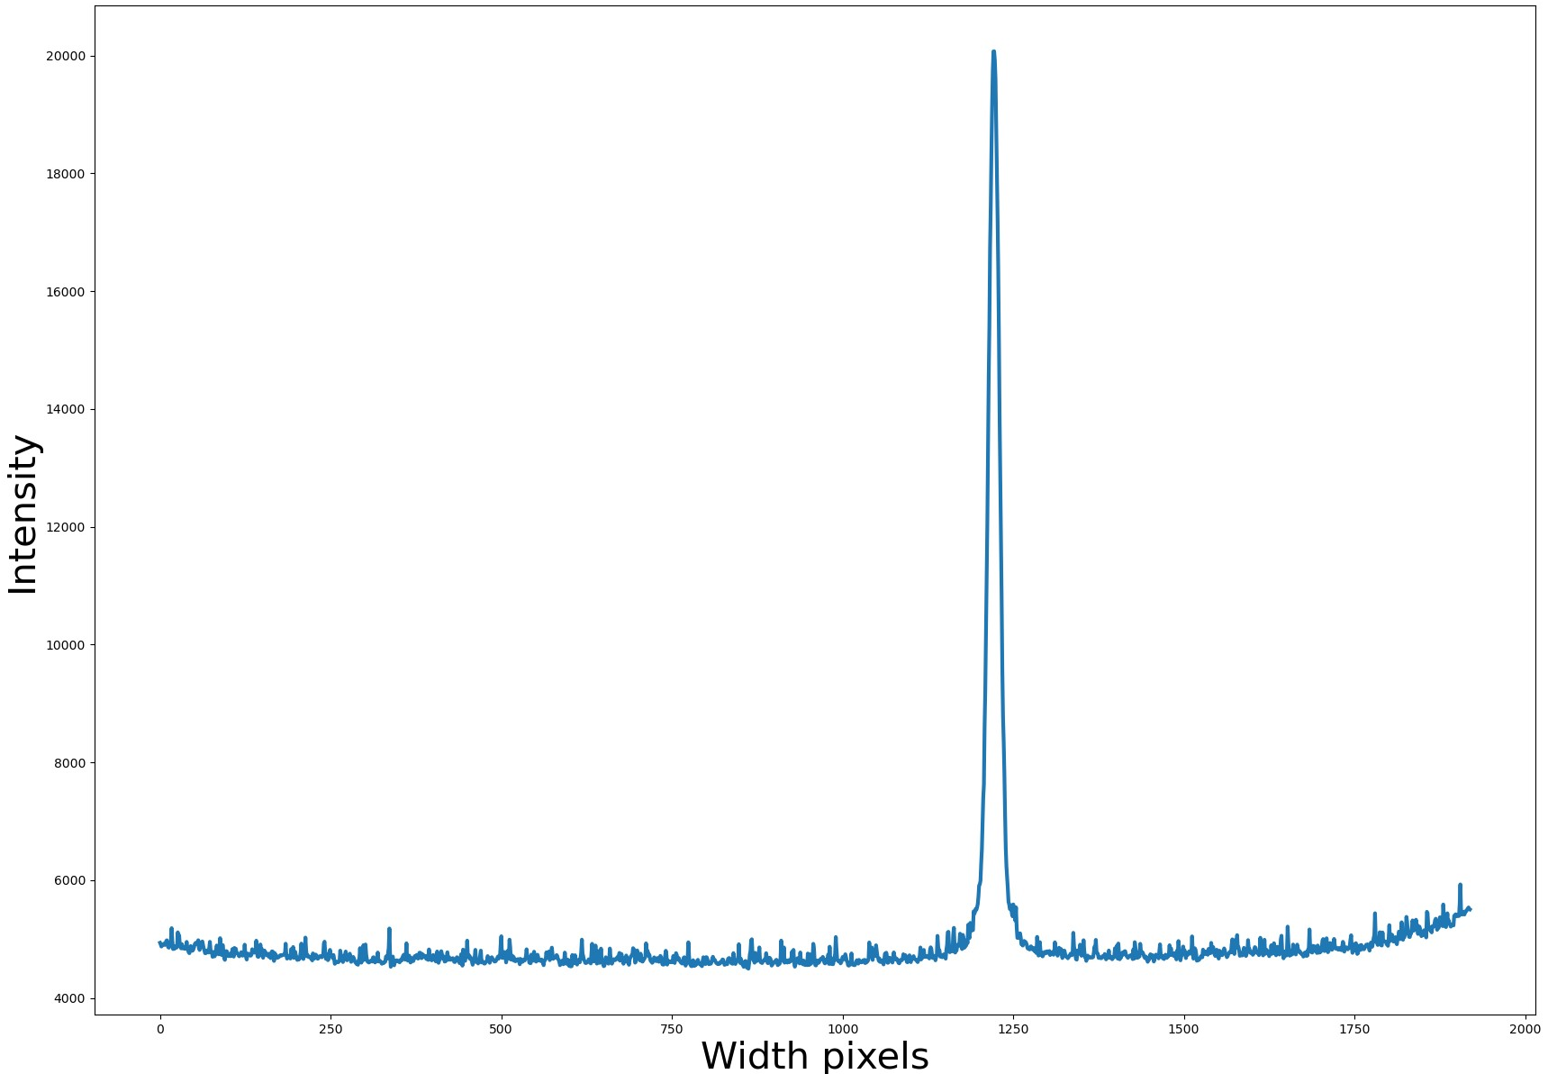
Looking for field emitters!
Is field emission (and light from field emission) dominated by field emitters?
Using the same camera to detect breakdowns, maybe we can detect field emitters!
Location of peak helps us triangulate the signal!
8

Slide 18
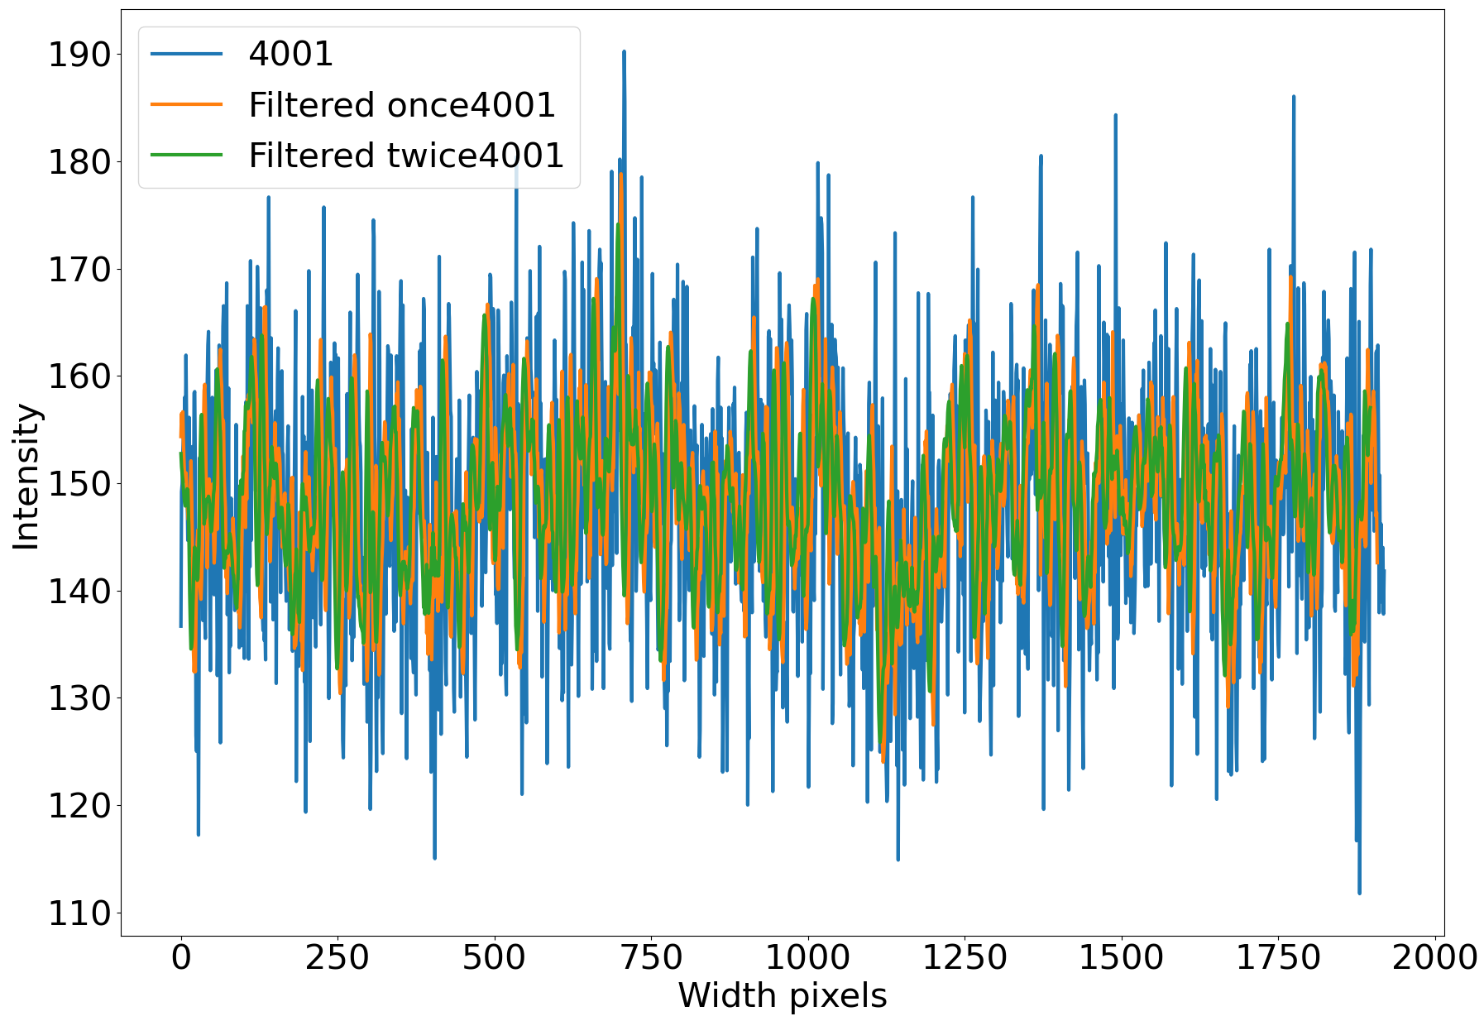
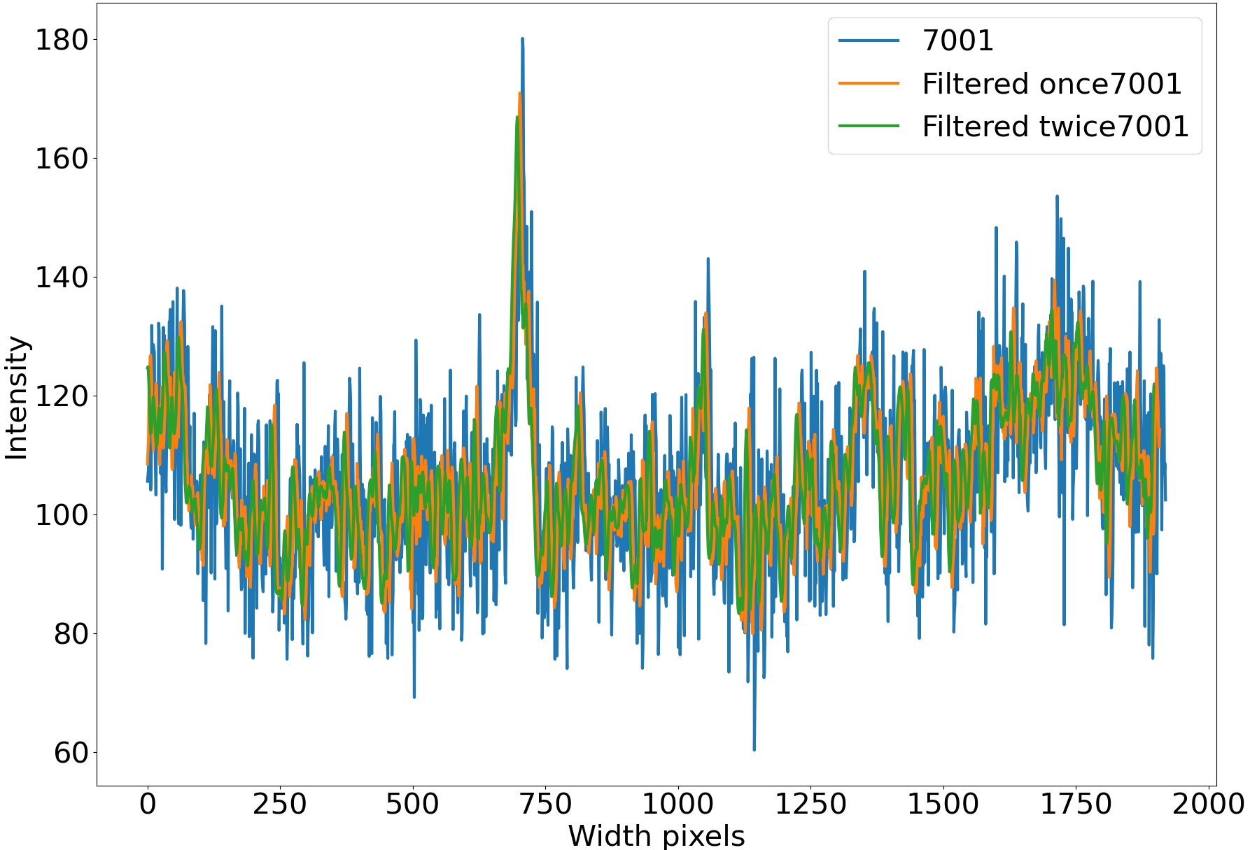
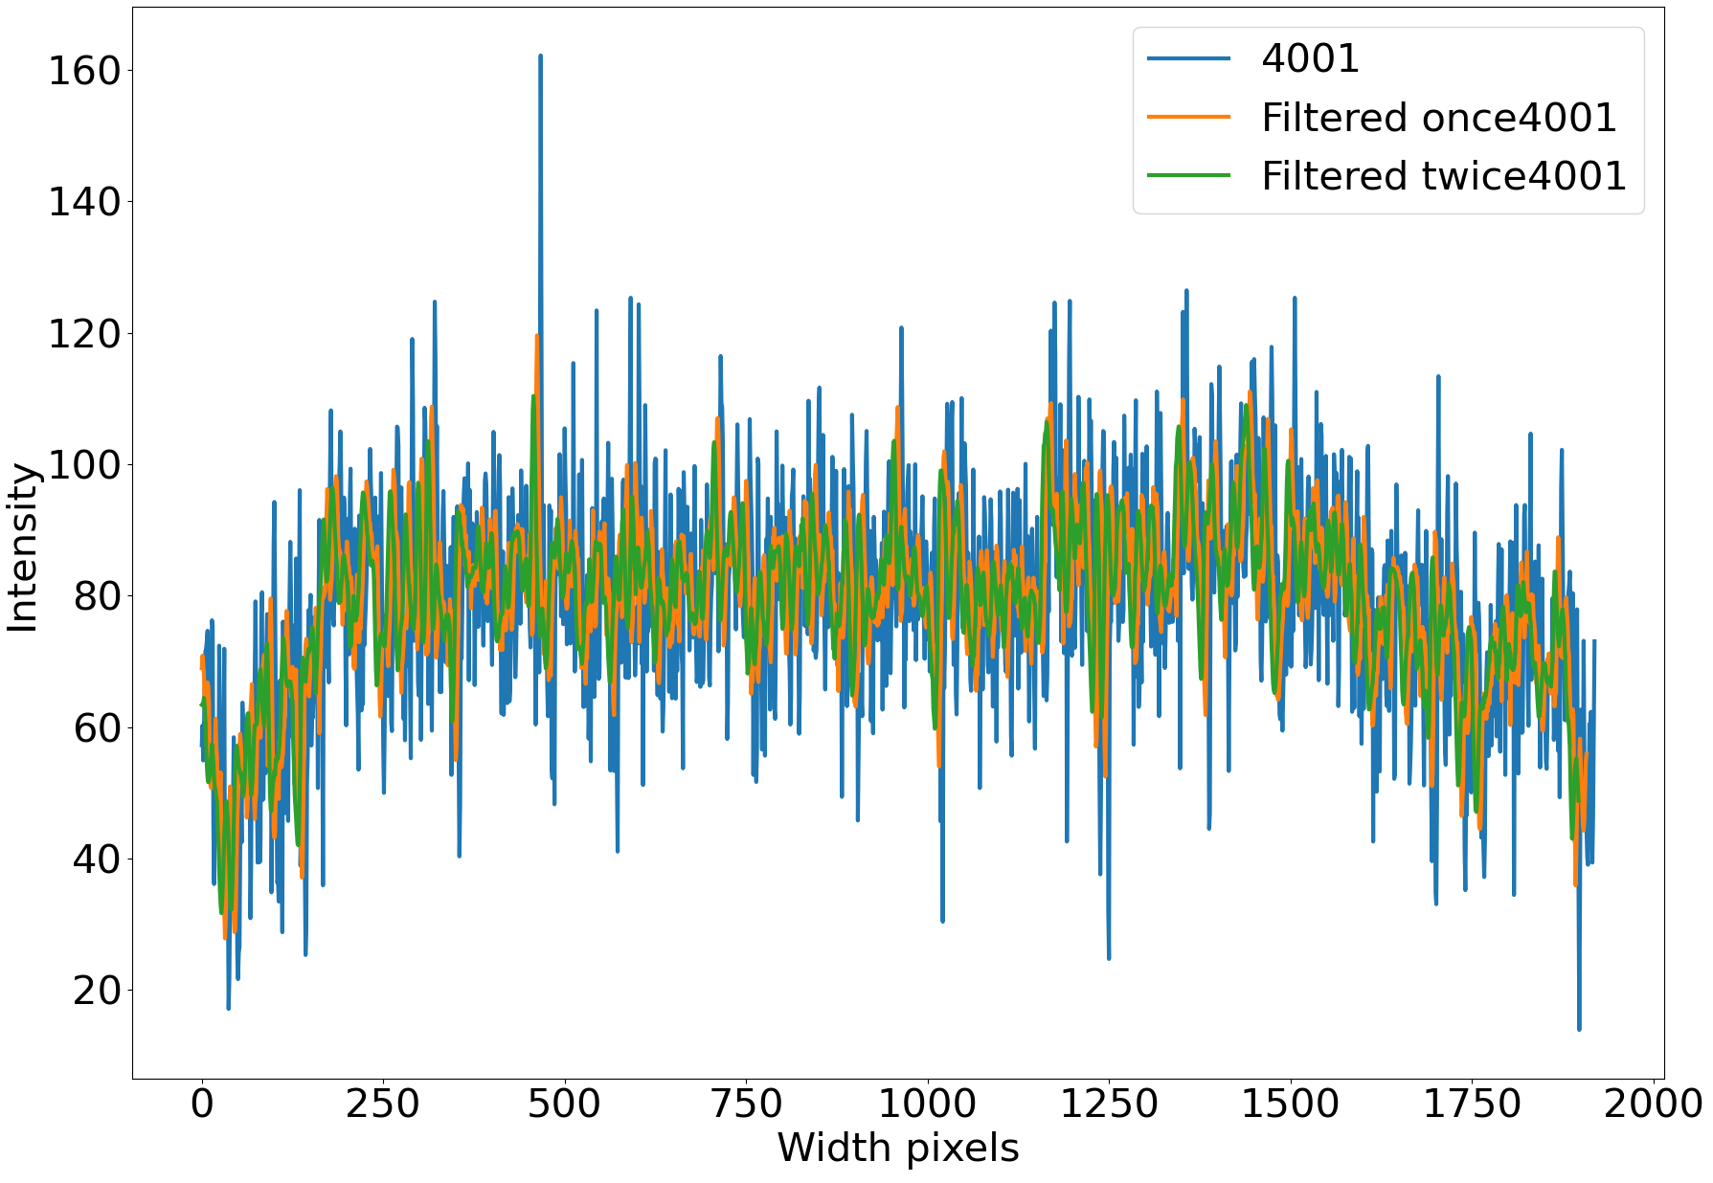
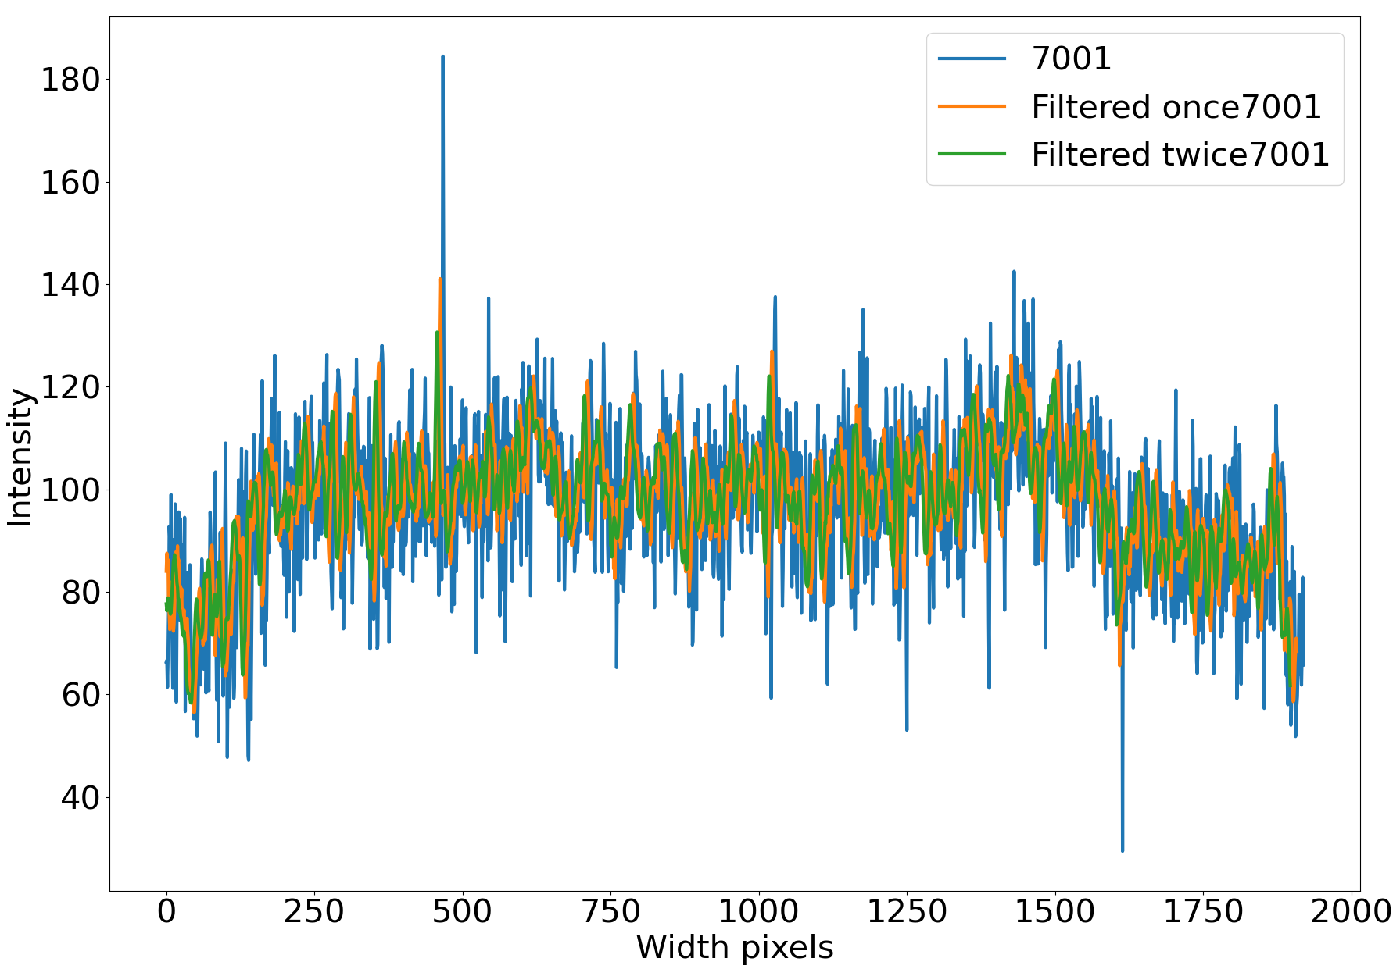
Looking for field emitters!
Camera 1
Initial testing of CuBe shows the measurement to be dominated by noise…
Some small feature was observed during high voltage, but cannot be distinguished from noise!
…
Camera 2
…
8

Slide 19
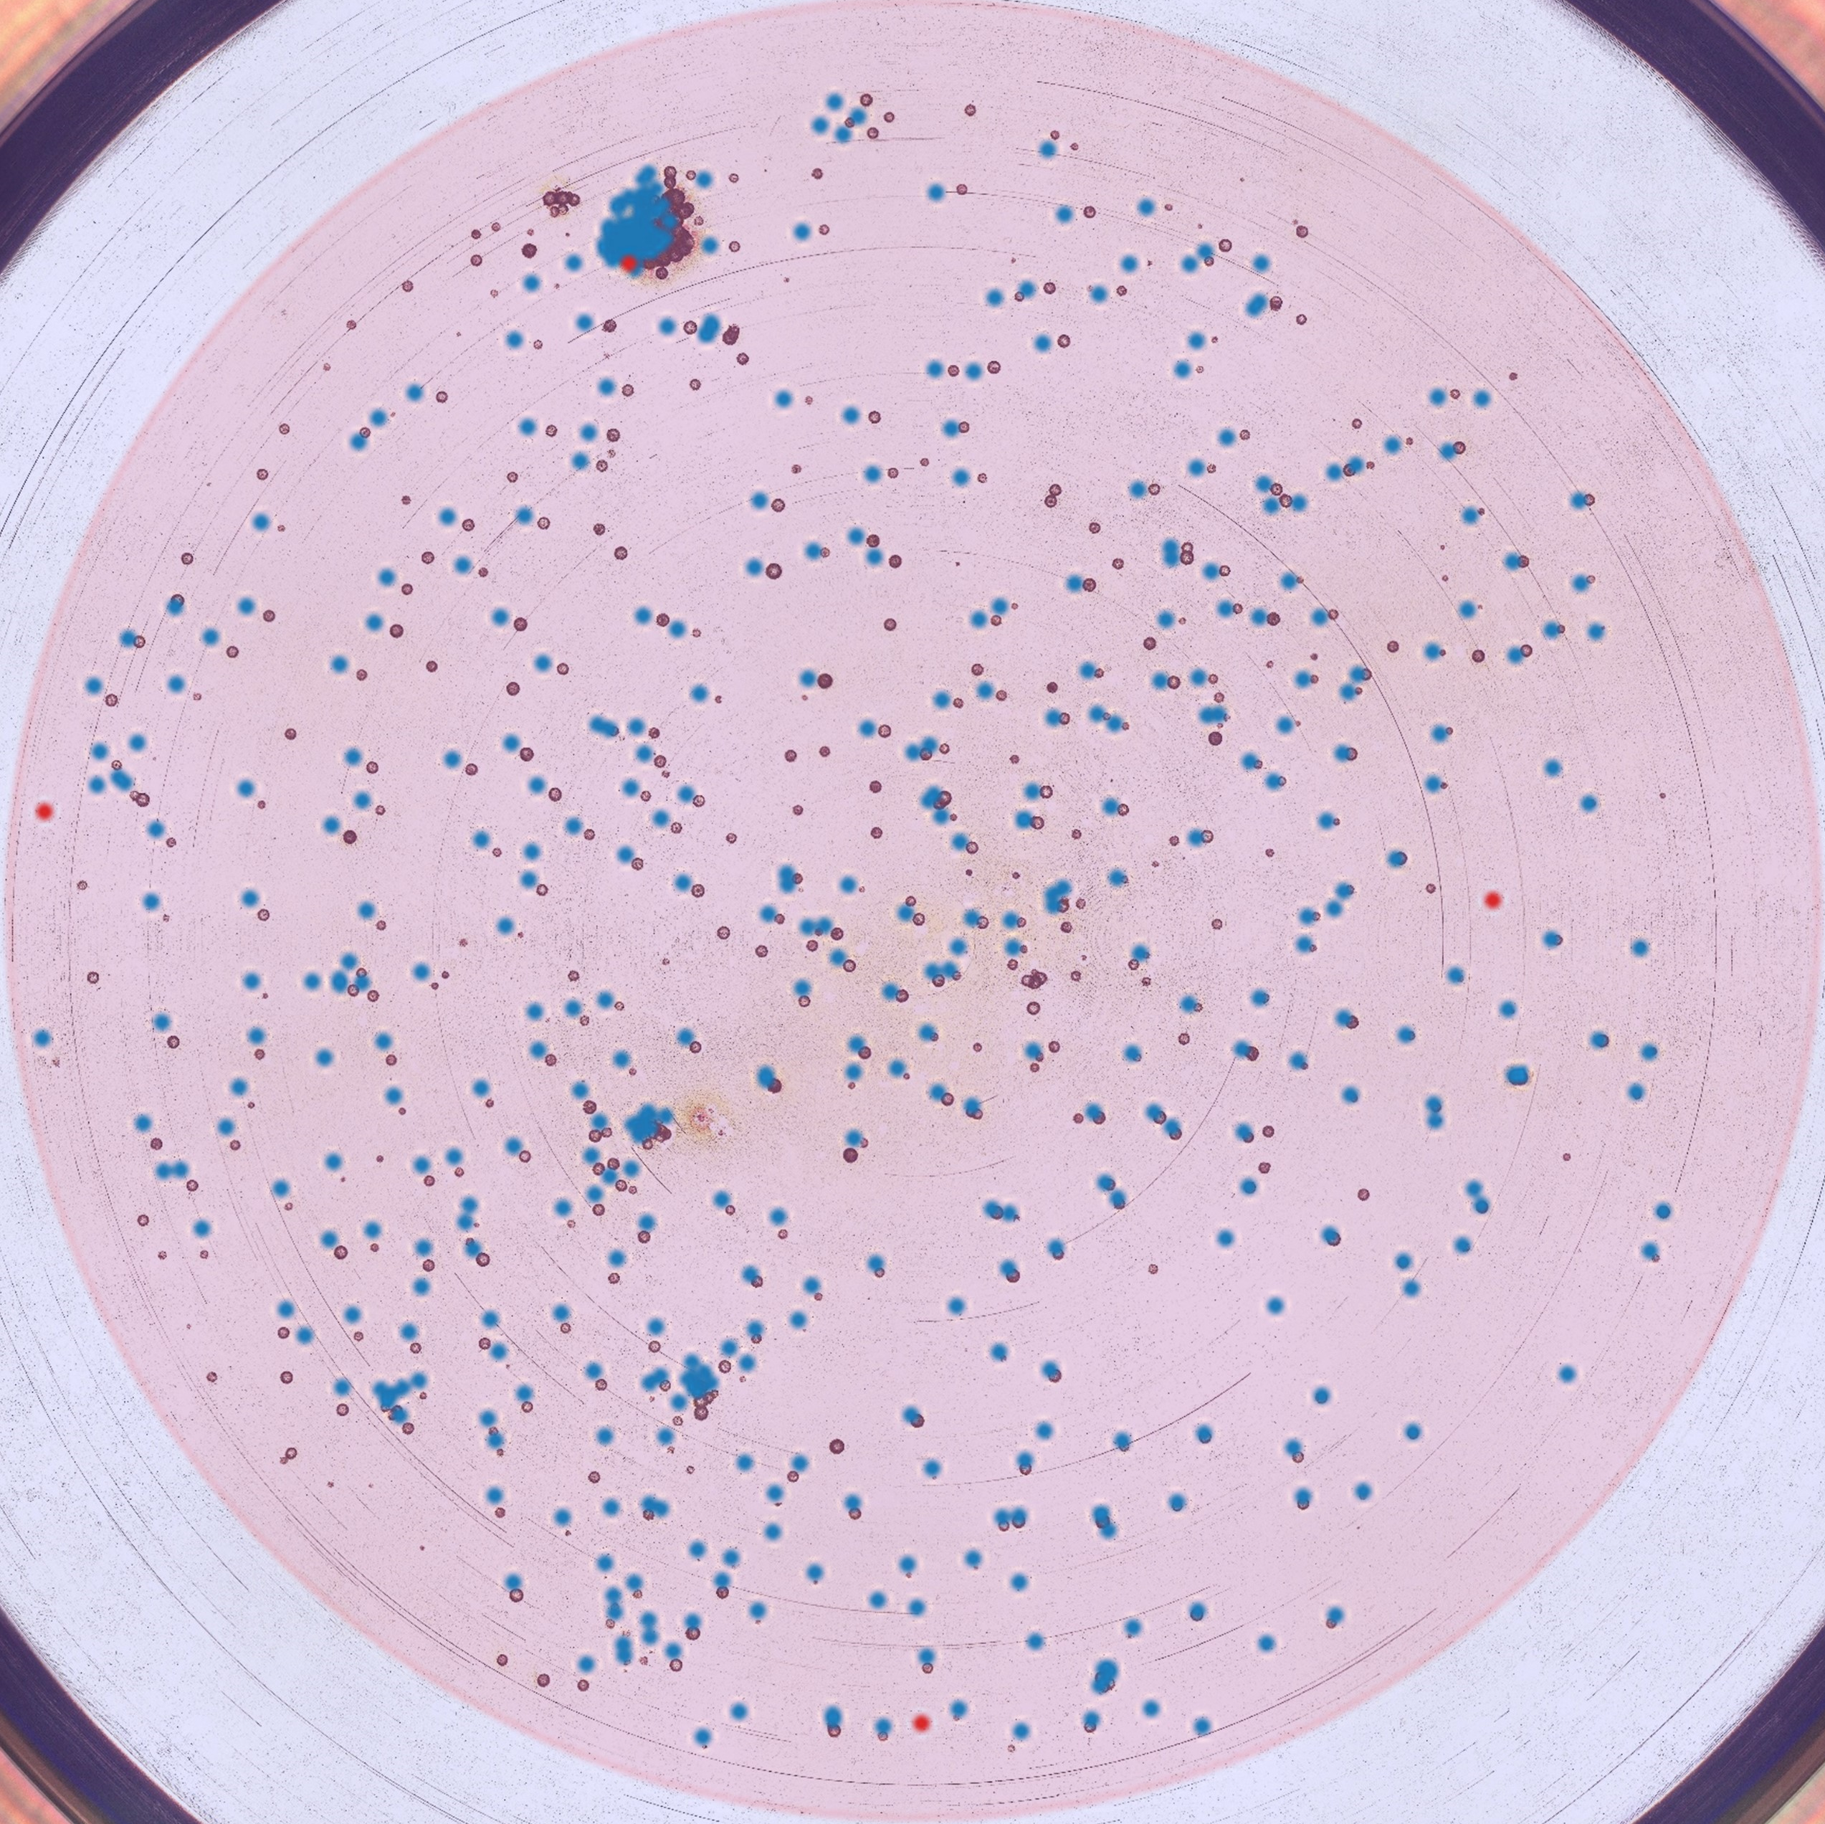
Looking for field emitters!
A few locations was estimated using the data.
Spectroscopic investigation revealed no additional features…

Slide 20
THANK YOU!
8

Slide 21
References
[1] https://journals.aps.org/prab/pdf/10.1103/PhysRevSTAB.12.074201
[2] file:///C:/Users/victormb/Documents/Papers/1-s2.0-0168900294912939-main.pdf
[3] https://accelconf.web.cern.ch/ipac2016/papers/thpow015.pdf
[4] https://psec.uchicago.edu/library/photocathodes/loch_thesis_CsTe.pdf
[5] Hot Electron enhanced photoemission from laser fabricated plasmonic cathodes
[6]https://pubs.aip.org/aip/jap/article/127/16/164903/153446/A-quantum-model-for-photoemission-from-metal
1

