Slide 1
SY/ABT needs for High Electric fields
Bruno Balhan, Jan Borburgh
15/9/2023

Slide 2
Applications of HV in accelerators under study
EDM: proton ‘Electric Dipole Moment’ experiment
One of the options is a fully electric field ring, with very high precision, cryogenic, beam position monitors (SQUIDs). Would there be an interest to run also the high field devices at cryogenic temperatures?
Storage ring of ~500 m circumference
Low spark rate: ~ 1/day
Usable fields: 8 MV/m
FCC-ee
For septum modest 2MV/m is targeted to keep spark rate to a minimum
Separators to keep electron beams apart
Low spark rate desired
Since separators after bending sections, x-ray photons will hit electrodes

Slide 3
R&D: present and plans
Need to qualify best electrode material for EDM:
First tests done in Uppsala and reported by FREIA team of great interest [1].
Collaborating with FREIA team to test alternative electrode materials (first Au coated Al).
Al electrodes manufactured, Au coating to be done.

Slide 4
R&D: present and plans
EDM + FCC-ee
Observed operational electric fields << measured max. performance in pulsed DC test facilities [2,3].
Set up collaboration with University of Tartu (Uot, Estonia) to simulate the impact of stored energy in the system on the spark rate.
Uot develops theory model
CERN will test several electrode geometries to obtain qualitative comparative results.
FCC
Impact of X rays on electrodes:
FCC-ee will run at 4 different energies with associated synchrotron radiation's critical photon energies:
for Z operation, at 45.6 GeV -> ec=18.2 keV
for W operation, at 80 GeV -> ec= 98keV
for Z-Highs operation, at 120 -> ec=332 keV
for top operation, at 182.5GeV -> 1168 keV
Set up collaboration with University of Tartu (Uot, Estonia) to simulate the impact X-rays on the spark rate.
Uot develops theory model
CERN will test several electrode materials in pulsed DC test set-up (TE-VSC) using an X-ray generator
CERN will test with X-ray gun with larger electrodes (gap ~ 40 mm) at ABT HV test set-up
Ultimately aim to repeat the test with the same set-up at a light source

Slide 5
Reference
M. Jacewicz et al, “Temperature-Dependent Field Emission and Breakdown Measurements Using a Pulsed High-Voltage Cryosystem”, Phys. Rev. Applied 14, 061002 – Published 30 December 2020
A. Descoeudres et al., “DC breakdown conditioning and brake down rate of metals and metallic alloys under UHV”, PHYSICAL REVIEW SPECIAL TOPICS - ACCELERATORS AND BEAMS 12, 032001 (2009)
R. Peacock et al, “Recent results from the CERN pulsed DC systems”, MeVArc 2022

Slide 7
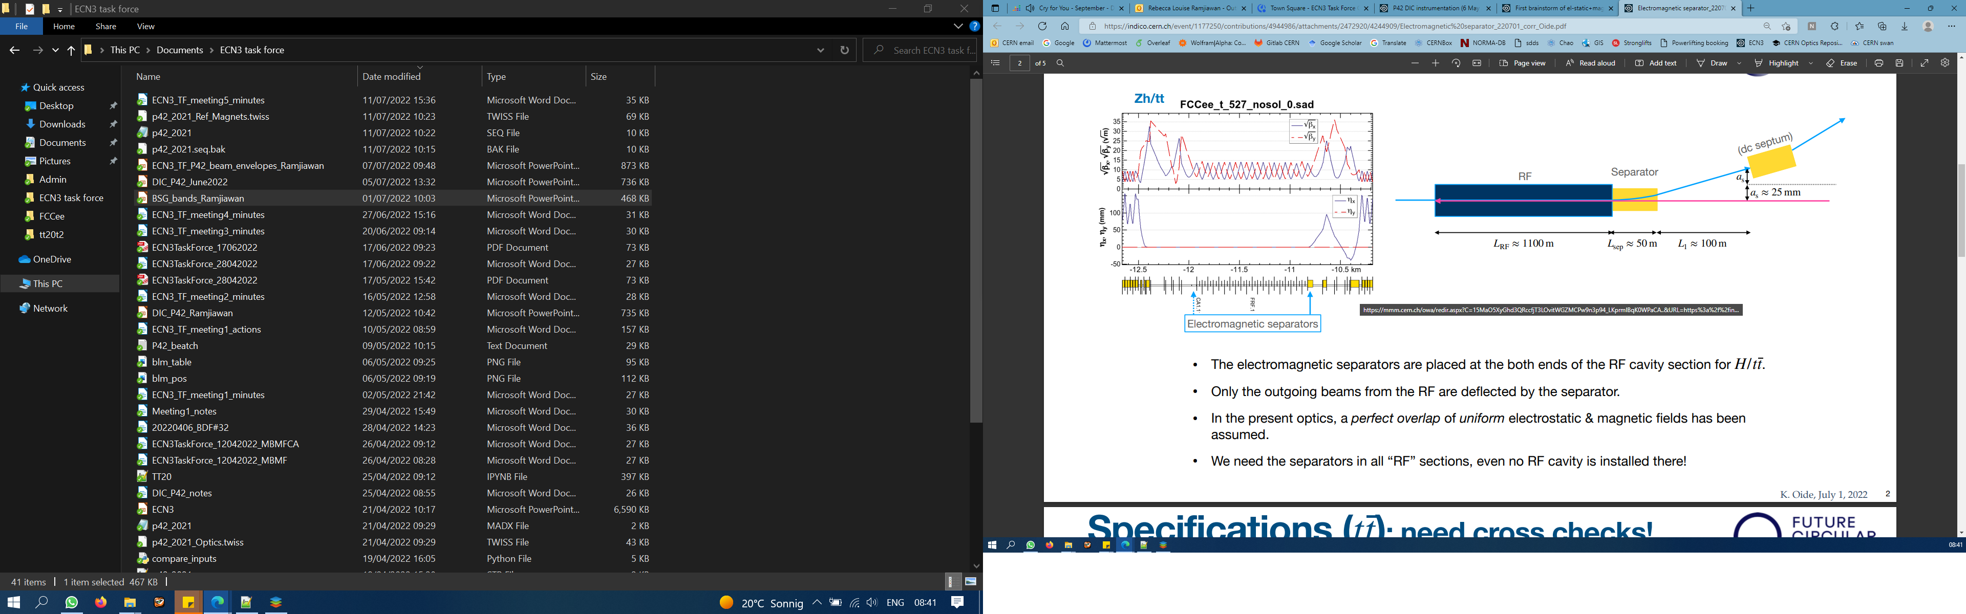
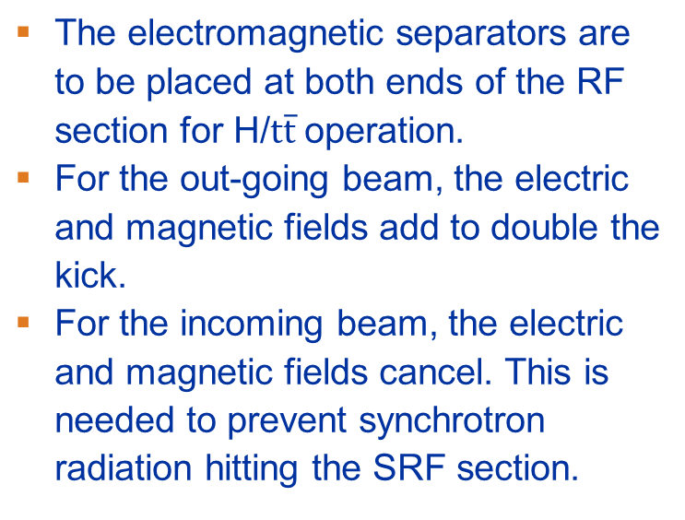
FCC-ee electromagnetic separator
K. Oide
The electromagnetic separators are to be placed at both ends of the RF section for H/$t\overline{t}$ operation.
For the out-going beam, the electric and magnetic fields add to double the kick.
For the incoming beam, the electric and magnetic fields cancel. This is needed to prevent synchrotron radiation hitting the SRF section.
300 mm
550 m
50 m
100 m
1 mrad
300 m
RF
separator
septum
400 urad
50 mm
1000 m

Slide 8
Preliminary separator parameters
Using 10 separator modules
Parameter | Separator Module
Length | 2.5 m
Deflection angle (E+M) | 40 μrad
Magnetic field | 4.9 mT
Electric field | 1.5 MV/m
Plate separation | $±$ 60 mm
Potential difference | $±$ 88 kV
Good field region $x$ | $±$ 15 mm
Good field region $y$ | $±$ 10 mm
K. Oide
Parameter | Value
RF length | 1100 m
RF half aperture | 50 mm
Distance to septum | 100 m
Separator deflection | 400 μrad

