Slide 1


Superconducting Properties Evaluation At Daresbury Lab
Liam Smith, Daresbury Lab, ASTeC, VSG.
On Behalf of the Team
Notes:
Hi everyone, good to see you all. Most of you will know by now, We have the Magnetic Field Penetration Facility at Daresbury. Some of you will probably remember I took over responsibility of the facility last year. The facility has been running quite consistently since December. I am just going to show you where we are up to and go through the methods we are using to test for Bfp and Tc.

Slide 2
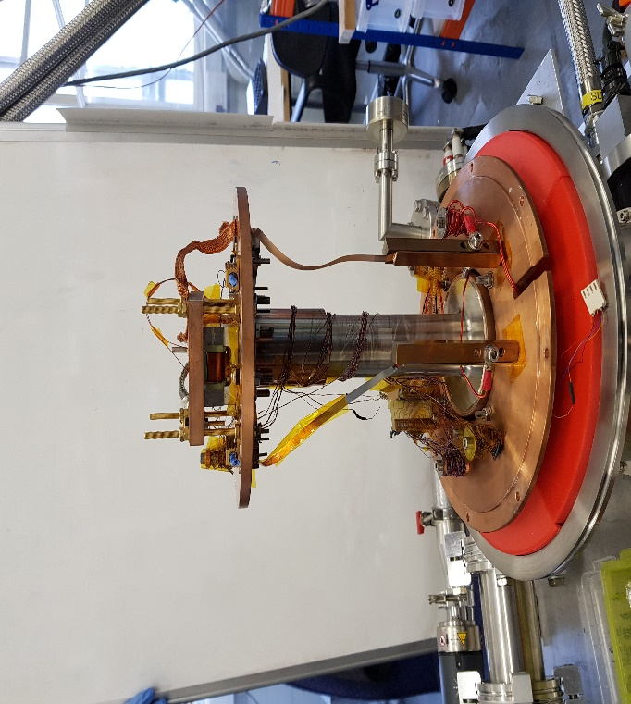
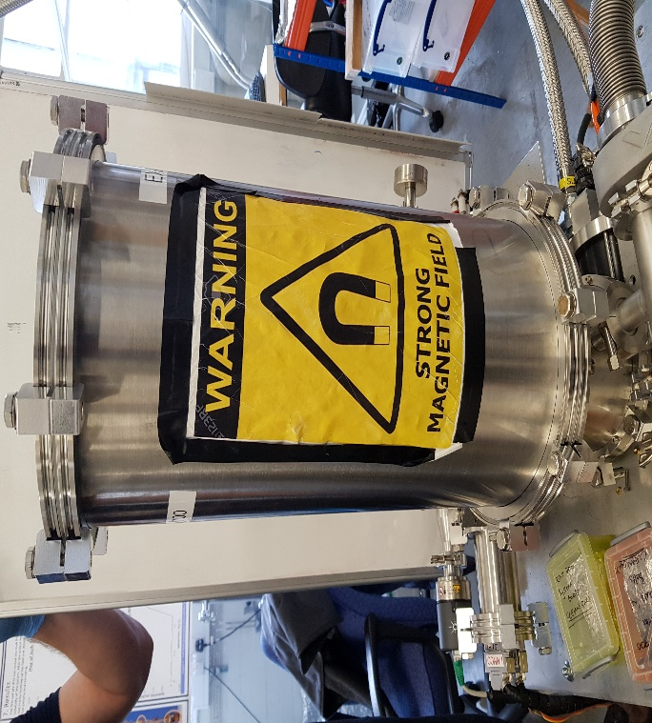
Magnetic Field Penetration Facility
The MFPF measures samples using a DC localised field, applied parallel to a sample surface to replicate the conditions within the cavity walls.
The system has a superconducting coil made of NbTi with C-shaped yoke that applies a field of up to 600 mT parallel to a sample, through a 2 mm gap.
There are two Hall probes located each side of the sample (Hp1 & Hp2) that determine Bꬵᴩ.
The system can efficiently test sample sizes from 75 x 45 – 40 x 40 mm². It is possible to test samples of a smaller geometry, however, field leakage around the sample becomes an issue at these dimensions.
The system can reach temperatures as low as 2.6 K and up to 30 K.
Notes:
I am just going to remind you of a few of the characteristics of the facility itself.

Slide 3
Raw Data, B2(B1).
Notes:
Looking at the raw data first. The sample is V3Si/Nb/Cu. We have B1/K2 which shows a superconducting state and the top line which is K1, the normal conducting line at the top, and we can see that the higher temperatures follow the normal conducting line, whereas 11.5 K shows some screening and the lower temperatures show full screening effect with transitions starting roughly after 30 mT.

Slide 4
V3Si/Nb/Cu. R Value Method.
Notes:
We have different methods to try and determine Bfp. This is the R value method. One on the graph represents the Meissner effect, and then we can identify where the data deviates from one and we identify 1 or 2 % from that line as the transition point, illustrated here as 98 and 99%. We can see I have circled the transition point within the plots, and that is to illustrate the next method for plotting Bfp is taken. For this we use the first and second derivatives. So once we have taken Bfp Values from 98 and 99 % We move on to the next method.

Slide 5
V3Si/Nb/Cu
Nb Foil 50 Micron.
Notes:
Here are a couple of examples of the first and second derivatives, the two on the right are from the from the V3Si/Nb/Cu that we have been looking at whereas the two on left are from Nb foil samples as they provide a better example the first and second derivatives. We can see in the instance of the 2nd derivative for the V3Si sample that there is too much noisemaking it hard to identify a transition. The 1st derivative shows a transition point around120 Mt (roughly in this example. Looking at the Nb Foils it is easy to take Bfp using both of these methods. This provides a good example of how we use multiple methods to try and formulate the most sensible Bfp.

Slide 6
Results for V3Si/Nb/Cu.
 | 98% | 99% | dB2/dB1
 | 1.6817 | 1.4076 | 1.1675
Bfp(0K)= | 222.73 | 189.14 | 150.19
Tc(0mT) = | 11.5 | 11.5 | 11.3
 |  | 4.2 K
 | Bfp = | 146.8 | mT
Mag | Tc = | 10.3
 | Tc [K] | ∆Tc [K]
100 | 11.5
90 | 11 | 0.49
50 | 10.51
10 | 10 | -0.51
0 | 9.3
Notes:
All methods are then plotted for comparison. Each sample tested concludes with this graph allowing easy comparisons between materials. I usually define 4.2 K. We can then define Tc using a couple of methods. We can use the plotted data to extrapolate to zero and identify Tc. This method has certain issues as the coil has a similar Tc to Nb. We can also identify Tc using ?

Slide 7
Results for Nb foils
Notes:
You may remember we tested foil samples last year to try and determine the limits of sample size before leakage becomes a problem. We concluded that 75 x 40 – 40 x 40 mm sample sizes provided the optimal dimensions to achieve good results. It is possible to test slightly smaller samples in some instances, however, as said earlier leakage around the sample will become more of an issue. More recently we tested further Nb Foils, however, this time focusing on thickness. I have plotted results above. We can see that 4.4 K seems to make sense, however, we can also see that

Slide 8
Samples Tested at MFPF over last 4 months
Sample | Deposition Date | Deposition Method/Rig | Deposition Temp ° | Polished | Comments | Date of Measurment | Tc K Pen | Tc Mag | Tc Resistance RRR | Scientist | Bfp Mt 99% 4.2 k | 98% 4. 2 k | dH2/dH1 | d²H2/dH1² 4.2 k
Nb3Sn | 28/11/2022 | Octopus |  |  |  | 13/12/2022 | 13.7 |  |  | Liam Smith | 50.84 | 54.85 | 44.44
V3Si x1 | 09/01/2023 | Alfie |  |  |  | 31/01/2023 | 9.2 |  |  | Liam Smith | 106 | 124 | 77
V3Si (22) |  |  |  |  | Poor SC. R > 0! | 24/02/2023 |  |  |  | Liam Smith
Nb Sapphire |  |  |  |  |  | 09/03/2023 | 8.06 |  |  | Liam Smith | 43.9 | 48.6 | 38.4
V3Si-Nb-Cu (27) |  |  |  |  |  | 14/03/2023 | 11.5 | 10.37 |  | Liam Smith | 146.8 | 168.5 | 110
V3Si Run2 | 16/01/2023 | Alfie |  |  | Poor SC. R > 0! | 25/03/2023 |  |  |  | Liam Smith
NbTiN | 03/04/2023 | Darcy |  |  | Poor SC. R > 0! | 04/04/2023 |  |  |  | Liam Smith
V3Si 26 | 02/03/2023 | Alfie |  |  | Not SC | 21/03/2023 |  |  |  | Liam Smith
Nb Foil (Micron)
1 |  |  |  |  |  | 25/01/2023 |  |  |  | Liam Smith
1 BS |  |  |  |  |  | 23/01/2023 |  |  |  | Liam Smith
3 |  |  |  |  |  | 27/12/2022 | 9.19 |  |  | Liam Smith |  |  | 76.4 | 77.4
5 |  |  |  |  |  | 09/01/2023 |  |  |  | Liam Smith | 99.8 | 121 | 155.4 | 157.1
5 BS |  |  |  |  |  | 05/01/2023 |  |  |  | Liam Smith
10 |  |  |  |  |  | 16/01/2023 |  |  |  | Liam Smith | 244.4 | 244.4 | 244 | 243
10 BS |  |  |  |  |  | 12/01/2023 |  |  |  | Liam Smith
50 |  |  |  |  |  | 20/01/2023 |  |  |  | Liam Smith | 366.9 | 366.9 | 381.5 | 381.5
100 |  |  |  |  |  | 27/01/2023 | 8.6 |  |  | Liam Smith | 151 | 151 | 183 | 183

Slide 9
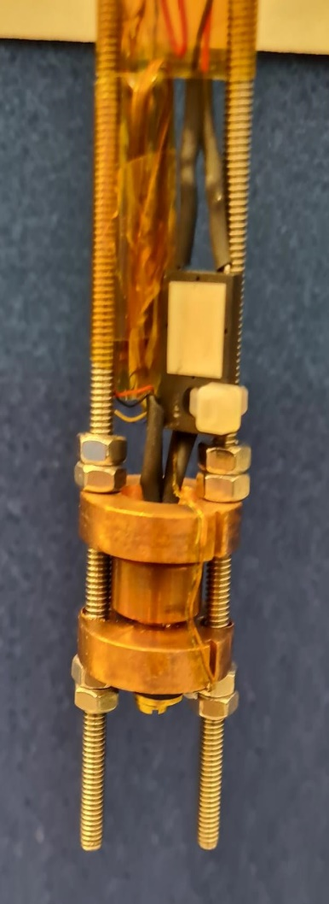
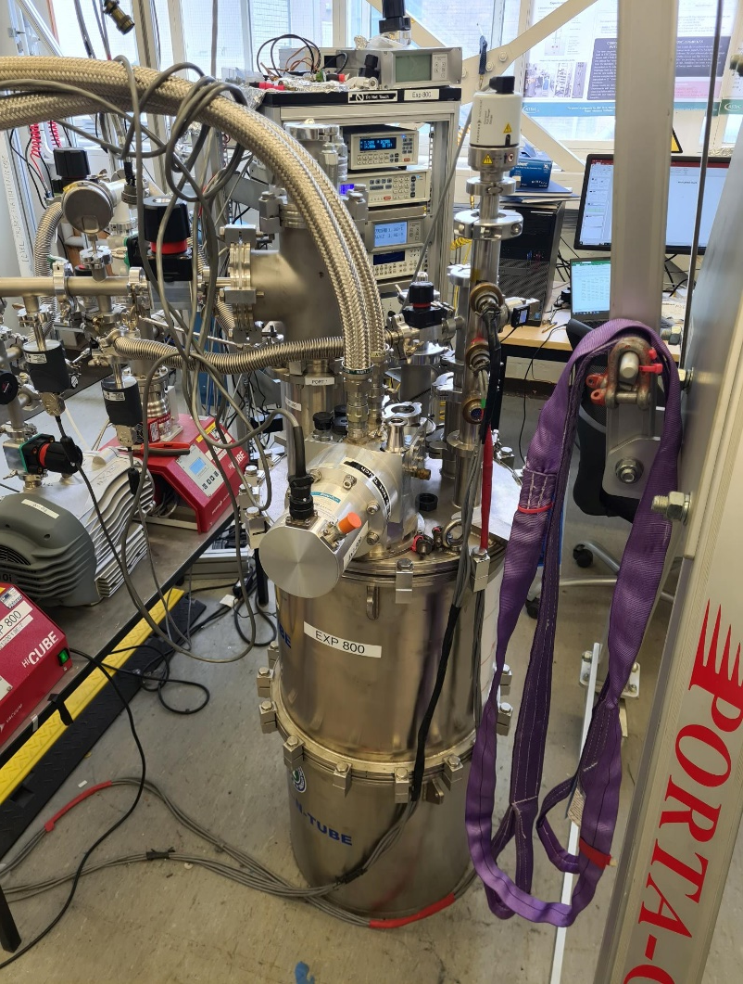
Multi-probe Insert for RRR measurements
 | Cool |  |  | Warm
100 | 4.51E-03 |  | 100 | 4.51E-03
90 | 4.06E-03 | 12.643 | 90 | 4.06E-03 | 12.656
50 | 2.28E-03 | 12.284 | 50 | 2.28E-03 | 12.292
10 | 4.89E-04 | 12.042 | 10 | 4.89E-04 | 12.047
0 | 4.27E-05 |  | 0 | 4.27E-05
Av |  | 12.323 |  |  | 12.33167
Tc |  | 12.2 |  |  | 12.2
Delta |  | 0.359 | 0.242 |  | 0.364 | 0.245

Slide 10
Samples Tested at RRR facility over last 4 months
Sample+A1:I20 | Deposition Date | Deposition Method and Rig | Deposition Temp ° | Polished | Comments | Date of Tc measurement | Tc (K) | T90%-Tc [K] | T10% - Tc [K] | R(300K) [Ohm] | R(T100%) [Ohm} | T100% [K] | RRR | Scientist | Current (mA) | Pressure (mbar)
Nb3Al | 22/03/2008 | Divers Rig | 400 |  | N/A | 02/03/2022 | 10.3 |  |  |  |  |  |  | Liam Smith
Nb3Al | 21/04/2022 |  | 650 |  | N/A | 04/05/2022 | 14.5 |  |  |  |  |  |  | Liam Smith
NbTiN | 09/03/2022 |  |  |  | N/A | 12/04/2022 | 14.8 |  |  |  |  |  |  | Liam Smith
Nb |  | Sharon |  |  |  | 13/12/2022 | 9.16 |  |  |  |  |  |  | Liam Smith | 10 | 1.00E+00
Nb Foil 3 Micron |  | Goodfellows |  |  |  |  | 8.9 (30mA) , 8.9 (3mA)) |  |  |  |  |  |  | Liam Smith
Nb3Sn |  |  |  |  |  | 12/12/2022 | 16.5 |  |  |  |  |  |  | Liam Smith | 10 | 8
NbSn |  |  |  |  |  | 25/01/2023 | 16.2 |  |  |  |  |  |  | Liam Smith
V3Si x 1 | 09/01/2023 | Alfie/ Pulsed DC magnetron | 650 |  | N/A | 10/01/2023 | 14.2 | 0.01 | 0.001 |  | 1.84E-04 | 14.9 |  | Liam Smith |  | 6.00E-01
V3Si x 2 |  | Alfie/ Pulsed DC magnetron | 750 |  | N/A | 25/01/2023 | 14.8 |  |  |  |  |  |  | Liam Smith |  | 6.00E-01
V3Si x 3 |  | Alfie/ Pulsed DC magnetron | 880 |  |  | 02/02/2023 | 12.6 | 0.1 | -0.07 |  | 2.94E-04 | 13.2 |  | Liam Smith |  | 6.00E-01
V3Si x 4 |  | Alfie/ Pulsed DC magnetron | 567 |  |  | 30/02/2023 | 14.3 | 0.15 | -0.09 |  | 3.22E-04 | 14.5 |  | Liam Smith |  | 6.00E-01
V3Si x 5 |  | Alfie/ Pulsed DC magnetron | 660 |  |  |  | 11.3 | 0.06 | -0.4 |  | 1.97E-05 | 11.5 |  | Liam Smith |  | 6.00E-01
V3SI X6 |  | Alfie |  |  |  | 24/02/2023 | 13.3 | 0.348 | -0.3 |  | 5.90E-04 | 13.5 |  | Liam Smith |  | 6.00E-01
V3SI X7 |  | Alfie |  |  |  |  | 12.5 | 0.27 | -0.3 |  | 4.50E-04 | 14 | 0 | Liam Smith |  | 6.00E-01
V3SI X8 |  |  |  |  | Not SC |  |  |  |  |  |  |  | #DIV/0!

Slide 11
Acknowledgments
Oleg Malyshev
Reza Valizadeh
Dan Seal
Chris Benjamin
James Conlon
Taaj Sian
Dan Turner
Nathan Leicester

Slide 12
Thank You For Listening. Any Questions?

