Slide 1
SOME CONSIDERATIONS ON INJECTION ENERGY IN FCC-hh
CERN, 17th May 2017
TE TM
E. Todesco
CERN, Geneva Switzerland
Thanks to S. Izquierdo Bermudez

Slide 2
BASICS
Main option for FCC-hh injection: 3.3 TeV using the LHC
Alternative: 1.3 TeV using a superconducting machine in the SPS tunnel

Slide 3
ENERGY SWING
For the baseline, energy swing in FCC-hh is 50/3.3=15, that is not far from the LHC value
  Tevatron had 6
  HERA had 26, with numerous issues
Going to 1.3 TeV, we would have a factor 38 – extremely challenging with respect to what done in the past in superconducting machines

Slide 4
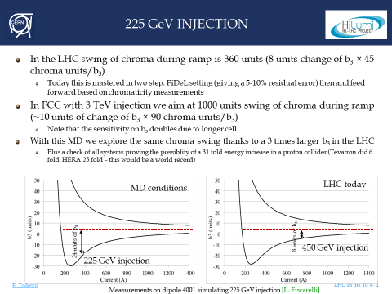
ENERGY SWING
An MD proposed in 2018 to inject in the LHC at 225 GeV

Slide 5
APERTURE
Aperture of the FCC-hh magnets is 50 mm
  Reducing the injection energy by a factor 3 gives a 60% larger beam
  Probably (to be confirmed) 50 mm is still perfectly adequate for an injection at 1.3 TeV
  Aperture of LHC (56 mm) is fine for 0.45 TeV injection, so there is a wide margin
On the other hand the large margin that we have today in aperture could be used for
  Getting rid of all the issues related to high order nonlinearities
  Use a much longer cell to increase the filling factor and reduce quadrupole number and strength

Slide 6
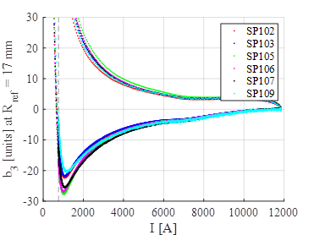
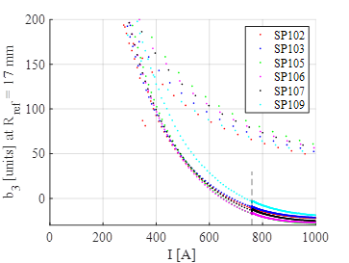
B3 AND CHROMATICITY
The main issue is the fact that with a Nb3Sn magnet, not having filaments so small (6-7 mm) as Nb-Ti, we will inject well below the penetration field
  Injection current with 3.3 TeV: 800 A
  Injection current with 1.3 TeV: 300 A
  Issue is not only the swing during ramp, but also reproducibility
b₃ swing for the 11 T short models (S. Izquierdo Bermudez)
1.3 TeV
3.3 TeV

Slide 7
B3 AND CHROMATICITY
A study dedicated to this problem (1.3/3.3 TeV injections, and issues related to b3 and chromaticity swing), using the designs considered for FCC-hh was presented in 2018, see EDMS 2036614 (S. Izquierdo Bermudez)
  Not to be presented here, but may be by Susana in one of the next meetings
Another way to work on the issue of chromaticity swing is to reduce the sensitivity (how much 1 unit of by gives as chromaticity) acting on the lattice

Slide 8
THANKS
In conclusion, we do not have elements today to prove that a 1.3 TeV injection is viable
  Some bottlenecks should be addressed
On the top of this, with the recent reduction of FCC size, a revision of the FCC-hh energy is needed
  The 17 T, 100 TeV option that is being presented is not sound
  A branching between a 80 TeV all Nb₃Sn machine at 14+ T, and a 120 TeV, 20+ T machine with Nb₃Sn + HTS would be the most sound proposal

