Slide 1
CLIC G structure Update
Pedro Morales
16/03/2023

Slide 2
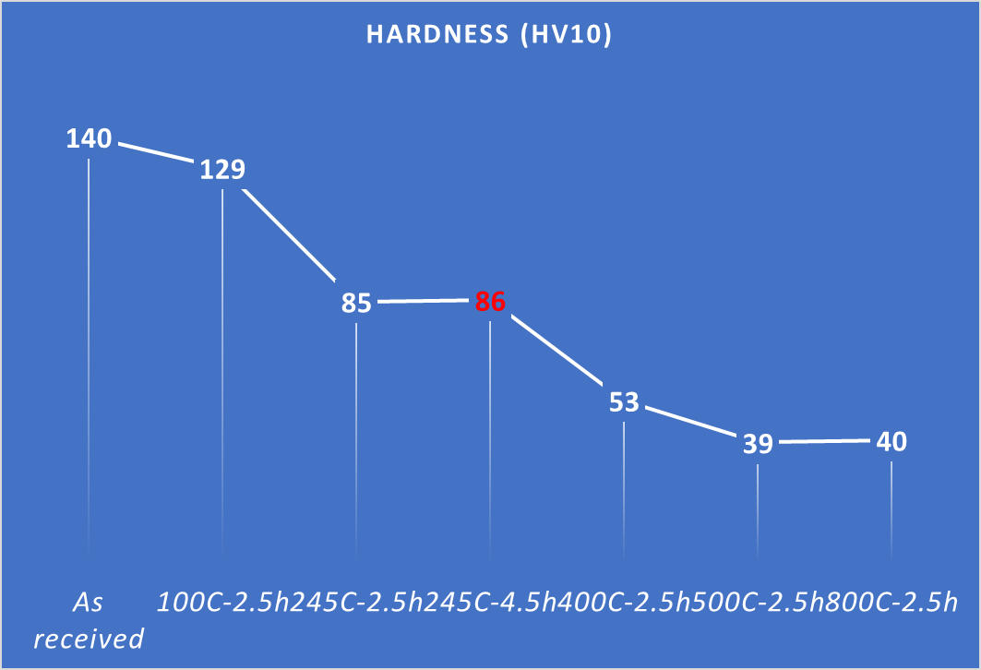
Copper characterization
Our current cycle. 245C – 4,5h from laminated copper.
Next week will start the machining of the next test.
We will test 3 more options.
Exactly same design of the regular cell
Laminated Cu 500C – 2h
3D forged Cu 245C – 4,5h
3D forged Cu 500C – 2h
Thanks Ana Teresa and the team from materials, for the work here

Slide 3
Tooling for the assembly
Column
Graphite
Tuning of the metrology column

Slide 4
Tooling for the assembly
Air bearing system to move it easily.
Weight 58kg
Adapting our air system to this with filters and some extensions

Slide 5
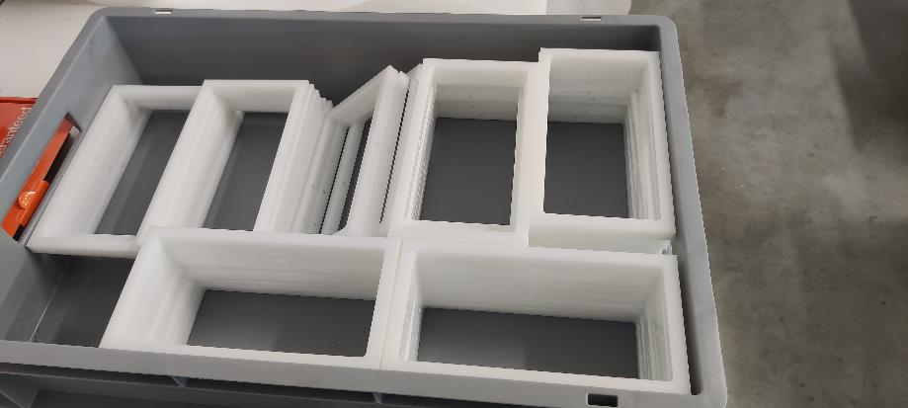
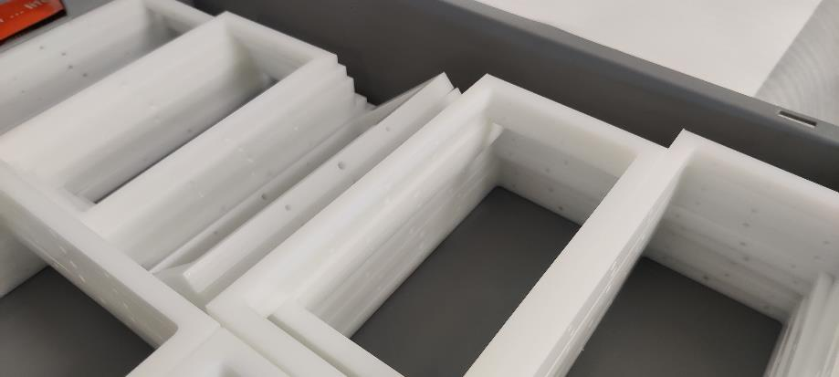
Tooling for the assembly
Compatible with previous frame.
Saving money, resources and time

Slide 6
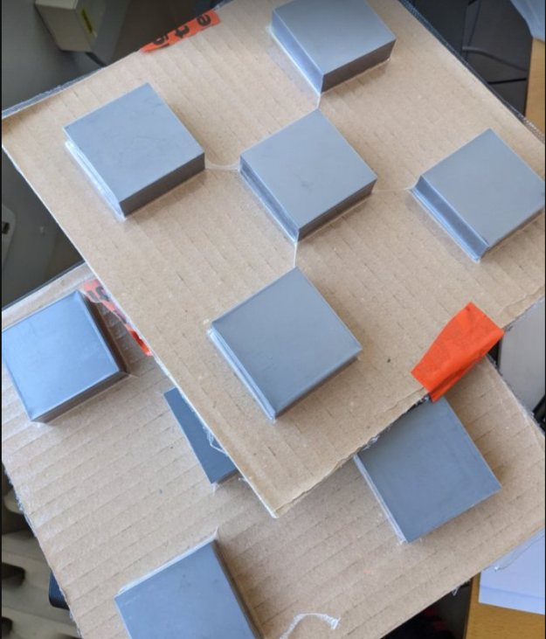
HOM Loads - Measurements

Slide 7
HOM Loads
Symmetric part

Slide 8
HOM Loads
Lower upper plane to hit with a hummer with no issue
Bigger gap to allow a bigger tool

Slide 9
HOM Loads - Alternatives

Slide 10
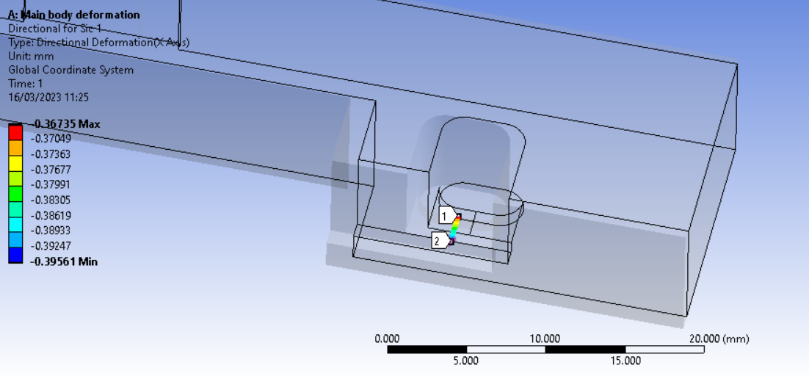
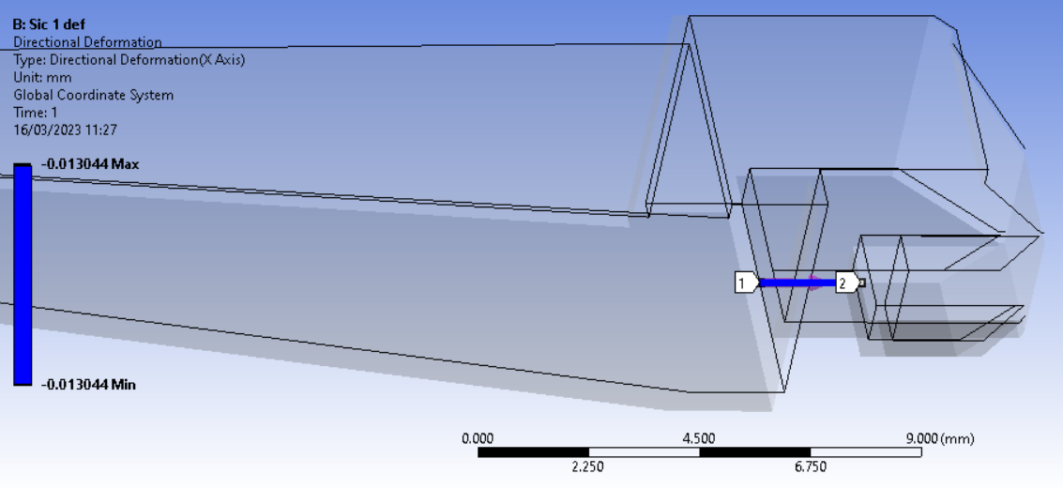
HOM Loads - Alternatives
Def = 0.02826mm
Def = 0.013044mm

Slide 11
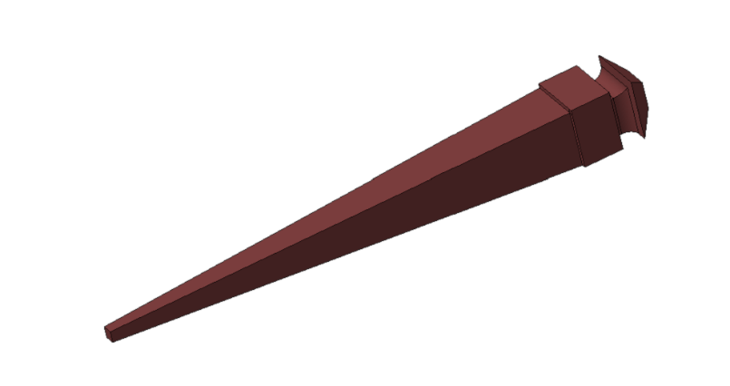
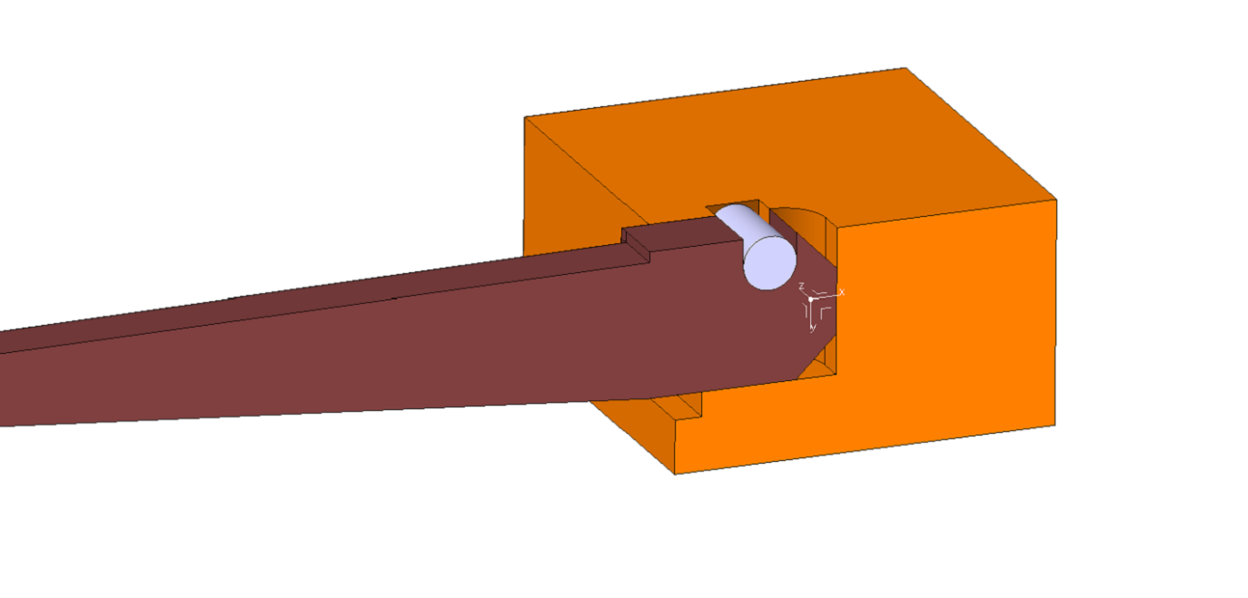
HOM Loads - Alternatives

Slide 12
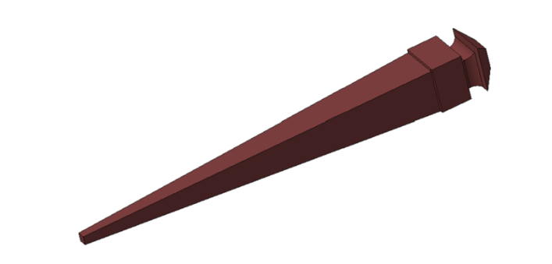
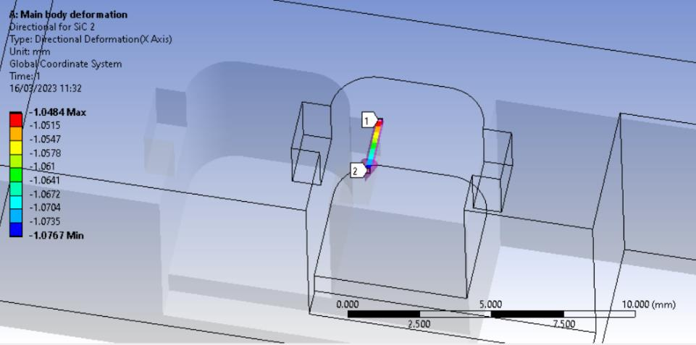
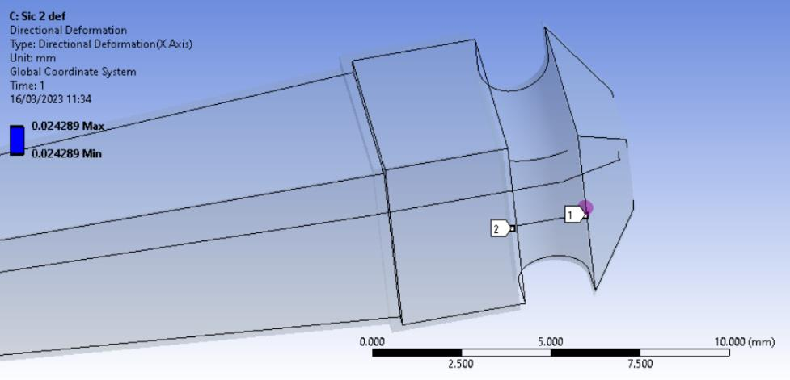
HOM Loads - Alternatives
Def = 0.0283mm
Def = 0.024289mm

Slide 13
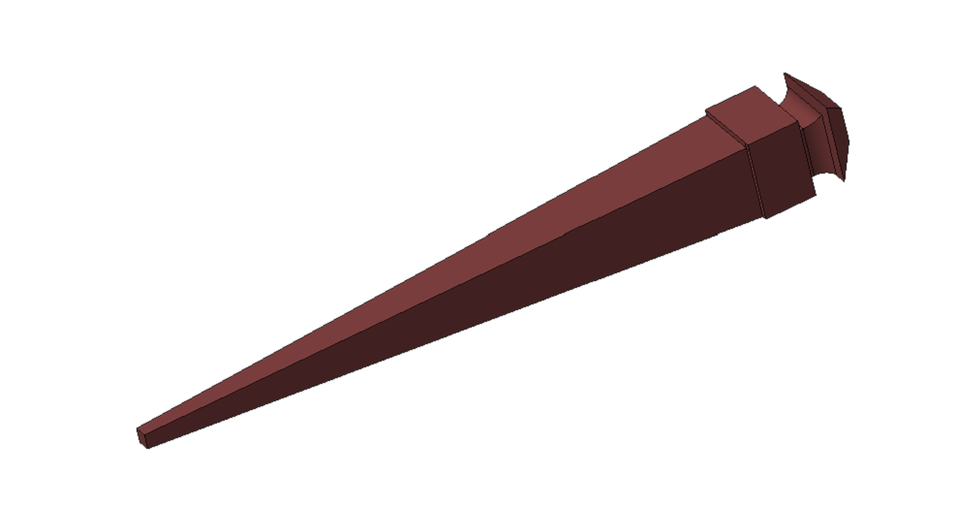
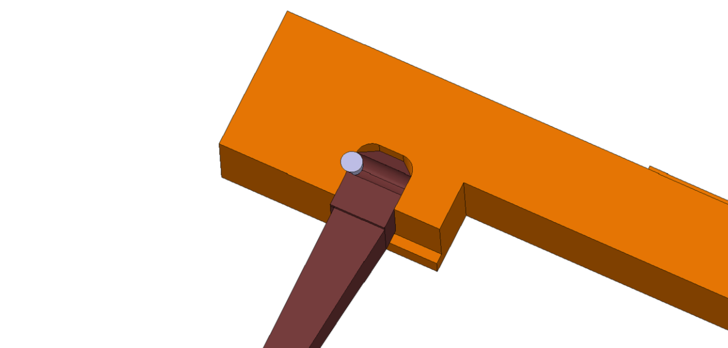
HOM Loads - Alternatives
The pin must be SiC too

Slide 14
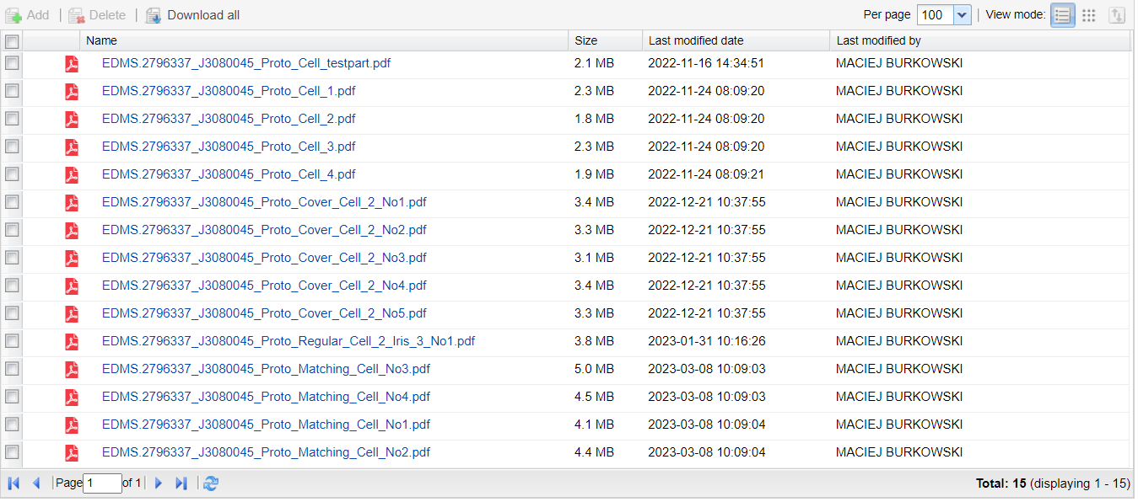
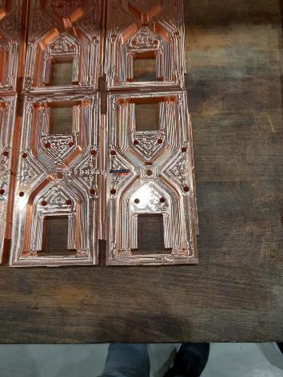
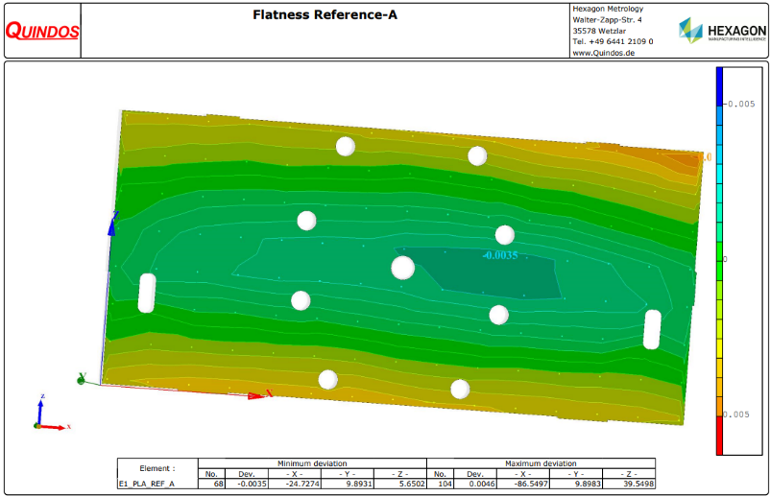
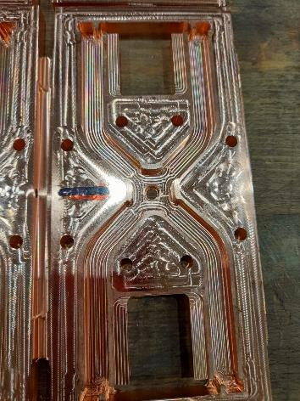
Mock – up

Slide 15
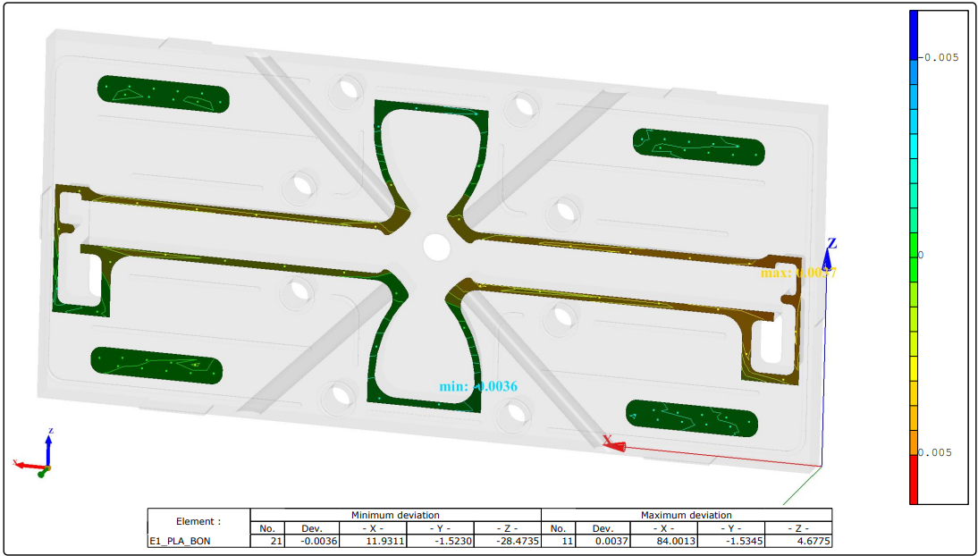
Mock – up
Congrats from LT-Ultra for the performance of the last cells delivered.
They are starting the machining after our confirmation of the good achievement on these cells.
The project is slowly progressing.
6 um Flatness on the bonding surface

