Slide 1
SNS for Muon Collider Proton Driver R&D
Presented at the
Muon Synergies Workshop
Nicholas Evans
Friday, June 23, 2023

Slide 2
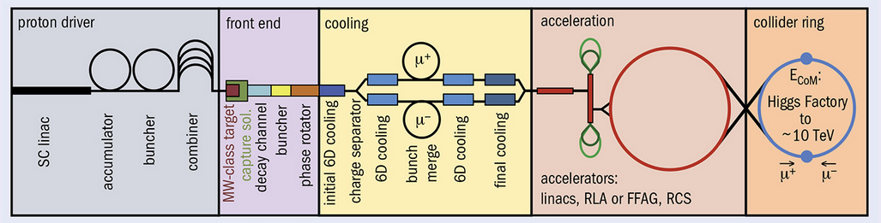
Muon Collider Proton Driver
First stage of MC is a high power, short pulse proton beam for secondary production – not the biggest challenge, but still a challenge!
Proposals call for a high-energy linac + rings in some combination
SNS resembles some conceptions of a proton driver – SC linac + Accumulator
We can study beam physics at SNS near MAP requirements for a proton driver with accumulator/buncher combined addressing most of the identified technical challenges in MAP and March 2023 IMCC report.

Slide 3
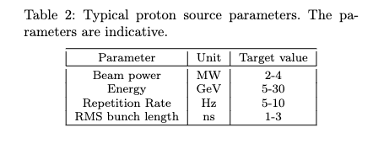
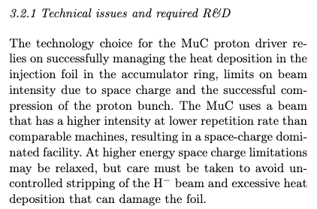
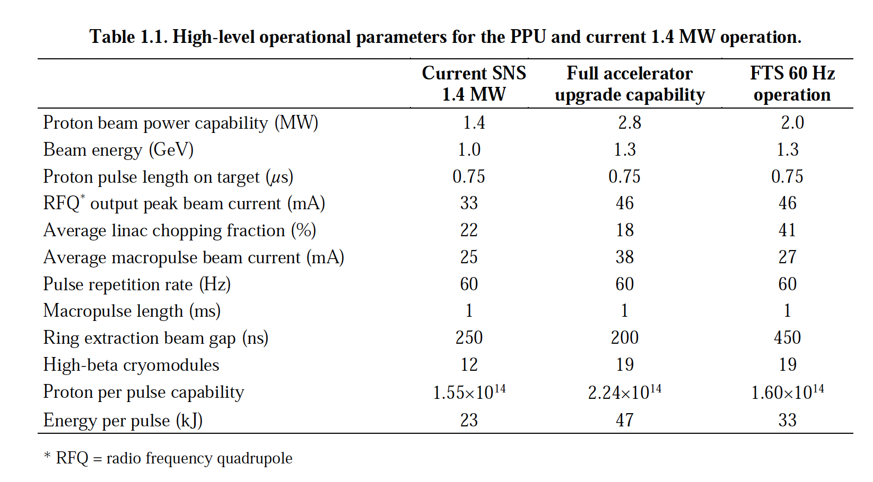
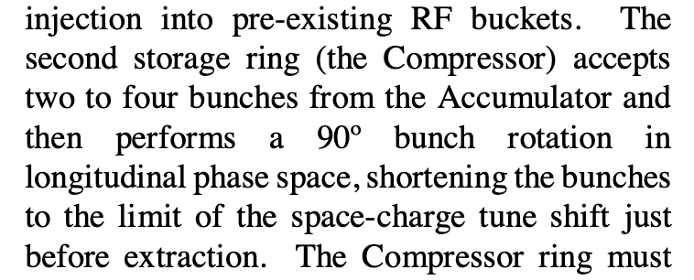
Proton Driver Challenges: Where SNS fits in
Accettura et al. arXiv:2303.08533v1
We’re actively addressing these issues.
Accettura et al. arXiv:2303.08533v1
Post-upgrade SNS charge per pulse satisfies a 10 Hz, 8 GeV requirements (albeit at lower energy)
Because of scaling, space charge regime is probably reachable.
Boscolo et al. Rev. of Acc. Sci. and Tech, vol. 10, 2019
Also looking into “the limit” of space charge for accumulators. Ways around “the limit”?
SNS Proton Power Upgrade Final Design Report

Slide 4
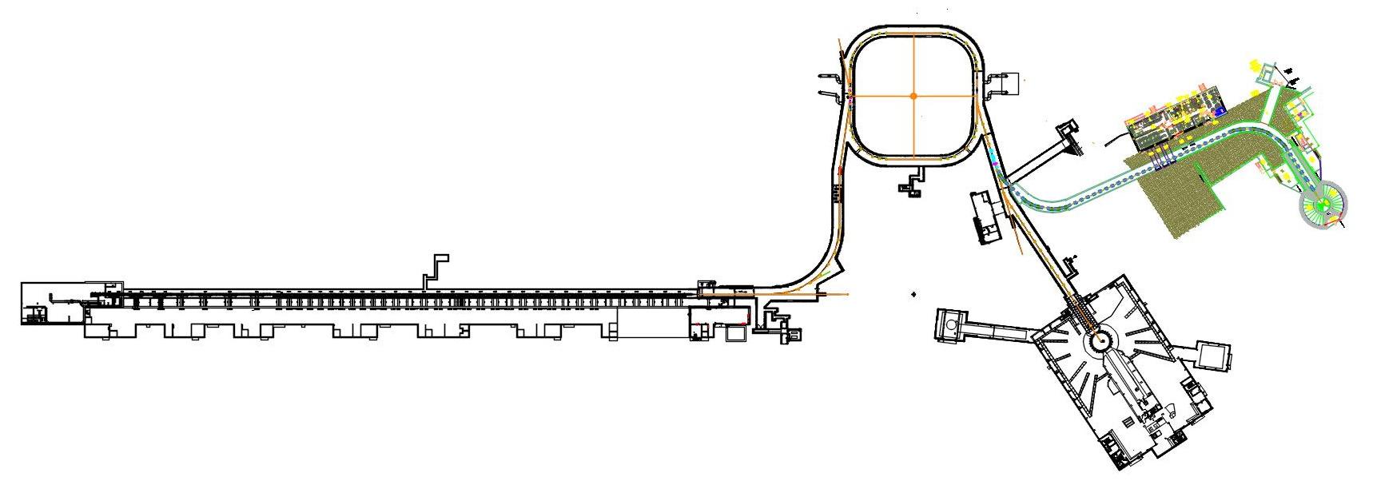
SNS – Today
1.0 GeV H- linac – 1 ms long pulse
1.0 GeV accumulator ring – no acceleration
700 ns long pulse at extraction
h=1, 2 RF for extraction gap, bunch flattening
1.55E14 ppp (24 uC)
60 Hz operation – 1.4 MW average power

Slide 5
SNS – Proton Power Upgrade (PPU) (2024)
1.3 GeV H- linac – 1 ms long pulse
1.3 GeV accumulator ring – no acceleration
660 ns long pulse at extraction
h=1, 2 RF for extraction gap, bunch flattening
2.25E14 ppp (36 uC)
60 Hz operation – 2.8 MW capable
Operation limited to 2.0 MW by target – studies possible at full charge
800 kW of idle power for a decade – what should we do with it?
???

Slide 6
SNS – Second Target Station (mid-2030’s)
Accelerator is identical to PPU with additional 700 kW target station
Accelerator operates at 60 Hz, 2.7 MW
  700 kW to STS at 15 Hz
  2 MW to FTS at 60 Hz ¾ duty cycle
700 kW @ 15 Hz
2 MW @ 60 Hz and ¾ duty
= 45 pulses/sec

Slide 7
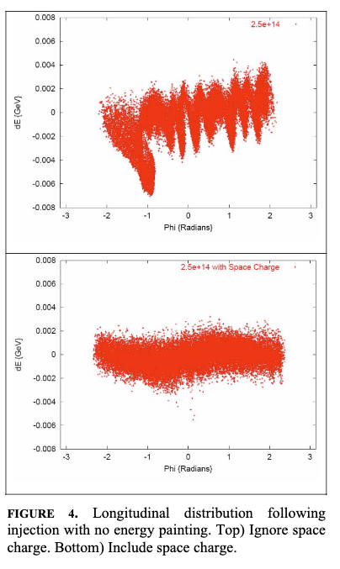
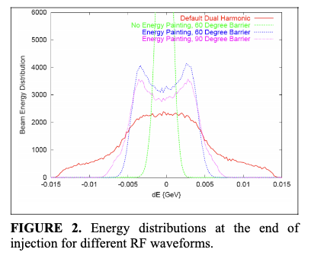
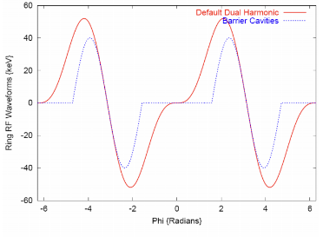
Bunch Compression at SNS – Proposal
High bandwidth ring RF allows control of bunch structure – SNS does NOT currently have a barrier RF system
Explored early on to reduce peak intensity in the ring to combat instabilities, but there is potential for bunch compression
SNS linac energy spread is not matched to much larger acceptance of ring offering opportunity for large bunch compression putting us in the longitudinal space charge regime of MCPD
Could support simulation and
experimental program with
funding
Holmes et al. HB2006 THAW03
Difference between red and green is essentially an indication of max bunch compression we could get.
Barrier cavity waveforms (blue) used for simulations
vs. SNS design waveforms (red) currently available

Slide 8
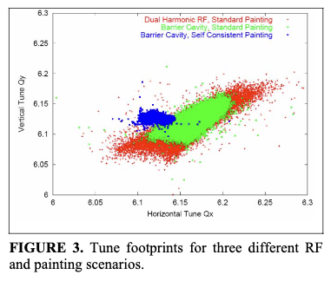
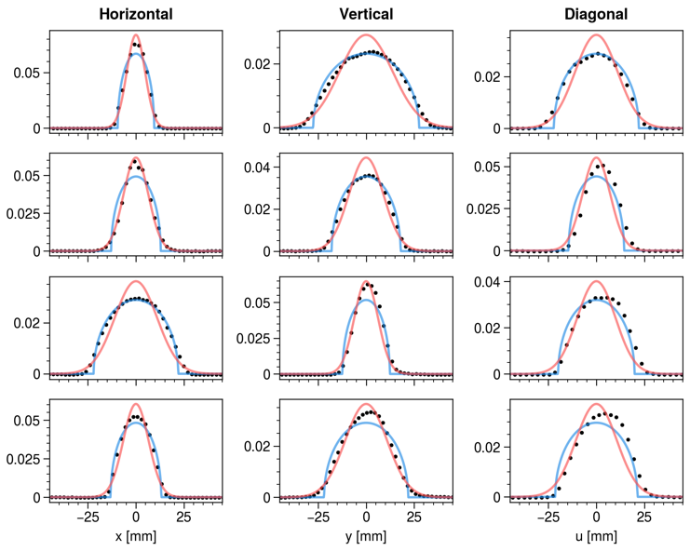
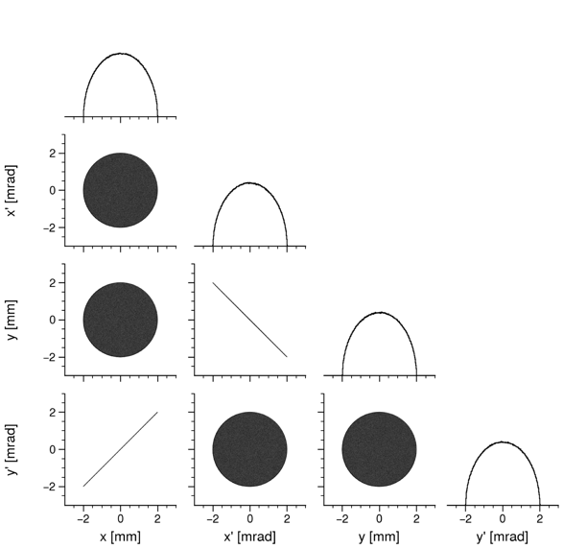
Self-Consistent Beams – Current Experimental Program
Actively working to paint self-consistent Danilov distribution (Danilov et al. PRSTAB 6, 094202) in SNS ring – reduce space charge tune shift, spread – overcome space charge limit?
Next step is to explore space charge dynamics – funding uncertain
Also has benefits for a collider, but not sure how to apply to muons (see. Burov, PRSTAB 16, 061002)
Holmes et al. HB2006 THAW03
Data
Gaussian Fit
Elliptical Fit
x-y’ Correlations paintable with flexible SNS kicker system allow injection of uniform density bunches.
Simulation showing reduced tune footprint for 2.5E14 self-consistent bunch in SNS ring
Uniform density manifests as elliptical profiles in wirescanners.

Slide 9
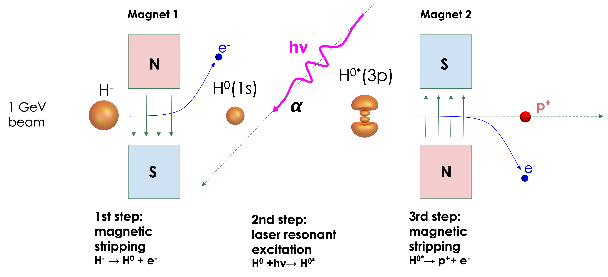
Laser Assisted Charge Exchange – Current Experimental Program
For multi-MW injection with material interaction is problematic interaction with photons is the obvious alternative
SNS is the ONLY H- linac capable of testing LACE operationally
With foils, injection area
>1 rem/h @ 30 cm 3-5 hrs
after operation

Slide 10
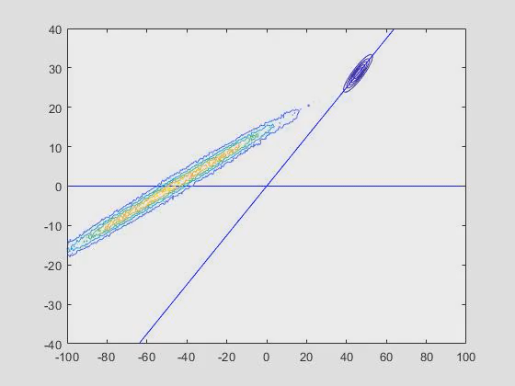
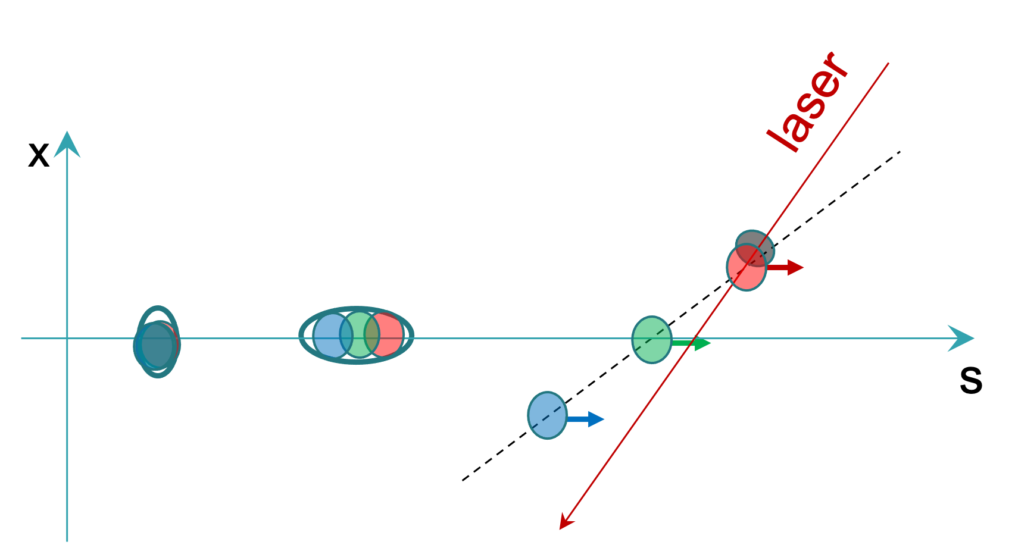
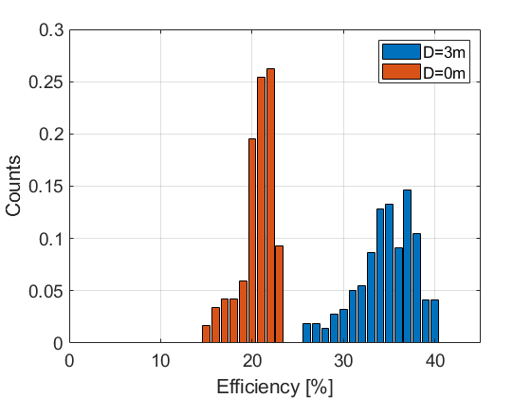
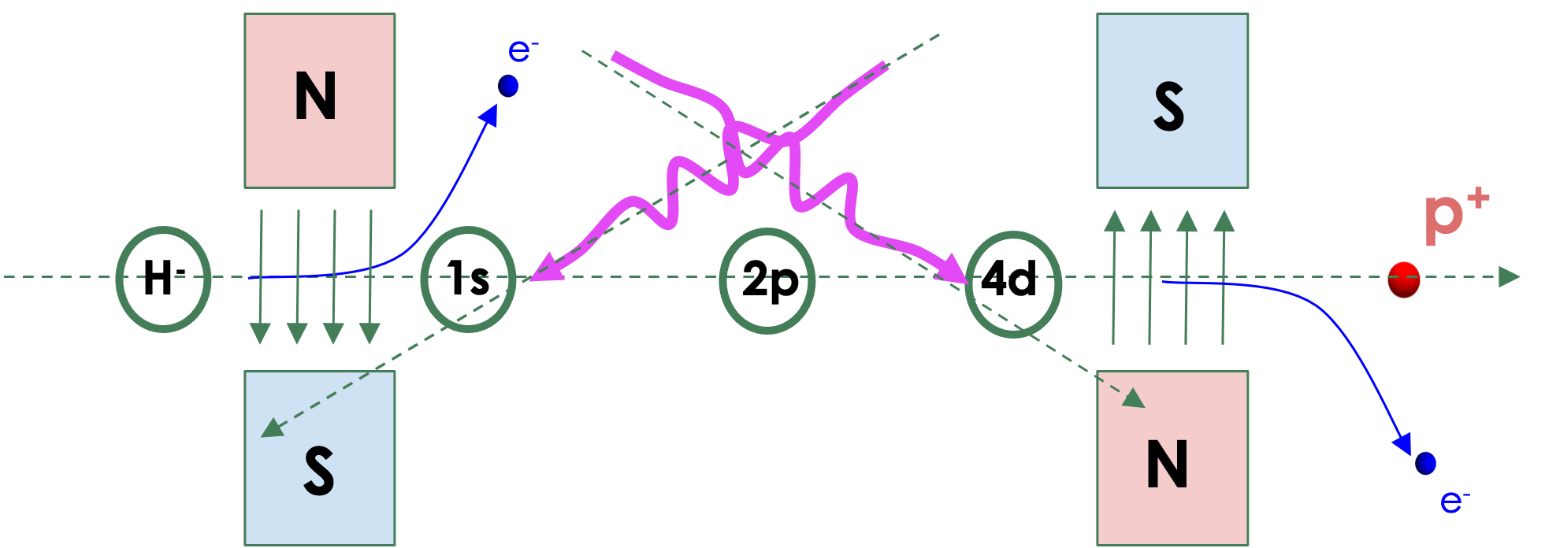
The laser power challenge for LACE has been SOLVED
2006
Proof of principle
2016
10us Experiment
2018
Sequential Resonance Excitation scheme proposed
2020
Experimental Vessel Modified for Sequential Resonance
2023
Demonstration of laser crab crossing technique
2022
Experimental Demonstration of Sequential Resonance
2023 Development of new Chamber, Design of injection demonstration system start
6ns
10us
1 ms capable
1 ms optimization
A slew of innovations to maximize utility of available laser power puts an operational system within reach
~1-2 kW average power, 1MW peak power

Slide 11
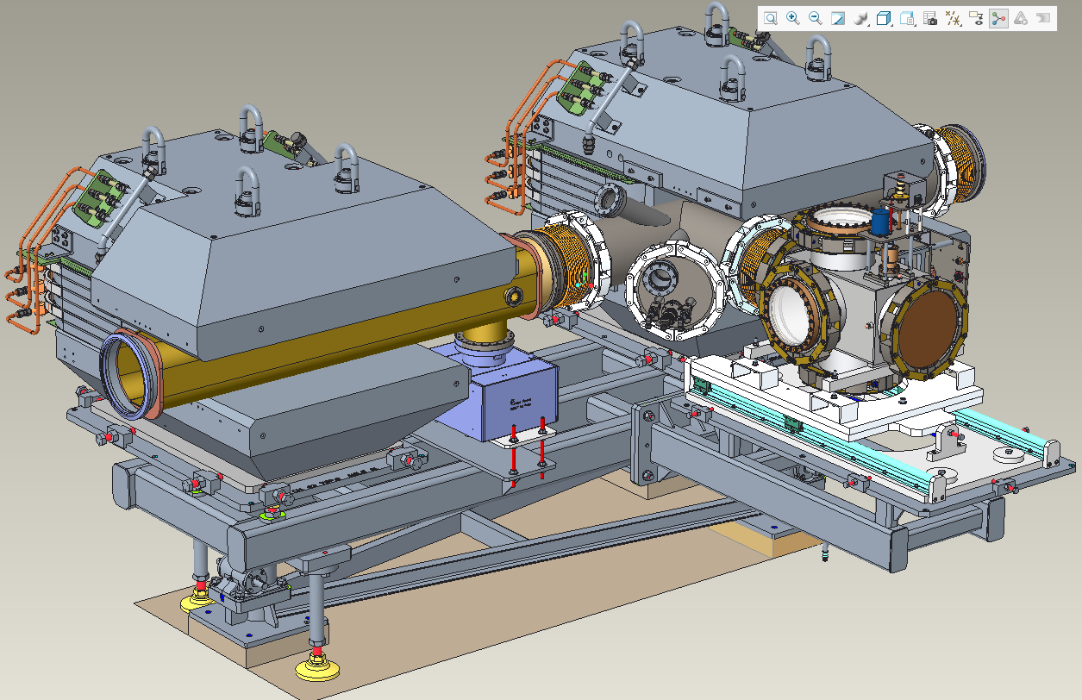
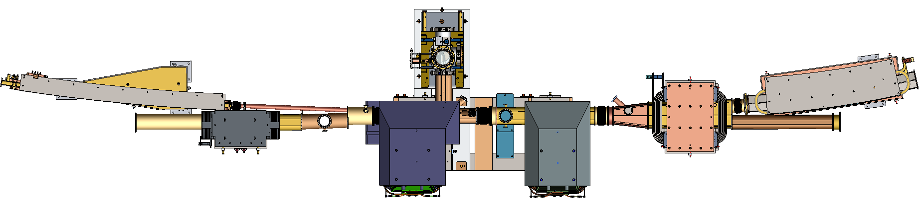
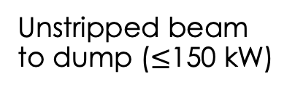
Toward Operational LACE - Proposal
Ring Injection
Working on conceptual design of ring injection demo system in SNS – real ring injection, not stripping studies
SNS is the only option for testing operational LACE
Plan is to utilize long shutdown in 2028, but funding source is not secure!
Existing LACE
experiment station
Unstripped beam to dump ($≤$150 kW)
From linac
Post-PPU injection region is tight – engineering will be a challenge
Recirculating ring beam
Recirculating ring beam
~ 1m

Slide 12
Summary
SNS resembles some conceptions of a Muon Collider Proton Driver, particularly in charge per pulse
Space charge limit for bunch compression is an open question, experimentally accessible at SNS
Currently exploring techniques to push space charge limit that could benefit MCPD
SNS is the only linac capable of testing operational laser assisted charge exchange injection – in active development, looking for funding
Soliciting ideas for 1.5-2.25e14 bunch at 1.3 GeV, 15 Hz
SNS ready to contribute to Muon Collider R&D

Slide 13
Extra Slides

Slide 14
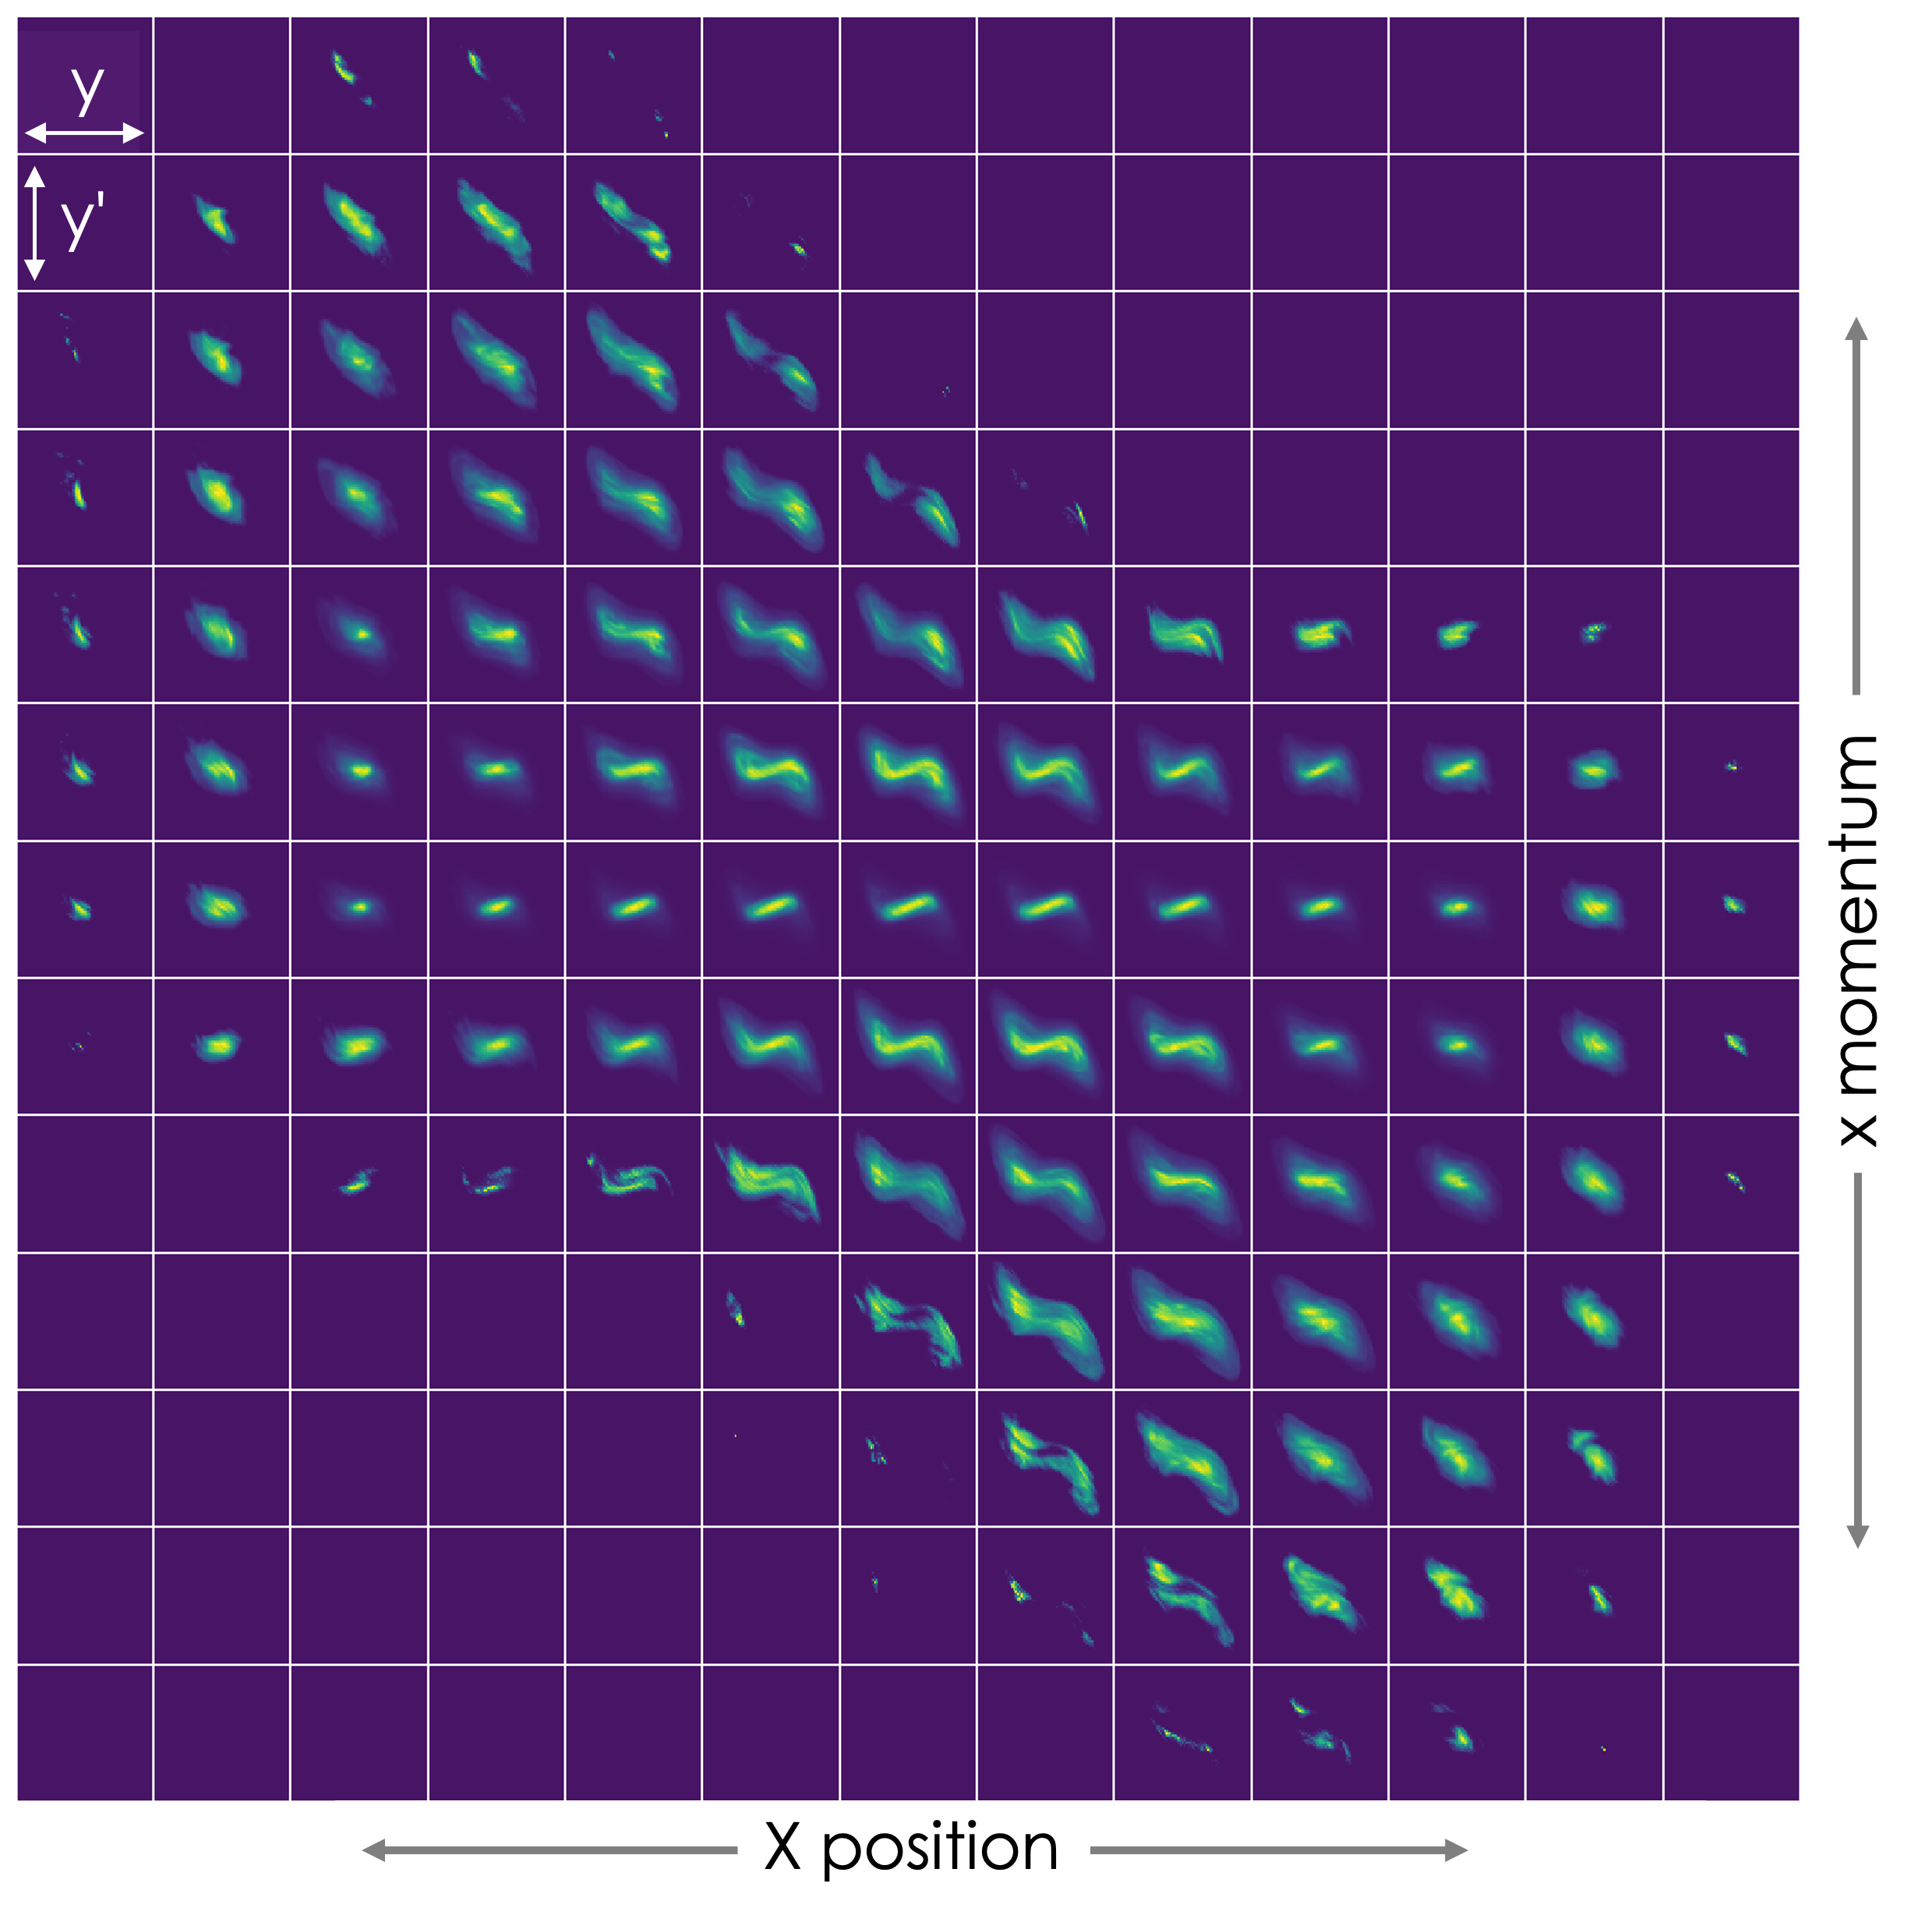
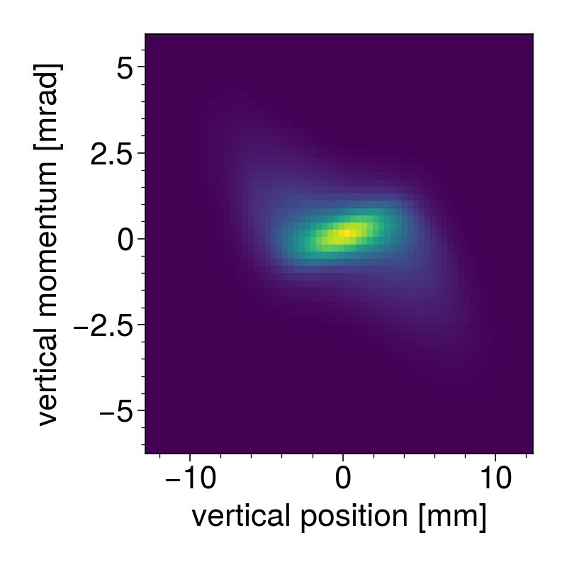
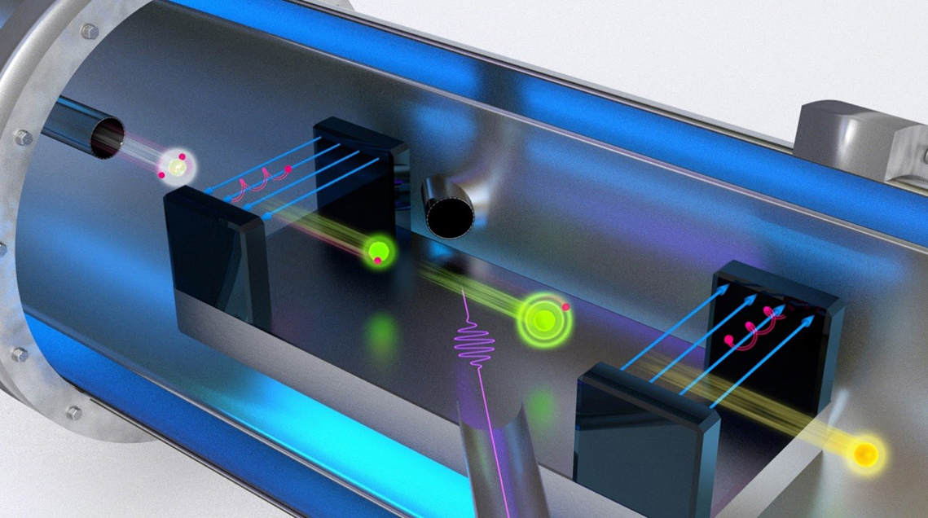
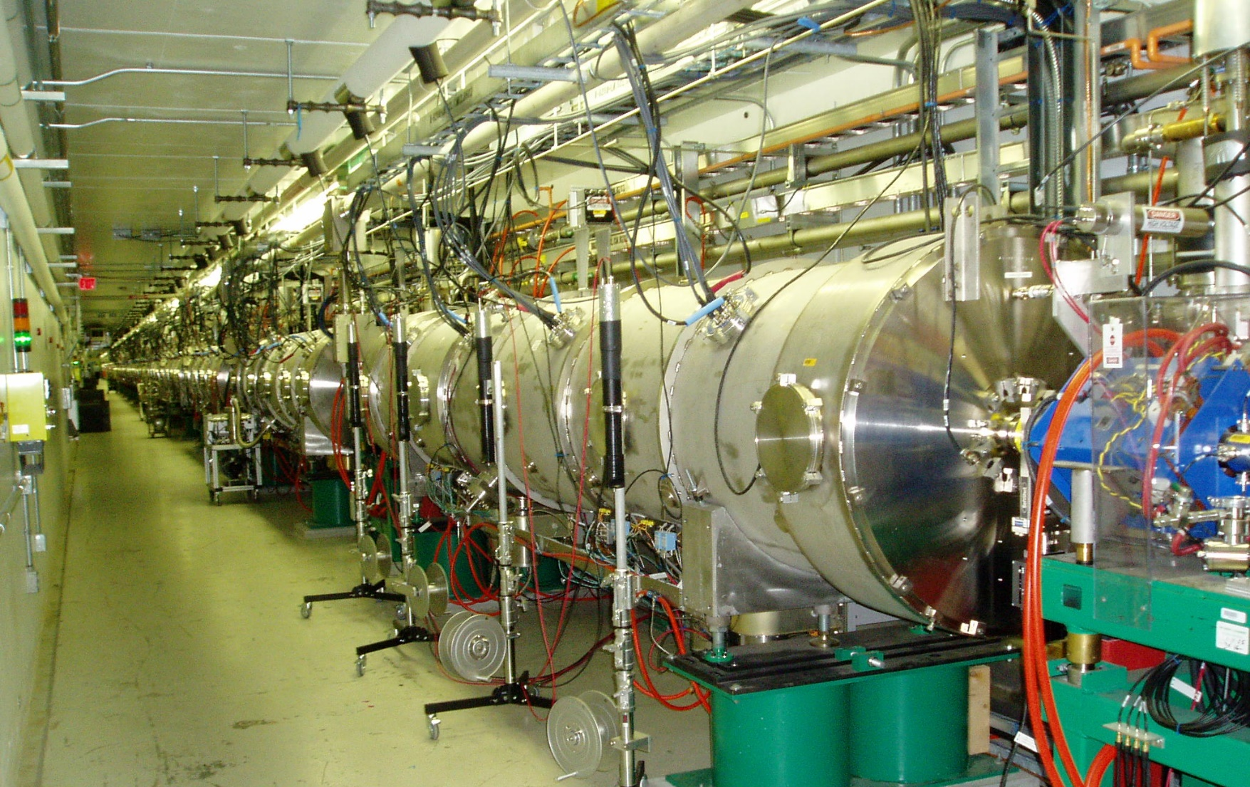
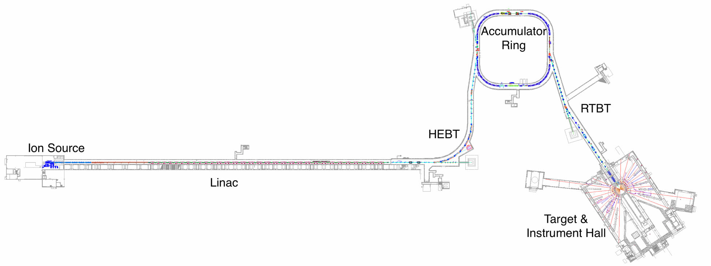
Spallation Neutron Source – High Power Beam, High Impact R&D
1.0 GeV (1.3 GeV after upgrade) super conducting H- linac
1.4 MW (2.8 MW in 2024) average power
1.55e14 ppp (2.24e14 after upgrade)
Capable of 4D transverse phase space painting for distribution tailoring
Active laser assisted charge exchange injection R&D program
Active self-consistent beam program to push limits of space charge in high intensity machines
Beam Test Facility (BTF) - full 6D phase
space, and high-dynamics range measurements
Direct 4D phase space measurement at BTF for understanding the origin of beam loss
Laser assisted Charge Exchange
Experiments at full energy – a path to replace foil-based injection
New cryomodules installed as
part of 2.8 MW upgrade

Slide 15
25D50 Pulsed Dipole timing
The pulsed magnets are driven at maximum rate of 15 Hz to extract every fourth proton bunch into the second target beamline
~660 ns
33.3 ms
FTS
STS
FTS
Pulsed dipole fields must be at zero during proton bunches going to first target Therefore, a maximum time window of 33 ms is available for the pulse to rise, stabilize, then fall

