Slide 1
nuSTORM and the Muon Collider

Slide 2
CERN
Horn and bubble chamber
First neutrino beam
IHEP
SKAT, JINR
CERN
Gargamelle, Aachen/Padova, CDHS,
CHARM, BEBC, CCFR, NOMAD, CHORUS
FNAL
MINOS, MINOS+, NOvA
Global neutrino
progamme
Hyper-K
LBNF/DUNE
CERN Neutrino Platform
CERN
OPERA, ICARUS
BNL
first neutrino
“beam”
BNL/FNAL
CITF, HPWF, 7’ BC, 15’ BC, E605,
E613, E734, E776, NuTEV
KEK/J-PARC
K2K, T2K
CERN
Horn #2 & Gargamelle
1950
1960
1970
1980
1990
2000
2010
2020
2030
ν_{μ}
discovery
Development of
E/w SM, QPM, QCD
Development of
Standard Neutrino
Model
ν_{e}/ν_{μ}
universality
Neutral
Current
discovery
Discovery of
CP-invariance violation?
Innovation in detectors to provide:
— High-precision
— Large data sets
— Control of systematics
Innovation in accelerators to go beyond

Slide 3
Neutrinos from stored muons
Scientific objectives:
  %-level ( ν_{e}N ) cross sections
    Multi differential / E_{ν} scan
  BSM searches
    E.g. steriles beyond FNAL SBN
  Muon collider demonstrator
Precise neutrino flux:
  Normalisation: < 1%
  Energy (and flavour) precise
π ⇢ μ injection pass:
  “Flash” of muon neutrinos
(—)

Slide 4
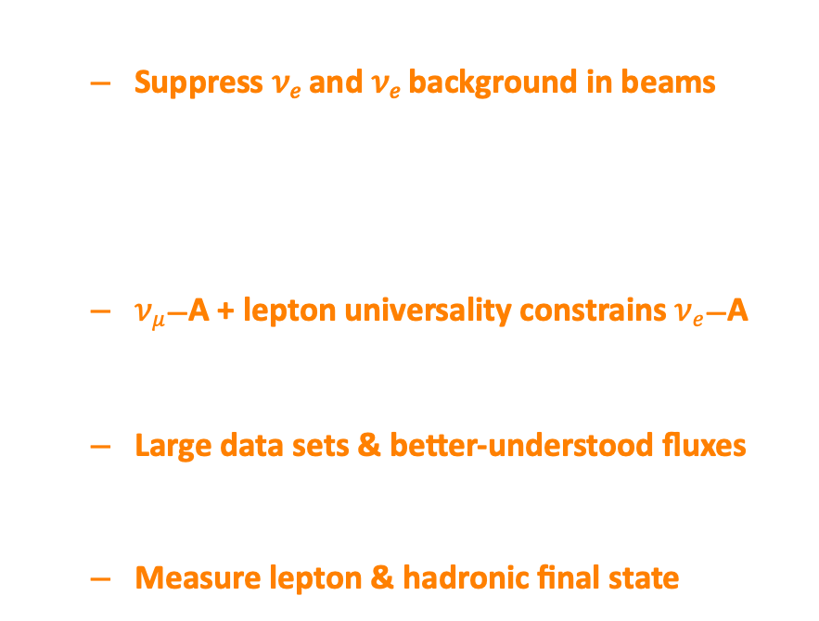
𝝂_{𝒆}/𝝂̅_{𝒆} interactions for oscillations
𝛿_{CP} requires 𝜈_{𝑒} and 𝜈_{𝑒} appearance
  Suppress 𝜈_{𝑒} and 𝜈_{𝑒} background in beams
Need $νe$/$\overline{ν}e$ interaction data
At 1st order precision:
  $νμ$—A + lepton universality constrains $νe$—A
𝛿_{CP} requires requires 2nd order precision!
  Large data sets & better-understood fluxes
High-specification detector:
  Measure lepton & hadronic final state

Slide 5
Strategic mid-term goal
2020
Goal: over next ~3 years, prepare for next ESPPU:
Study and document the science case:
  Cross sections, BSM, and MC demonstrator
Prepare “pre-CDR” as input to the Strategy Update
arXiv:2203.07545
ESPPU
202x

Slide 6
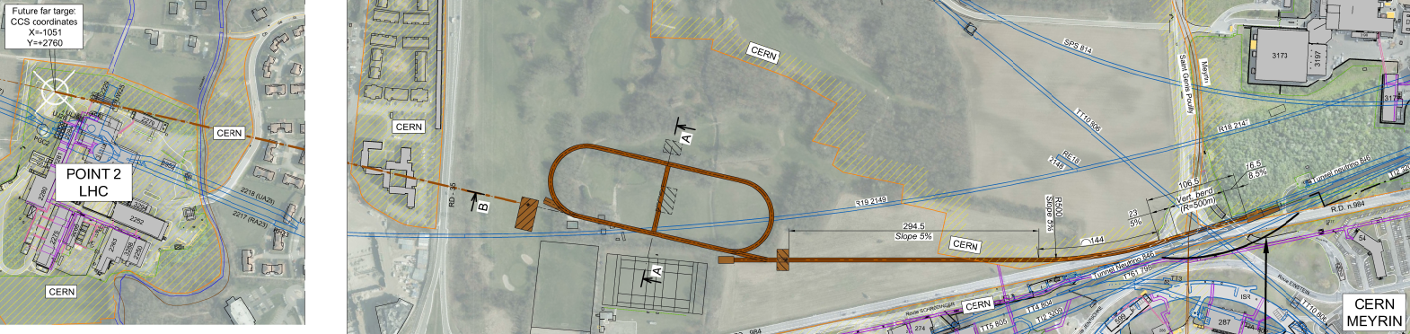
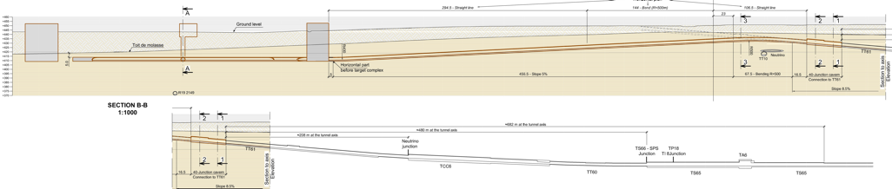
Overview
CERN-PBC-REPORT-2019-003
DOI:10.17181/CERN.FQTB.O8QN
Extraction from SPS through existing tunnel
Siting of storage ring:
  Allows measurements to be made ‘on or off axis’
  Preserves sterile-neutrino search option

Slide 7
nuSTORM for νN scattering @ CERN — parameters
CERN-PBC-REPORT-2019-003
DOI:10.17181/CERN.FQTB.O8QN

Slide 8
Accelerator
CERN-PBC-REPORT-2019-003
DOI:10.17181/CERN.FQTB.O8QN

Slide 9
Ximines et al
Under discussion!
ENUBET
6D cooling
test facility
nuSTORM
Under study

Slide 10
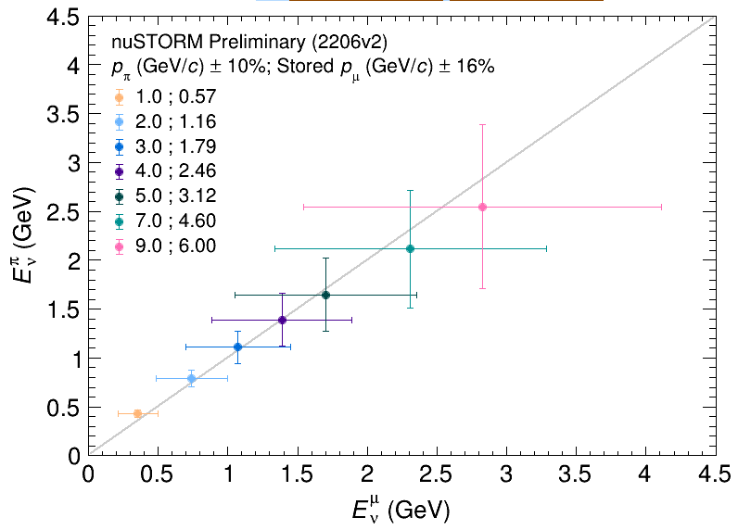
End-to-end simulation for (re)optimisation
P. Kyberd et al
“nuSIM” under development to:
  Simulate facility “from target to detector”:
    Pragmatic approach:
      Fast simulation, parametric approach
      Full tracking using G4 based code; “BDSIM”
T. Alves, M. Pfaff
Neutrino energy scan:
  “Pion flash” in first pass
  Subsequently neutrinos from muon decay
    Spectrum determined by accelerator tune
Mean
RMS

Slide 13
nuSTORM specification: energy range
Guidance from:
  Models:
    Region of overlap
    0.5—8 GeV
  DUNE/Hyper-K far detector
  spectra:
    0.3—6 GeV
Cross sections depend on:
  Q² and W:
    Assume (or specify) a detector
    capable of:
      Measuring exclusive final states
      Reconstructing Q² and W
    → E_{μ} < 6 GeV
So, stored muon tunable in energy range:
DUNE
Hyper-K
1 < E_{μ} < 6 GeV

Slide 14
nuSTORM@CERN: flux estimation
T. Alves, M. Pfaff
Area normalised
Area normalised
μ
μ
Oscillation-relevant energy regime
  Hyper-K: 0.6 GeV
  DUNE. : 2.4 GeV
Set by stored-muon momentum
Unique opportunity:
  𝐸_{𝜈}-scan measurements
Accelerator "tune" gives fine control
  E.g. optimise flux shape (or spread) by adjusting the ring acceptance

Slide 15
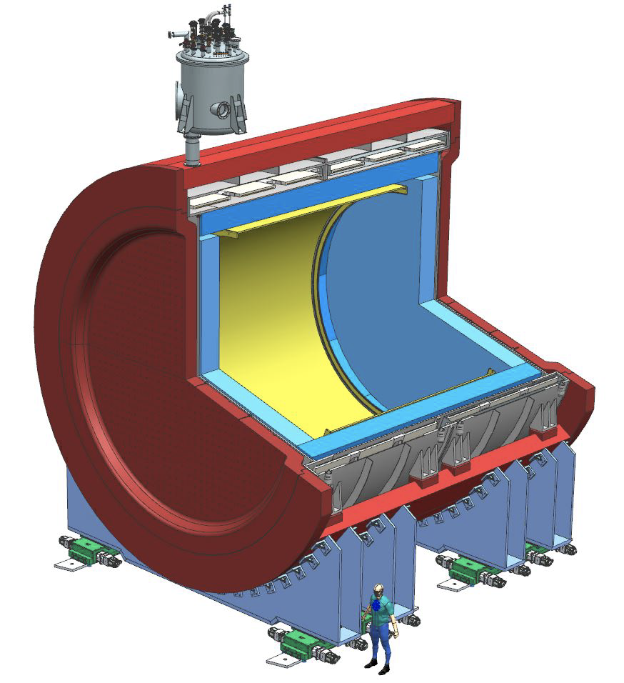
nuSTORM@CERN: working towards a detector concept
DUNE, instruments 5, 31 (2021)
nuSIM ready to allow performance evaluation:
  Require “highly capable” detector:
    Scattered lepton
    Inclusive and exclusive final states
Initial study use DUNE ND-GAr:
  TPC reference design
    10-bar argon-based gas TPC
    Large gas volume
    Surrounded by calorimeter
  4𝝅 acceptance, very low threshold
  B-field provides sign selection
  e/μ id; final state reconstruction

Slide 16
nuSTORM@CERN: 𝑬_{𝝂}-scan measurements
X. Lu
Quasi-elastic
cross section
function of δα_{T}
Transverse boosting angle
Lu et al. Phys. Rev. C 94, 015503 (2016)
Low δα_{T}: impact of nuclear effects low:
  “Nuclear model calibration”
High δα_{T}: energy-dependent nuclear effects:
  Constrain nuclear models of, e.g. 2p2h, pion absorption, …

Slide 17
nuSTORM@CERN: 𝑬_{𝝂}-scan measurements
T. Alves
M. Pfaff
X. Lu
Quasi-elastic
Differential
cross section
vs δα_{T}
Cross-section estimation using (preliminary) nuSTORM flux
Energy evolution “tunable” to optimise sensitivity of measurement
Start of study of energy dependence of various exclusive measurements:
  To provide precise constraints on nuclear effects and their evolution

Slide 18

https://conference.ippp.dur.ac.uk/event/1169/

Slide 21
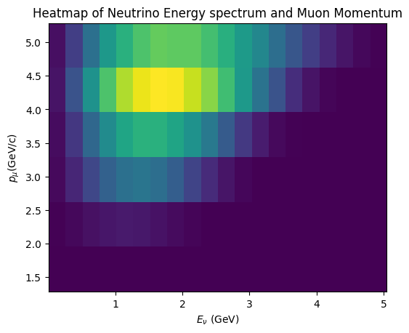
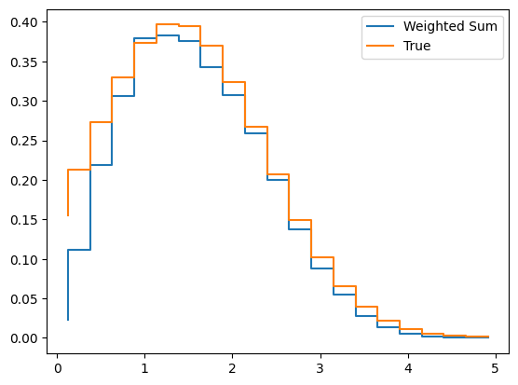
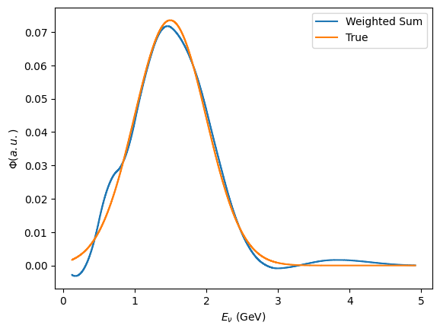
nuSTORM-PRISM
R. Kamath
Just starting, so indicative study:
  Take 6 data sets that are available
Target function
Target function
Weighted sum
60 stored muon energies:
Created using (spline) interpolation for now
Weighted sum

Slide 22

Case study: strangeness production
C. Thorpe
Improve nuclear, final-state interaction models:
  Presently, data is “sparce”
Use nuSTORM flux to look at event rates:
  NuWro used to simulate scattering
  Assume energy threshold of 0.3 GeV, typical of LAr
Rate
Λ
$$K^{±}$$

Slide 23
BSM opportunities (“beyond steriles”)
Y.F. Perez-Gonzalez

Slide 24
https://conference.ippp.dur.ac.uk/event/1169/
✓
Review landscape were nuSTORM will contribute
Seek to identify key topics and directions
Plot a course towards follow-up workshop:
  In around 9 to 12 months
  Which quantifies cross section, BSM, … opportunities
Ideally:
  “Proceedings” of follow-up workshop:
    Document science case for nuSTORM in peer-reviewed publication
    Provide evidence to support submission to ESPPU27
✓
✓

Slide 26
Recruitment:
P. Jurj (ex MICE)
Hope in post
“next week”

Slide 27
P. Jurj,
R. Kamath
Demonstrator
development

Slide 28
P. Jurj,
R. Kamath
Demonstrator
development

Slide 31
Conclusions
nuSTORM will be a unique facility:
  %-level electron and muon neutrino cross-sections
    Neutrino energy scan; spectrum at each point precisely known
  Exquisitely sensitive BSM & sterile neutrino searches
  Serve as muon accelerator test bed
Feasibility of executing nuSTORM at CERN:
  Established through Physics Beyond Colliders study
nuSTORM: a step towards the muon collider:
  Proof-of-principle of high brightness stored muons beams
5-year goal: prepare robust case and “pre-CDR” for nuSTORM

Slide 32
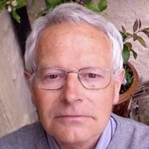
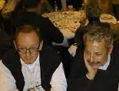


Historical interlude
20th century:
  ‘70s Budker, Skrinskii
  ‘90s Palmer, Tollestrup, Sessler:
    MCC, MCNFC, NFMCC
  ‘99 Autin, Blondel, Ellis
    …
21st century:
  CERN MC/NF study
  BENE, EUROnu
  NFMCC → MAP
  MICE
  P5 (2013) …
Snowmass ‘96

Slide 33
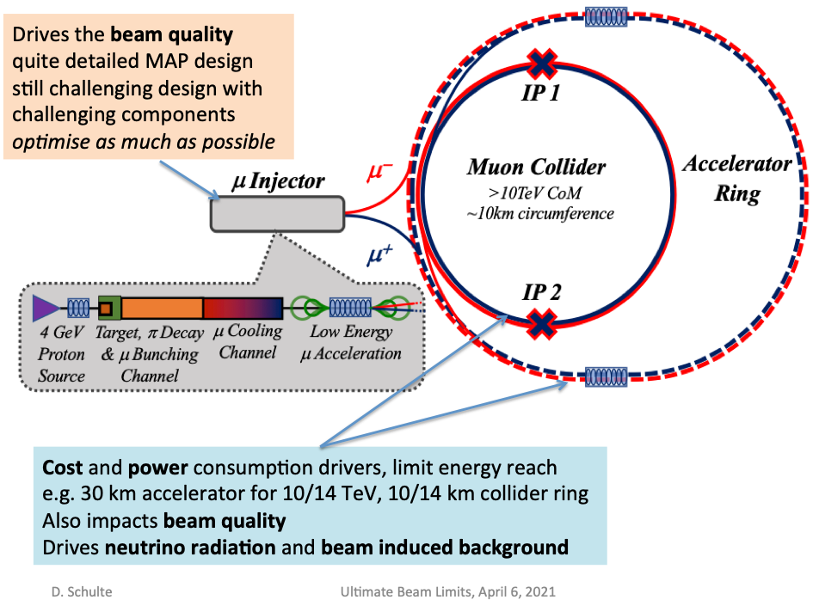
Science case remains fantastic
Technological R&D still ground-breaking
Risks to programme remain too
Demonstrator is critical to the programme:
  6D cooling and world-leading particle physics

Slide 34
Thank you

