Slide 1
Moving forward
Sites, Facilities and Infrastructures
Jingyu Tang (USTC)
IMCC Annual Meeting 2023 – Synergies Workshop
2023.06.22-23, IJCLab, Paris

Slide 2
Sites, Facilities and Infrastructures
Try to bring world-wide existing or planned facilities which share similar technologies with MC, could be candidate sites for MC demonstrator, and provide useful infrastructures for potential MC R&D
High-power proton accelerators, muon sources or beams, neutrino beams, high-power targets, mainly in three continents (Europe, Asia, Nor-Am)

Slide 3
Talks in the session
  Nick Evans
  Nick Evans
Nicholas Evans (ORNL): SNS for Muon Collider Proton Driver R&D
Katsuya Yonehara (Fermilab): US Strategy for Muon Collider Targetry R&D Based on Fermilab Accelerator Complex Evolution Plan
Rhea Stewart (UKRI): Muon Facilities Beyond Particle Physics
Yuan He (IMP): Proton Facilities and Muon Plans in China
Masashi Otani (KEK): Proton and Muon Applications in Japan
Nikolaos Charitonidis (CERN): Protons in Europe : Possible synergies with the Muon Collider

Slide 4
Highlights - Proton sources in Europe
CERN:
  PS: T08/09/10, n-TOF, ISOLDE
    Possible for MC demonstrator
  SPS: H2/H4/H6/H8, M2, HiRadMat
PSI:
  SμS: Muon/pion beamlines
  SINQ: neutron beamlines
GSI:
  SIS18 Synchrotron & HEST beam lines
ISIS:
  Muon beamlines, neutron beamlines
Future
  CERN HI ECN3, ESS (&ESSnuSB), ENUBET & NuSTORM

Slide 6
Highlights - Proton sources in China
CSNS:
  Proton beam: 1.6 GeV/140 kW, 25 Hz
  CSNS-II (2023-2028): 500 kW
  MELODY Muon beam
HIAF:
  High intensity heavy-ion beam and proton beam, 34 Tm
  Muon beam: muon applications, muon ionization cooling
CiADS:
  CW linac: 500 MeV/2.5 MW, flexible time structure
  Muon beam: muon applications

Slide 7
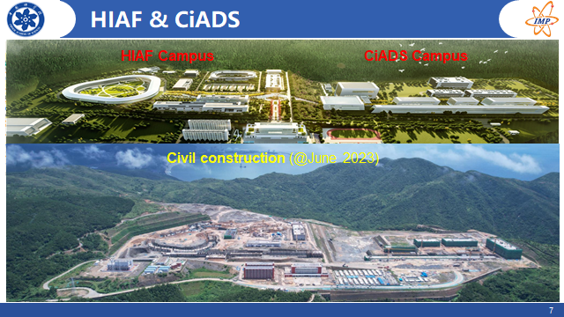
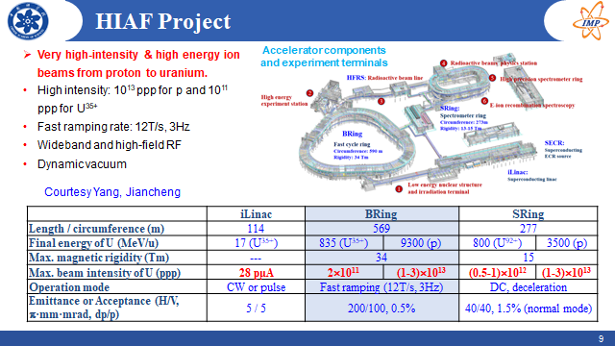

Slide 8
Highlights - Proton sources in Japan
J-PARC:
  Current: 400 MeV linac, 3 GeV RCS (1 MW), 30 GeV MR (750 kW)
  Muon beams: MUSE, COMET
KEK-Tsukuba:
  SC-linac based multi-MW proton driver
Unique technologies and scenario:
  μ+ cooling and acceleration (MUSE)
  Capture solenoid for μ-e conversion (@MuSIC, COMET)
  FFAG accelerators (KEK, Kyoto U, Osaka U)

Slide 10
Highlights - Proton source at SNS
SNS accelerator complex
  Current: 1 GeV linac, 1 GeV accumulator ring (1.4 MW)
  Proton Power Upgrade: 1.3 GeV (2.8 MW)
  Idle power: PPU, 0.8 MW to be defined (before 2nd TS, middle 2030)
Techniques
  Bunch compression, RF barrier
  Laser assistant stripping injection

Slide 11
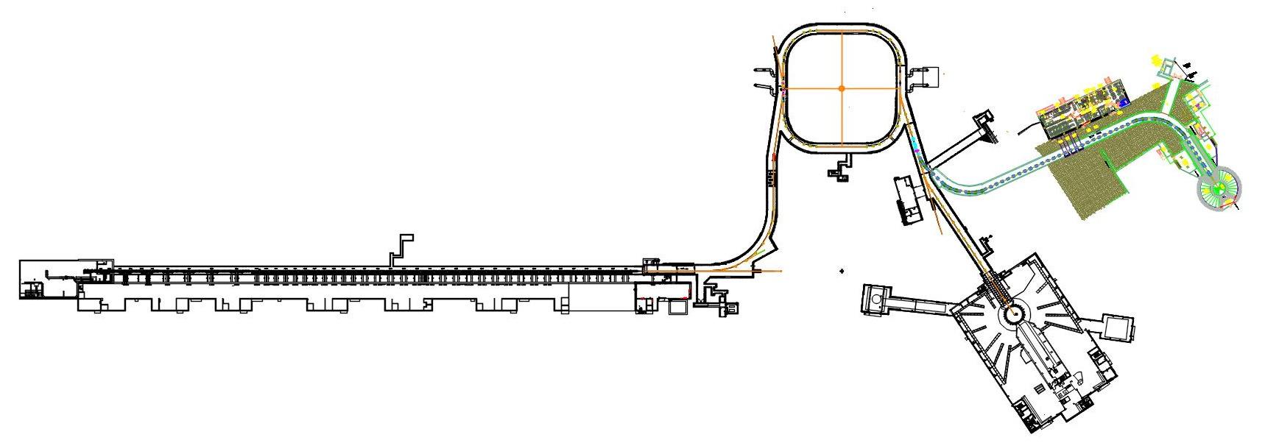
Idle beam power after PPU:
for MC proton driver R&D?
700 kW @ 15 Hz

Slide 12
Highlights – Targetry R&D in US
Fermilab Accelerator Complex Evolution (ACE) + Booster Replacement plan
  ACE: 2+ MW
  Booster replacement options: potential as MC proton driver
Targetry R&D
  Support LBNF/DUNE at 2.4 MW, Mu2e-II at 100 kW
  MuC targetry R&D (GARD)

Slide 13
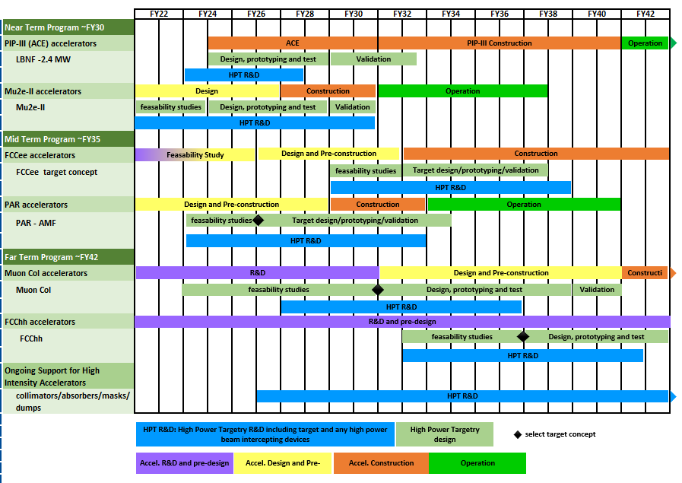
Proposed Roadmap of Targetry R&D

Slide 14
Highlights – Multi-disciplinary App. of Muon Beams
Worldwide muon user facilities
  Existing and planned
Wide fields
  Core: condensed matter with μSR.
  Energy ranges: low energy: (0.5 - 30) keV, surface: ~4MeV, and decay: (15 – 60) MeV
  Muon beam types: Continuous beams and pulsed beams
ISIS muon facility
  Techniques and science
  Future development

Slide 15
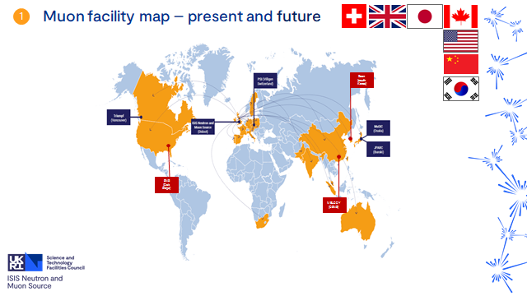
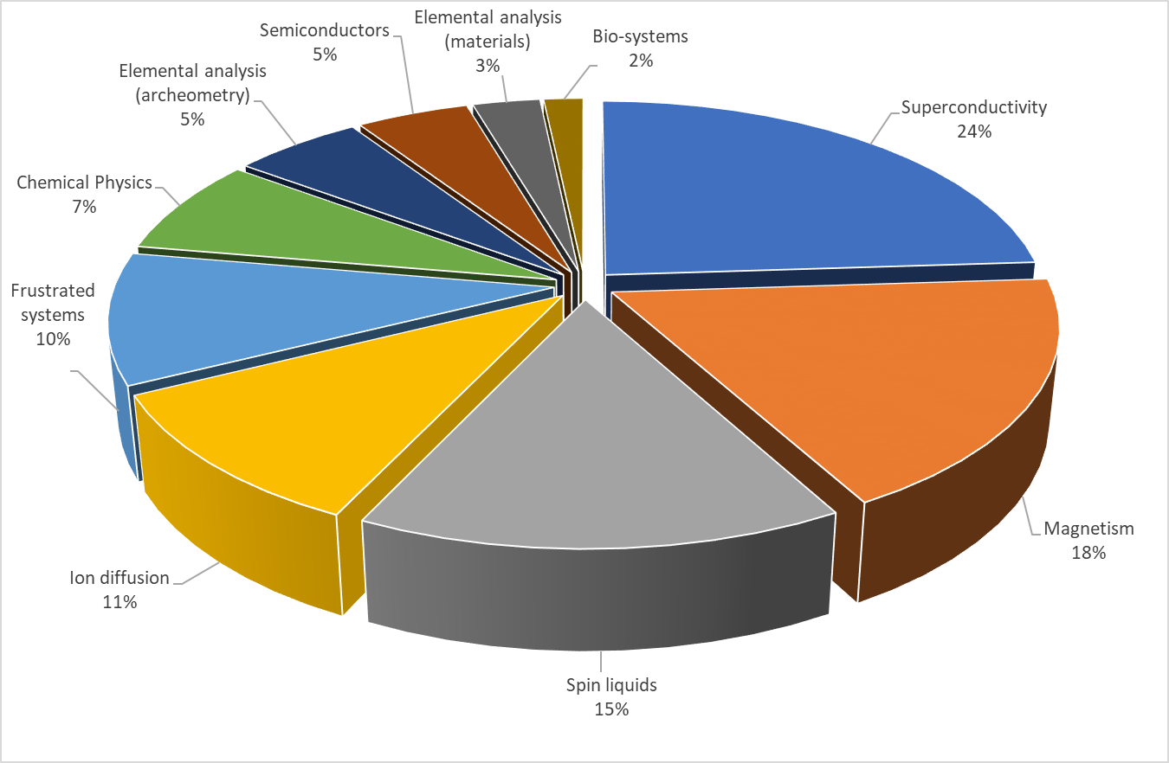
Science highlights – science supported

Slide 16
Next?
Welcome international partners to contribute the study and R&D of Muon Collider
Share the technologies, infrastructures
Win-win synergy efforts
Many thanks to all the speakers and the other conveners!
Thanks for attention!

