Slide 2
Work Package WP2.2 (HTS conductor, cables & associated technologies)
Author: Christian Barth on behalf of the TE-MSC-HSD section
Date: 02.05.2023

Slide 3
Introduction
Objective:
Demonstrator of 5 T in a background field of 15 T
Work Package 2.2:
Specification and procurement of tape.
Generate material database
Development of electrically insulated cables. Target: 10 kA @ 20 T, 5 kV .

Slide 4
Scope of Work Package 2.2
Exploration of REBCO tapes for suitability for fields > 16 T.
→ Establish REBCO characterization capabilities
→ Derive tape specifications, procure tape
Development of cables, cabling and other associated technologies including insulation
→Establish cabling & insulation capabilities
→Establish cable characterization capabilities

Slide 5
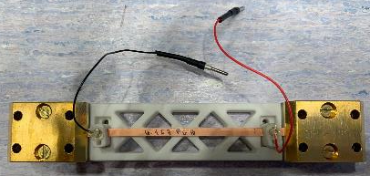
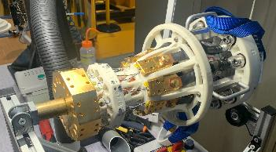
Characterization of REBCO tapes #1
Automated 8-channel, 77 K, self-field, I_{c} test station developed
in operation, also used for HL-LHC
for REBCO cable QC: extracted tapes I_{c} measurements
Reel-to-reel tape QC system in development
will be used to precisely map I_{c} along tape length

Slide 6
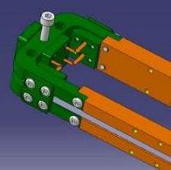
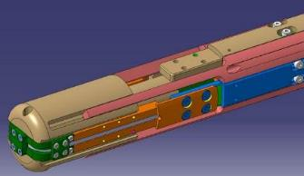
Characterization of REBCO tapes #2
‘U’-shape adapter to characterize REBCO tapes in 15 T wire test station developed (B || c)
in operation
‘1-turn’ adapter to characterize REBCO tapes in 15 T wire test station developed (B || ab)
in fabrication

Slide 7
Characterization of REBCO tapes #3
‘Compact sample holder for high-field tests (LNCMI) developed (B || c, or B ||ab)
being assembled
Large-bore, 20 T test station with VTI will be installed at CERN for high field characterizations
~100 mm Ø targeted
Split-coil test station with VTI will be installed at CERN for variable angle characterizations
~10 T targeted, feasibility study with suppliers

Slide 8
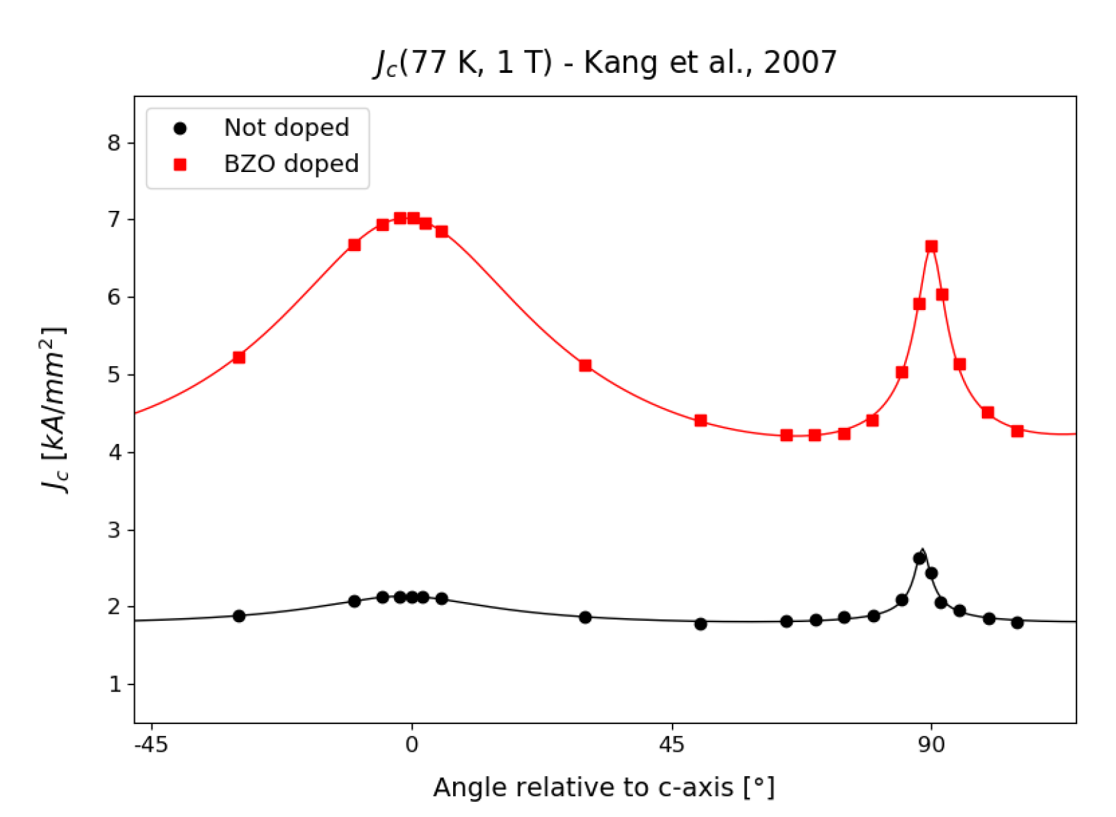
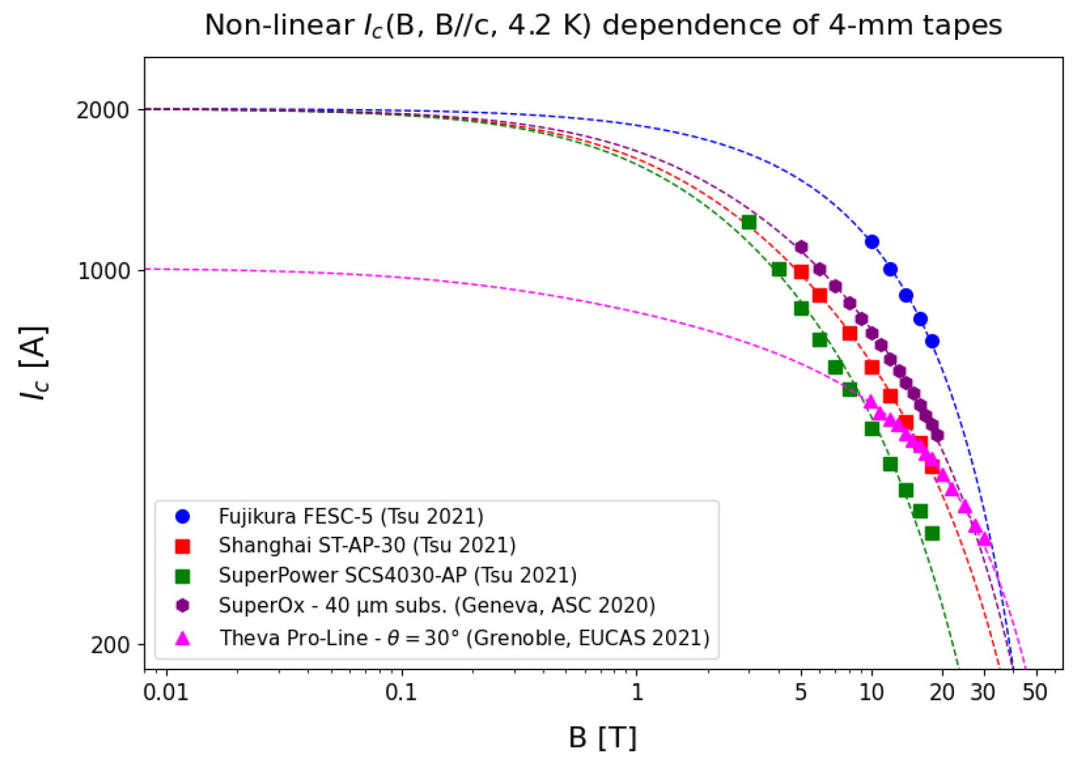
Characterization of REBCO tapes #4
Field, angle & temperature scaling relations for REBCO tape of different industrial suppliers
SuperPower, Fujikura, SST, SuperOx, Theva
Released as internal note (EDMS: 2747837)
Examples:

Slide 9
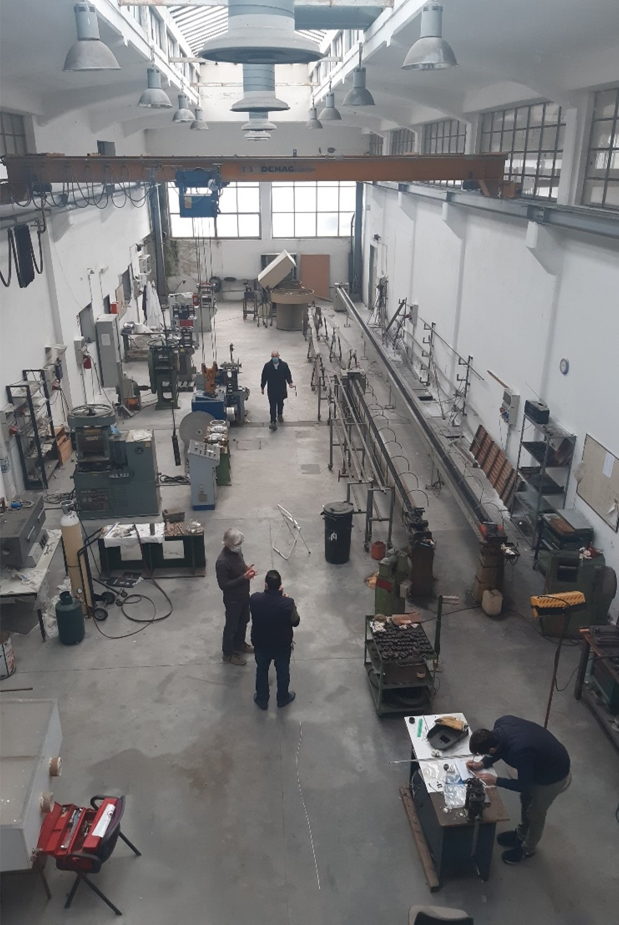
Other superconductors
Future collaboration CERN/CNR-SPIN – Iron Based Superconductors
drawing machines
groove rolling machines
flat rolling machine
Courtesy A. Malagoli
CNR- SPIN, Genova

Slide 10
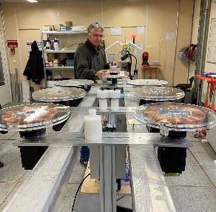
Cabling & insulation capabilities #1
Round, insulated power transmission cables
operational, used for HL-LHC
‘Stack’ type cables
14 tapes + insulation, torque control only: operational
7 tapes, precise tension control: being upgraded to 15 tapes + insulation

Slide 11
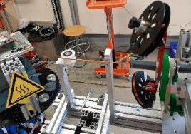
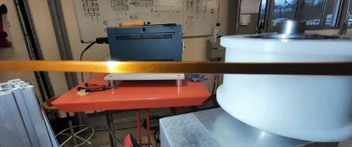
Cabling & insulation capabilities #2
Kapton tape wrapping for round and ‘stack’ cables
operational, long lengths possible
‘c-shape’ Kapton tape insulation for ‘stack’ cables
operational, long lengths possible

Slide 12
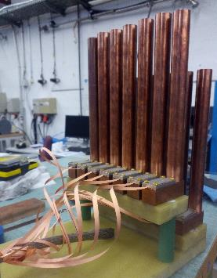
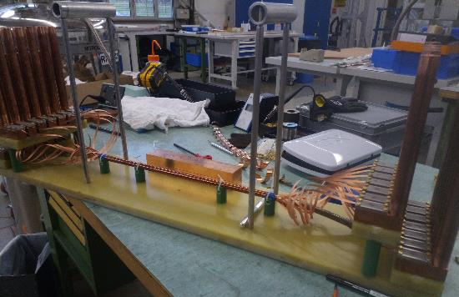
Characterization of cables #1
Intertape resistance measurement setup (77 K, self-field) developed
in operation

Slide 13
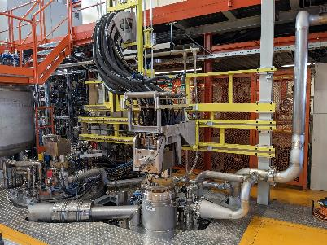
Characterization of cables #2
In-field characterization of cables with the FRESCA & FRESCA2 test stations
FRESCA (9.6T, 1.9K & 4.2K): in operation
FRESCA2 (13T, 1.9K & 4.2K & gas-flow): being commissioned
Dedicated test station for splice & current lead characterization
in development

