Slide 1






Funded by the European Union (EU). Views and opinions expressed are however those of the author only and do not necessarily reflect those of the EU or European Research Executive Agency (REA). Neither the EU nor the REA can be held responsible for them.
EU Project MuCol
Status and Plans
R. Losito
CERN

Slide 2
Summary
History of MuCol
MuCol Organisation
WorkPackages
Milestones & Deliverables

Slide 3
Evaluation from the reviewers
An excellent 14.5/15!
  “The scientific goals of the project are clear and important”
  “A muon Collider offers a way (..) that is novel and complementary to existing approaches”
  “The proposed work is timely, important and strategically positioned to influence the next European Strategy Exercise (….) and global decision making”
  “The project objectives are realistically achievable”
  “The potential impact of the proposed work is very high”
  “The workplan has been developed with pathways to impact in mind”
  “Environmental aspects are well covered in the proposal”
  “The make-up of the consortium is of high quality”

Slide 4
MuCol Organisation
The consortium includes 32 31Institutes:
  CERN as coordinator and beneficiary
  11 more Beneficiaries (no UK Institutes)
  19 Associated Partners

Slide 5
MuCol Organisation
Study Leader : Daniel Schulte (CERN)
Technical Coordinator (WP1 leader) : Roberto Losito (CERN)
Deputy Study Leader: Chris Rogers (UKRI)
Transversal Roles :
  Gender Adviser Officer : E.J. Bahng (Iowa State University)
  Communication and dissemination Officer: Elias Metral (CERN)
WP Coordinators:
  WP1: Roberto Losito (CERN)
  WP2: Donatella Lucchesi (UNIPD)
  WP3: Natalia Milas (ESS)
  WP4: Chris Rogers (UKRI)
  WP5: Antoine Chance (CEA)
  WP6: Claude Marchand (CEA)
  WP7: Luca Bottura (CERN)
  WP8: Lucio Rossi (UNIMI)

Slide 6
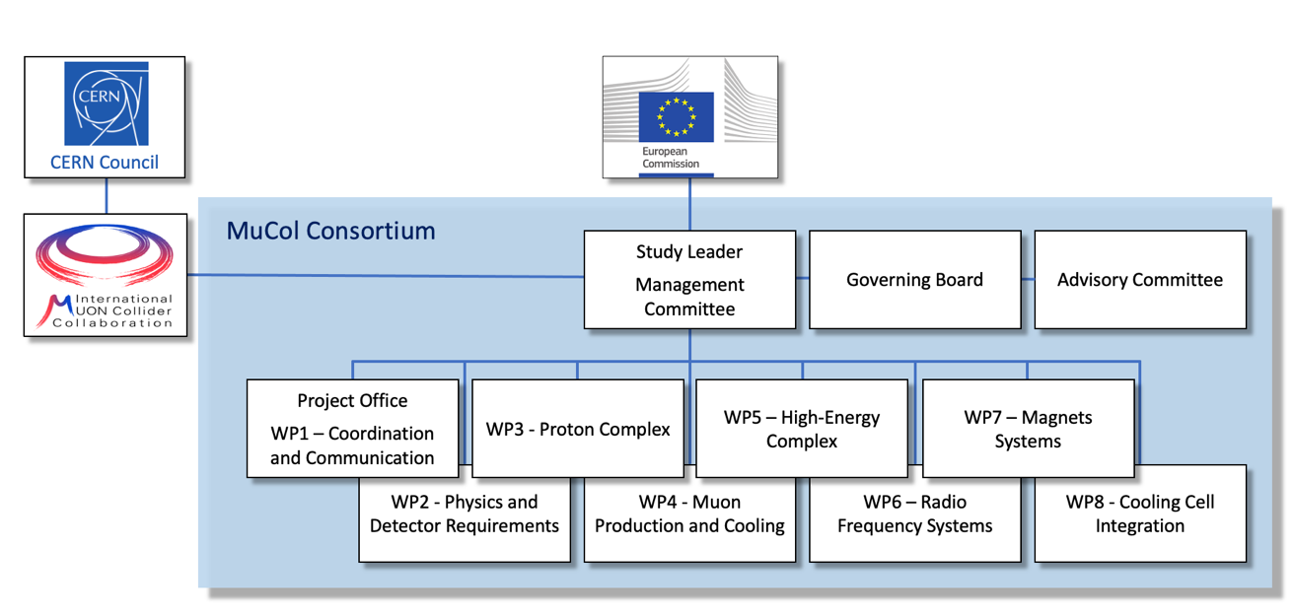
MuCol Organisation

Slide 7
Goals of the project
MuCol has been shaped to coordinate the effort of the International Muon Collider Collaboration towards the specific goal of providing a comprehensive input for the next European Strategy for Particle Physics Update
The main deliverables will be yearly progress reports, that will be used to edit the report that will be submitted to the ESPPU in 2025/26 as input from the Collaboration.
The same material can be used by the collaboration to provide input to other prioritization processes/funding agencies (e.g. P5 in US).

Slide 8
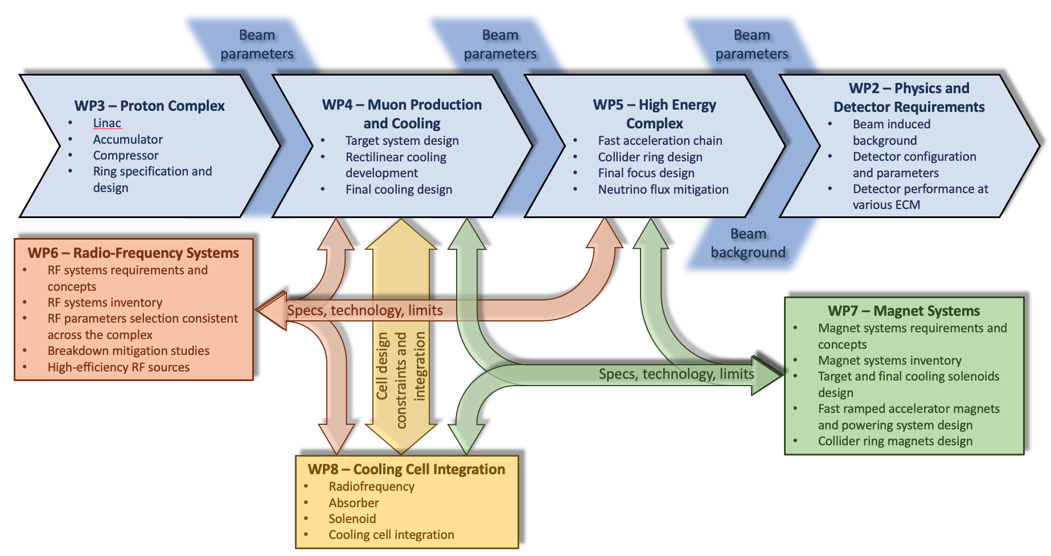
Scientific and technical organization of the project

Slide 9
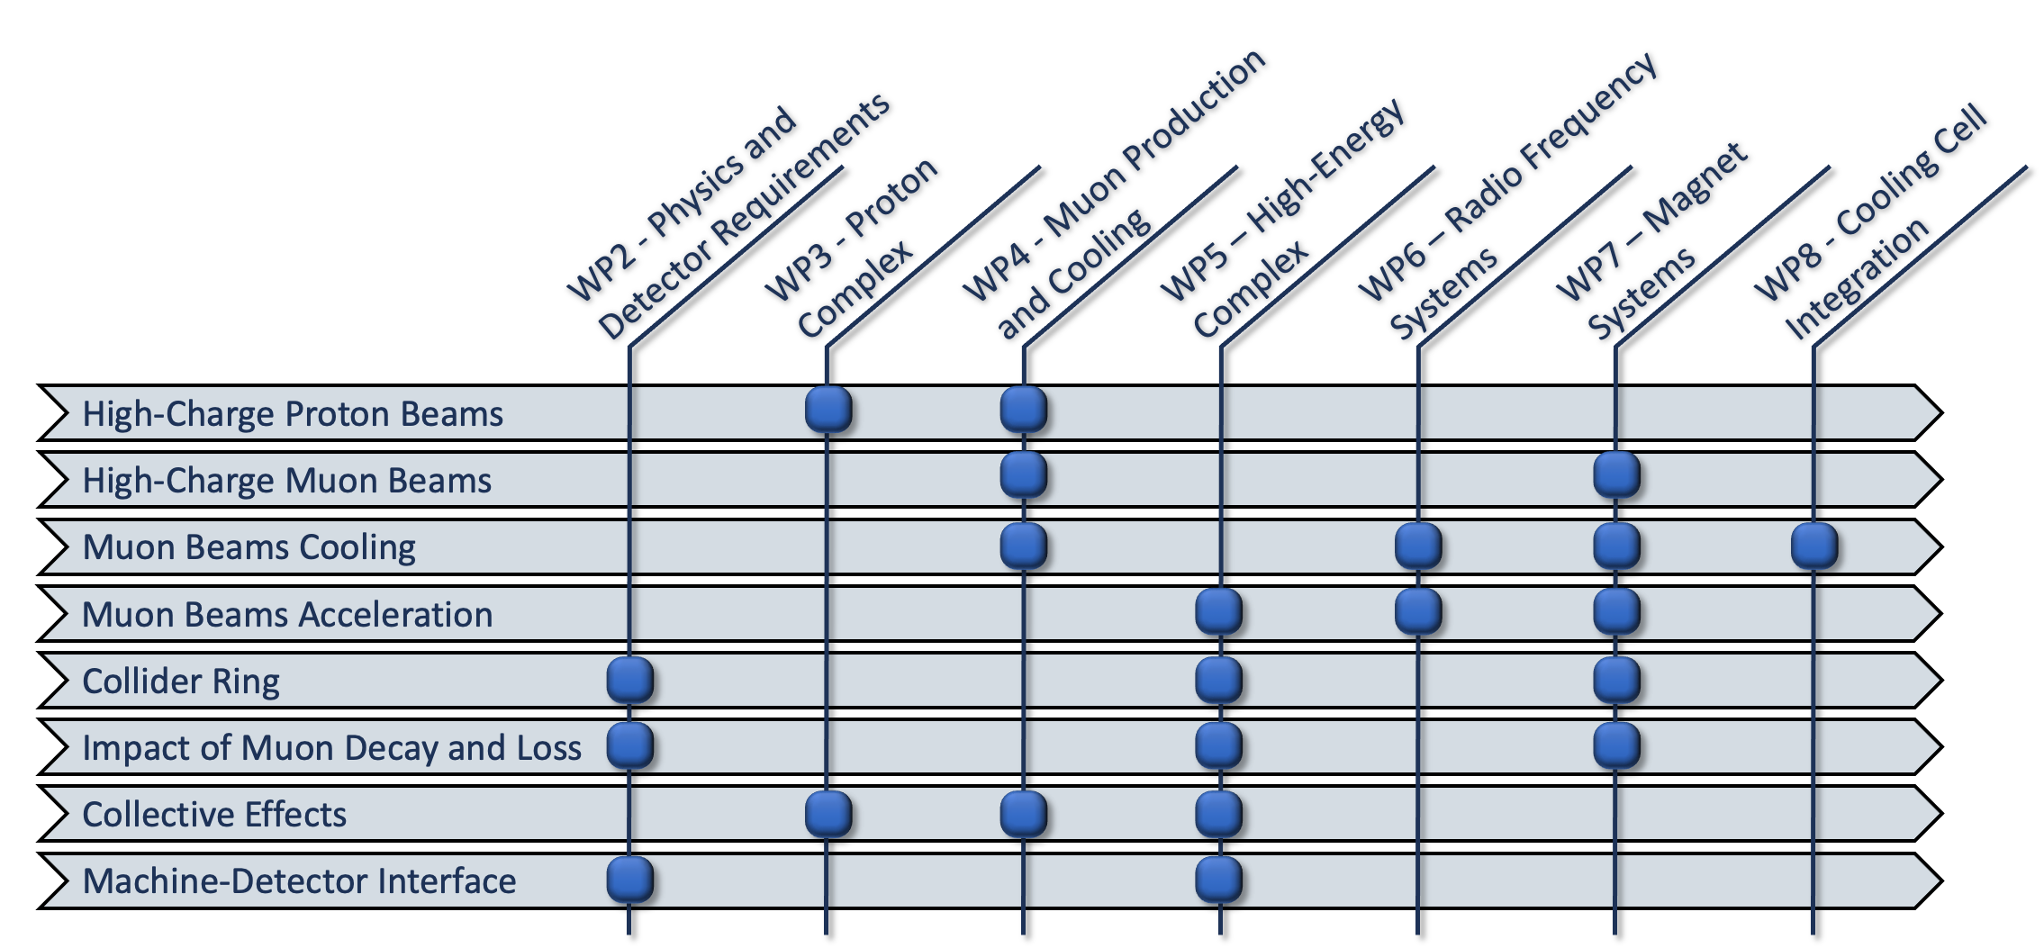
Scientific and technical organization of the project

Slide 10
Scientific and technical organization of the project
All along the duration of the project we will animate a table of parameters, covering both the accelerator layout and the main technologies (magnets, RF, beam diagnostics…)
Overleaf document being edited, during the project we will publish
  M6: Tentative Parameters
  M18: Preliminary Parameters
  M30: Consolidated Parameters

Slide 11
Milestones & Deliverables
Deliverables for year 1:
  Data Management Plan, M5: WP1 (CERN) + all
    CERN is working on a “standard” data management plan, that can be customized for our needs
  Preliminary ESPPU report No. 1 : WP1 (CERN) + all
  Both to be approved by the Governing Board of Mucol
    Approval of the first report will provide the green light to CERN’s administration to proceed with the second payment (about 15% of total).

Slide 12
Milestones & Deliverables
Milestones for year 1:
  Website online, M2: WP1 (CERN)
  Kick-off meeting, by M3: M2
  Tentative Parameters available, M6: WP1 (SL) + all
  Training on detector design and physics performance tools, M6, WP2

Slide 13
Deliverables

Slide 14
Milestones

Slide 15
Achievements
We have a website:
  https://mucol.web.cern.ch/
Well on schedule with milestones
Working on DMP and table of Parameters
Hiring of PHD and postdocs started
  Please let us know about openings, we will advertise on our website and socials…

Slide 16
Thank you
for your attention

Slide 17
MuCol Organisation
Transveral roles
  Gender Adviser:
    responsible for the enforcement of gender equality in the Project
  Dissemination and Communication Officer
    Will monitor the effective implementation of the dissemination and communication plan

Slide 18
WP1: Coordination and Integration
Task 1.1: Study coordination (Daniel)
  Focus on Overall design and table of parameters
Task 1.2: Technical Coordination (Roberto)
  Ensures timely delivery of milestones and Deliverables
  Ensures the application of the Data Management Plan
  Monitors Gender Dimension Issue with the help of the Gender Dimension Officer.
Task 1.3 & 1.4: Elias
  Peer review process with an editorial board
  Communication and Dissemination together with Other institutes…
Task 1.5: Daniel
  Implementation Scenarios, in particular implementation at CERN

Slide 19
WP2: Physics and Detector Requirements
Task 2.1: Design of detector configurations at √s=3 TeV and √s=10 TeV with the optimised interaction regions (D. Zuliani)
  Focus on BIB with a strong interaction with WP5 (High Energy)
Task 2.2: Design and implementation of event reconstruction algorithms in 5D at √s=3 TeV and √s=10 TeV (F. Meloni)
  developing reconstruction algorithms exploiting 3D position, energy, and timing measurements to mitigate beam-induced background and perform tracking and calorimetry clustering
  this task will explore machine learning solutions and parallel computing.
Task 2.3: Evaluate detector performance at different collision energies by using major physics processes: (M. Casarsa)
  This task will explore the detector performance of a muon collider operating at different collision energies.
  Will evaluate the reach of major physics processes for Standard Model measurements, and for searches for physics beyond the

Slide 20
WP3: Proton Complex
This work package aims to define the most promising scheme for the linac, accumulator and compressor rings and prepare a comprehensive summary of the current technology and possible R&D topics of importance for the proton complex
Task 3.1: High Power Linac (A. Lombardi, CERN)
  Collection of parameters based on ESS and LINAC4/SPL designs
Task 3.2 – Compressor ring design (E. Laface, ESS)
  The ring will create the high intensity short bunches that will be delivered to the target for muon production

Slide 21
WP4: Muon production and cooling
Task 4.1 Cooling system development (UKRI)
  Need to design a system that will compress the phase spece of the muon beams by 5 orders of magnitude
  Will liaise with WP6, WP7 and WP8 in order to provide a design based on a realistic assessment of the main technological aspects.
Task 4.2 – Target system development (R. Franqueira Ximenes, CERN)
  Has to deal with high power (2÷4 MW) and short pulse (1 nsec).
  Will investigate possible technology but also consequences for infrastructure, shielding, materials etc…
Task 4.3 Code development (Imperial)
  Will develop specific modules of BDSIM to reach and go beyond the performance of G4Beamline

Slide 22
WP5: High Energy Complex
Task 5.1 Collider Design (C. Carli, CERN)
  Will interface closely with WP2 for the optimization of the interaction regions and minimization of BIB
Task 5.2 Pulsed synchrotron and FFA design (A. Chance, CEA)
  Will provide start 2 end simulations of the two alternatives based on reasonable assumptions on the development of associated technologies.
Task 5.3 Beam dynamics (E. Metral, CERN).
  This task focuses on the transverse collective effects all along the muon accelerator chain
Task 5.4 MDI design and background to experiment (A. Lechner, CERN)
  Will implement in FLUKA, based on input from task 5.1, a detailed model of the interaction regions and will provide the map of BIB to WP2.
Task 5.5 Radiation studies for the accelerators (C. Ahdida, CERN)
  Mitigation of radiation effects to personnel and public, including evaluation of neutrino radiation hazard.

Slide 23
WP6: RadioFrequency
Task 6.1 High Energy Complex RF (U. Van Rienen, UROS)
  Main focus on the design of cavities for acceleration in a Rapid Cycling Synchrotron.
Task 6.2 Muon Cooling Complex RF (D. Giove, INFN)
  Will address high gradients in high magnetic fields, limited space for integration.
Task 6.3 Breakdown mitigation studies (G. Ferrand, CEA).
  This task will study and enhance the present comprehension of the intrinsic concepts that influence the break down rate of RF cavities submitted to strong magnetic fields
Task 6.4 High efficiency RF sources (G. Burt, ULA)
  Will provide confidence that present assumptions for high efficiency klystrons (24 MW @ 700 MHz with efficiency of 80%) is reasonable.

Slide 24
WP7: Magnets
Task 7.1 Integration and Magnet Catalog (L. Bottura, CERN)
  Will provide coordination of the other tasks and aim at “standardization” of magnets, maintaining a complete catalog of magnets being used on each WP.
  Will also provide interface fro radiation tolerance, magnet cooling, radiation protection studies etc..
Task 7.2 Target, Capture and Cooling Solenoids (M. Statera, INFN)
  Will address large bore solenoids, for fields up to 40÷60T.
Task 7.3 Fast Ramped Accelerator magnet systems (F. Boattin, CERN).
  Will provide performance targets for fast ramping accelerator systems, with the aim of limiting to realistic values the power consumption.
Task 7.4 Collider ring magnets (S. Mariotto, UMIL)
  Will study realistic performance targets for large bore (150 mm) magnets at 16 T (and above?).

Slide 25
WP8: Cooling cell integration
Will perform the detailed study of a representative cooling cell, with the goal of integrating the single components in a complete 3D model
Task 8.1 Absorbers and Windows (J. A. Ferreira Somoza, CERN)
Task 8.2 Solenoids (S. Sorti, UMIL)
Task 8.3 RadioFrequency (D. Giove, INFN).
Task 8.4 Cooling Cell Performance (C. Rogers, UKRI)
Task 8.5 Cooling Cell Integration (L. Rossi, UMIL)

