Slide 2
Recommissioning 2023
M. Solfaroli

Slide 3
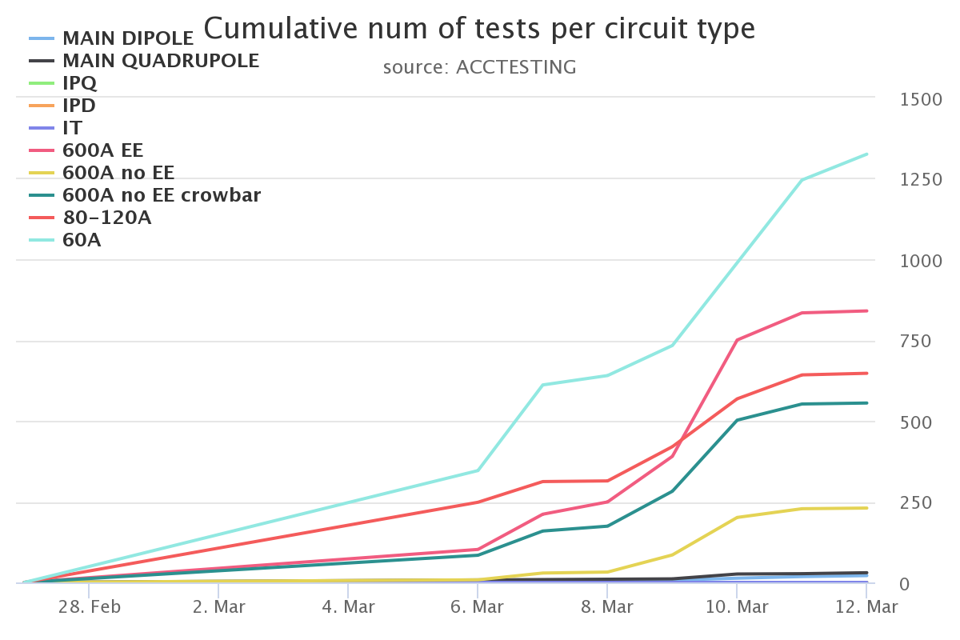
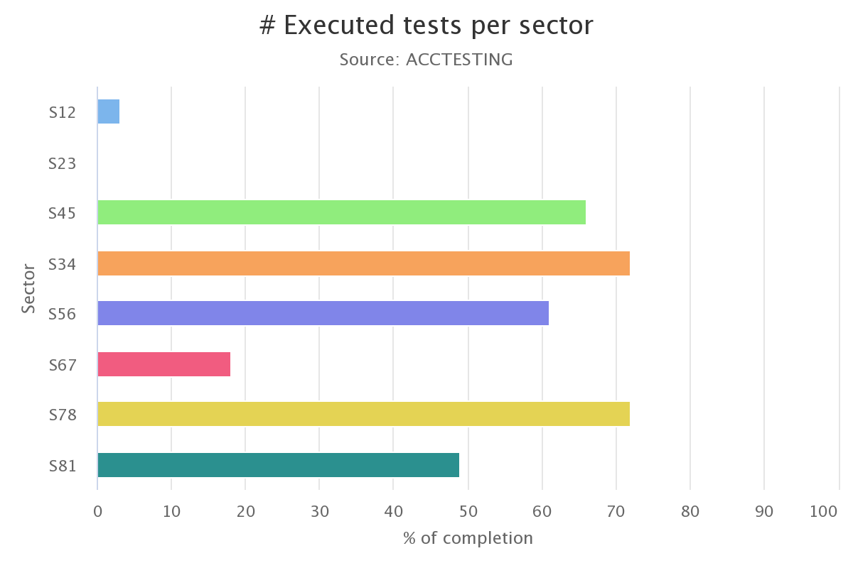
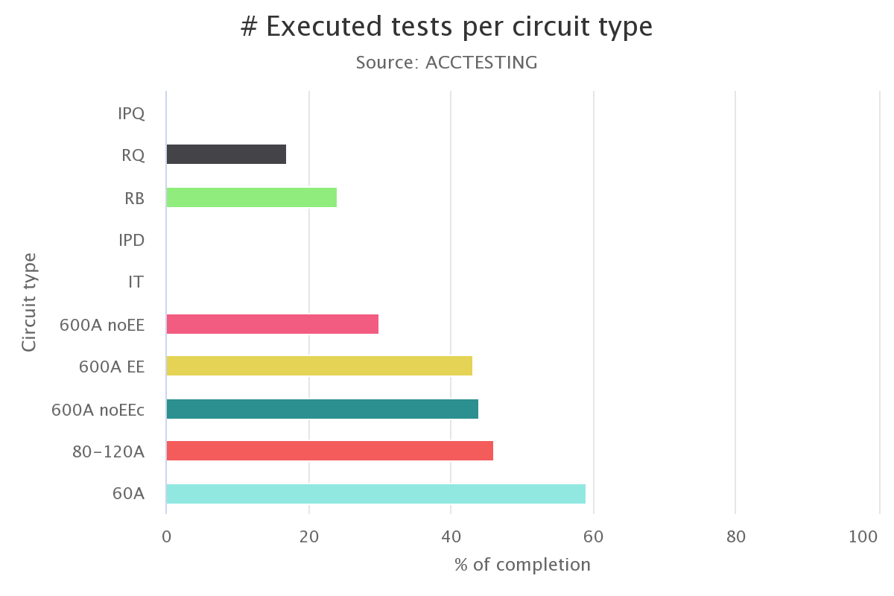
Progress
www.cern.ch/poweringtests

Slide 4
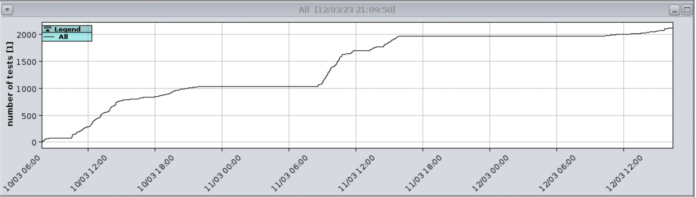
Progress
More than 2k tests done since Friday morning.
MANY THANKS to the support from MP3, MI, EPC

Slide 5
General
ElQA campaign completed successfully
All PIC-CRYO tests done but: XL2 (to be done today)
All PCs unlocked, but S23 (RR13+XR8 have been re-locked)
  All will be unlocked today
Coupure du 3,3KV du SU2 on March 13th at 9h => on shade of CV reconfiguration
Current Lead heater modification completed in RR13 and RR17
13 kA preparation ongoing in S34+S45+S67 (QH to be switched ON in S12+S23+S56+S81)
IPQ/IPD/IT: NO circuit is ready (all QHs to be switched ON)
Powering tests started on 60 A + 80/120 A + 600 A (+RB.A78+RQD/F.A78)

Slide 6
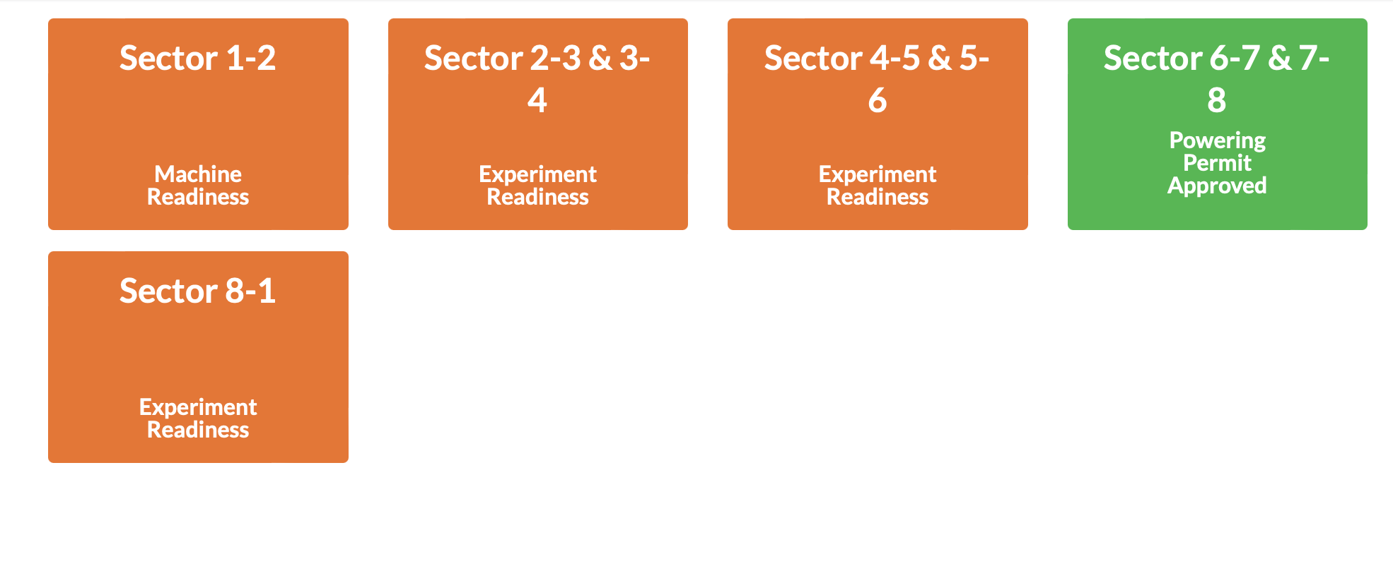
Powering permits
Following success of DSO tests, S67-S78 powering permit for Phase2 was approved on Friday afternoon. Others will follow today

Slide 7
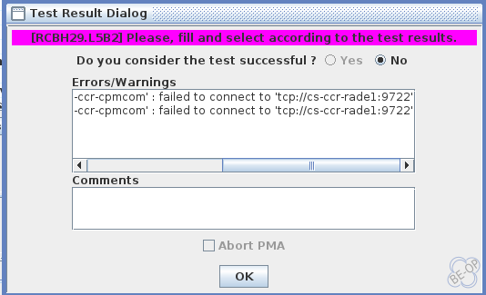
PM connection problem
On Saturday we experienced problems in connection with services on cs-ccr-rade1 (problem was already observed on Friday, solved by server reboot)
➔ Many tests failed and had to be repeated (+PMEA was out of service for a short while)
Problem was temporarily solved by machine reboot (thanks Odd, Enzo, Julien). On Saturday evening all the Post Mortem services were moved to another machine (cs-ccr-rade2). Problem did not reappear on Sunday. Investigations are ongoing

Slide 8
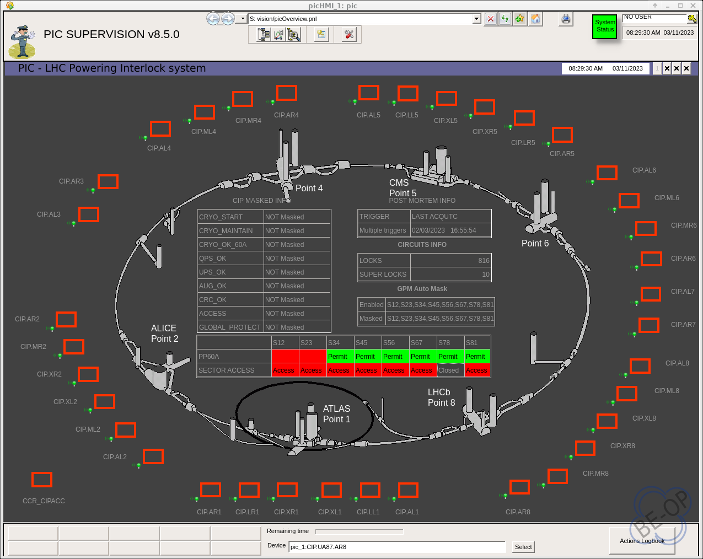
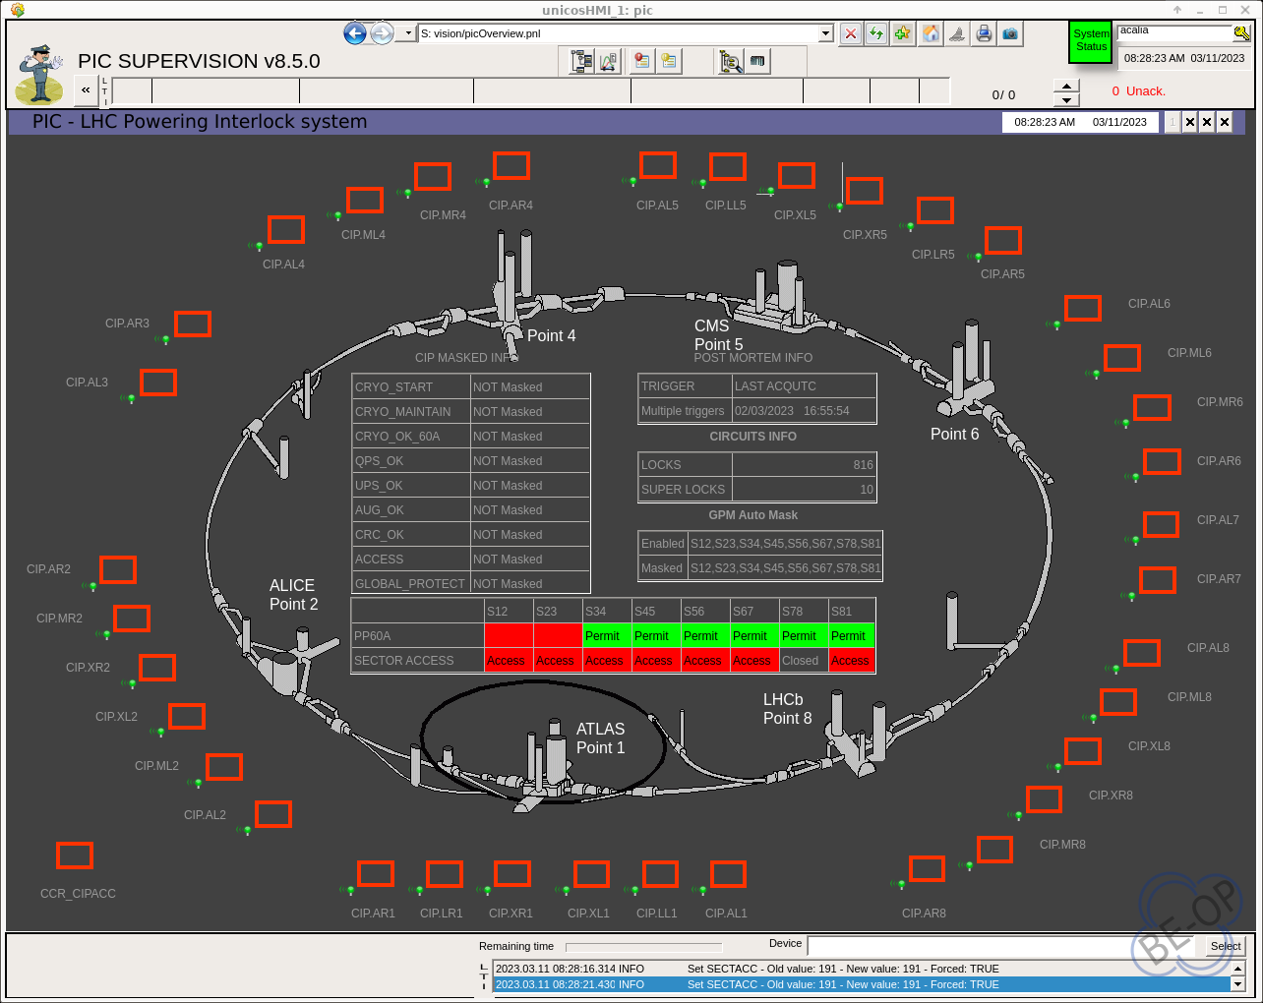
PIC PVSS application
It looks like the PVSS application “version” depends on the console…to be followed up

Slide 9
S12, S23
Cryo conditions expected to be ready on Wednesday 15th March
CIRCUIT READINESS
Power converter to be unlocked in S23 (today)
13 kA: QH to be switched ON today in S12 and tomorrow in S23
600A: QDS crate re-installation in UA23/UA27 to be completed (on Tuesday)

Slide 10
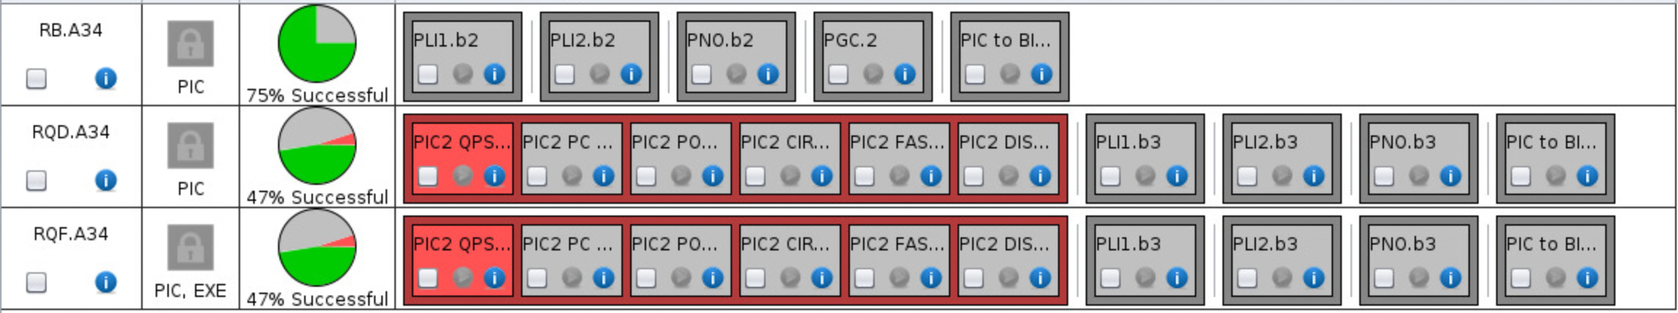
S34
600 A: well advanced
  RQTL9.R3B1/B2: EXTERNAL I_EARTH OVER CURRENT
  ROF.A34B1 – intervention needed by the EE team
80-120 A: almost completed, quite a few signature in ACCTESTING (EPC)
60 A: COMPLETED
13 kA:
  RB ➔ Interlock tests completed!
  RQD/F ➔ EE systems do not communicate

Slide 11
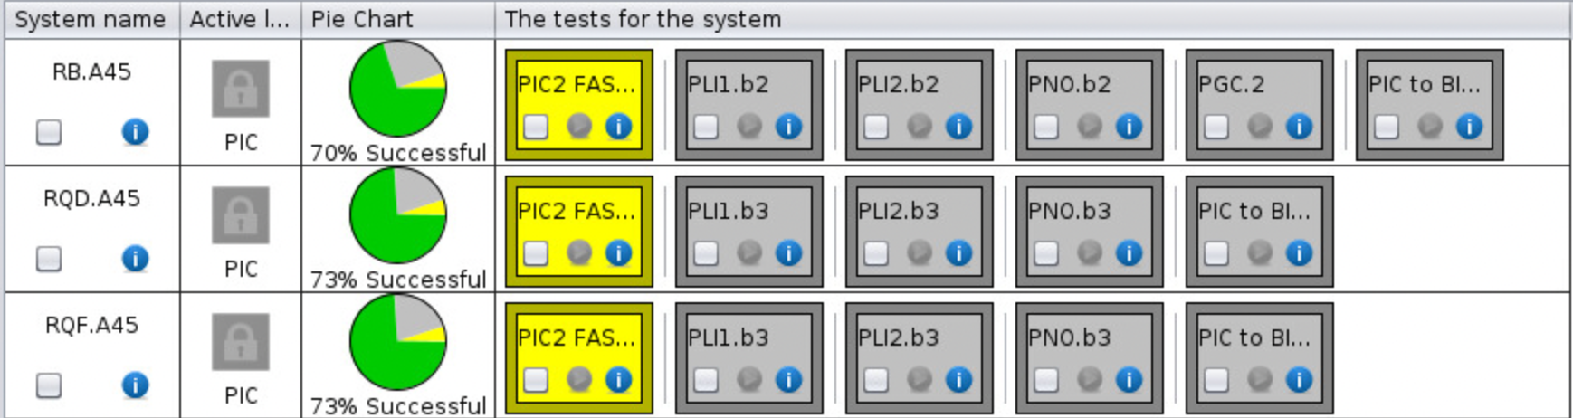
S45
600 A: very well advanced
  RCD.A45B2 – slow communication with EE
80-120 A: well advanced, quite a few signatures in ACCTESTING (EPC):
  RCBCH5.L5B2 trips on regulation problem
60 A: well advanced
  RCBH12.L5B1 EPC intervention needed
  RCBV27.L5B1 failed to reach on_STANDBY
13 kA:
  Interlock tests completed

Slide 12
S56
600 A: well advanced, some QDS.INTEGRITY to be signed
80-120 A: almost completed, one signature in ACCTESTING (EPC)
60 A: almost completed, some circuit failed PCC on missing FGC_STATE after fault is provoked (to be checked in ACCTESTING):
  RCBH26.R5B2
  RCBH31.R5B1
  RCBH14.L6B2
  RCBH14.R5B2
  RCBV12.R5B1
  RCBH12.L6B2
13 kA: QH to be switched ON on Wednesday 15th March

Slide 13
S67
600 A: ongoing, some QDS.INTEGRITY to be signed
80-120 A: ready to start
60 A: ready to start
  RCBV34.L7B2 – no communication with PC, EPC intervention needed
13 kA: QH ON (tests to be signed), interlock tests on RB done?

Slide 14
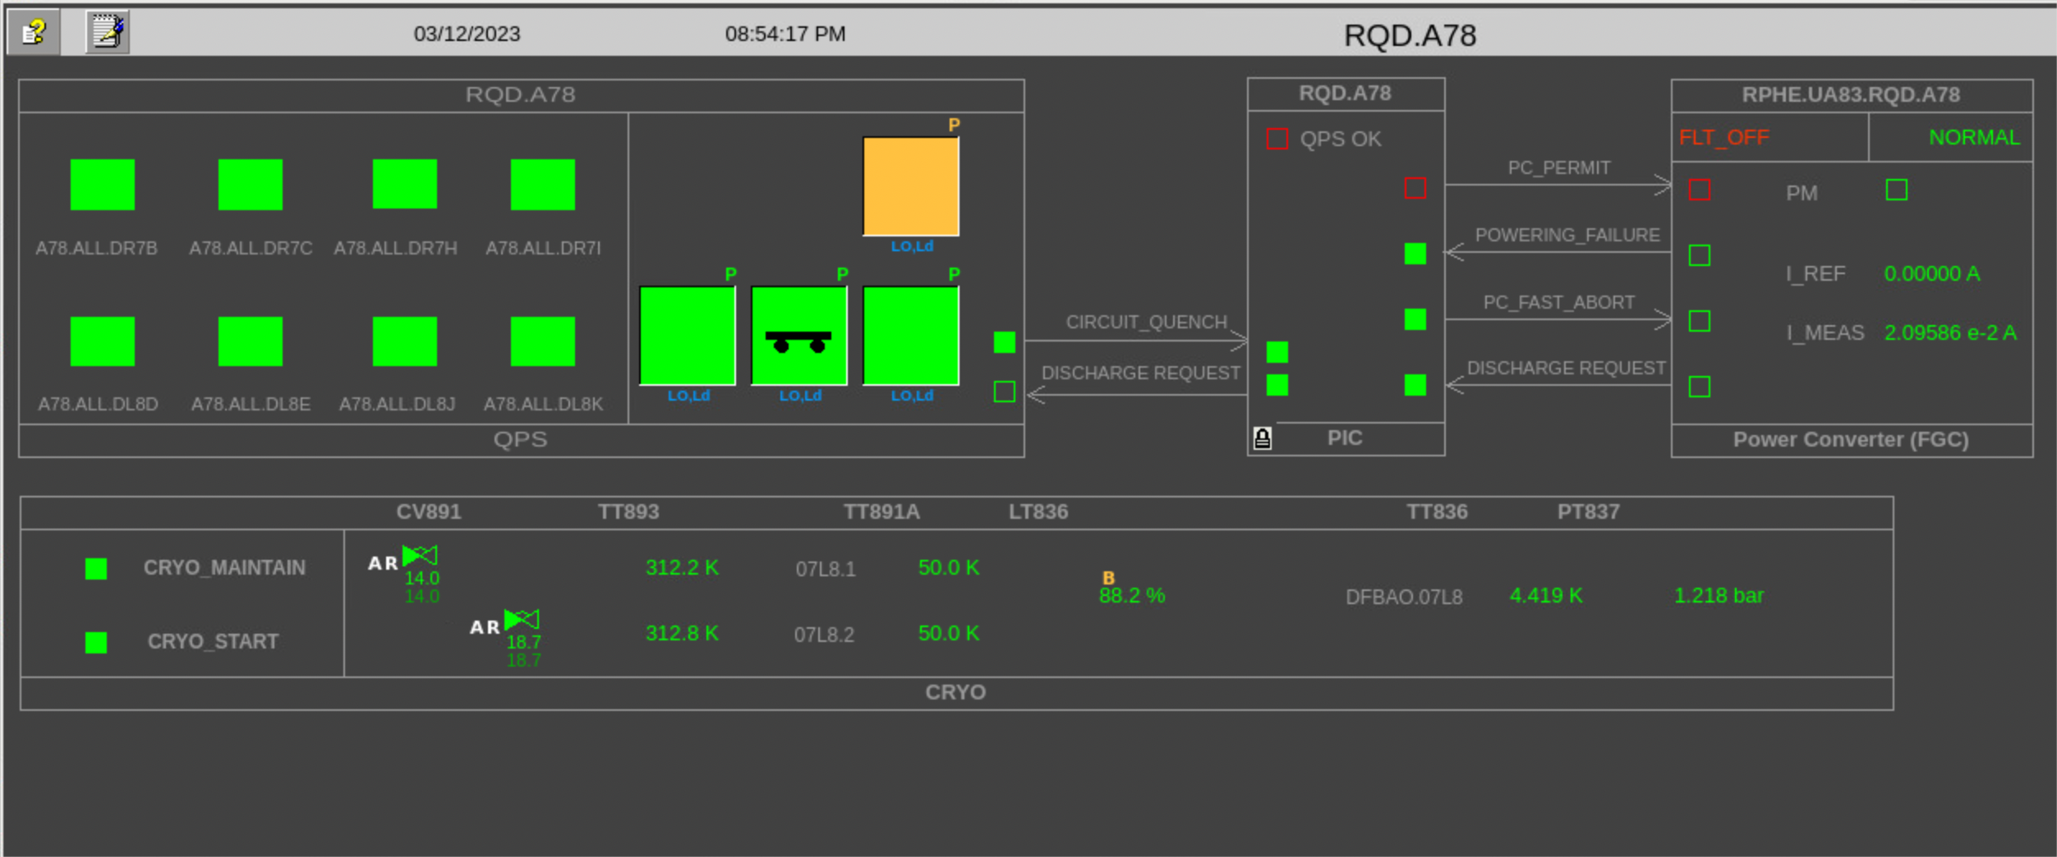
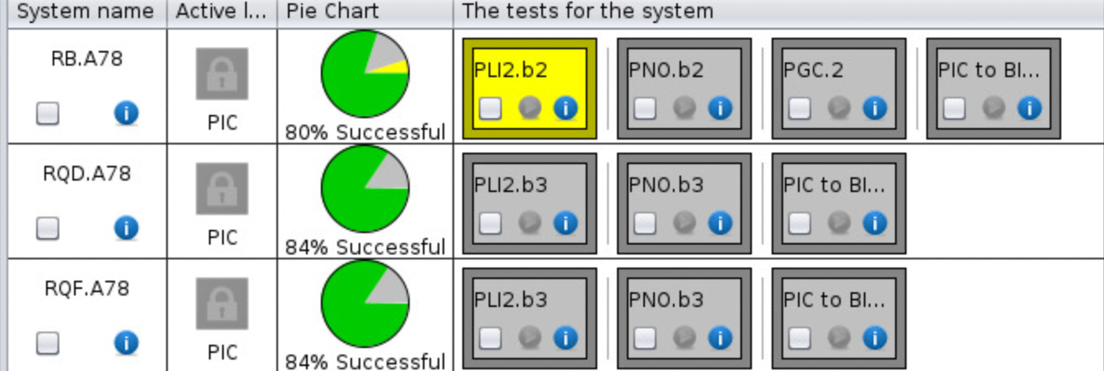
S78
600 A: ongoing, some QDS.INTEGRITY to be signed for XL8
80/120 A: completed, one signature in ACCTESTING (EPC)
60 A: COMPLETED but RCBH33.R7B1 (EPC intervention needed)
13 kA: Tests @760A done, test @2kA done on RB

Slide 15
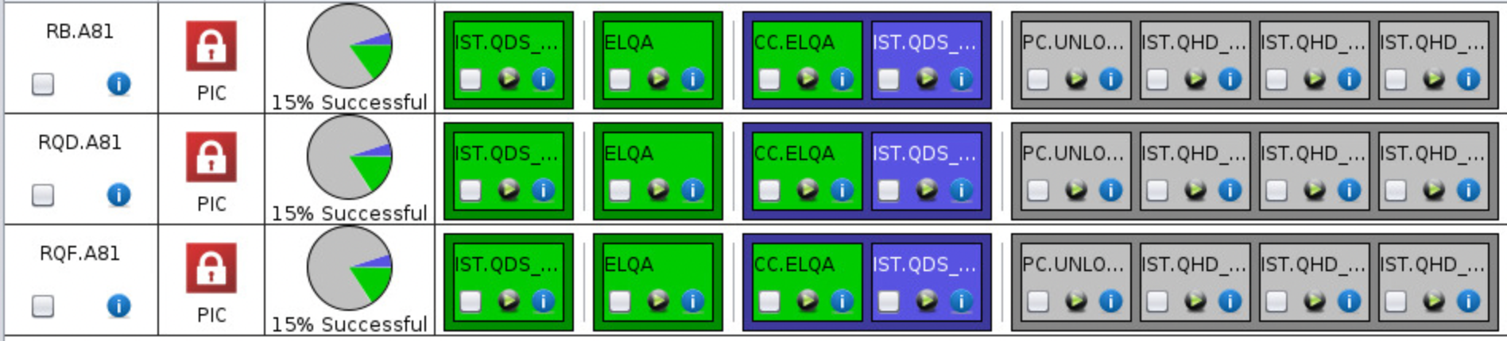
S81
RR13 and XR8 still to be re-unlocked (today)
600 A: ongoing
  RSF1.A81B2 – slow communication with EE
  RCS.A81B1 – slow communication with EE
  RQTL11.R8B2 - probable cabling problem, most likely on QPS side
80-120 A: well advanced
60 A: COMPLETED
13 kA: quench heaters to be switched ON on Thursday

Slide 16
Special tests
PGC.2 – In order to check the global reaction to FPA of main circuits, a FPA test at 6.8 TeV (using nominal cycle) will be performed in each arc
FPA of RB circuits at 10 A/s is requested by MP3:
  @2kA (adjustment of iQPS settings is needed to ensure tripping BS boards AND reset to nominal situation after the test)
  @11kA

Slide 17
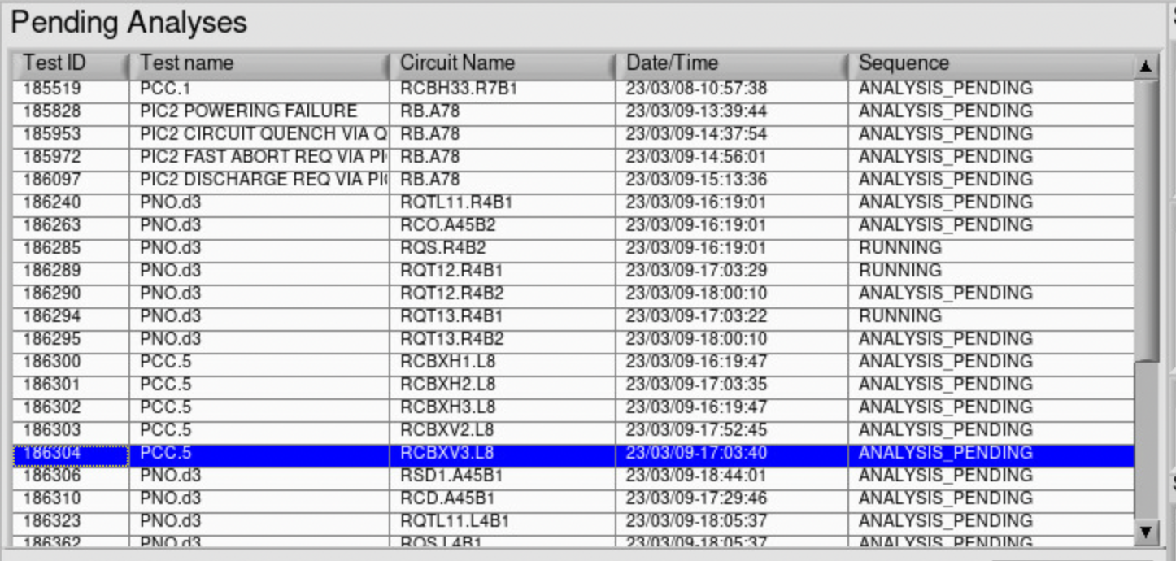
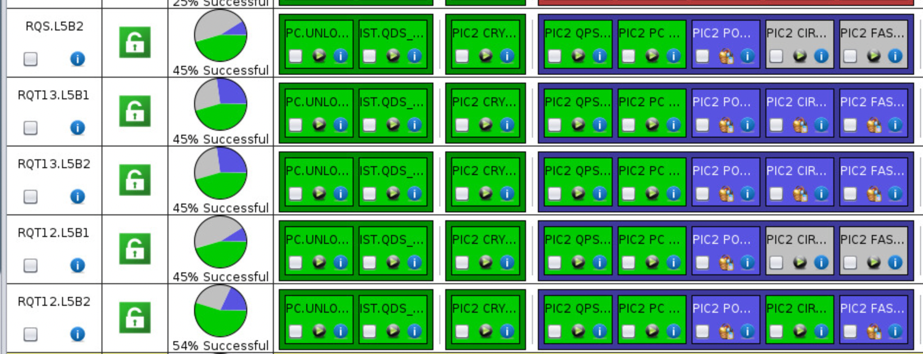
Signatures

Slide 18
This week access
Access this week will be devoted ONLY to activities related to powering tests
IMPACT:
  YETS IMPACTs are suspended
  Piquet IMPACTs can be used
  New ones are to be created on Operation-LHC-2023 period
Access will be done in the mornings and finish as early as possible in the (very) beginning of the afternoon

