Slide 2
Recommissioning 2023
M. Solfaroli

Slide 3
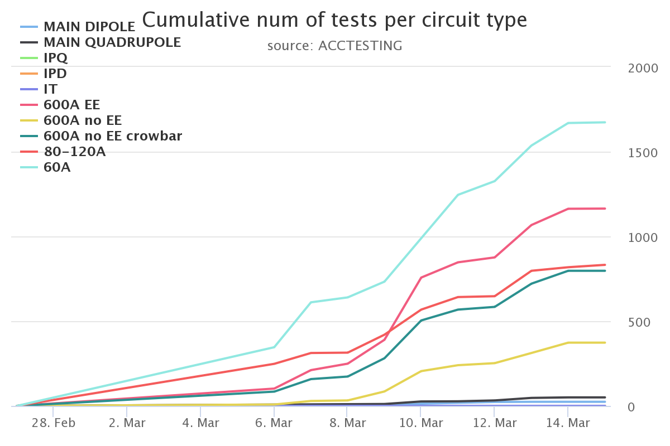
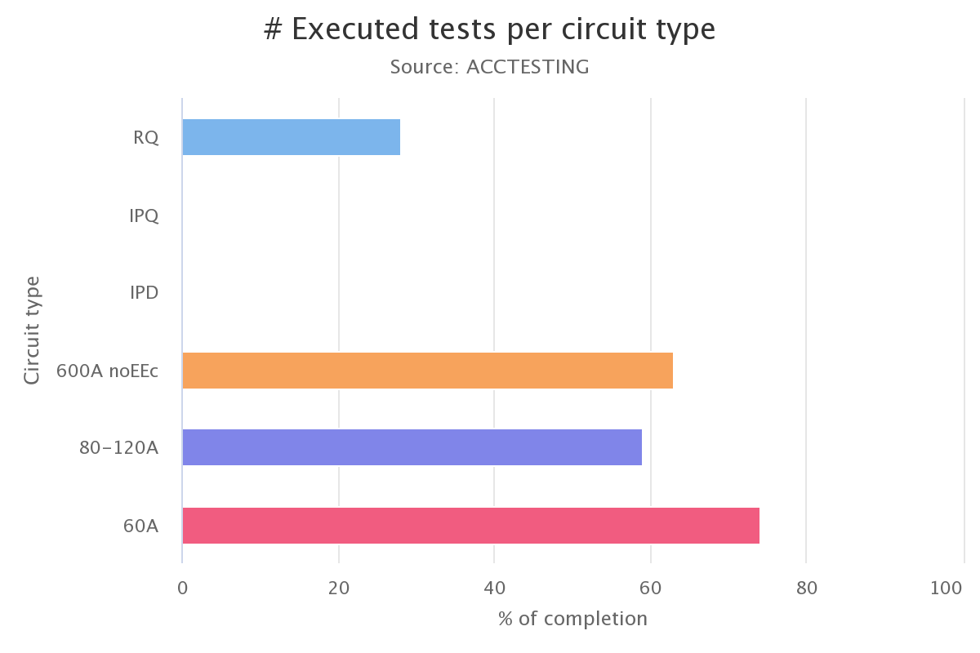
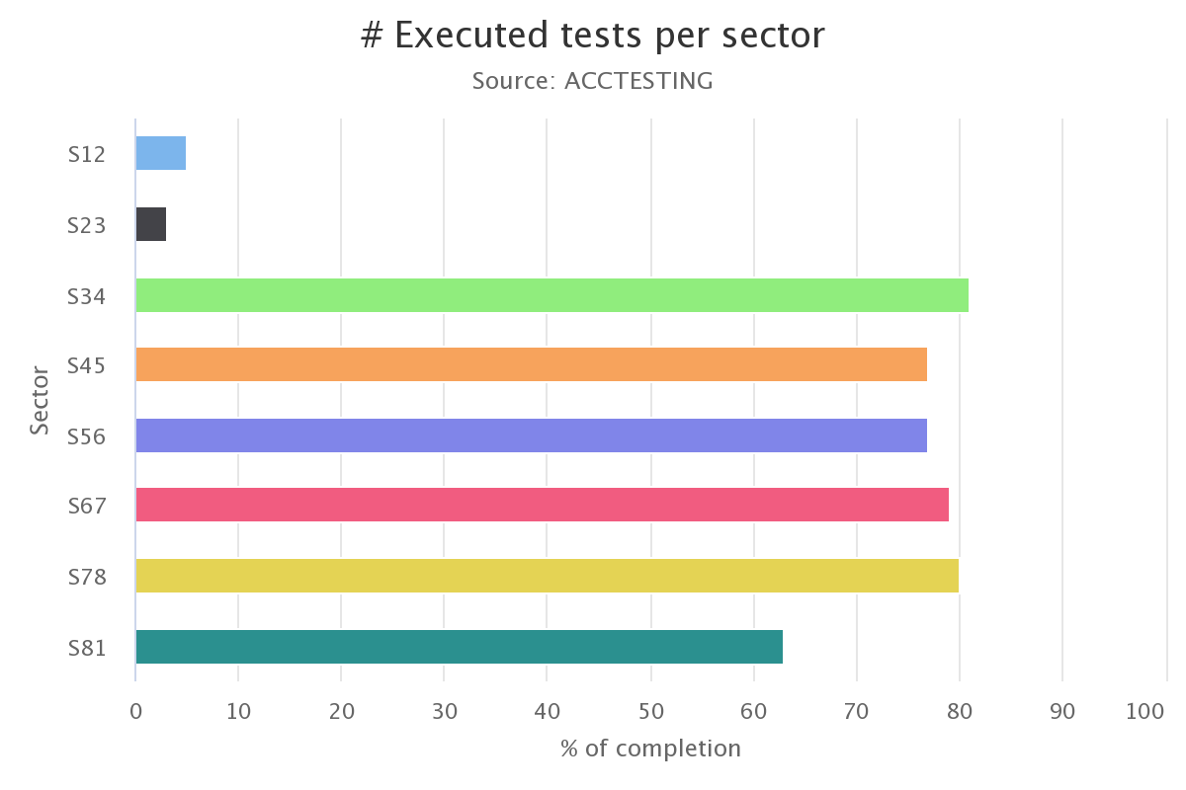
Progress
www.cern.ch/poweringtests

Slide 4
General
ElQA campaign completed successfully
All PIC-CRYO tests done but: XL2 (to be done today…NO cryo until today)
All PCs unlocked
Coupure du 3,3KV du SU2 on March 13th at 9h => DONE
Current Lead heater modification completed in RR13 and RR17
13 kA preparation ongoing in S67+S12+S23 (QH to be switched ON in S56+S81)
IPQ/IPD/IT: interlock tests ongoing (all QHs to be switched ON)
Powering tests started on 60 A + 80/120 A + 600 A + 13 kA (S34, S45, S78)
First dipole circuit powered to nominal current (+I_DELTA) – RB.A78
First quadrupole circuits powered to nominal current (+I_DELTA) – RQD/F.A45

Slide 5
PMEA connection issues last night
“PMEA client has unstable connection to the server”
“NO data in PMEA”

Slide 6
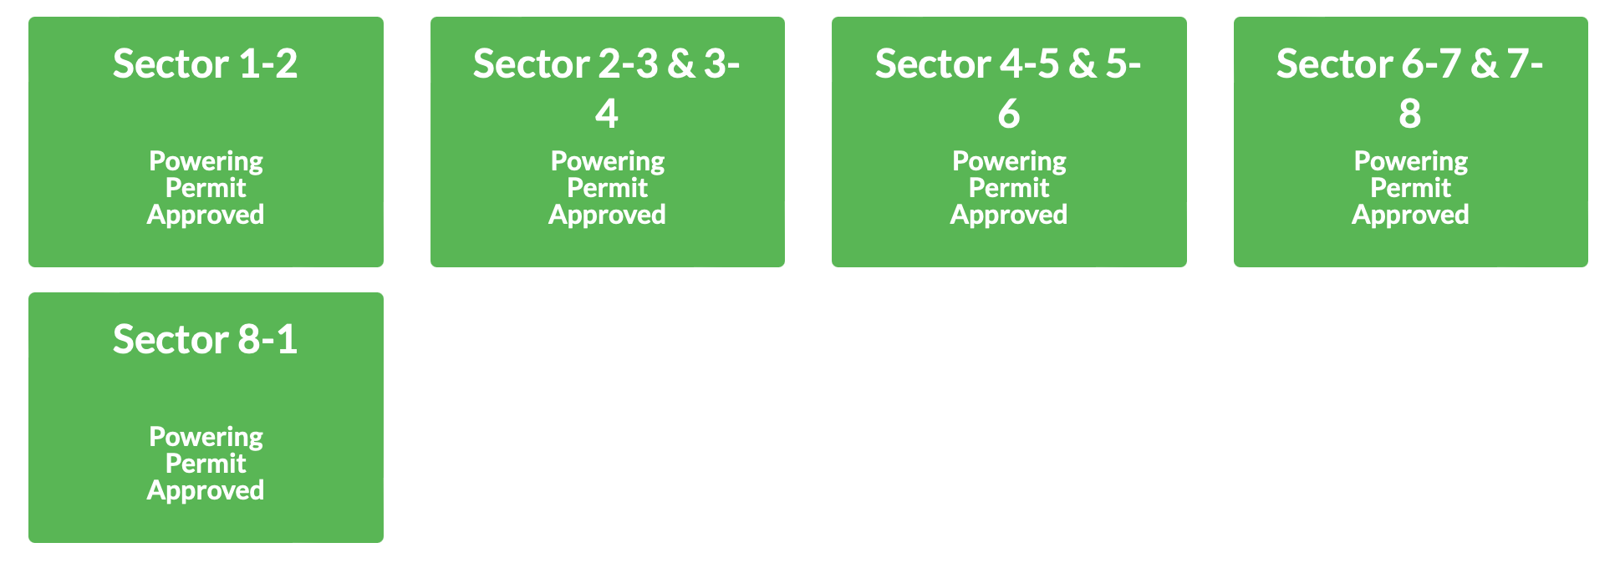
Powering permits
Following success of DSO tests, powering permits approved

Slide 7
S12, S23
Cryo conditions expected today
CIRCUIT READINESS
Power converter unlocked
13 kA: QH ON in both sectors
600A: QDS crate re-installation in UA23/UA27 completed

Slide 8
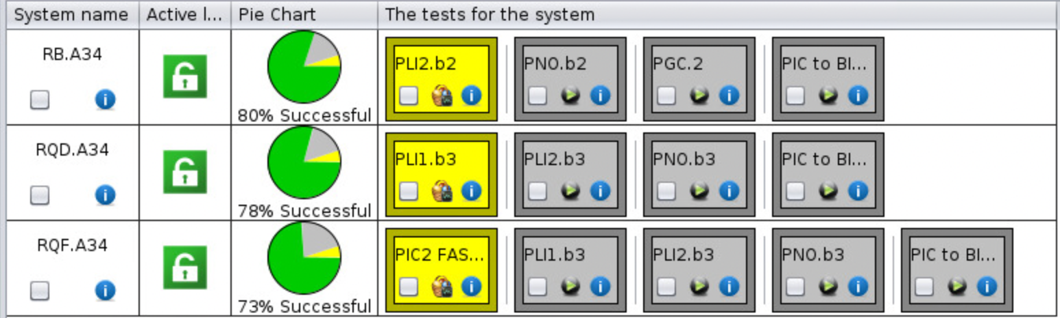
S34
600 A: almost completed advanced
RQTL9.R3B1/B2: EXTERNAL I_EARTH OVER CURRENT DONE
ROF.A34B1 – intervention needed by the EE team – DONE
RQTL9.R3B1 (MP3 signature in ACCTESTING)
80-120 A: almost completed, quite a few signature in ACCTESTING (EPC)
60 A: COMPLETED
13 kA:
RB ➔ 2 kA test done
RQD ➔ 760 A test done
RQF interlock tests completed

Slide 9
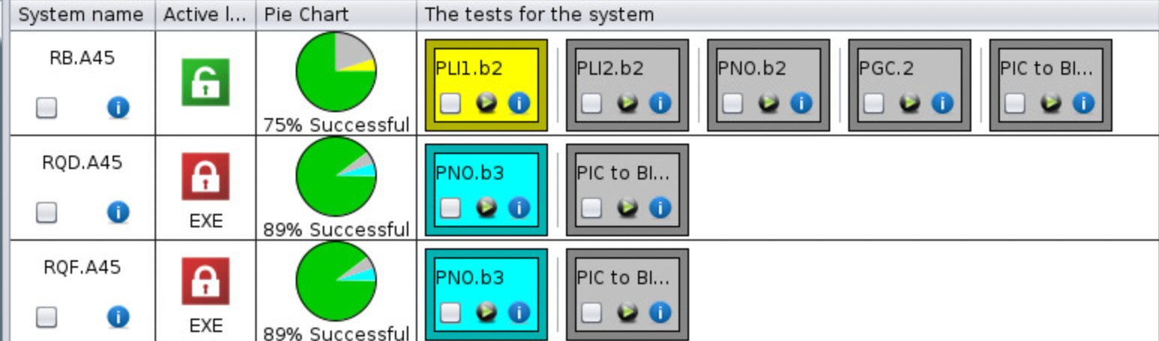
S45
600 A: almost completed
80-120 A: almost completed
RCBYHS4.L5B1 - signatures in ACCTESTING (EPC)
60 A: well advanced
RCBH12.L5B1 - EPC intervention needed
RCBV27.L5B1 - EPC intervention needed
13 kA:
RB – 760 A test done
RQD/F COMPLETED

Slide 10
S56
600 A: well advanced, some QDS.INTEGRITY to be signed
80-120 A: almost completed, one signature in ACCTESTING (EPC)
60 A: almost completed:
RQT13.L6B2 - signature in ACCTESTING (MP3)
RQTF.A56B2 - signature in ACCTESTING (MP3)
13 kA: QH to be switched ON on today

Slide 11
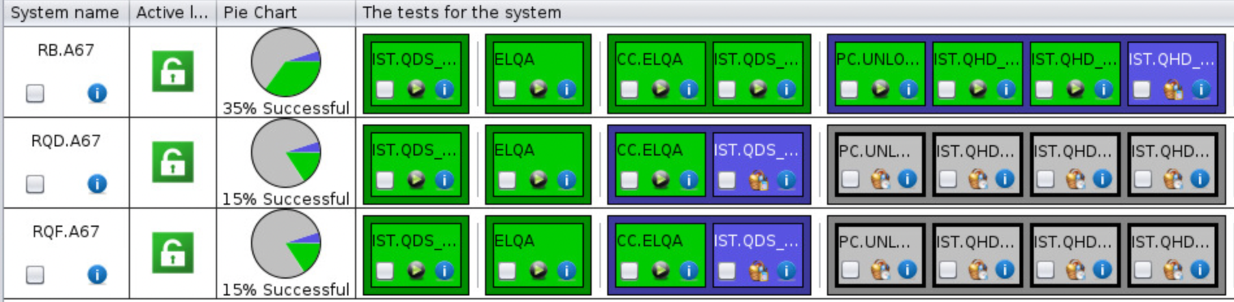
S67
600 A: ongoing:
RQTL10.L7B1 – signature in ACCTESTING (MP3)
80-120 A: COMPLETED but MR6 (RQ5.R6 in FPA - GPM)
60 A: almost completed
RCBH28.L7B1 – EPC intervention needed
13 kA: RB almost ready for powering, RQD/F ongoing

Slide 12
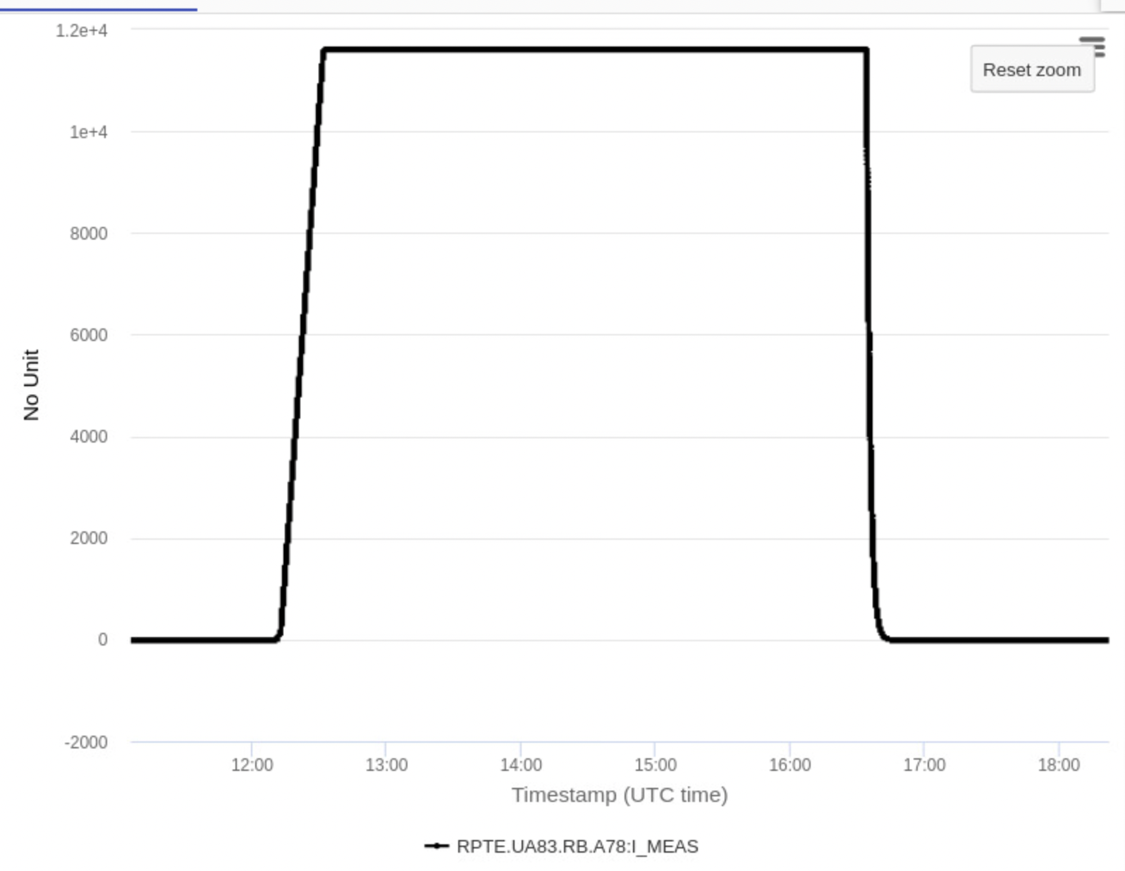
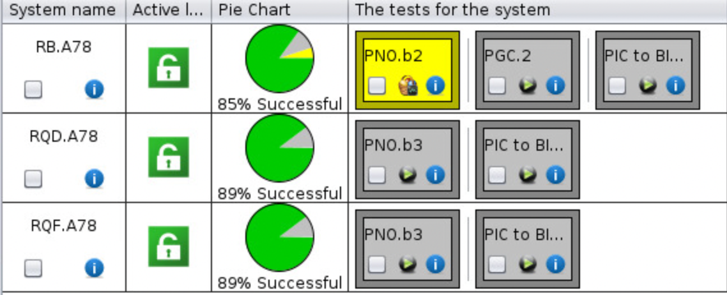
S78
600 A: almost completed
80/120 A: COMPLETED
60 A: COMPLETED
13 kA: RB fully tested, RQD/F ready for nominal current

Slide 13
S81
600 A: very well advanced, a few signatures in ACCTESTING
80-120 A: almost completed
XR8 – RQX in FPA (GPM)
60 A: COMPLETED
13 kA: quench heaters to be switched ON on Thursday

Slide 14
Special tests
PGC.2 – In order to check the global reaction to FPA of main circuits, a FPA test at 6.8 TeV (using nominal cycle) will be performed in each arc
FPA of RB circuits at 10 A/s is requested by MP3:
@2kA (adjustment of iQPS settings is needed to ensure tripping BS boards AND reset to nominal situation after the test)
@11kA

Slide 15
This week access
Access this week will be devoted ONLY to activities related to powering tests (9am – 12pm)
IMPACT:
YETS IMPACTs are suspended
Piquet IMPACTs can be used
New ones are to be created on Operation-LHC-2023 period

Slide 16
Equipment checkout
Machine – experiment signal exchange and interlock test completed successfully
SMP tested with new LHC BCT connection
Attempt to remotely pulse the injection kickers MKI2 and MKI8 failed
No cryo conditions in point 2 → no opening of vac. valves
Issue with abort gap keeper signal in point 8
Next attempt today or Thursday
Vacuum valves tests for the LSS4 and LSS6 done

