Slide 2
Introduction to the activities of WP4.6 at CERN
Cryogenic and thermal management studies for HFM magnets
HFM – RD Line 4 kick-off Forum meeting
Modelling Tools, Materials Protection and Cryogenics
R. van Weelderen, P. Borges de Sousa
RD Line 4 kick-off Forum meeting - Indico, 18th April 2023

Slide 3
Table of contents
Comments/Foreword
Scope of the Work Package
Recall of the milestones and deliverables
Summary of planned activities for 2023
Activities in 2022/2023
Conclusions

Slide 4
Comments/Foreword:
The milestones and deliverables for WP4.6 were presented during the HFM workshop in November 2022.
The intense ramp-up of Muon Collider activities at CERN has had an impact on the HFM activities of WP4.6:
  It kick-started the activities of WP4.6-T1, and prompted them to all start in parallel in January 2023
  It highlighted the need to bring forward in the schedule the combined approach to the overall optimization of cryogenic infrastructures (WP4.6-T1), considering both sustainable magnet design and optimization of cryogenic infrastructures accounting for all other temperature levels
  This provides essential input for magnet & accelerator designers on where to orient their development efforts, focusing not only on the coil but also on the magnet cold mass as part of a sustainable cryo-layout.

Slide 5
Scope of the Work Package
Studies of novel cryogenic cooling modes for future high-field magnets including:
Innovative options towards reduced helium content or dry magnet cooling modes based on remote cooling circuits and its integration into large scale cryogenic infrastructures
Thermal management of LTS and HTS magnets with associated R&D program during the global process of magnet design and development.
Thermohydraulic calculations and numerical simulations of cryogenic refrigeration processes
Investigation of associated material properties at cryogenic temperatures.
Upgrade of Cryogenic Laboratory facilities for testing and experimental validation of thermal characteristics on novel cryogenic cooling modes.

Slide 6
TASK | Description | Assigned to | Progress | Start | End
WP4.6-T1 | Innovative large scale cryogenic infrastructure options towards reduced accelerator & magnets’ helium-content cooling-modes and minimal total energy consumption |  |  | Jan 2023 | Dec 2025
WP4.6-T1-D1 | Report on main accelerator at 1.9 K |  |  | Jan 2023 | Dec 2023
WP4.6-T1-D2 | Report on main accelerator at 4.5 K |  |  | Jan 2023 | Dec 2024
WP4.6-T1-D3 | Report on main accelerator at 5.0 K |  |  | Jan 2023 | Dec 2024
WP4.6-T1-D4 | Review report for superfluid, saturated to supercritical scenarios |  |  | Jan 2024 | Dec 2024
WP4.6-T1-D5 | Report on main accelerator at >10 K |  |  | Jan 2024 | Dec 2025
WP4.6-T1-D6 | Report on main accelerator with hybrid coils |  |  | Jan 2024 | Dec 2025
WP4.6-T1-D7 | Summary review report |  |  | Jan 2024 | Dec 2025
WP4.6-T2 | Thermal properties of magnet components at cryogenic temperatures |  |  | Sep 2022 | Dec 2027
WP4.6-T2-D1 | Thermal conductivity, thermal diffusivity and specific heat of pure epoxy resins (WP4.4) |  |  | Sep 2022 | Dec 2027
WP4.6-T2-D2 | Thermal expansion/contraction of pure epoxy resins (WP4.4) |  |  | Jan 2023 | Dec 2027
WP4.6-T2-D3 | Superfluid He permeability of pure epoxy resins (WP4.4) |  |  | Jan 2023 | Dec 2025
WP4.6-T2-D4 | Thermal conductivity, thermal diffusivity and specific heat of magnet and cold-mass materials (WP4.3) |  |  | Jan 2023 | Dec 2027
WP4.6-T2-D5 | Thermal conductivity, thermal diffusivity and specific heat of coil mock-ups (RD2 & RD3) |  |  | Jan 2024 | Mar 2027
WP4.6-T2-D6 | Yellow Report on low temperature thermal properties of magnet components |  |  | Jan 2027 | Dec 2027
Work triggered by Muon Coll. studies highlighted the need to regroup the deliverables differently

Slide 7
TASK | Description | Assigned to | Progress | Start | End
WP4.6-T3 | Thermal design, modelling and validation of coils towards reduced magnets’ helium-content including conduction-cooling |  |  | Jan 2023 | Dec 2027
WP4.6-T3-D1 | Study on Nb₃Sn-coils at 1.9 K (RD3) |  |  | Jan 2023 | Dec 2025
WP4.6-T3-D2 | Study on Nb₃Sn-coils at 4.5 K (RD3) |  |  | Jan 2023 | Dec 2025
WP4.6-T3-D3 | Study on Nb₃Sn-coils at 5.0 K (RD3) |  |  | Jan 2023 | Dec 2025
WP4.6-T3-D4 | Summary review report on thermal design options for Nb₃Sn-coils (RD2) |  |  | Sep 2025 | Dec 2025
WP4.6-T3-D5 | Study on Alternative wires (HTS, iron-based…)-coils at 1.9 K (RD2) |  |  | Sep 2023 | Sep 2026
WP4.6-T3-D6 | Study on Alternative wires (HTS, iron-based…)-coils at 4.5 K (RD2) |  |  | Sep 2023 | Sep 2026
WP4.6-T3-D7 | Study on Alternative wires (HTS, iron-based…)-coils at > 5.0 K (RD2) |  |  | Sep 2023 | Sep 2026
WP4.6-T3-D8 | Study on Hybrid coils (RD2 & RD3) |  |  | Sep 2023 | Sep 2026
WP4.6-T3-D9 | Summary review report on thermal design options for Alternative (HTS, iron-based…)-coils (RD2) |  |  | Sep 2023 | Sep 2026
WP4.6-T3-D10 | Demonstrator of reduced helium content cooling variants for Nb₃Sn |  |  | Sep 2024 | Dec 2027
WP4.6-T3-D11 | Demonstrator of reduced helium content cooling variants for HTS, iron-based, MgB₂,… (non-Nb₃Sn) |  |  | Sep 2024 | Dec 2027
WP4.6-T3-D12 | Heat extraction measurement of coil-packs (RD2 & RD3) |  |  | Sep 2023 | Dec 2026
Nb₃Sn-related studies must be strongly connected to RD3 needs, in combination with overall cryo-infrastructure energy optimisation

Slide 8
TASK | Description | Assigned to | Progress | Start | End
WP4.6-T4 | Modelling of full cold mass designs' thermal performance |  |  | Jan 2024 | Dec 2026
WP4.6-T4-D1 | Robust performance Nb₃Sn 12T-dipole (WP3.3) |  |  | Jan 2024 | Dec 2024
WP4.6-T4-D2 | Utlimate performance Nb₃Sn dipole (WP3.5) |  |  | Jan 2025 | Dec 2025
WP4.6-T4-D3 | HTS, iron-based, MgB₂,… (non-Nb₃Sn) magnets (RD2) |  |  | Jan 2025 | Dec 2026
WP4.6-T5 | Small scale, variable temperature-range HTS-coils and splice characterisation |  |  | Sep 2023 | Dec 2027
WP4.6-T5-D1 | HTS splice tests in 5T background field |  |  | Sep 2023 | Dec 2027
WP4.6-T5-D2 | Small HTS coils tests 4 K - 70 K |  |  | Sep 2023 | Dec 2027
WP4.6-T6 | Thermal aspects of quench protection with WP4.5 |  |  | Jan 2023 | Dec 2027
WP4.6-T6-D1 | To be discussed with M. Wozniak |  |  | Jan 2023 | Dec 2027
WP4.6-T7 | Test stands for HFM measurements |  |  | Sep 2022 | Dec 2025
WP4.6-T7-D1 | Dedicated thermal conductivity, diffusivity and specific heat test stand |  |  | Sep 2022 | Dec 2023
WP4.6-T7-D2 | Upgrade of thermal expansion/contraction test stand |  |  | Sep 2022 | Dec 2022
WP4.6-T7-D3 | Upgrade of Superfluid He permeability test stand |  |  | Jan 2023 | Dec 2023
WP4.6-T7-D4 | Upgrade of test stand for heat extraction measurement of coil packs |  |  | Jan 2023 | Dec 2023
WP4.6-T7-D5 | Upgrade of variable temperature range test stand for HTS coils and splices |  |  | Sep 2023 | Dec 2023
WP4.6-T7-D6 | Test stand for demonstrator of reduced helium content cooling variants including conduction-cooling |  |  | Jan 2024 | May 2025

Slide 9
Summary of planned activities for 2023
WP4.6-T1: Cryogenic options towards reduced He content cooling
  Report on studies for reduced He cooling options for collider-type magnets for different temperature configurations, definition of possible cryogenic layouts
WP4.6-T2: Thermal properties of magnet components at cryogenic temperatures
  Measurements of thermal contraction of pure epoxy resins – test stand ready
  Measurements of thermal conductivity and specific heat of pure epoxy resins
WP4.6-T3: Thermal design, modelling and validation of coils with reduced He content
  Cooling scheme design of conduction-cooled magnet demonstrator at 4.5 K
WP4.6-T5: Small-scale, variable temperature range HTS-coils and splice characterisation
  Splice characterisation in background 5 T field
WP4.6-T7: Test stands for HFM measurements
  Completion and commissioning of thermal conductivity test stand (< 2 K )
  Commissioning of test stand for heat extraction measurements of coil packs
  Start of construction of test stand for demonstrator magnet (conduction-cooled/reduced He content) – activity ahead of scheduled start date

Slide 10
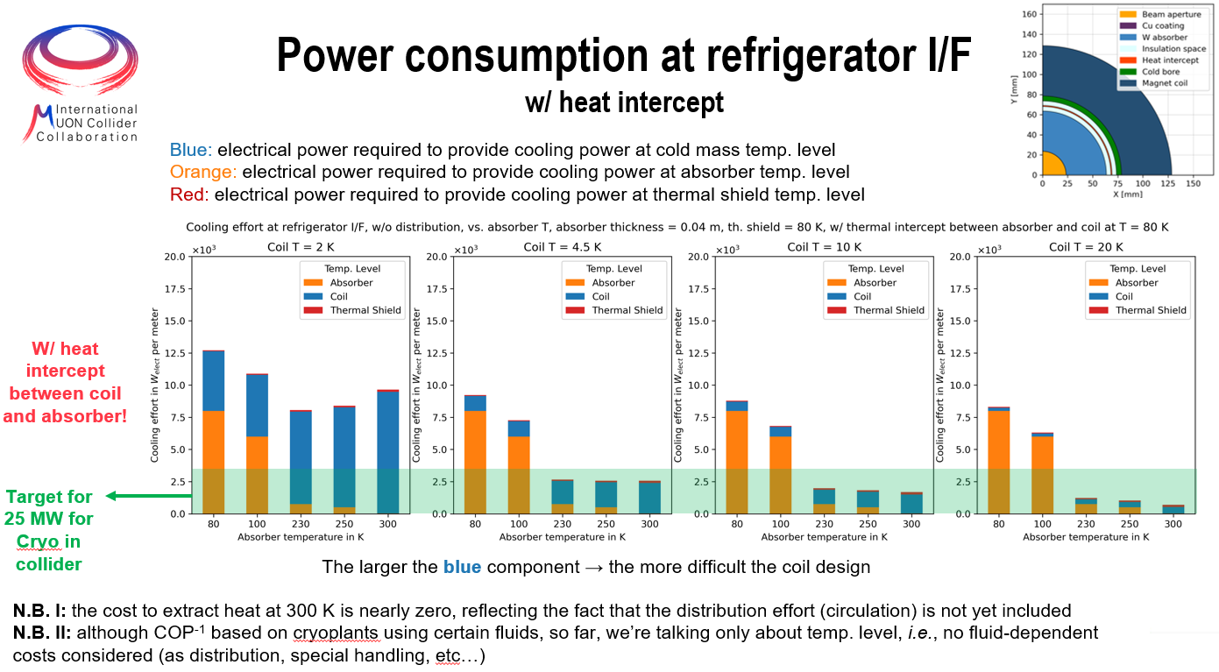
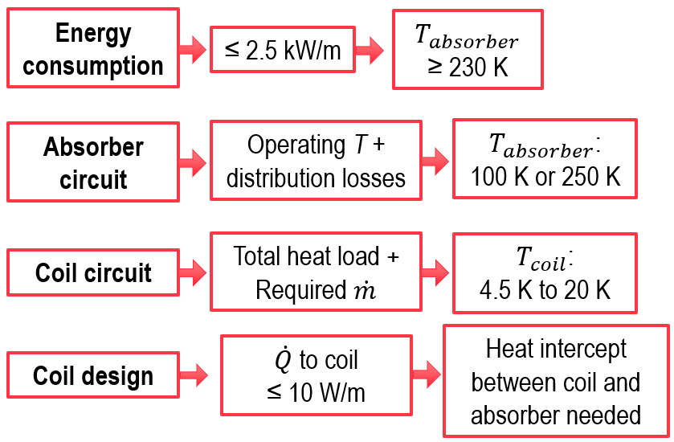
Activities in 2022/2023 (1/4)
WP4.6-T1: Cryogenic options towards reduced He content cooling
  Overview of cooling options for collider-type magnets considering optimisation of overall cryogenic infrastructure (i.e. considering all temperature levels), triggered by magnet designers for Muon Collider studies
This type of study needs to be generalised to other accelerators/colliders
→ purpose of WP4.6-T1
Outcome should have an impact on the Nb₃Sn studies targeted in WP4.6-T2

Slide 11
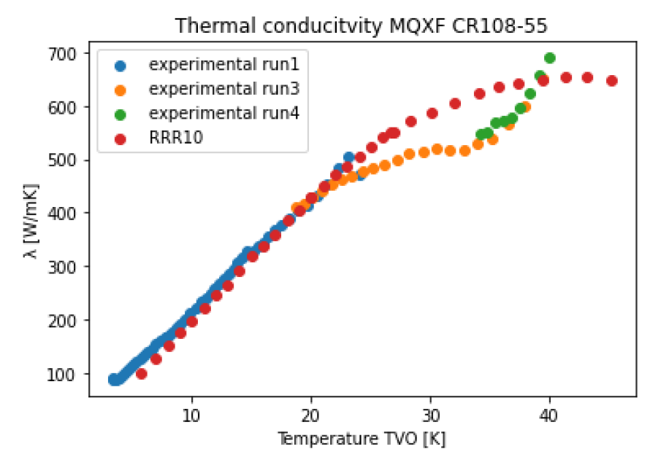
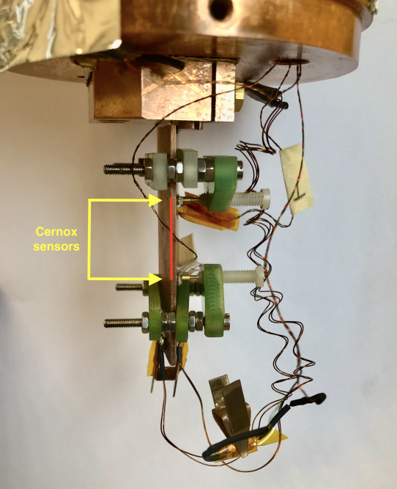
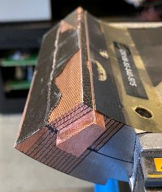
Activities in 2022/2023 (2/4)
WP4.6-T2: Thermal properties of magnet components at cryogenic temperatures
  Measured thermal conductivity of DISCUP C3/30 (coil wedges) down to 6 K (shown)
  Measured thermal conductivity of Mix 61 (below 10 K)
coil wedge
Anomaly seen in values between 25 K – 38 K → interaction of
phonons with the fine alumina powder
Cold data show RRR10 Cu equivalent thermal conductivity
Good candidate for future cooling tubes (limited quench interaction)
Extraction of sample from bulk coil CR108-S5

Slide 12
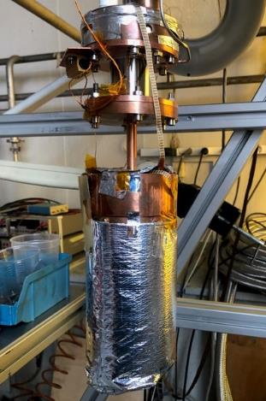
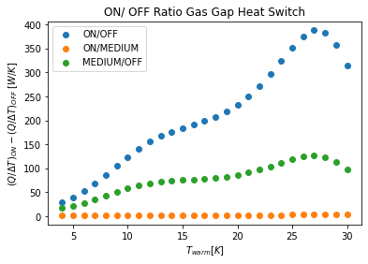
Activities in 2022/2023 (3/4)
WP4.6-T7: Test stands for HFM measurements
  Design of a test stand to measure thermal
  conductivity and diffusivity of materials down
  to 1.8 K (GGHS and He loop)
  Set-up in construction
  Components being individually tested
Gas-gap
heat switch

Slide 13
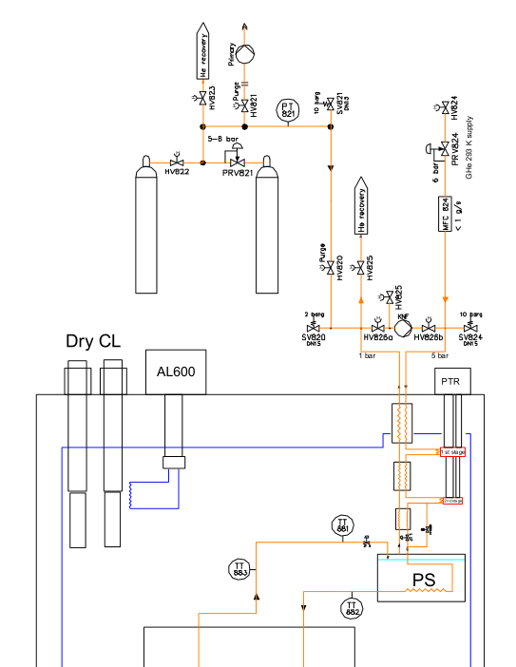
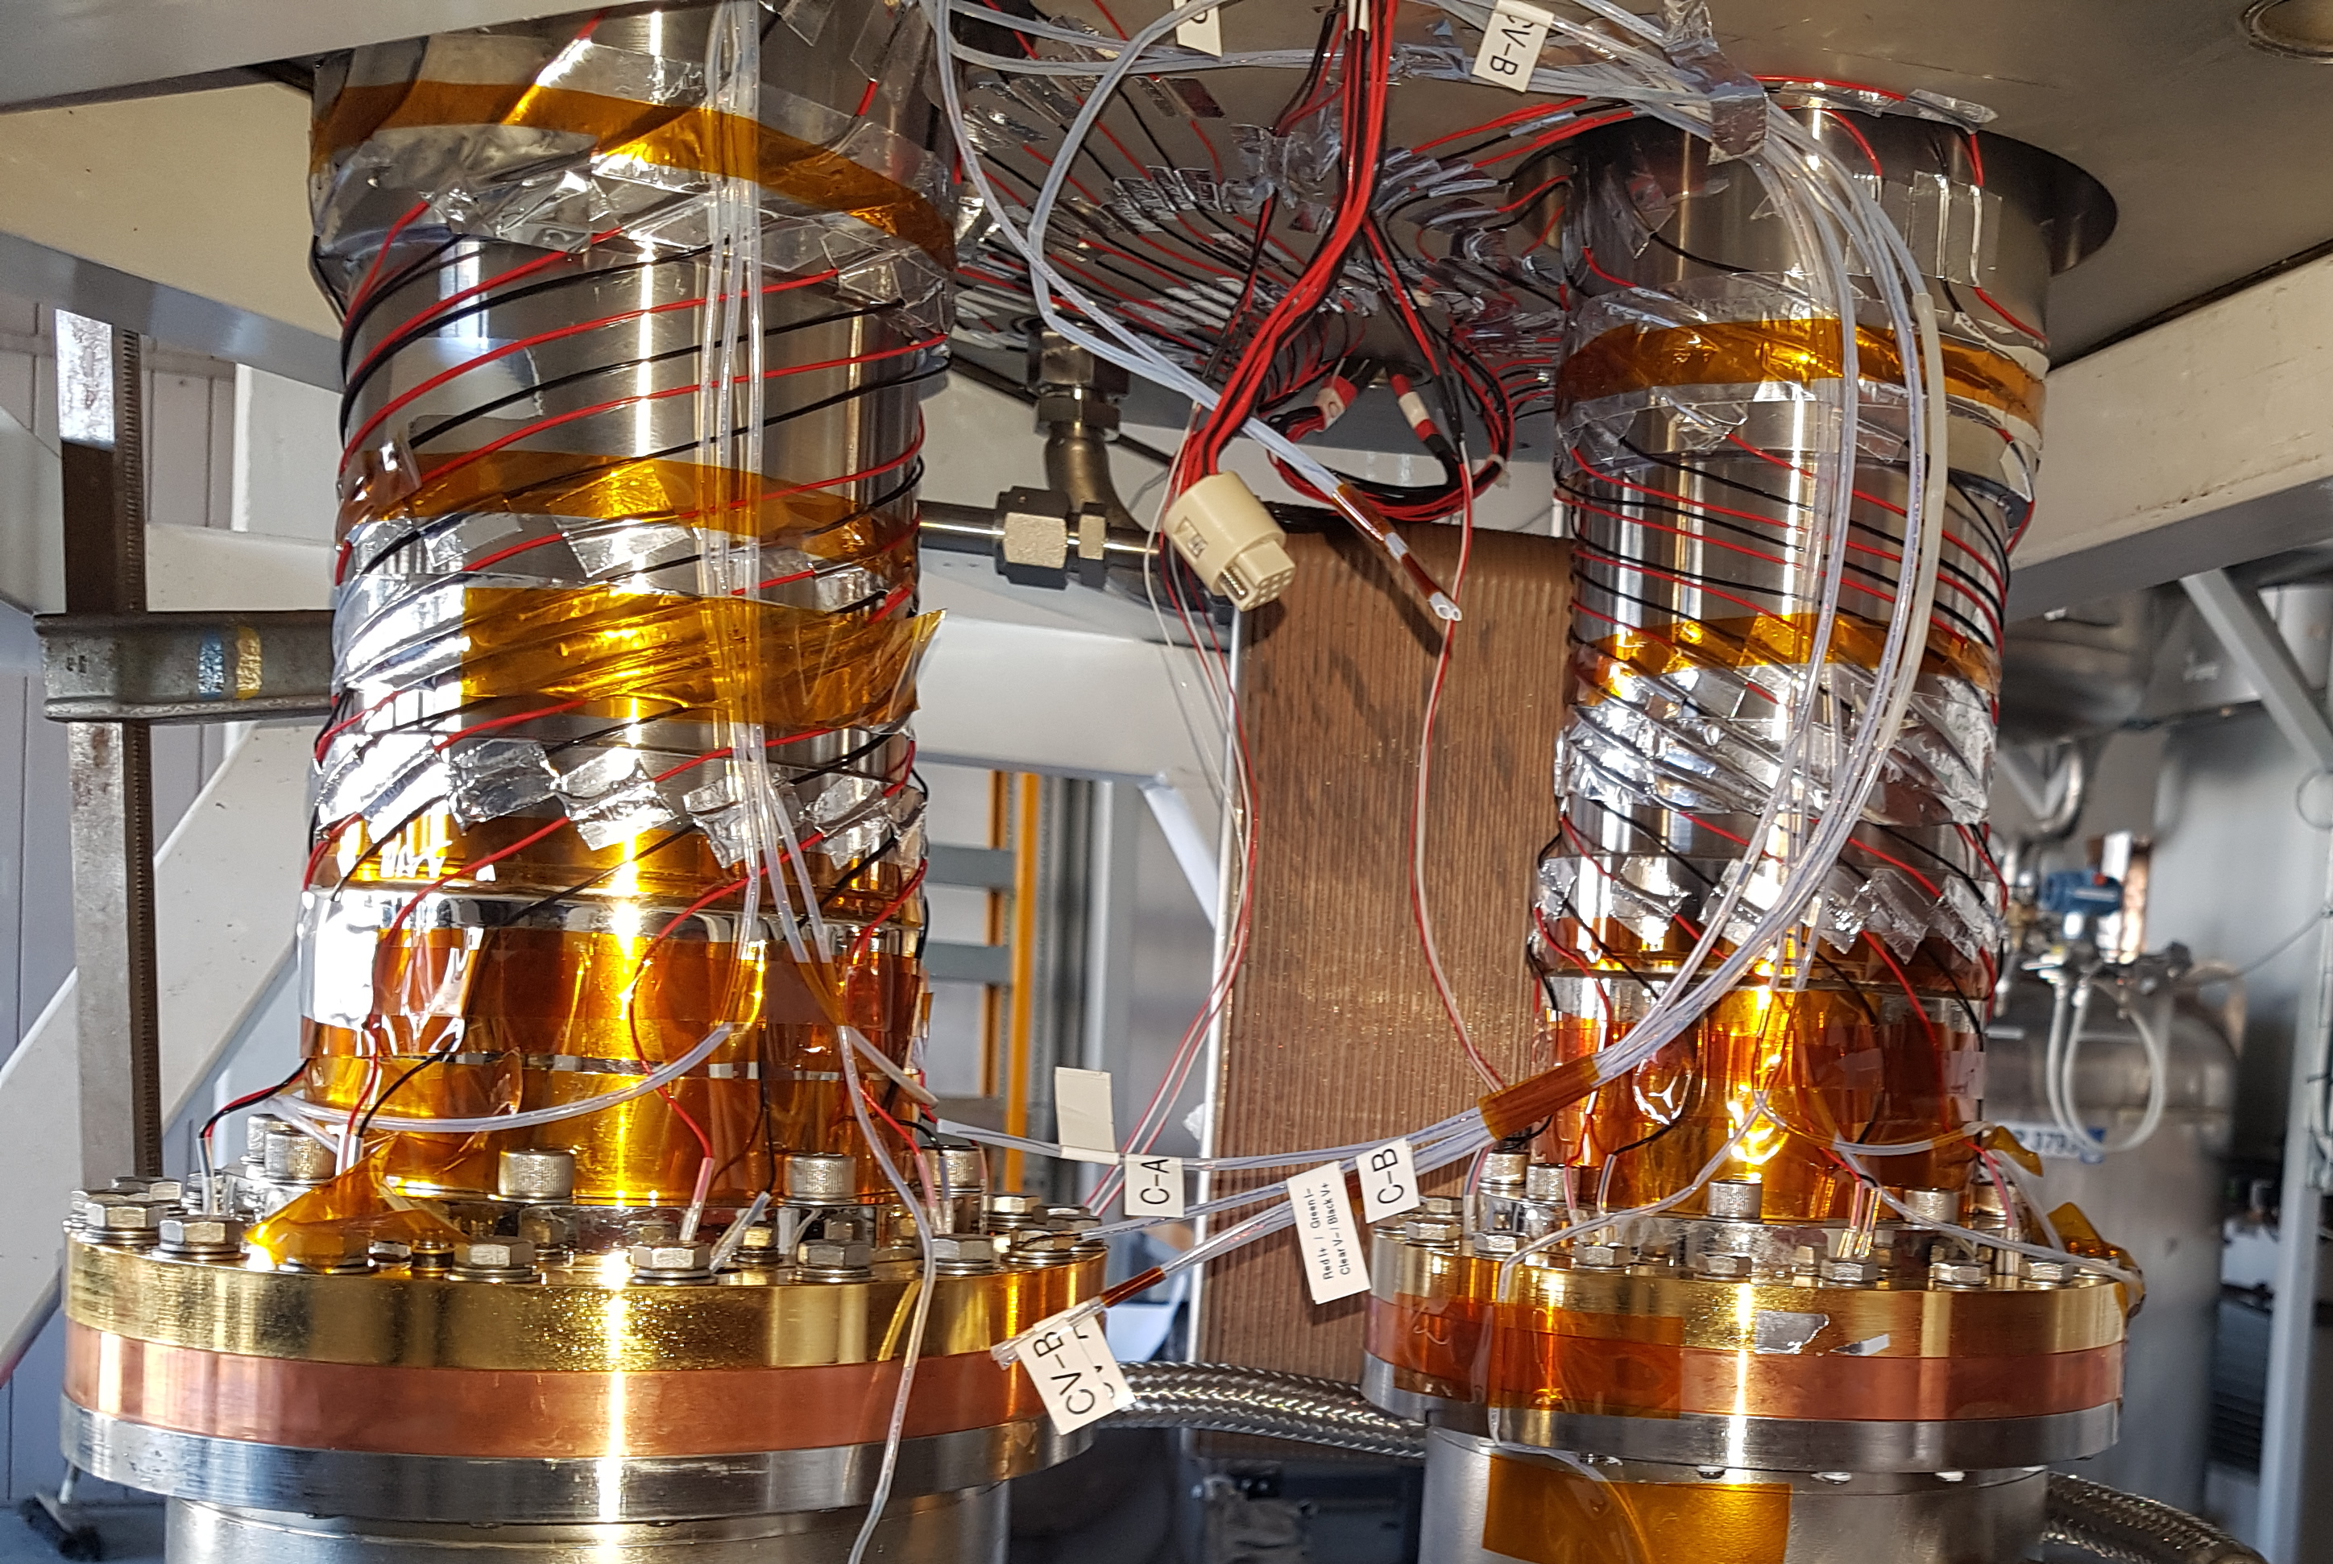
Activities in 2022/2023 (4/4)
WP4.6-T7: Test stands for HFM measurements
  Design of a test stand for conduction-cooled/reduced He content demonstrator magnet (ahead of schedule)
  Testing of individual components ongoing
Single-stage cold heads in a cryostat
HFM test stand 4.5 K
EH mock-up & PID controlled
Performance check of two AL600 GM cryocoolers,
Use it for “dry” current lead cooling at 60 K Cu to HTS transition
Sample

Slide 14
Conclusions
Work is progressing on all tasks, with special emphasis on the construction of test stands for conduction-cooled/reduced He content magnets and on the studies for optimized cooling options for future accelerators
Cross-WP and cross-RD exchange of information needs to intensify
Nb₃Sn-related tasks must be adapted according to RD3 needs
Open points:
  Discussion on thermal aspects of quench protection (WP4.6-T6)
  Need input on developments from RD2 (HTS) and RD3 (Nb₃Sn magnets) to advance on the thermal design of reduced He content/conduction-cooled magnets (WP4.6-T2)

