Slide 2
Introduction to the activities of WP4.5 at CERN
Quench detection, protection and diagnostic methods for HFM
Mariusz Wozniak
18.04.2023

Slide 3
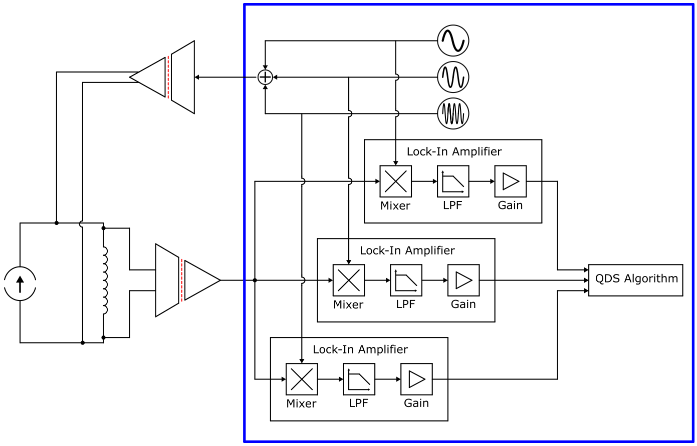
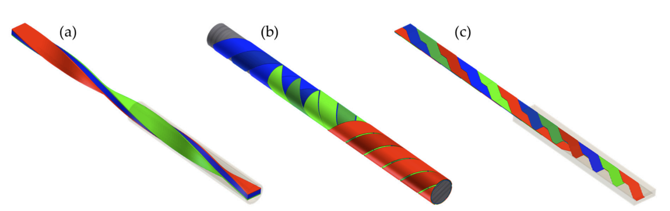
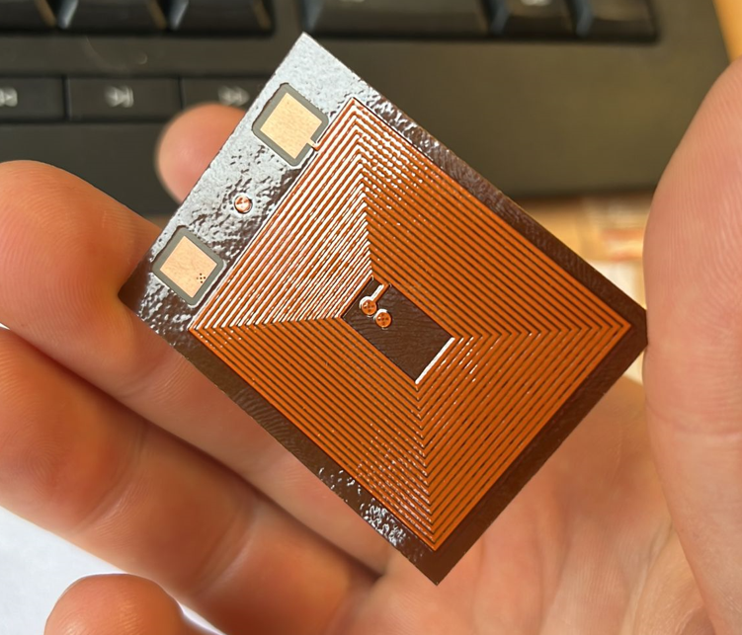
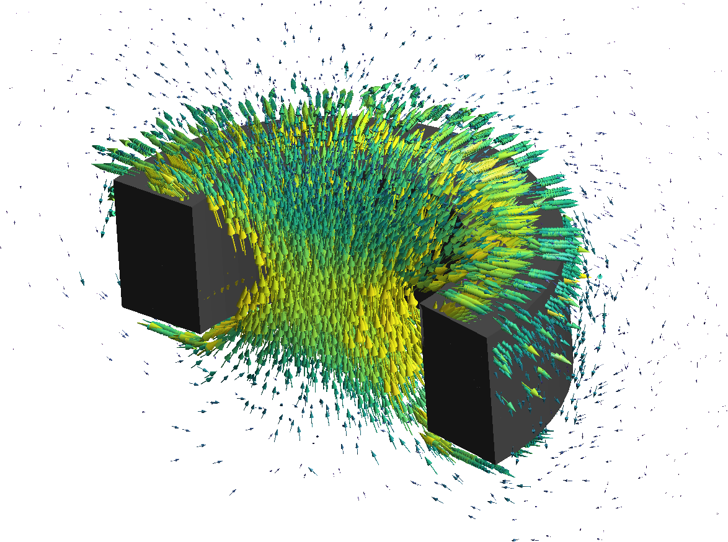

Scope of the WP4.5
1) Quench Detection Technology Development
2) Conductors for Protection
3) Protection Limits Development
4) Protection Technology Development
5) Models and Simulation Tools Development
2 images from:
L. Rossi et al. Instruments 2021, 5(1), 8. and J Ferradas Troitino et al. Supercond. Sci. Technol. 34 (2021) 084003 (17pp)

Slide 4
Complete list of defined activities
The following slides will cover the most recent results on
selected activities
If you are interested in not covered activity please contact me for discussion or ask questions at the end.
Note: some activities are not resourced or scheduled for later

Slide 5
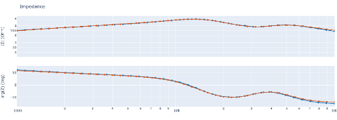
Impedance Measurement for Continuous Condition Monitoring (including quench detection)
Conceptual illustration of how future quench detection may be implemented.
Current Status:
Built hardware required to inject and measure the response of stimuli signals, like:
  DAC (inject) & ADC (measure) cards
  FPGA to supervise the cards and relay the collected samples
Quantified performance when measuring LTS magnets in non-powered state
Upcoming Tasks:
Quantify the performance when measuring HTS magnet (non-powered)
Quantify the performance when powering magnets for LTS and HTS
Evaluate the systems operational impact on auxiliary systems.
Stimuli inject.
FPGA
SC circuit
Impedance of warm D2 magnet, all coils in series.
Orange – ELQA team with ‘commercial hardware’,
Blue - Newly Developed hardware, tot. aquisition time 1.2s
Courtesy of Magnus Christensen and SM18 colleagues
WP4.5-T1-D5
Notes:
Concept advantages:
-Allows for enhanced noise rejection compared to contemporary methods.
-Can provide insight into magnet’s instantaneous impedance – this could aid in quench detection.
To minimize the operational impact on auxiliary equipment, such as power converters and existing quench detection systems, the injection hardware is designed to inject low amplitude signals (1-100mV).

Slide 6
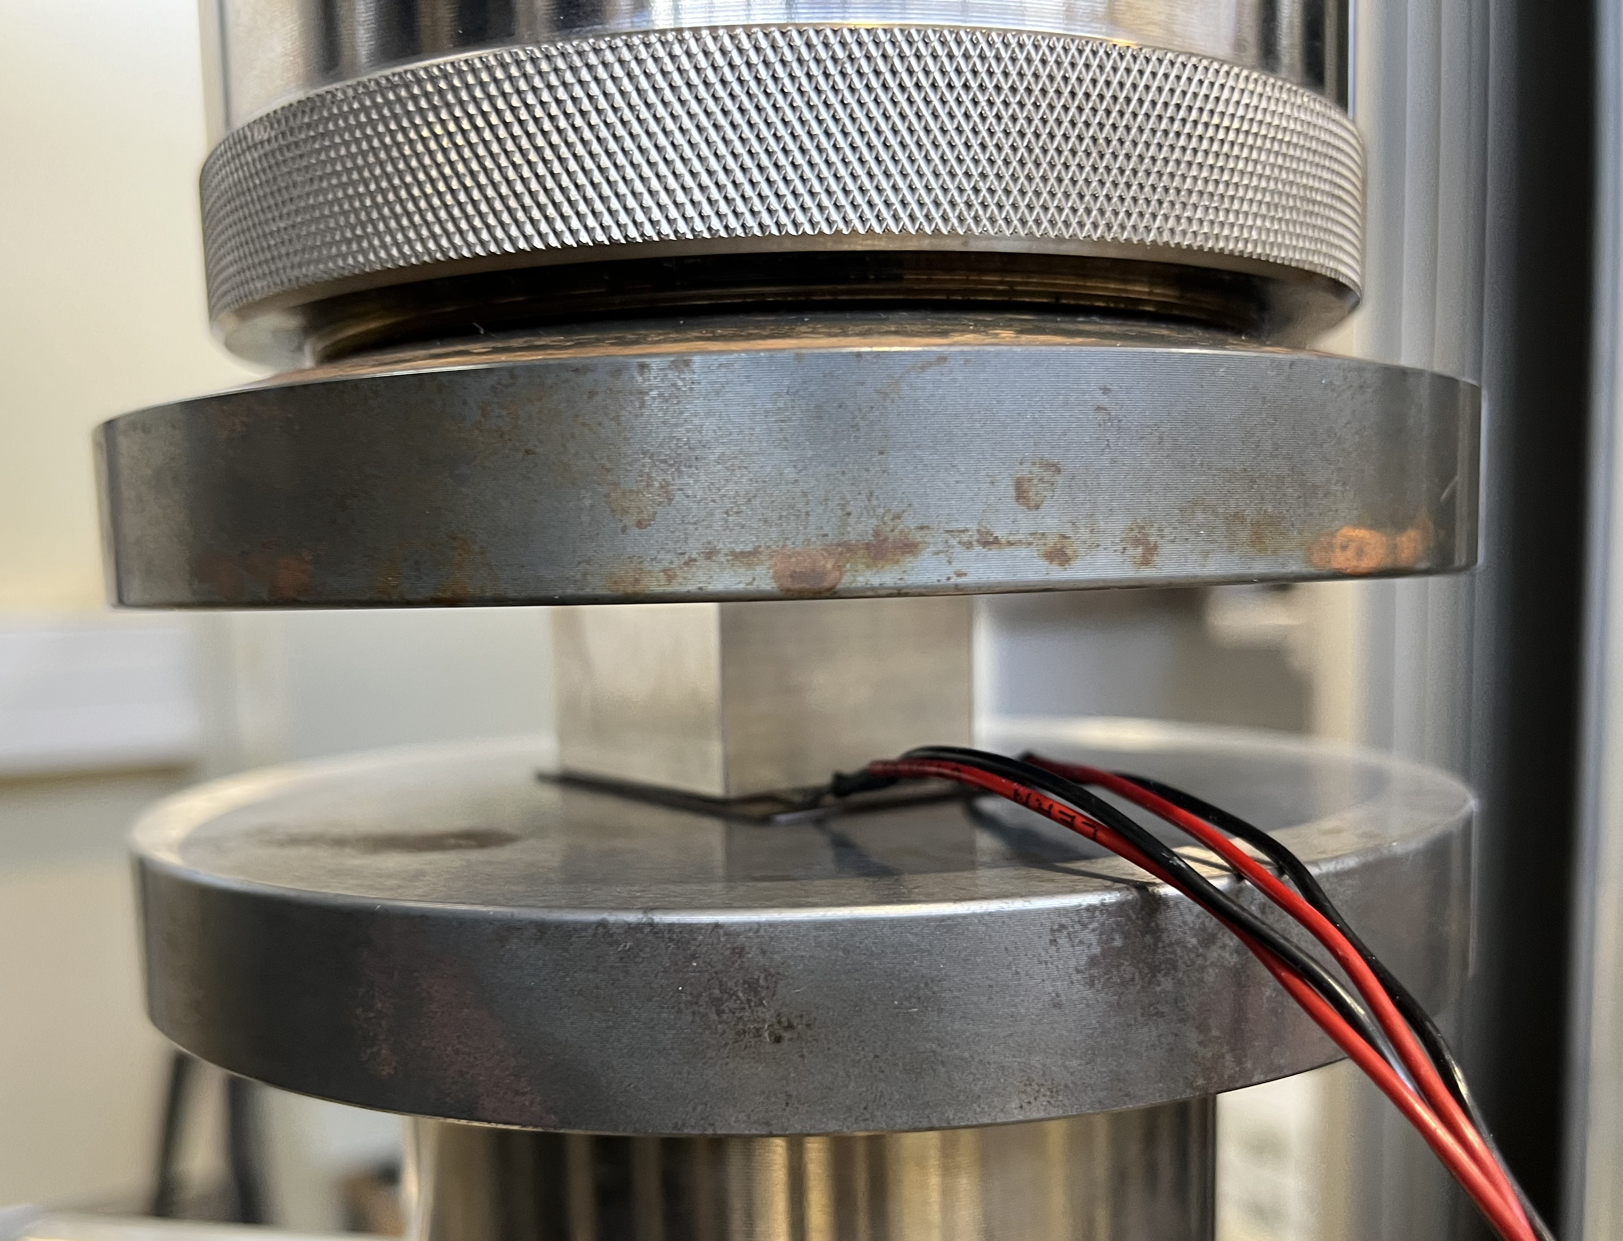
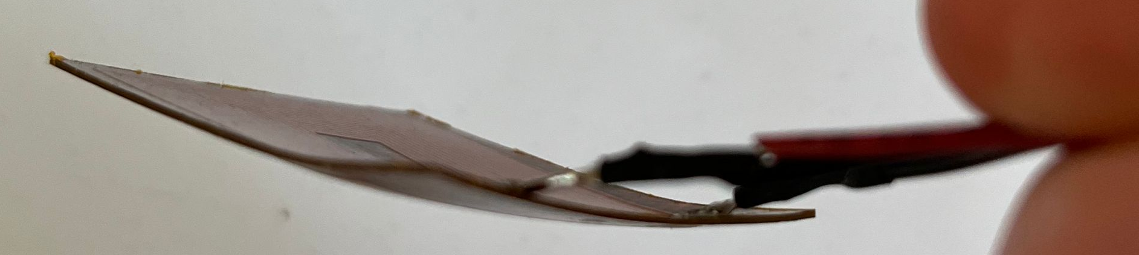
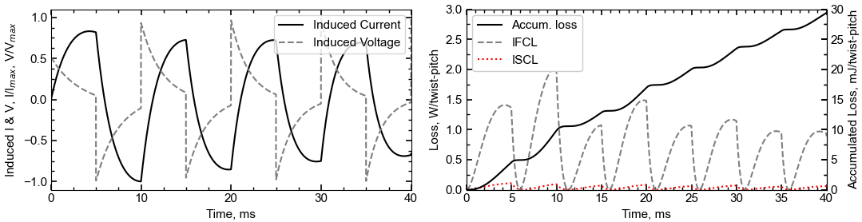
E-CLIQ: External Coil Coupled Loss Induced Quench
A set of very compact copper coils strategically positioned close to the primary coils, similar to resistive quench heaters, see Mulder et al. 2023
PCB E-CLIQ in development for integration with an SMC
  Optimized for use with low-current amplifier
  Able to generate local dB/dt of > 100 T/s
  Compact envelope, width of a Nb₃Sn cable
The design is experimentally verified to withstand mechanical loads of over 200 MPa ✓
Thanks to I. Santillana and A. Terricabras (EN/MME) for effort during the mechanical tests
Modeling tools further matured
Courtesy of Tim Mulder
WP4.5-T4-D2
WP4.5-T5-D5

Slide 7
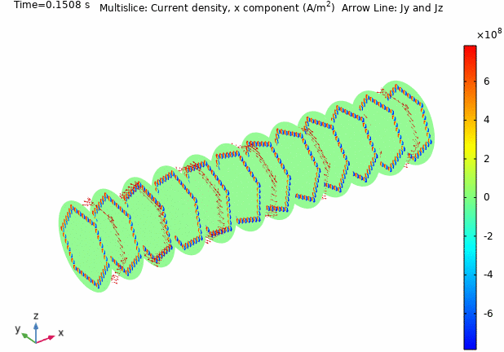
Dynamic effects in composite superconductors
Developed a 3 D thermo-electromagnetic FEM (Comsol) model to simulate dynamic effects in twisted composite superconductors
  Presently built for high-J_{c} Nb₃Sn wires composed by up to 108 sub-elements, the model can be adapted to other superconductors
Next Steps:
  Validation vs simple cases having an analytical solution and vs existing representative experimental results
  Simulate relevant cases to estimate losses and time constants during magnet quenches
  Derive, from the numerical solutions, semi-analytical formulas that can be implemented in other STEAM codes to estimate the losses in superconducting magnets
Magnetization current distribution in 0.85 mm high J_{c} wire composed by 37 sub-elements during a quench starting at 11 T and 1.9 K
Courtesy of Bernardo Bordini
WP4.5-T5-D4

Slide 8


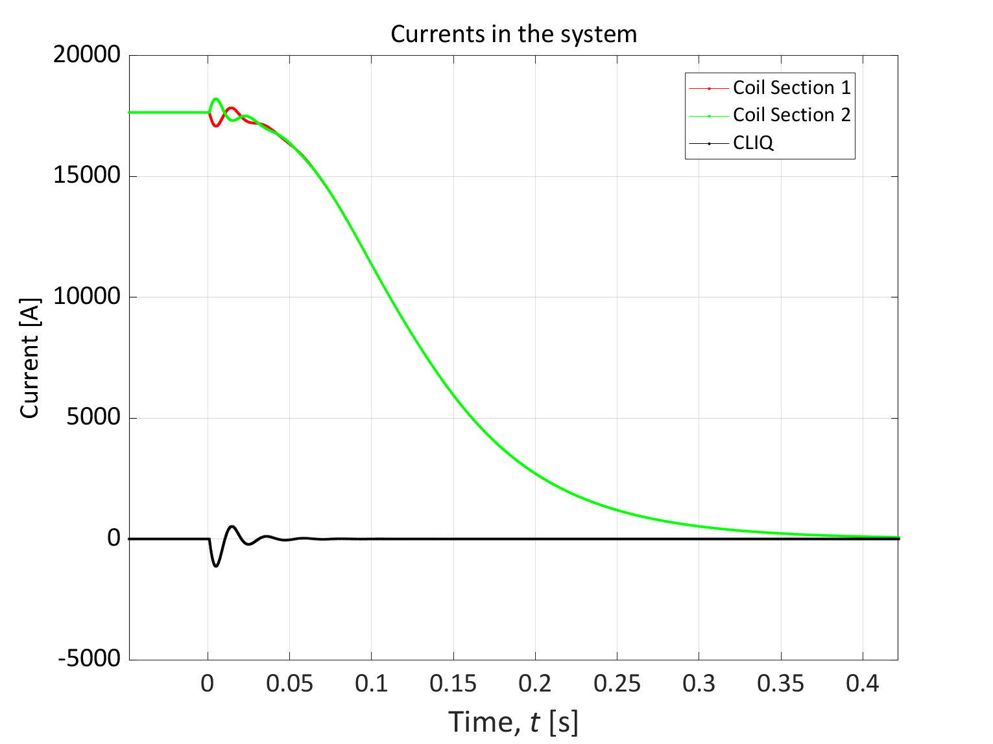
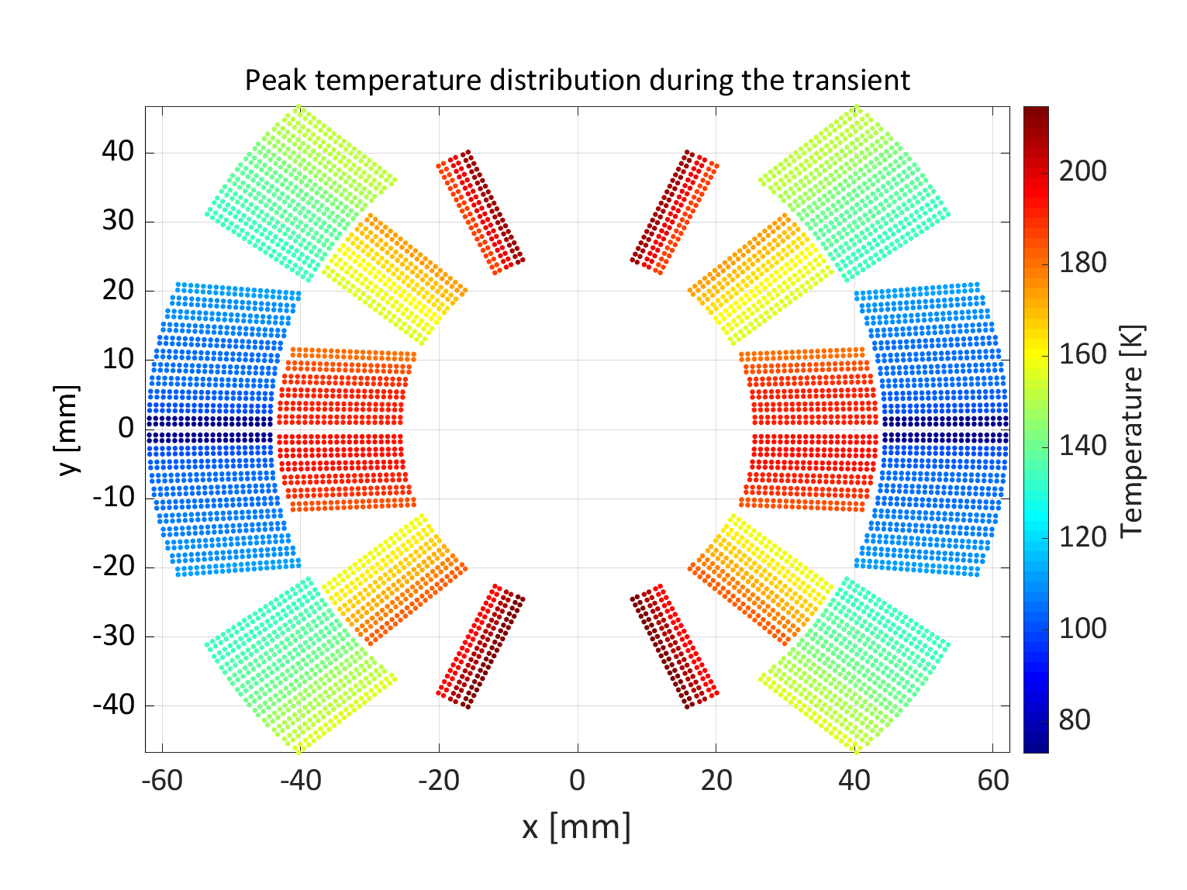
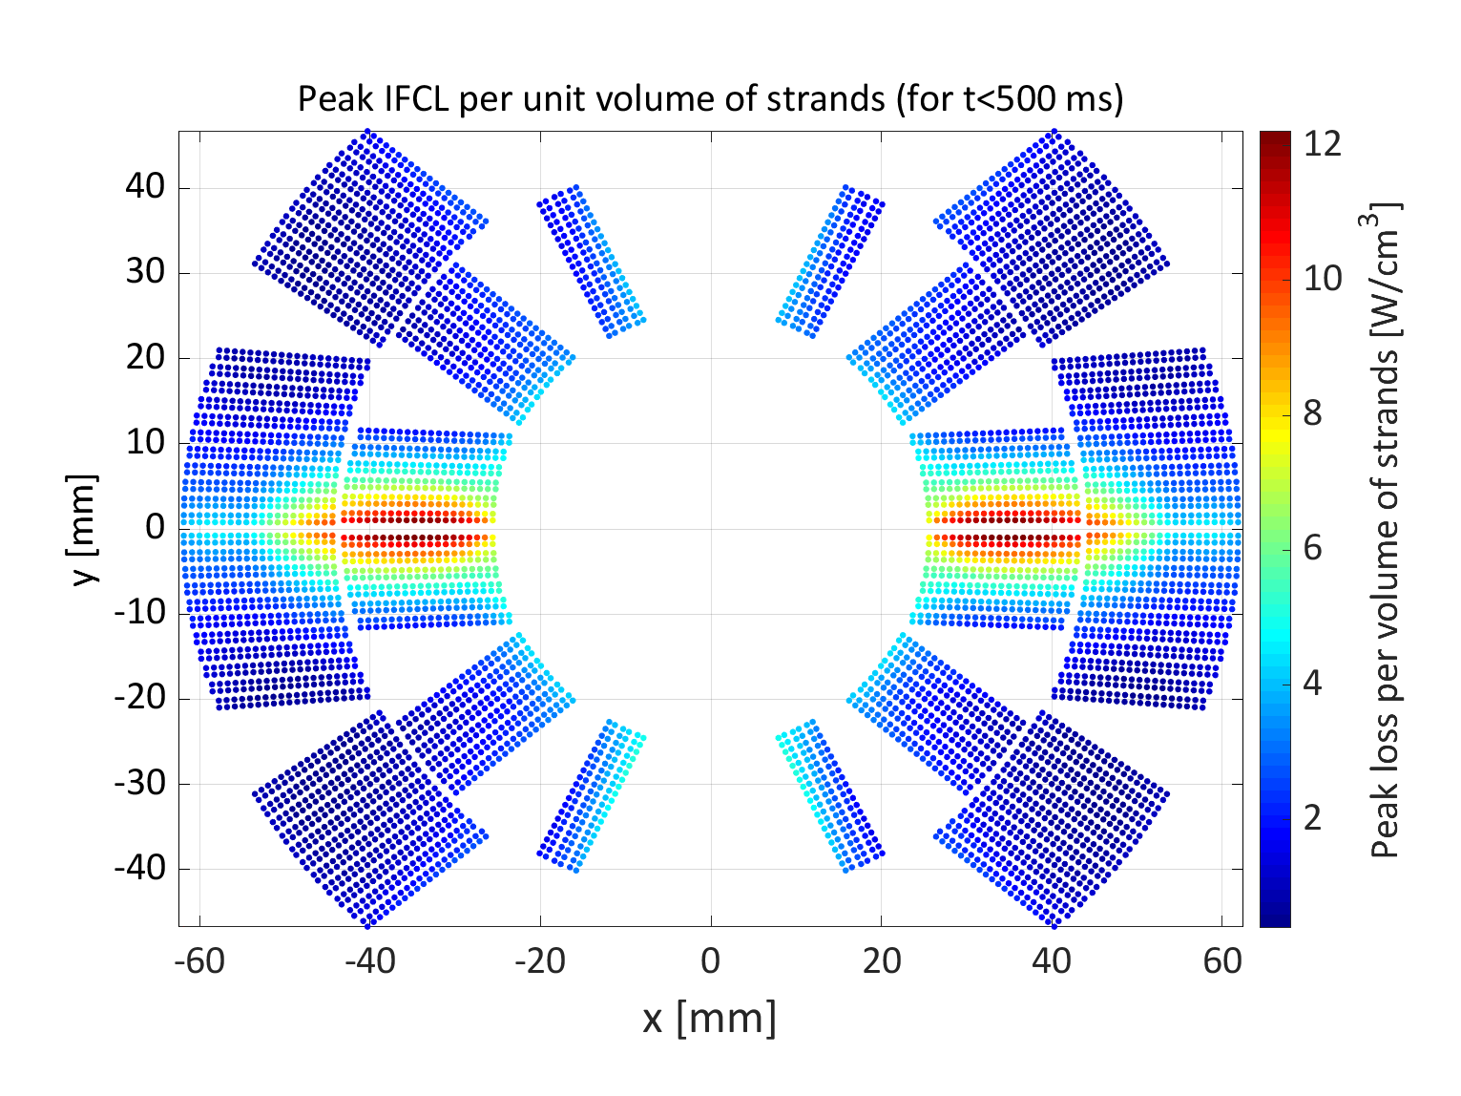
HFM Protection Studies
12T robust dipole - initial concepts
LEDET
Results from:
https://gitlab.cern.ch/steam/analyses/m12t_r
Tag: 2024.4.0
Case 3 for QH+CLIQ for magnet: modelData_robust_12T_50_mm_MQXF_cable_5_blocks_V2
Work request from HFM WP3.1. Collaboration with: Diego Perini, Lucio Fiscarelli. With thanks to Emmanuele Ravaioli.
WP4.5-T5-D1

Slide 9
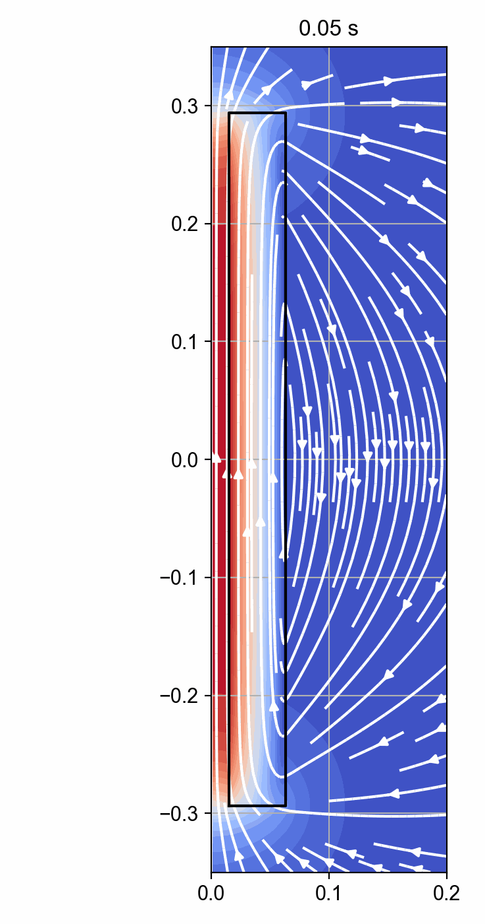
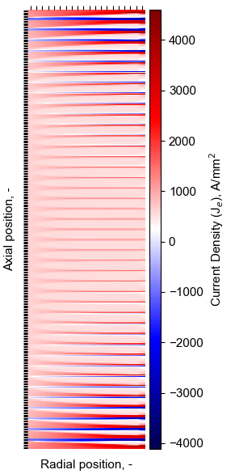
HTS Quench tools development
Selected Finite Difference results
NICQS
NICQS : No-Insulation HTS Coil Quench Simulator
Modeling tools are in development to describe the thermo-electromagnetic behavior of NI/Controlled-Resistance HTS coils
New: persistent currents within the tapes.
  Required for mechanical evaluation.
  Magnetization and its loss during operation.
New: Eddy currents in structural elements.
  Important for quench protection studies.
  AC-loss generated during operation.
Fast, example:
40 T cooling solenoid: 42 pancake coils, 600 turns each -> simulation time of a few minutes to an hour*.
* Depending on the scenario and solver settings.
Courtesy of Tim Mulder
WP4.5-T5-D6

Slide 10
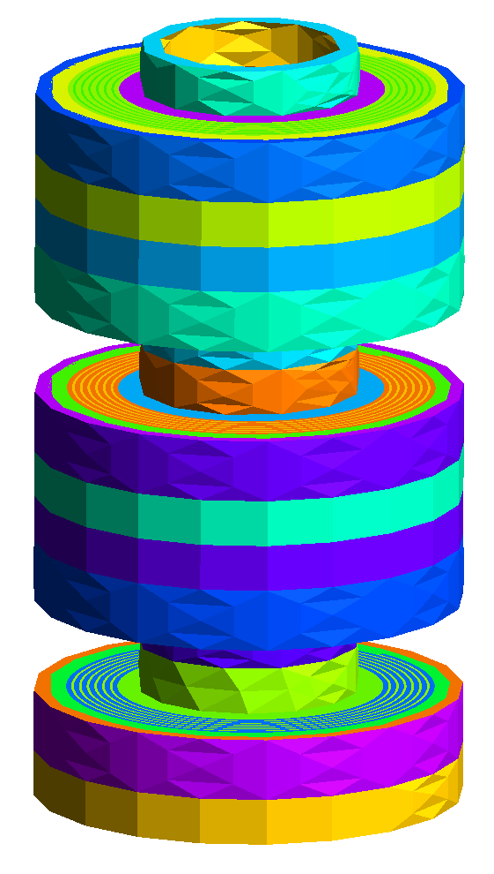

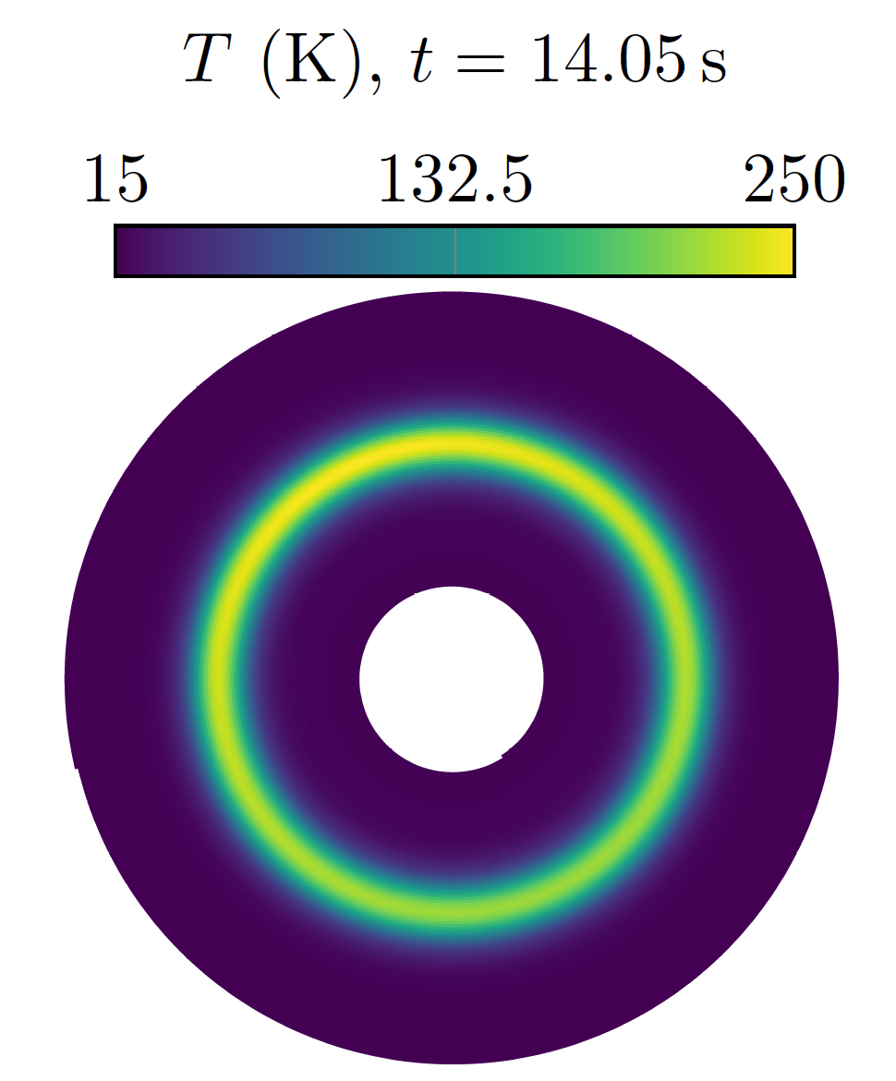
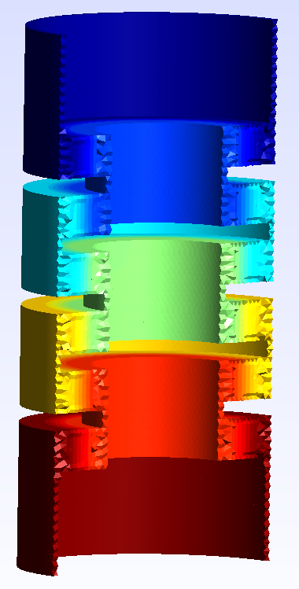
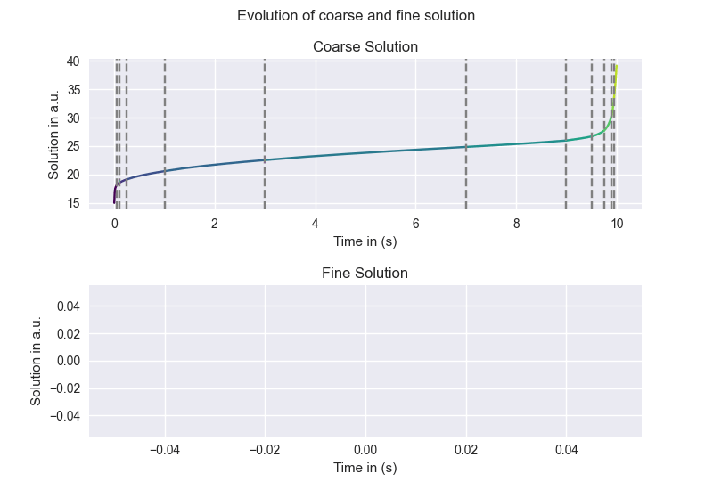
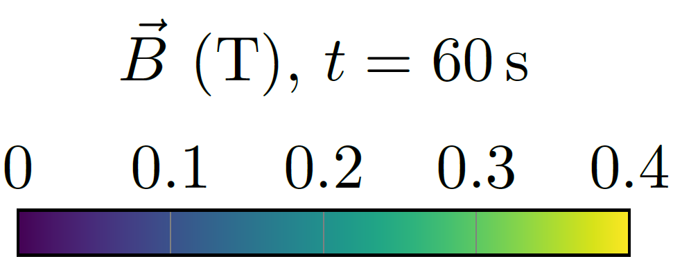
HTS Quench tools development
Selected FE results
FiQuS : Finite Element Quench Simulator
Dedicated tools for Quench Sim.: A. Vitrano et al.
Numerical approaches for more efficient or faster solutions:
- Thermal Thin Shell Approx. E. Schnaubelt et al.
- EM (H – ϕ) Thin Shell Approx. E. Schnaubelt et al.
- Automated geometry, mesh and solution stages
- Concurrent in time and/or space solving (HPC) (w.i.p.)
Mesh of 3D HTS stack of double pancakes
Thermal sol. for multiple pancakes
Corse and fine solutions for parareal algorithm
Courtesy of S. Atalay and E. Schnaubelt
WP4.5-T5-D6

Slide 11

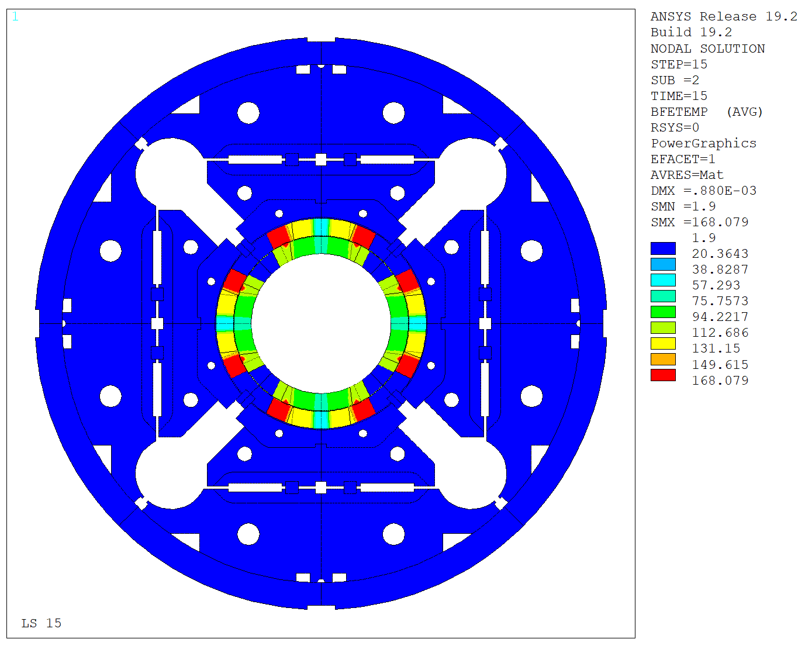
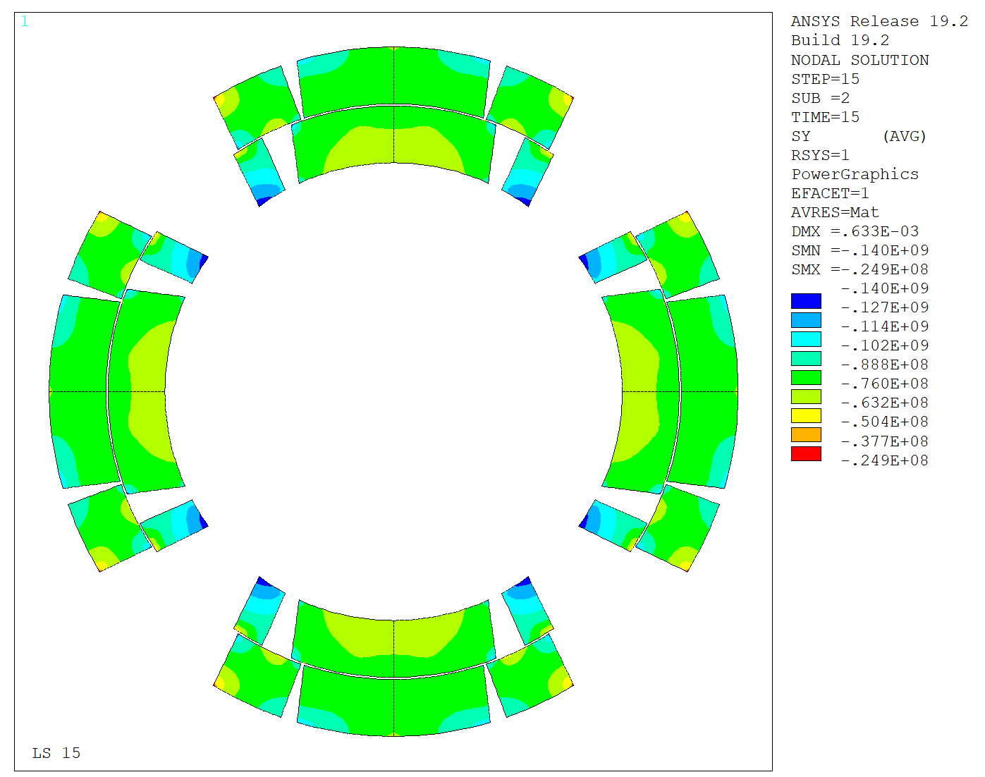
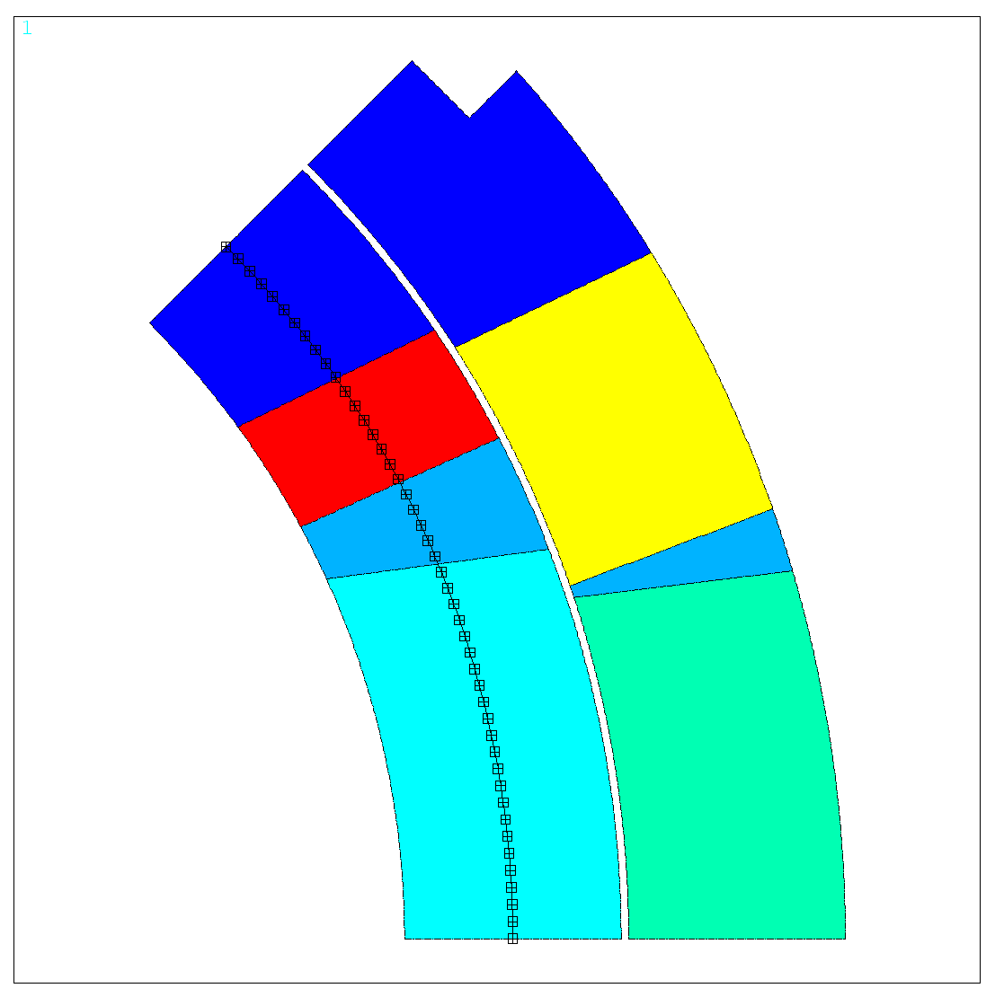
Coupled structural and quench tools
Two-way coupling successfully implemented between ANSYS-LEDET models:
ANSYS APDL provides the element centroids to LEDET.
LEDET solves the transient and transfers back to ANSYS the temperature and e.m. forces across the magnet.
ANSYS solves the transient mechanics problem as a series of static steps (quasi-static approximation).
LEDET
Results comparison (IL path) between this new approach and a full ANSYS model*.
[J. Ferradas, “Mechanical behavior of a Nb₃Sn accelerator magnet during a quench”, PhD Thesis)
Temperature distribution during a Quench Integral test (OL Heater discharge, t = 1 s)
Winding pole is assumed to stay at 1.9 K
Resulting azimuthal stress in the coils. (t = 1 s)
* Largest discrepancy (5 MPa) due to the different pole temperature. Small mismatch in the coil windings due to a larger temperature from LEDET (more accurate coupling losses).
Slide courtesy of J. Ferradas Troitino & E. Ravaioli
WP4.5-T5-D8

Slide 12

Parametrized quench tools
FRAMEWORK
Need to consider multiple design constraints in the analysis (specifications, tolerances, failure cases,…)
Capabilities (WIP):
  Uncertainty Quantification
  Design of Experiment
  Optimization
https://espace.cern.ch/steam
https://indico.cern.ch/event/1161448/
Slide courtesy of E. Ravaioli & M. Wozniak
WP4.5-T5-D10

Slide 13
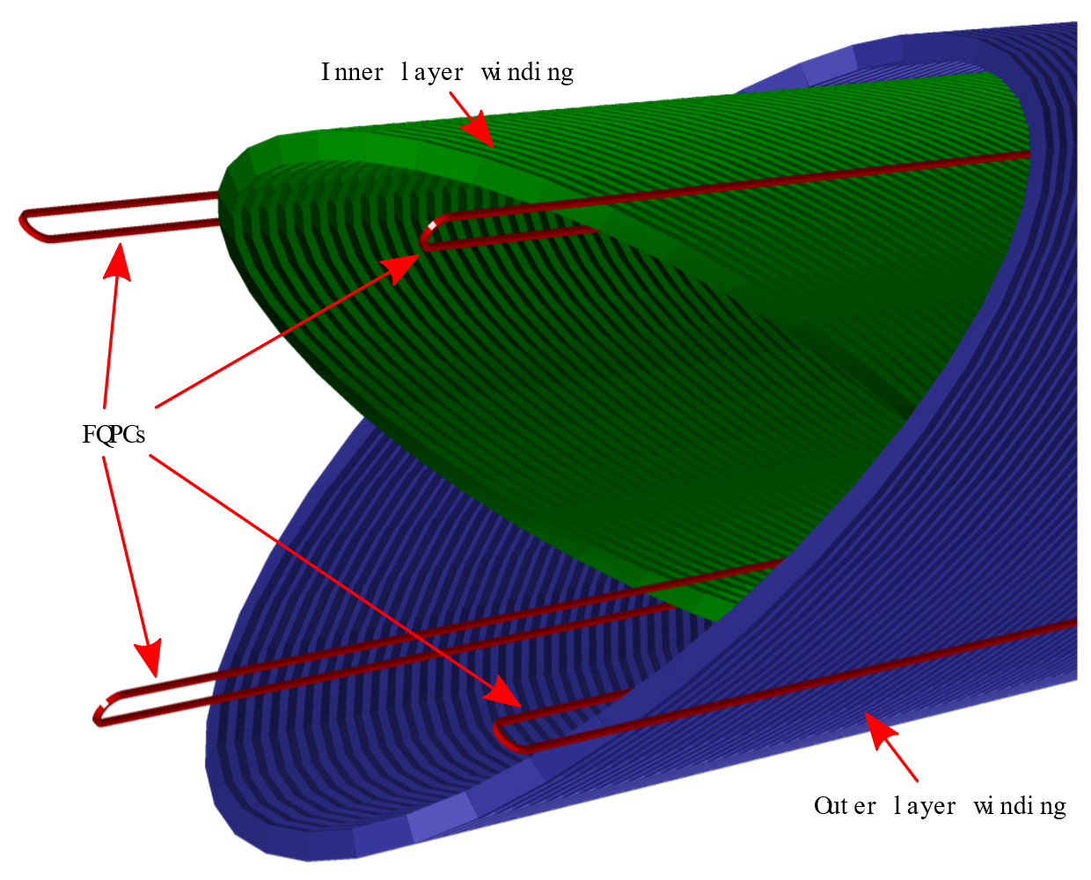
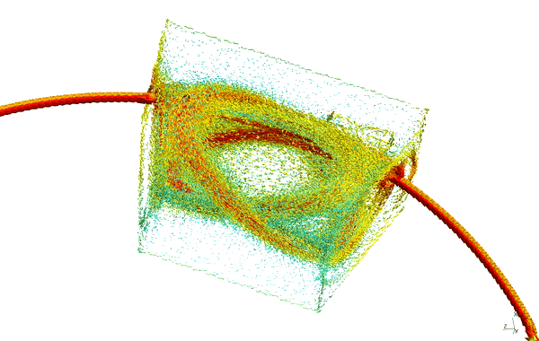
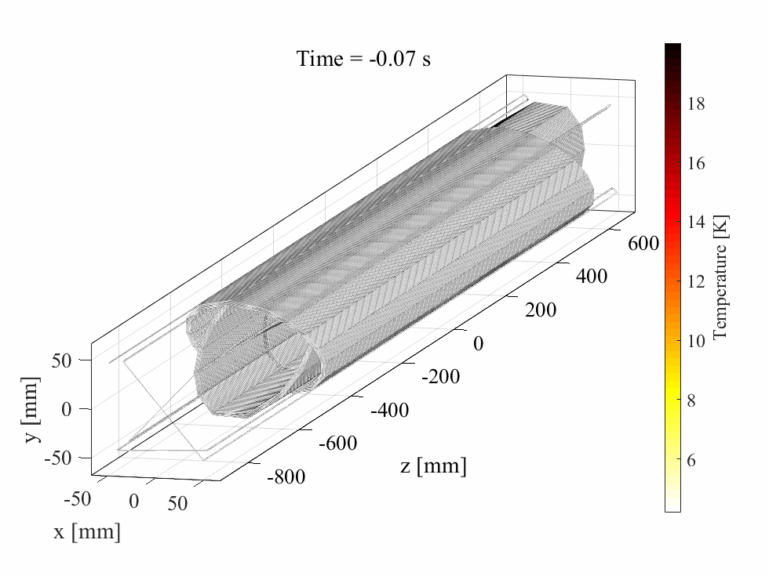
CCT magnet quench tools
Work to simulate quench in 3D in CCT magnets
Coupling between FiQuS (FE) and LEDET (FD)
Exchange of temperatures due to eddy currents (WIP)
LEDET
Initial simulation of eddy currents in the formers and outer shell of Fusillo magnet (w.i.p.)
Concept of Fast Quench Propagation Conductors for CCT magnets, M. Wozniak et al.
Slide courtesy of E. Ravaioli & M. Wozniak
Collaboration with and support of the Fusillo team at CERN
WP4.5-T5-D13

Slide 14
Conclusions
Activities scope and structure are defined
Many interesting R&D topics are identified
Very good progress on resourced tasks
Many tasks are not initiated due to a lack of manpower for WP4.5 or collaborating WPs.
Further refinements and adjustments of activities are expected and required
Clarification of budget and priorities is required
Clarification of collaboration in and outside CERN

