Slide 1
Introduction to the activities of WP4.1
Common modelling and simulation tools for HFM magnets and conductors
Model-Based Systems Engineering (MBSE) and Product Cycle Engineering
Merging simulations, test and magnetic measurements of accelerator magnets
Stephan Russenschuck
18.04.2023

Slide 2
Overview
What we can(not) calculate
What we can(not) measure
Generalized field descriptions
Model-based system engineering (MBSE)
Product cycle engineering
Software and database frameworks interfaces
M. Bonora: Advances on an open software environment, hosting psMBSE

Slide 3
Conclusions
HFM magnets require multiphysics calculations in the early design phase.
Multiphysics simulations must be validated with measurements.
Validation requires proper design of experiments.
Design of experiments require collaborative efforts
Collaborative efforts must consider
ownership (being a co-author on a paper is not enough)
accessibly (sending files and software exec is not enough)
sustainability (a ppt presentation or paper is not enough)
Model-based systems engineering
Product generation engineering

Slide 4
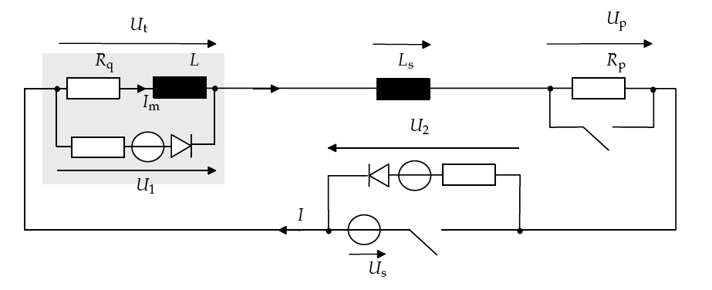
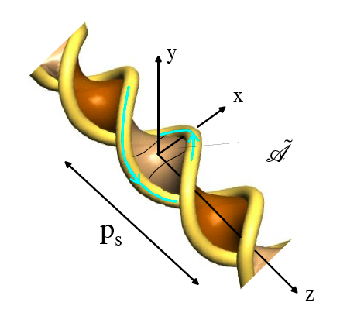
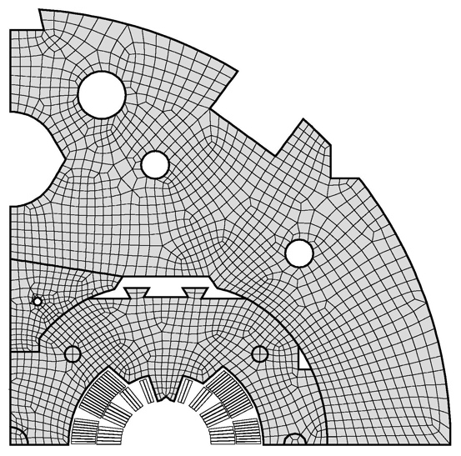
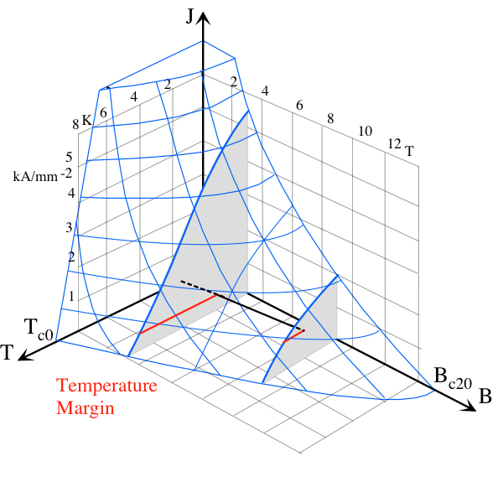
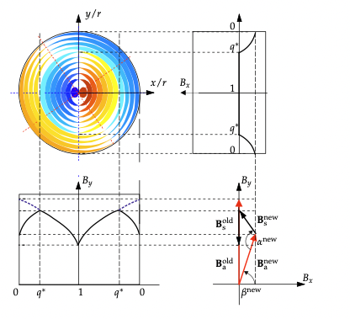
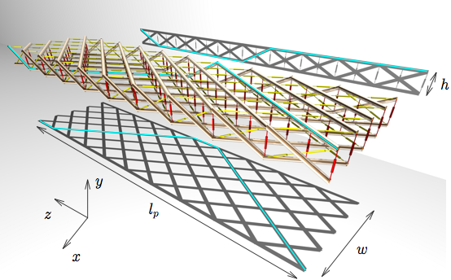
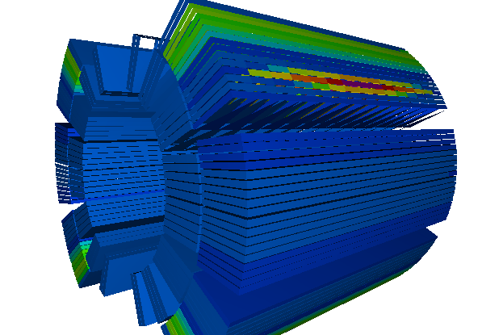
Quench Simulation (Multi-Physics, Multi-Scale)
Multi physics
  Thermo (hydraulic)
  Mechanic
  Electric (circuit)
  Magnetic
Multi rate
  Fast effects on long time scales
Multi scale
  Filaments 6 μm
  Strands 1 mm
  Cable 0.1 m
  Magnet 10 m
  String 3.2 km
Quench Simulation
19
Notes:
quench simulation requires coupling of different models
paper reference
adiabatic !?

Slide 5
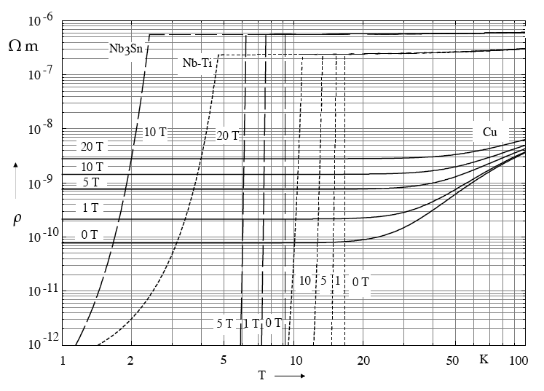
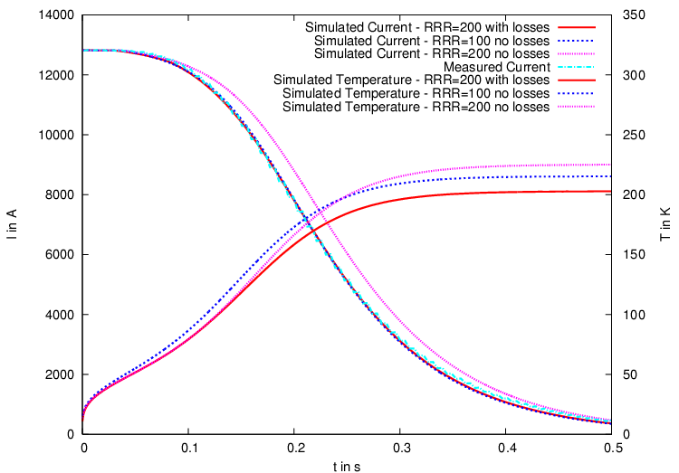
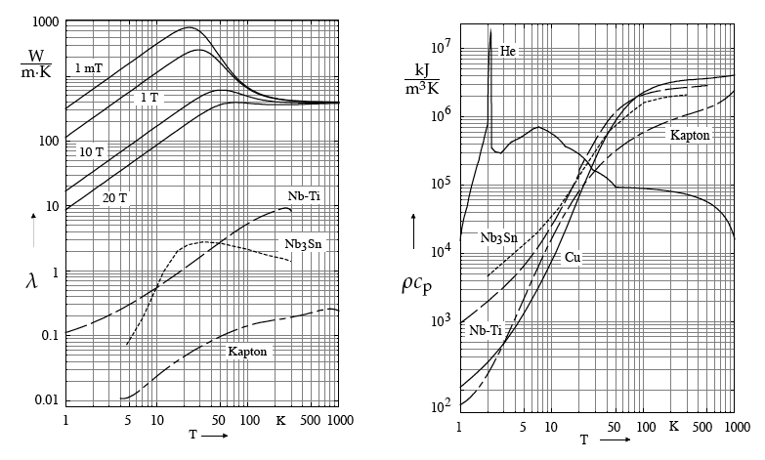
Material Parameters
Electrical resistivity
Thermal conductivity
Volumetric heat capacity
Empirical parameters:
- RRR
- Ra/Rc
- IFCC effective res.
- heat conductivity
- heat capacity
Measured quantities to be reproduced with all material- and model-parameters within their range of uncertainty.
5

Slide 6
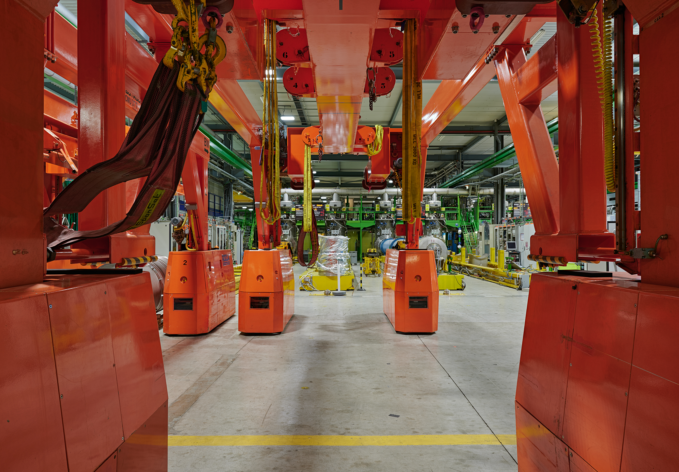
SM18 Test Station for SC Magnets

Slide 7
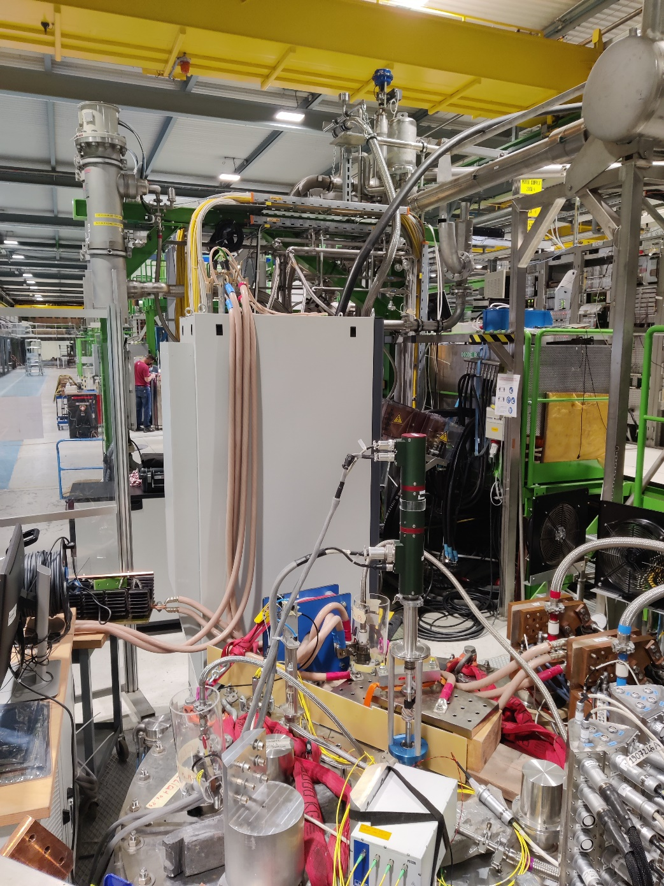
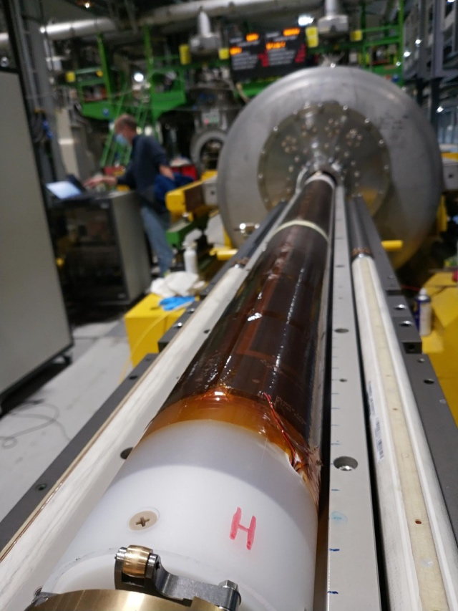
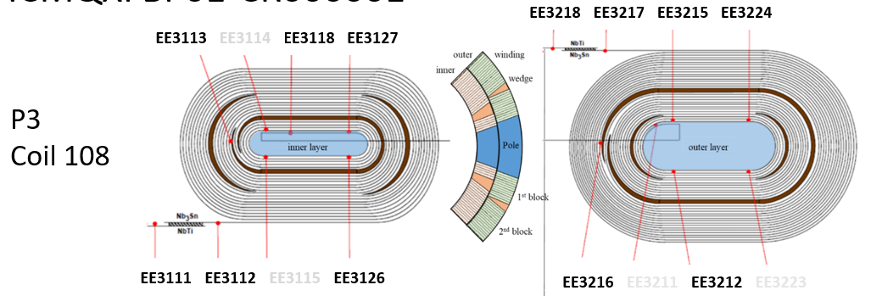
Cold-Testing of Superconducting Magnets
Instrumentation
VI Measurements
Quench localization
U₁
U₂
U₁
U₂
Trim powering
Quench antenna

Slide 8
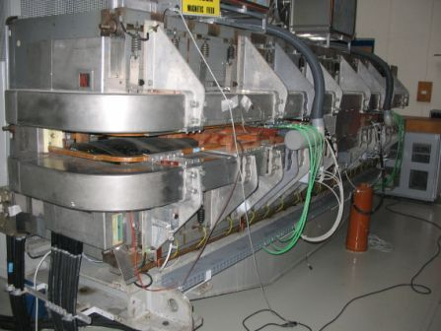
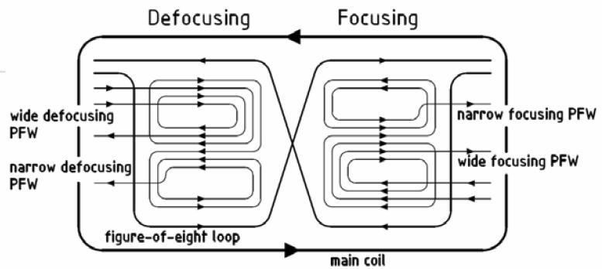
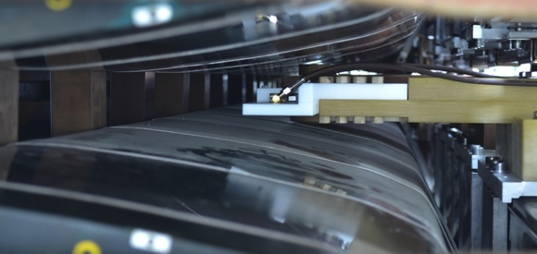
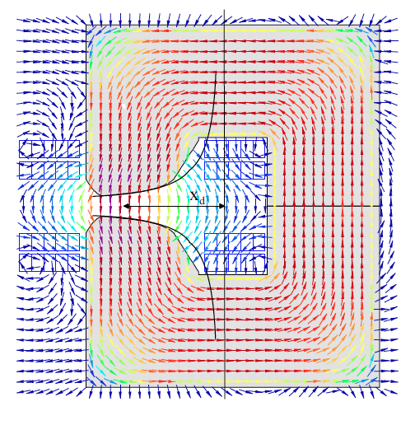
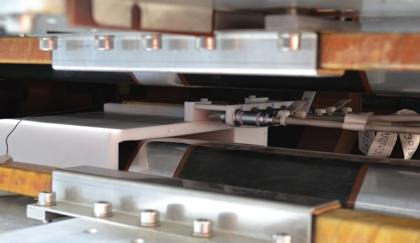
Combined Function Magnets (CERN PS)
Strongly coupled
excitation circuits
No 10⁻⁴ predictive model
Remanent field ≈ 0.2%
Figure-of-eight loop
to control B₂
FMR field
marker
4 pole face windings
affecting B₁ to B₅
Fluxmeter
for gradient
measurements

Slide 9
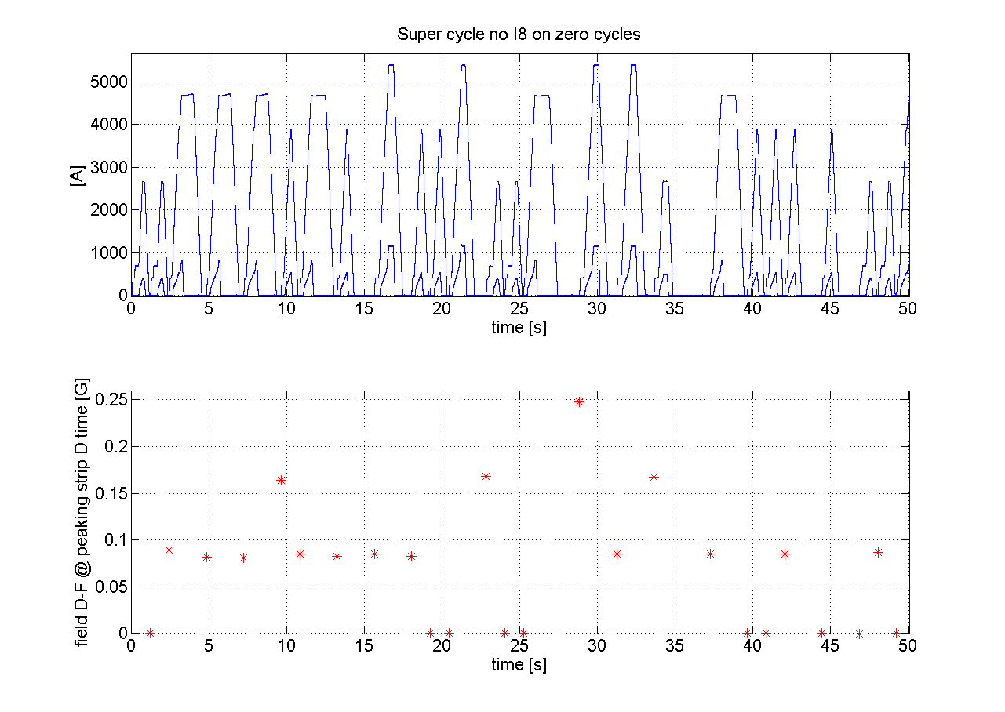
PS Beam Stability Test at Injection
  CNGS
  CNGS
  CNGS
Specific powering cycles (CNGS) lead to reproducible radial positioning errors
from relative field changes on the order of 10⁻⁵

Slide 10
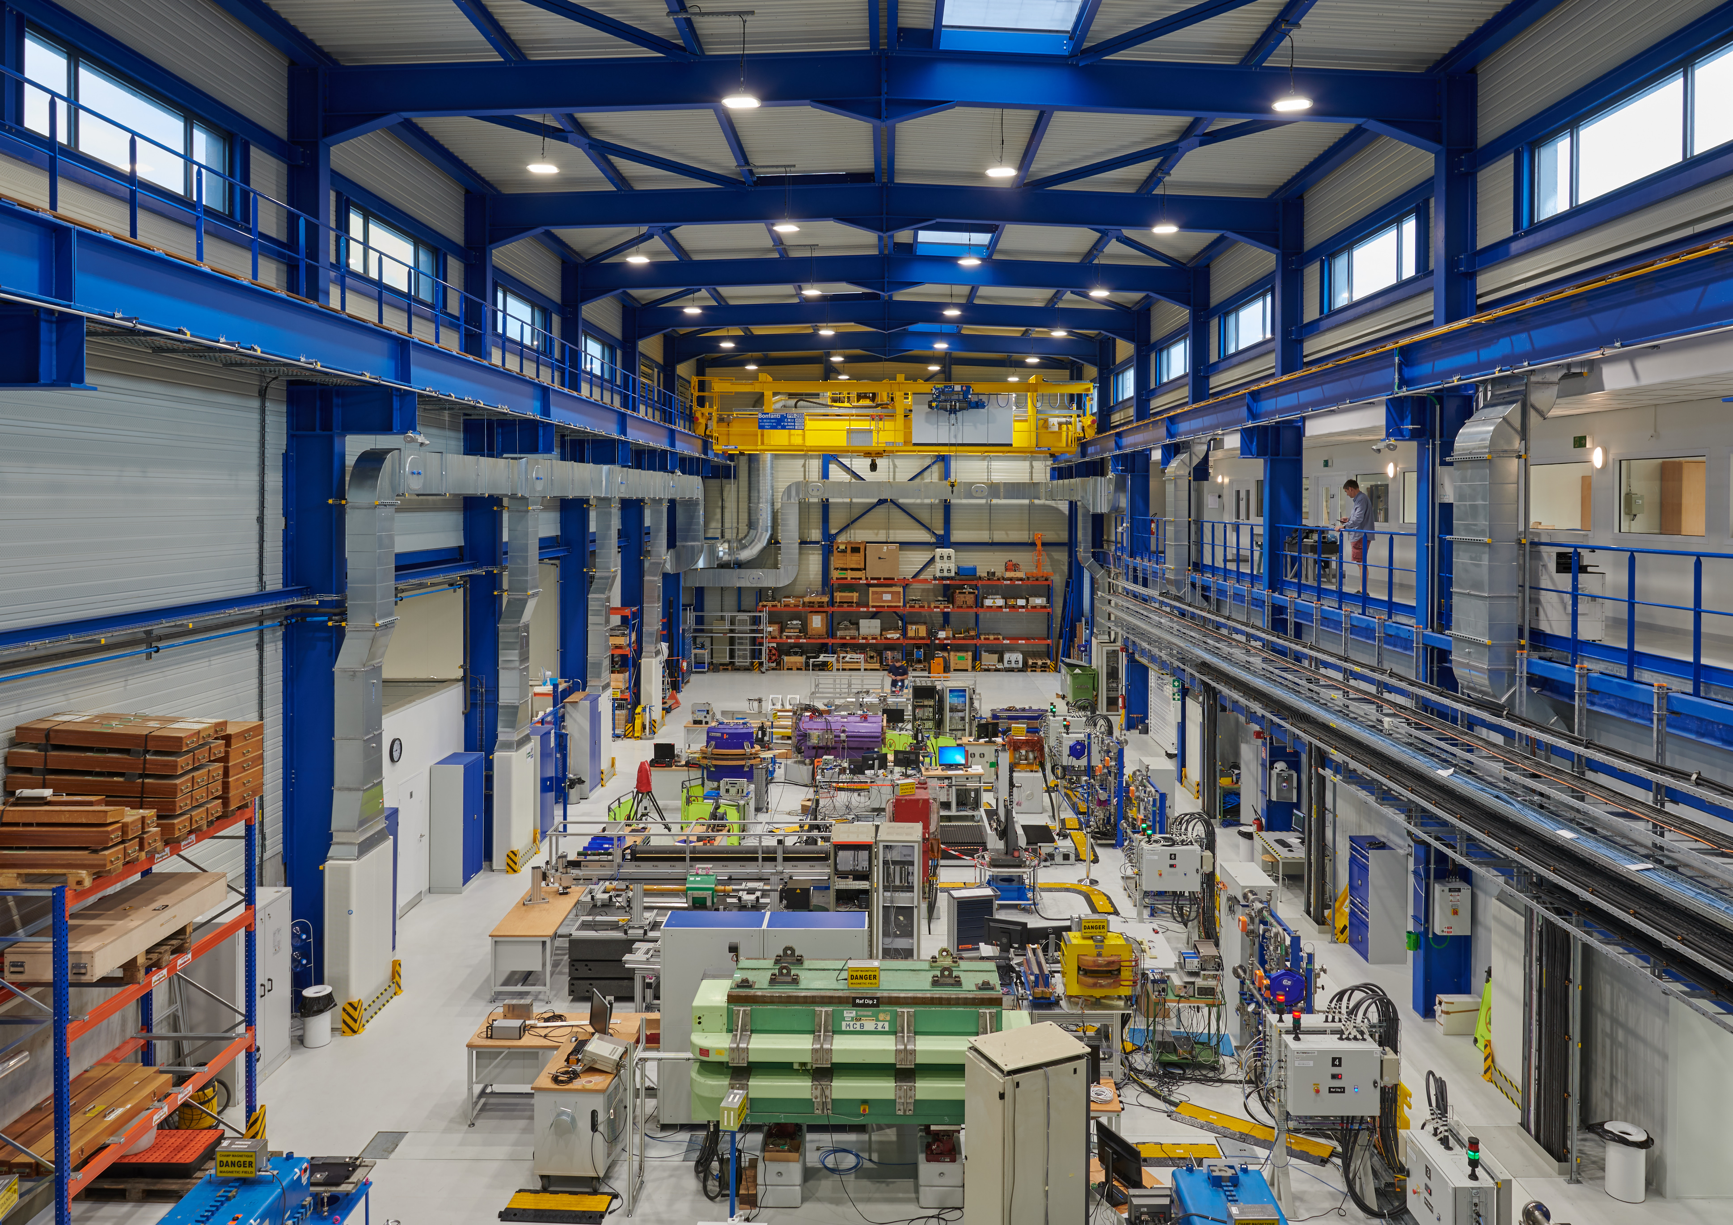
311 Magnetic Measurement Laboratory for NC magnets

Slide 11
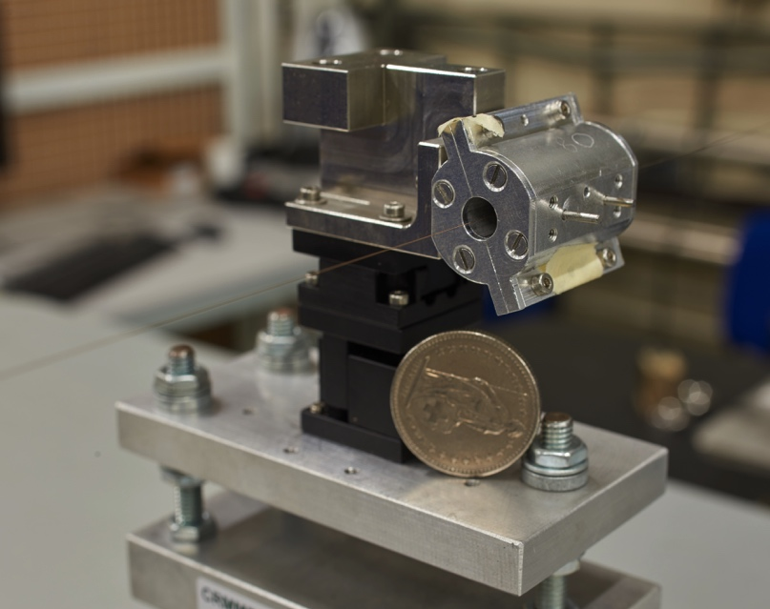
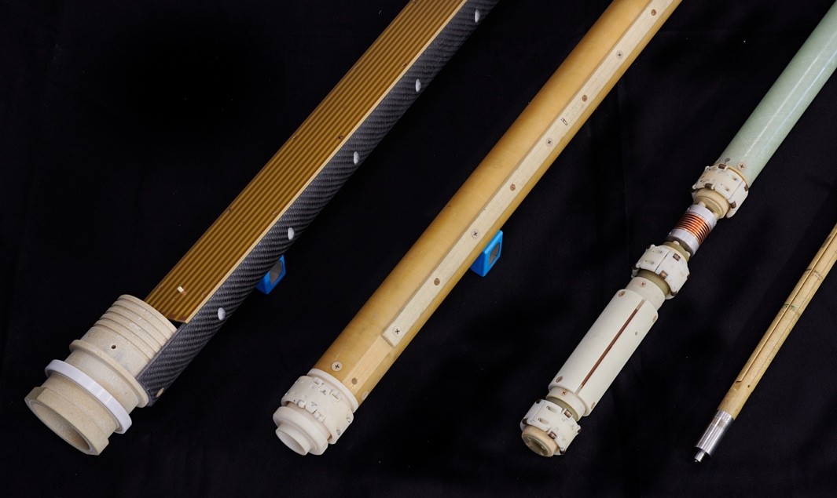
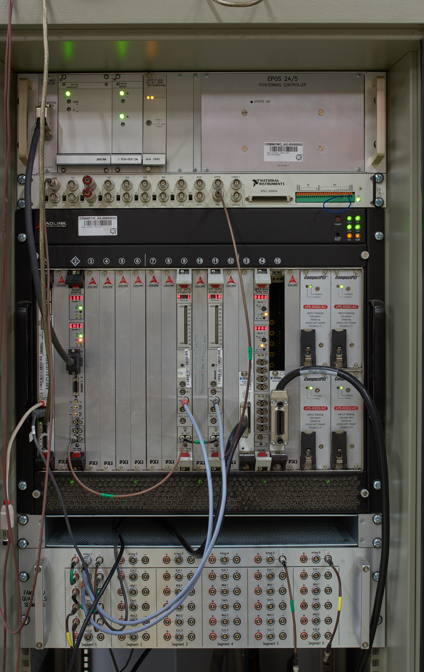
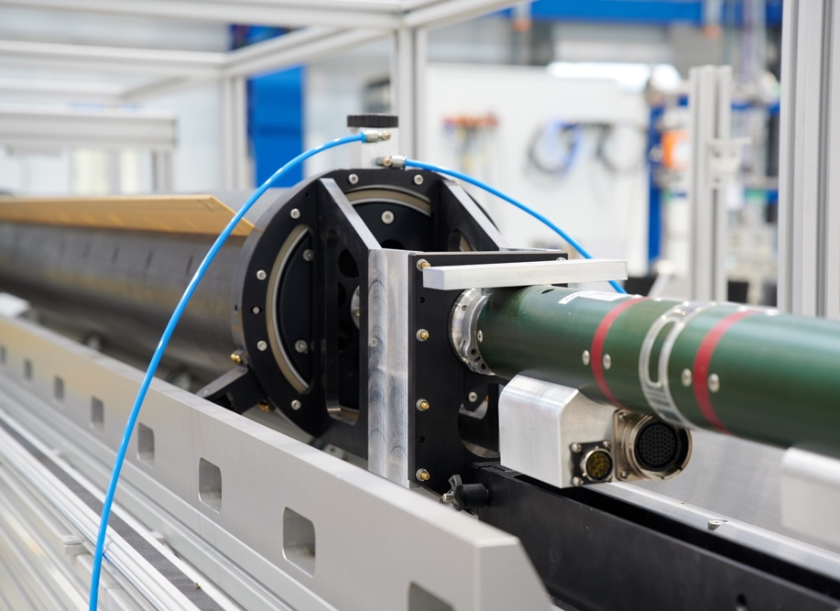
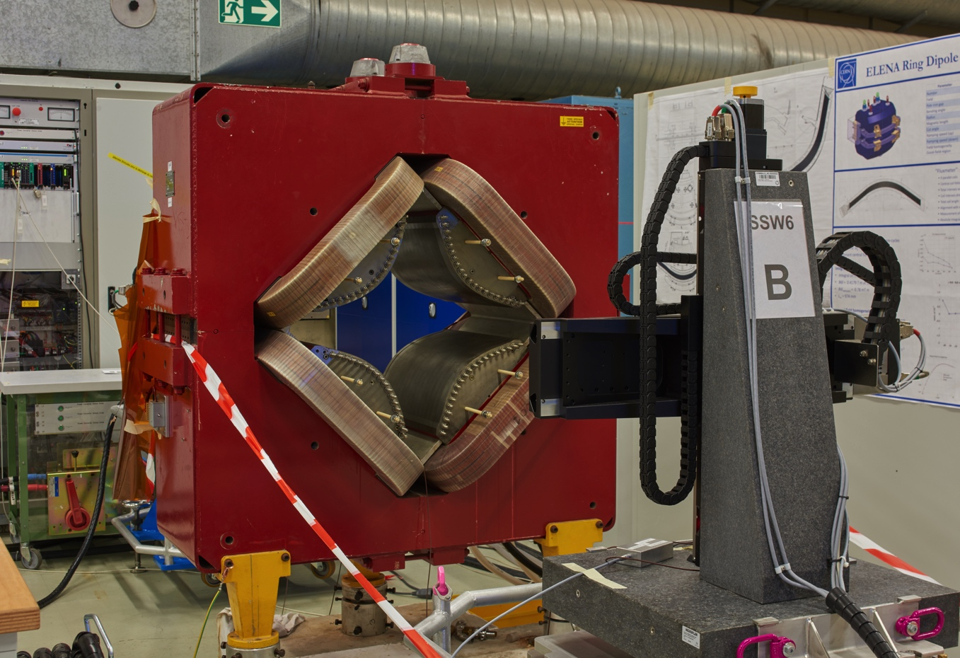
Rotating Coil Magnetometers
Rotating Coil Magnetometers
380 mm

Slide 12
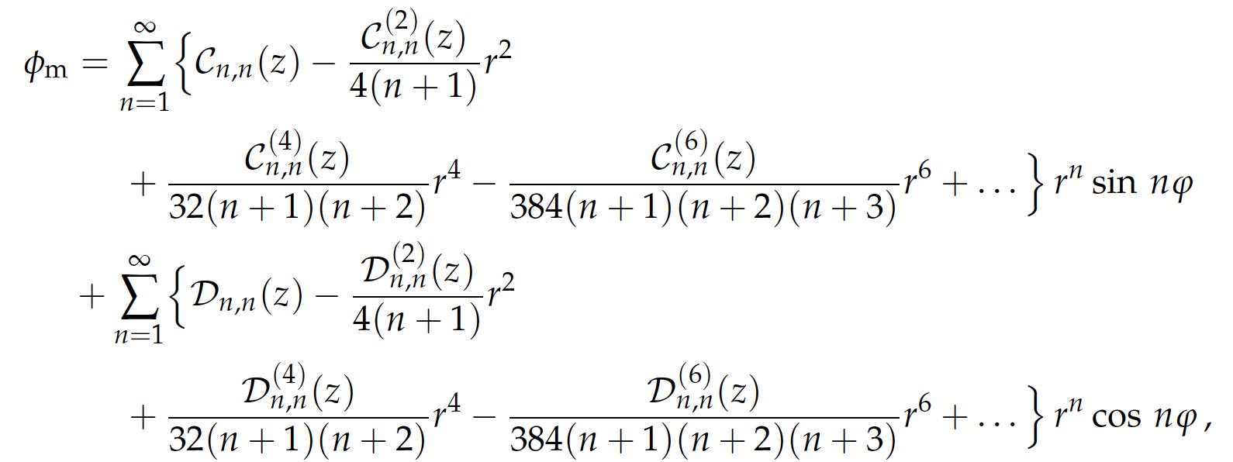
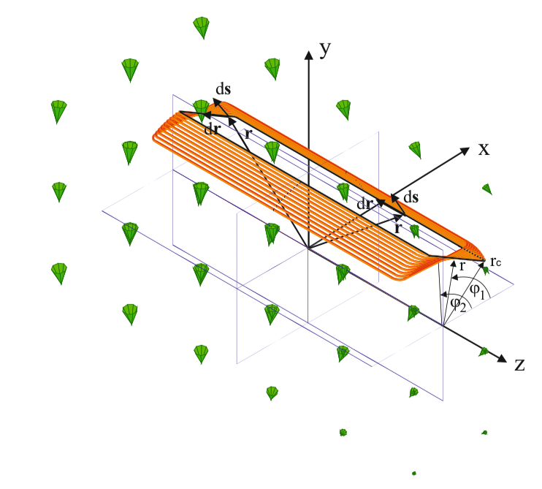
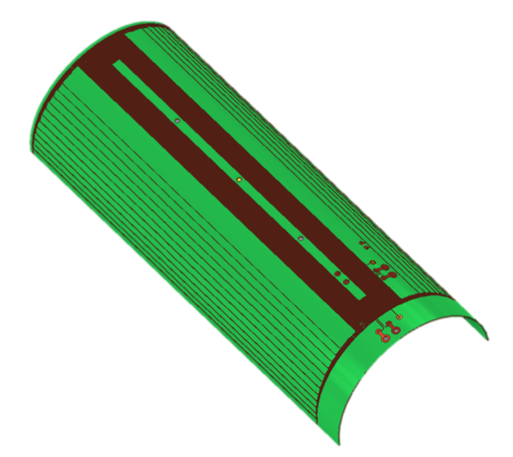
Local Field Distribution (Fourier-Bessel Series)
Problems arising: You can’t unscramble the egg

Slide 13
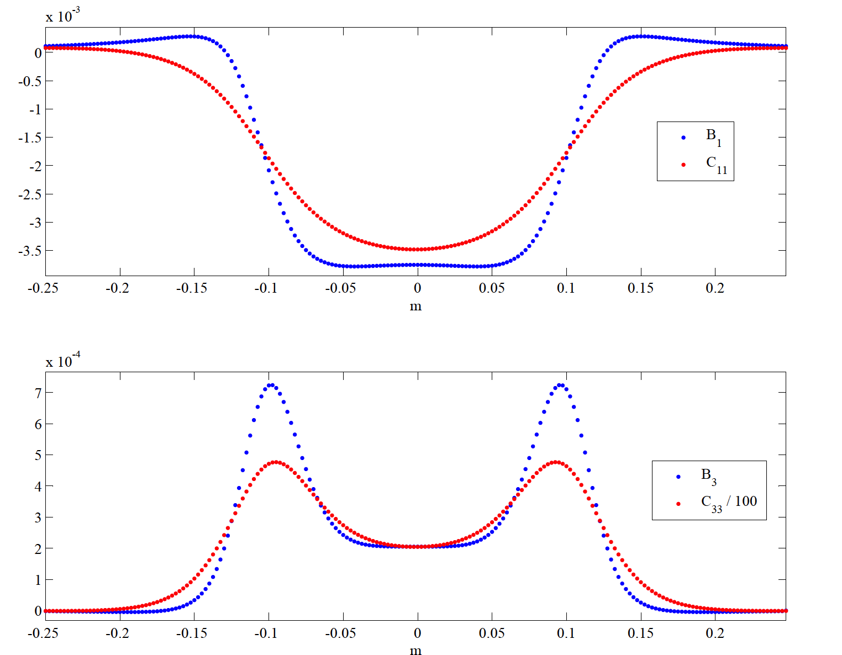
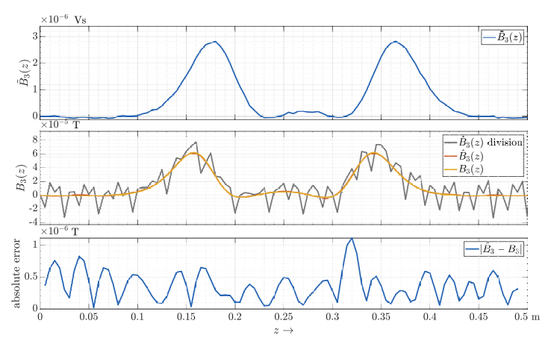
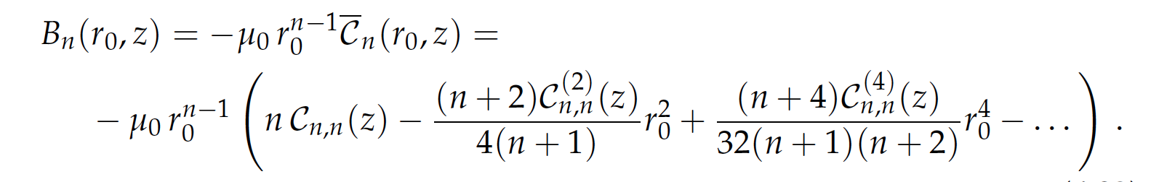
The Leading Term is NOT the Measured One
Deconvolution of the Measured Transversal Harmonics

Slide 14

The Avatar and Twin (classical black-box measurement)
Bringing together Simulations and Magnetic Measurements
Physical object (magnet)
Magnetic flux density in the magnet bore
Capture noise
(random, systematic)
Field Transducer
Read-out noise
(electronics, maiinly random=
Raw signal
(voltages)
AD-conversion
Digital integration,
Drift correction
Processed data (fluxes)
Modelling,
Calibration,
Approximation errors

Slide 15


The Avatar and Twin (tracing of manufacturing tolerances and errors)
Bringing together Simulations and Magnetic Measurements
Manufacturing tolerances/errors
Modeling errors
Num. magnet model (design)
Physical object (magnet)
Num. magnet model (as built)
QA
Magnetic flux density in the magnet bore
Approximation errors
Discretization errors
Capture noise
Numerical errors
Prediction
Solver
Field
Transducer
Post-processor
Magnetic flux
density in Ω
Read-out noise
Observation function
Raw signal
(voltages)
AD-conversion
Digital integration,
Drift correction
Processed data (fluxes)
$$X$$
$$\tilde{X}$$
Simulated ????? Measured

Slide 16
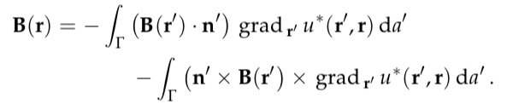


The Avatar and Twin (generalized field description with updated model)
Bringing together Simulations and Magnetic Measurements
Physical object (magnet)
Physical state variables
Boundary Sources (Single and Double-layer Potentials, or Harmonic coefficients on trivial domains)
Magnetic flux density in the magnet bore
Prediction
Observation function
Magnetic flux density in
trivial domain Ω
Field
Transducer
Expected voltages in transducer, including uncertainty
Avatar
Raw signal
(voltages)
Quantity of interest
Comparable quantity
Processed data
Weighted least-squares
$$X$$
$$\tilde{X}$$
Inverse field problem

Slide 17
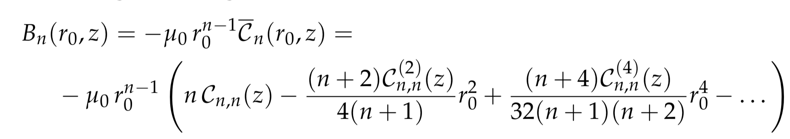
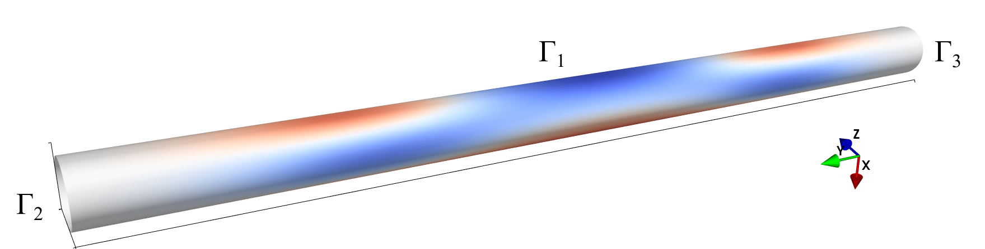
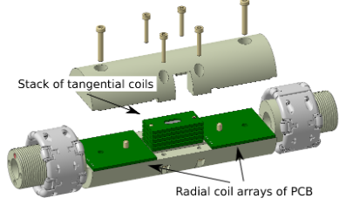
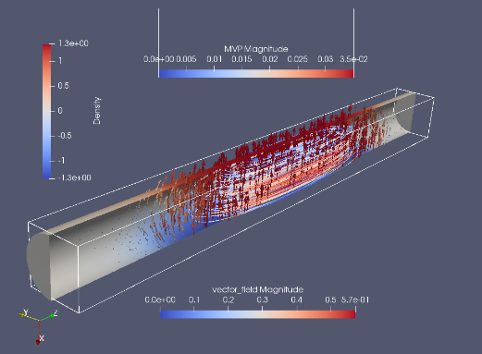
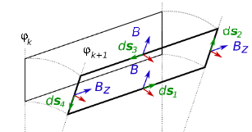


Example: 3D Multipole Fields in Magnet Ends
Bringing together Simulations and Magnetic Measurements
Magnetic flux density parameterized by pseudo-multipoles at the surface of cylinder
Physical object (magnet)
Magnetic flux density in the magnet bore
Prediction
Observation function
Rotating coil
Magnetic vector potential for particle tracking
Flux linked with the coil area
Raw signal
(voltages)
Quantity of interest
Comparable quantity
Flux increments
Weighted least squares
$$X$$
$$\tilde{X}$$
3D Field inversion

Slide 18
Model-Based Systems Engineering
PROEJCT AND TEST ENGINEERS
DESIGNERS AND CODE SUPERUSERS
SOFTWARE DEVELOPERS
Design & analysis software
ROXIE
Ansys
Opera
P-spice
LEDET
ProteCCT
Design & numerical modelling
Material data
Input files (models)
Input files(as built)
Notebooks &
Snapshots
Magnets & Devices
Model
Prototype
Series
Instrumentation & Transducers
Design
Calibration
Uncertainty analysis
Test & magnetic measurements
Raw data
Protocols
Validation
Avatars
FIDEL
DAQ & analysis software
Carpenter (Test follow-up and visualization)
FFMM
(Magnetic measuremts)
Offline
Post-processing
Model-based systems engineering
Asset management, E-Traveler, Databases, Version control (Gitlab)
Product cycle engineering

Slide 19



Simulation Framework Interface
Releases
Ownership
Developer
Designer
Designer
Developer
Designer
Expert
user
Simulation
software
Software
application
Expert
user
Simulation
software
Software
application
Expert
user
Simulation
software
Software
application
F1
F2
F3
Ansys
Opera
Comsol
F1
F2
F3
F1
F2
F3
Roxie
Steam
Accessibility
Glue Logic (Interface Software)
CHART MagNum
Data manager
Ownership
Data manager
Data manager
Quench
data
Mag.
measure
BH
data
Cable
data
Design
files
Data
manager
Releases
Sustainability
Oracle
Infor
EDMS
Gitlab
NXCALS
CERN services

Slide 20
Ecosystem Extension
Opening up Design Software

Slide 21
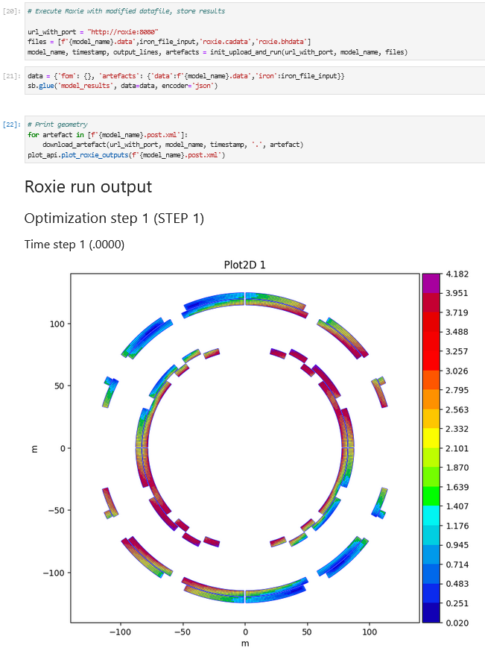
ROXIE Python API
Structured Access To Roxie data files
  Modify blocks, flags, plots, etc
  Combine files
Structured Output
  XML output of run information, results and plots
  Associated parser for data access
Interface to execute Roxie from code
  On local machine
  Via Docker

Slide 22
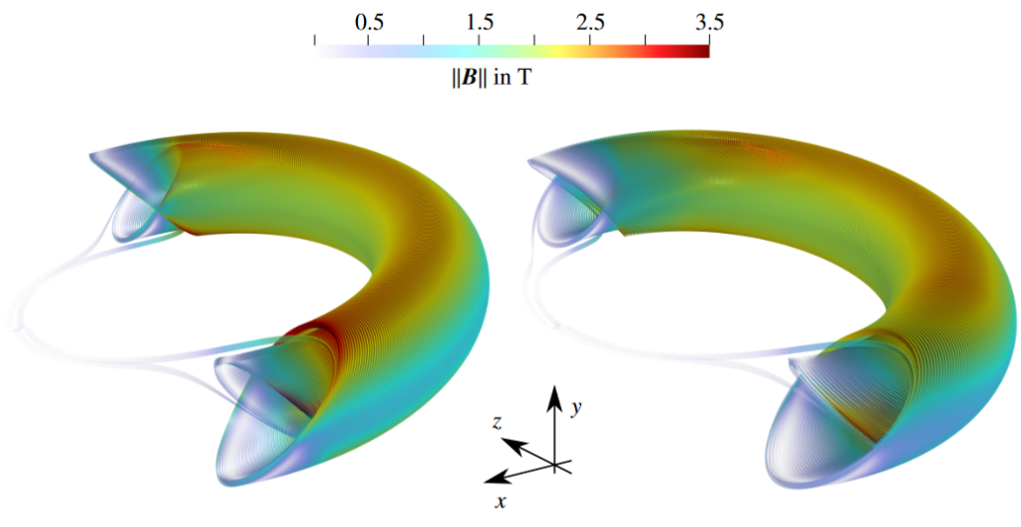
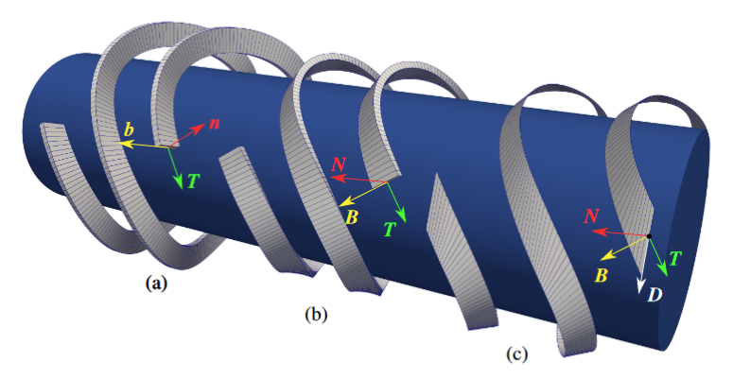
CCT module (python API)
Script based modelling of CCT magnets.
Features:
  Straight and curved magnets
  Accurate computation of curvature parameters by automatic differentiation → basis for strip theory (HTS)
  Field quality optimization based on analytic field solutions in straight and curved domains
  Tapered magnets → Stress accumulation
  Faded pitch → peak field reduction
  Multiprocessing
  Interfaces:
    paraview (vtk)
    gmsh (msh)
    Opera3D (cond)
    Catia (step)
Figure 1: Conductor peak fields in curved CCT magnets. Left: constant pitch. Right: Pitch faded in the magnet ends.
Figure 2: Winding frames (a) the Darboux frame, (b) the Frenet Frame (c) a ruled surface developed from the Darboux vector (HTS)

Slide 23
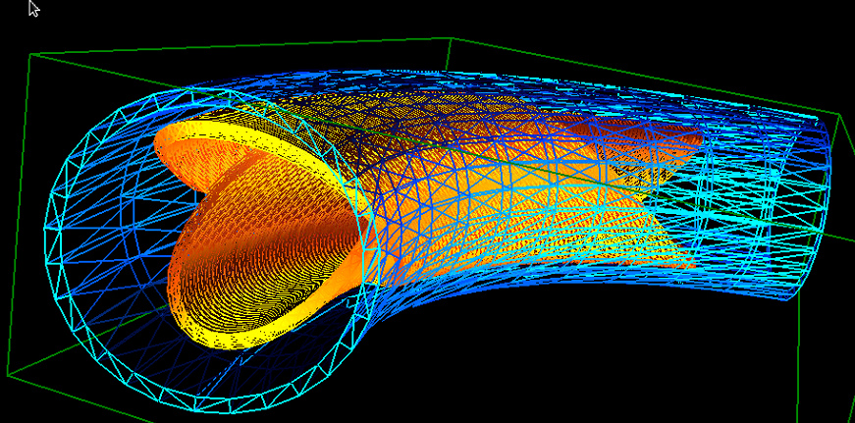
Iron Meshing
Internal Roxie Meshing extended
  Curved extrusion
Load Arbitrary 3D mesh
  Produce 3D Mesh in Hypermesh
  Translate into Roxie mesh file format (Python script)
  Run Roxie as usual

Slide 24
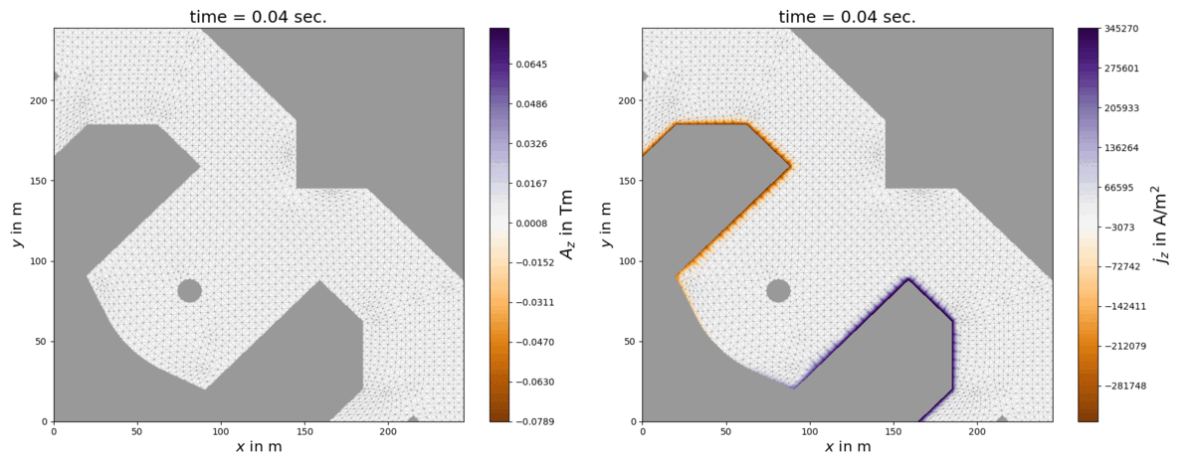
Eddy current solver
Features:
Eddy current computation in yoke and endplates (2D and 3D)
Skin effect in conductors in 2D
Skin effect in pancake coils in 3D
Post processing
Visualization
  Python (2D)
  Vtk (3D)
Python script
Parameters
Initialization file
.ini
edytrans
Edyson files
.cor
.ele
.inp
.bdr
edy_son
Result files
.dyn
.lop
.out
Geometry (iron)
Mesh file
.hmo
Biot-Savart (coil)
Source file
.src
Python
processing
Evaluation locations
Eval loc file
.loc

Slide 25
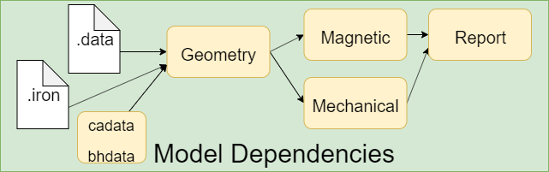
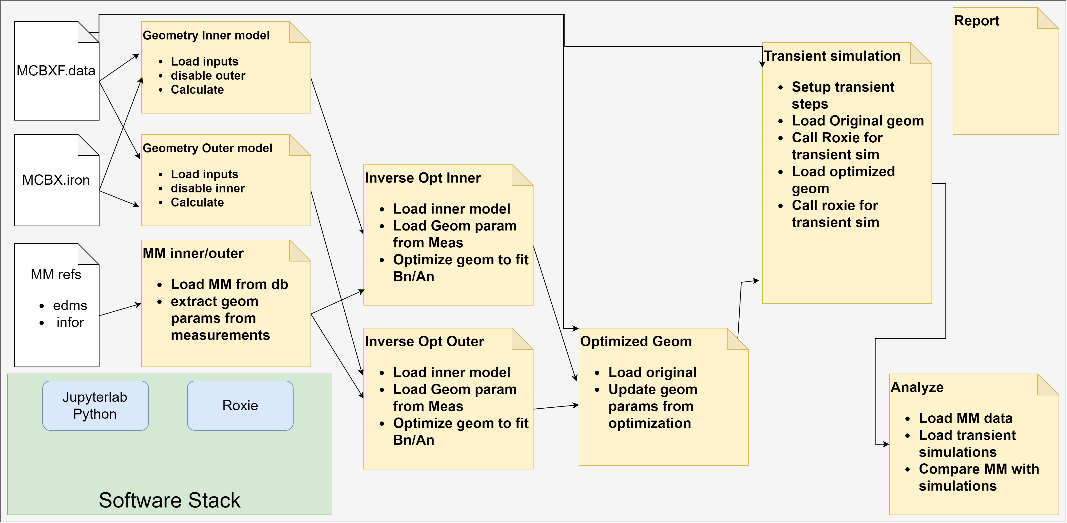
Linking everything together - pyMBSE
So far: Small modules, packages and projects on top of ROXIE
  R&D of features and extensions
  Missing Concept of Integration
→ pyMBSE
  Started in PSI for the CHART/MagNum project
  Introduce the concept of models, interfaces and model based system engineering to magnet design
  Define Magnet Models, dependencies, inputs, outputs, Dependency graph
  Link with Measurements
  Integrated Environment
    Software
    Tools
    Packages

Slide 26
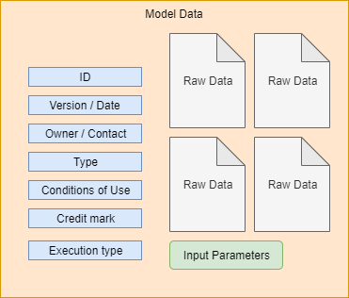
Linking everything together
Use MBSE concept, but extend Interface
  Load from Databases (e.g Measurement data)
  Load from other Repositories
  Load from other Groups
Define a commonly understood format for data exchange
  Interface to Query Available data for an object
  Documented and curated types of data
    What is included, how it is interpreted
    Version, status, terms of use
  Still in Idea phase
User
Requester
Owner
Provider

