Slide 1
Protection design and modelling at Tampere University (TAU)
Tiina Salmi
with contributions from: D. Liu, D. Sotnikov, M. Lyly, H. Milanchian, M. Haajari, S. Bakrani Balani, D. Wu, P. Lammintaus, …

Slide 2
Current status of superconducting magnet research at TAU
PI: Academy Research Fellow Tiina Salmi
Team: 1 PhD student, 1 postdoc, 1 part-time postdoc, 2-3 researchers/research assistants
Projects:
  Academy reserach fellow project for Nb₃Sn magnet quench protection (2020-2026),
  Academy project for HTS magnet modeling, (2019-2023)
  Business Finland co-innovation project for HTS magnet design, manufacture and test (2020-2023)

Slide 3
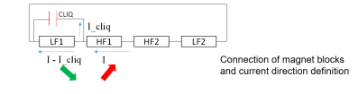
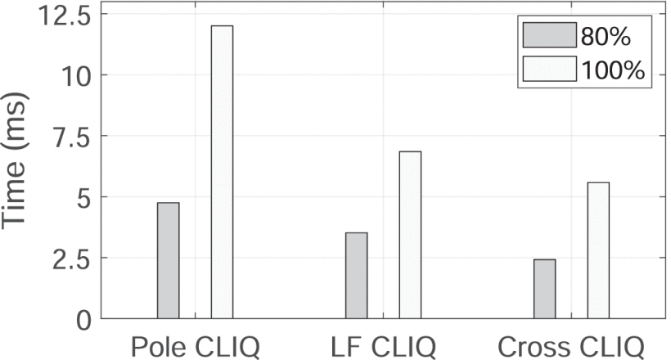
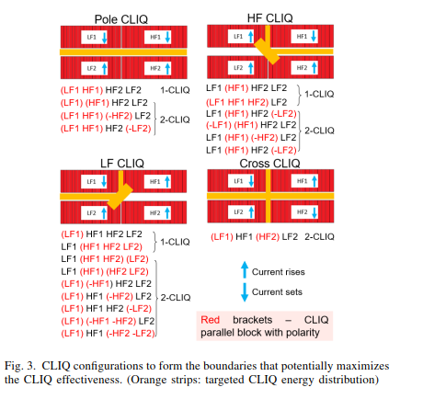
Nb₃Sn accelerator magnet quench protection
Academy of Finland funding for high-field magnet quench protection
Up to now: Analysis of the CEA magnet R2D2 with CLIQ or heaters
1. Analyzing different CLIQ connection options and optimizing the parameters (D. Liu, now at LUT)
Time to quench 80% and100% the magnet with the optimized CLIQ C and V at I_{nom} (14588 A).
Simulations with CERN STEAM-LEDET

Slide 4
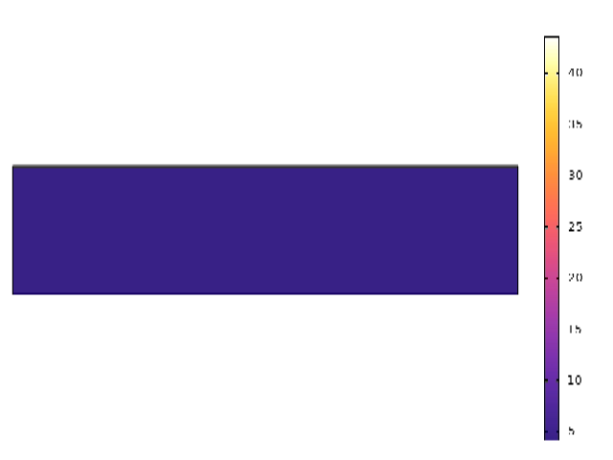
Nb₃Sn accelerator magnet quench protection
3. Improving modeling tools
(S. Bakrani Balani, T. Salmi)
Academy of Finland funding for high-field magnet quench protection
Up to now: Analysis of the CEA magnet R2D2 R2D2
Numerical simulation of quench propagation in cable pre-heated with heater
2. Analyzing different heater layout options, and optimizing the parameters (T. Salmi)
COMSOL
Excel spread-sheet tool to guide heater design
Simulations with Coodi & CoHDA

Slide 5
Small contribution to the muon collider accelerator magnet protection
Contributing to the accelerator magnet parameter feasibility mapping with the INFN team
Analytical mapping of feasible parameters based on limits from quench protection (T. Salmi)
Example calcuation about magnetic field aperture vs. dipole field based on analytic expressions
– Updated calculation to be presented at the Muon collider Magnets WG meeting 27.4.2023
Simulations with MATLAB

Slide 6
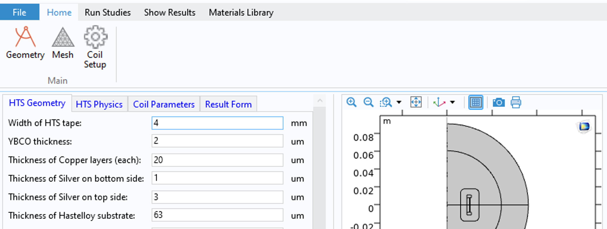
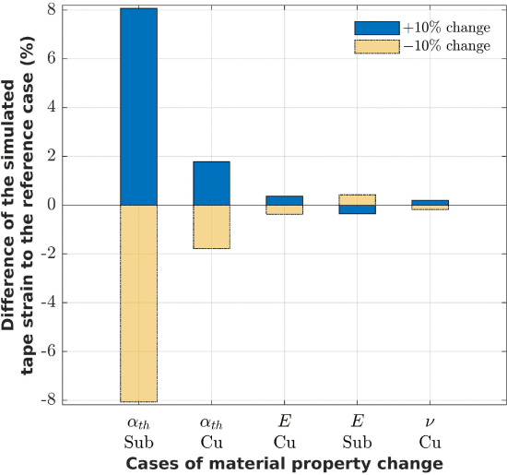
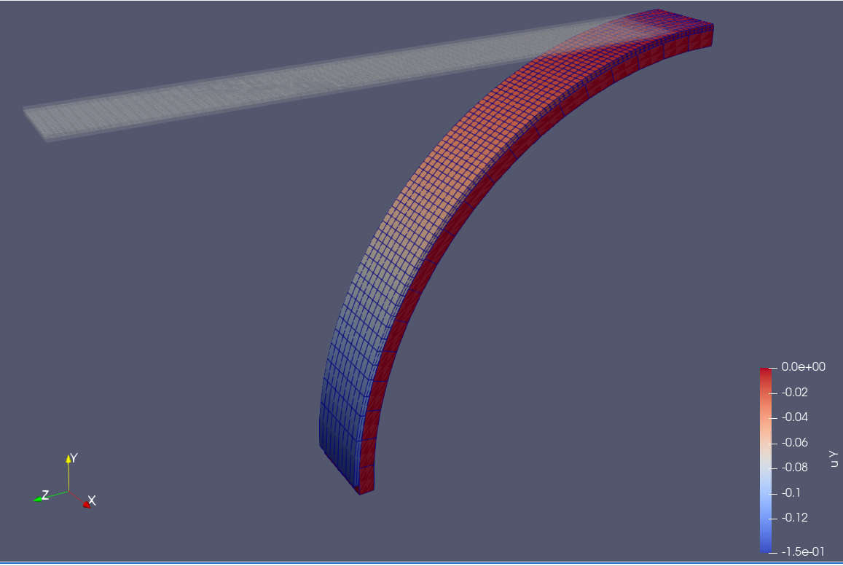
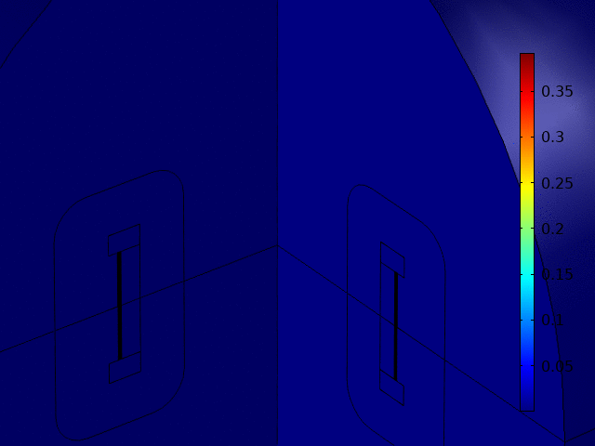
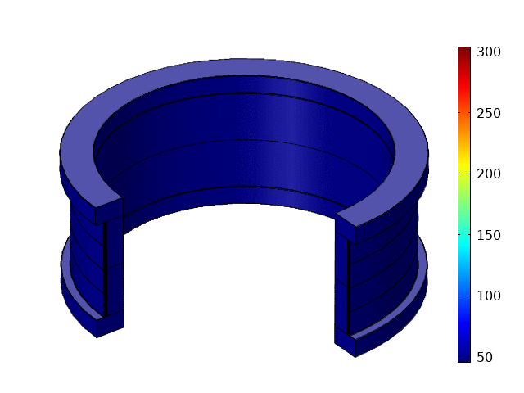
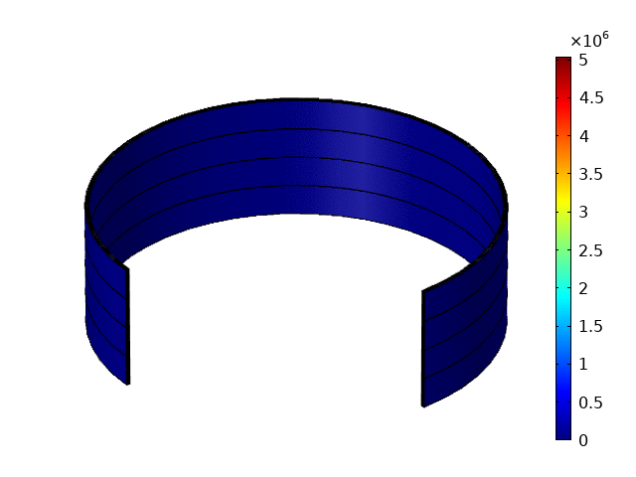
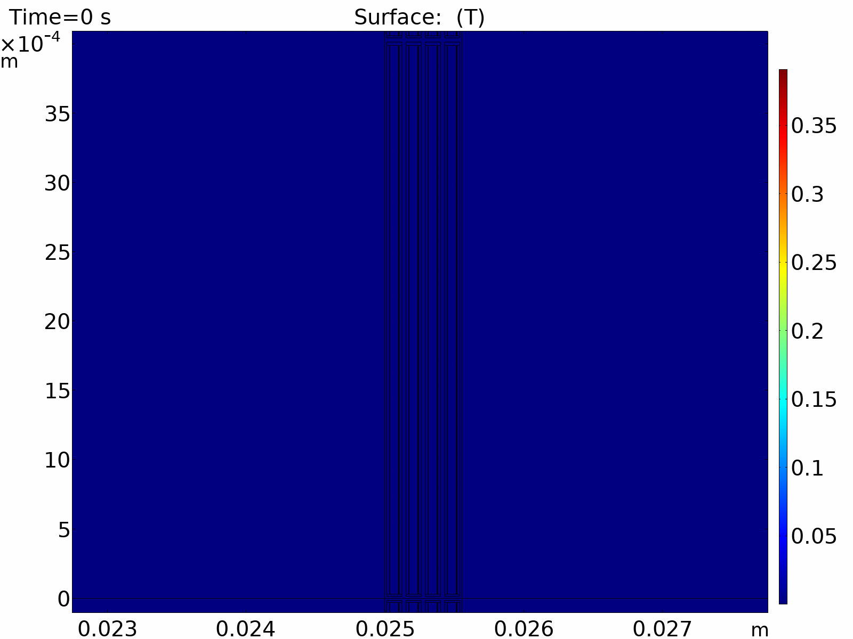
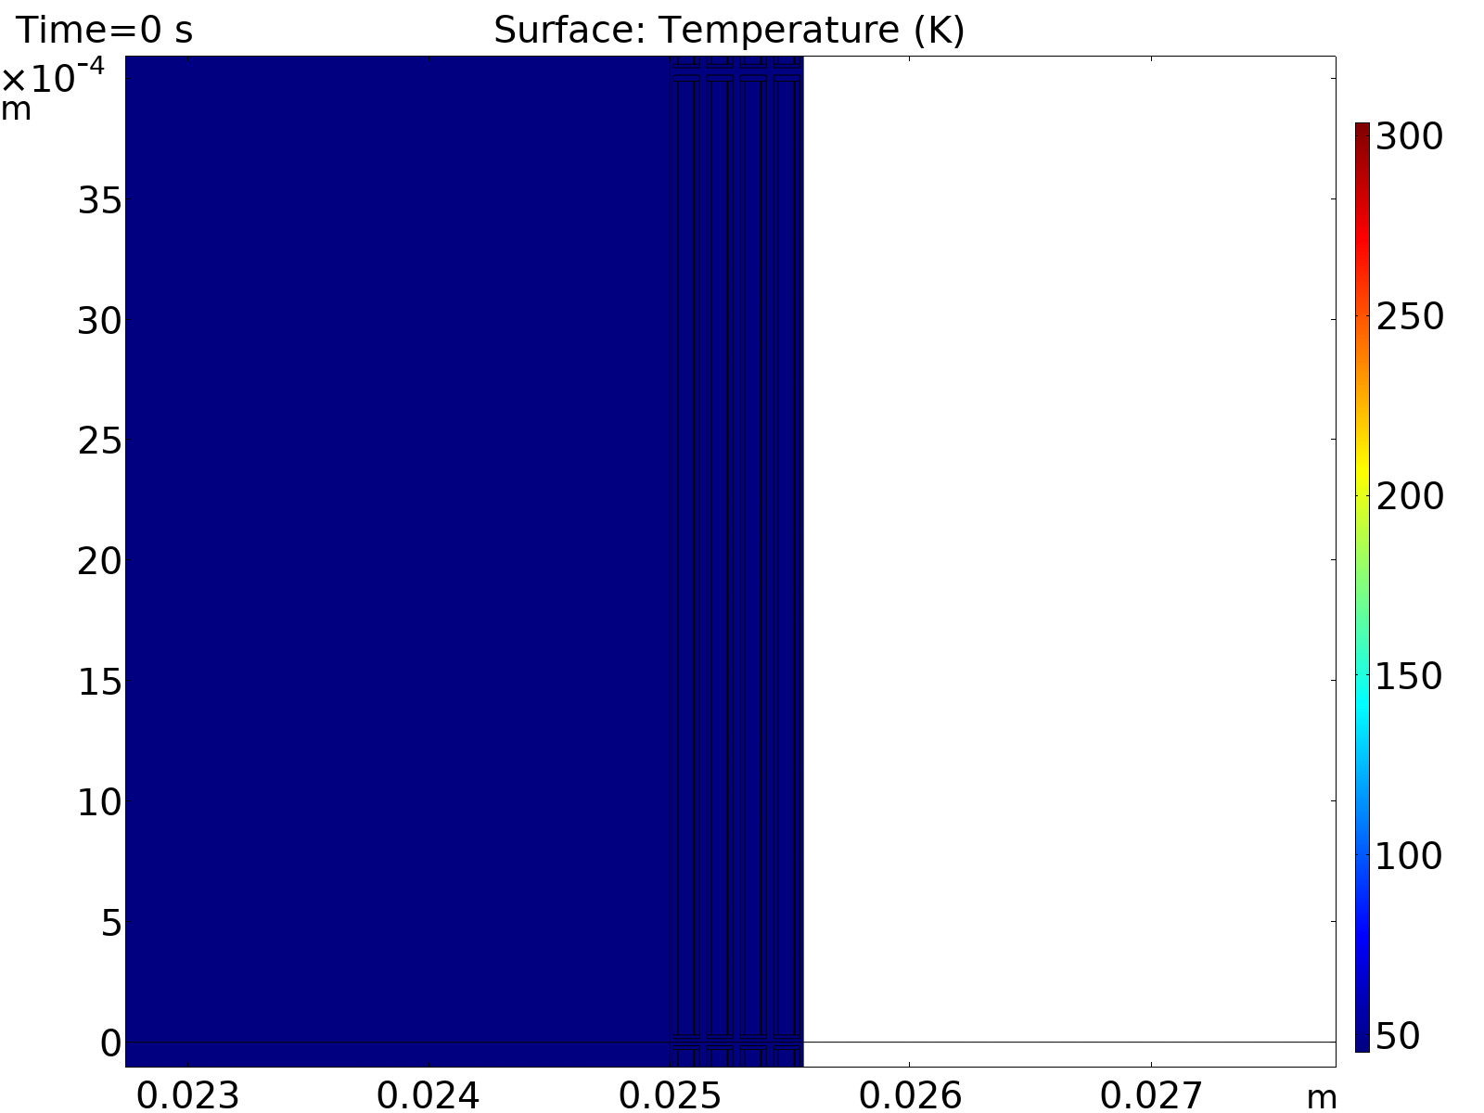
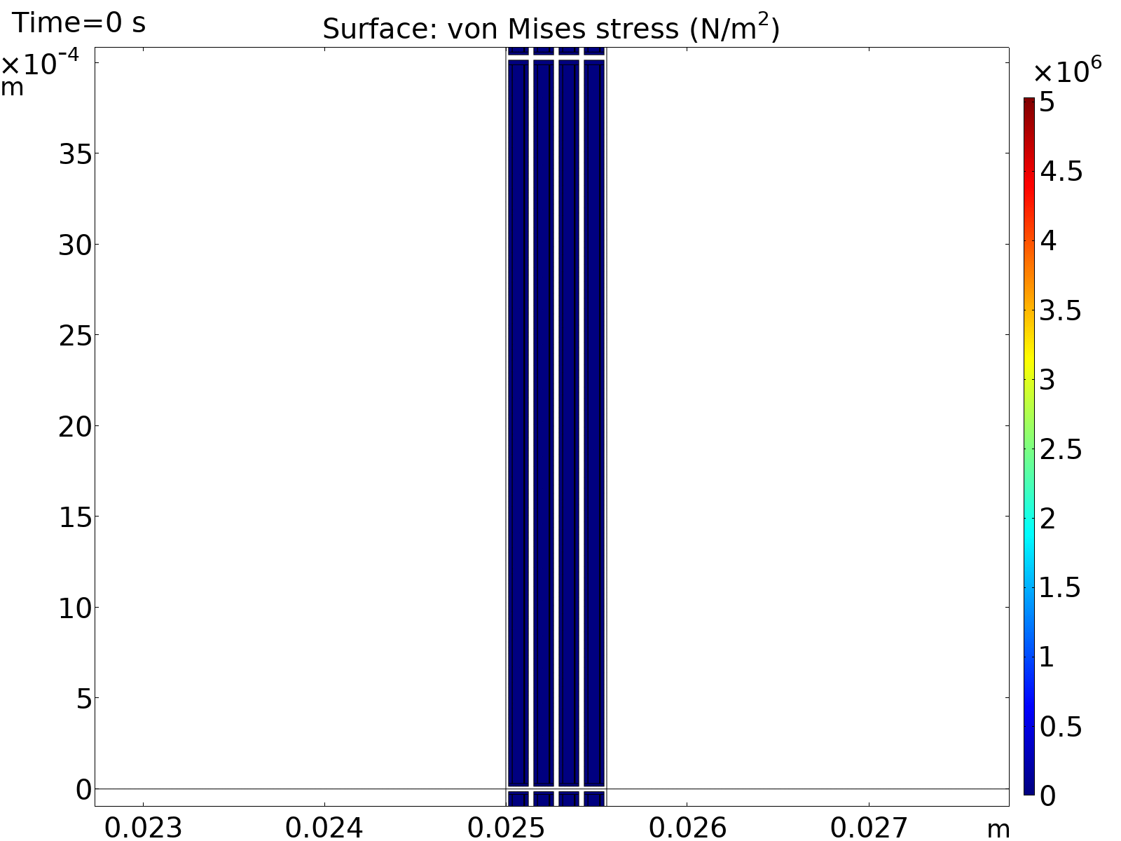
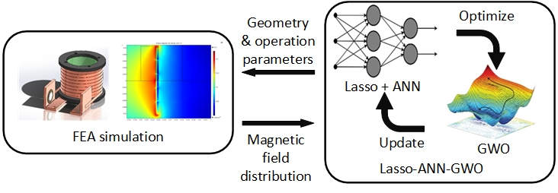
HTS magnet modeling
2. Application for user-interface of the COMSOL model (M. Haajari, D. Sotnikov)
Several simulation models for quench, electromagnetics, and mechanics (COMSOL, Sparselizard, Matlab, Fortran90,… + AI explorations
Currently being applied to a single-tape solenoid demo
3. HTS tape stress and strain during cool-down, loading, quench, etc. (H. Milanchian)
1. Example of coupled multiphysics simulation for HTS solenoid (Dmitry Sotnikov (now at PSI))
Electro-Magnetic
Quench
Mechanical
SPARSELIZARD
4. Surrogate model based optimization, case study of solenoid field (D. Wu)
COMSOL
COMSOL, Matlab, Python..

Slide 7
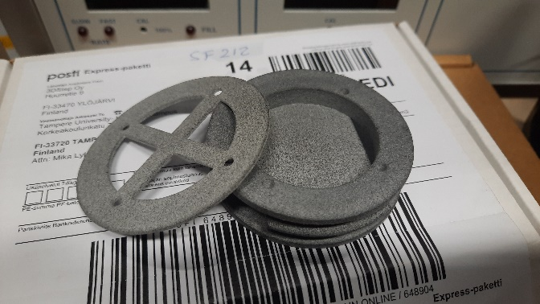
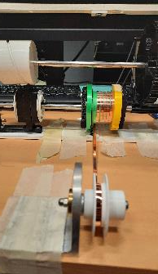
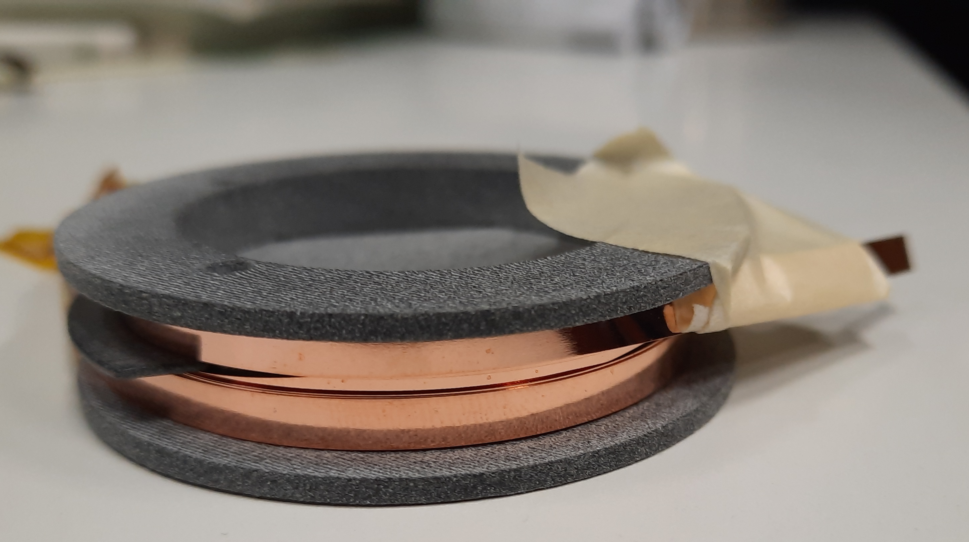
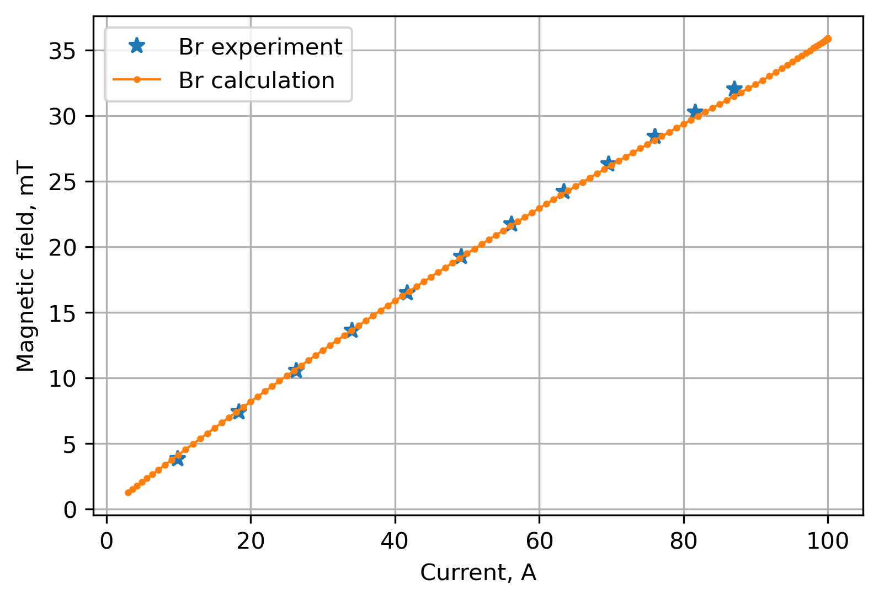
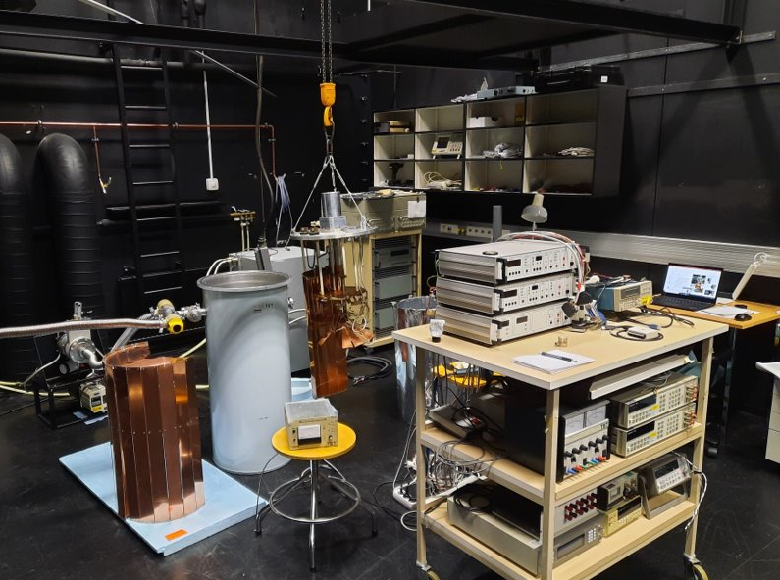
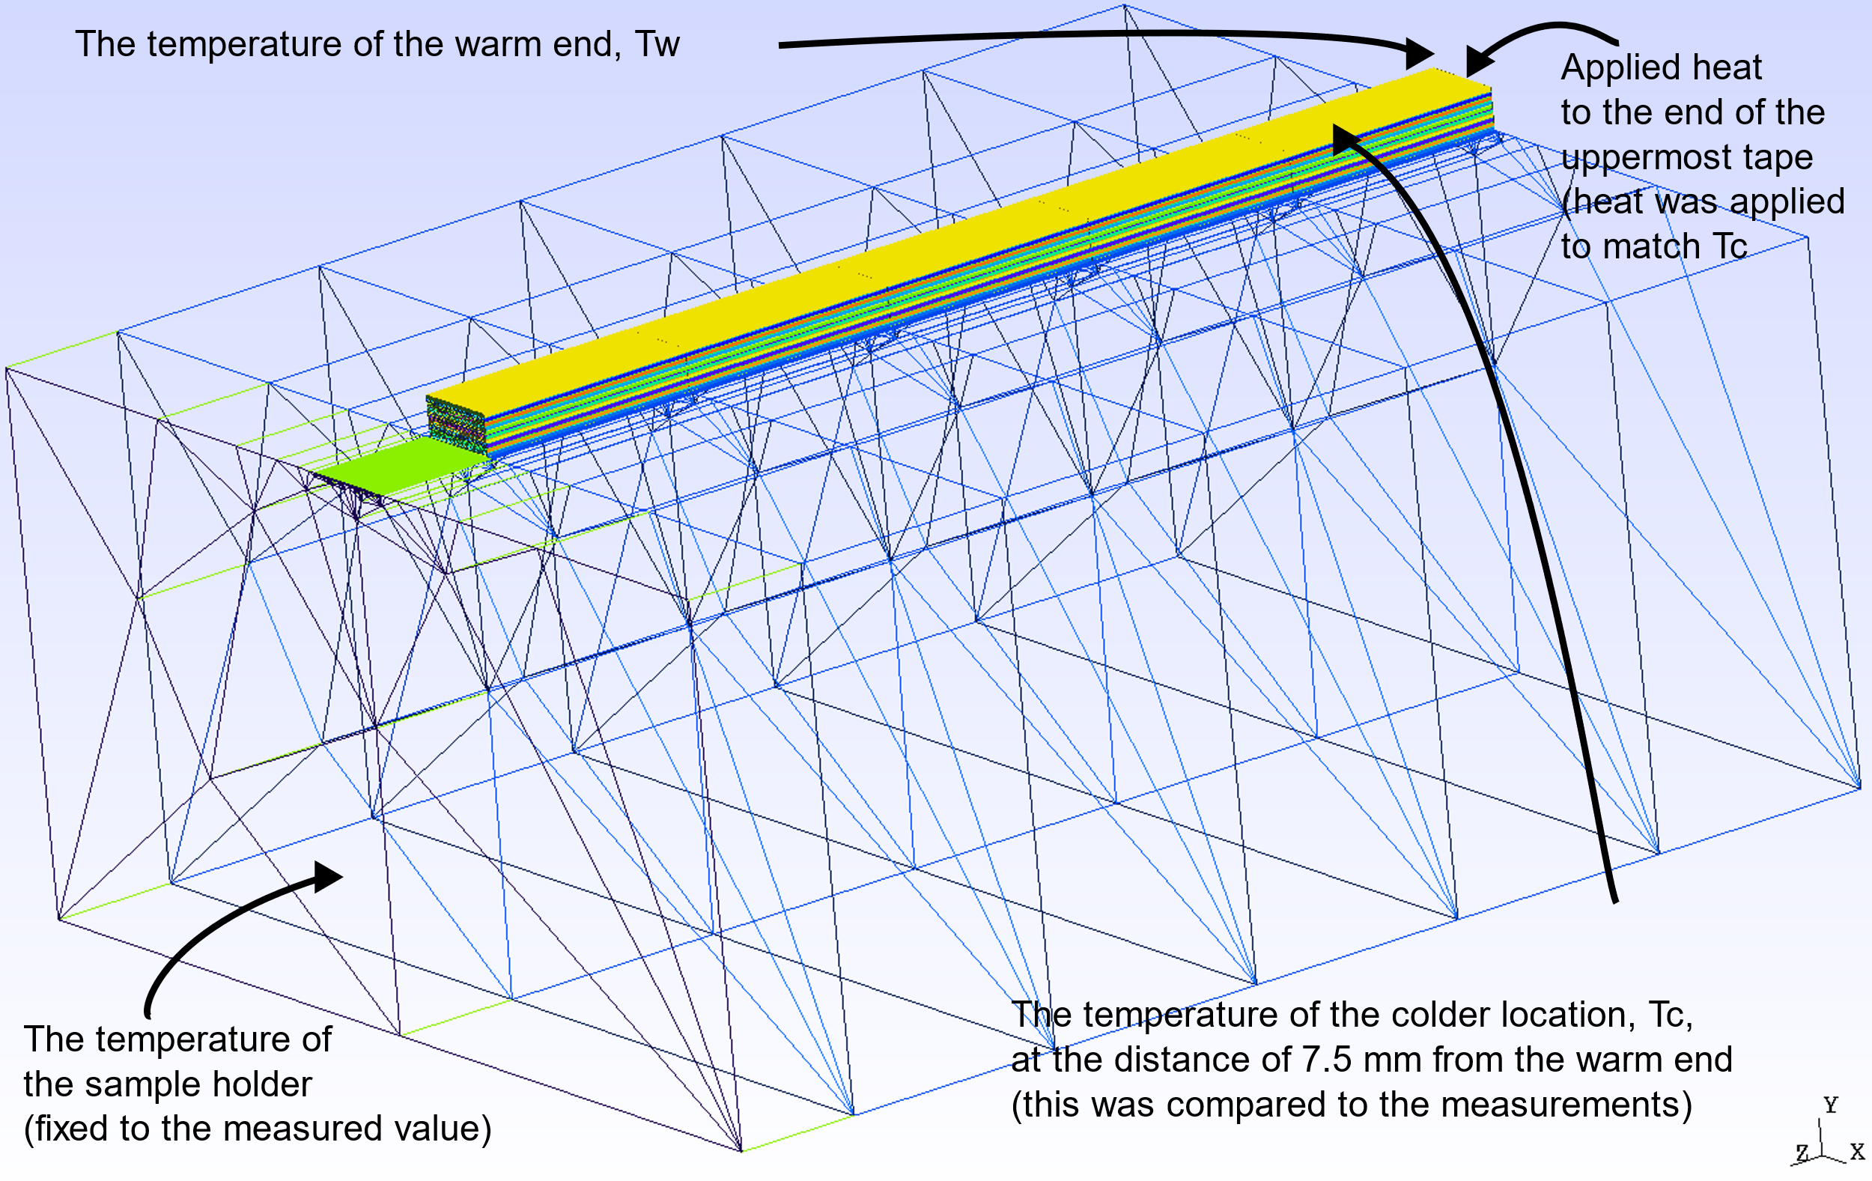
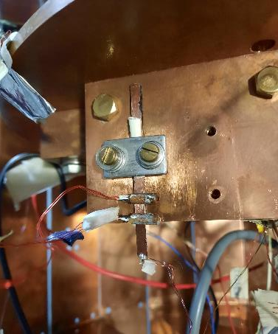
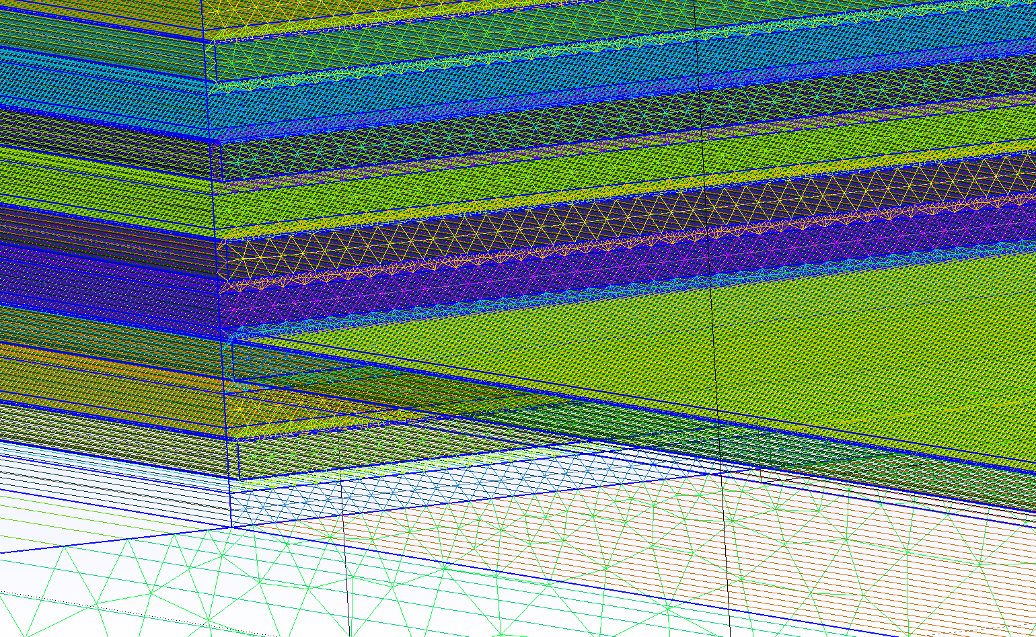
HTS magnet experimental
Solenoid exercises (D. Sotnikov)
TAU Cryolab re-started and upgraded 2021-2023
First mini demo solenoids wound and tested in LN2
Small sample measurements (resistivity, thermal cond.) in Cryocooler (down to 12 K)
  HTS tapes, 3D-printed metals
Experiments with AE, etc…
Thermal cond. measurement of HTS tape stacks and simulation (M. Lyly, P. Lammintaus)
Cryolab
Magnetic field vs calculation
SPARSELIZARD

Slide 8
Recent publications
N3Sn magnet quench protection
D. Liu et al., "CLIQ Protection Design for the Graded Nb3Sn Research Racetrack Dipole Demonstrator (R2D2)," IEEE TAS, 2023, 4701105, doi: 10.1109/TASC.2023.3247983.
T. Salmi et al., "Quench Protection of Nb3Sn High Field Magnets Using Heaters, a Strategy Applied to the Graded Racetrack Dipole R2D2," IEEE TAS 2023, doi: 10.1109/TASC.2023.3251280.
HTS tape and magnet simulation
H. Milanchian et al., "HTS Tape Mechanical Behavior Sensitivity on Material Properties and Thickness of Material Layers," IEEE TAS 2023, doi: 10.1109/TASC.2023.3251293.
J. Ruuskanen et al., "Modeling Eddy Current Losses in HTS Tapes Using Multiharmonic Method," IEEE TAS 2023, doi: 10.1109/TASC.2023.3242619.
With AI explorations:
D. Sotnikov, et al., "Prediction of 2G HTS Tape Quench Behavior by Random Forest Model Trained on 2-D FEM Simulations," IEEE TAS, 2023, doi: 10.1109/TASC.2023.3262212.
M. Yazdani-Asrami et al , ”Roadmap on artificial intelligence and big data techniques for superconductivity”, SUST, 2023, doi: 10.1088/1361-6668/acbb34
D. Wu et al A novel constrained multiobjective optimization algorithm based on dimension selection using AI, Journal of Mechanical Design, 2023
Other:
D. Liu, T. Salmi and J. Lin, "Potential Performance of Fully Superconducting Generators for Large Direct-Drive Wind Turbines," IEEE TAS, 2023, doi: 10.1109/TASC.2023.3255826.

Slide 9
Strenghts and interests in HFM
Nb₃Sn accelerator magnet protection, especially with quench heaters
Accumulating HTS magnet modeling and analysis skills
Philosophy is towards sharable tools, e.g., ”spreadsheet tool” for HTS magnets analysis, open-source model for HTS tape mechanical analysis, etc…
Currently no larger-scale application development at TAU, would be happy to direct activity to bring contribution to bigger international projects and to HFM
Would be exteremely valuable to arrange exchange periods to the TAU team-members abroad to learn and contribute (e.g., multiphysics modeling and analysis, magnet technology and testing)

