Slide 1
AMC and uRTM load boards
AMC and uRTM load boards
    Introduction
    Main functionalities and features
    Block diagram overview
    Status and plan

Slide 2
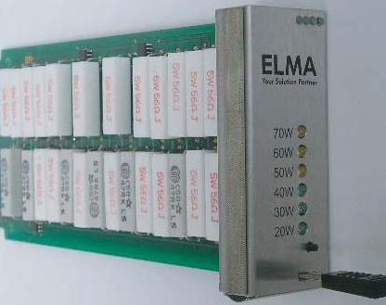
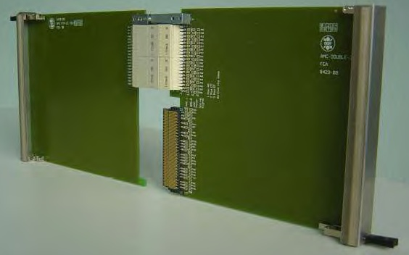
AMC and uRTM load boards
Introduction
Simple dummy load modules.
These load boards will be used as test tools in the frame of the uTCA evaluation project.
Single width load boards already exist on the market. However, we want to build our own set of MTCA.4 compatible boards (double width, mid-size AMC load board and uRTM load board).
ELMA load module: single width, full-size
AMC and uRTM formats

Slide 3
AMC and uRTM load boards
Main functionalities:
AMC and uRTM payload power simulation (remote and local switching capability of on-board dummy loads)
Remote control and monitoring (IPMI)
  On-board temperature readings.
  Backplane voltage readings (MP and PP).
  Switching (actuation) of loads (custom IPMI commands).
  Payload power current reading (custom IPMI command).
Clock and power voltages test points.
External power connection for the use of lab electronics loads.
Optional (AMC load board specific): uRTM connector for connection of the uRTM load board (MTCA.4).

Slide 4
AMC and uRTM load boards
AMC load board main features:
Double-width, mid-size AMC.
Based on the CPPM MMC (new connector version).
Front panel:
  LEDs: standard AMC status, load monitoring, MP and PP presence.
  Test points: MP and PP voltages, (optional: clks).
  Dip switch: manual switch on/off of loads.
Load distribution (90W, AMC std: 80W):
  1 x 20W
  7 x 10W
uRTM load board main features:
Same as AMC load board but:
  No MMC.
  Load distribution (40W, MTCA.4: 30W):
    1 x 10W
    6 x 5W

Slide 5
AMC and uRTM load boards
AMC block diagram

Slide 6
AMC and uRTM load boards
uRTM block diagram

Slide 7
AMC and uRTM load boards
Current status:
Schematic design is finished and has been reviewed for both, AMC and uRTM.
Placement and routing: - AMC: nearly finished.
  - uRTM: to be started.
First proto AMC load board (without the uRTM connector) is expected end of April.
First uRTM proto is expected ~ mid-May.
Production plan:
    12 AMC without the uRTM connector.
    12 AMC with the uRTM connector.
    12 uRTM.
More information is available here: https://espace.cern.ch/ph-dep-ESE-BE-uTCAEvaluationProject/uTCA_load_board/uTCA_load_board_public/default.aspx

