Slide 1
xTCA projects (HW and SW) related to ATLAS LAr
xTCA interest group - CERN
07/03/2011
Nicolas Letendre – Laurent Fournier - LAPP

Slide 2
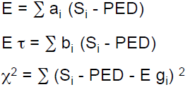
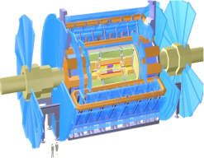
ATLAS LAr Context
FRONT END
ELECTRONIC
BACK END ELECTRONIC
Calibration
ROD
ROS
Today
800 Optical
Links
Analog
Pipeline (SCA)
ADC 5MHz
16x12-bits
1
x192
Optical Link
1.6 Gbit/s
Σ
128 cells/FEB
FEB
x1600
8 ROD/FEB
L1 Trigger
100kHz max
FRONT END
ELECTRONIC
BACK END ELECTRONIC
Calibration
ROD
ROS
12@10Gbits ??
?? Optical
Links
ADC 40MHz
128x18-bits
Mux /
Serializer
Upgrade
Optical Link
100 Gbit/s
128 cells/FEB
FEB
14 ROD/FEB ?
x1600
L1 Trigger
> 100kHz

Slide 3


BNL & Univ. of Arizona contribution
BNL
  Readout Driver Board in ATCA plateform
    Receive 12x6.25Gbps parallel optical link
    Process data in a Xilinx Virtex 5 FXT FPGA
  Design of a Readout Driver Processing Unit in AMC plateform
    Receive four 12x10Gbps parallel optical links (from Avago receiver)
    Process data in a Xilinx FPGA
University of Arizona
  Readout Driver Injector in ATCA plateform
    Transmit data through 12x6.25Gbps parallel optical link
    Based on a Altera Stratix IIGx FPGA
  Developpement of an AMC PU Injector
    Transmit data through four 12x6.5Gbps parallel optical link (from ReflexPhotonics)
    Based on Altera FPGA

Slide 4
LAPP contribution
ROD Evaluator
  ATCA Board size
  High speed and high density links to read data from FEB
  High processing power
ATCA Test Board
  ATCA Board size
  Validate ATCA IPM Controller with the ATCA Controller Mezzanine
  Validate ATCA Board management with the ATCA Controller Mezzanine
  Validate ROD Evaluator parts (Power Supplies, DDR3 interface, DSP computing in FPGA)
ATCA Controller Mezzanine
  FMC (FPGA Mezzanine Card) format
  ATCA IPM Controller
  User defined ATCA Board management (board configuration etc..)

Slide 5
ROD Evaluator
CPLD
- 48 optical Rx links @8.5Gbit/s
- 48 optical RTx links @8.5Gbit/s
- High DSP computation BW for Energies and L1 Trigger computation
FPGA BLOCK
Flash
DDR3
PS
Rx 12
12
CPLD :
=>Boot FLASH-FPGA
=>T°, power supply FPGA monitoring
12
FPGA 1
ALTERA STRATIX-IV
48 transceivers
@8.5Gbps
2 FEBs
FPGA1 Config
Tx 12
CPLD
Rx 12
12
4
Flash
DDR3
PS
To ATCA backplane:
=> High speed serial links
Tx 12
12
2
L1 Sum
4
J2
Update
channels
Energy
FPGA 3
ALTERA STRATIX-IV
48 transceivers @8.5Gbps
JTAG
CPLD
8
Fabric channels
L1 Sum
Flash
DDR3
PS
Energy
Base
Interface
Rx 12
12
4
FPGA3 Config
12
FPGA 2
ALTERA STRATIX-IV
48 transceivers @8.5Gbps
2 FEBs
Tx 12
2
- Links to ATCA backplane (to send data to a ROS? )
- ATCA Controller Mezzanine to configure and manage the board
FPGA communication :
=> High speed serial links
FPGA 2 Config
FPGA 3 Config
12
FPGA 1 Config
Rx 12
Tx 12
12
FPGA2 Config
12x10Gbps Optic Fibers:
ATCA Controller Mezzanine
(IPMI & Config)
Power supplies
J1
Ethernet
ATCA Board
I2C,SPI : to CPLDs
IPMB : from Shelf manager

Slide 6
ATCA Test Board
ATCA Test board
ROD demonstrator tests
  Check Board configuration with the ATCA Controller Mezzanine (Firmware upgrade, Configuration upload etc..)
  Test ATCA compliant power supplies
  Check FPGA Design (communications with DDR3, Flash, configuration with Flash)
ATCA Controller Mezzanine tests
  IO connections (JTAG boundary scan tests)
  IPMI management with the Shelf manager
  Ethernet communication through ATCA Base Interface
Insertion
Switch
Sensors
FPGA
ARRIA IIGx
ATCA
led 1 & 2
CPLD
DDR3
POL
Supplies
Flash
Update
Channel
Zone 2
ATCA Controller Mezzanine
(IPMC & Config)
Base
Interface
Ethernet
Ethernet
IPMBus
Zone 1
ATCA blue
led
Power
Supplies

Slide 7
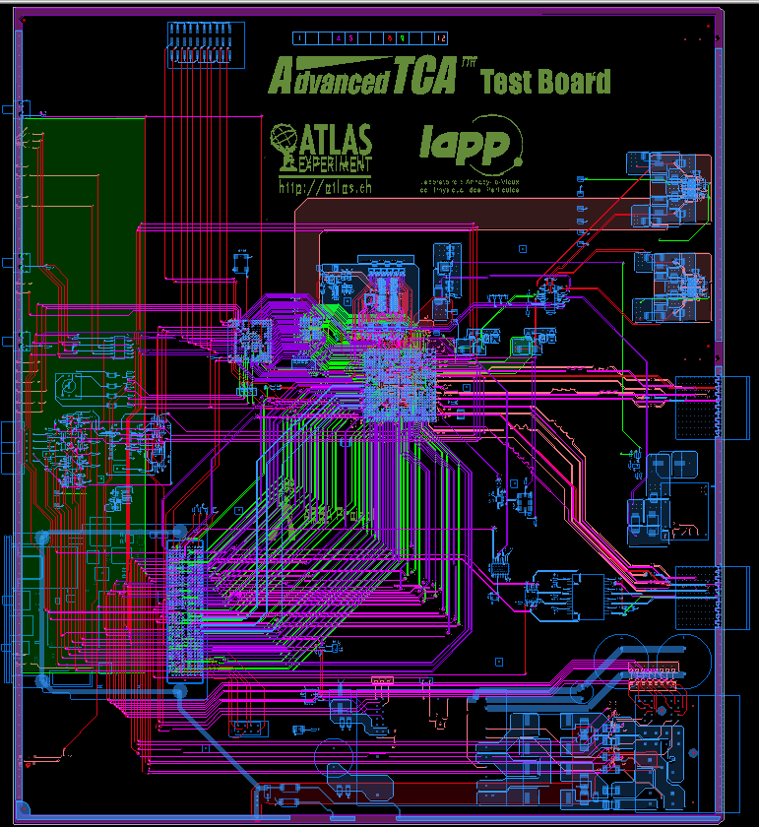
PCB already ordered
The board will be available end of March
DDR3
CPLD
Flash
ArriaIIGx
J2
Update Channel
J2
Fabric Interface
Base Interface
ATCA Controller
Mezzanine
J1
Power &
IPMBus
Emerson ATC250
DC-DC converter

Slide 8
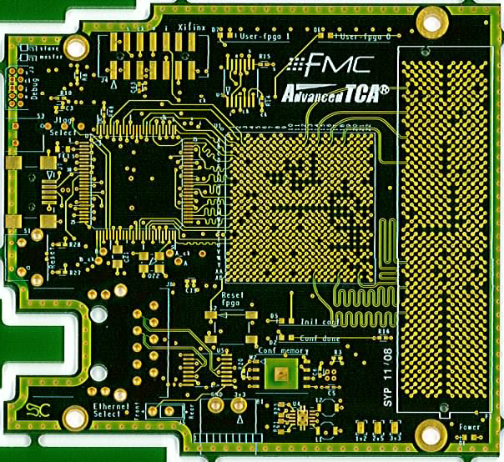
ATCA Controller Mezzanine
IPM Controller
  Communication with Shelf manager through IPMBus A & B
  Hot Swap, Power management etc..
ATCA board management
  Communication via Ethernet (front panel or ATCA Base Interface)
  User functions
    Firmware Upgrade
    ATCA board monitoring & configuration
    Users stuffs….
FMC (FPGA Mezzanine Card) compliant
  up to 160 customizable links( including 74 differential links)
  Low cost
Features:
  ARM cortex M3 processor
  Xilinx Spartan 6 for highly configurable user IO
  Ethernet / USB / JTAG interfaces
FMC
Mezzanine
Power Supplies
connector
Ethernet
µC
LM3S9B92
FPGA
Spartan 6
bus
IO
USB
JTAG
JTAG
JTAG
EEPROM
I2C IPMBus
A&B
µC
FPGA
IO
69mm
=> We will receive the board this week
76.5mm

Slide 9
Tests with commercial board
Hardware setup (Adlink 6900 + Vadatech AM210):
OS: Scientific Linux CERN SLC release 5.4 (Boron) 64bits
KERNEL: 2.6.18-194.3.1
CPU: Intel Xeon L5408 (Quad Core)
NETWORK BENCHMARKING TOOL: netperf version 2.4.5
Communication 10GbE between two blades
  Front (i.e. via AMC) : done
    TCP=5.4 Gb/s (message 1 GB)
    UDP=5.6 Gb/s (message 64 KB)
  Zone 3 (RTM) : to be done...
  Zone 2 (fabric interface): done
    TCP=8 Gb/s (message 1GB)
    UDP=6.8 Gb/s (message 64 KB)
Lossless data compression algorithms: to be done

Slide 10
ATCA Controller Mezzanine Software
Specification compliant
  PICMG 3.0 R3.0 – AdvancedTCA base specification
  IPMI v1.5 and relevant subset of IPMI v2.0
control of the board :
  program the FPGAs
  monitor of the working conditions
  remotely driven

Slide 11
ATCA Controller Mezzanine Software
LM3S9B92 (texas Instruments)
+ FPGA (Xilinx)
Development tools
ARM cross compiler
JTAG module
debugger (gdb) + OpenOCD
IPM Controller
JTAG Controller
board configuration and monitoring
IPMC
module
programmer (Texas Instruments)
JTag/USB
IP stack
library
User environment
web interface
Ethernet
client interface
hardware library
file server
(boot and board control)
I2C (IPMI protocol)

Slide 12
ATCA Controller Mezzanine Software
Development tools (operational)
  OS : Linux
  Compiler GNU GCC for ARM Cortex-M3
  Specific drivers (TI Luminary LM3S9B92)
  Debugger GNU GDB + OpenOCD
IPM (Intelligent Platform Management) Controller software
  Implementation of IPMI 2.0 specification
    Library ported and hardware dependent interface written and compiled
    Test foreseen as soon as we have the hardware

Slide 13
ATCA Controller Mezzanine Software
JTAG control
  allows for initial programming of the FPGAs on main board
  xsvf interpreter tested in simulation
  JTAG connector on front of the board allows for control of the whole JTAG chain or for microcontroller debugging
  the JTAG chain can be controlled either by the microcontroller or by an external device
Board control and monitoring (via Ethernet interface) (in development)
  FPGA firmware upgrade
  Board configuration (e.g. coefficient for physics algorithms)
  Board monitoring (temperature, voltage …)

