Slide 1
Design options for a 14 T + block type dipole using 40 strands cable
April 2023
Susana Izquierdo Bermudez

Slide 2
Design target
> 14 T bore field with 20 % load line margin
Protection time margin > 40 ms
Aperture = 50 mm → 40 strands cable
‘Accelerator coil size’, i.e, < 60 mm
Field quality within 10 units at all current levels (excluding PC effects)
Magnet OD, take Euro-Circol dimensions as reference (Intra-beam distance: 250 mm; Cold mass OD: 800 mm; Magnet OD : 760 mm
  For the 1in1, we will scale down

Slide 3



What does it mean reducing the aperture?
Smaller bending radius, more difficult to wind
In the first order, if we keep the same aperture field:
  Smaller force in x-y (scale with the aperture)
  Smaller F_{z} and stored energy (scale with the square of the aperture)
$$B_{y}=−\frac{μ_{0}j_{0}}{2}w$$
$$F_{x}=−F_{y}=\frac{B_{y}^{2}}{2μ_{0}}\frac{4}{3}a$$
$${ F}_{z}=\frac{B_{y}^{2}}{2μ_{0}}2πa^{2}$$
We will see that then when you look to the details, in some cases you are getting very far from the ‘thin shell’ approximation, so in practice things are slightly different

Slide 4
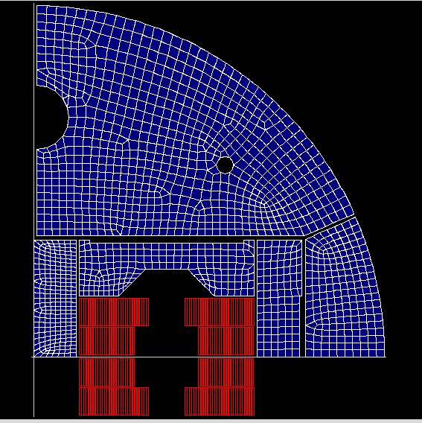
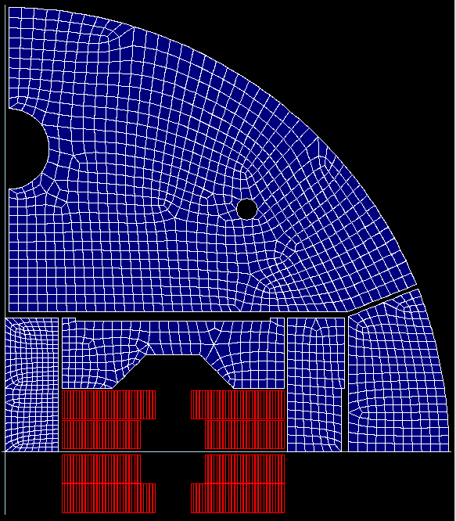
From 50 mm to 40 mm aperture
Let’s start by keeping more or less the same dimension in x, but reducing only the cable height (note that the turns far from the aperture they are very inefficient)
V205: AP 50 mm, 4 mm wall thickness, 48 x 1 mm strand
V301: AP 50 mm, 4 mm wall thickness, 48 x 1 mm strand
Aperture is not in scale, just a cartoon

Slide 5
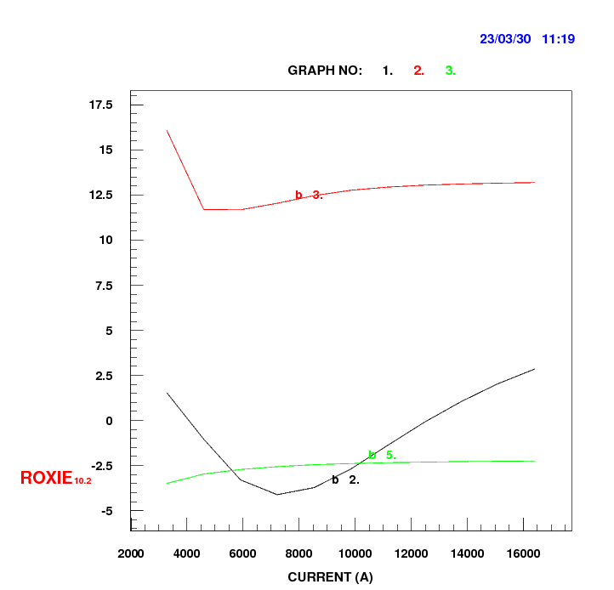
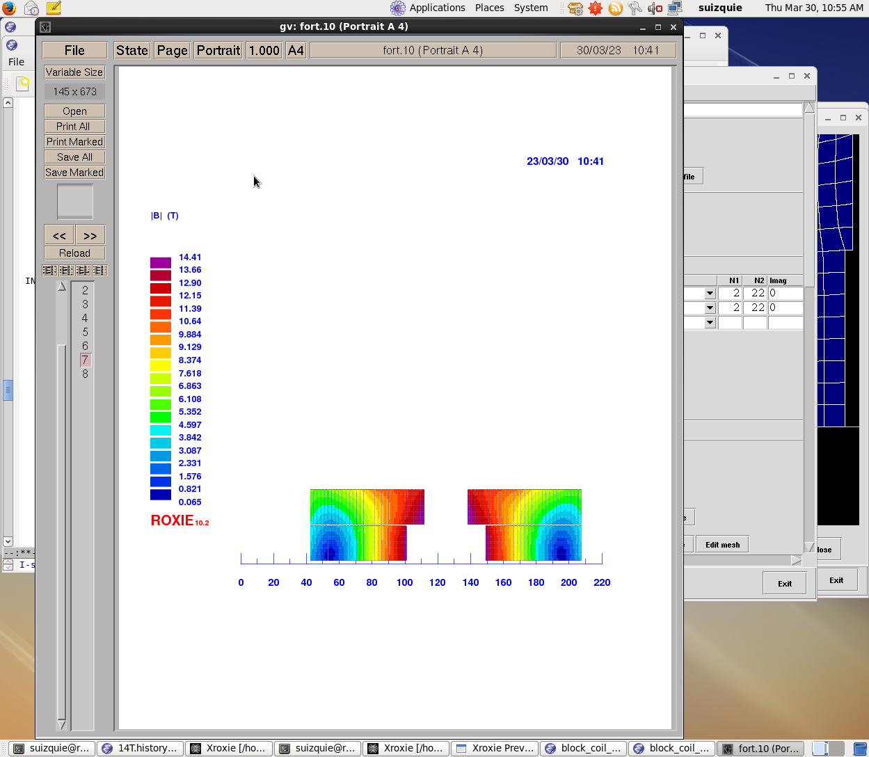
v301
b3 is a bit high, but we can fix it a bit later, for a first round let’s keep it like this.

Slide 6
Magnet parameters
Even if the aperture is smaller, we have a bit more horizontal stress (the coil is wider)
 |  | RMM non graded | HD2 | v205 | v301 | DEMO
 |  |  |  |  |  | HF | LF
strand diameter | mm | 1 | 0.8 | 1.00 | 1.00 | 1.1 | 0.85
Cu/SC | -- | 1 | 0.94 | 0.90 | 0.90 | 0.8 | 1.2
# of strands/cable | -- | 40 | 48 | 48 | 40 | 44 | 56
# turns/quadrant | -- | 132 | 54 | 54 | 59 | 13 | 42
Clear aperture | mm | 50 | 37 | 50 | 40 | 50
I_{nom} | A | 8850 |  | 20390 | 16411 | 21000
J_{overall} | A/mm² | 248 |  | 357 | 352 | 339 | 422
J_{cu} | A/mm² | 735 |  | 1142 | 1103 | 904 | 1454
J_{sc} | A/mm² | 735 |  | 1028 | 993 | 1130 | 1212
Ratio LF/JF | -- | n.a. |  |  |  | 1.25
B₀ at I_{nom} | T | 16 |  | 14.00 | 14.00 | 15.43
B_{p} at I_{nom} | T | 16 |  | 14.66 | 14.42 | 16.08 | 13.22
B_{ss} | T | 19.3 |  | 17.56 | 17.83 | 18.6 | 13.9
F_{x}/h at I_{nom} | MPa | 122 |  | 113 | 119 | 141
F_{y}/w at I_{nom} | MPa | -46 |  | -52 | -42 | -72
F_{z}/aperture at I_{nom} | MN | 2.2 |  | 1.13 | 0.90
Stored energy density (overall) | MJ/m³ | 88 |  | 91.8 | 82.3

Slide 7
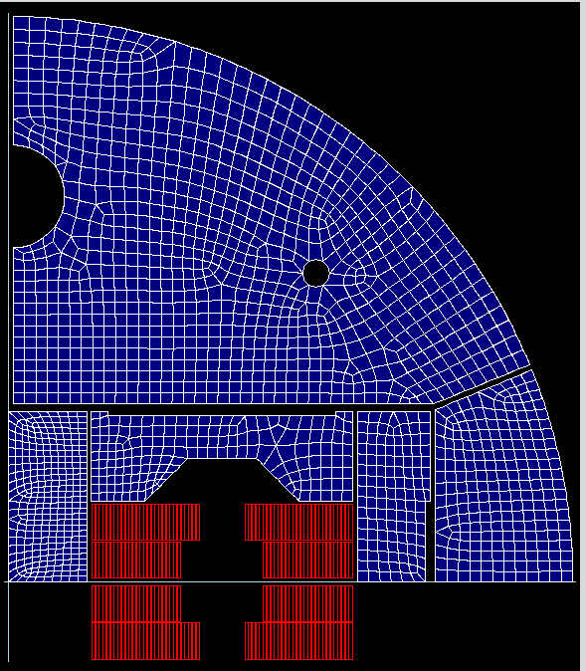
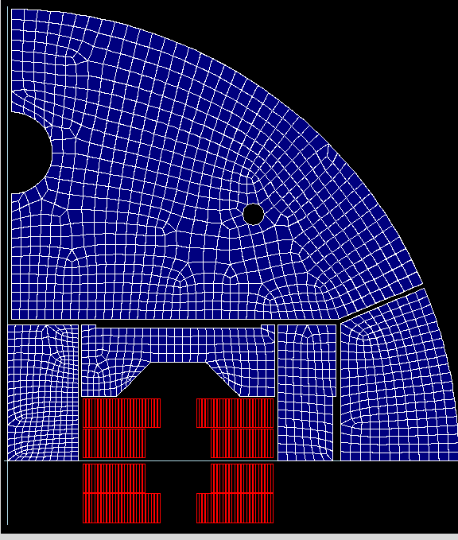
Comments
The coil is very wide – turns far from the aperture are not very efficient
Let’s make the coil smaller and verify impact on quench field. Note that I am not re-optimizing for field quality in every step, just the iron is following the reduction of coil size.
Scaling HD with the strand diameter, we need 43 turns
I don’t think we should go here, we are wasting conductor
59 turns,
Bss = 17.8 T
UL∿157 m
53 turns,
Bss = 17.6 T
UL∿141 m
Option 2, if we want to have a bit more margin in field
Option 1, if we want to be a bit more efficient in conductor use
47 turns,
Bss = 17.3 T
UL∿125 m
41 turns,
Bss = 17.0 T
UL∿109 m
Remark1: This is all for 2in1 configuration. When going from 2in1 to 1in1 we looe 0.1-0.2 T of Bss
Remark2: eRMC coil has 90 turns per quadrant, cable UL = 200 m. Estimated UL for designs presented here = 200m*NTURNS/90*1.2

Slide 8
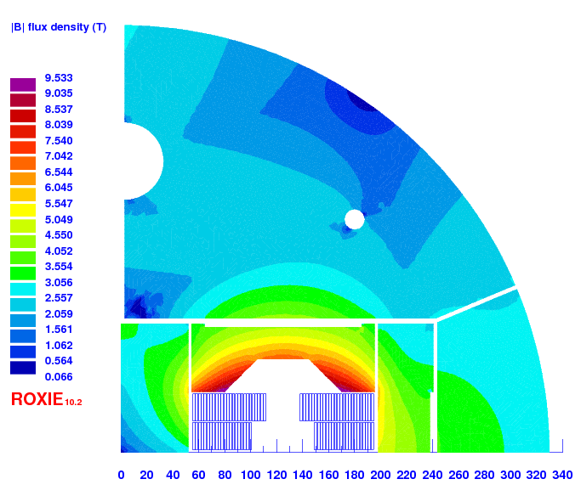
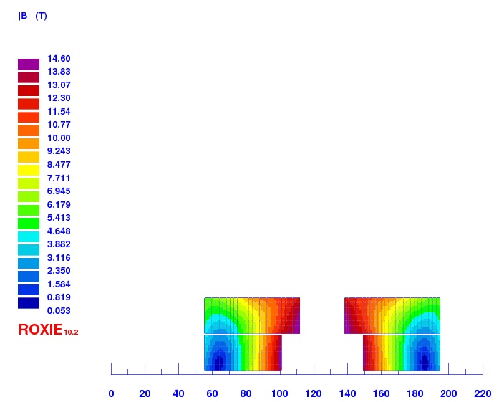
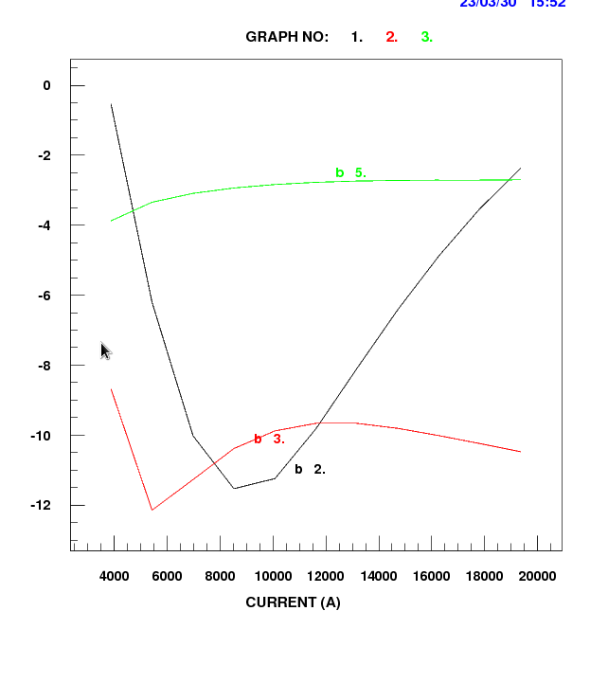
v303
47 turns, first rough optimization, detailed optimization needed to decrease Bp/Bap and improve a bit hamonics

Slide 9
Magnet parameters
 |  | RMM non graded | HD2 | V205 (2in1) | V301 (2in1) | V303 (2in1) | DEMO
 |  |  |  |  |  |  | HF | LF
strand diameter | mm | 1 | 0.8 | 1.0 | 1.0 | 1.0 | 1.1 | 0.85
Cu/SC | -- | 1 | 0.94 | 0.9 | 0.9 | 0.9 | 0.8 | 1.2
# of strands/cable | -- | 40 | 48 | 48 | 40 | 40 | 44 | 56
# turns/quadrant | -- | 132 | 54 | 54 | 59 | 47 | 13 | 42
Eq. coil width | mm | 50 | 37 | 56 | 55 | 48 | 50
I_{nom} | A | 8850 |  | 20390 | 16411 | 19372 | 21000
J_{overall} | A/mm² | 248 |  | 357 | 352 | 416 | 339 | 422
J_{cu} | A/mm² | 735 |  | 1142 | 1103 | 1302 | 904 | 1454
J_{sc} | A/mm² | 735 |  | 1028 | 993 | 1172 | 1130 | 1212
Ratio LF/JF | -- | n.a. | n.a. | n.a. | n.a. | n.a. | 1.25
B₀ at I_{nom} | T | 16 |  | 14.00 | 14.00 | 14.00 | 15.43
B_{p} at I_{nom} | T | 16 |  | 14.66 | 14.42 | 14.60 | 16.08 | 13.22
B_{ss} | T | 19.3 |  | 17.56 | 17.83 | 17.31 | 18.6 | 13.9
F_{x}/h at I_{nom} | MPa | 122 |  | 113 | 119 | 116 | 141
F_{y}/w at I_{nom} | MPa | -46 |  | -52 | -42 | -50 | -72
F_{z}/aperture at I_{nom} | MN | 2.2 |  | 1.13 | 0.90 | 0.78
Stored energy density (overall) | MJ/m³ | 88 |  | 91.83 | 82.31 | 88.86
Remark: with v303 we are getting close in terms of protection to MQXF (previous versions had a bit more margin)

Slide 10
Additional slides

Slide 11
Where we are
48 mm, 14 T
56 mm, 14 T
48 mm, 617 A/mm²
56 mm, 540 A/mm²
14 T, 92 J/cm³
14 T, 89 J/cm³

Slide 12
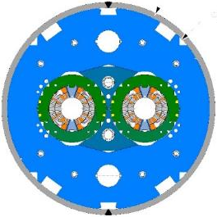
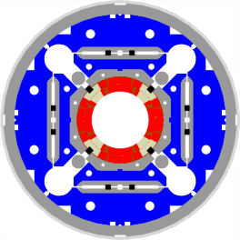
HL magnets parameters
LHC-MB
HL-LHC 11 T
HL-LHC MQXF
B_{p}(I_{nom})= 8.6 T
J_{overall}(I_{nom})= 356/442 A/mm²
J_{cu}(I_{nom})= 763/932 A/mm²
e_{m} (I_{nom})= 71 MJ/m³
B_{p}(I_{nom})= 11.8 T
J_{overall}(I_{nom})= 523 A/mm²
J_{cu}(I_{nom})= 1439 A/mm²
e_{m}(I_{nom})= 130 MJ/m³
B_{p}(I_{nom})= 11.4 T
J_{overall}(I_{nom})= 469 A/mm²
J_{cu}(I_{nom})= 1330 A/mm²
e_{m}(I_{nom})= 129 MJ/m³

Slide 13
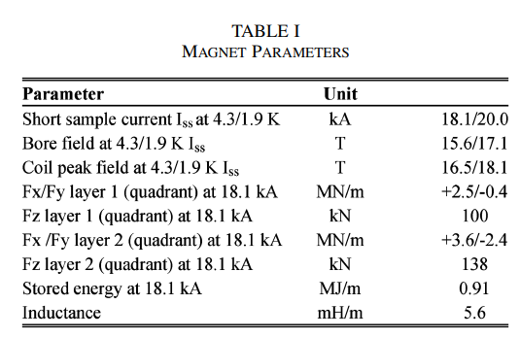
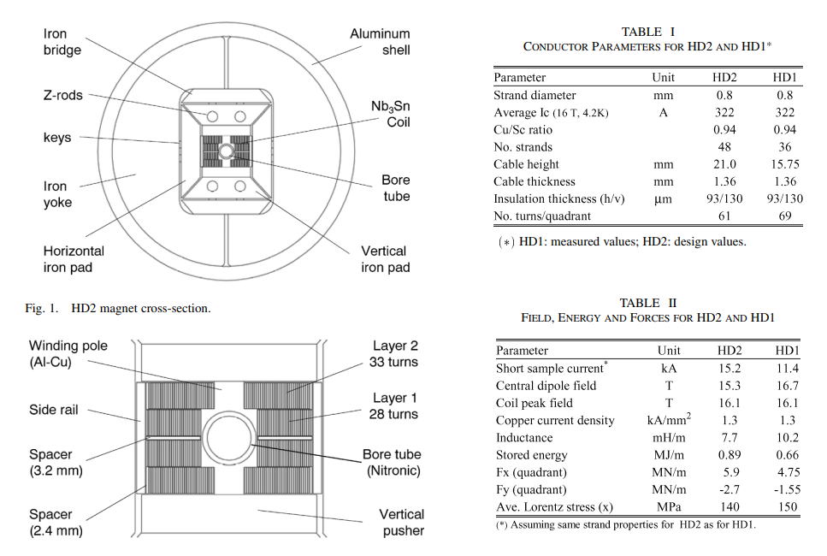
HD
HD2: 1243 A/mm2 @ 16 T, 4.2 K
HFM: 1200 A/mm2 @ 16 T, 4.2 K (i.e., 3.6% lower)

Slide 14
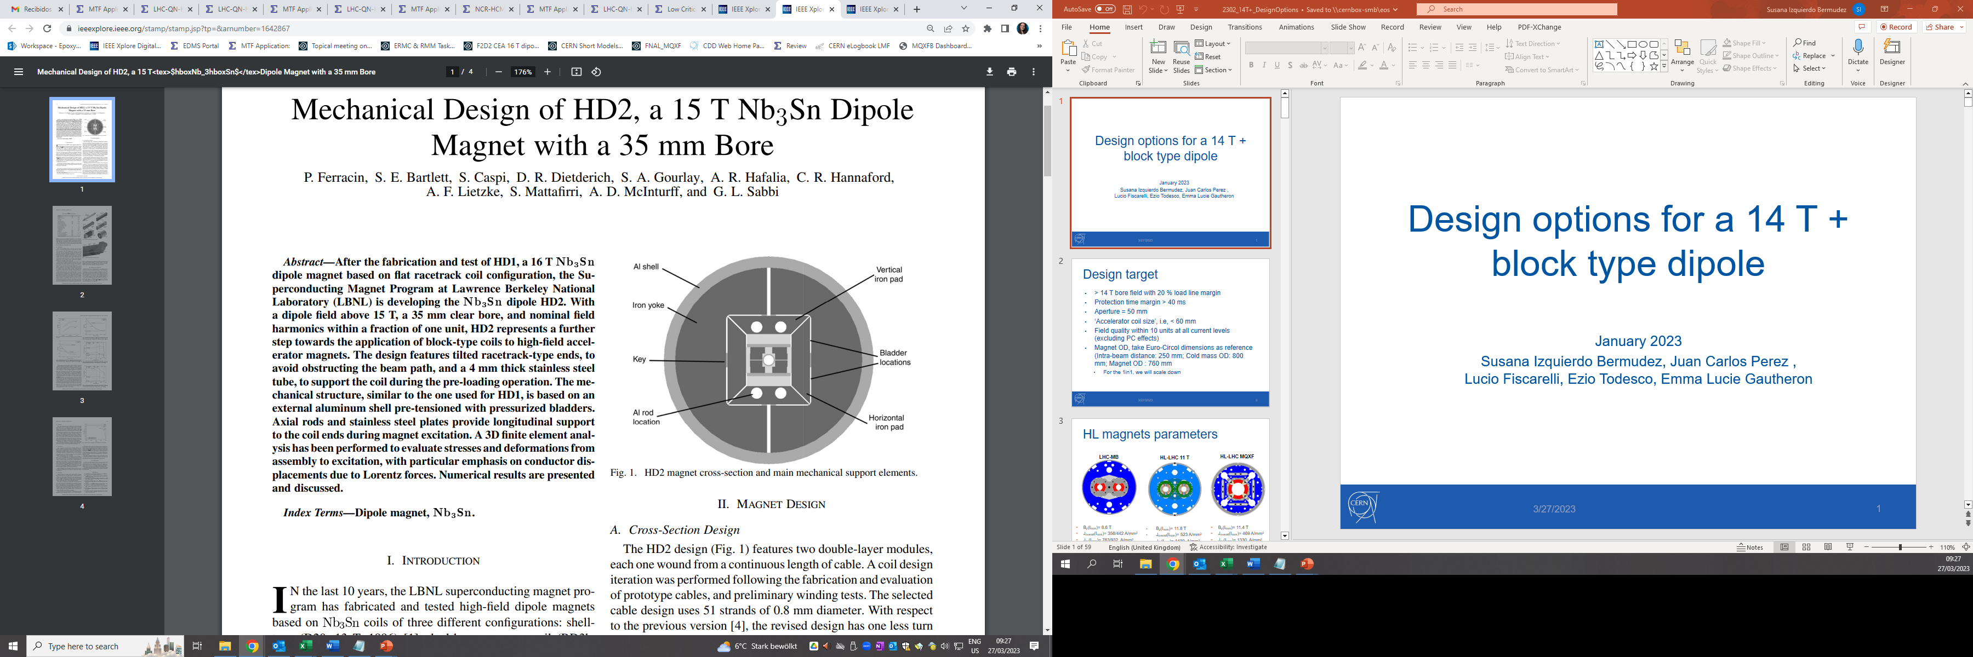
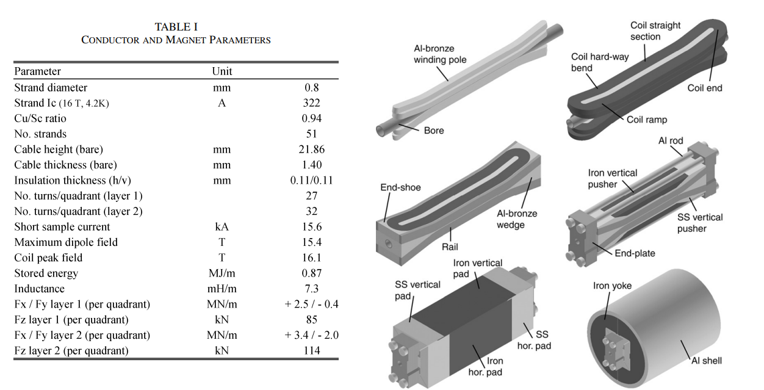

Slide 15
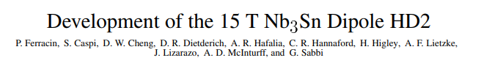
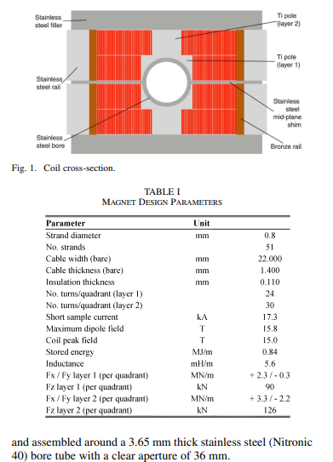
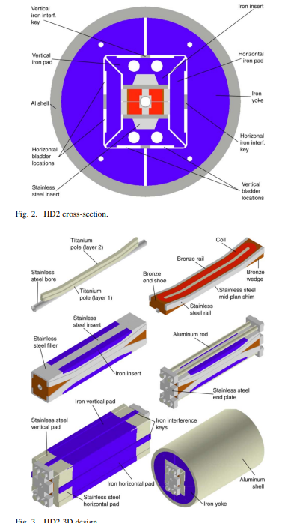

Slide 16
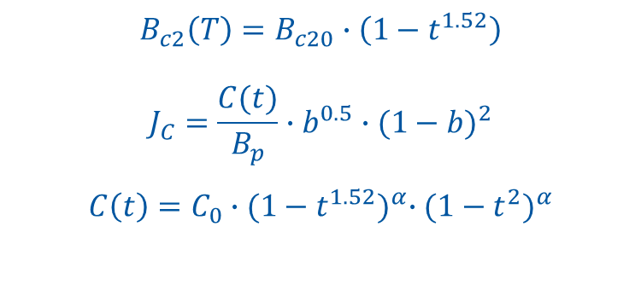
Critical Current Density
HFM and what we were using for FCC models is basically the same ☺. For the 14 T, we use the HFM specification i.e., 2800 A/mm2 at 12 T,4.2 K assuming 5 % degradation
$$B_{c2}\left(T\right)=B_{c20}∙\left(1−t^{1.52}\right)$$
$$J_{C}=\frac{C(t)}{B_{p}}∙b^{0.5}∙{(1−b)}^{2}$$
$$C\left(t\right)=C_{0}∙{(1−t^{1.52})}^{α}∙{(1−t^{2})}^{α}$$
 | Hi-Lumi | FCC models | FCC target | HFM
T_{c0} (K) | 16 | 16 | 16 | 16
B_{c20} (T) | 29.38 | 28.8 | 29.38 | 29.38
α | 0.96 | 0.96 | 0.96 | 0.96
C₀(A/mm²T) | 188870 | 255230 | 275880 | 214462
HD2: 1243 A/mm2 @ 16 T, 4.2 K
J_{c} at 4.2 K | Hi-Lumi | FCC models | FCC target | HFM
12 T | 2450 | 2880 | 3600 | 2800
16 T | 1058 | 1236 | 1545 | 1200

Slide 17
J - range
If we want 14 T with abut 20 % margin, we should target to a short sample field of 17.5 T
  Without grading, compared to MQXF short sample, we will have 15-20 % lower current density (will help for protection and mechanics, but this also means a bit less compact magnet)
  There is not much we can do about it unless
    We get more Jc
    We have strands with less Cu (we are already at 0.9, a lot of reluctant during EuroCirCol to go lower than that, but HD2 was 0.55)
    We grade the coil
 |  |  |  |  |  | Difference to MQXF-SS
 | 1.1 mm | 1.0 mm | 0.85 mm | MQXF-SS | MQXF-OP | 1.1 mm | 1.0 mm | 0.85 mm
Bss (T) | 18.00 | 18.00 | 18.00 | 14.50 | 11.30 | % | % | %
Jc (with 5 % cabling deg) | 1126 | 1126 | 1126 | 2066 | 1573 | -29 | -29 | -29
Jcu | 1252 | 1252 | 939 | 1722 | 1311 | -16 | -16 | -29
Jeng | 593 | 593 | 512 | 939 | 715 | -23 | -23 | -29
Joverall | 400 | 392 | 328 | 601 | 457 | -20 | -21 | -29
 |  |  |  |  |  | Difference to MQXF-SS
 | 1.1 mm | 1.0 mm | 0.85 mm | MQXF-SS | MQXF-OP | 1.1 mm | 1.0 mm | 0.85 mm
Bss (T) | 17.50 | 17.50 | 17.50 | 14.50 | 11.30 | % | % | %
Jc (with 5 % cabling deg) | 1257 | 1257 | 1257 | 2066 | 1573 | -24 | -24 | -24
Jcu | 1397 | 1397 | 1047 | 1722 | 1311 | -10 | -10 | -24
Jeng | 662 | 662 | 571 | 939 | 715 | -17 | -17 | -24
Joverall | 446 | 437 | 365 | 601 | 457 | -15 | -16 | -24
 |  |  |  |  |  | Difference to MQXF-SS
 | 1.1 mm | 1.0 mm | 0.85 mm | MQXF-SS | MQXF-OP | 1.1 mm | 1.0 mm | 0.85 mm
Bss (T) | 17.00 | 17.00 | 17.00 | 14.50 | 11.30 | % | % | %
Jc (with 5 % cabling deg) | 1397 | 1397 | 1397 | 2066 | 1573 | -19 | -19 | -19
Jcu | 1552 | 1552 | 1164 | 1722 | 1311 | -5 | -5 | -19
Jeng | 735 | 735 | 635 | 939 | 715 | -12 | -12 | -19
Joverall | 496 | 486 | 406 | 601 | 457 | -10 | -11 | -19

Slide 18
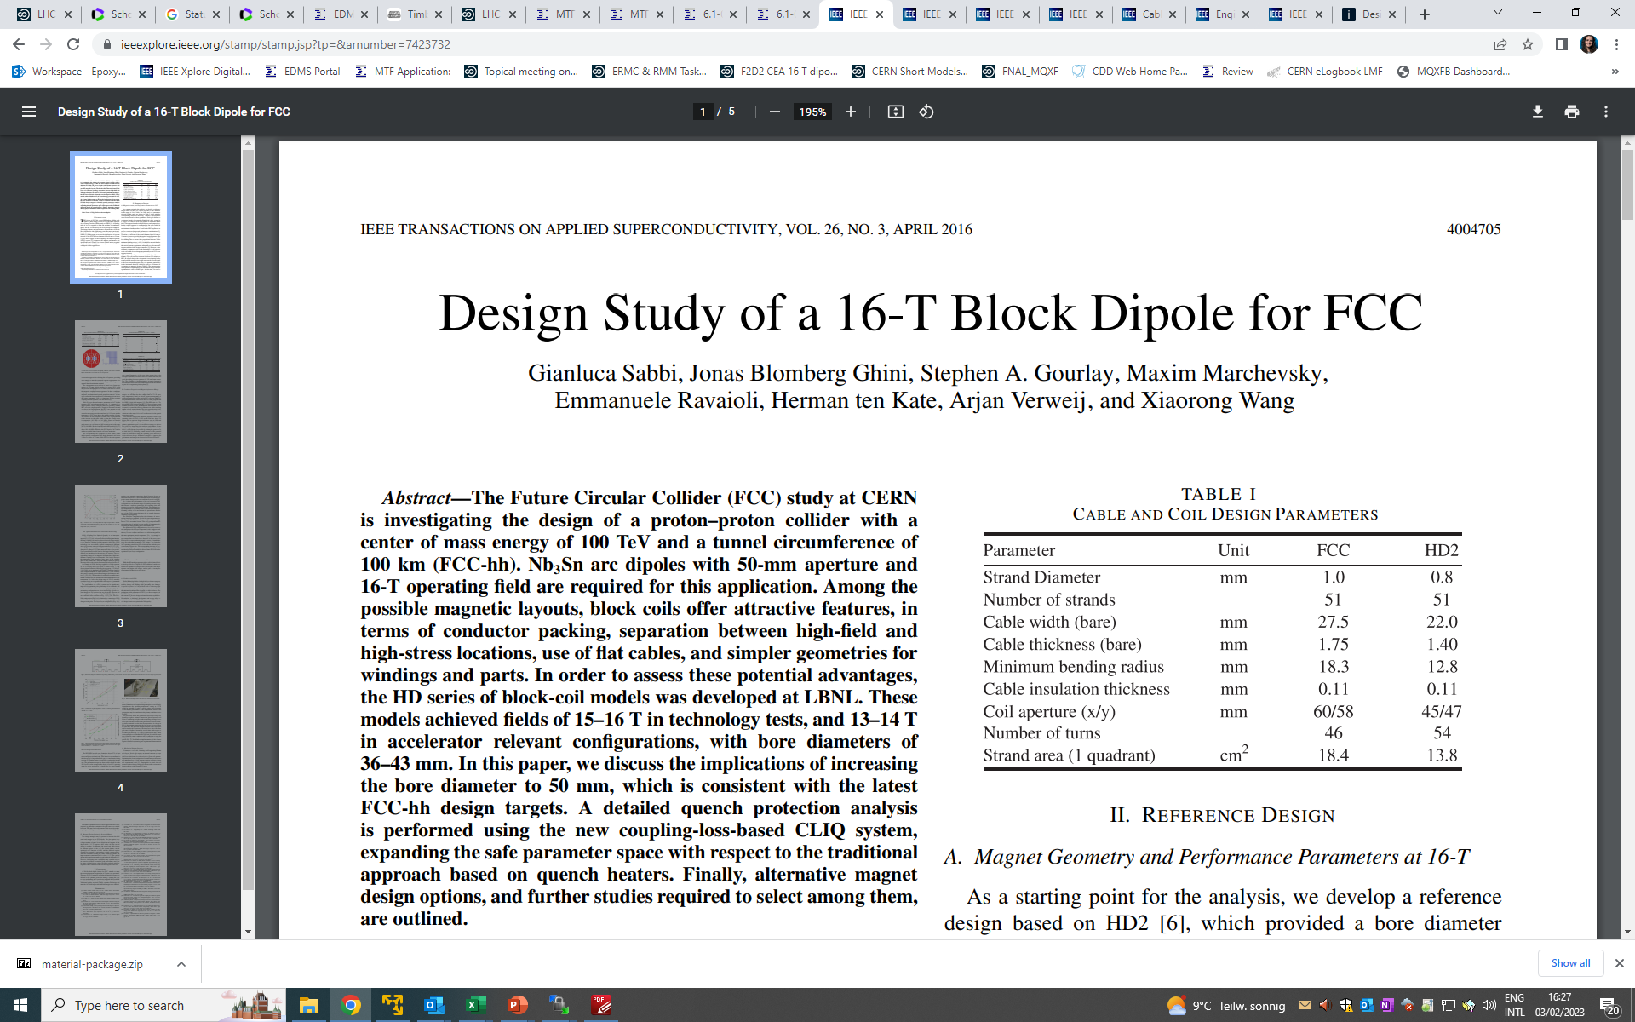
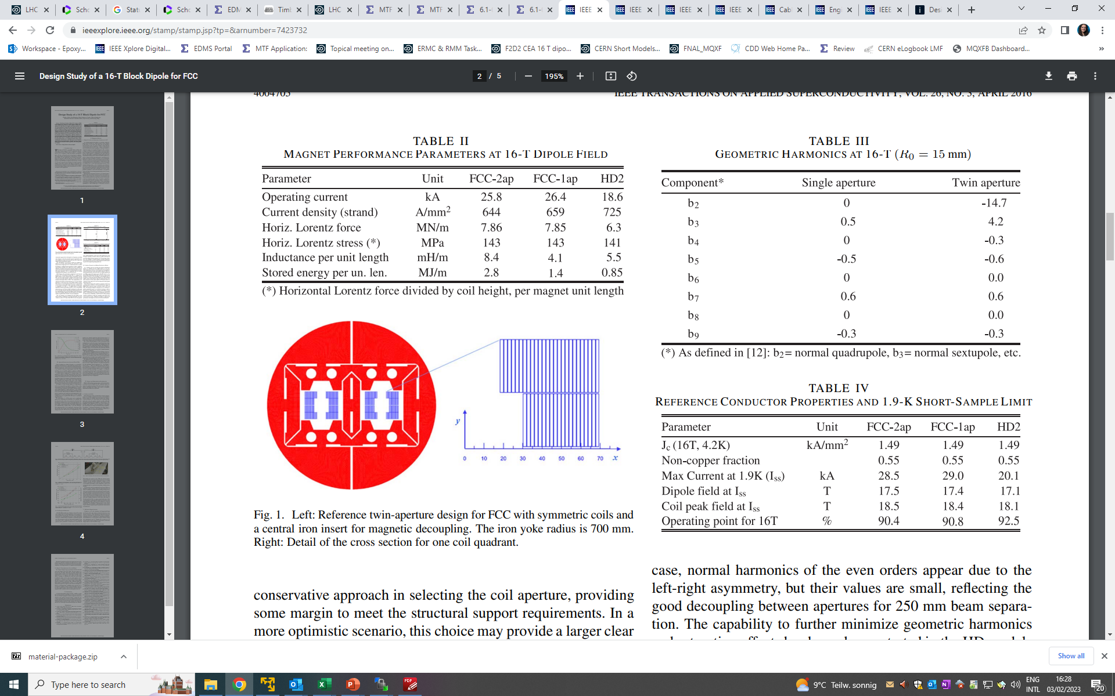

Slide 19
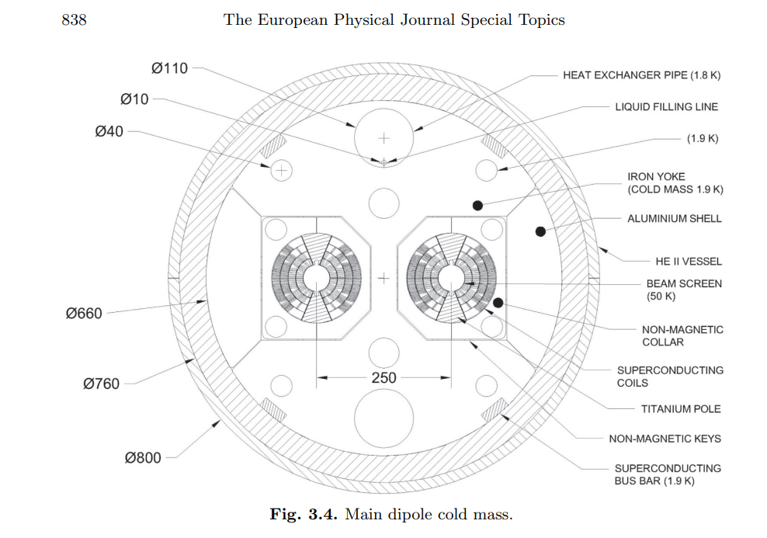
Magnet size
Ref FCC design study: https://cds.cern.ch/record/2651300/files/CERN-ACC-2018-0058.pdf
Intra-beam distance: 250 mm (12 T is 194 mm)
Cold mass OD: 800 mm
Magnet OD : 760 mm

Slide 20
Magnet parameters –
Pros and Cons of the different options
14 T – V1 (44 strands x 1.1 mm)
  Same cable as TFD, so cabling development already done +++
  The 1.1 mm strand is also used for F2D2, so synergies with CEA development in block coils ++
  In the long term, and we ever think about grading, it makes more sense to have the biggest possible difference in strand diameters between HF/LF, so it is more attractive to develop the 1.1 mm strand than the 1.0 mm +
  It seems from the data of Simon that is more stable than the 1.0 mm, but we need to be careful with this assessment since he is mixing the impact of the keystone (in the 1.0 mm datasheet there were samples coming from a keystone cable) and the strand itself
  Only 50 km of strand available at CERN, to be shared with CEA for F2D2, but one could look to efficient procurement strategies, time required to procure to be assessed (Simon thinks it cannot be an addendum of the HFM contract) -
14 T – V2 (48 strands x 1.0 mm)
  It seems from the data of Simon that is less stable than the 1.0 mm, but we need to be careful with this assessment since he is mixing the impact of the keystone (in the 1.0 mm datasheet there were samples coming from a keystone cable) and the strand itself
  Much more strand available in stock, Simon to confirm how much+
  Cable development needed
14 T – V3 (56 strands x 0.85 mm)
  The strand is very well known (MQXF strand)
  For the same coil equivalent with, we get 0.5 T less (the strand has too much copper)
  Cable development needed
We should choose one option of the three…I would go for V1.

Slide 21
Where we are
56 mm, 14 T
56 mm, 640 A/mm²
14 T, 95 J/cm³

Slide 22
