Slide 1
Mechanical analysis for a block-type 14 T magnet,
1in1 configuration
March 2023
Susana Izquierdo Bermudez, Juan Carlos Perez , Lucio Fiscarelli, Ezio Todesco, Emma Lucie Gautheron

Slide 2
Outline
V1: first exploration of parameters
V3: ‘traditional’ design, fulfilling general targets
  Basic optimization
  Bladders
  Stiffness
V4: horizontal split yoke with open gap after cool down
V5: vertical split yoke with close gap after loading
V6: horizontal split yoke with close gap after loading

Slide 3
V1: first exploration of paramteers

Slide 4
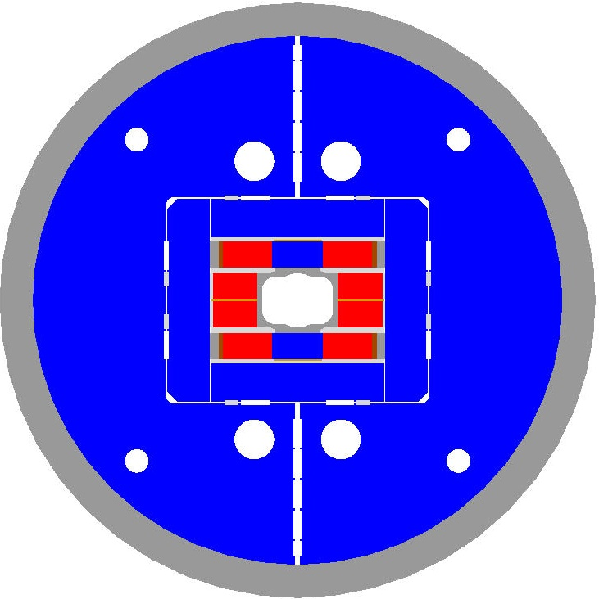
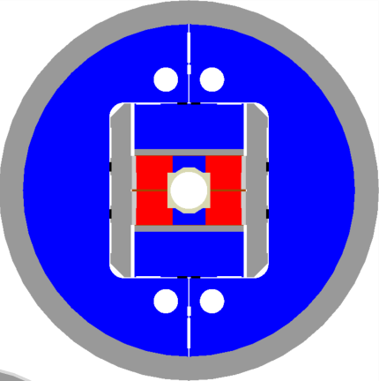
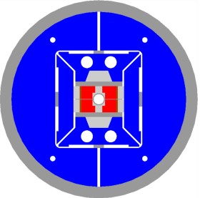
Block magnets with flared ends
HD2
Aperture = 36 mm
OD = 0.705 m
Cable width = 22
Al-shell thickness =
FRESCA2
Aperture = 100 mm
OD =1.03 m
Cable width = 20.9
Al-shell thickness = 65 mm
L = 1.6 m; Lm = 1.2 m
TFD
Aperture = 100x?? mm
OD = 1.3 m
Al-shell thickness =

Slide 5
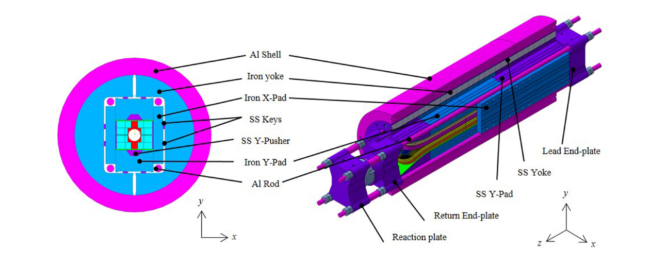
F2D2
Al-shell thickness = 70 mm
Magnet OD = 2*(255 + 70) = 650 mm

Slide 6
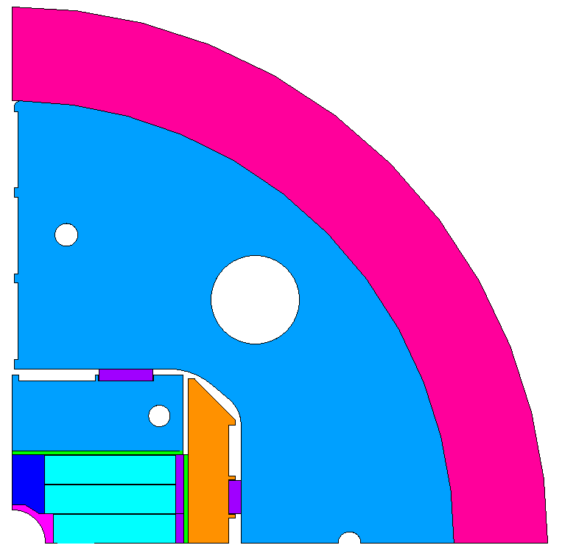
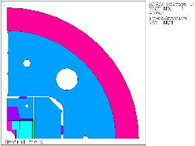
RMM
Al-shell thickness = 70 mm
Magnet OD = 2*(255 + 70) = 800 mm
Juan
70 mm
66 mm
49 mm
130 mm
66 mm
171 mm

Slide 7
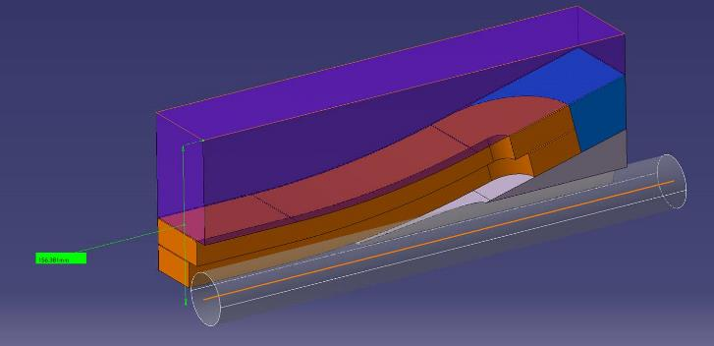
L’encombrement vertical du “coil pack” serait de 156mm par rapport à l’axe de l’aimant.
Cette valeur est obtenu avec les hypothèse suivantes :
Rayon de courbure dans le sens défavorable : 800mm (rayon de courbure du câble FReSCa2 700 mm x 25/21.8=802.75)
Les câbles externes des têtes sont alignés
Angle des têtes = 14 degrés (pour conserver plus de 10mm entre le conducteur interne et l’ouverture faisceau)
Longueur des pièces d’extrémité de bobines = 50mm minimum (comme sur FReSCa2), pour garder de la place pour les connexions d’éventuelles « trace »
Epaisseur du « pad » supérieur à l’extrémité = 40mm

Slide 8
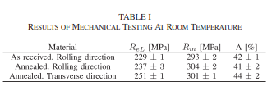
Mechanical design criteria
Pole-coil contact in pole-turns midpoint
p_{cont} ≥ 2 Mpa @ 17.5 T
Max bladder pressure
< 50 MPa
Bladder should open the
interf=interf_{nom} + 100μm
All components σ ≤ R_{p 0.2}
For iron at 4.3K (brittle)
σ_{I} ≤ ~200 MPa
Material | R_{p 0.2} [MPa]
 | 293 K | 4.3 K
Al 7075 | 480 | 690
SS 316 LN | 286 | 930
NITRONIC 40 | 353 | 1240
MAGNETIL | 180 230 | 723
Ti 6Al 4V | 827 | 1654

Slide 9
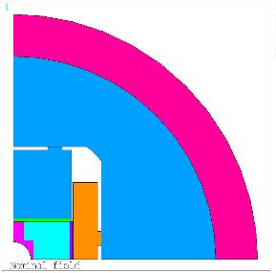
14T
Shell thickness, I start with 60 mm, maybe a bit less works as well
Magnet OD, 700 mm, as HD
Axial rods diameter , 35 to 40 mm (with 40 we have the same Fz/A than for RMM, with 35 we are as MQXF)
I start with a ‘thin pad solution’ with the axial rods kind of in the coil pack , cannot be in iron
Pad in iron
Current = 21667 A.
Bore field = -14.8525909 T.
Peak field layer 2 = 15.6030426 T.
Peak field layer 1 = 15.0379992 T.
Current density = 346.358781 A/mm^2.
Pad in nitronic
Current = 21667 A.
Bore field = -14.4971455 T.
Peak field layer 2 = 15.2904453 T.
Peak field layer 1 = 14.6346979 T.
Current density = 346.358781 A/mm^2.

Slide 10
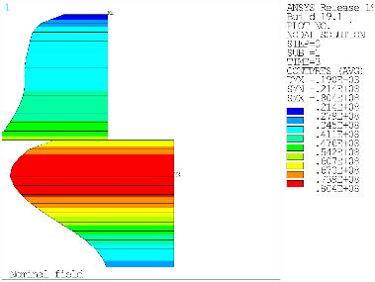
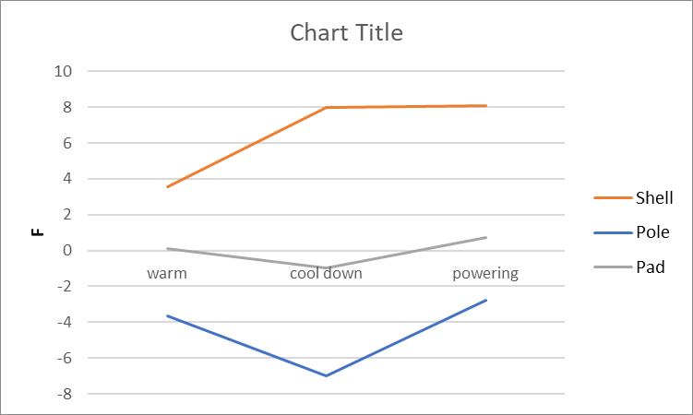
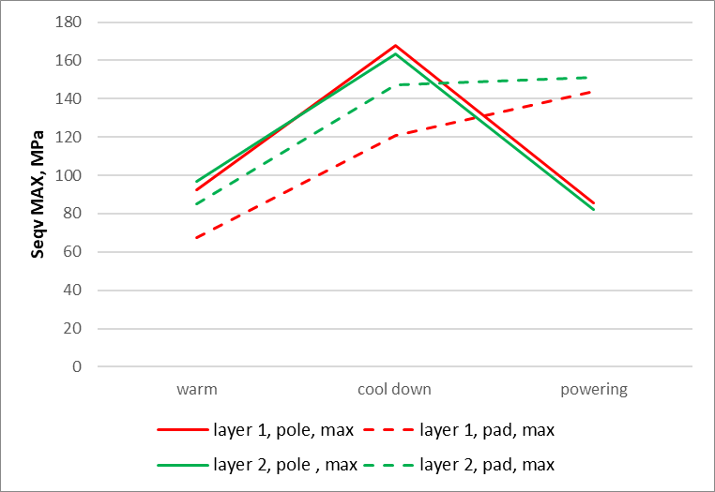
Intf 0.7 mm and 60 mm shell gives us more than enough preload.
  0.7 mm we can get with XX bar
  See v3 with 50 mm shell

Slide 11
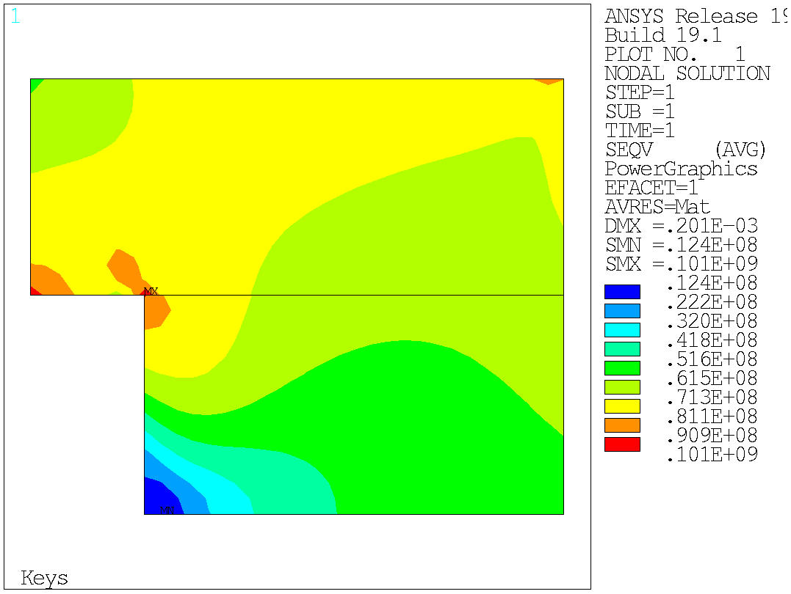
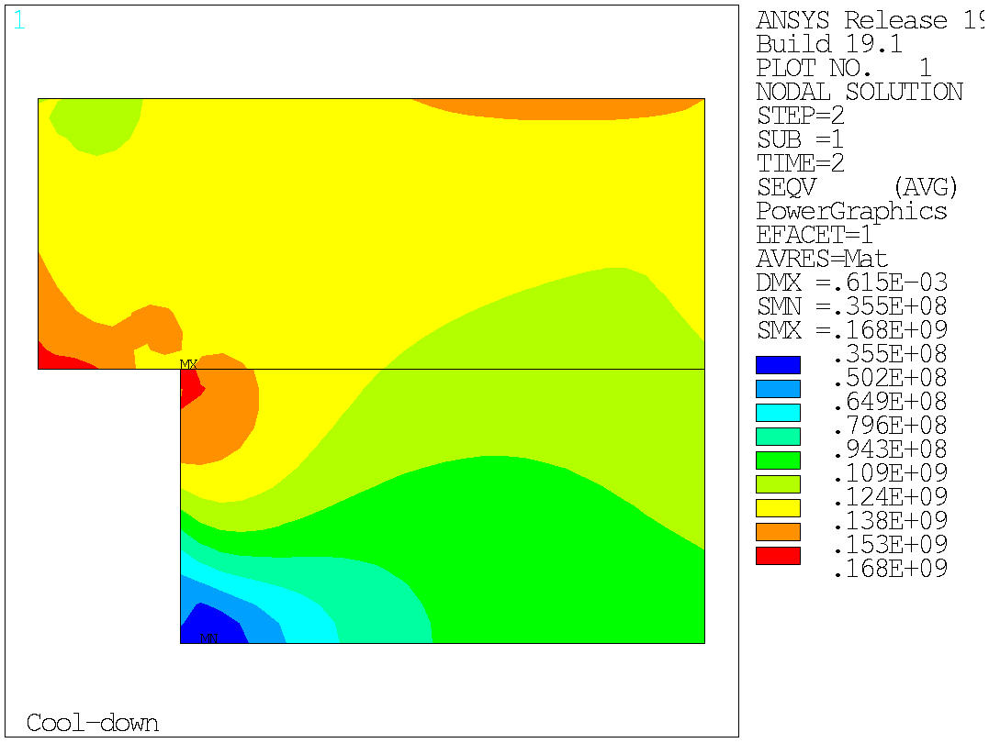
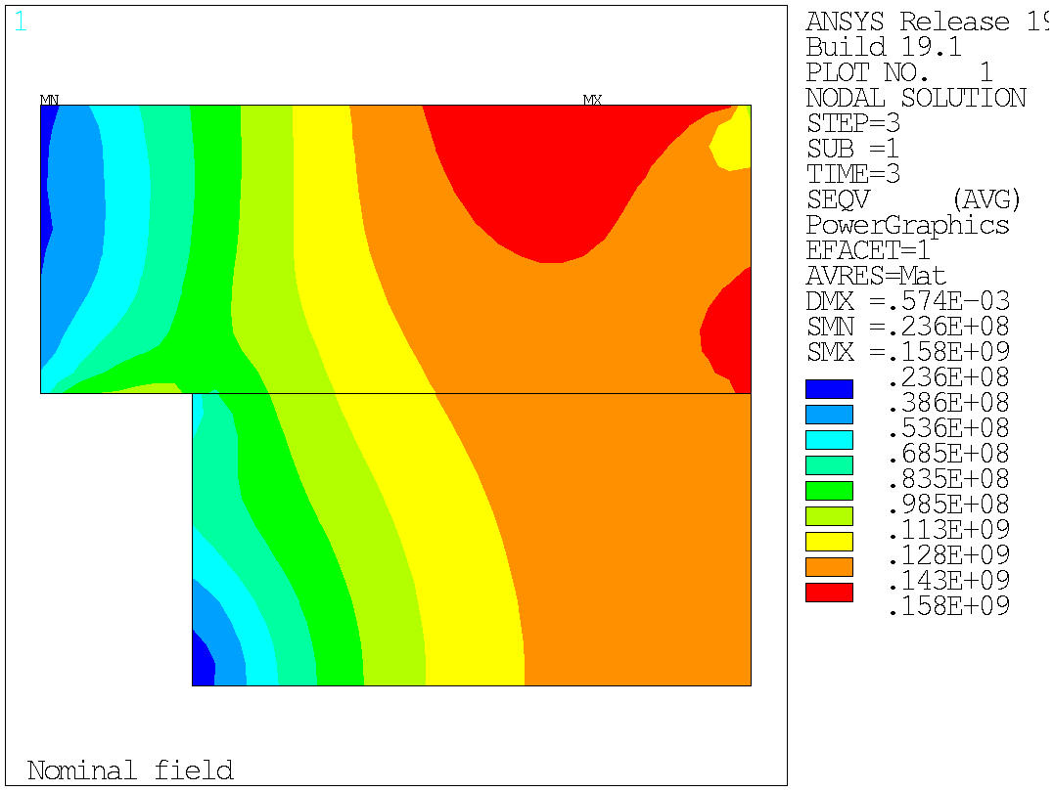
0.7 interf

Slide 12
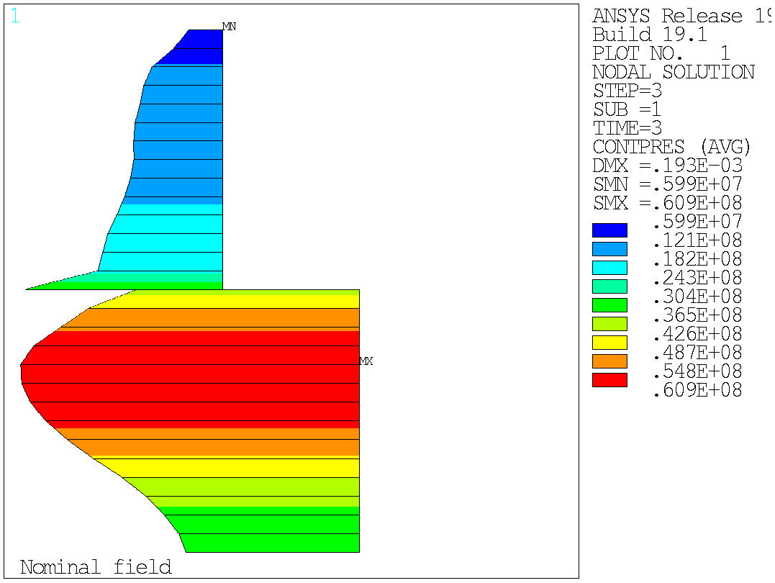
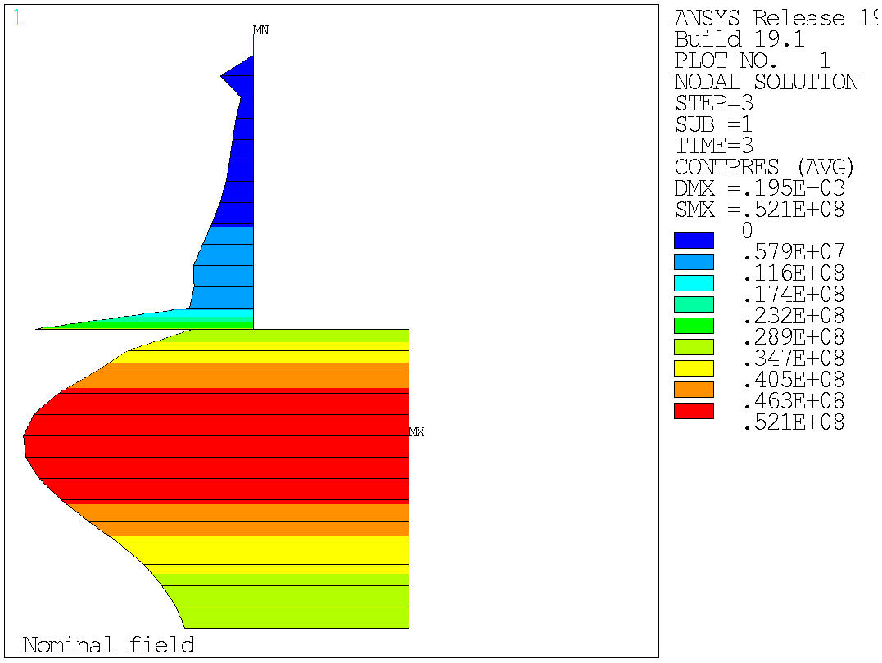
To be loaded to 14 T, 0.4 mm interf is enough with 60 mm shell
0.7
0.5
0.4

Slide 13
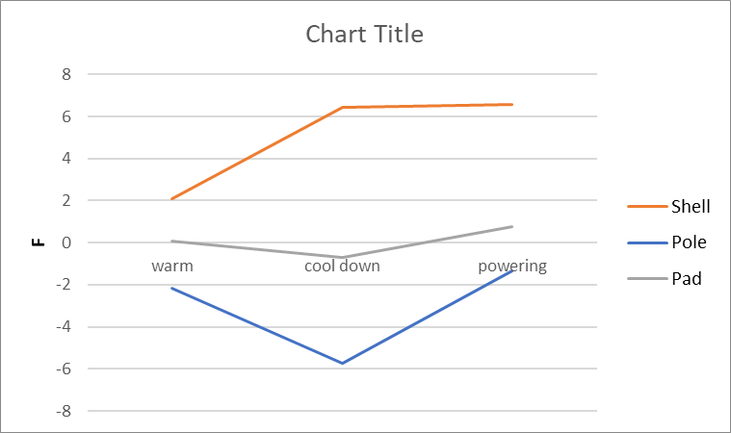
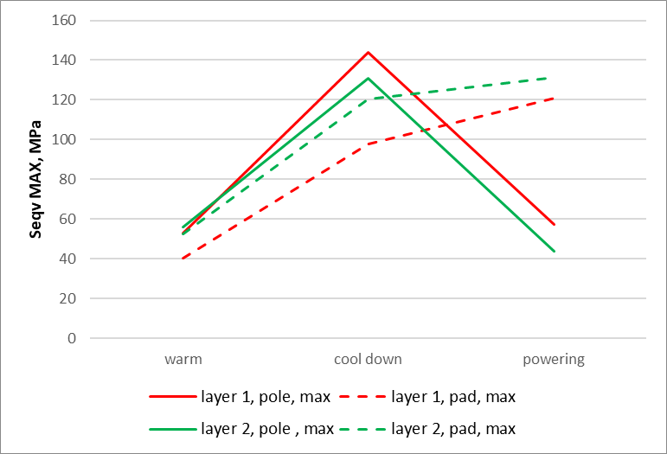

Slide 14
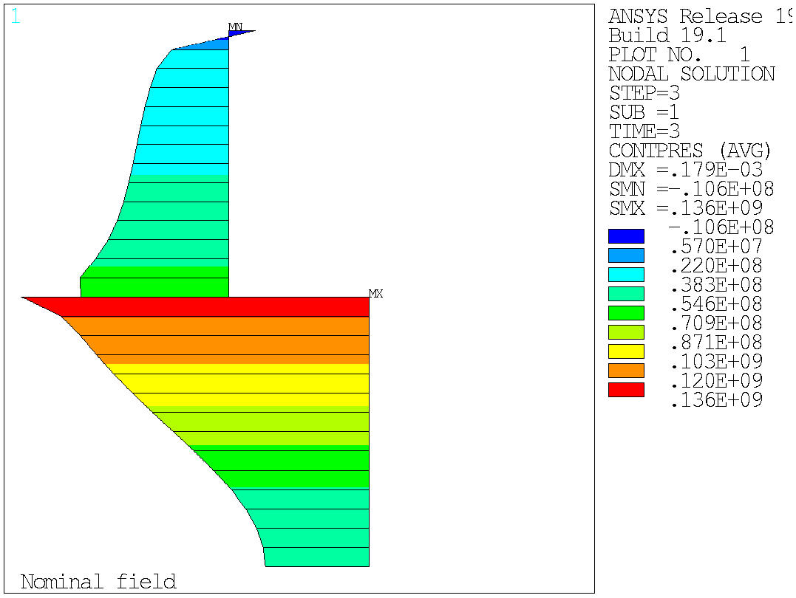
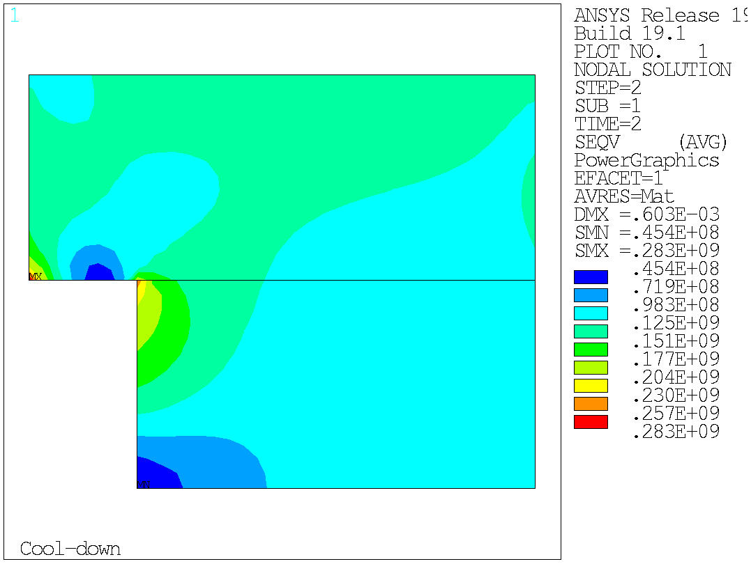
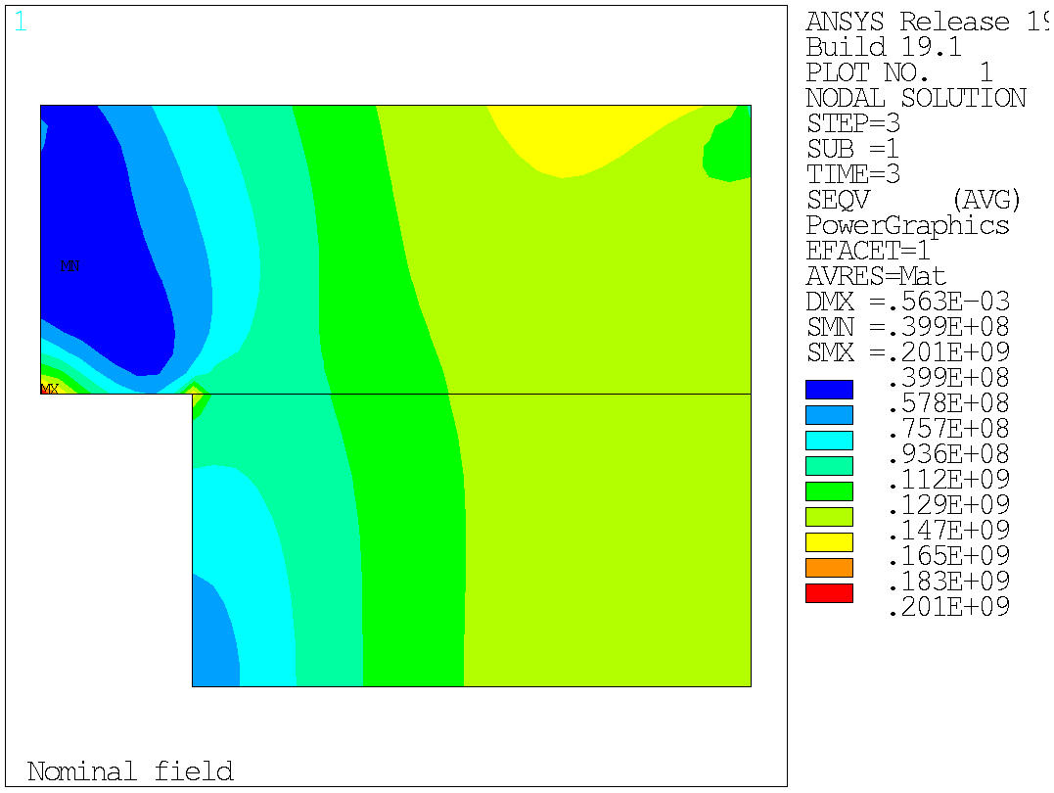
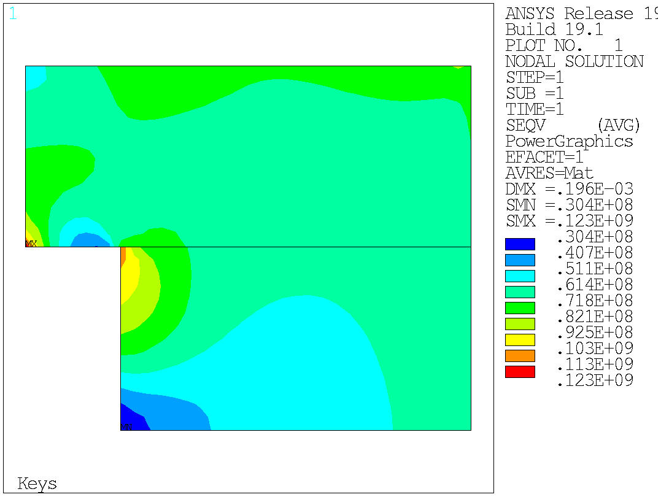
If I glue the poles, I get a lot of corner effect

Slide 15
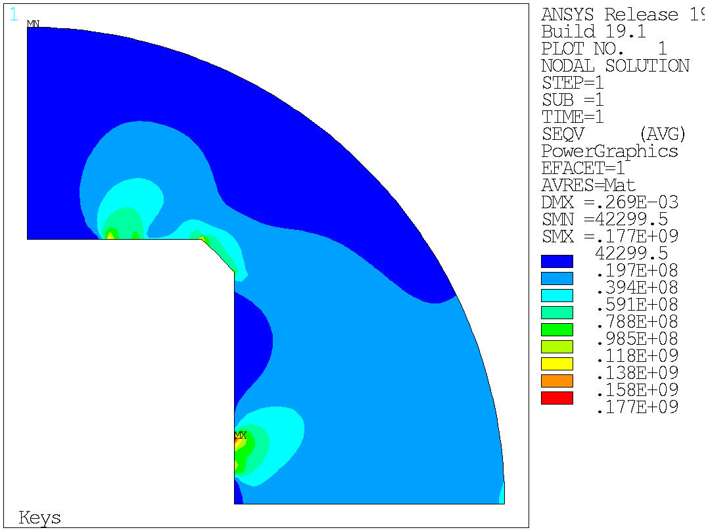
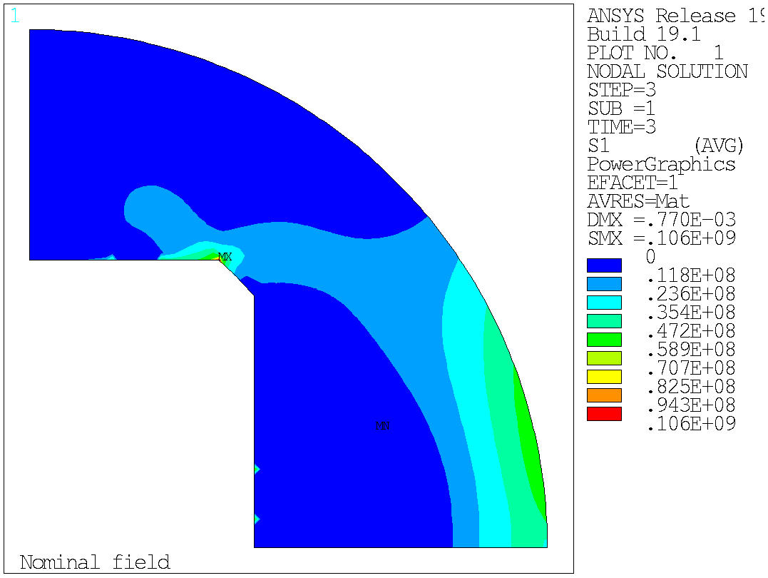
The yoke has a lot of margin, I think I can make a thicker pad such that we keep it in iron

Slide 16
Potential improvements
Better balance of pre-load between IL and OL, maybe 3 mm bore instead of 4, move one turn from layer 2 to layer 1→ this I don’t try to optimize for the moment, lets optimize a bit more the rest of the things
I think the yoke has enough margin to go for a thicker iron pad → axial loading rods probably go to the rod, up
Thinner shell, 60 mm is to much

Slide 17
Version 3
- Basic optimization
- Bladders
- Stiffness

Slide 18
Basic optimization

Slide 19
v3
Let’s go better for 50 mm shell for the moment, to give about half and half of the pre-load (RT and cool down)
Let’s give a try to an iron pad
I need to put the SS filler in the vpad to fix b3, but not yet in this iteration (it will decrease the field and I want to check first the thicker iron pad how much gives us)

Slide 20
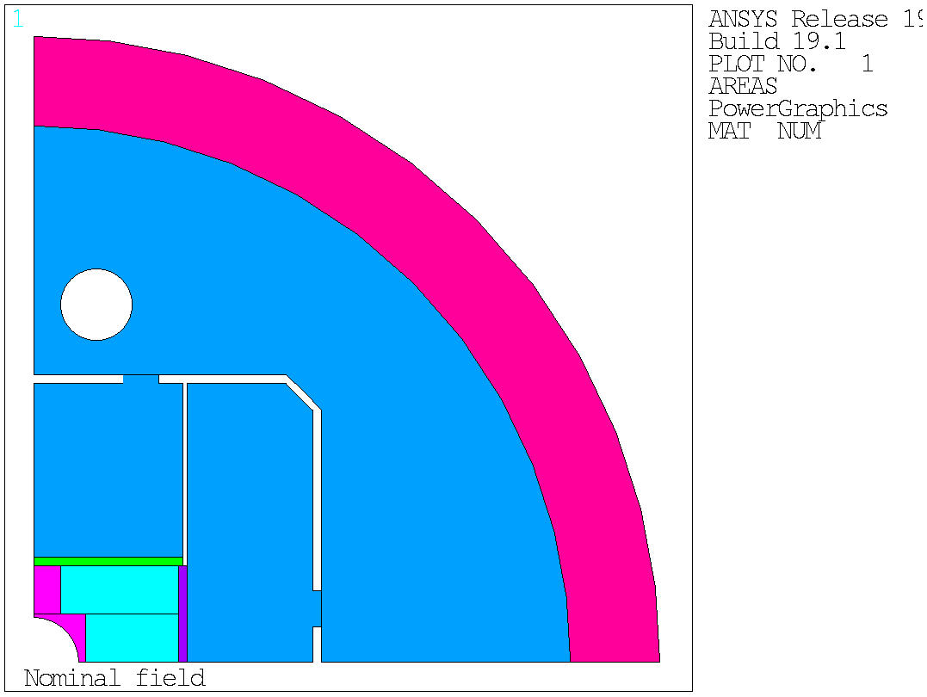
v3
Current = 21667 A.
Bore field = -14.9559928 T.
Peak field layer 2 = 15.7009258 T.
Peak field layer 1 = 15.1477766 T.
Current density = 346.358781 A/mm^2.

Slide 21
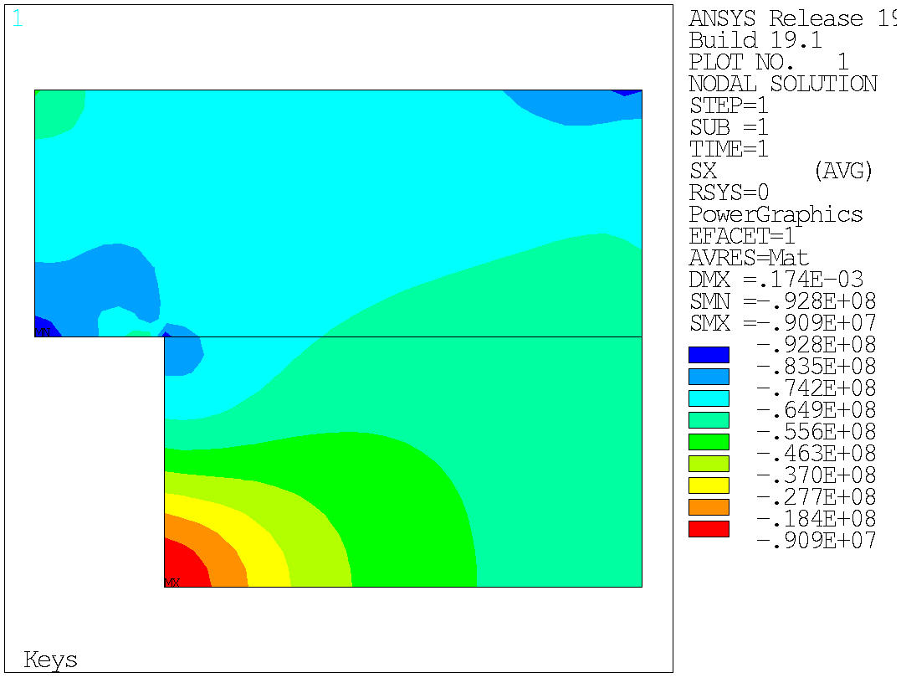
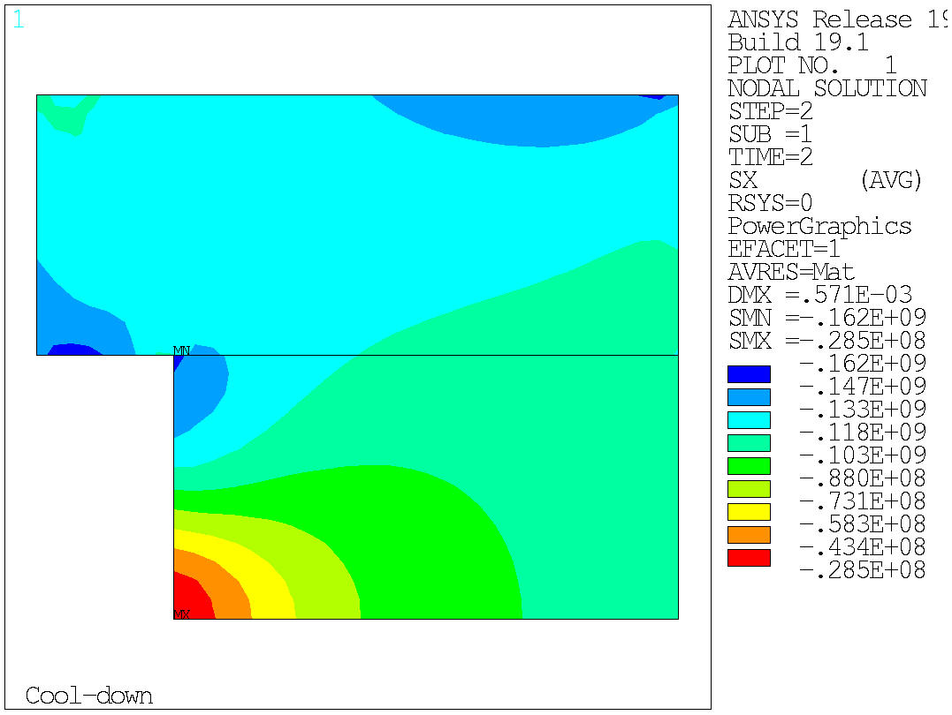
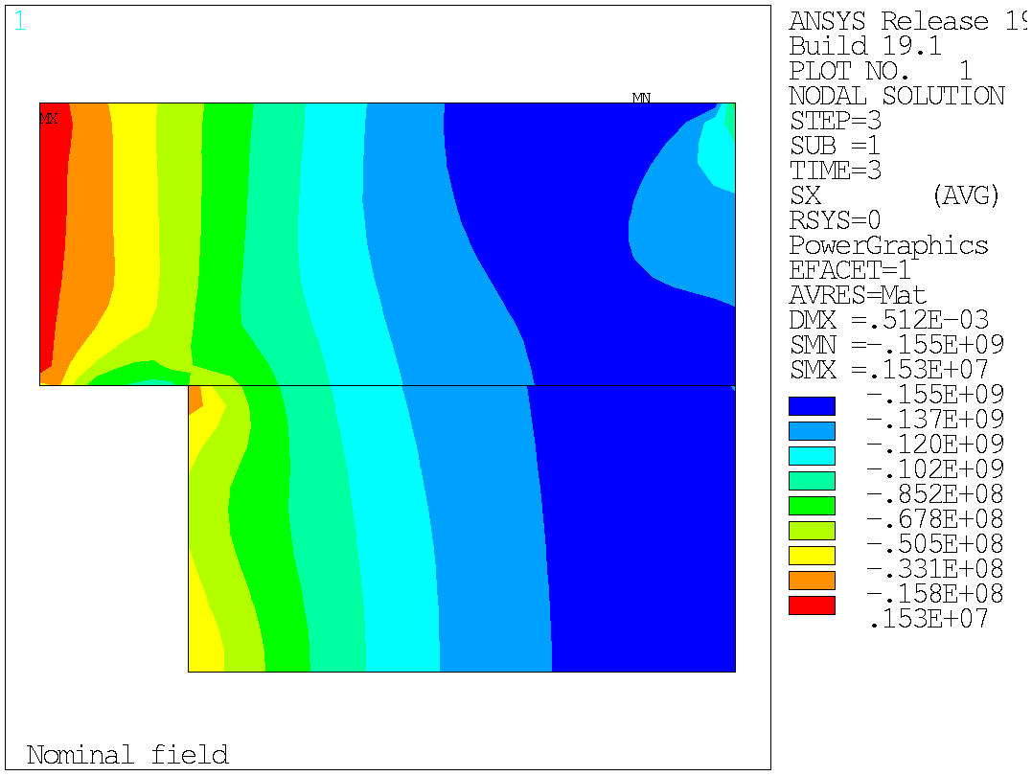
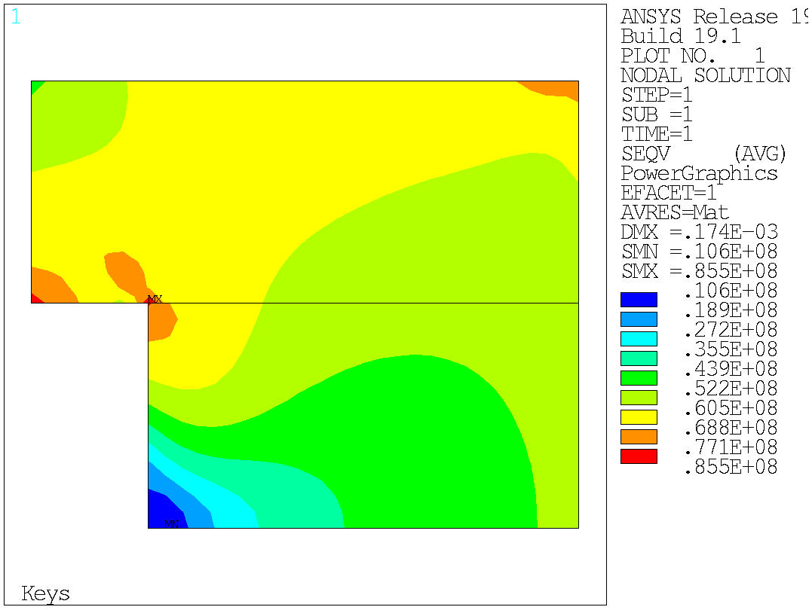
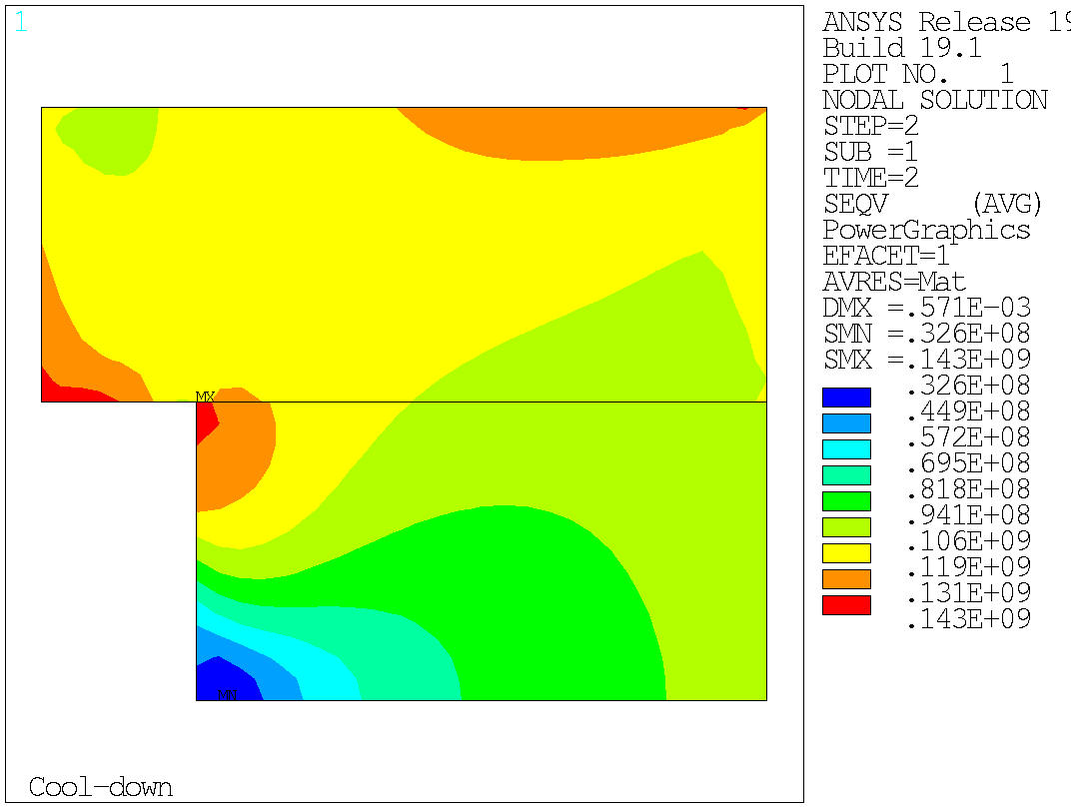
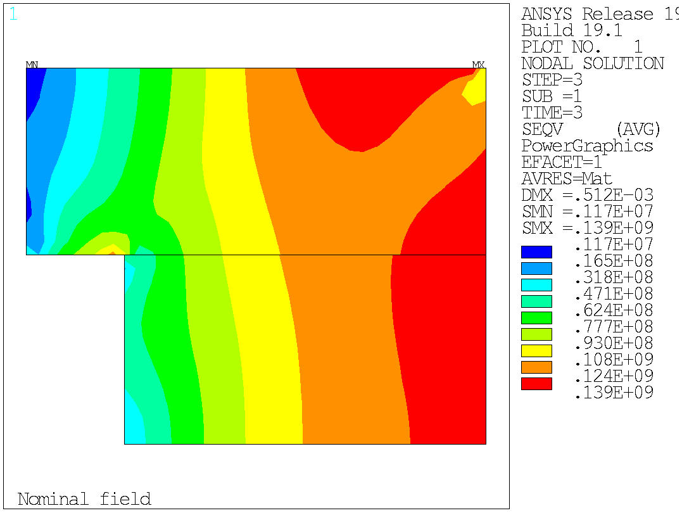

Slide 22
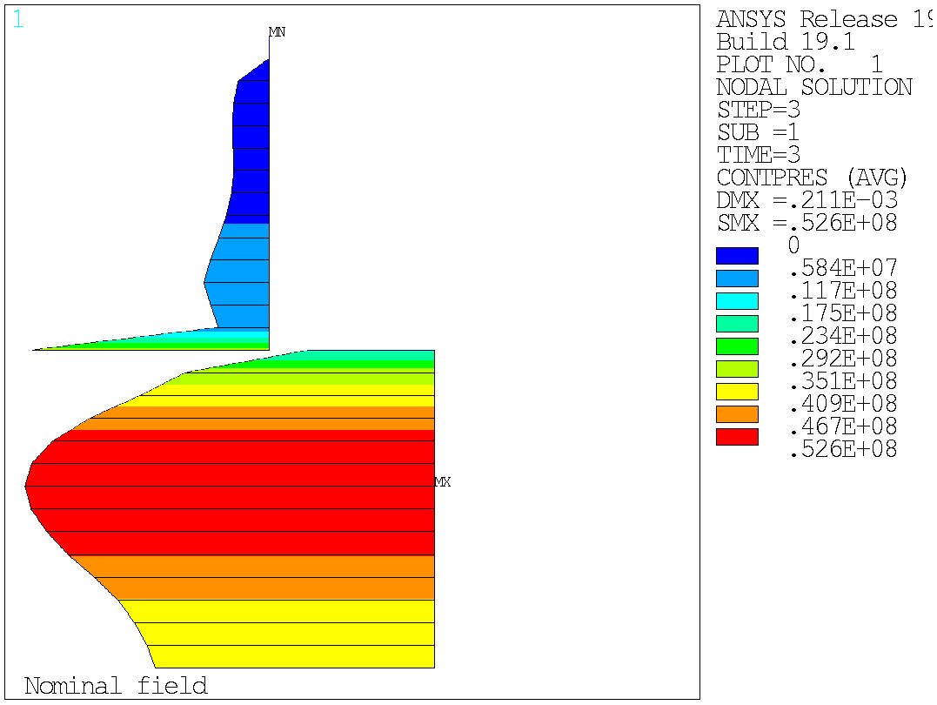
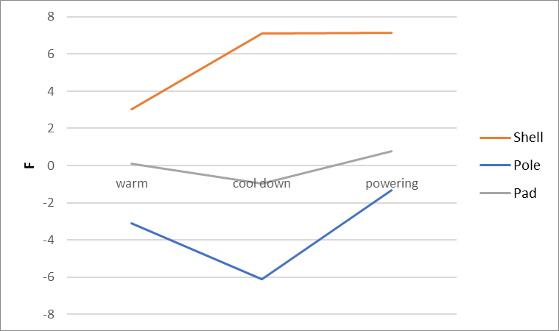
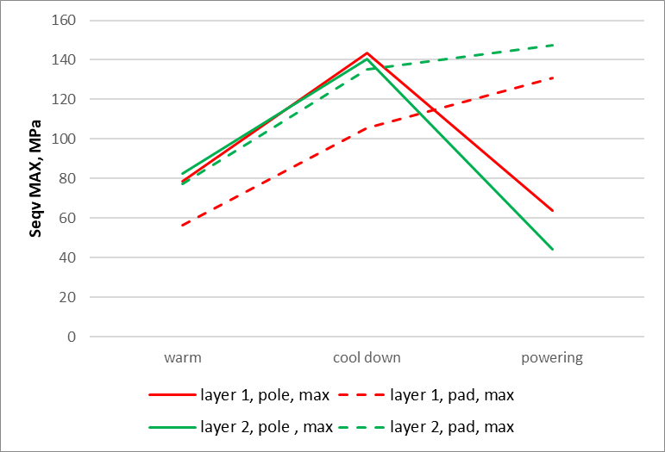

Slide 23
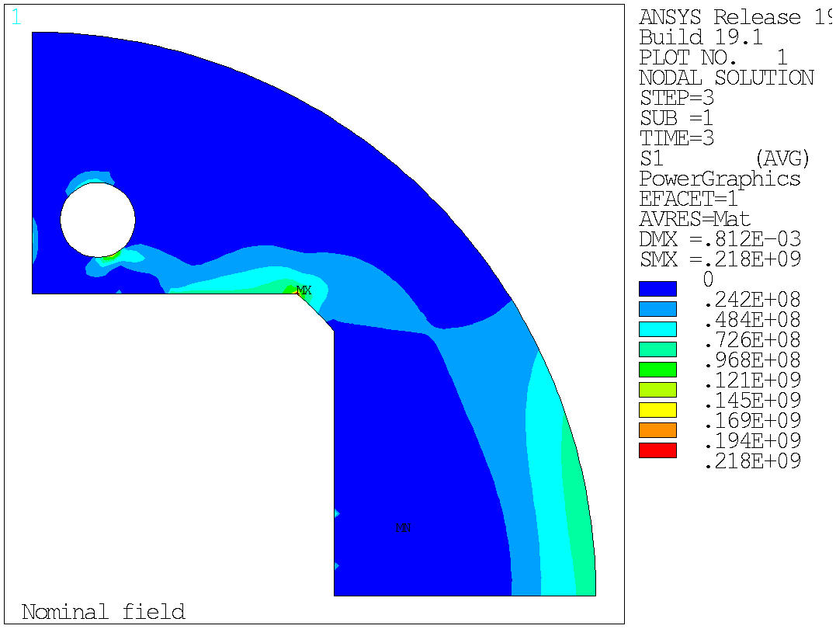
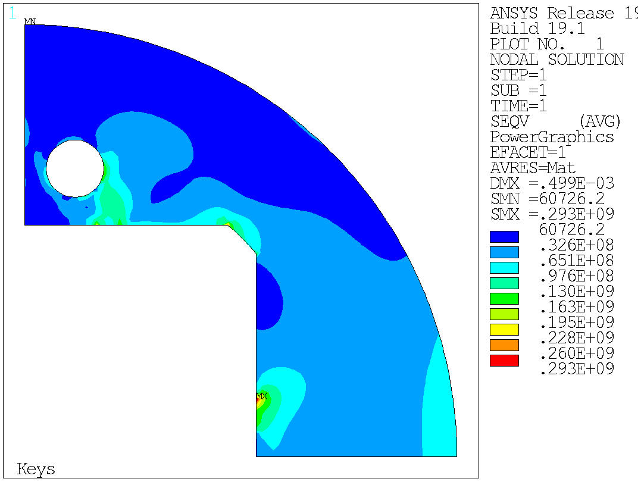

Slide 24
Things to be optimized next iteration
Play in ROXIE with the shape of the SS filler for b3 and the position of the axial rod to optimize b3 and maximize the field
If we want, we can make the horizontal pad still a bit thicker
Still room to play a little bit with the key size and position for the very last MPa, but to be done after a magnetic iteration of the cross section
Would be nice to have 1 turn less in the top layer, one turn more in the bottom layer, for a better balance of electromagnetic forces/pre-load. 3 mm bore thickness would be ok mechanically I think

Slide 25
Bladders

Slide 26
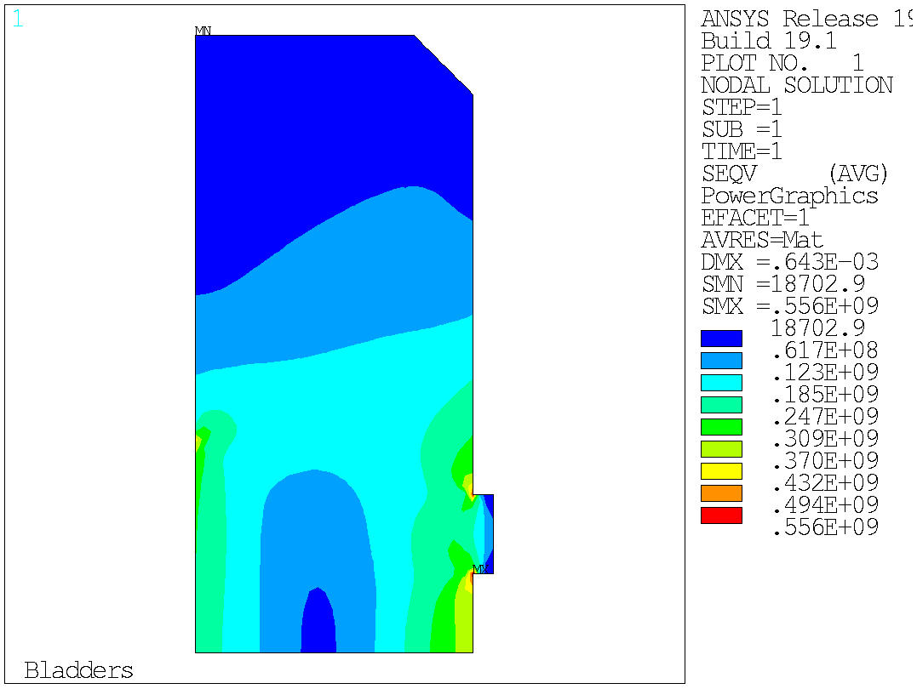
Bladder step
PARAMETER H1BLAD_P_BAR = 500.0000000
PARAMETER H2BLAD_P_BAR = 500.0000000
PARAMETER H3BLAD_P_BAR = 500.0000000
PARAMETER VBLAD_P_BAR = 0.000000000
PARAMETER DISPLY = 0.3064747010E-02
PARAMETER DISPLX = 2.017367878
H1 140 mm
H3
100 mm
H2
20 mm

Slide 27
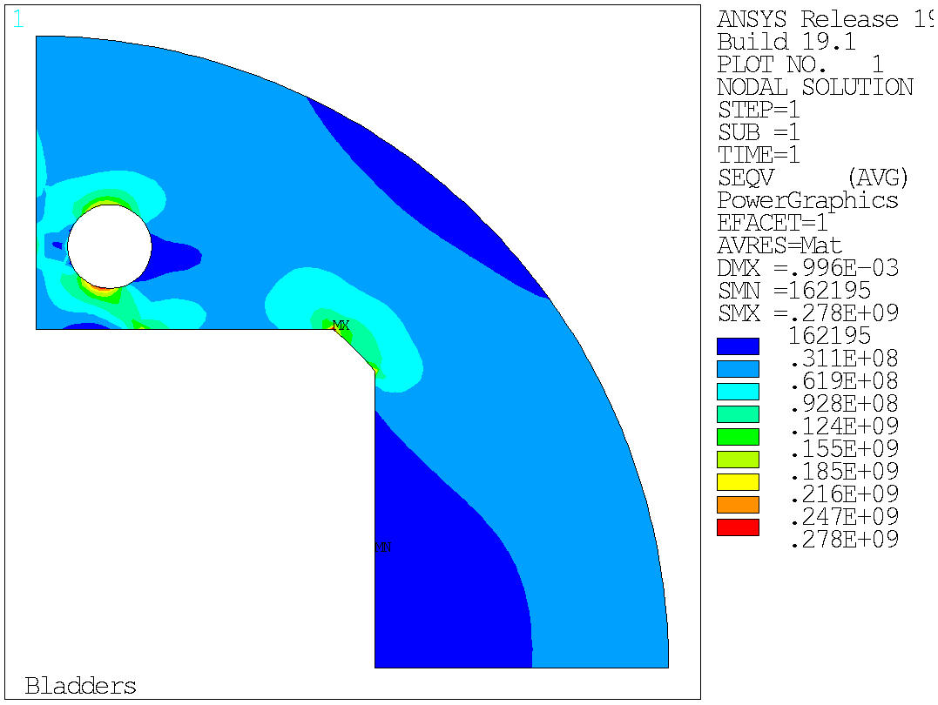
Bladder step
PARAMETER H1BLAD_P_BAR = 500.0000000
PARAMETER H2BLAD_P_BAR = 0.000000000
PARAMETER H3BLAD_P_BAR = 0.000000000
PARAMETER VBLAD_P_BAR = 0.000000000
PARAMETER DISPLY = 0.1031214670E-02
PARAMETER DISPLX = 0.8683866854
H1 140 mm
H3
100 mm
H2
20 mm

Slide 28
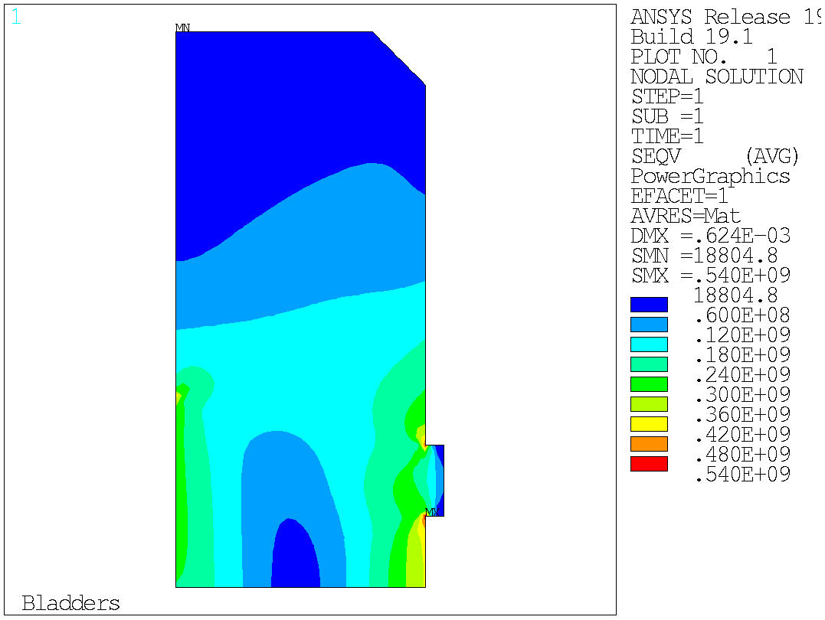
Bladder step
PARAMETER H1BLAD_P_BAR = 0.000000000
PARAMETER H2BLAD_P_BAR = 0.000000000
PARAMETER H3BLAD_P_BAR = 500.0000000
PARAMETER VBLAD_P_BAR = 0.000000000
PARAMETER DISPLY = 0.3498035613E-03
PARAMETER DISPLX = 0.9473647364
H1 140 mm
H3
100 mm
H2
20 mm

Slide 29
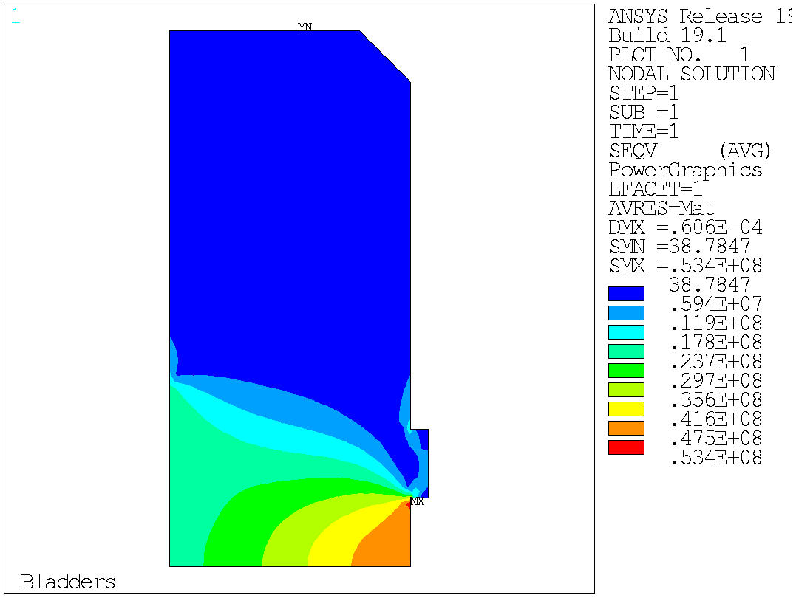
Bladder step
PARAMETER H1BLAD_P_BAR = 0.000000000
PARAMETER H2BLAD_P_BAR = 500.0000000
PARAMETER H3BLAD_P_BAR = 0.000000000
PARAMETER VBLAD_P_BAR = 0.000000000
PARAMETER DISPLY = -0.6522932228E-04
PARAMETER DISPLX = 0.2025615106
H1 140 mm
H3
100 mm
H2
20 mm

Slide 30

Bladder step
PARAMETER H1BLAD_P_BAR = 0.000000000
PARAMETER H2BLAD_P_BAR = 500.0000000
PARAMETER H3BLAD_P_BAR = 500.0000000
PARAMETER VBLAD_P_BAR = 0.000000000
PARAMETER DISPLY = 0.8001443655E-03
PARAMETER DISPLX = 1.152106827
H1 140 mm
H3
100 mm
H2
20 mm

Slide 31
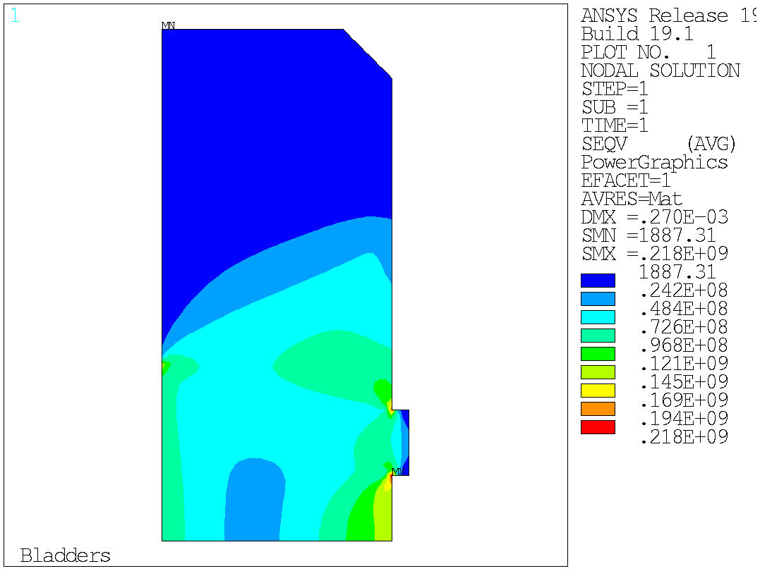
Bladder step
PARAMETER H1BLAD_P_BAR = 500.0000000
PARAMETER H2BLAD_P_BAR = 500.0000000
PARAMETER H3BLAD_P_BAR = 500.0000000
PARAMETER VBLAD_P_BAR = 0.000000000
PARAMETER DISPLY = 0.1849649488E-02
PARAMETER DISPLX = 1.351772738
H1 112mm
H3
56 mm
H2
18 mm

Slide 32
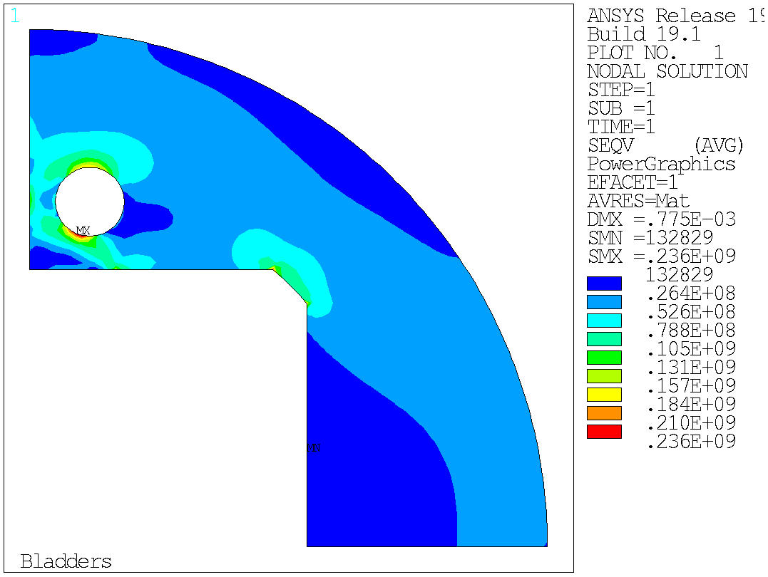
Bladder step
PARAMETER H1BLAD_P_BAR = 5000000000
PARAMETER H2BLAD_P_BAR = 000.0000000
PARAMETER H3BLAD_P_BAR = 000.0000000
PARAMETER VBLAD_P_BAR = 0.000000000
PARAMETER DISPLY = 0.6871562389E-03
PARAMETER DISPLX = 0.6682660410
H1 112mm
H3
56 mm
H2
18 mm

Slide 33

Bladder step
PARAMETER H1BLAD_P_BAR = 0.000000000
PARAMETER H2BLAD_P_BAR = 500.0000000
PARAMETER H3BLAD_P_BAR = 500.0000000
PARAMETER VBLAD_P_BAR = 0.000000000
PARAMETER DISPLY = -0.1302898520E-03
PARAMETER DISPLX = 0.6880776162
H1 112mm
H3
56 mm
H2
18 mm

Slide 34

Bladder step
PARAMETER H1BLAD_P_BAR = 000.0000000
PARAMETER H2BLAD_P_BAR = 500.0000000
PARAMETER H3BLAD_P_BAR = 000.0000000
PARAMETER VBLAD_P_BAR = 0.000000000
PARAMETER DISPLY = -0.5645534860E-04
PARAMETER DISPLX = 0.1674256687
H1 112mm
H3
56 mm
H2
18 mm

Slide 35
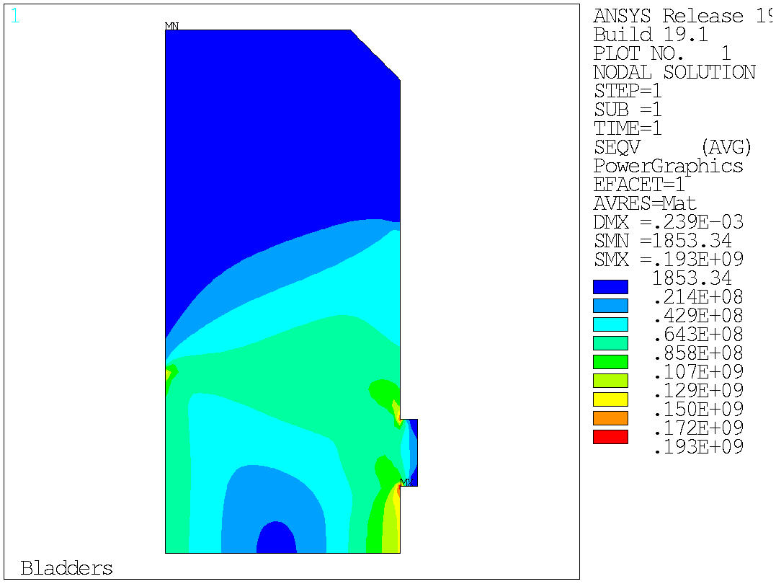
Bladder step
PARAMETER H1BLAD_P_BAR = 0.000000000
PARAMETER H2BLAD_P_BAR = 0.000000000
PARAMETER H3BLAD_P_BAR = 500.0000000
PARAMETER VBLAD_P_BAR = 0.000000000
PARAMETER DISPLY = -0.9599685149E-04
PARAMETER DISPLX = 0.5198327744
H1 112mm
H3
56 mm
H2
18 mm

Slide 36
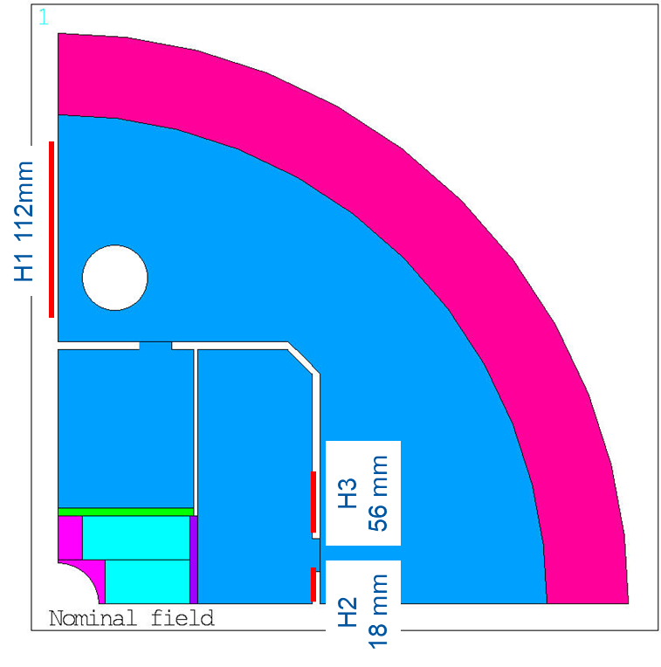
Summary bladders
Intf for 15 T pre-load = 0.7 mm
1.35 mm/500 bars putting standard size bladders
  To open 0.7 mm we need 260 bars
  To open 1 mm we need 370 bars
Seems reasonable starting point for bladders configuration
Gap opening, mm, assuming no vertical bladder/intf
500 bar | All | Yoke | H2 | H3 | H2+H3
Everywhere | 2.02 | 0.87 | 0.20 | 0.95 | 1.15
Reasonable | 1.35 | 0.69 | 0.17 | 0.52 | 0.68
Reasonable including Vbladder | 1.35 |  |  |  | 0.58
Numbers in red indicate that the pad is above yield limit

Slide 37
Structure stiffness

Slide 38
Cases for comparison
V4: Horizontally split yoke, open gap
Gap

Slide 39
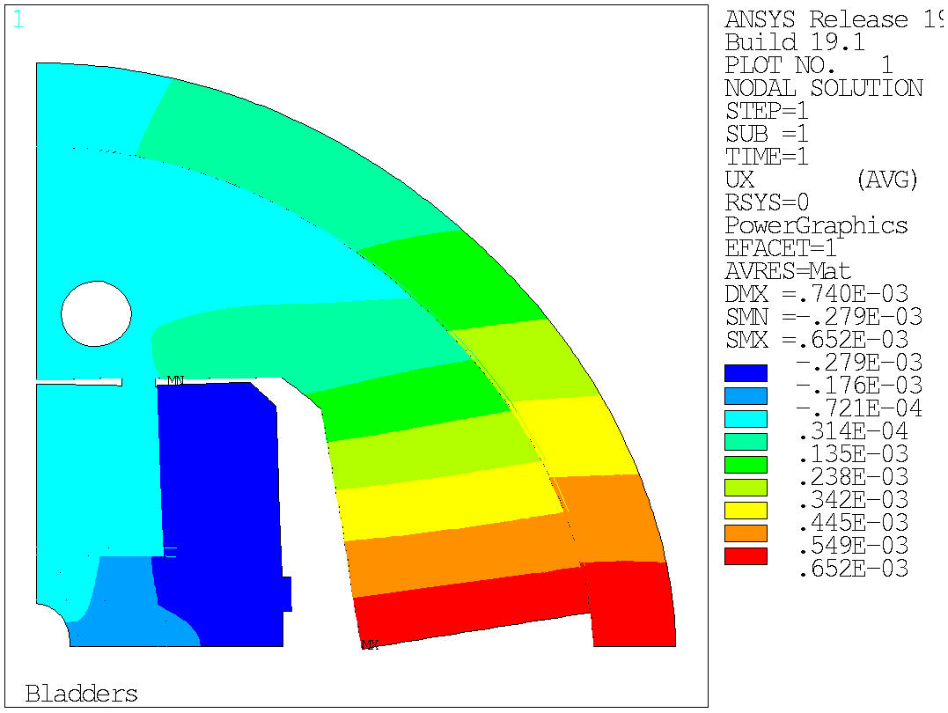
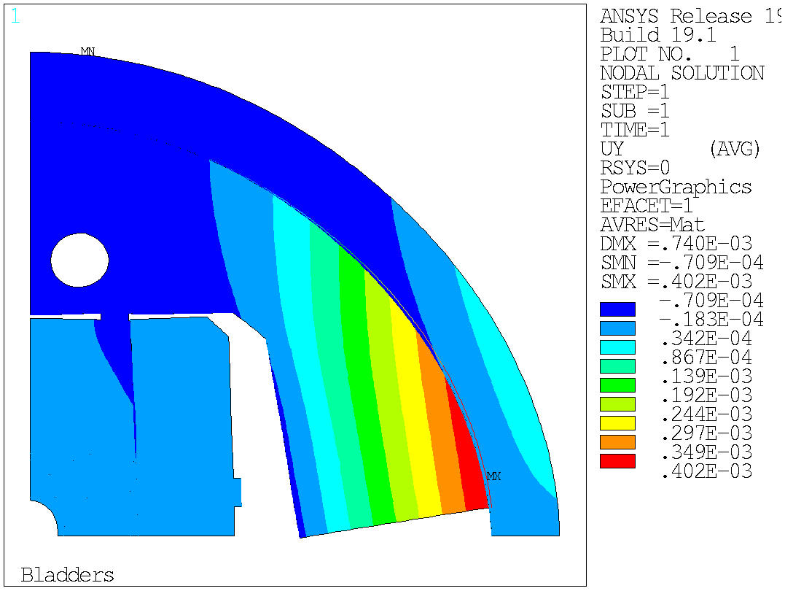
V4, bladders
V4: Horizontally split yoke
  With 500 bar in H2 and H3, we can open 0.7 mm (0.58 mm if we pump also the vertical bladder)
  We need to round a bit more the corner of the yoke, stress to high

Slide 40
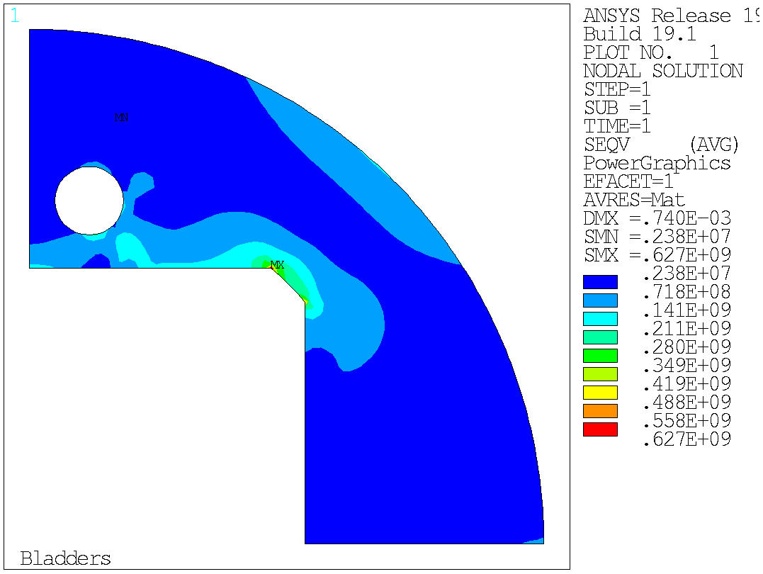

V4, bladders
V4: Horizontally split yoke
  With 500 bar in H2 and H3, we can open 0.7 mm
  We need to round a bit more the corner of the yoke, or change the shape, the stress too high

Slide 41
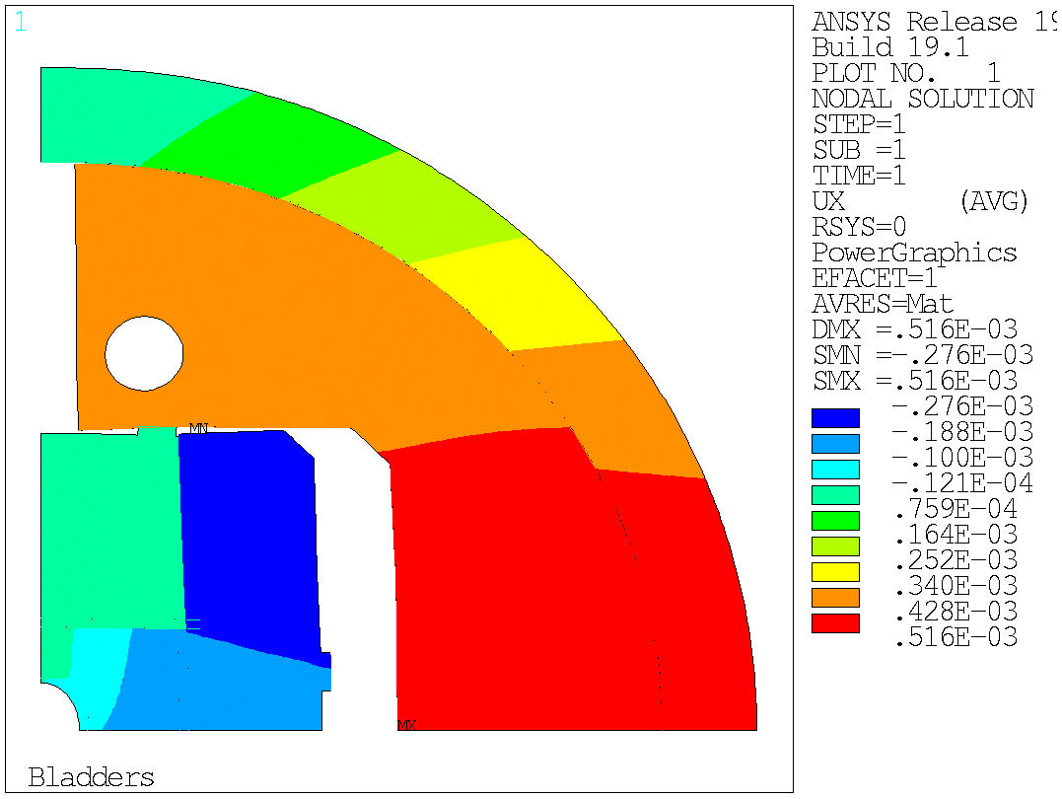
Bladders: v3 vs v4
Quite interesting, with a horizontal split yoke we can open similar gap using H2 and H3
V4: Horizontally split yoke, 500 bars in H2 and H3, gap opening 0.705 mm (0.58 mm if we pump also the vertical bladder)
V3: Vertically split yoke, 500 bars in H2 and H3, gap opening 0.688 mm (0.58 mm if we pump also the vertical bladder)

Slide 42
V4, pre-load
Intf. in v3 was 0.7 mm. Here I put 0.7*0.7/1.35=0.36 mm to be ‘equivalent’ in terms bladder usage
V4, why delta cool down is so big? With the shell force is so big → there should be force in the yoke as well
v3

Slide 43
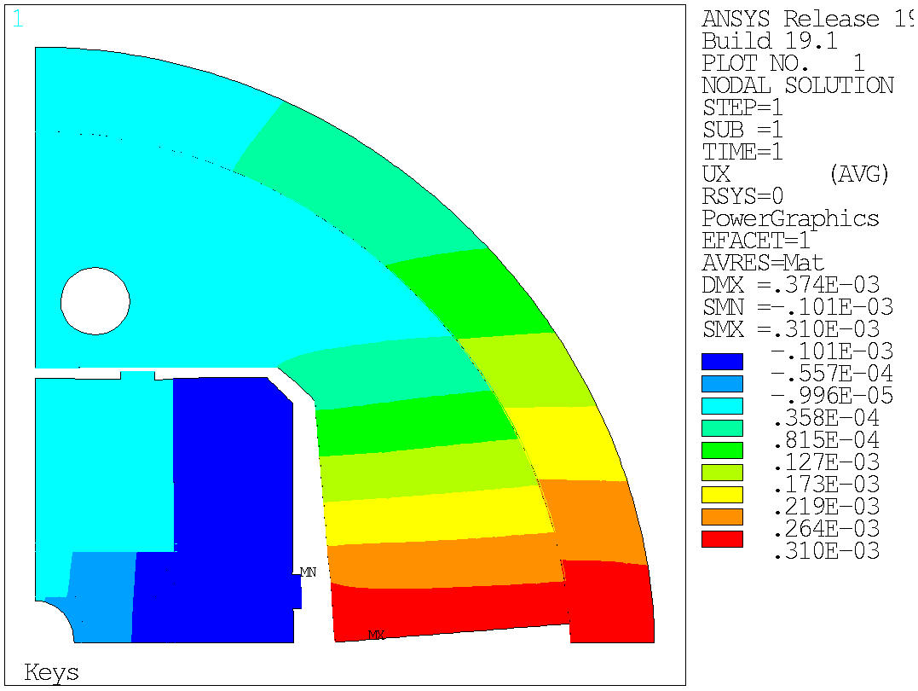





v4
v3

Slide 44






v4
v3

Slide 45






SX
v4
v3

Slide 46






SY
v4
v3

Slide 47






SEQV
v4
v3

Slide 48
0.7 mm intf
0.36 mm intf
v3, displacements in um |  | 1 (bottom left) |  | 2 (bottom right) |  | 3 (top left) |  | 4 (top right)
 |  | x | y | x | y | x | y | x | y
RT preload | layer1 | -92 | 0 | -169 | 0 | -51 | -6 | -169 | -3
 | layer2 | -10 | 1 | -169 | -3 | -6 | -1 | -174 | -8
CD | layer1 | -211 | 0 | -533 | 0 | -152 | -78 | -537 | -73
 | layer2 | -38 | -77 | -536 | -73 | -36 | -143 | -550 | -155
Powering | layer1 | -90 | 0 | -443 | 0 | -89 | -104 | -450 | -85
 | layer2 | -11 | -121 | -450 | -85 | -25 | -210 | -479 | -180
Delta Powering | layer1 | 121 | 0 | 90 | 0 | 64 | -26 | 86 | -12
 | layer2 | 27 | -45 | 86 | -12 | 11 | -67 | 70 | -25
v4, displacements in um |  | 1 (bottom left) |  | 2 (bottom right) |  | 3 (top left) |  | 4 (top right)
 |  | x | y | x | y | x | y | x | y
RT preload | layer1 | -41 | 0 | -74 | 0 | -23 | -4 | -75 | -3
 | layer2 | -4 | -2 | -75 | -3 | -2 | -3 | -80 | -6
CD | layer1 | -112 | 0 | -370 | 0 | -103 | -94 | -373 | -92
 | layer2 | -25 | -112 | -373 | -92 | -30 | -191 | -387 | -189
Powering | layer1 | 132 | 0 | -164 | 0 | 121 | -123 | -171 | -106
 | layer2 | 198 | -169 | -171 | -106 | 172 | -278 | -219 | -221
Delta Powering | layer1 | 244 | 0 | 207 | 0 | 224 | -29 | 201 | -15
 | layer2 | 223 | -58 | 202 | -15 | 202 | -87 | 168 | -32
If in v3 I put 0 interference, I get similar displacements than in v4

Slide 49


Let’s try to improve this ugly corner
Change key position (v4b); xvkey = 10 mm instead of 50 mm

Slide 50


Let’s try to improve this ugly corner
Make thicker inner support v4c (aperture 30 mm instead of 50)

Slide 51
My conclusions
Given the height of the coil pack, a horizontal split yoke is not increasing significantly the rigidity of the structure, and we are losing the possibility of loading through the Al-shell at warm
  I see more disadvantages than advantages, so I will study the close yoke option with vertical split yoke and not horizontal. At least in that way I can pre-load a bit more at warm the coil without overshoot, and..
  If the yoke closes after cool down, maybe the rigidity of the yoke helps a bit, to be checked
If we don’t provide enough pre-load, the top left corner of layer 2 becomes critical → even if we have a closed yoke or an infinitely rigid structure around our coil, it will break at this corner if we don’t intercept the forces
  This would need some stress management at the coil level. For example, a SS plate in between the two layers, connected to the poles. This is difficult to implement in the coil.

Slide 52
V5
Vertical split yoke closing during cool down
  - less pre-load in the coil, we will have the same problem in the corner
  Still let’s close the loop and do the exercise to have numbers
H1 112mm
H3
56 mm
H2
18 mm

