Slide 1
Chamonix 2011
LHC Performance Workshop
Summary of session 9:
"LHC Injectors Upgrade"
(protons only)
Performance reach of the injectors in 2011 - R. Steerenberg
Possibility of a higher PSB to PS transfer energy - K. Hanke
PS potential performance with a higher injection energy - S. Gilardoni
Electron Clouds in the SPS: progress in the analysis of cures/mitigations measures and potential schedule of implementation - J.M. Jimenez
Lessons from SPS studies in 2010 - E. Shaposhnikova
Alternative / complementary possibilities - C. Carli
R. Garoby
9/02/2011
Notes:
1

Slide 2

Beam characteristics
1). R. Steerenberg
 | Obtained Characteristics 2010
 | PSB extraction |  |  |  | PS extraction |  |  | SPS extraction
 | Ip / ring | ɛ_{h} and ɛ_{v} | nb | nb | Ip / bunch | ɛ_{h} and ɛ_{v} | Nb | Ip / bunch | ɛ_{h} and ɛ_{v} | ɛ_{longit} | nb
 | [x10¹¹] | [mm ∙ mrad] | batches | bunches | [x10¹¹] | [mm ∙ mrad] | bunches | [x10¹¹] | [mm ∙ mrad] | [eVs] | bunches
 |  | 1σ, norm. |  |  |  | 1σ, norm. |  |  | 1σ, norm.
LHC25 | 16 | 2.5 | 2 | 4 + 2 | 1.3 | 2.5 | 72 | 1.15 | 3.6 | ≤ 0.8 | 1 - 4 x 72
LHC25 High int. | 25 | 3.6/4.6 | 2 | 4 + 2 | 1.7 (1.9) | 5 | 72 | 1.5 | ~ 10 | ~ 0.8 | 1 – 4 x 72
LHC50 (SB) | 16 | 2.5 | 1 | 6 | 1.3 | 2.5 | 36 | 1.15 | 2.5 | ≤ 0.8 | 1 - 4 x 36
LHC50 High int. (SB) | 24 | 3.5 | 1 | 6 | 1.8 | 3.5 | 36 | 1.5 | 3.5 | ≤ 0.8 | 1 - 4 x 36
LHC75 (SB) | 11 | 1.5 | 1 | 6 | 1.3 | 1.8 | 24 | 1.2 | 2 | ≤ 0.8 | 1 - 4 x 24
LHC150 | 5 | < 1.5 | 1 | 6 | 1.2 | < 2 | 12 | 1.1 | < 2.5 (1.6) | ≤ 0.8 | 1 - 4 x 12
Peak
Performances !!!
 | Possible Characteristics 2011
 | PSB extraction |  |  |  | PS extraction |  |  | SPS extraction
 | Ip / ring | ɛ_{h} and ɛ_{v} | nb | nb | Ip / bunch | ɛ_{h} and ɛ_{v} | nb | Ip / bunch | ɛ_{h} and ɛ_{v} | ɛ_{longit} | nb
 | [x10¹¹] | [mm ∙ mrad] | batches | bunches | [x10¹¹] | [mm ∙ mrad] | bunches | [x10¹¹] | [mm ∙ mrad] | [eVs] | bunches
 |  | 1σ, norm. |  |  |  | 1σ, norm. |  |  | 1σ, norm.
LHC25 (DB) | 16 | 2.5 | 2 | 4 + 2 | 1.3 | 2.5 | 72 | 1.1 5 | 3.6 | 0.7 | 1 - 4 x 72
LHC50 (SB) | 24 | 3.5 | 1 | 3 x 2 | 1.75 | 3.5 | 36 | 1.45 | 3.5 | ≤ 0.8 | 1 - 4 x 36
LHC50 (DB) | 8 | 1.2 | 2 | 4 + 2 | 1.3 | 1.3 | 36 | 1.15 (?) | 1.5 (?) | ≤ 0.8 | 1 - 4 x 36
LHC75 (SB) | 11 | 1.5 | 1 | 3 x 2 | 1.3 | 1.8 | 24 | 1.2 | 2 | ≤ 0.8 | 1 - 4 x 24
LHC75 (DB) | 5.5 | 0.9 | 2 | 4 + 2 | 1.3 | 0.9 | 24 | 1.2 (?) | 1 (?) | ≤ 0.8 | 1 – 4 x 24
LHC150 (SB) | 5 | < 1.5 | 1 | 3x 2 | 1.2 | < 2 | 12 | 1.1 | < 2.5 (1.6) | ≤ 0.8 | 1 - 4 x 12
The LHC50 and LHC75 double batch beams were not used in 2010.
  LHC50DB characteristics remain to be confirmed and can perhaps be pushed
  LHC75DB characteristics at extraction of SPS were never obtained, “tentative guess”

Slide 3
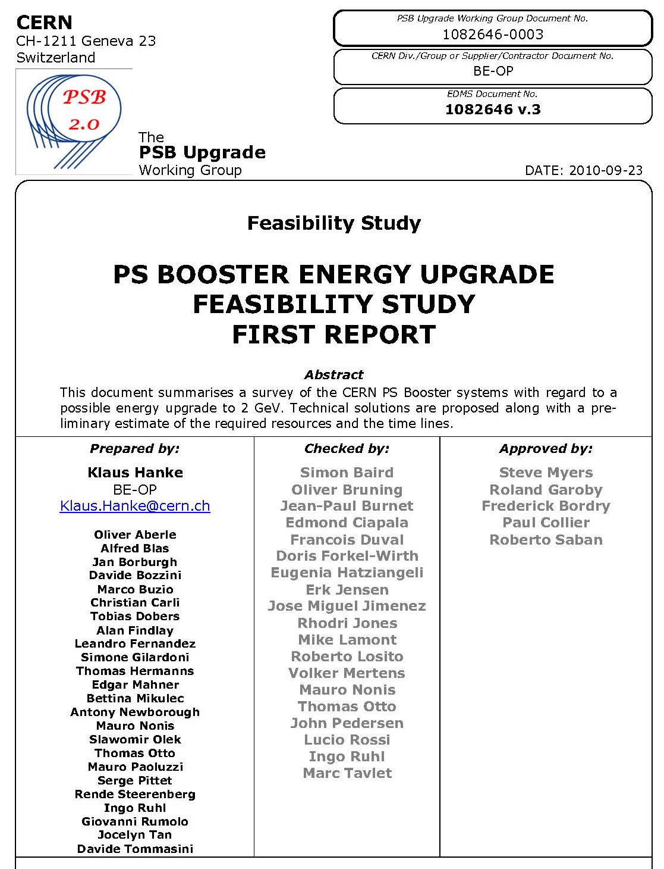
Increased PSB to PS transfer energy (1/2)
2). K. Hanke
Outcome of the Task Force nominated after the LHC Workshop in 2010 for studying and costing the increase of the PSB to PS transfer energy above 1.4 GeV.
Task Force members
document released

Slide 4
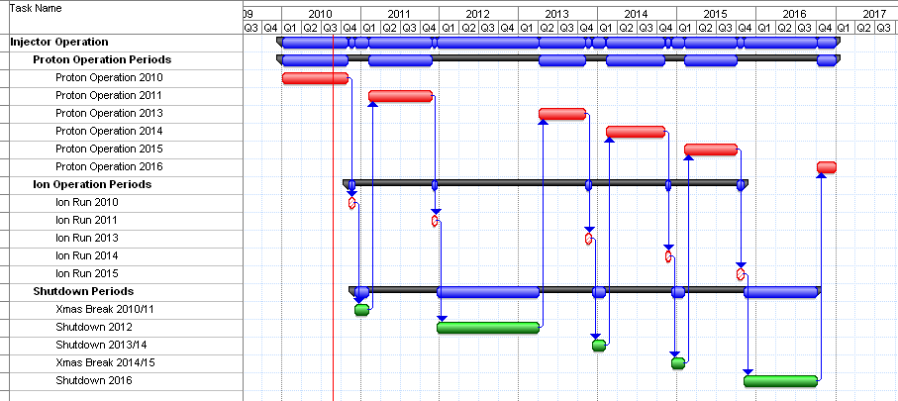
Increased PSB to PS transfer energy (2/2)
2). K. Hanke
Estimated total cost:
~60 MCHF
(Consolidation: 27.320 MCHF
Upgrade: 26.432 MCHF
H- injection: ~ +10 MCHF
2 GeV PS injection: ~ -5 MCHF )
one year of intense work
different options studied; baseline scenario chosen
an upgrade of the PSB from 1.4 GeV to 2.0 GeV is technically feasible
a realistic estimate of budget and time lines has been made; the upgrade can be completed by 2016
the budget has been entered in the MTP according to our estimate (consol. and upgrade)
ready for preparing TDR, pending evaluation of alternative scenarios and management decision

Slide 5
PS performance potential with 2 GeV injection (1/2)
3). S. Gilardoni
Issues:
Hardware for injection at 2 GeV: studied by the Task Force on «PSB energy upgrade » preliminary solutions found
Blow-up and instabilities in the transverse phase planes:
  Dilution after injection oscillations due to mis-steering
  Laslett tune shift due to space charge (even if < |0.3|)
  → Blow-up of first batch waiting for the second batch injection
  Head-tail instability at low energy
  TMCI close to transition
  e-clouds effects on high energy flat-top
Blow-up and instabilities in the longitudinal phase plane:
  Transient beam loading effects especially at low voltage during gymnastics
  Coupled bunch instabilities due to cavities impedances (reminder: 5 different RF systems in the PS for a total of 22 cavities)

Slide 6
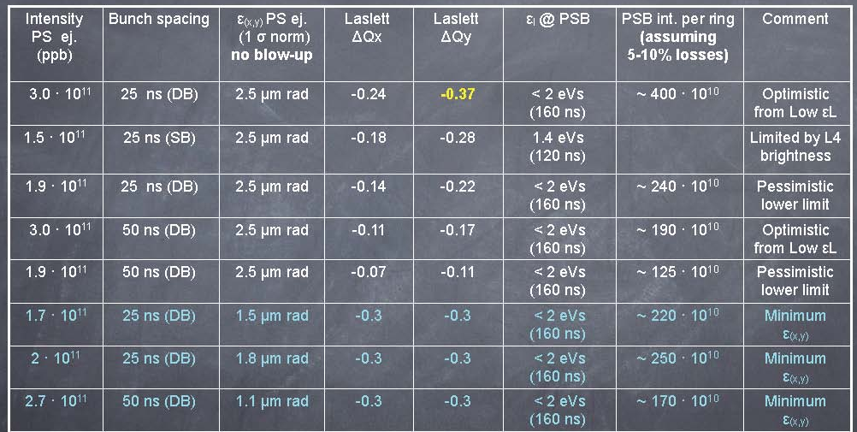
PS performance potential with 2 GeV injection (2/2)
3). S. Gilardoni
Preliminary extrapolations with Linac4
Stretched
Realistic
Stretched
Realistic
Stretched
Need further studies and MDs to improve these estimates:
  Longitudinal phase plane: impact of beam loading and possible cures,
  Transverse phase planes: blow-up rate with high space charge, e-clouds effects
  Radio protection (especially if other users attempt to profit from a higher PS intensity)
  Specifications of feedbacks and analysis of feasibility

Slide 7
SPS performance potential (1/2)
4). E. Shaposhnikova
Main lessons/results from 2010
Nominal 25 ns beam in good shape: low beam losses (5%) even with low ξ_{v} = 0.1
Ultimate (injected) beam - needs studies
  25 ns: large losses and emittances, instabilities
  50 ns: 15% losses, 1.5x10¹¹/bunch at 450 GeV/c in 4 batches
TMCI threshold is at ultimate intensity (low ξ). Ultimate single bunch accelerated to 450 GeV/c with low loss and ξ_{v}, but with some emittance blow-up. More problems for small injected emittances.
New low γ_{t} optics: promising results for beam stability and brightness
Limitations for dedicated LHC filling/MD: MKE, MKP, MKDH3 heating/outgassing
MDs issues: transverse emittance measurements, time allocation, data analysis

Slide 8
SPS performance potential (2/2)
4). E. Shaposhnikova
Conclusions - Q&A
Intensity per bunch and emittance as a function of the distance between bunches today and after upgrade?
- now one can hope to reach single-bunch performance with 50&75 ns beams (~3 μm emittances at ultimate intensity); probably less (2.5 μm ?) with low γ_{t} (RF voltage limit to be seen); > 4 μm for 25 ns (ultimate beam)
- after upgrades (200 MHz RF upgrade, e-cloud mitigation/cure, transverse impedance reduction, upgraded transverse feedback, etc.) one can hope to be at the space charge limit (~2.5 μm with ultimate intensity for 50&25 ns beams)
What should be done for delivering smaller transverse emittances at ultimate current?
- more MDs with PS beams of very small transverse emittances
- need for improved beam instrumentation (trans. emittance measurement)
- low γ_{t} optics ?

Slide 9
e-clouds in the SPS (1/2)
5). J.M. Jimenez
Operating the SPS with:
  High bunch intensity, up to 2.5 10¹¹ p/bunch
  and/or
  Small emittances (LHC requirements)
  is impossible at short bunch spacing because of electron clouds generating:
  pressure rise: beam gas scattering, dose rates to tunnel and components
  beam instabilities: transverse emittance blow-up and single bunch vertical instability
Suppression
Mitigation
Cures
Clearing
electrodes
Coatings
a-C
Scrubbing
Run
Feedback
systems ?
Milestones for decision process and implementation are proposed:
  Strategy : October 2012 ( for installation of pilot sector during LSD1)
  Full installation: LSD2

Slide 10
e-clouds in the SPS (2/2)
5). J.M. Jimenez
Pending questions
Suppression: Clearing electrodes
  Aperture, impedance, technical solution, full-scale feasibility, lifetime, quads, LSS, cabling, powering, etc.
Mitigations
  a-C coatings
    Lifetime, stability with venting, outgassing rates, in-situ coating, LSS.
  Scrubbing runs
    Feasibility and margin, MD time.
(Potential) Cure
  Wide band feedback systems
    High speed digitization and digital treatment
Simulations
  e-cloud budget, stability expected, emittance growth, impedance from electrodes, effectiveness of wide band feedback, etc.
  If we rely on beam scrubbing in the LHC why not in the SPS?

Slide 11
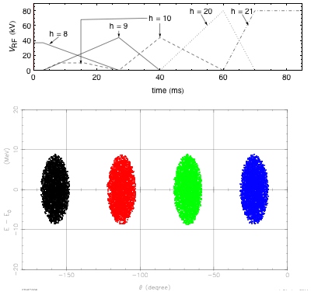
Alternative scenarios (1/2)
6). C. Carli
Batch compression schemes using all PSB rings
Scheme yielding 64 bunches per PS batch
  Brightness increase: 1.5
  Reasonable complexity of RF gymnastics
Scheme yielding 48 bunches per PS batch
  Brightness increase compared to present situation: 2
  Complex RF gymnastics with many batch compression steps
Any compression scheme can be combined with a PSB energy upgrade
Tests can proceed immediately with double batch transfer from the PSB at 1.4 GeV and lead to delivering beyond ultimate 25 ns bunch trains to the SPS before the end of 2012 (although at the cost of significant MD time and efforts from the PS LLRF team).

Slide 12
Alternative scenarios (2/2)
6). C. Carli
Tentative parameters for an RCS replacing the PSB
Energy range | 160 MeV to 2 GeV
Circumference | (200/7) π m ≈ 89.76 m
Repetition rate | ~10 Hz
RF voltage | 60 kV
Harmonics | h = 2 or 3
Frequency range | 3.48 MHz (h=2 at injection) to 9.5 MHz (h=3 at ejection)
Beam parameters for LHC (for lower emittances scale down intensity accordingly) | Intensity: up to 12×2.7 10¹¹ protons/cycle Transv. emittance: ε*_{rms} ≈ 2.5 μm Long. emittance: ε_{l} < 12×0.27 eVs (determined by acceptance for most cases)
Lattice | FODO with 15 cells and 3 periods, 4 cells in arc, straight with one cell
Tunes | 4 < Q_{H,V} < 5
Relativistic gamma at transition | ~4
Bending magnet filling factor | 56 %
Maximum magnetic field | 1.16 T
Benefits:
Competitive cost wrt PSB consolidation and upgrade (?)
Reliability (new hardware / modern design)
Commissioning decoupled from physics operation
Limited risk: Linac2 + PSB can remain available for a few years as back-up solutions.

Slide 13
Conclusions
Beam specifications at LHC injection are essential to guide the choices in the injectors => need for close collaboration between HL-LHC and LIU projects.
Experience with beam in the LHC in 2011-2012 will help refine the potential of low transverse emittances.
New batch compression schemes in the PS can immediately help test the generation of beyond ultimate 25 ns bunch trains in the PS and, if successful, provide the possibility to explore the SPS potential.
Increasing the energy of the PSB is the primary solution for substantially upgrading the brightness that the PS can deliver.
A small size RCS replacing the PSB is an especially interesting alternative option.
The SPS remains the limiting accelerator in the injector chain. The well-identified improvements shall be implemented as soon as possible to allow studying the other limitations.
The possibility to connect Linac4 to the PSB during the first long shutdown is worth being investigated.

