Slide 1
BE-CEM-EPR
ERP: Electronics Production and Radiation Tolerance
S. Danzeca s.danzeca@cern.ch

Slide 2
Section mandate
Provide CERN-wide support in the domain of Printed Circuits Boards (PCB), electronic systems assembly, radiation testing, radiation monitoring for the electronics and radiation test facilities for radiation tolerance assessment.
The ERP section provides:
Service of PCB Layout design for electronic boards and crates
Service for electronic cards assembly and cabling, internally or by subcontracting including components procurement.
Procurement of bare PCB, manufactured internally at CERN or by subcontracting
Manufacture and Assembly for prototypes in fast track production lines
Repair and modification of electronic systems
Service of radiation testing on electronic components and systems
Coordination and the operation of the CC60 gamma and CHARM radiation test facilities at CERN.
Reliability in electronic systems
Design, installation, operation and maintenance of the IoT Wireless Radiation monitoring

Slide 3



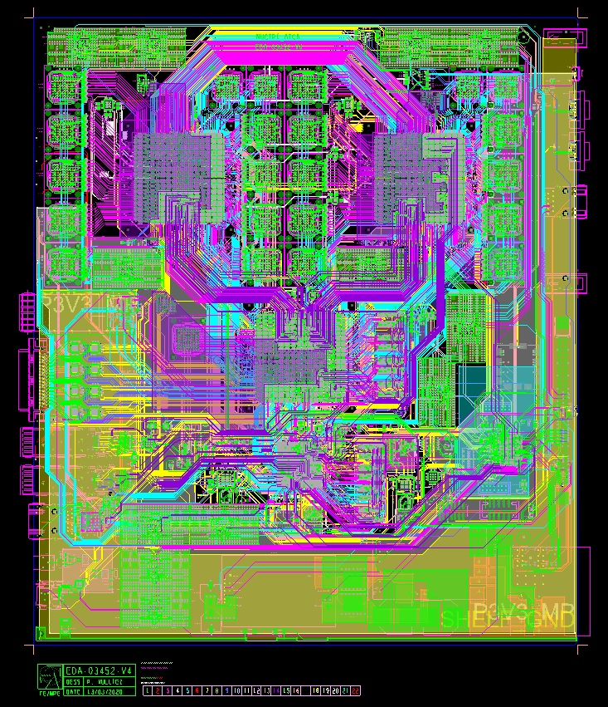
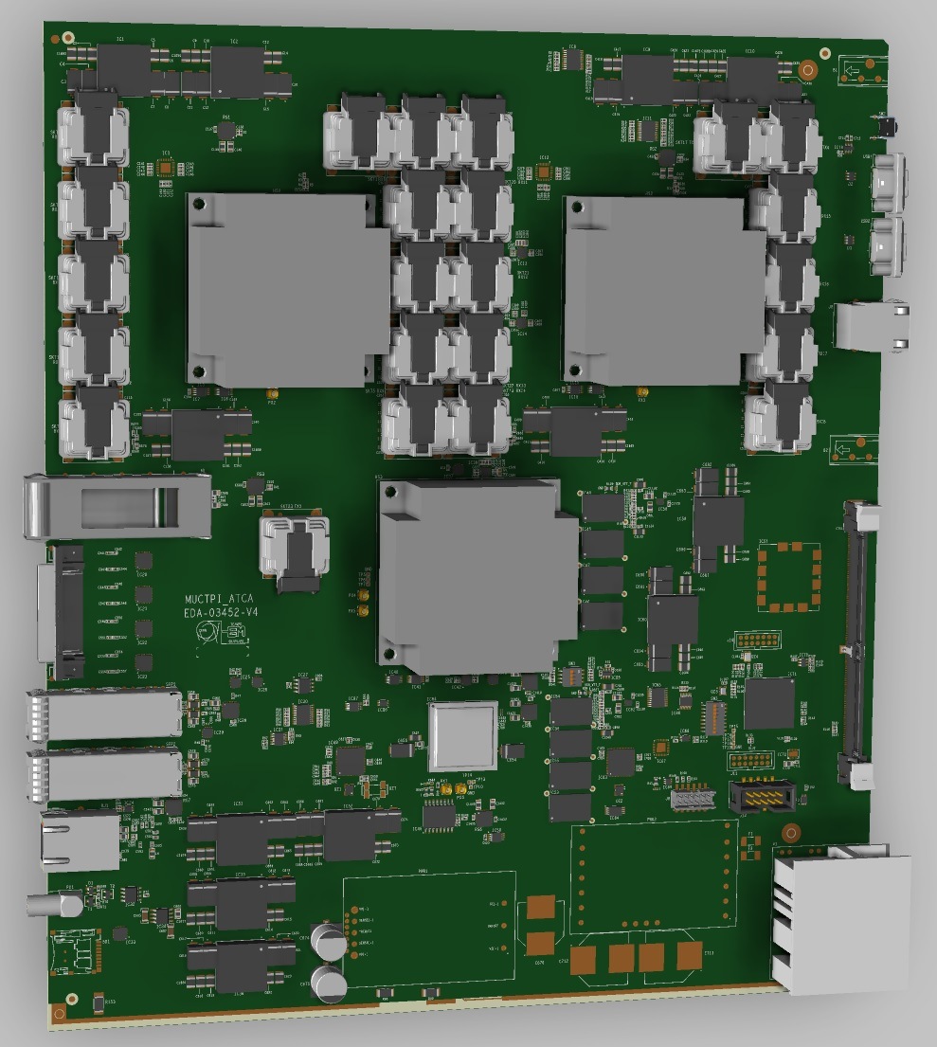
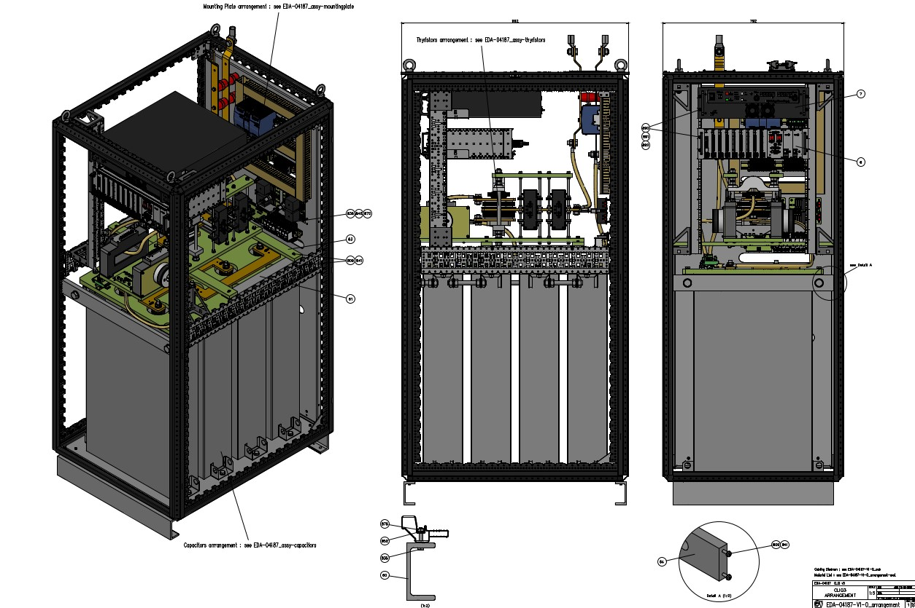
Service of PCB Layout design for electronic boards and crates
The Design Office provides an on-demand design service by a team of specialised engineers, including:
Complete PCB layout and mechanical design.
Management of the CERN Altium and Cadence component libraries and library search tools.
Preparing a project for production by finalising designs already created or partially created by the client.
Projects/designs organization with EDA number and complete set of documentation stored on EDMS (including all production files, 3D renders, etc)
CAD Designs for create assembly (Autocad)
Procurement of bare PCB internally at CERN or by subcontracting
Example: https://cms-daq-dth-p2.web.cern.ch/

Slide 4
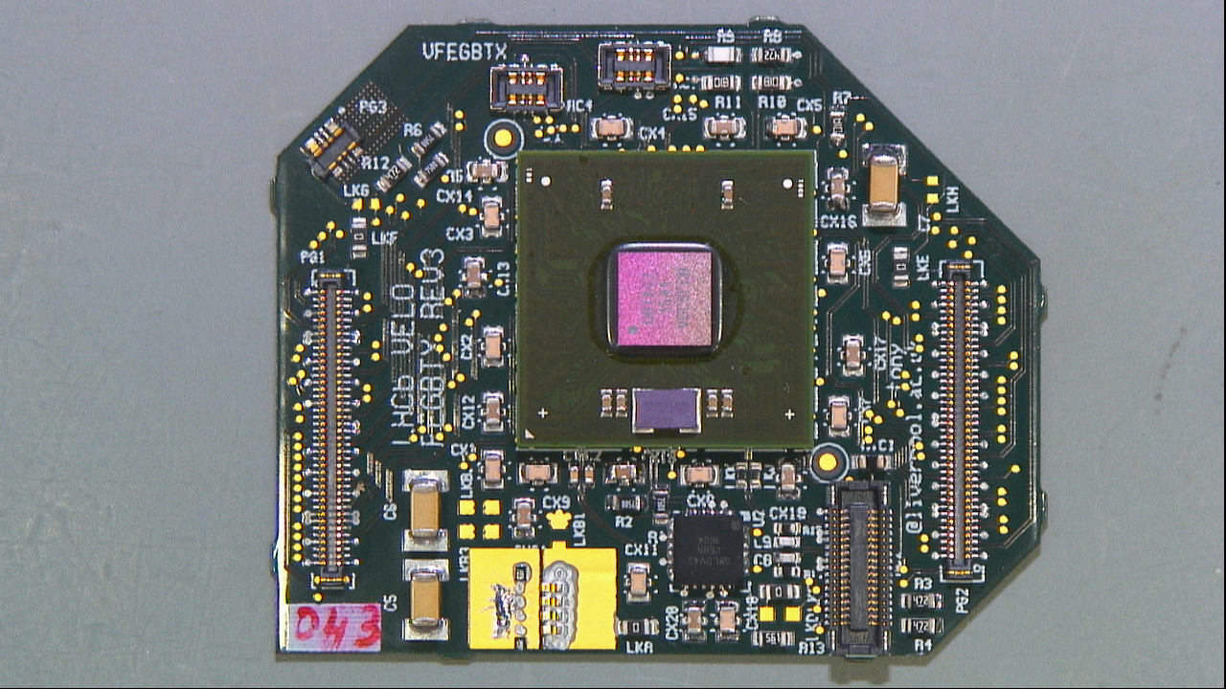
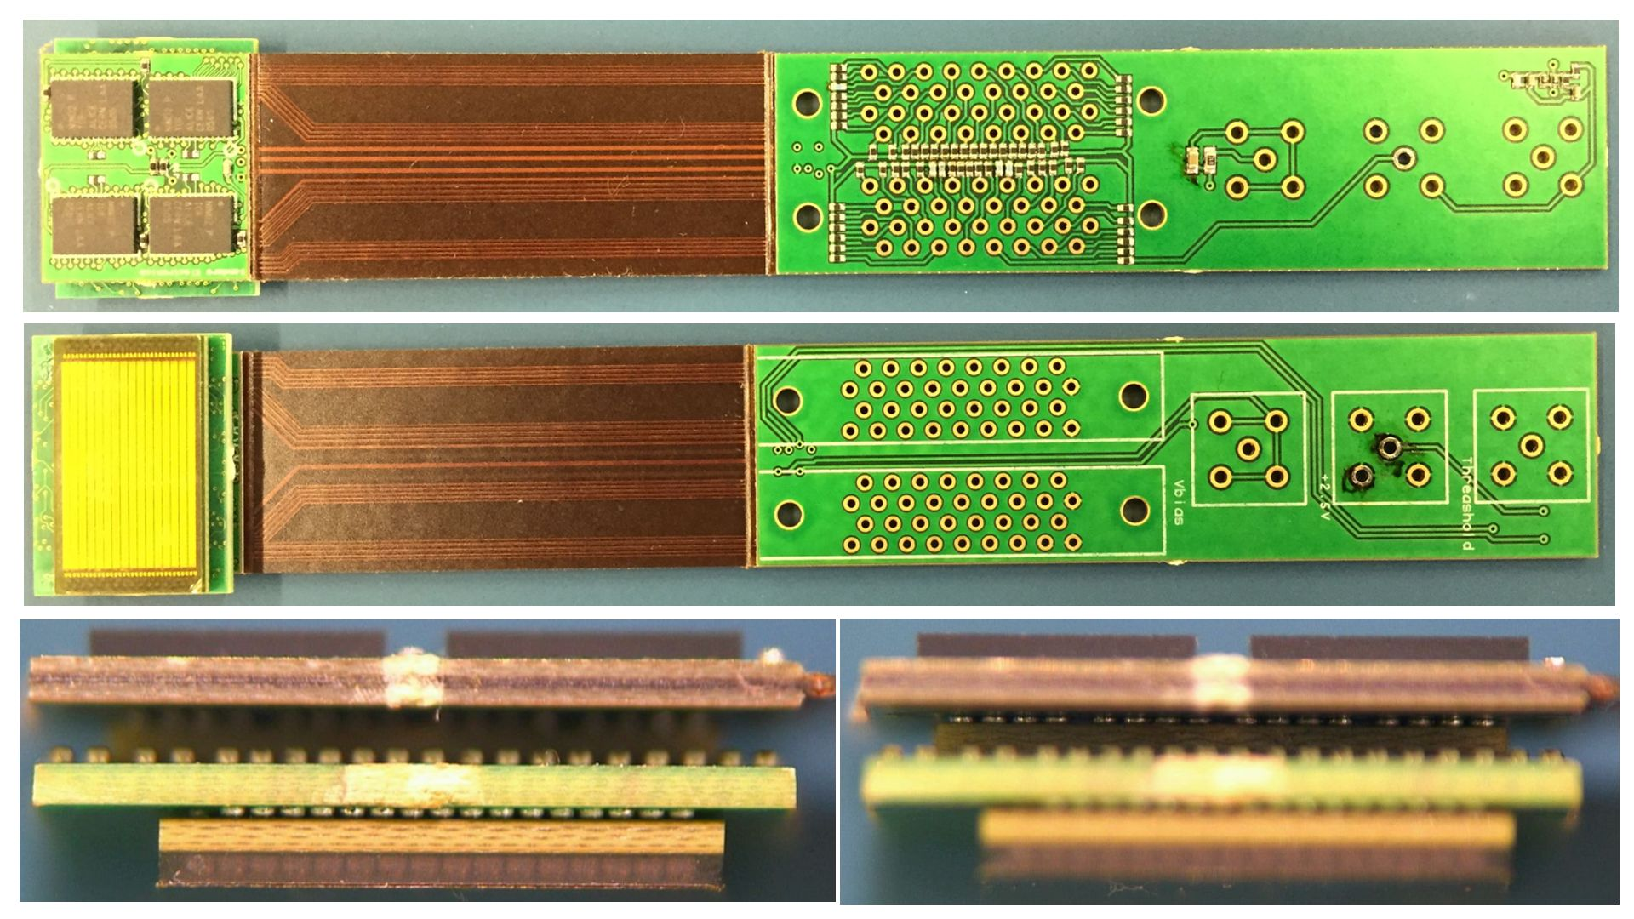
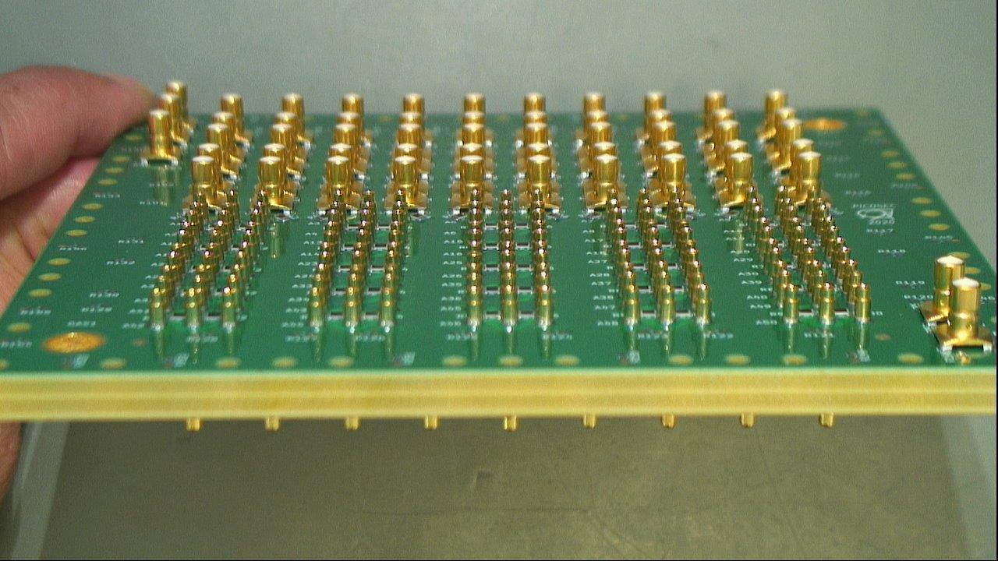
Service for electronic cards assembly
Realisation of prototypes and production runs, which includes PCB production subcontracting, electronics assembly and mechanical assembly, aided by strong ongoing relationships with a variety of subcontractors.
Passive components and connectors storage in case missing in production
Expertise available includes managing production, procurement and component packaging, subcontracting PCB manufacturing and subcontracting assembly.
Manufacturing and Assembly for prototypes in fast track production lines
LHCb_VELO_VFEGBTX
Picoseconsds board

Slide 5
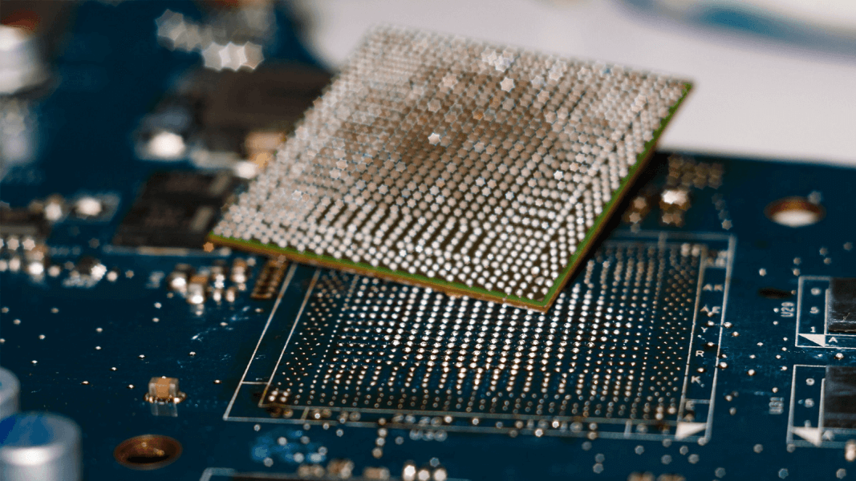
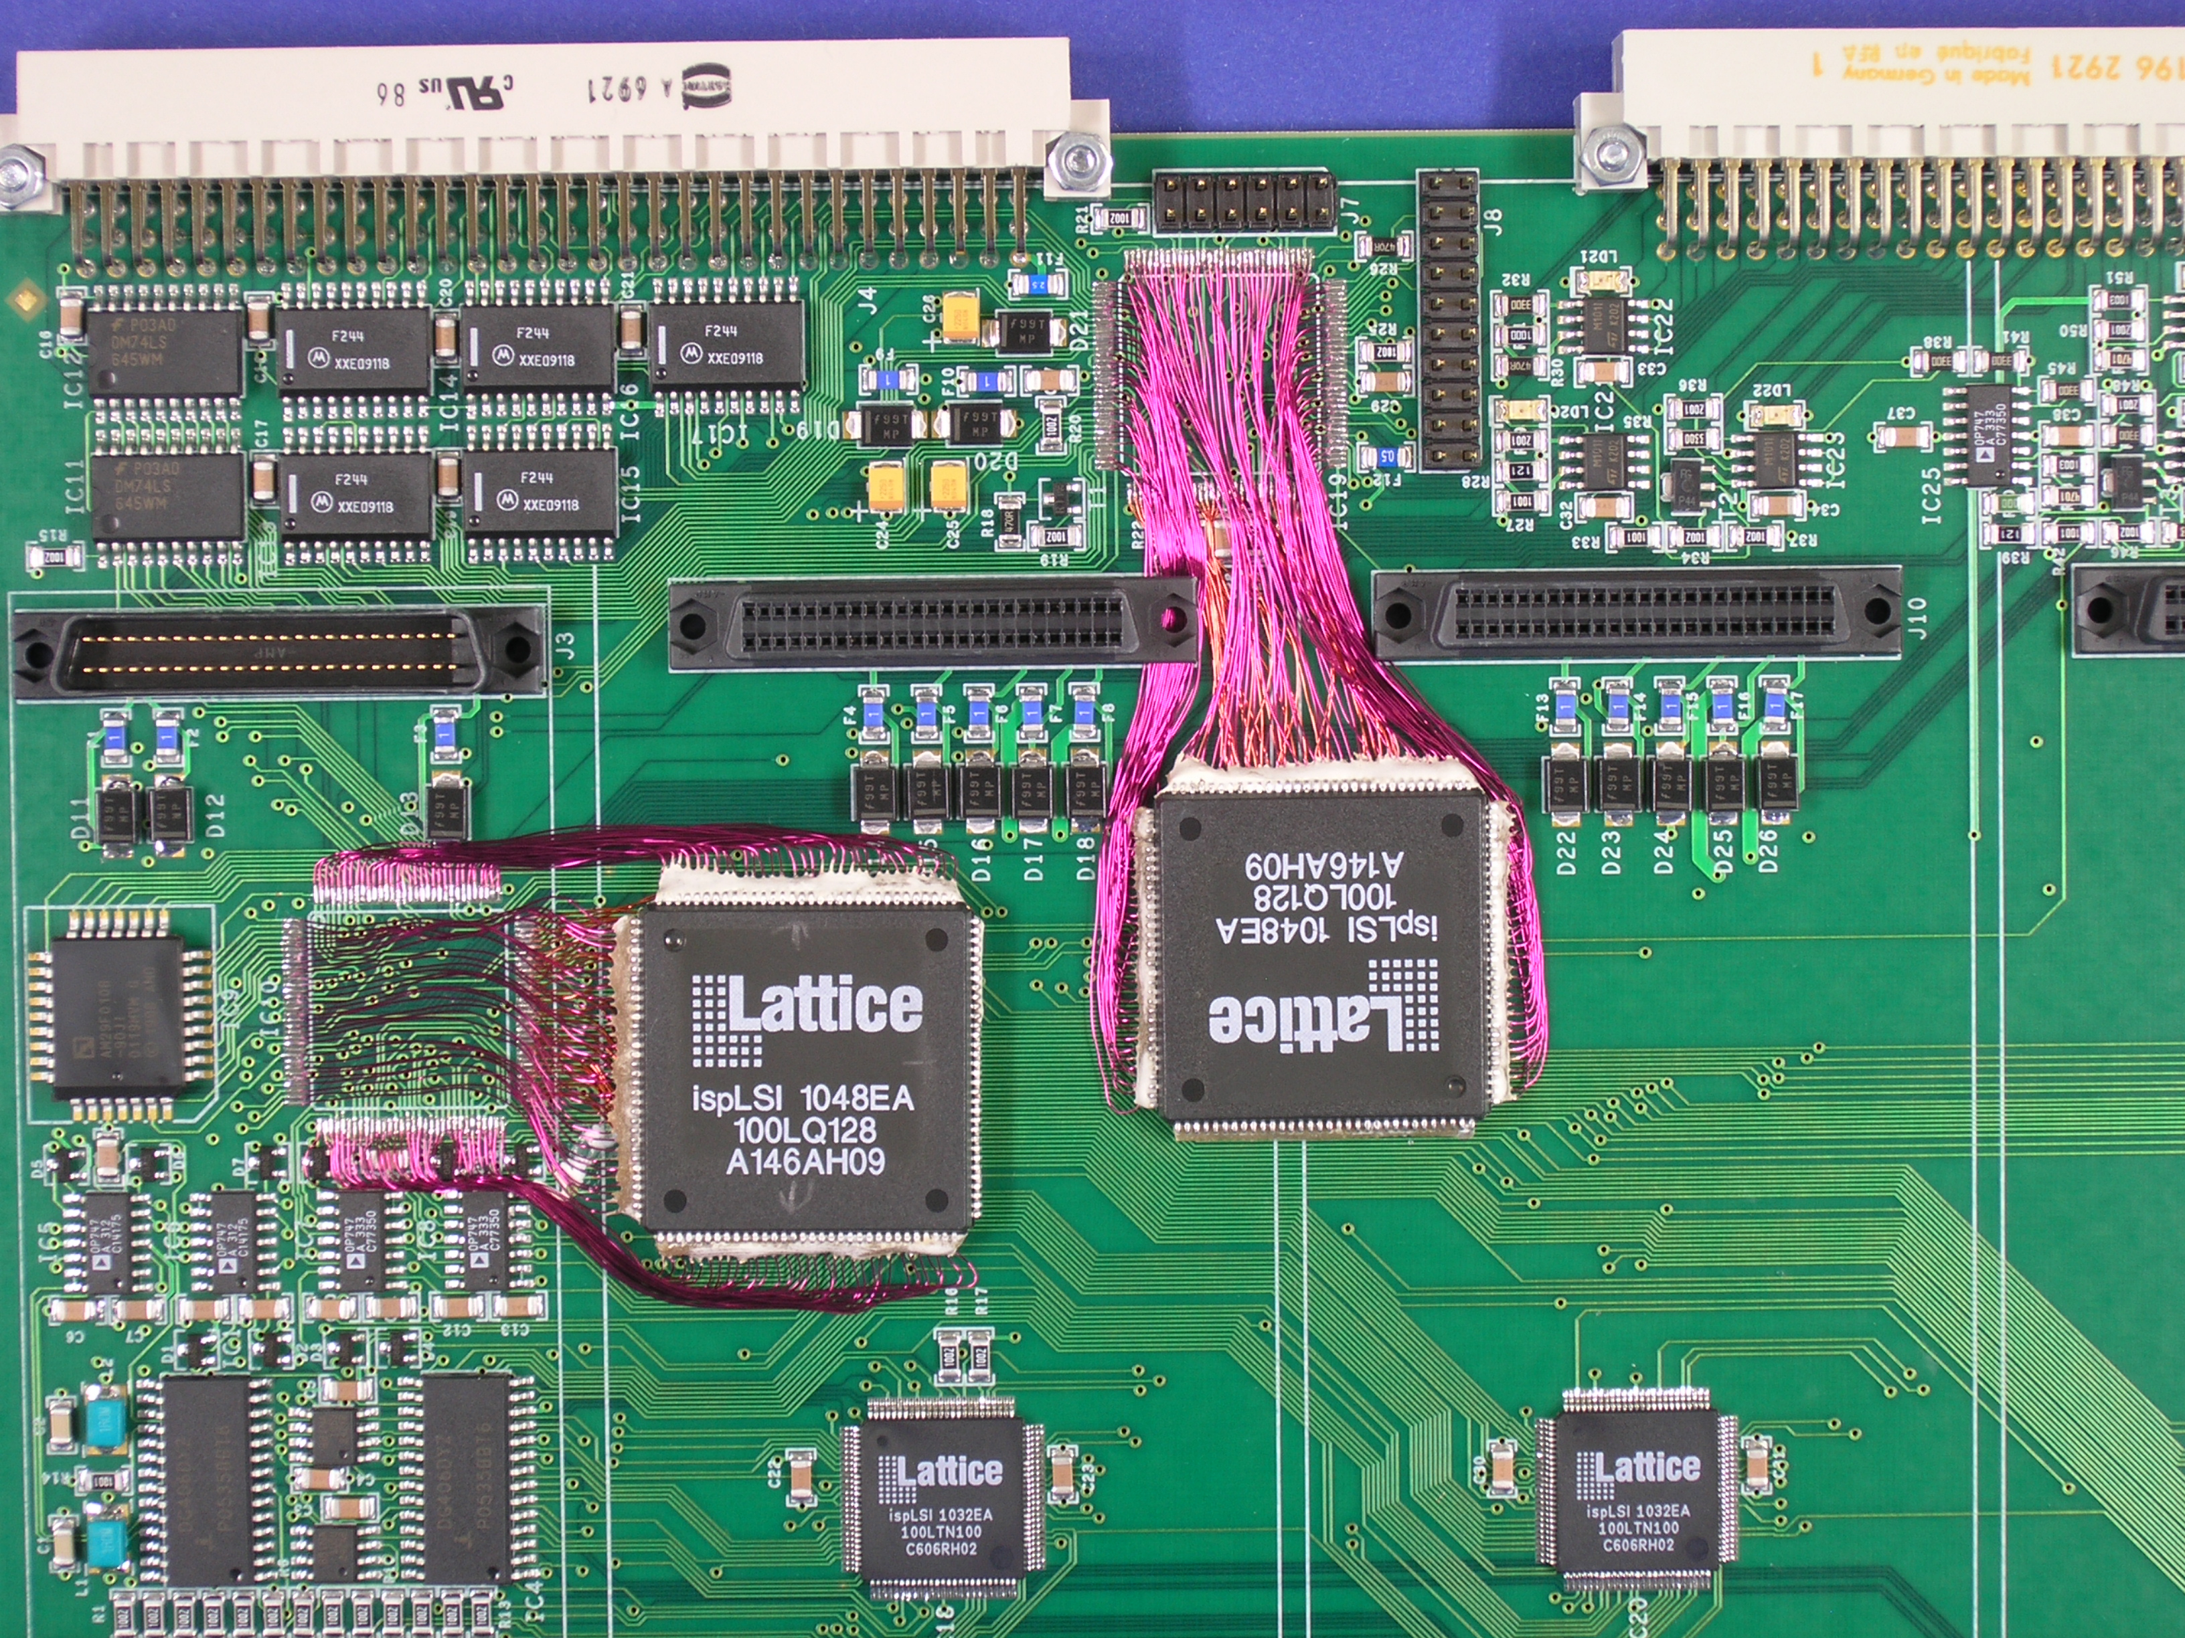
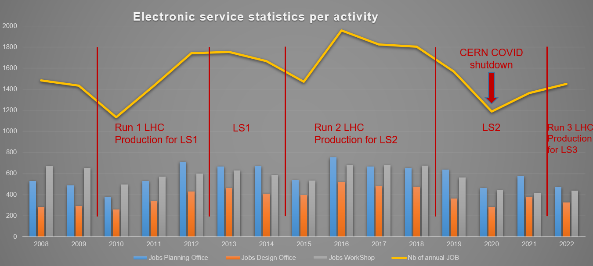
Repair and modification of electronic systems
Assembly workshop maintains a range of available processes, capabilities and expertise on-site, offering a highly flexible service for production of prototypes, failure analysis and rework.
Repair and rework of almost any type of component
On-demand PCBA cleaning

Slide 6
Section mandate
Provide CERN-wide support in the domain of Printed Circuits Boards (PCB), electronic systems assembly, radiation testing, radiation monitoring for the electronics and radiation test facilities for radiation tolerance assessment.
The ERP section provides:
Service of PCB Layout design for electronic boards and crates
Service for electronic cards assembly and cabling, internally or by subcontracting including components procurement.
Procurement of bare PCB, manufactured internally at CERN or by subcontracting
Manufacture and Assembly for prototypes in fast track production lines
Repair and modification of electronic systems
Service of radiation testing on electronic components and systems
Coordination and the operation of the CC60 gamma and CHARM radiation test facilities at CERN.
Reliability in electronic systems
Design, installation, operation and maintenance of the IoT Wireless Radiation monitoring

Slide 7
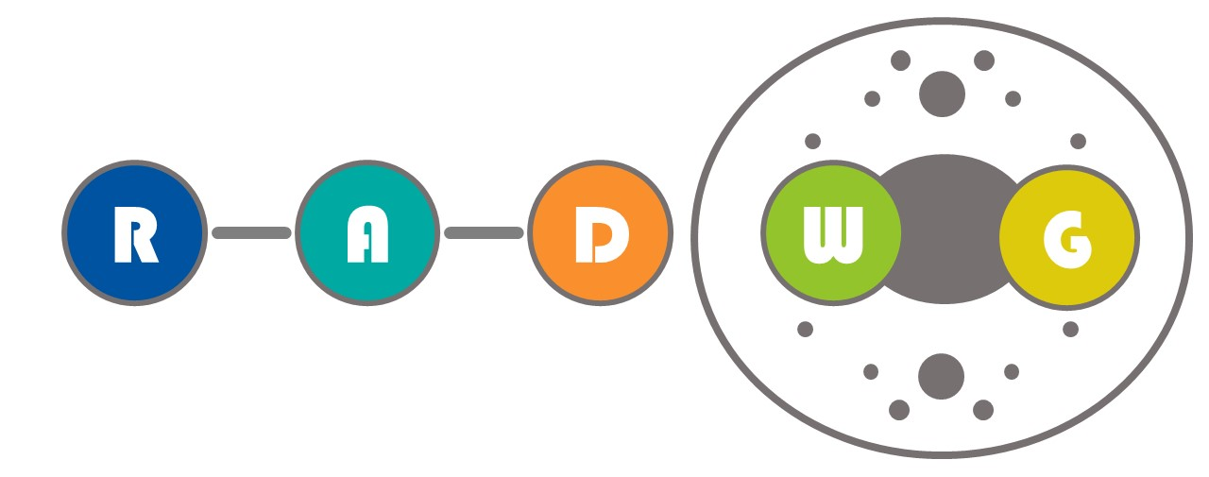

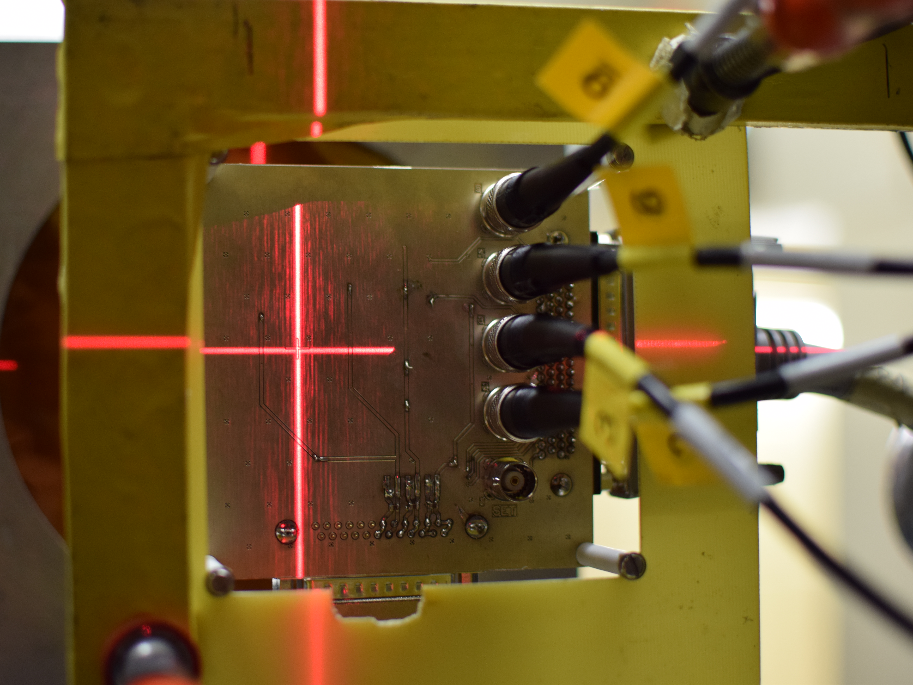
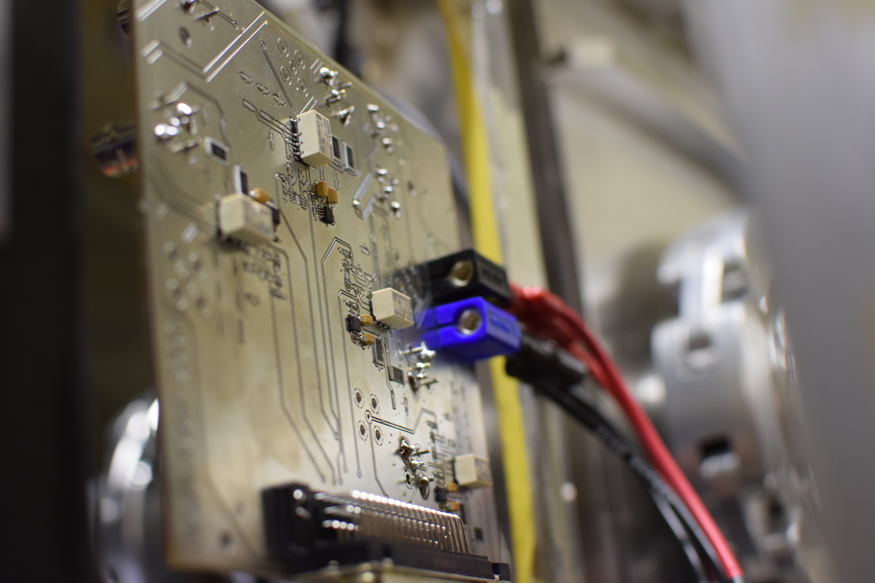
Radiation testing
Request collection
The request for radiation testing are collected and processed selecting the most suitable methodology and facilities
01
Database and Publication
Test planning and structure
The results are collected, stored and in EDMS and published in the RADWG database to allow an easy research of the best candidates for the new radiation tolerant designs
06
02
Each component/system is analyzed and all the possible radiation effects are taken into account for planning the test and structure it
Result analysis
The results are analyzed during and after the tests for each components considering the end application and the possible operational issues
Board and instrumentation preparation
05
03
For each component a dedicated set of test board is prepared and the associated instrumentation is chosen to face the complexity of the radiation test
04
Testing
The test are carried out at CERN facilities such as CHARM or Co60 and in external facilities. The transport, personnel and instrumentation are selected considering the peculiar aspect of each faiclity

Slide 8
Section mandate
Provide CERN-wide support in the domain of Printed Circuits Boards (PCB), electronic systems assembly, radiation testing, radiation monitoring for the electronics and radiation test facilities for radiation tolerance assessment.
The ERP section provides:
Service of PCB Layout design for electronic boards and crates
Service for electronic cards assembly and cabling, internally or by subcontracting including components procurement.
Procurement of bare PCB, manufactured internally at CERN or by subcontracting
Manufacture and Assembly for prototypes in fast track production lines
Repair and modification of electronic systems
Service of radiation testing on electronic components and systems
Coordination and the operation of the CC60 gamma and CHARM radiation test facilities at CERN.
Reliability in electronic systems
Design, installation, operation and maintenance of the IoT Wireless Radiation monitoring

Slide 9
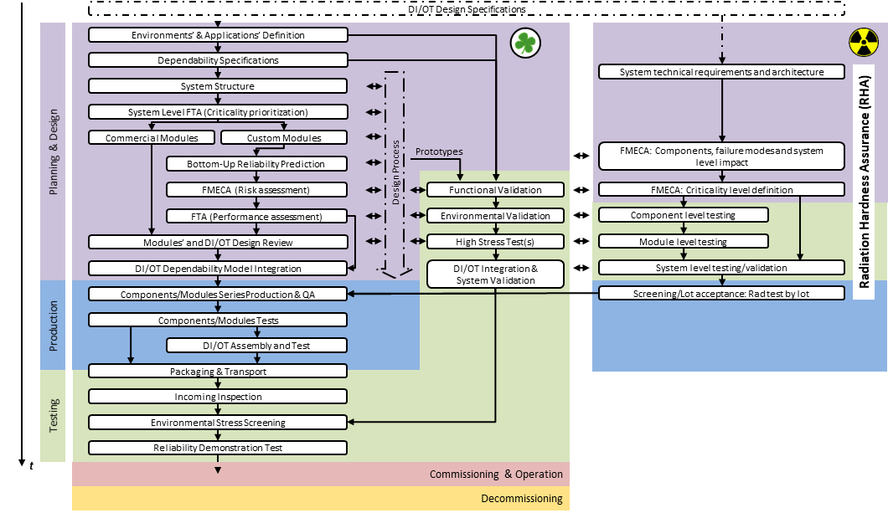
Global qualification procedure
EPR reliability qualification process – M. Di Mita (BE-CEM-EPR)

Slide 10
Integration and Organization
Radiation Testing
Radiation Facilities
Design Office
PCB and CAD
Layout
Production and Assembly
Radiation Monitoring
and Wireless IoT
Reliability

Slide 11







Services and Team organization
CEM-ERP
Section Leader: Salvatore Danzeca
Manuel Sanchez Suarez
Raphaël Berberat
Peter Bell
Sylvain Kaufmann
Gilles Foucard (FSU)
Panagiotis Gkountoumis (FELL)
Rudy Ferraro (FELL)
Alessandro Zimmaro(PJAS)
Marco Giordano (TS)
Antonio Scialdone (TS)
Zoubir EL MARRAHI (FSU)
Raphaël Berberat
Manuel Sanchez Suarez
Sylvain Kaufmann
Stéphane Excoffier
Lucas Thiebaux
Megan Kitchen (TTE)
Sebastien Demal (TTE)
Vladyslav Baklan (FSU)
Zoubir EL MARRAHI (FSU)
Raphaël Berberat
Peter Bell
Manuel Sanchez Suarez
Luca Filippini (TTE)
Joana Sofia Repolho Correia (ADMIN)
Alexandre Canel (FSU)
Sébastien Ciutad (FSU)
Raphaël Berberat
Peter Bell
William Billereau (FSU)
Pascal Vulliez(FSU)
Jeremy Kuhn (FSU)
Jean-Marc Wickham(FSU)
Jean_louis Chouvet (FSU)
Benoit Civel (FSU)
Jean-Marc Combe(FSU)
Bruno Recordon(FSU)
Serge Chalaye
Salvatore Fiore(FELL)
Gilles Foucard (FSU)
Rudy Ferraro (FELL)
Timothee Machlanski (FSU)
Marta Rizzo (TS)
Serge Chalaye
Manuel Sanchez Suarez
Raphaël Berberat
Matteo Brucoli (FELL)
Rudy Ferraro (FELL)
Marta Rizzo (TS)
Marco Giordano (TS)
Alessandro Zimmaro (PJAS)
Timothee Machlanski (FSU)
Vladyslav Baklan (FSU)
Rudy Ferraro (FELL)
Michele di Mita (FELL)
Raphaël Berberat
Sylvain Kaufmann
Production and Assembly
Internal
Production and Assembly
Outsourcing
Design Office
PCB and CAD
Layout
Radiation Testing
Radiation Facilities
Radiation Monitoring
and Wireless IoT
Reliability

Slide 12
Collaborations and points of discussion
Reliability assessment of electronic assemblies subjected to radiation
Failure mechanisms and root cause analysis of electronic assemblies
The use of modeling and simulation to predict standard reliability (+ considering the effects of radiation)
Radiation-induced single-event effects in electronic system and their impact on reliability
The use of machine learning and artificial intelligence for predicting the reliability of electronic assemblies under radiation exposure
Others:
  Training at CERN on reliability

Slide 13
Thank you for your attention!

