Slide 1
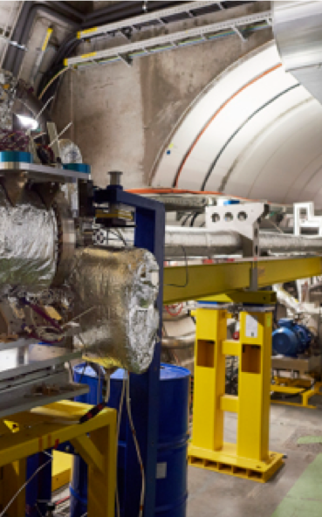
Industrial Control at CERN
A glimpse of activities… https://indico.cern.ch/event/1262370/
Enrique Blanco
Industrial Controls Systems Group
Beams Department, CERN

Slide 2
Outline
Introduction to the CERN organization
Activities in Industrial controls
  Give an overview Industrial Controls technologies and their applicability to some industrial control systems
  Advanced automation & Industry 4.0
  Disclaimer: Many automation technologies are not described in this presentation (e.g. robotics…)

Slide 3
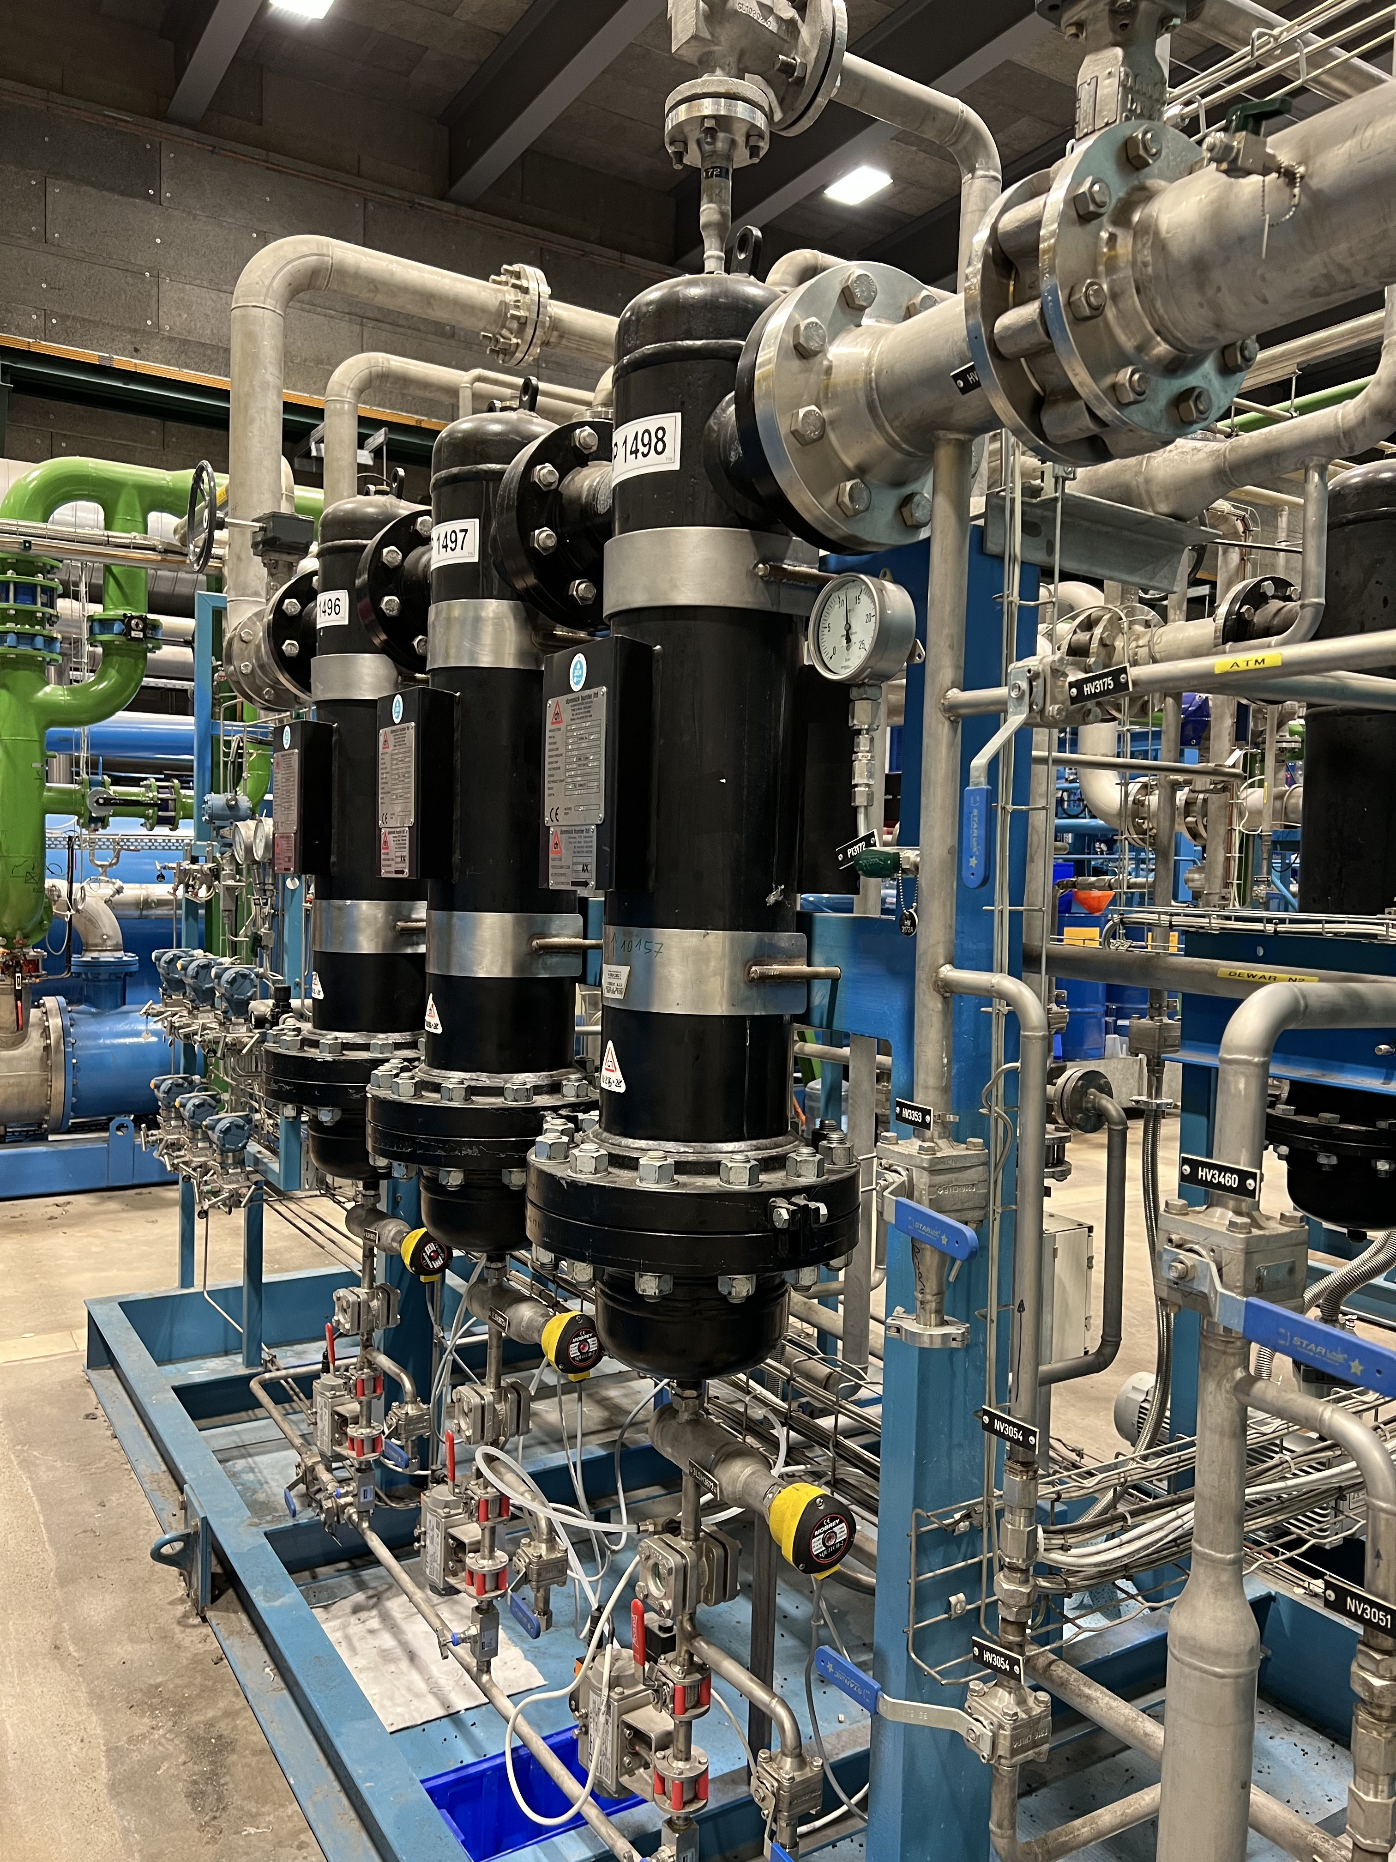
Industrial Controls group (BE-ICS)
The Industrial Control Systems group within the Beams Department (BE-ICS) has the mission to provide the technology, frameworks, engineering and CERN-wide support for systems and projects in all domains using standard industrial control solutions.
  Identifying, proposing and selecting industrial controls technologies
  Design, implementation and support of frameworks to standardize
  the development of industrial control systems
  Engineering of complete control systems (e.g. process control,
  machine protection, functional safety, monitoring…)
  CERN-wide support in industrial controls technologies
Additional services and R&D
  Advanced control, modelling and simulation
  Formal methods applied to control code verification
  Data analytics and artificial intelligence in automation

Slide 4
Industrial Control challenges
One of the CERN goals: maximize uptime of the instruments (accelerators, detectors,…) in order to optimize physics data availability
This objective implies the maximum availability and optimal operation of all the auxiliary/utilities systems (e.g. cryogenics, cooling, HVAC, gas, motion, interlocks,…) -> the correspondent control systems must ensure this.
What is uncommon at the CERN accelerators control systems?
Environment (radiation areas): Safety and rad-tol electronics
Large systems: highly distributed and/or interconnected
Complexity: control logic
Precision: measurements
Performance: feedback control
Data: number and frequency

Slide 5
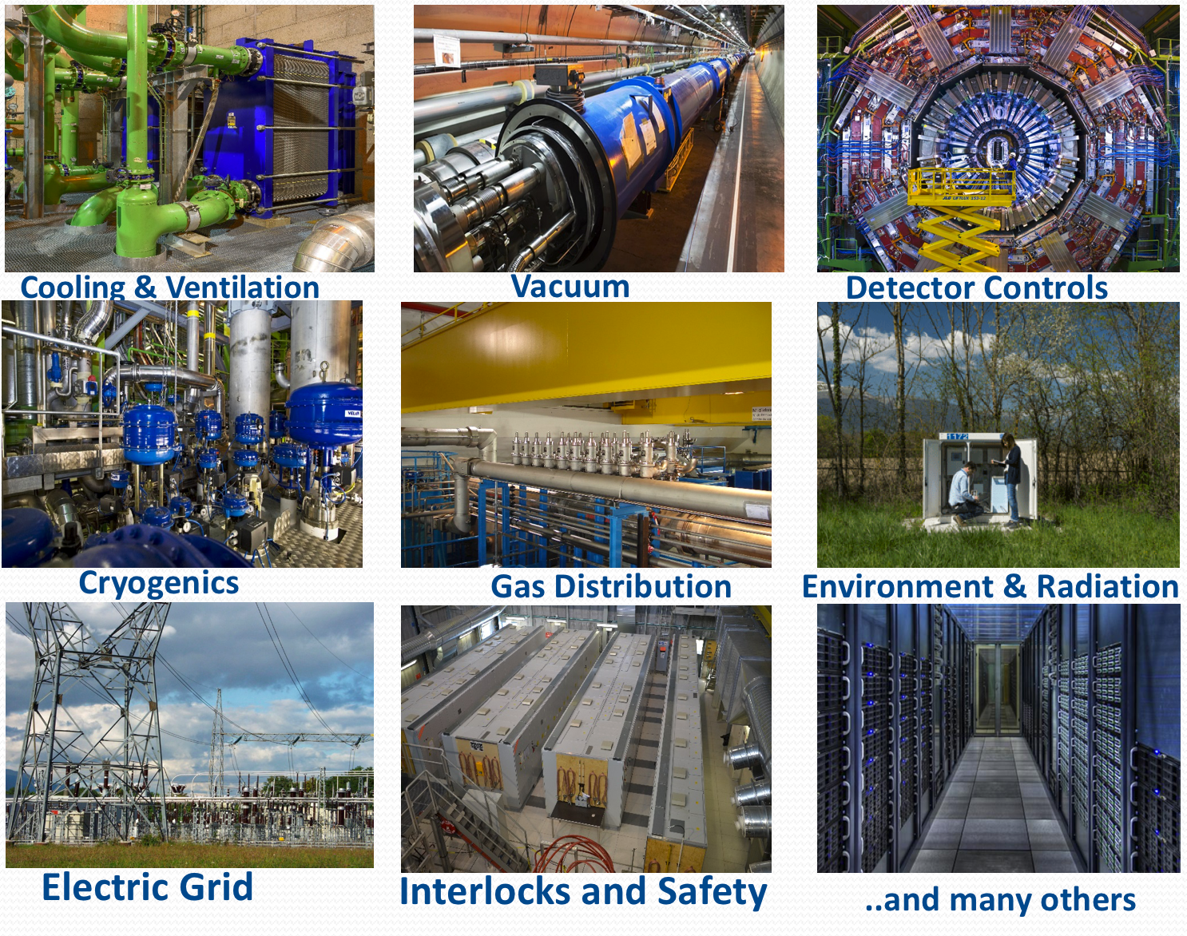
Industrial Controls
Industrial automation
  Industrial automation is the application of control systems, such as computers, robots, and information technologies, for handling different processes and machineries in industry.
CERN: engineered by BE-ICS and many others equipment groups

Slide 6
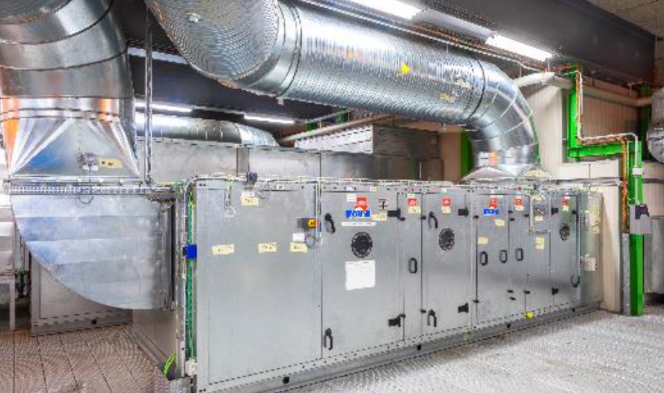
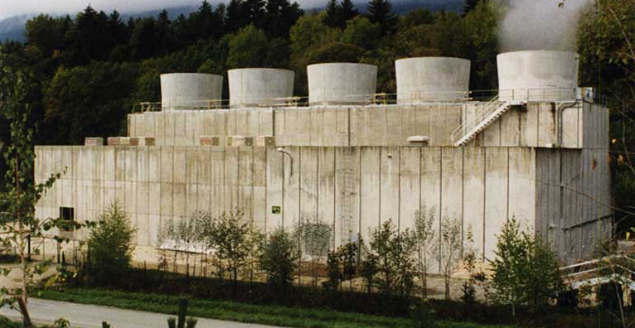
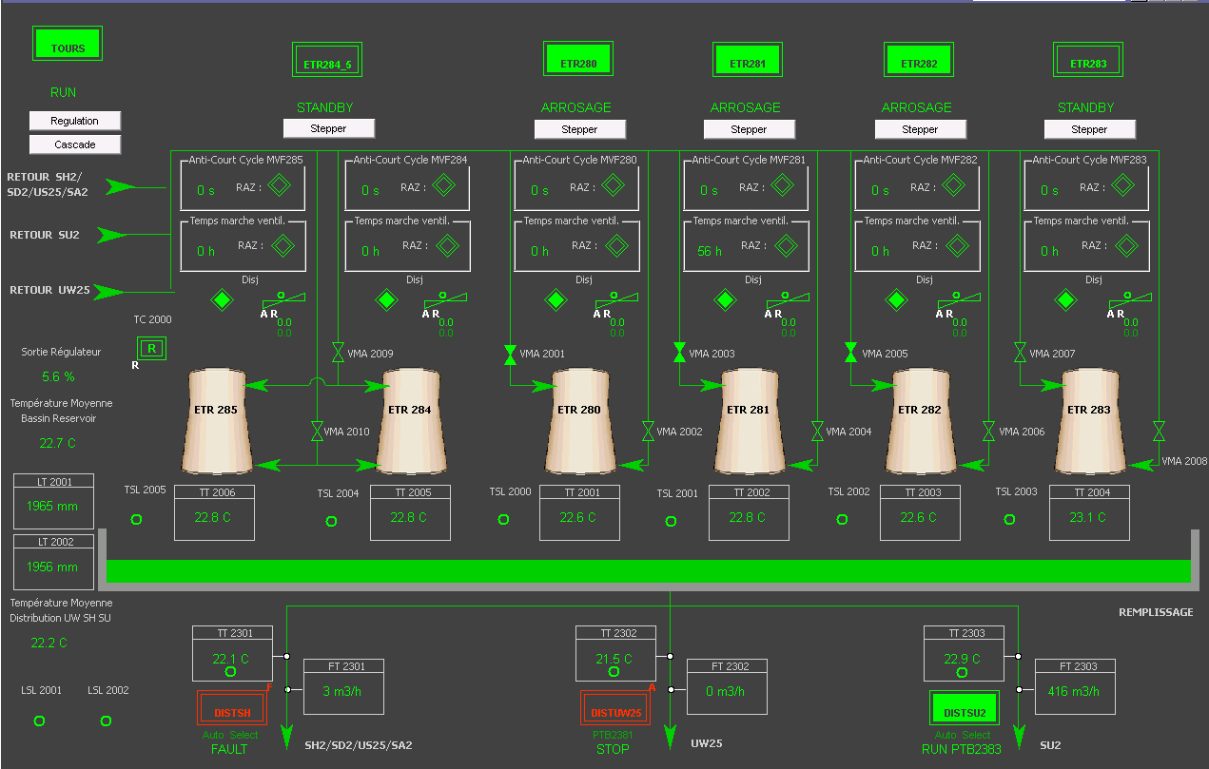
Cooling and Ventilation
Water Cooling
  Primary water @ 20 C: Cryogenics, other cooling plants…
  Chilled Water @ 5 C: Ventilation, magnets, cables, electronics, …
  Demineralized Water: magnets, power converters, RF cavities…
  LHC = 160 MW @ 24C for primary water
Heating, Ventilation and Air Conditioning (HVAC)
  Cavern and tunnels, Computing centres
  Electronic racks, Large control rooms
  1500 units
  LHC = 300K m3/hour

Slide 7
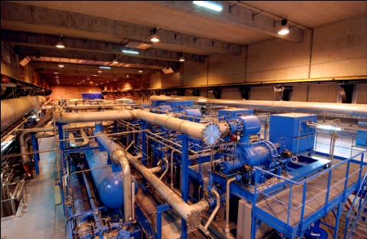
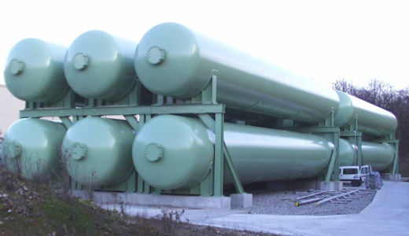
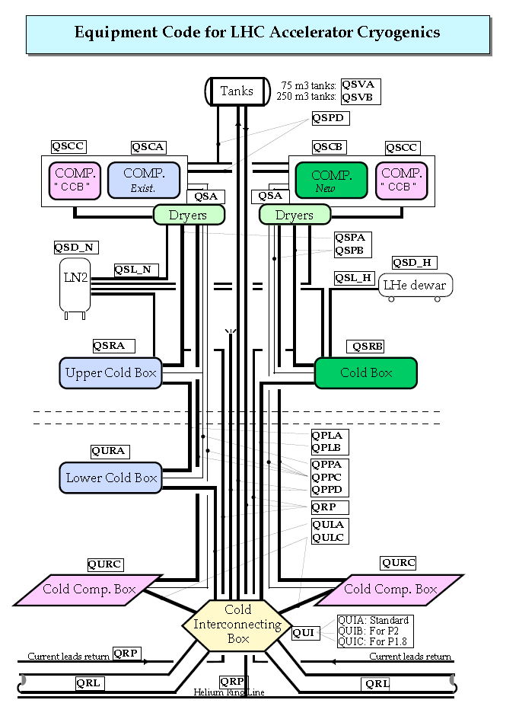
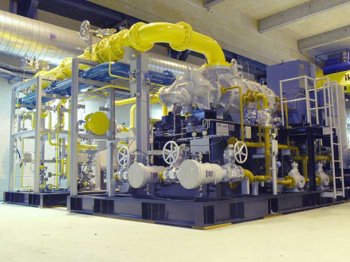
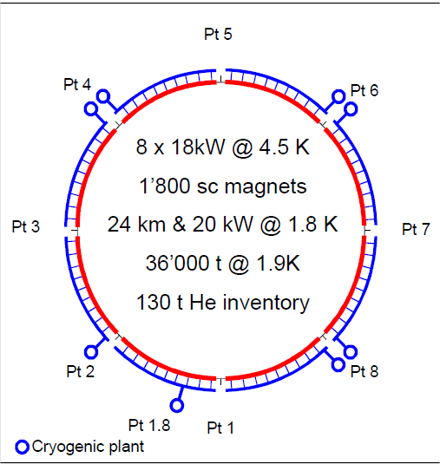
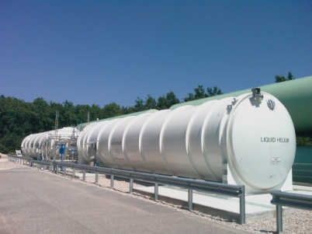
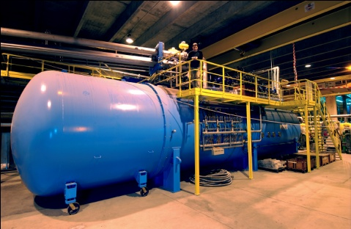
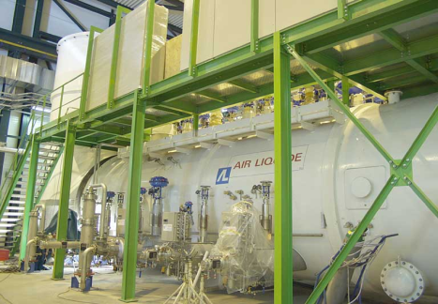
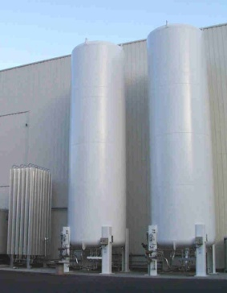
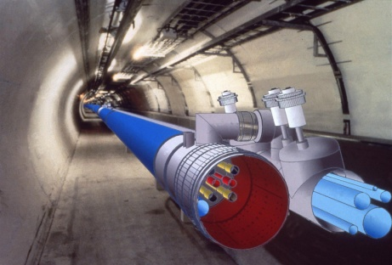
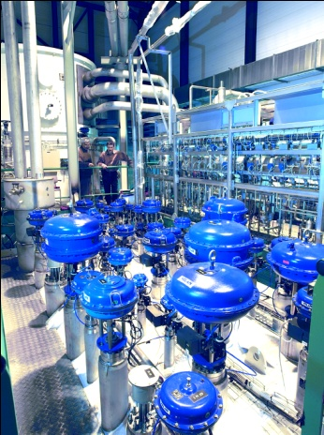
LHC Cryogenics (or the coldest place in universe! -271ºC)
compressor
stations
helium storage
liquid helium storage
cold boxes
liquid nitrogen storage
3.3 km
3.3 km
helium transfer line
Notes:
Pour faire fonctionner le LHC, nous devons réfrigérer 24 km d’installations à une température de -271°C. Notre fluide réfrigérant est l’hélium qui est refroidi par huit grands réfrigérateurs.
Ces huit grand réfrigérateurs sont indiquées par des points rouges sur cette carte. A part ces installations nous avons encore une douzaine d’autres installations plus petites – représentés par les autres points colorés sur la carte. Les moyennes et petites installations alimentent plusieurs détecteurs et des stations de test.
Les tailles des systèmes sont très différentes, mais les principes de fonctionnement se ressemblent. Thermodynamiquement c’est toujours le même procès. Voici le schéma d’une des installations qui alimentent le tunnel avec du hélium refroidi.
Ces installations consistent en stockages d’hélium, en stations de compression, en réservoirs de stockages pour l’hélium et l’azote sous forme liquide, en boîtes froides qui contiennent tous les composants pour le procès cryogénique et la ligne de transfert isolée dans le tunnel qui alimente les aimants avec de l’hélium à -271 °C.
Ce sont donc les installations que nous devons maintenir.

Slide 8
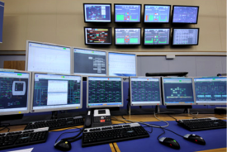
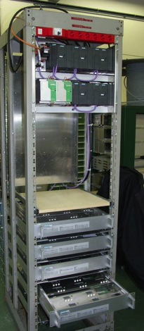
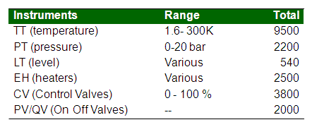
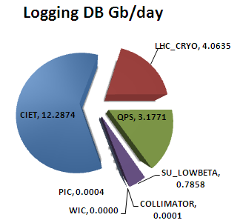
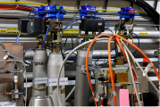
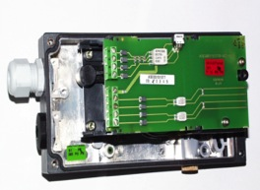
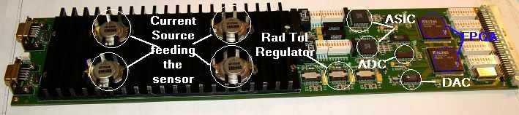
LHC cryogenics control: Use case : facts
27 km of decentralized instrumentation and control
50k I/O, 11k actuators, ~5k feedback control loops
Control: ~100 PLCs (Siemens, Schneider),
~40 FECs (industrial PCs)
Supervision: 26 SCADA servers : 1.5 million TAGS
WinCC OA HMI in the CCC
Tunnel Instrumentation
Electro-pneumatic positioner, SIPART PS2
RadTol in-house electronics for signal conditioning and actuation

Slide 9




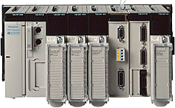

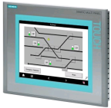


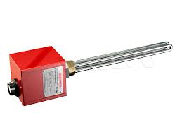
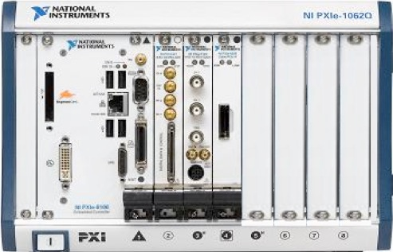

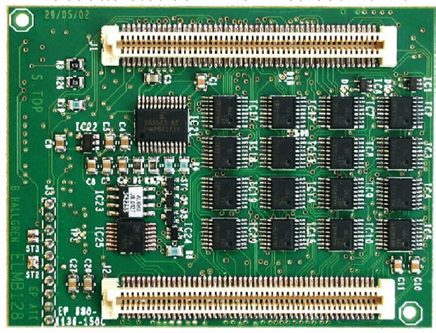



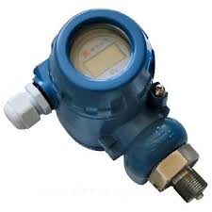
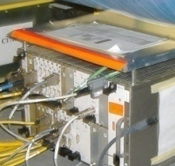
Industrial Controls Architecture
Frameworks:
UNICOS
JCOP
FESA
(BE-CO)
OWS: Operator Workstation
EWS: Engineering Workstation
FEC: Front-End Computer: IPC
EWS
OWS
TN or EN (Technical network)
SUPERVSION
SCADA Servers
SCADA Servers
600 SCADA Applications
400 Industrial PCs
10 RAC Oracle Servers
200 TB stored per year
OPC Servers
FEC
DCS
Local panels
600 PLCs
200 OPC UA Servers
90 FECs
CONTROL
PLCs
Fieldbus: e.g Profinet
Fieldbus: i.e. WFip
Fieldbus: i.e. CAN
Hundreds of PS
Hundreds of Fieldbuses
Thousands of intelligent instruments
10 M Hardware I/O
FIELD
IO & devices
CAEN/Wiener/ISEG
ELMB

Slide 10
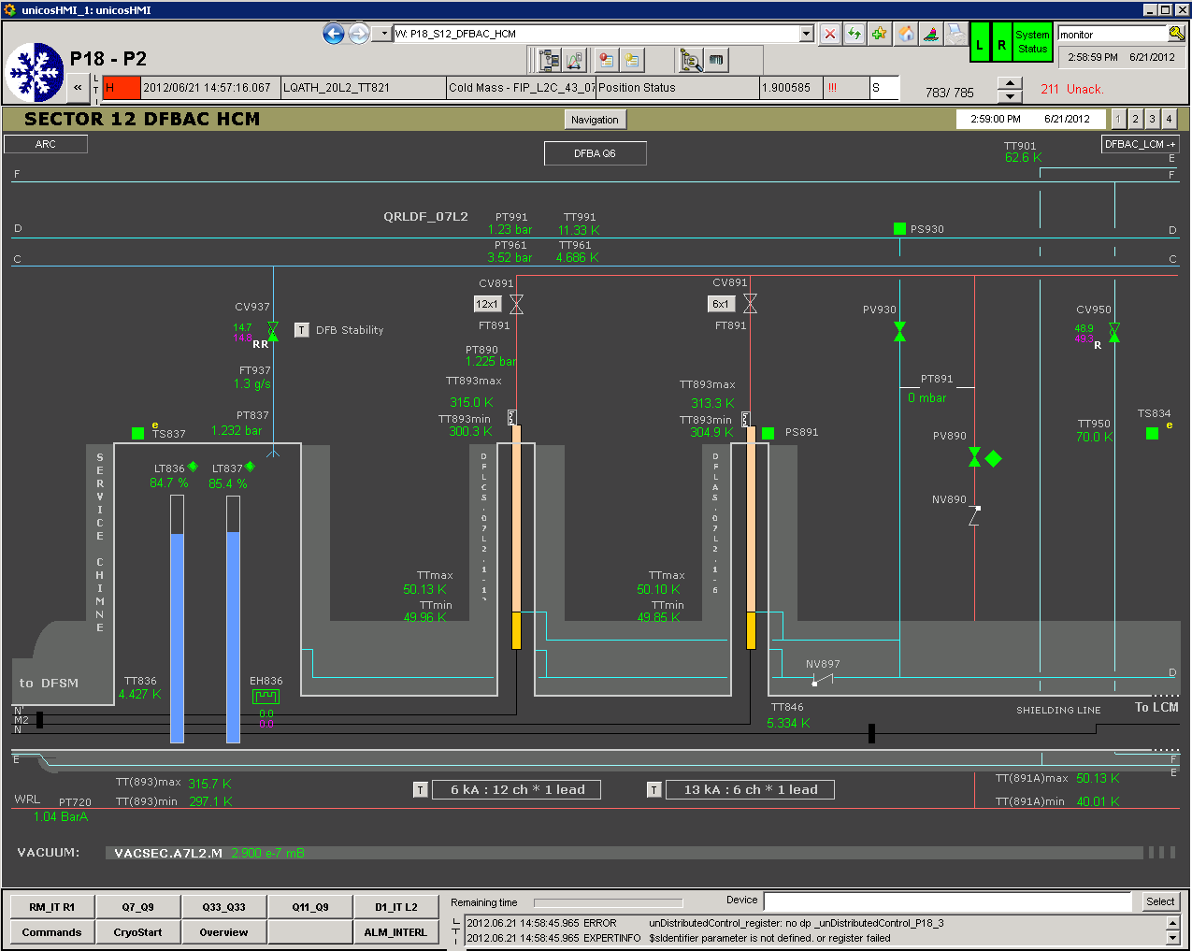
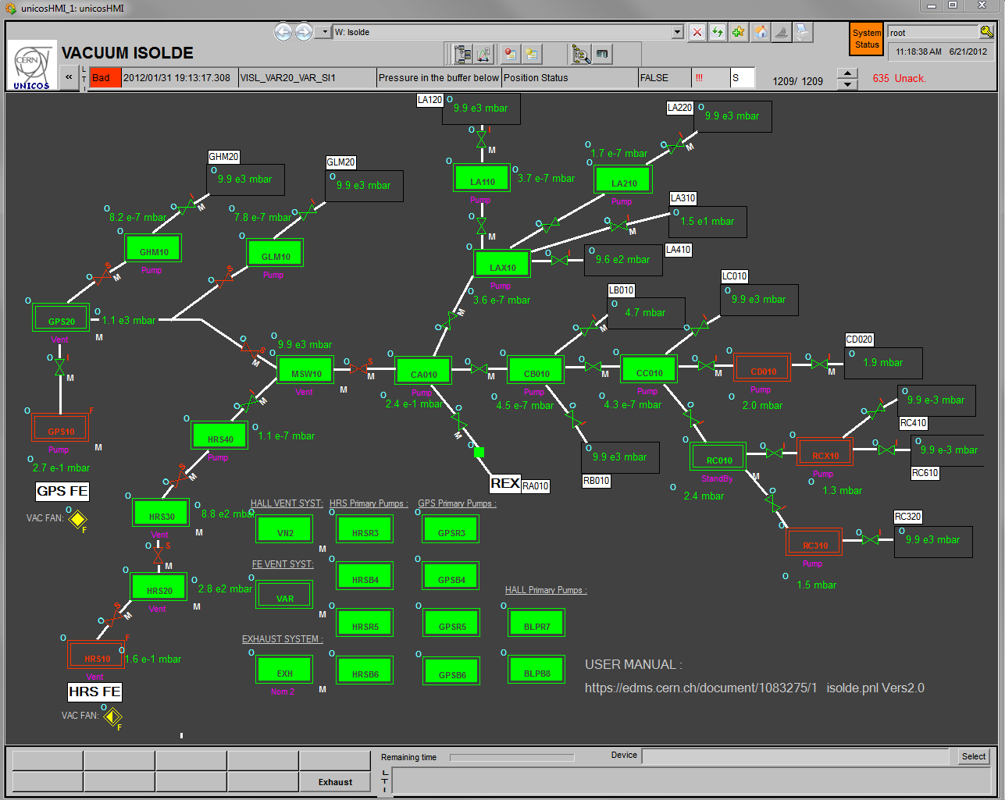
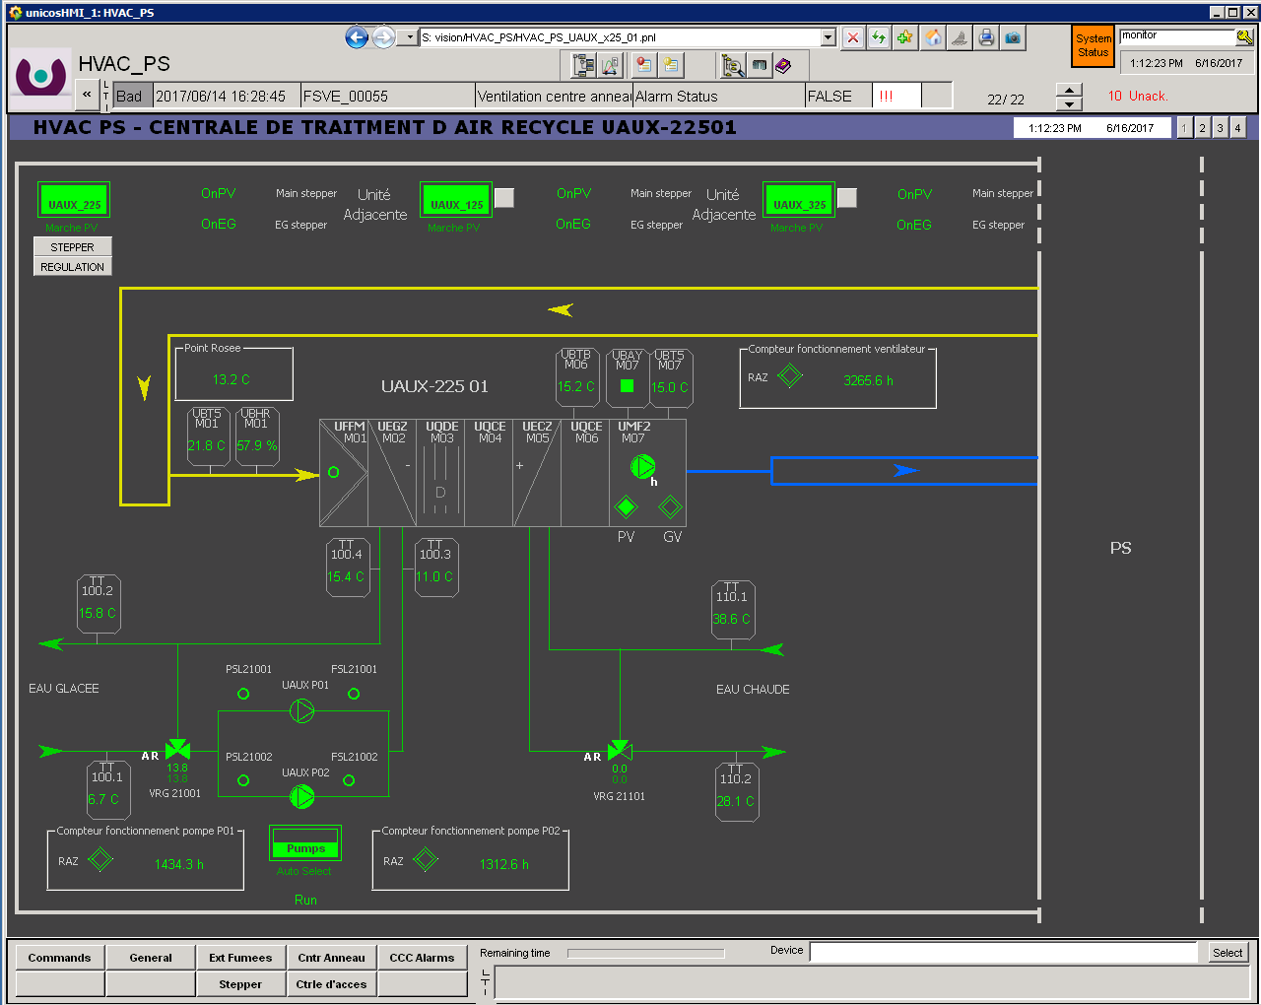
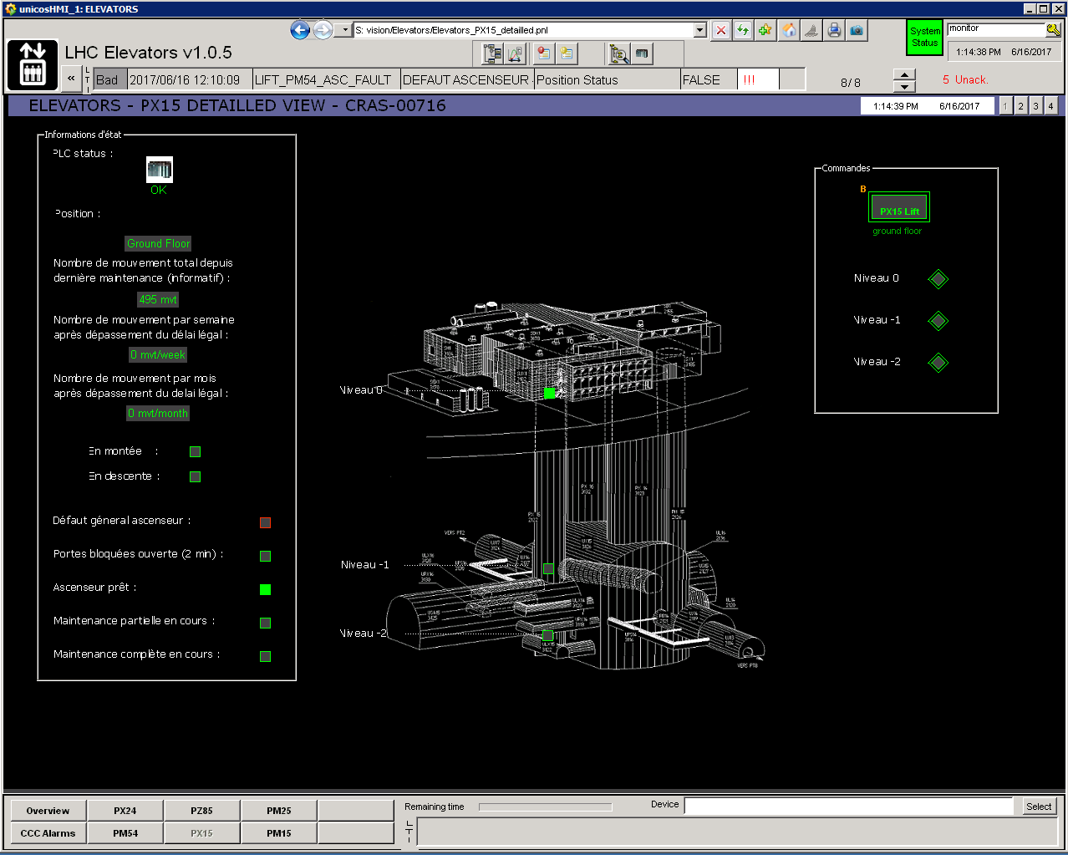
Industrial Controls: Standards & Frameworks
Off-the-shelf components (COTS) whenever possible
Standardization (ISA, IEC)
Frameworks
  JCOP: A homogeneous way to build
  the detector control systems
  UNICOS: A unified way to build
  process control systems
Homogenization
Cryogenics, Vacuum, HVAC, Electricity…

Slide 11

Industrial Partners & Collaborations
(some examples…)
Integrators
GTD Systems: LHC cryogenics project (initial budget ~ 6 MCHF)
Assystem: Industrial controls support contract
Suppliers
Siemens, Schneider,: PLCs; ARC Informatique, ETM (Siemens): SCADA; Empresarios Agrupados: Industrial modeling and simulation.
Academia
UVA (University of Valladolid, Spain): modelling & simulation, PLC embedded controllers (MBPC)
BME (Budapest University of Technology and Economics, Hungary), EPFL (Lausanne, Switzerland):
Formal methods applied to PLC code verification, NTNU (Norway) Advanced Control.
HEP Institutes
GSI, ITER, ESO, SOLEIL, MPI…

Slide 12
Industrial controls & Industry 4.0
Mostly relevant to discrete products and their manufacturing – assembly lines, machines, and robots. In a process plant : processing equipment
The Industrial Internet of Things (IIoT): industrial-strength networks and cyber-physical security.
Additional sensors deployed to enable online monitoring of equipment (‘things’)
Analyze the raw data: process monitoring or anomaly detection: Big data.
Information exchange over the entire lifecycle of a product: convergence of OT and IT.
Digital twins fostering fabrication and performance
Industrial controls and drives: The future will bring more effective industrial controls and drive technologies that will reduce process variability while ensuring safety and security
Notes:
- Industry 4.0 is mostly relevant to discrete products and their manufacturing – assembly lines, machines, and robots. In a process plant, the Industry 4.0 concept applies mostly to the processing equipment
- Plants are now deploying additional sensors to enable the condition and performance of a broader scope of equipment (‘things’) such as pumps, cooling towers, blowers, and valves around the site to be monitored online
- The Industrial Internet of Things (IIoT) requiring enhancements in industrial-strength networks and cyber-physical security.
In the cloud, software ‘apps’ are running to analyze the raw data from the sensors in the plant allowing process monitoring or anomaly detection: Big data.
- Central to Industry 4.0 is information exchange over the entire lifecycle of a product
- Fabrication is improved by having digital twins enabling virtual design and commissioning
- Industrial controls and drives: The future will bring more effective industrial controls and drive technologies that will reduce process variability while ensuring safety and security

Slide 13













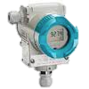







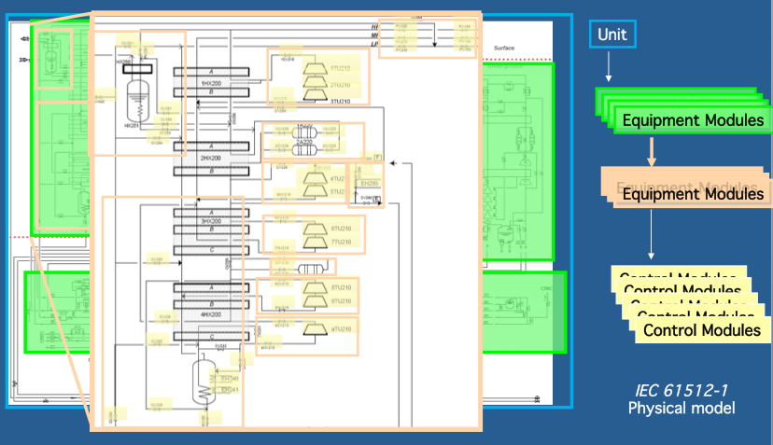

OT and IT convergence (Project Life cycle)
Databases (Assets, Layout
Controls conf.)
Versioning (SVN, GIT)
Verification, Simulation,
Test (Continuous Integration)
Deployment
& Monitoring
Maintenance
Analytics
PLCVerif
Moon
Assets
Specifications
Automatic
Code
Generation
Test
(FAT,
SAT)
Deployment
Reverse
Engineering
Analysis
PLC
PLC
Notes:
- Life cycle of an industrial control project: towards IT methodologies
- High level programming: efficiency on engineering with still reliability of the solution
- More complexity requires better Q&A: Formal methods

Slide 14
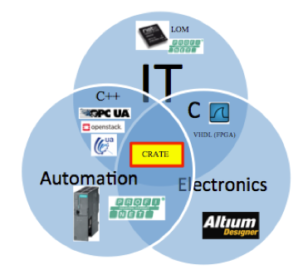

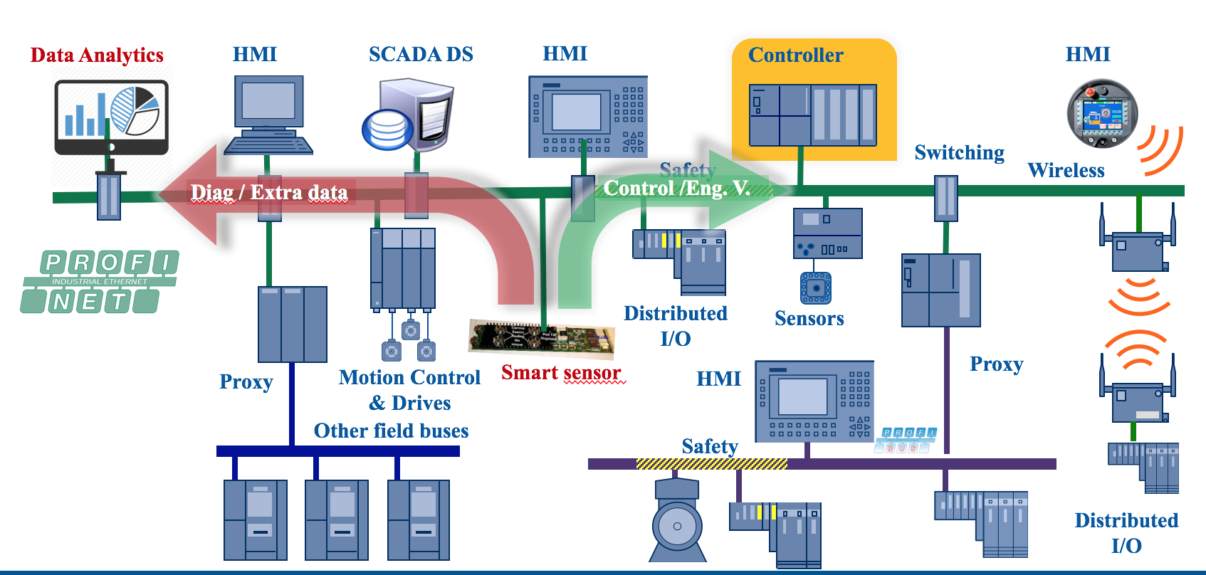
IIoT (Industrial IoT)
IIoT equipped sensors
Cryogenics instrumentation electronics cards design (high precision)
IIoT architectures
Fully integrated within industrial fieldbuses (e.g. Profinet)
- Profinet RT for control purposes (engineering values)
- OPC-UA for sensor diagnostics (data analytics)

Slide 15
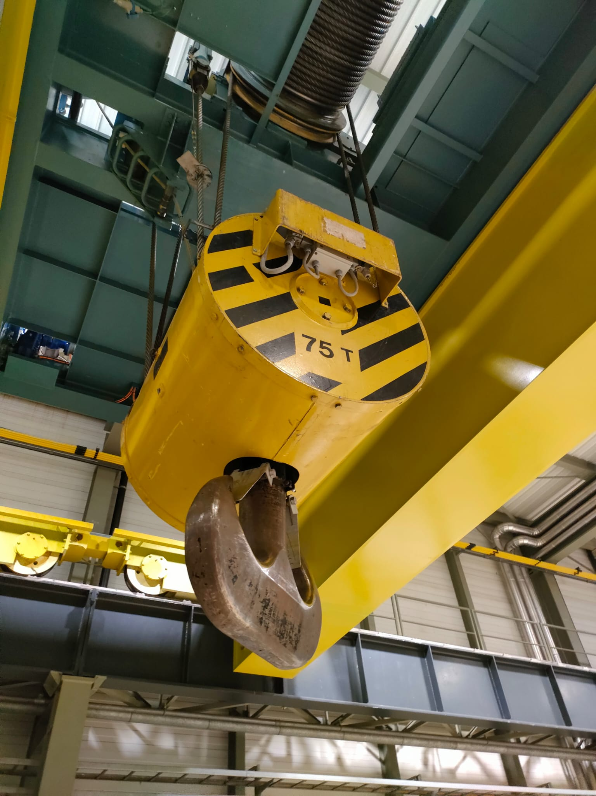
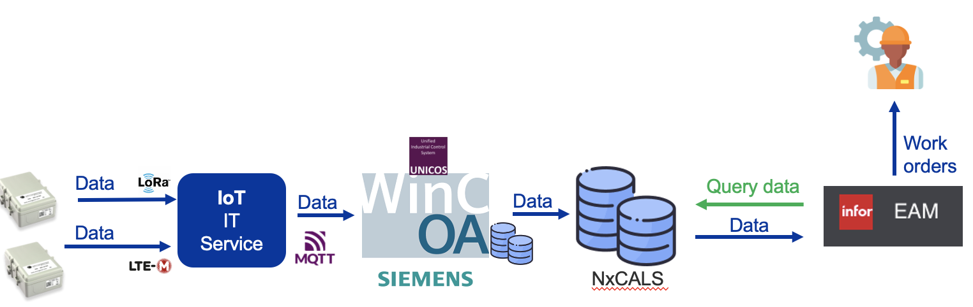
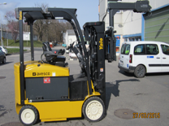
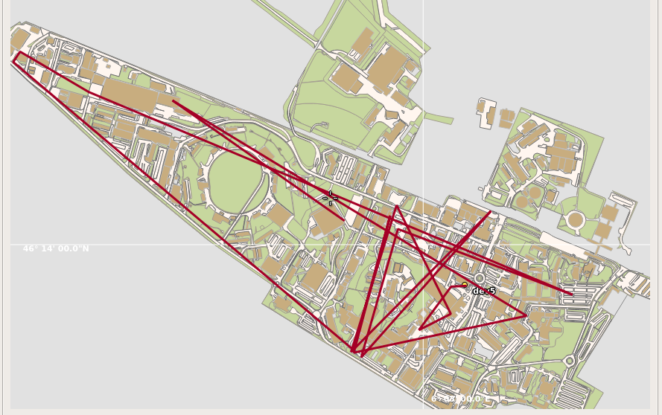
IIoT Condition monitoring
CRANES (EN-HE)
  Cost reduction by optimizing maintenance while maximizing availability
  Based on the IoT service by IT (LORAWAN)
  WinCC OA + CMMS
  Extended to the LIFTS maintenance
DataWorkflow
Forklifs (EN-HE)
  Efficient equipment geo-localisation.
  Optimize use and maintenance
  Detecting and able to see the trajectory an asset has made.
Geo- tracking
Notes:
MESSAGES:
We are the biggest PLC based control project at CERN, by I
*Data gathered from UNICOS CV PROJECT LIST @ CV SVN REPOSITORY.

Slide 16
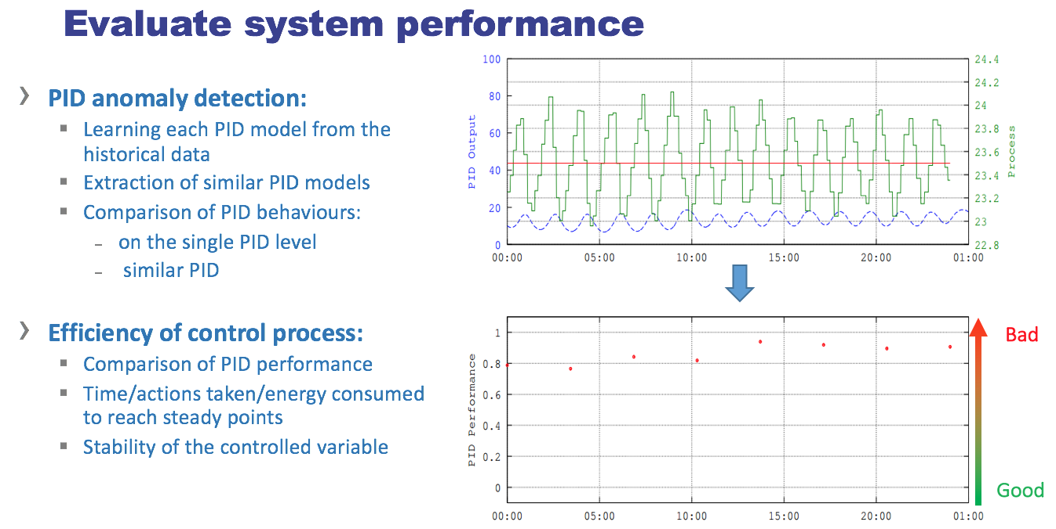

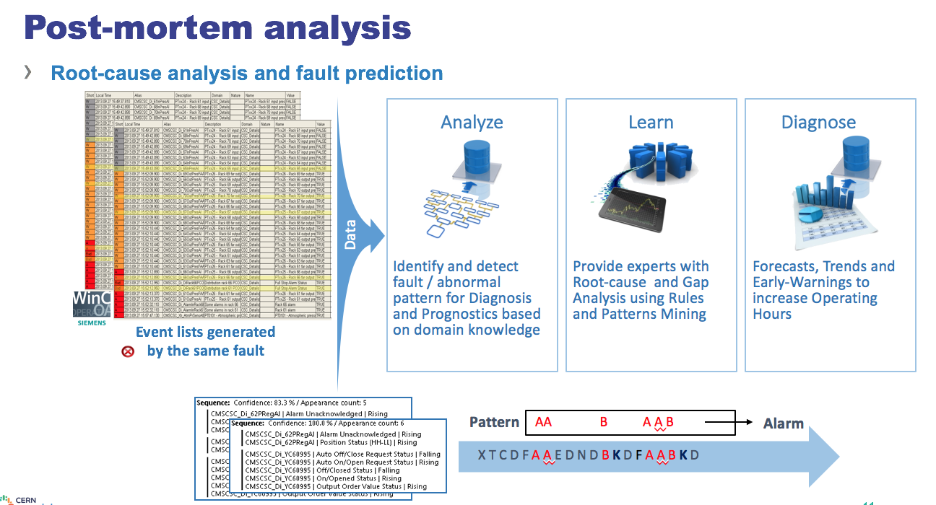
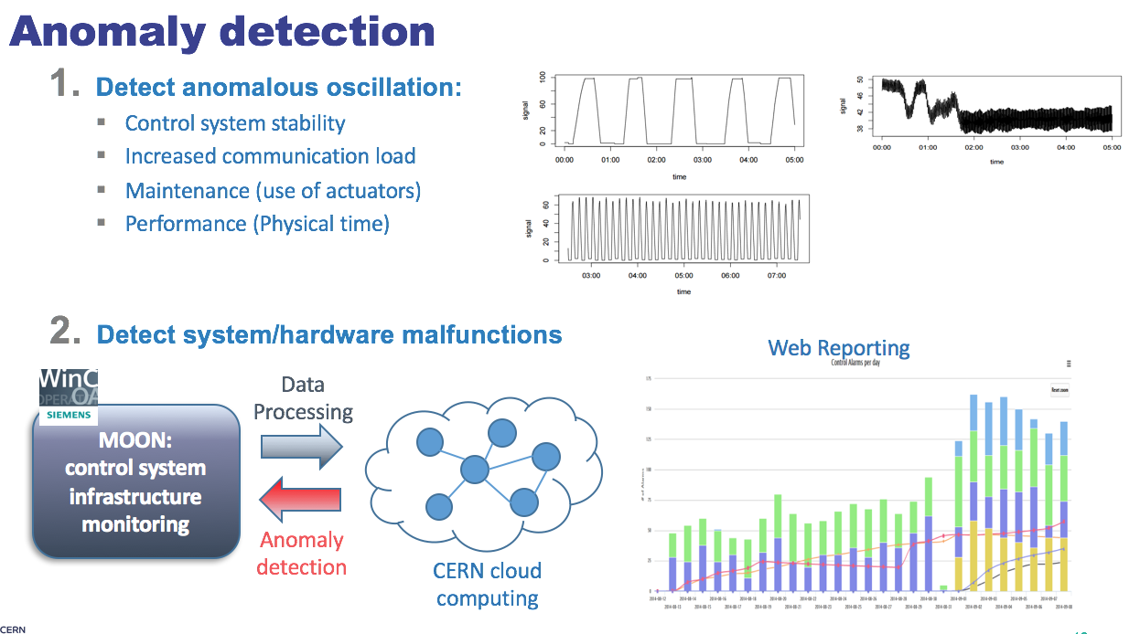
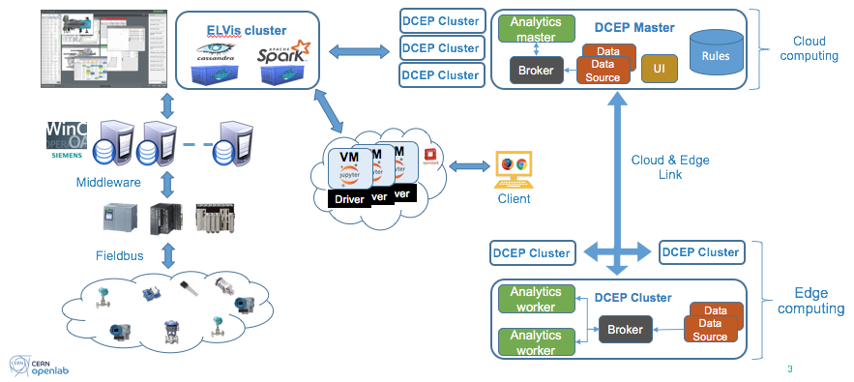
Data analytics
Courtesy of F. Tilaro (Openlab)
Notes:
Evaluation of the controller by analyzing the time series of its error and to very the existence predictable patterns in the control horizon.
Comparison of the actual controller variance to ideal of a minimum variance controller (Harris, predictability index)
Yes, we have been using machine learning techniques in all of the use-cases except for condition monitoring. Specifically we use the historical control data to extract or create a model that it can be used for anomaly detection; in the following use-cases:
- Oscillation detection (slide 10): we use the expert knowledge to create a model of the threshold, which is specifically achieved through an exponential regression)
- Root-cause analysis (slide 11): in this case we use pattern mining technique (the algorithm is known as CSpade) to detect the most relevant event for the specific fault and store this sequence
- Anomaly detection for sensors/actuators (slide13): in this case we developed 2 machine learning algorithms (to model the nominal behaviour of the sensors) and one which is only based on expert knowledge.
- Recommendation system for WinCC OA (slide 15): also in this case we use machine learning technique to profile each user (through another type of patter mining of the taken action)
- PID (slide 16): in this case the performance index is defined on the forecast residual error which is based on the past historical data and the future measurements of the system (so we use historical data to model the error distance). Specifically in the analysis we have a parameter 'm' which represents the order of the regression model, that is how much historical data we need to capture the characteristics of the time series of the error to reflect the predictable components in the model. We normally set this parameter to a value slightly bigger than the control loop settling time and in any case bigger than the control horizon 'b' (use for forecasting).

Slide 17


Increase SECURITY
Cybersecurity at CERN relies on three principles
Device registration, inventory and traffic auditing.
Network segregation : Separate networks for production, development and major experiments.
Device isolation through control sets: PLC devices are only allowed to speak to trusted equipment (SCADA servers, monitoring equipment…)
Robustness of PLCs, IoT devices and other equipment
CERN collaborated with *ANSSI (FR) / **BSI (DE) on an open-source initiative for an ISA-99 compliant robustness fuzzing platform (implemented by AMOSSYS). Released to the public domain early 2018 Q2.
* Agence nationale de la sécurité des systèmes d'information (France)
** Bundesamt für Sicherheit in der Informationstechnik (Germany)
Courtesy of B. Copy
Notes:
The IT department should keep a current inventory of all information assets and prioritize those that are most essential to advancing the organization’s objectives and sustaining operations.
Access-level evaluation and scanning that involves monitoring people with access to sensitive information to measure related cybersecurity risk
Vulnerability assessment: Regularly scanning systems is critical to identify vulnerabilities within the environment.
Ref: https://www.iia.nl/SiteFiles/vakpub/GTAG%20Assessing%20Cybersecurity%20Risk.pdf

Slide 18

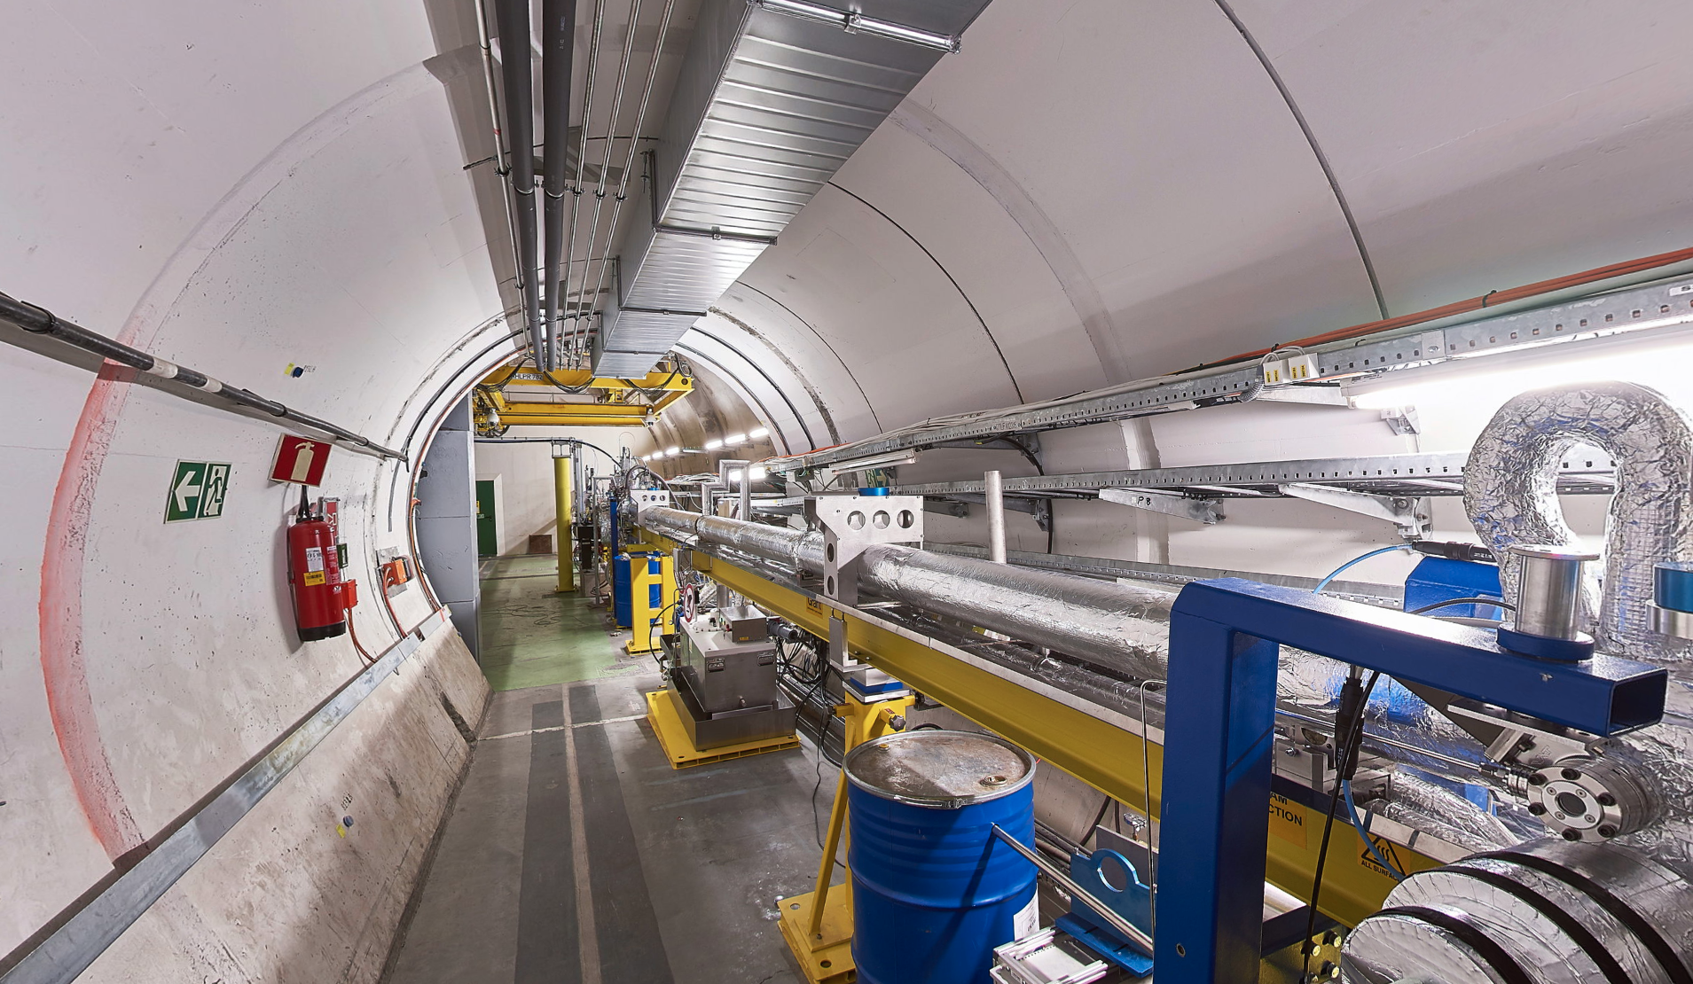
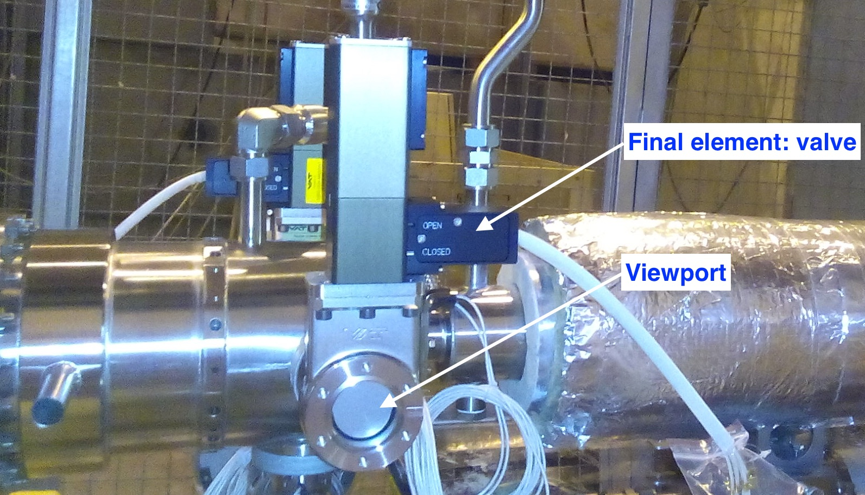
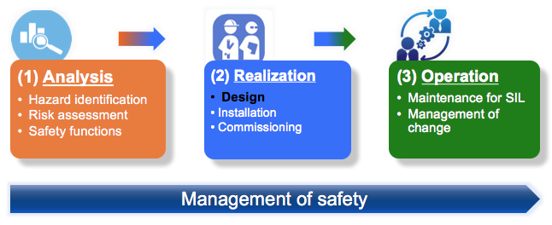


Increase SAFETY
Safety Instrumented Systems engineering
Standards
AWAKE Plasma cell
AWAKE Plasma cell (viewports)
Safety Instrumented Function Loop
Safety Instrumented Function architecture

Slide 19








Modeling & Simulation: Digital twin
CERN developed a cryogenic library with the commercial simulation software EcosimPro (Empresarios Agrupados): Cryogenic equipment modelled by DAEs. (Differential-Algebraic Equations)
Under a special Spanish programme of industry support to Science the library was the object of a technology transfer to EA International (2011)
Adopting the Virtual Commissioning concept reduces installation launch time and increase the control system quality by testing, validating, and debugging the system before physical commissioning
HIL: Hardware in the loop
18 kW @ 4.5 Refrigerators
C++ application
(OPC client)
Compressor station

Slide 20


Use case: Installation of waste heat recovery in LHC point 8
Cooling towers of LHC point 8
Entering cooling water
Average ~30 °C
With the heat exchanger: ~25-28 °C
New Installation
Cooling water from the common basin
22 °C
Circulation from the city
Heat Recovery
Heat Exchanger
Clients of cooling of LHC point 8
(e.g. LHC Cryogenics)
Average ~30 C°
Circulation to the city
Courtesy of Matias Peljo
Notes:
Geothermal energy heat pump stations allow use of such low temperature waste heat
Significant cost saving in the amount of geothermal wells needed
Stability must be guaranteed as the LHC cryogenics has a critical operation
François-Marie Arouet (French: [fʁɑ̃swa maʁi aʁwɛ]; 21 November 1694 – 30 May 1778), known by his nom de plumeVoltaire (/vɒlˈtɛər/;^{[2]} French: [vɔltɛːʁ]), was a French Enlightenment writer, historian and philosopher famous for his wit, his criticism of Christianity

Slide 21


Model validation
Dynamic
Steady state
Comparison against real data on 15.8.2014,
RMSE = 0.49 C
Residual densities for set of steady states from LHC run 2016
Courtesy of Matias Peljo
Notes:
Model can be used within in the validation data set range and expected to have errors between +-1 – 2 C
Residual = T2 - $T2e
=> Negative mean error means model is under performing, under estimating the cooling performance
1 MIN
15 MIN

Slide 22


Virtual commissioning
- Does my control system behaves as expected?
- Could it cope with unexpected scenarios?
Virtual commissioning architecture
Mid season scenario
Courtesy of Brad Schofield

Slide 23





Applied formal methods
Formal verification of PLC code: PLCVerif
  Mathematically sound methods to check the correctness
  of plans / implementations. e.g. Model checking
  Tool reengineering project funded by CERN KT
Used in real-life projects (to complement testing)
  At CERN: SM18 projects, B311 Switchboard, AWAKE
  Outside of CERN: ITER interlock masking (HIOC)
Collaborations
  BME (Budapest)
  EPFL (Lausanne)
  NASA (US)
Academia
Industry
Sophisticated
theoretical
algorithms
Missing tools for PLC verification
Courtesy of D. Darvas

Slide 24




Control Engineering: Advanced Control
LHC cryogenics standard cell PI&D (~100 meters)

Slide 25





Advanced control & energy savings
Model based predictive control
Ongoing Ph.D. project with NTNU (Norway) to apply to Air Handling Units and Cooling Towers.
Very promising results in simulation; preparing for pilot deployment in SR1
Optimization problem
R&D
Cooling Towers
Energy Saving $≈$ 12-14%
Work Scope $≈$ 10 CTs installations
Air Handling Units
Energy Saving $≈$ 15-20 %
Work Scope $≈$ 200 AHUs installations
Courtesy of Brad Schofield
Notes:
MESSAGES:
We are the biggest PLC based control project at CERN, by I
*Data gathered from UNICOS CV PROJECT LIST @ CV SVN REPOSITORY.

Slide 26

Control Engineering
PID auto-tuning
A collaboration with the Automation and
Systems Engineering department at the
University of Valladolid
Large number of PID based controllers: > 8000 (Installed in PLCs > 400)
Auto-tuning methods
  Relay Method
  SIMC (Skogestad Internal Model Control)
  IFC (Iterative Feedback Tuning)
Iterative Feedback Tuning

Slide 27
Recap
Sound base of standardized industrial control systems
Large installations usually well instrumented
Already large experience OT & IT convergence
Large amount of data available
But LHC will be there for 20 more years…
Evolution will naturally integrate Industry 4.0 concepts
An exciting period in front of us!

Slide 28
Foster collaborations
Cyber-security: Increase the robustness of the PLCs
Advanced automation: High level languages integration (DSLs)
Digital Twin: Improving commissioning
Formal verification: Improve the quality of the code
Data analytics, machine learning. Providing flexible platforms and tools allowing added-value algorithms (e.g. fault detection, predictive maintenance, performance issues…)
Advanced control: pushing the facilities to their limits to meet the HL LHC challenges

Slide 29
Acknowledgements & Credits
Material extracted from several sources:
CERN documentation
BE-ICS group (Industrial Controls & Safety Systems)
CERN equipment groups (e.g. Cryogenics, QPS…)
CERN LHC experiments
JCOP project
UNICOS project

Slide 30



Ph.D. Enrique Blanco
contact: Enrique.Blanco@cern.ch
Head of the Control Systems Engineering (CE) section
Industrial Controls group in the beams department at CERN
CERN, 2023

Slide 32
Formal verification: what is it?
Formal verification: mathematically sound methods to check properties of specifications / implementations / …
Model checking
  Automated formal verification method
  Checks all possible executions (contrarily to testing)
  Goal: prove correctness OR find hidden/rare problems
Real System
(hardware, software)
Formal Model
Formal Requirement
Model
checker
satisfied
not satisfied
✓
Counterexample
Courtesy of Daniel Darvas

Slide 33


Implementation in EcosimPro
Courtesy of Brad Schofield
Notes:
0.5 MIN

