Slide 1
Controls Infrastructure
Asset management & Reliability
Ioan Kozsar – CEM-IN

Slide 2
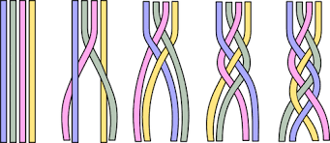
Agenda
Background
  CEM-IN
  Asset management
  Process
  CHDM approach
Outcomes - RAMS
Conclusions

Slide 3
CEM-IN Infrastructure - Mandate
* CERN Accelerator complex Frontend Systems
Specification, procurement, integration tests, operational installation and support of the Accelerator embedded systems in VME, cPCI and PICMG1.3, mTCA, PXIe form factors, distributed across the complete CERN Accelerator chain, from the LINACs up to the LHC.
* CERN Accelerator complex Fieldbuses Infrastructure
Deployment and operational support of the MIL-1553, WorldFIP, General Machine Timing (GMT) and White Rabbit field buses used for long-distance and sometimes radiation tolerant control of systems such as the LHC power converters, the LHC quench protection system, the LHC cryogenics system and the control of the Injector complex power converters.
* Infrastructure Asset Management and Diagnostics
Management of the Accelerator control system hardware assets (hardware boards, crates, processors, etc.) from the procurement until the final dismantlement.
Specification and development of all low-level remote diagnostic software required to operate the CERN accelerators` control system hardware infrastructure, including amongst others SNMP, AMT and IPMI.

Slide 4
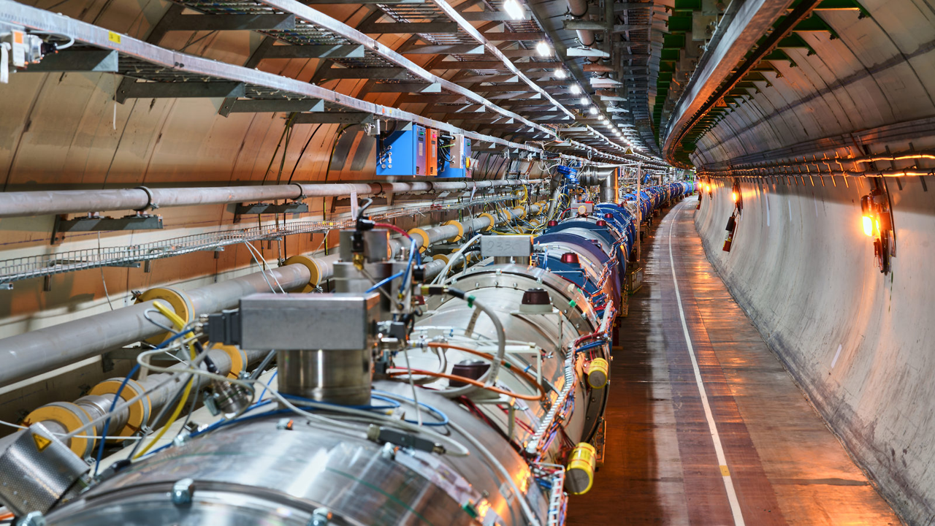

Asset Management – Introduction
Multiplication of assets
Information sharing
  Complex
CERN ← EAM

Slide 5
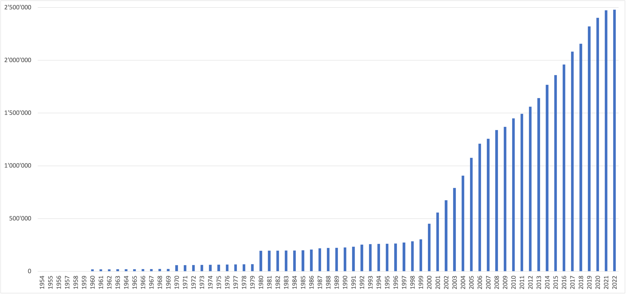
Asset Management – CERN assets over time
Start of LHC construction

Slide 6
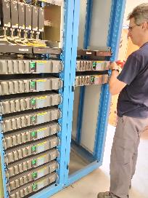
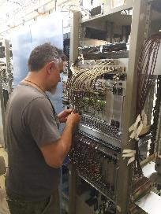
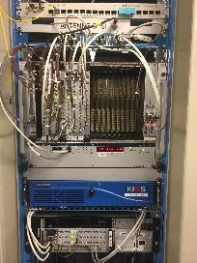
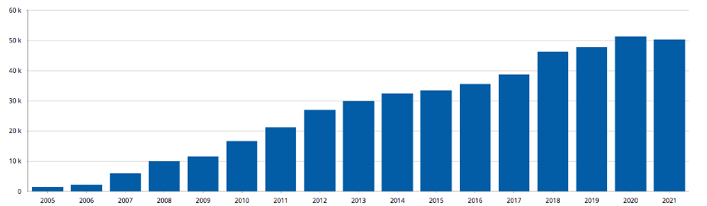
Asset Management – IN
Frontend Computers (FEC)
  VME, IPC, mTCA
  ~ 2,000 FECs
Fieldbuses
  GMT, WorldFIP, White Rabbit, signals & triggers
  ~ 63,000 connections
IN assets
  ~ 50,000 assets
  ~ 1,500 parts

Slide 7
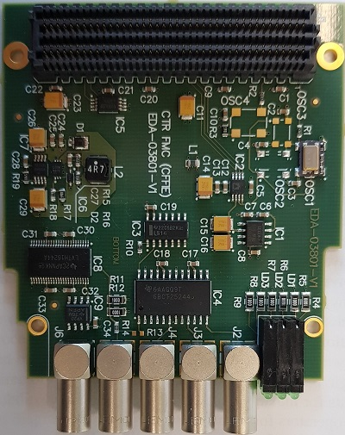
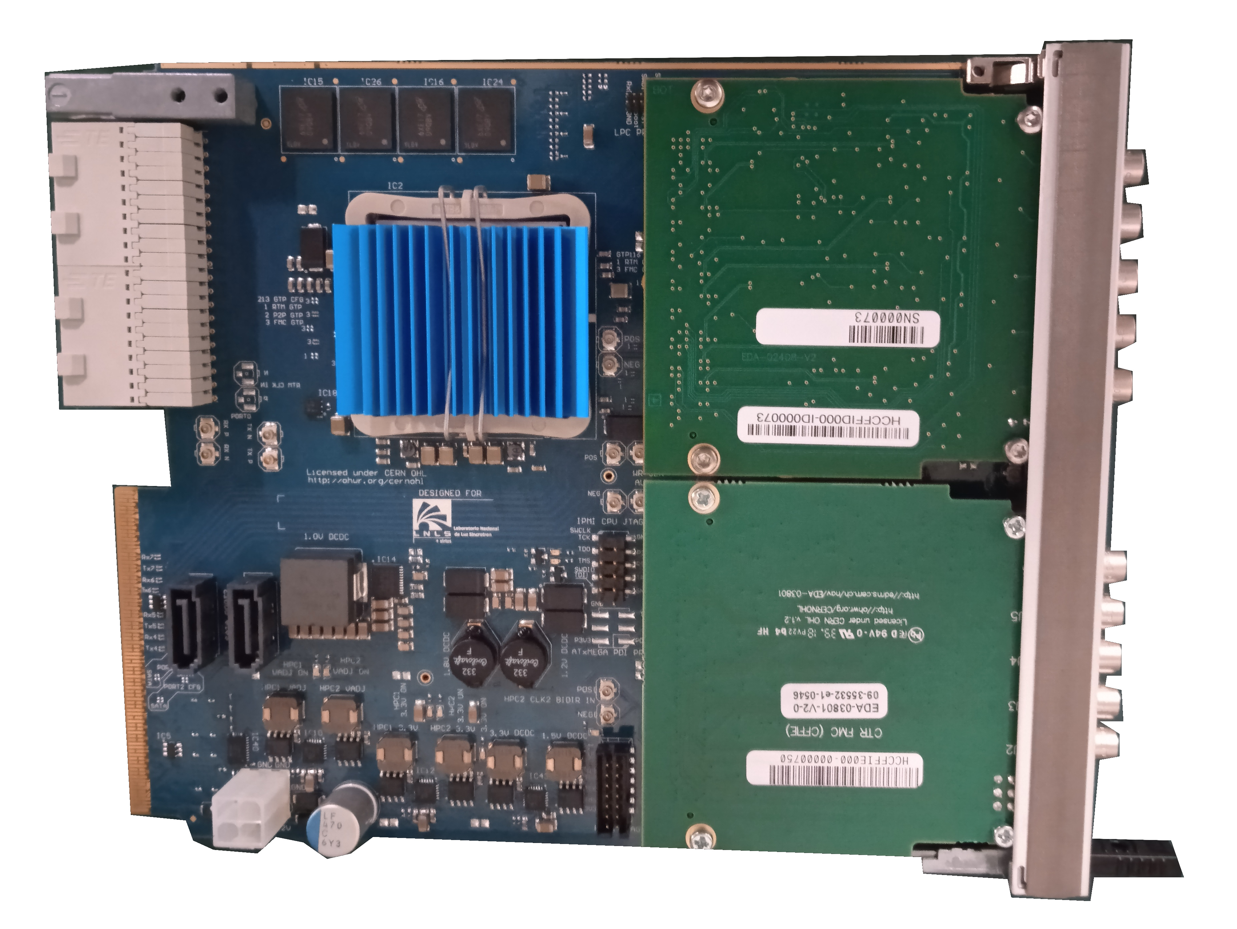
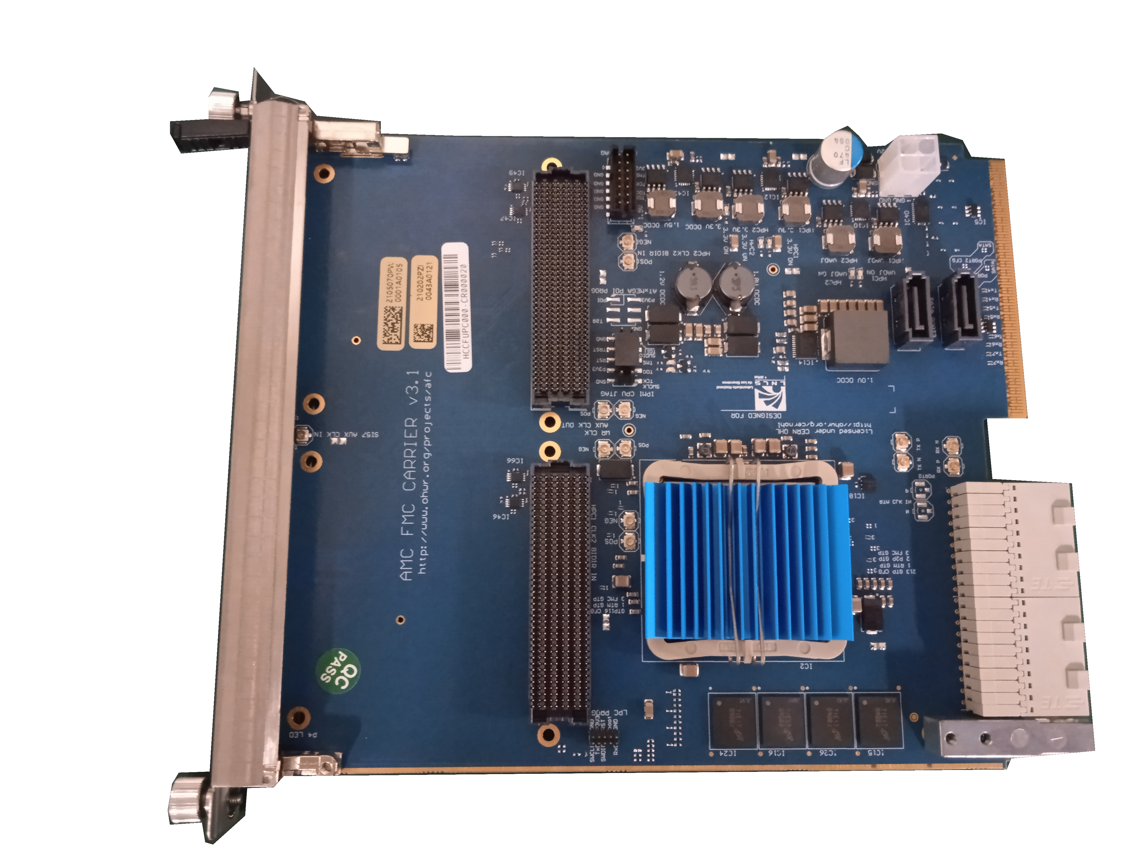
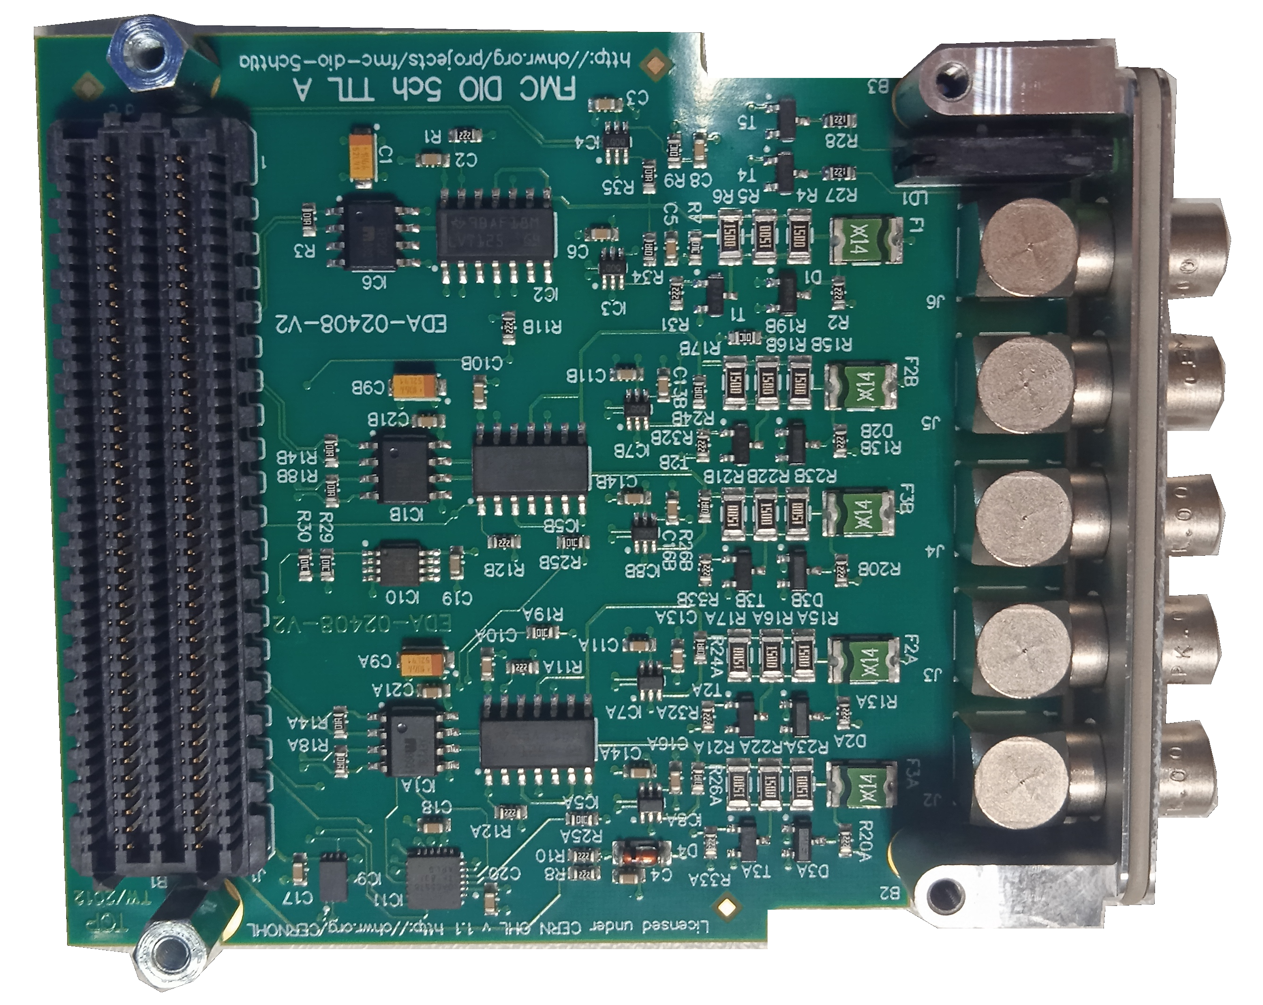
Asset – Example
HCCFFIE
HCCFUPC
HCCTRA
HCCFFID

Slide 8
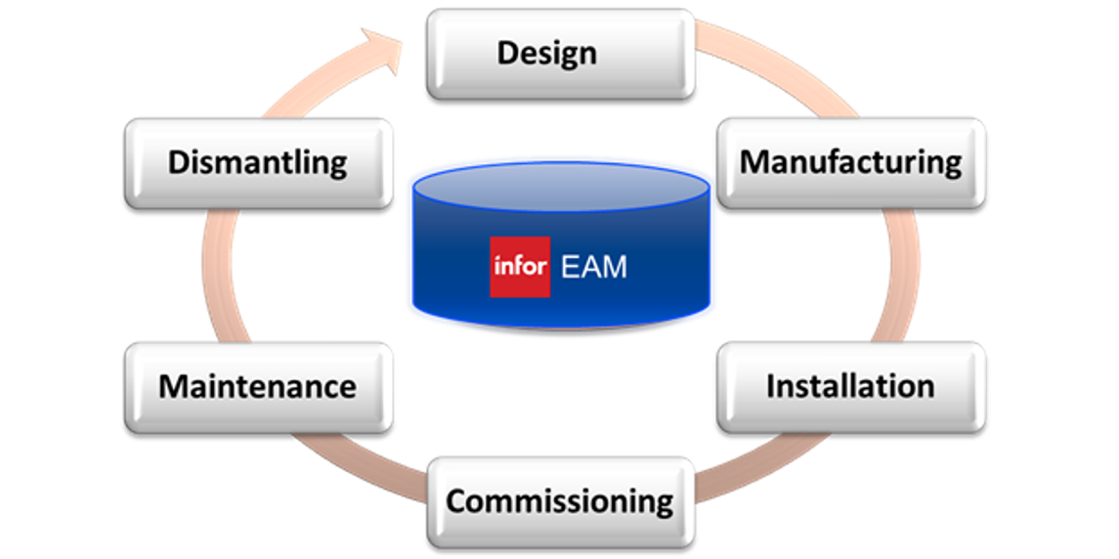
Asset Lifecycle

Slide 9
IN process
Focus on the business domain, not the AM in itself
Integrated into everyday work processes
1. WT Installation
1
RQF
InforEAM / Kiosq
2
2’
2’’
LanDB
CCDB
Layout
2. WT Asset
3
3. WT Finance
4
InforEAM
SNOW
RQF – ReQuest Fulfilment (SNOW ticket)
WT – Work Task
EDH

Slide 10
Controls Hardware Data Management approach
Diagnostics Tools, Auto-Generated Schematics
Reporting, Visualisations, Synoptics, Views
Layout DB
CCDB
InforEAM
Identification
What is my HW component?
Positioning
Where is my HW component?
Relationships
What is my component physically connected to?
Configuration
How is my component configured? What is it logically connected to?
Asset Management
When was my component installed, tested and maintained?
Quality Assurance (Naming conventions, data management processes)
Naming DB
Notes:
The main objective of doing all of this work is to exploit the resulting information, such as diagnostics, reports and statistics
However, in order to extract useful information, the hardware data has to be well structured in a coherent way.
The basis of this is first and foremost Quality Assurance, using naming conventions and applying good data management processes
Then for each piece of equipment we need information about :
Identification: What is my component?
Positioning: Where is my component?
Relationships: What is my component physically connected to?
Configuration How is my component configured and what is it logically linked to?
Asset Management: When was my component installed, tested or maintained. Has it had any failures or problems?
Once you have all of this data in place it is possible to collate it and produce reports, visualisations, and views
Which can then be used to feed diagnostic tools and auto-generated schematics, for example
As described before, according to our model, Identification, positioning and physical relationships should be defined in Layout, Configuration in CCDB and Asset management in InforEAM.
There is one more database, Naming, which although not strictly integrated linked to the other three, plays an important role.

Slide 11
CHDM advantages
The Hardware Infrastructure Team has a common way of managing its data
Eliminates the need for data distributed in local files. The DBs are the reference and the data is available to everyone
We can easily navigate between our data in Layout, CCDE & InforEAM
Mapping assets to functional positions allows traceability and identification of failures associated with given positions
InforEAM allows us to track maintenance activities and version upgrades
We can easily check how many spares we have, raise an alarm if the stock falls below a certain level and plan future purchases
Documenting the physical routing of signals helps us to diagnose problems and carry out interventions
Documenting spare cables arriving at a rack allows us to identify cables that can be reused or dismantled
We can analyse transition data to determine reliability metrics for our equipment (Rate of failure, MTBF etc)

Slide 12
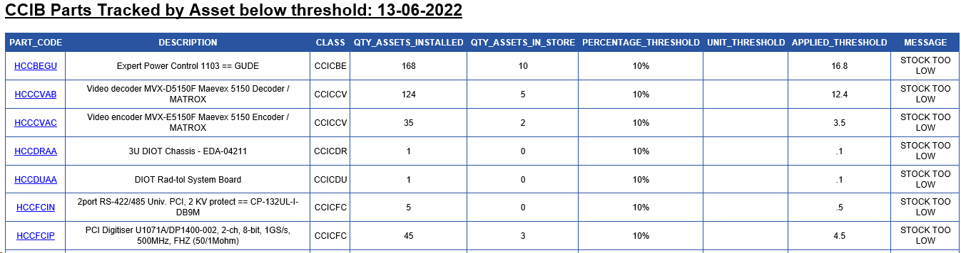
IN Outcomes – Procurement
Automatic orders (?)

Slide 13
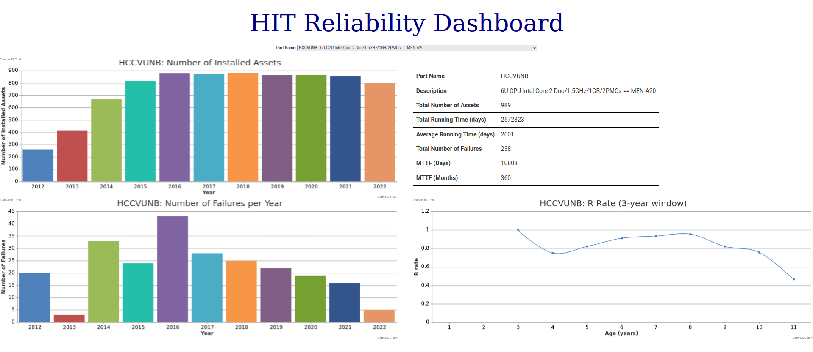
IN Outcomes – Reliability – non-repairable
HIT-Reliability: https://hit-reliability.web.cern.ch/

Slide 14
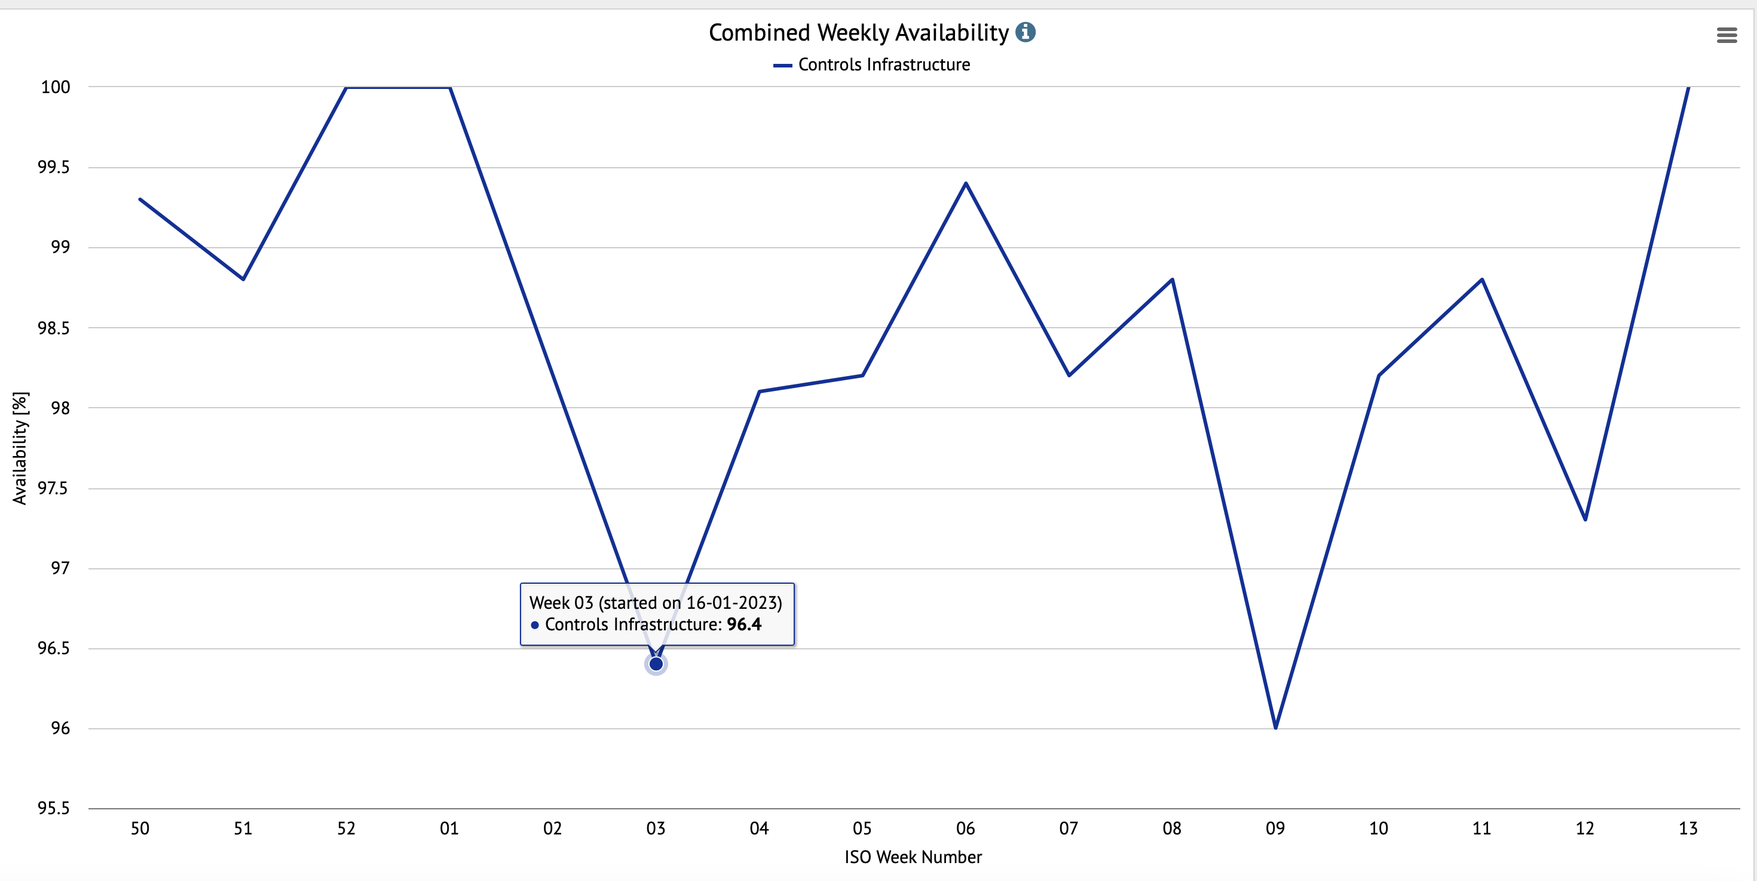
IN Outcomes – Reliability – 2nd repairable

Slide 15
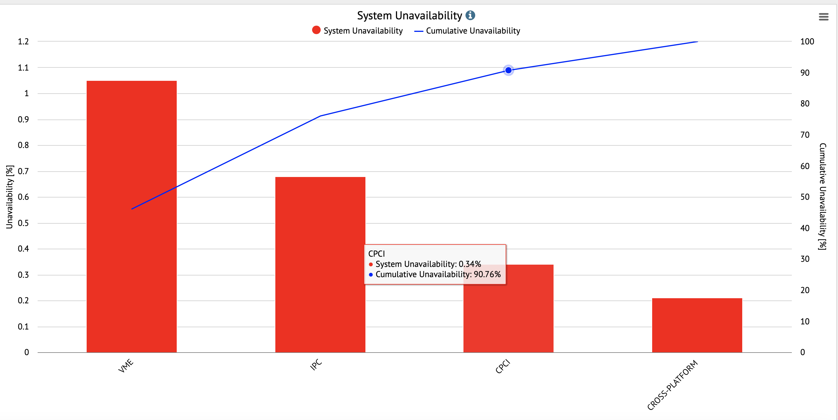
IN Outcomes – Reliability – 2nd repairable

Slide 16
Reliability Feedback on Workflow
OBJ Workflow applies to assets and functional positions
Admin only (for positions)
If barcode error
In Manufacturing
(IMFT)
If ok
In store
(C)
issue
Installed & Maintained
(I)
If obsolete
If exchanged
If testing required
If dismantled
& reusable
Acceptance Testing
(IAT)
Returned from Installation (IRI)
Exchanged
(EX)
If ok
If requires
maintenance
If not ok
Admin only
If ok
Testing & Maintenance (ITM)
If obsolete
Out of service, rejected (DX)
Admin only (for assets)
System code
User defined code
New code
Workflow start point
If defective
If repaired
In Repair
(IRP)
If unrepairable
Out of Service
(D)
If obsolete

Slide 17
Conclusions
Procurement
Consolidation
Informed judgement
  Impact on operations, maintenance, investment
Preventive maintenance
Integrated into everyday work processes

Slide 19
Parts Inventory and Control
Maintenance Productivity
Equipment Reliability

Slide 20
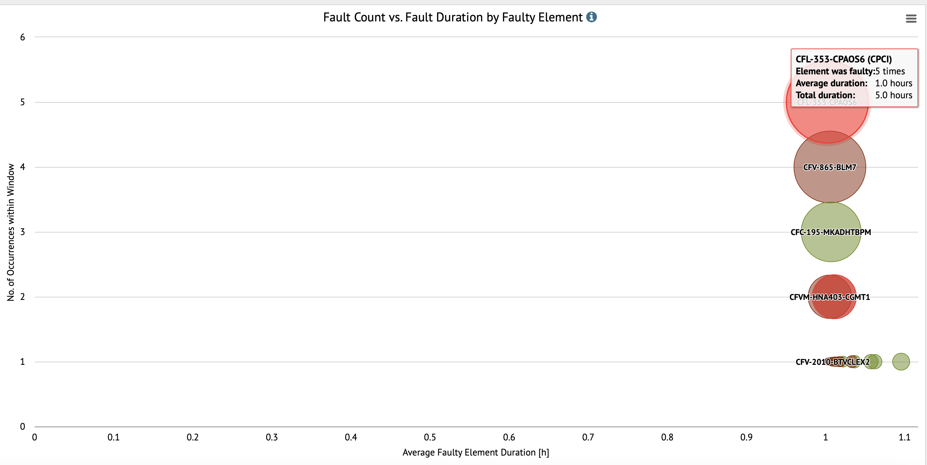

Slide 21
