Slide 1

Research on innovative materials for neutron and gamma radiation shielding

Slide 2
This project is addressing a real necessity in our domain and its outcome will have direct use as Radiation Shielding for High Energy Particle Physics Detectors & Accelerators and other fields (Medical Physics, AeroSpace, etc)

Slide 3
Summary
Introduction to CMS & its radiation field
Neutron flux simulations
Radiation shielding:
  Operational purpose
  Material protection
  Personnel protection
Perspectives
Extra slides
  Materials and attenuation factors
  MCDN Projects Highlights

Slide 4
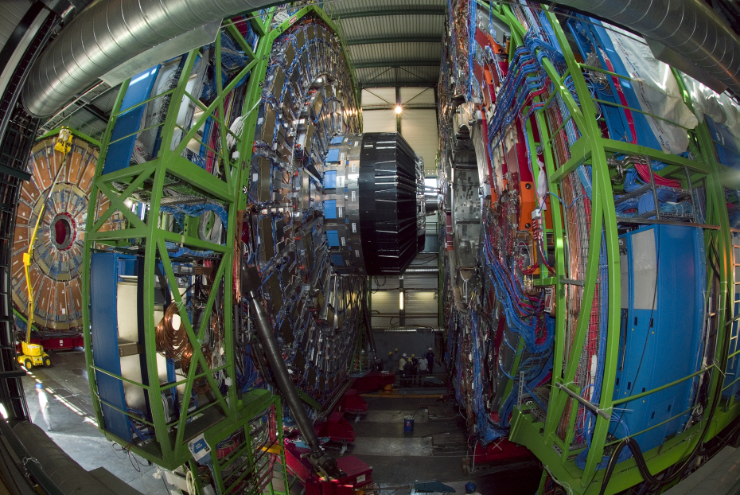
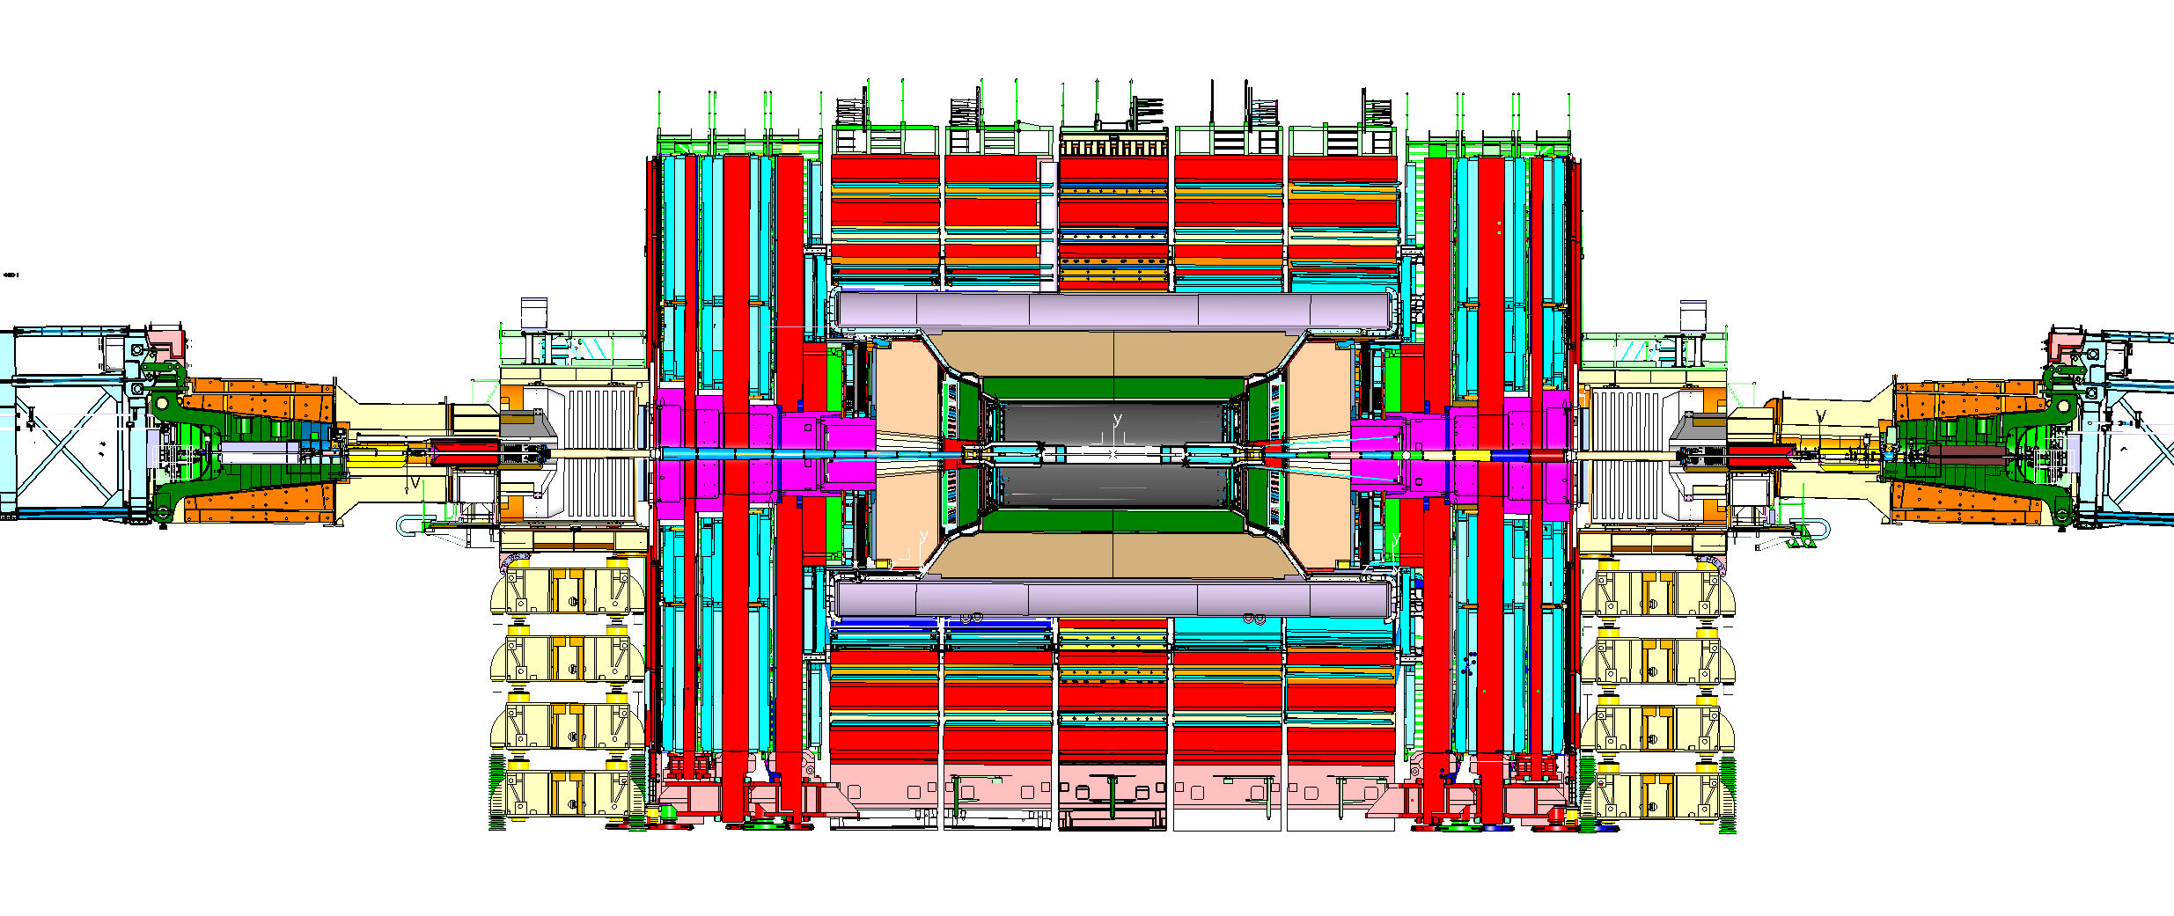

THE CMS HIGH ENERGY PHYSICS DETECTOR
AN UNIQUE DEMONSTRATOR FOR INNOVATION
CMS is one of the main experiments at the Large Hadron Collider at CERN. It has been built between years 2000 and 2008 and it has contributed to the discovery of the Higgs Boson in year 2013.
The experiment spans over 15m in diameter and 28m in length, inside a cavern 100m underground.
Its weight is about 12,500 tons.
Picture taken during construction on the surface assembly hall

Slide 5
CMS radiation field
The environment of a High Energy Particle Physics Detector is characterized by the combination of high intensity and high energy radiation fields, typically in the rage of 10 MeV for gammas (γ) and up to 100 MeV for neutrons. This high intensity mixed radiation field is present only during collisions (i.e. data-taking).
When the accelerator is off, a remanent γ radiation field is present, due to the activation of structural elements of the accelerator, the detector and the surrounding structures.

Slide 6
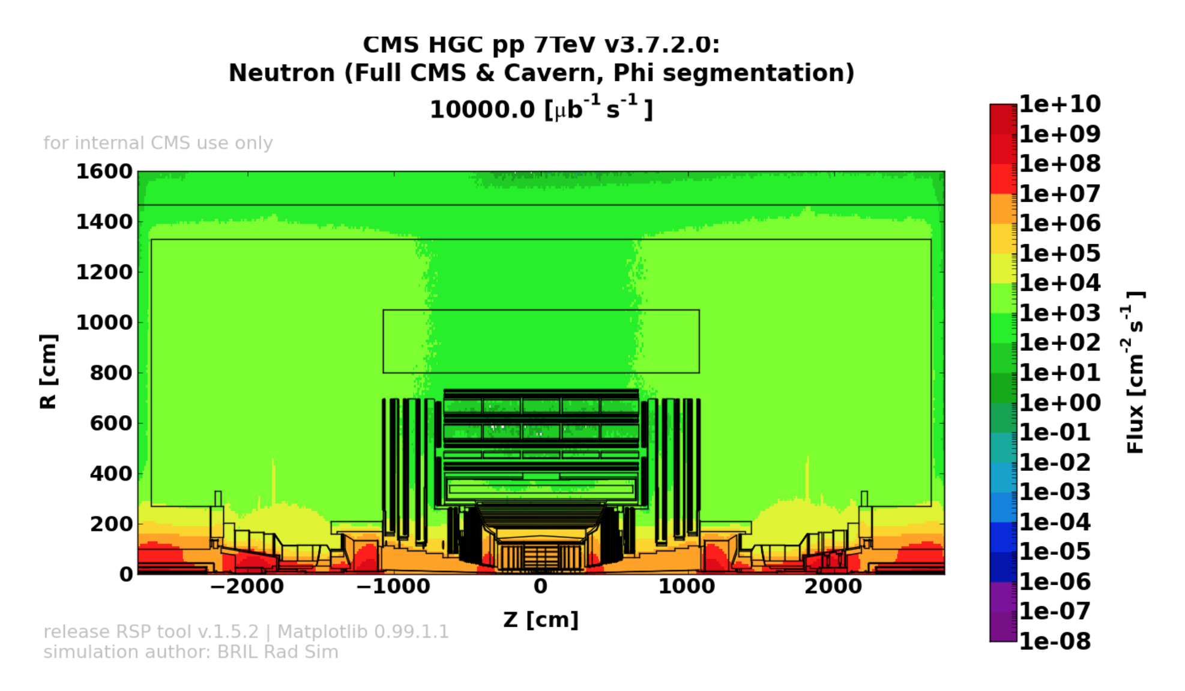
Neutron flux simulations

Slide 7
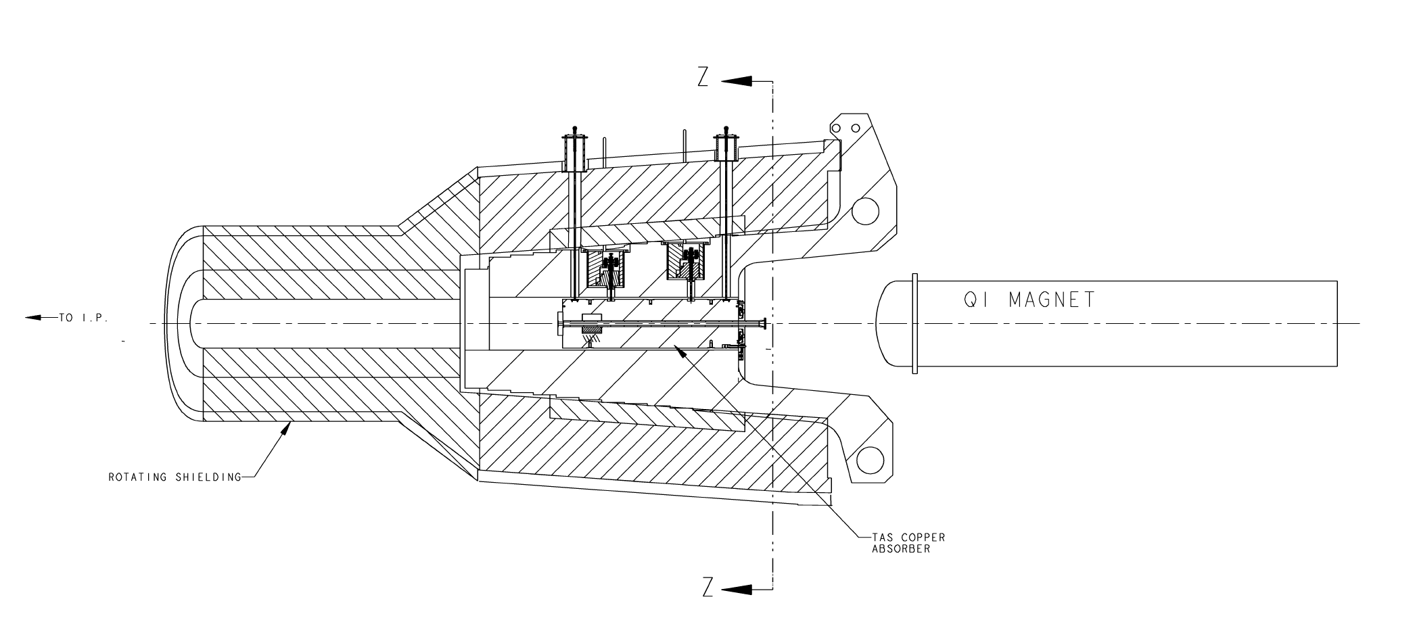
Radiation shielding for operational purpose
Quench protection (superconducting cables) for magnets.
  The (tiny) energy deposited by high energy bunches of ionizing particles traversing a superconducting cable may cause a transition to the resistive state of the conductor (quench). Thus, magnets exposed to high intensity energetic ionizing particles need to be shielded with massive screens.
Beam axis
TAS / High Purity Copper / D500 mmm – L 1,800 mm – Weight 3,200 kg

Slide 8
Radiation shielding for operational purpose
Background suppression for detectors.
  High energy ionizing particles interacting with massive materials (magnets screens, beam-pipe components, etc...) generate showers of secondary particles (mainly energetic neutrons) that induce background noise around the detector and could provoke single-event-upset to electronics.

Slide 9
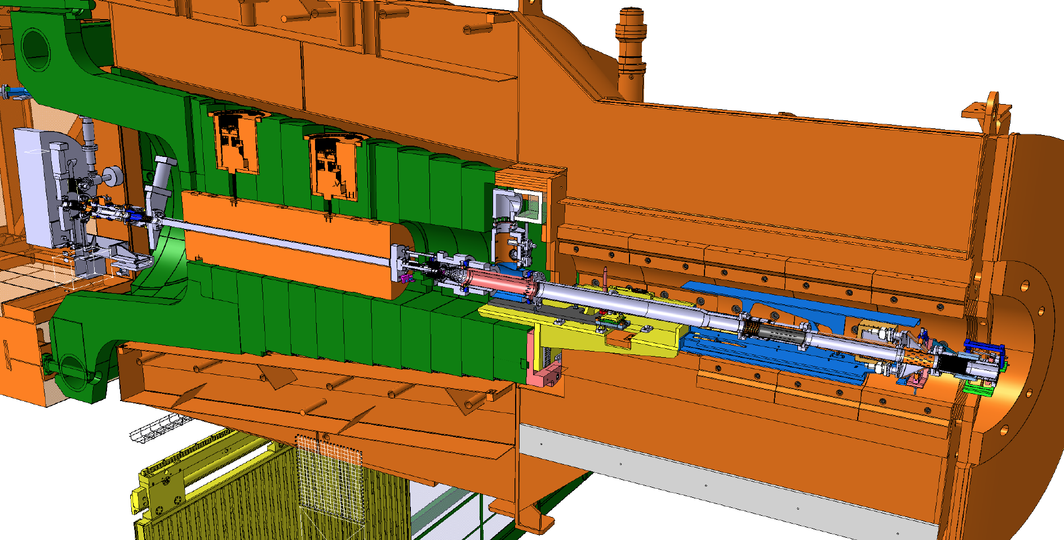
Radiation shielding for operational purpose
ROTATING SHIELDING
TAS
FIN
ROTATING SHIELDING / FIXED PART – Steel – Weight about 50 tons
/ MOVABLE PART – Steel + Heavy Concrete - Weight about 185 tons

Slide 10
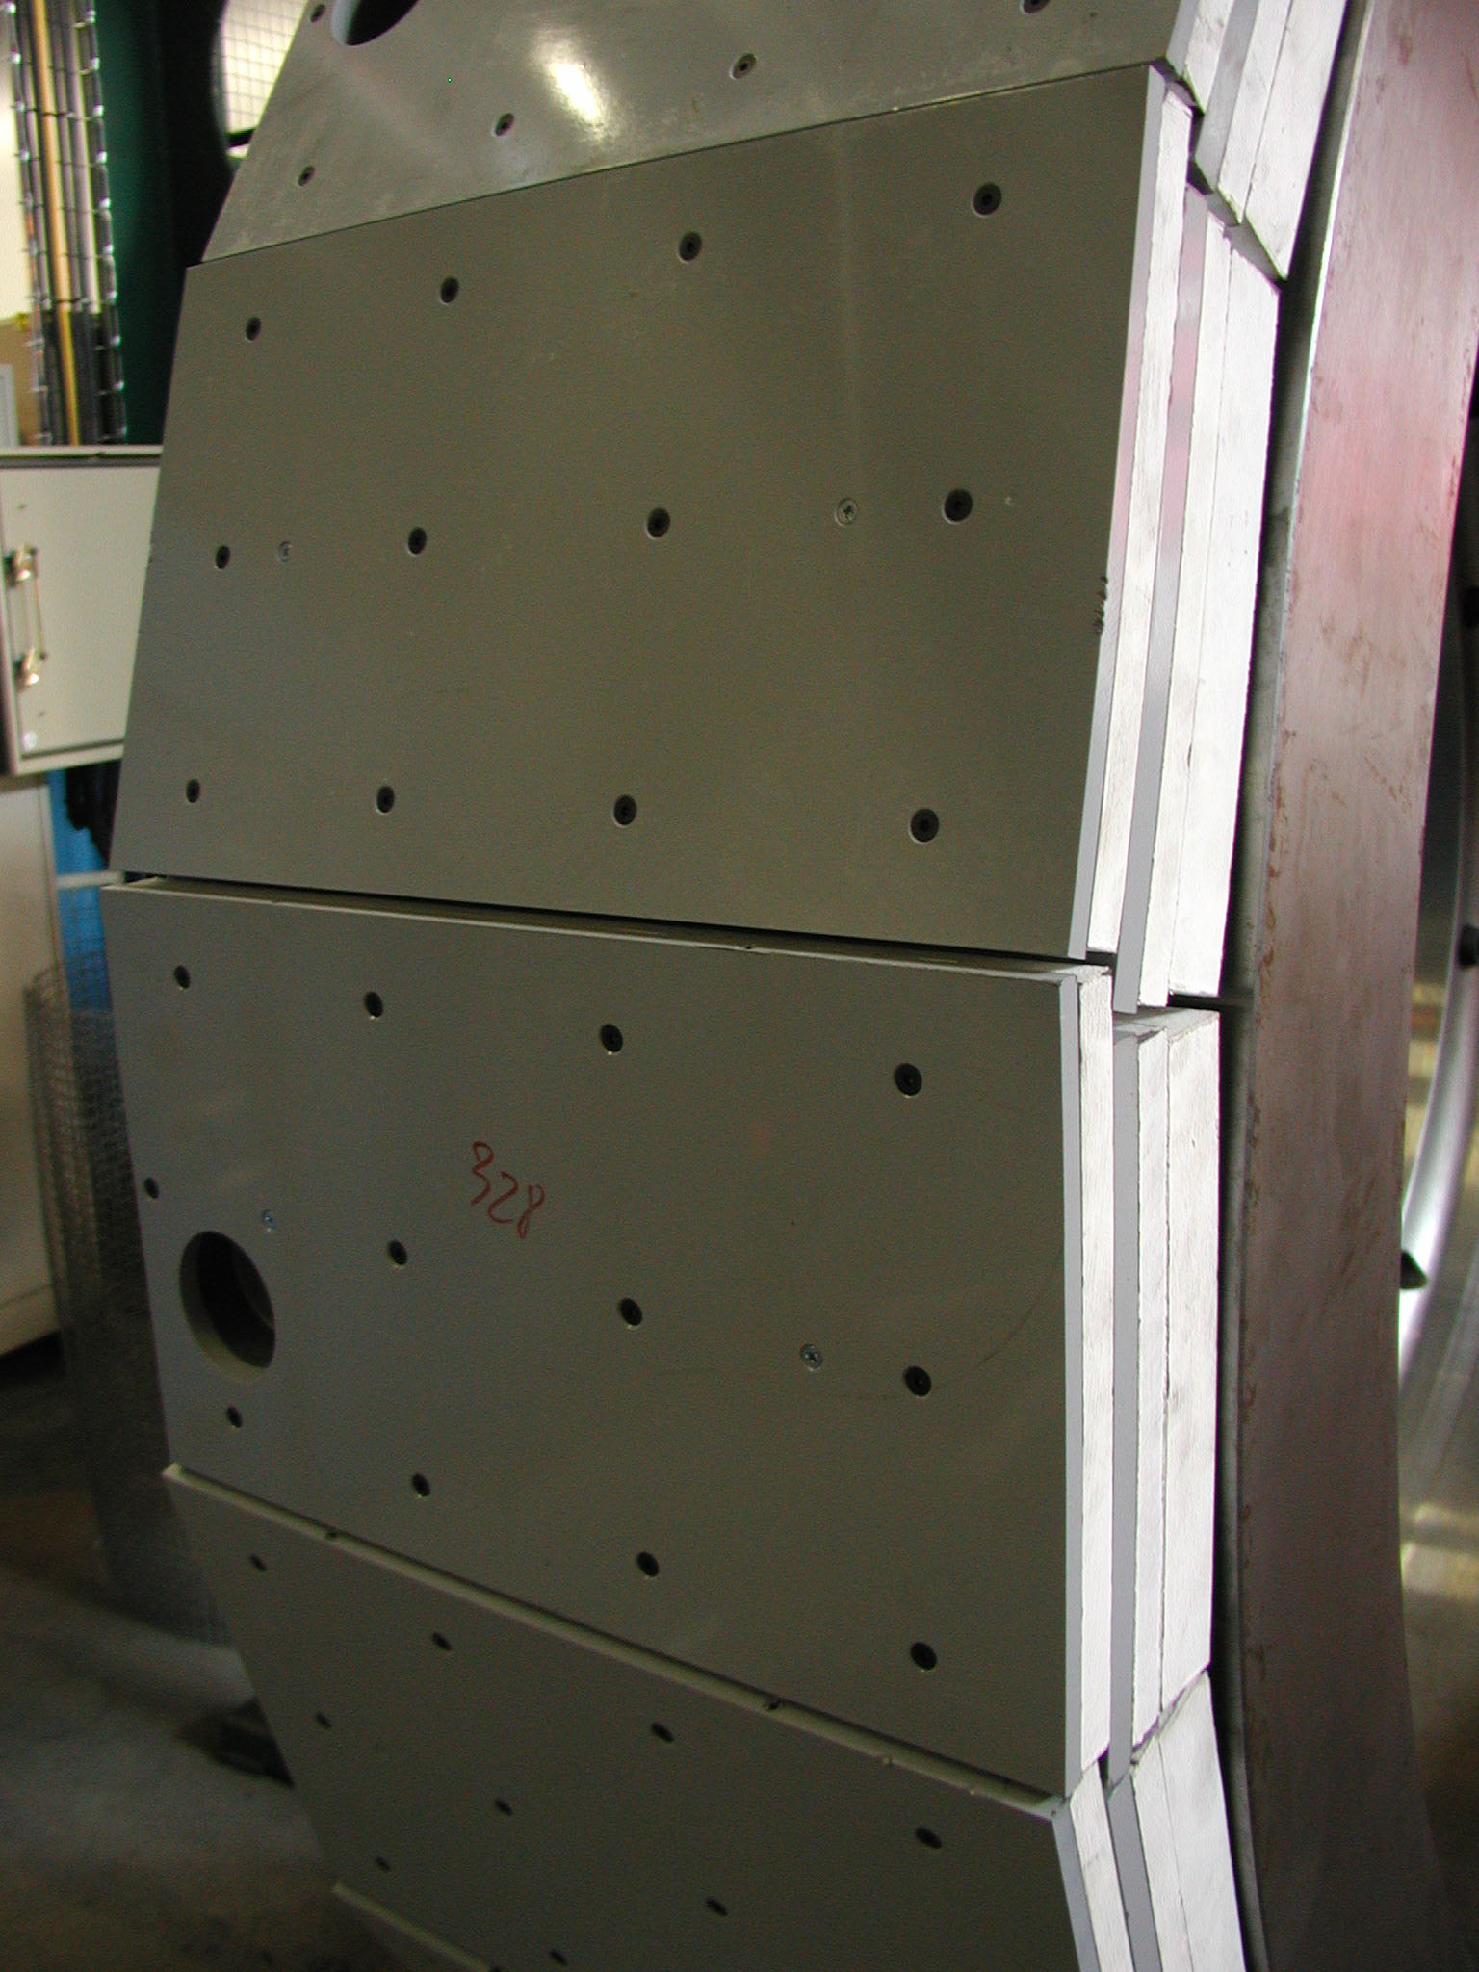
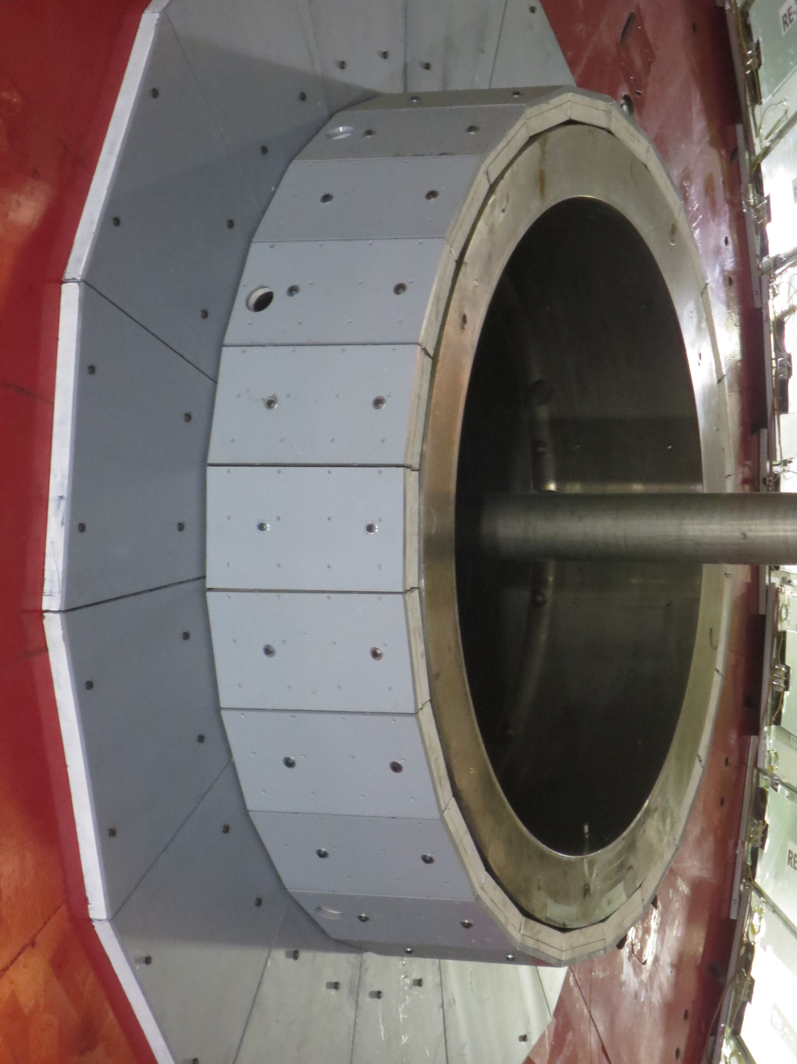
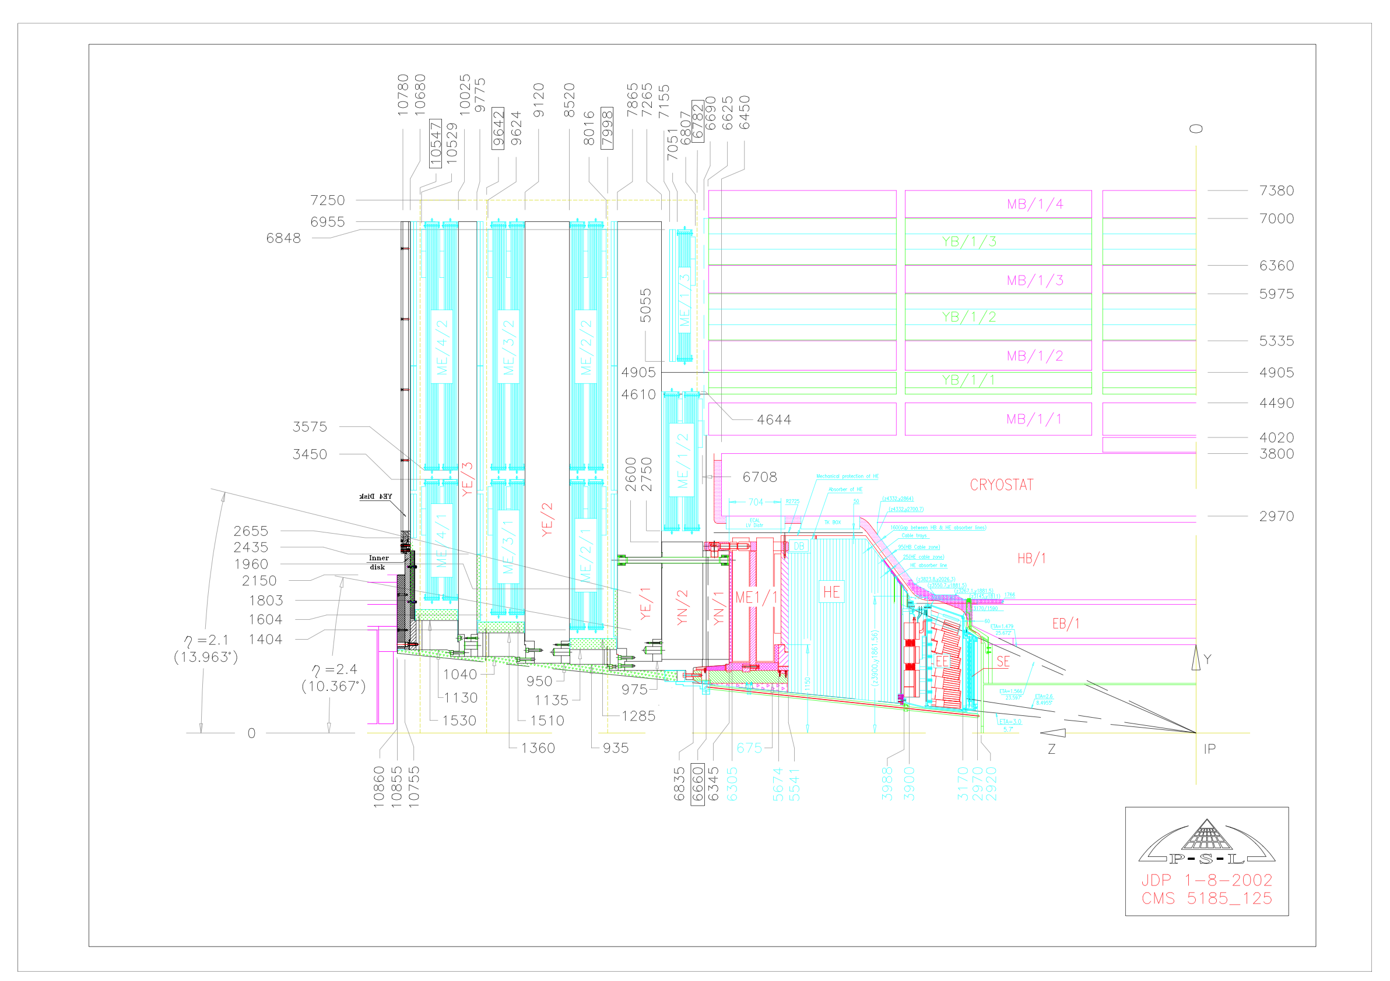
Radiation shielding for operational purpose
Endcap Muon Shielding:
  B-Polyethylene + Pb(Sb)
9
7
10
4
3
8
6
1
5
2

Slide 11
Radiation shielding for material protection
Radiation damage on cables insulation, composite structures and electronics (polymers & plastics - insulating materials, semi-conductors)
Neutron activation of surrounding materials:
Activation of cavern steel structures: Fe⁵⁴ + n → Mn⁵⁴ + p
Mn⁵⁴ is a γ emitter with half-life of 312 days.
Mn⁵⁴ presence in the cavern steel structures makes any destructive intervention very complicated from a procedural point of view.

Slide 12
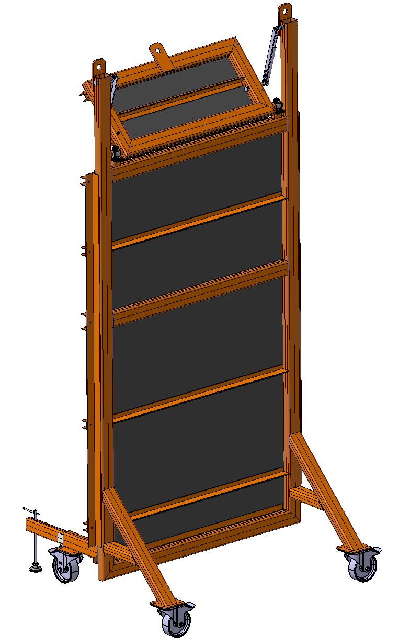
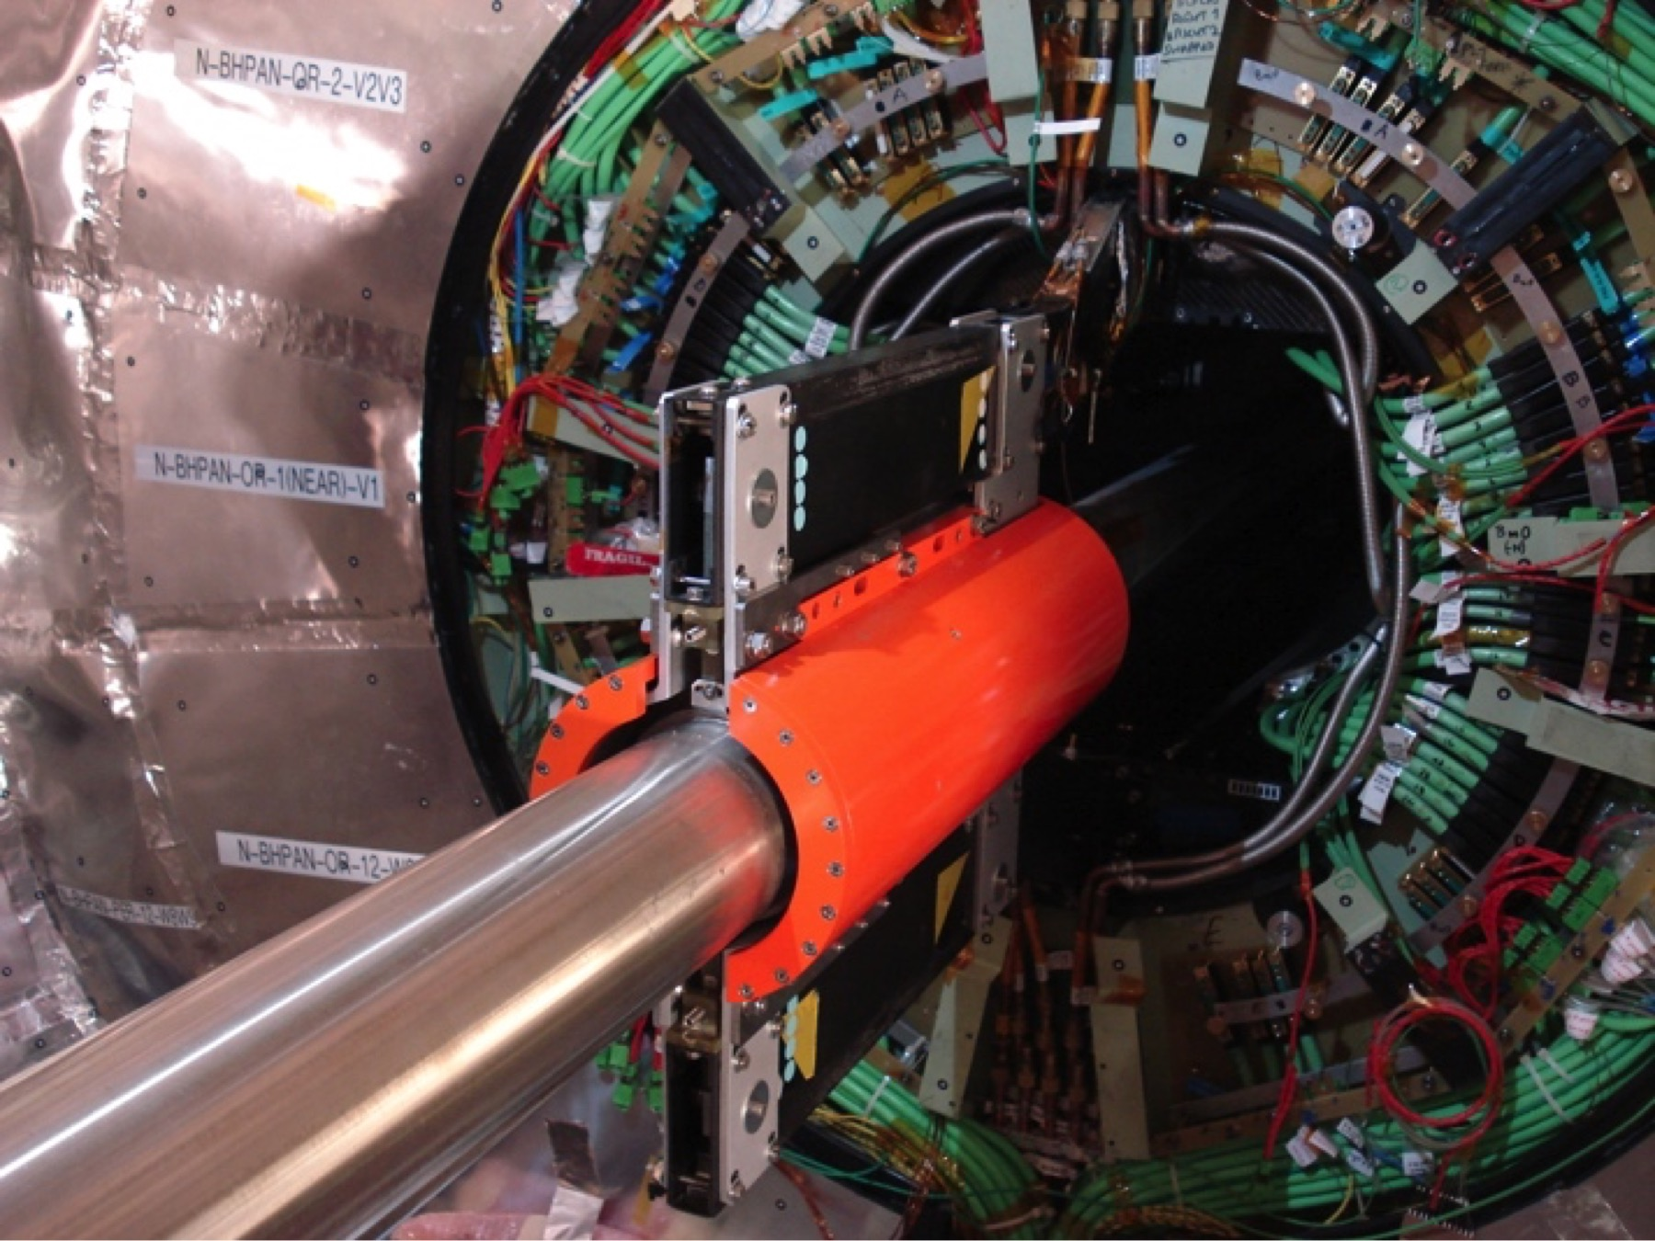
Radiation shielding for personnel protection
Source – Distance – Time
γ-screens (BP-bellow, collective personnel screens)
Beam-pipe shielding / Steel
Movable screen / Pb(Sb)

Slide 13

Fire-smoke-toxicity
resistance
Enhanced radiation shielding properties
Optimised
Lightweight
Compact
ALL CHARACTERISTICS IN ONE MATERIAL !
Able to sustain high temperatures
Mechanical & chemical stability vs radiation

Slide 14
EXTRA SLIDES

Slide 15
Innovative materials for Radiation Shielding.
In Europe, although the existing research and knowledge is of excellent quality, there is a lack of a standardised training programme for young researchers aiming to become the future professionals in a field of increasing demand. Moreover, there is a need to establish an enduring network of scientific, academic and industrial organizations where such training programme can take place hands-on, designed and assessed by top professional in the field.
This MCDN project aims to address this gap.

Slide 16
Lightweight materials have largely been developed for and further deployed in aerospace and automotive sectors.
Composite light-weight material is a very well-developed field and a promising starting point
to develop radiation shielding properties that may be beneficial to HEP, aerospace, nuclear, food-processing and medical applications.
Engineers have noticed a gap in the methodology that is applied for the selection of specific materials
this needs an efficient and rapid method for the assessment and selection of novel lightweight materials with radiation enhanced radiation shielding performances.
Our MCDN will address the various level criteria to be used for this assessment

Slide 17
Perspective (the Product)
Development of composite materials to combine the γ stopping power characteristic of high Z materials (e.g. Lead) with the good attenuation length for neutrons of high hydrogen content material (e.g. Polyethylene).
Stability of polymeric material under high dose radiation is an issue.
Light-weight personnel protection equipment for radiation is also an interesting open field for R & D, not only in High Energy Physics.
Innovative product developments (product ready to be used for various industrial application space & aeronautics, nuclear industry, food-processing, medicine, etc)

Slide 18
Perspective (the Network)
Network-wide Academic training & Practical subject- specific hands-on training to experience at first hand the most recent methods and developments in the field.
Scientific/technological breakthrough, publications, patents, awards and prizes, etc....
Specialist exchange among network teams and visit of Senior Researchers from inside and/or outside the network.
Individual and joint publications, directly related to the work undertaken within the project.
A HUGE IMPACT CAN BE EXPECTED, SPANNING OVER A VAST RANGE OF HUMAN ACTIVITIES:
COMMERCIAL VALUE
INDUSTRIAL USE
SPACE & AERONAUTICS …
TRAINING AND RESEARCH OF FUTURE EXPERTS

Slide 19
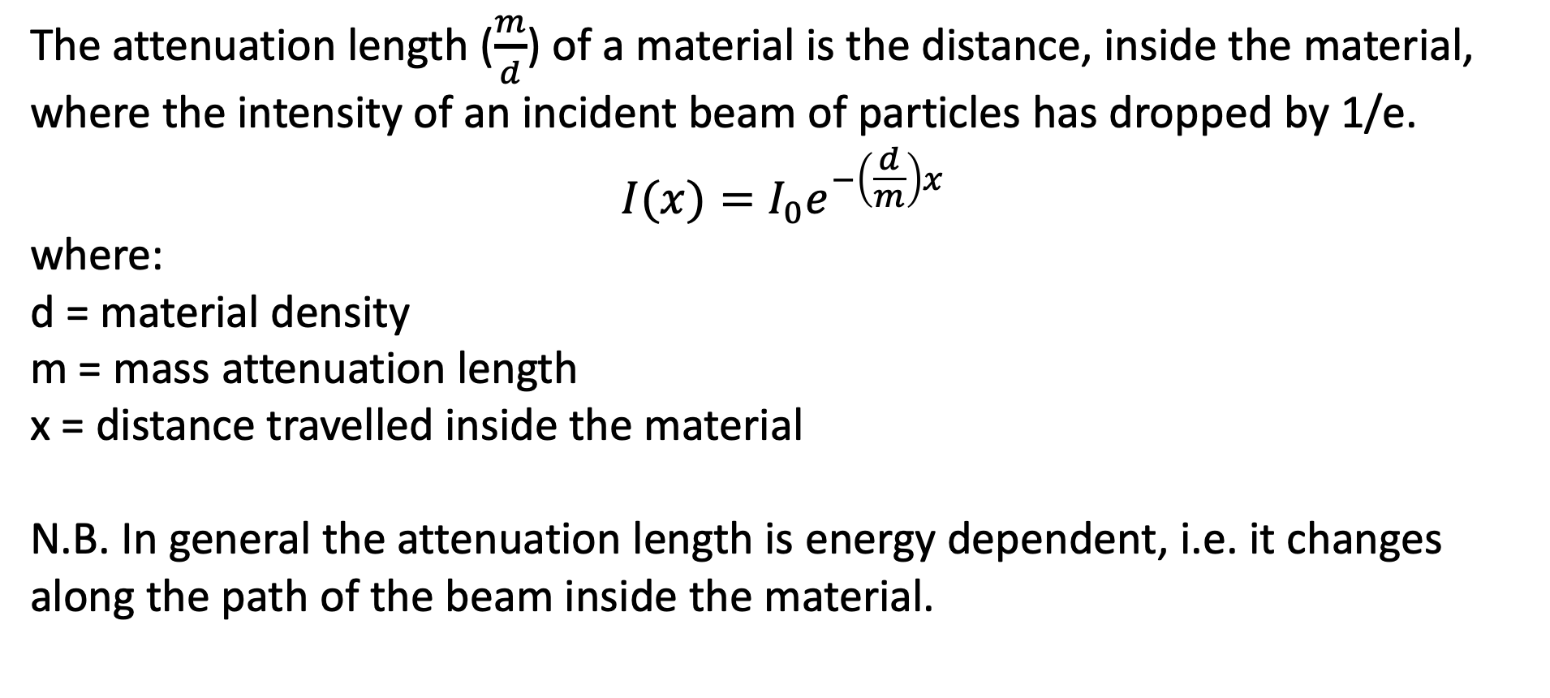
Materials and attenuation factors
The attenuation length ($\frac{m}{d}$) of a material is the distance, inside the material, where the intensity of an incident beam of particles has dropped by 1/e.
$$I(x)=I_{0}e^{−\left(\frac{d}{m}\right)x}$$
where:
d = material density
m = mass attenuation length
x = distance travelled inside the material
N.B. In general the attenuation length is energy dependent, i.e. it changes along the path of the beam inside the material.

Slide 20
Materials and attenuation factors
Radiation Component | Shielding Material | Density (g/cm³) | Mass Attenuation Length (g/cm²) | Attenuation Length (cm)
γ (Bremsstrahlung) | Concrete | 2.35 | 49 | 20.9
 | Heavy Concrete | 3.7 | 50 | 13.5
 | Lead | 11.34 | 25 | 2.2
 | Iron | 7.8 | 37 | 4.7
 | Polyethylene | 1 | 70 | 70
High Energy Neutrons | Concrete | 2.35 | 115 | 48.9
 | Heavy Concrete | 3.7 | 125 | 33.8
 | Lead | 11.34 | 191 | 16.8
 | Iron | 7.8 | 138 | 17.7
 | Polyethylene | 1 | 62 | 62
Table from – Brookhaven National Laboratory – ESH&Q

