Slide 1
Research on composites for use in superconducting accelerator magnets
C. Scheuerlein, TE-MSC-SMT, on behalf of CERN polymer lab team
30 March 2023
https://indico.cern.ch/event/1262370/

Slide 2
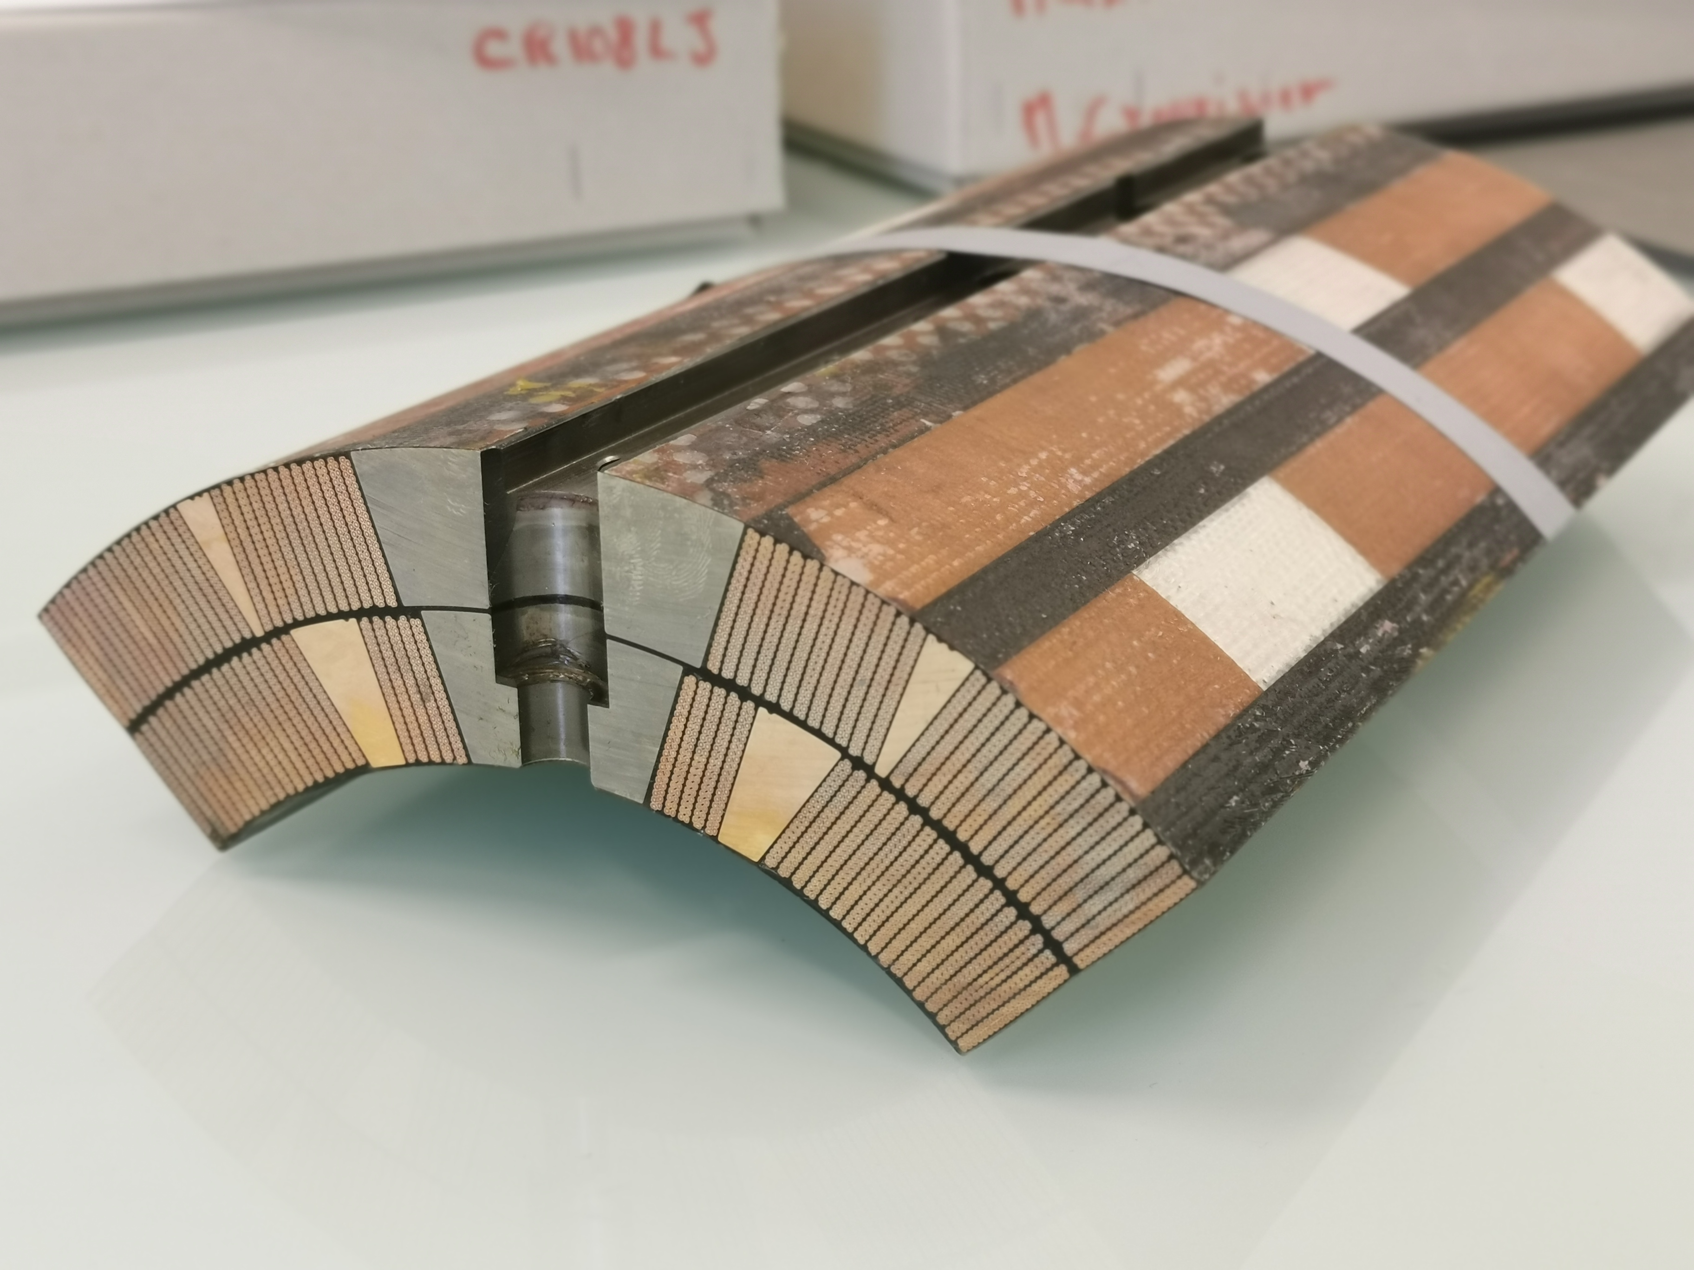
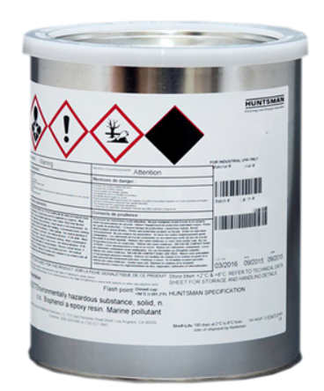
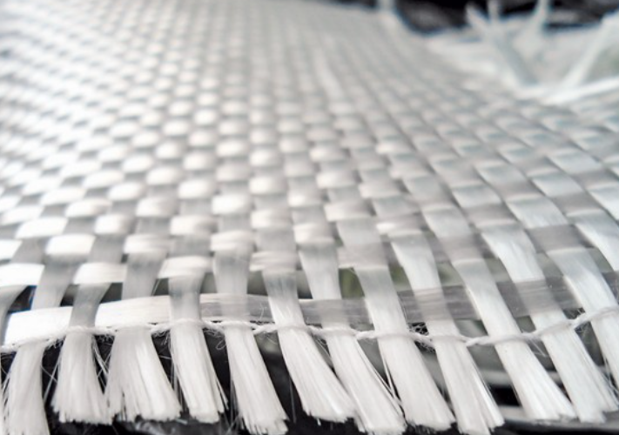
Driving questions
The technical questions driving the R&D on new insulation systems for accelerator magnets and the global scenario
The physical properties of the impregnation system that may impact the magnet performance
Methods to modify the epoxy properties to our needs
Alternative fibers and binders for the coil interlayer and conductor insulation
Ageing mechanisms

Slide 3
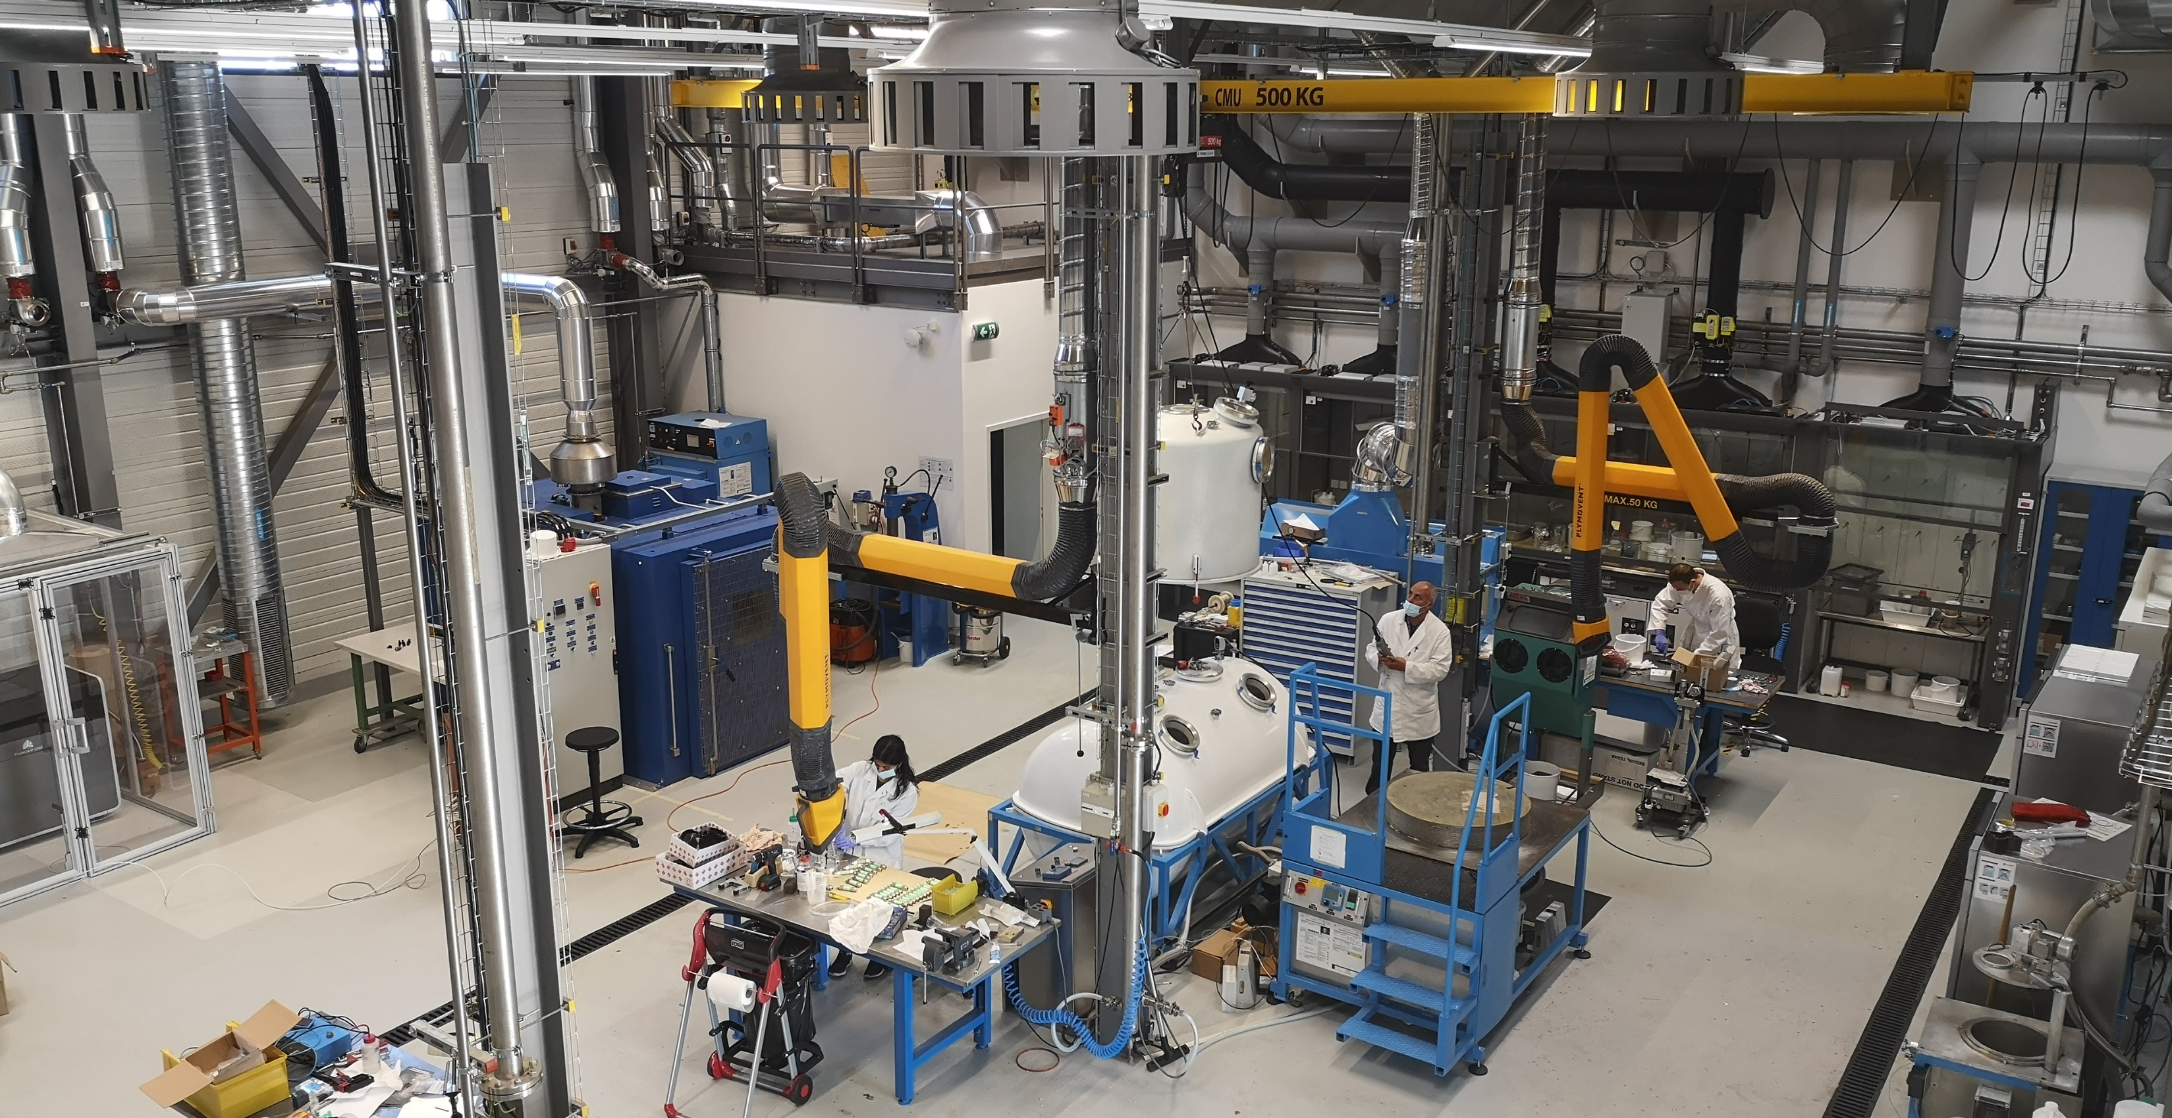
Polymer Laboratory

Slide 4
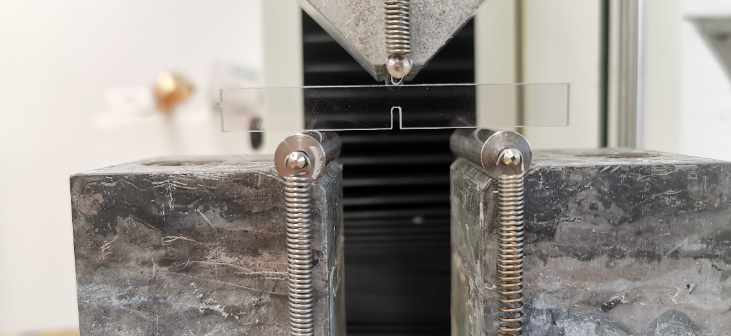
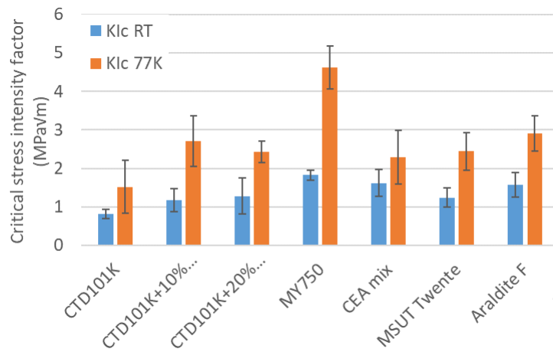
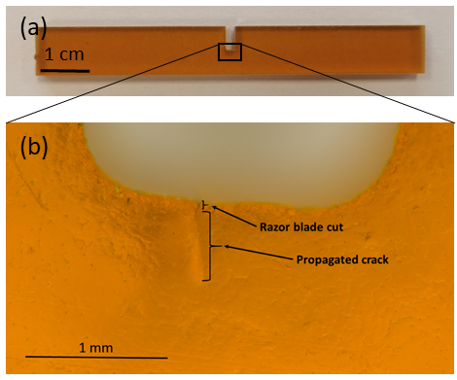
Fracture toughness
Courtesy A. Gaarud, former NTNU technical student at CERN, “CERN, EDMS 2728875

Slide 5
Effect of the S2-glass fibre orientation in CTD101K epoxy matrix composite
Comparison of 77 K flexural stress-strain curves for S2-glass reinforced CTD101Kepoxy resin composites of different fibre orientations.
From: Petter Wiker, ”Thermomechanical Characterization of Epoxy Composites Used in High Field Magnet Coils ”, Specialisation project at NTNU Department of Mechanical and Industrial Engineering
https://cds.cern.ch/record/2804561/files/CERN-OPEN-2022-003.pdf

Slide 6
Effect of epoxy matrix material on [0°/90°] S2-glass fibre-reinforced composites at RT and 77K
Flexural stress-strain curves of [0°/90°] S2-glass reinforced epoxies CTD101K, MY750 and Mix61 at RT.
Flexural stress-strain curves of [0°/90°] S2-glass reinforced epoxies CTD101K, MY750 and Mix61 at 77K.

Slide 7
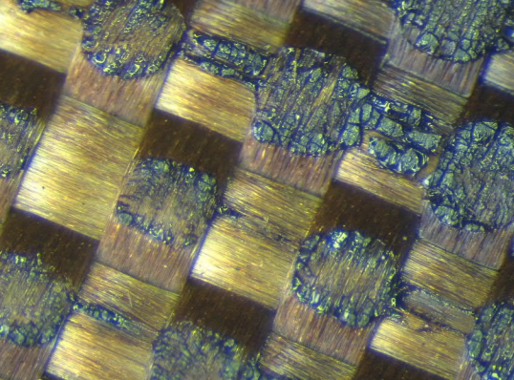
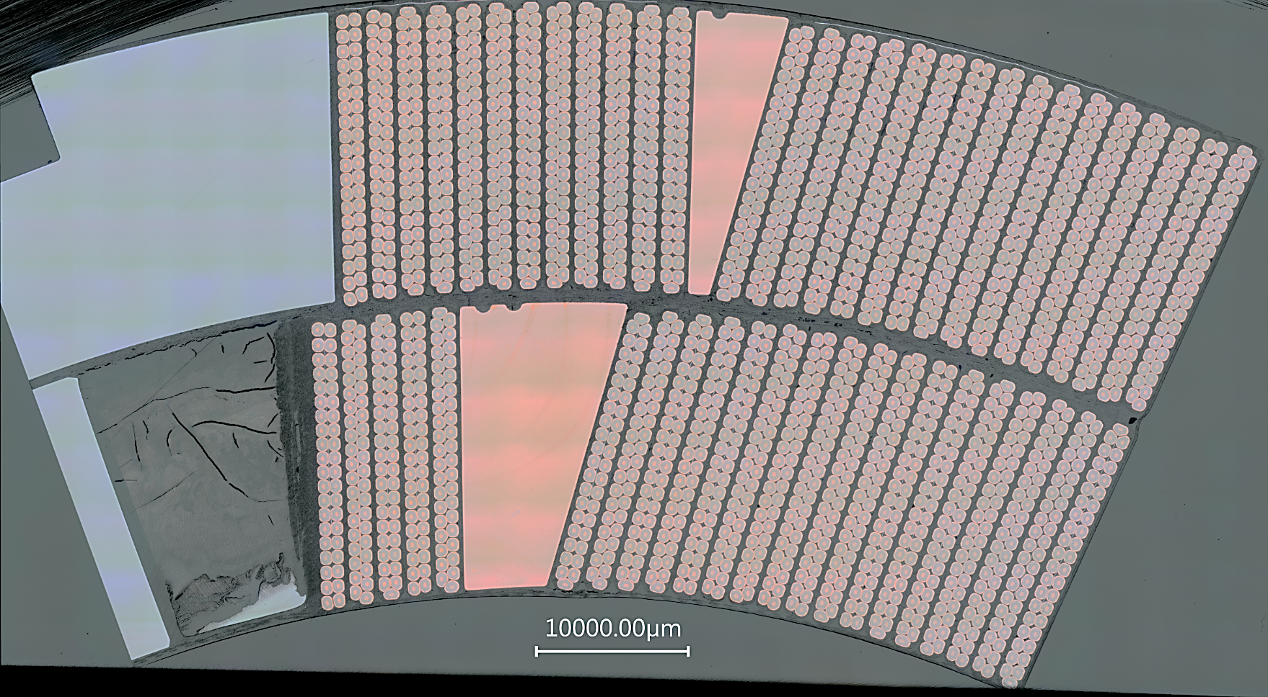
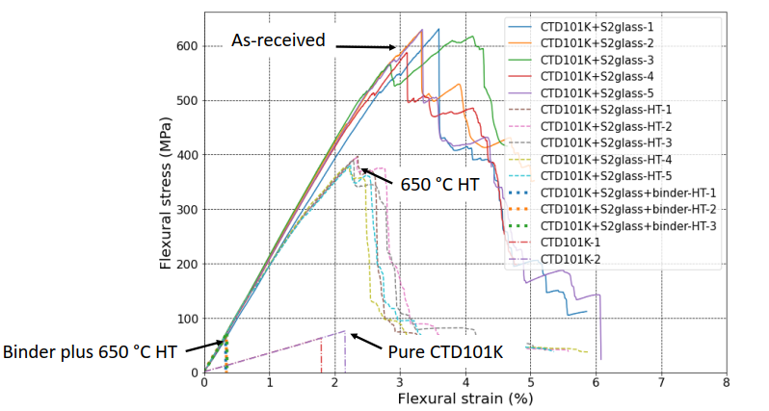
Fibers and binders
Cut 3b
Interlayer with binder CTD 1202
The ceramic binder CTD1202 in combination with the 650 °C coil reaction heat treatment leads to dramatic loss of the S2 glass fibre mechanical strength.
The pyrolysis of the binder creates a dark and tough ceramic structure called silicon oxicarbide (SiOC). The loss of fiber strength occurs likely during the process of formation of SiOC.
Under investigation alternative binders (PVA) and fibers (basalt).
[1] C. Scheuerlein, MQXF interlayer mechanical properties, EDMS N 2735359
[2] D. Ternova, FTIR and XRF analysis of the S2 TEX glass-fibre with the CTD-1202 ceramic binder after several treatments

Slide 8
Polymer lab irradiation study
1st phase (ongoing):
  Determine the effect of irradiation on thermomechanical and dielectric properties of polymers for potential use in superconducting accelerator magnets
  Understand the effect of different radiation sources (gamma rays, protons and neutrons)
  Understand the effect of different radiation atmospheres (ambient air, vacuum/inert gas)
  Understand the effect of the irradiation temperature (ambient and cryogenic temperature)
  2nd phase:
  Determine the effect of irradiation on selected composite systems

Slide 9
Irradiation sources and environments
  Proton irradiation at CERN IRRAD
    in ambient air
    at -20 °C
    in liquid helium
  Gamma irradiation in ambient air at Steris Marcoule
  Neutron irradiation at NEAR nTOF
    in ambient air
  Neutron irradiation at Triga Mark II reactor of ATI Vienna
    in ambient air
    in vacuum at ambient temperature

Slide 10
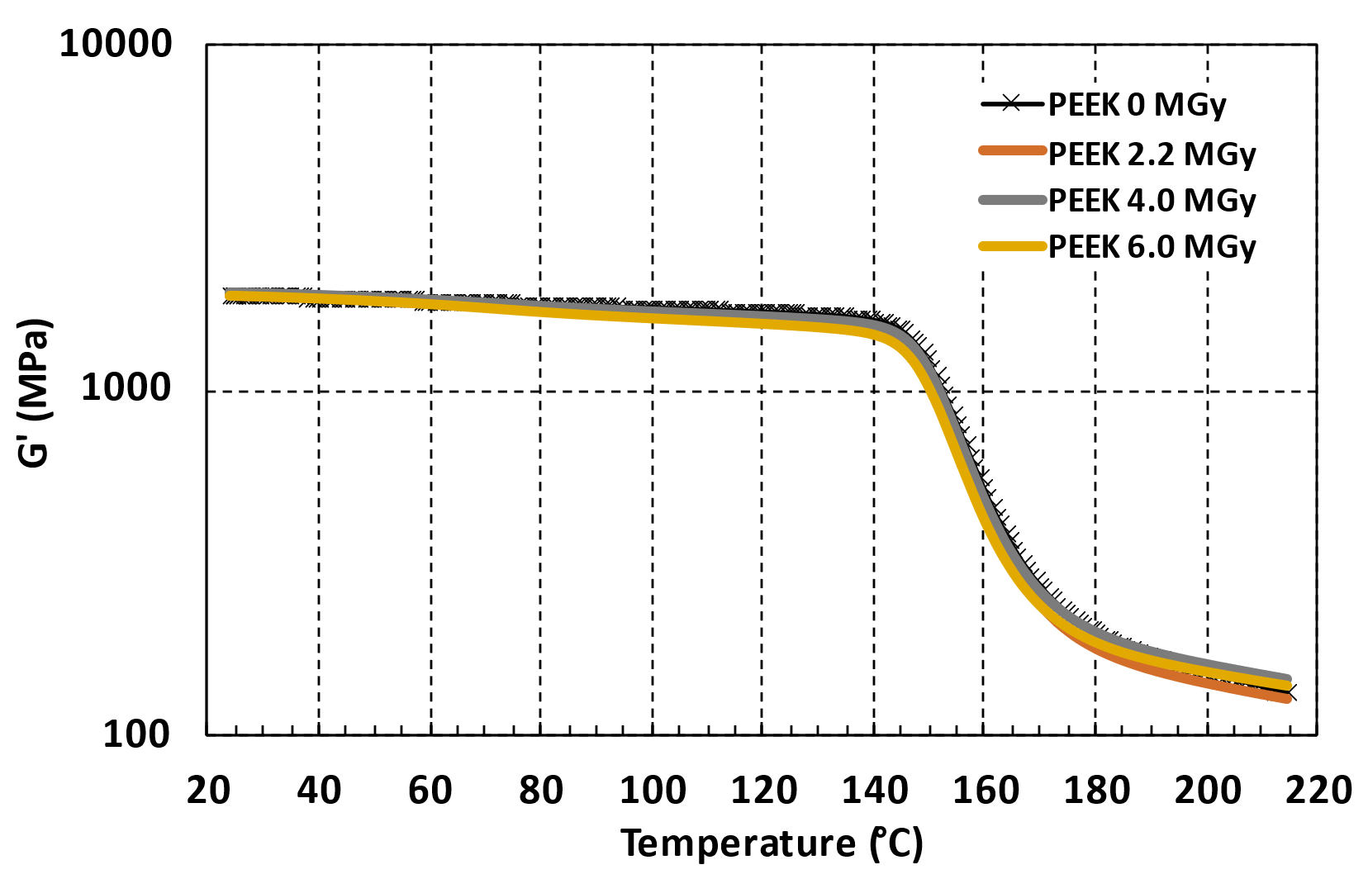
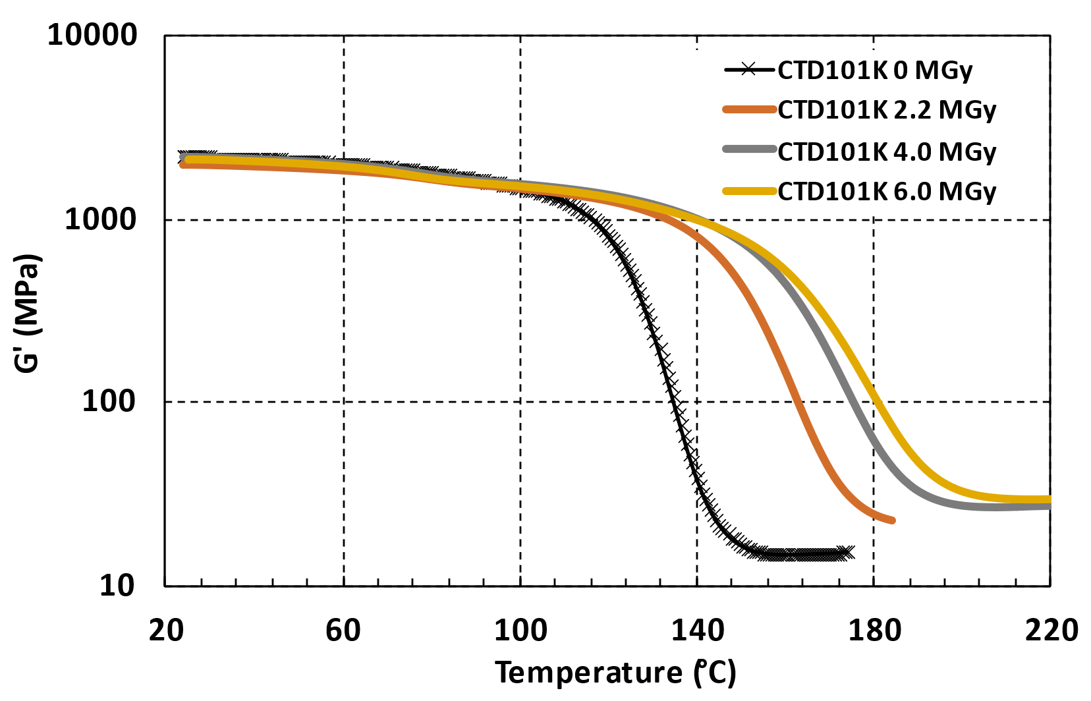
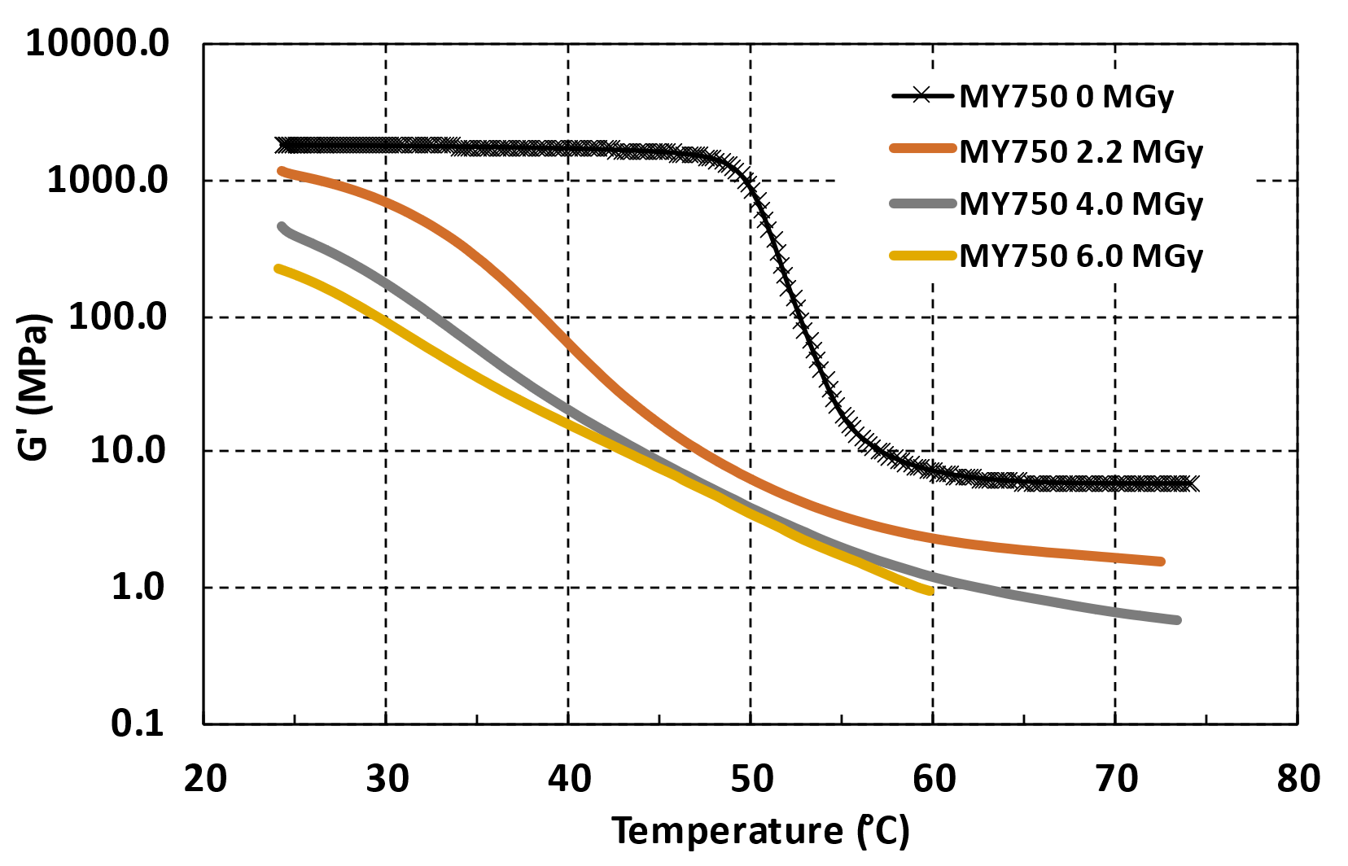
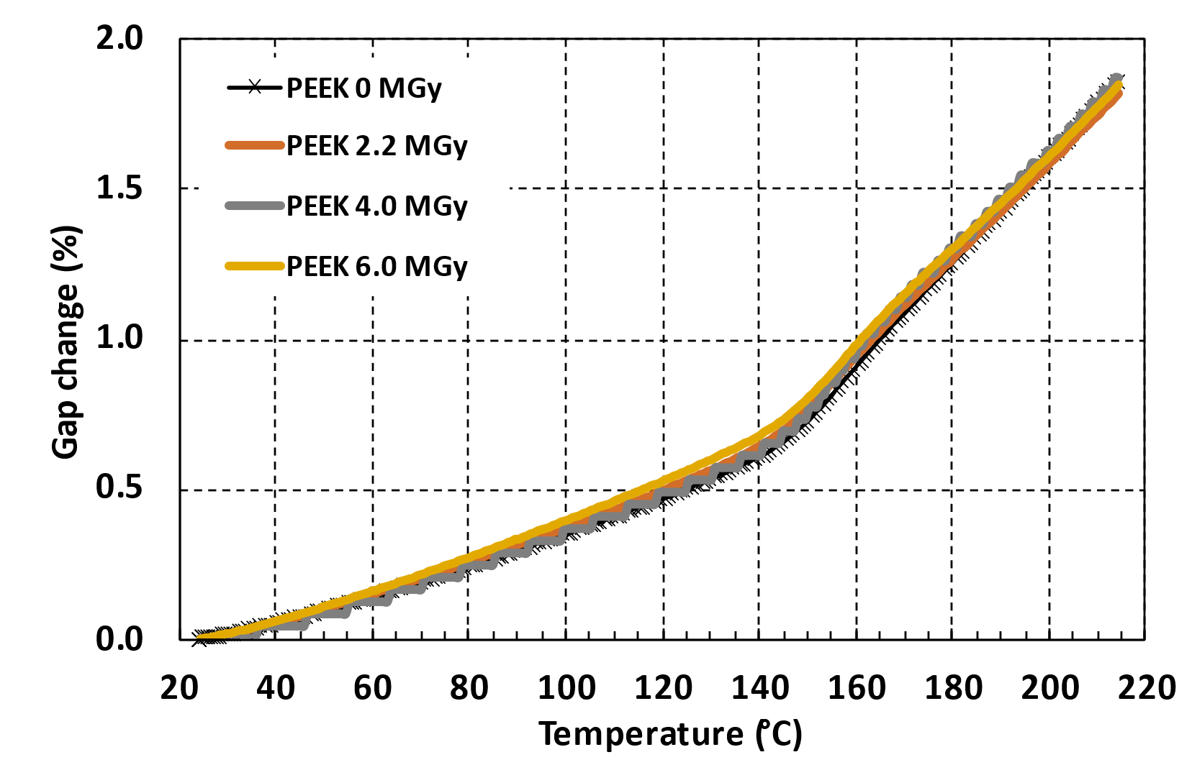
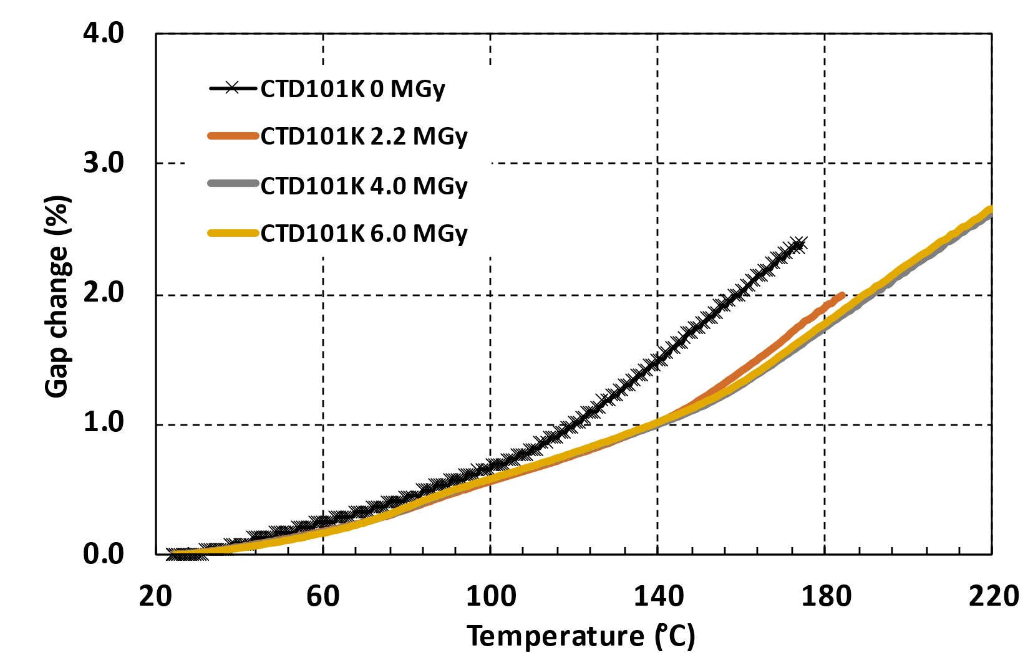
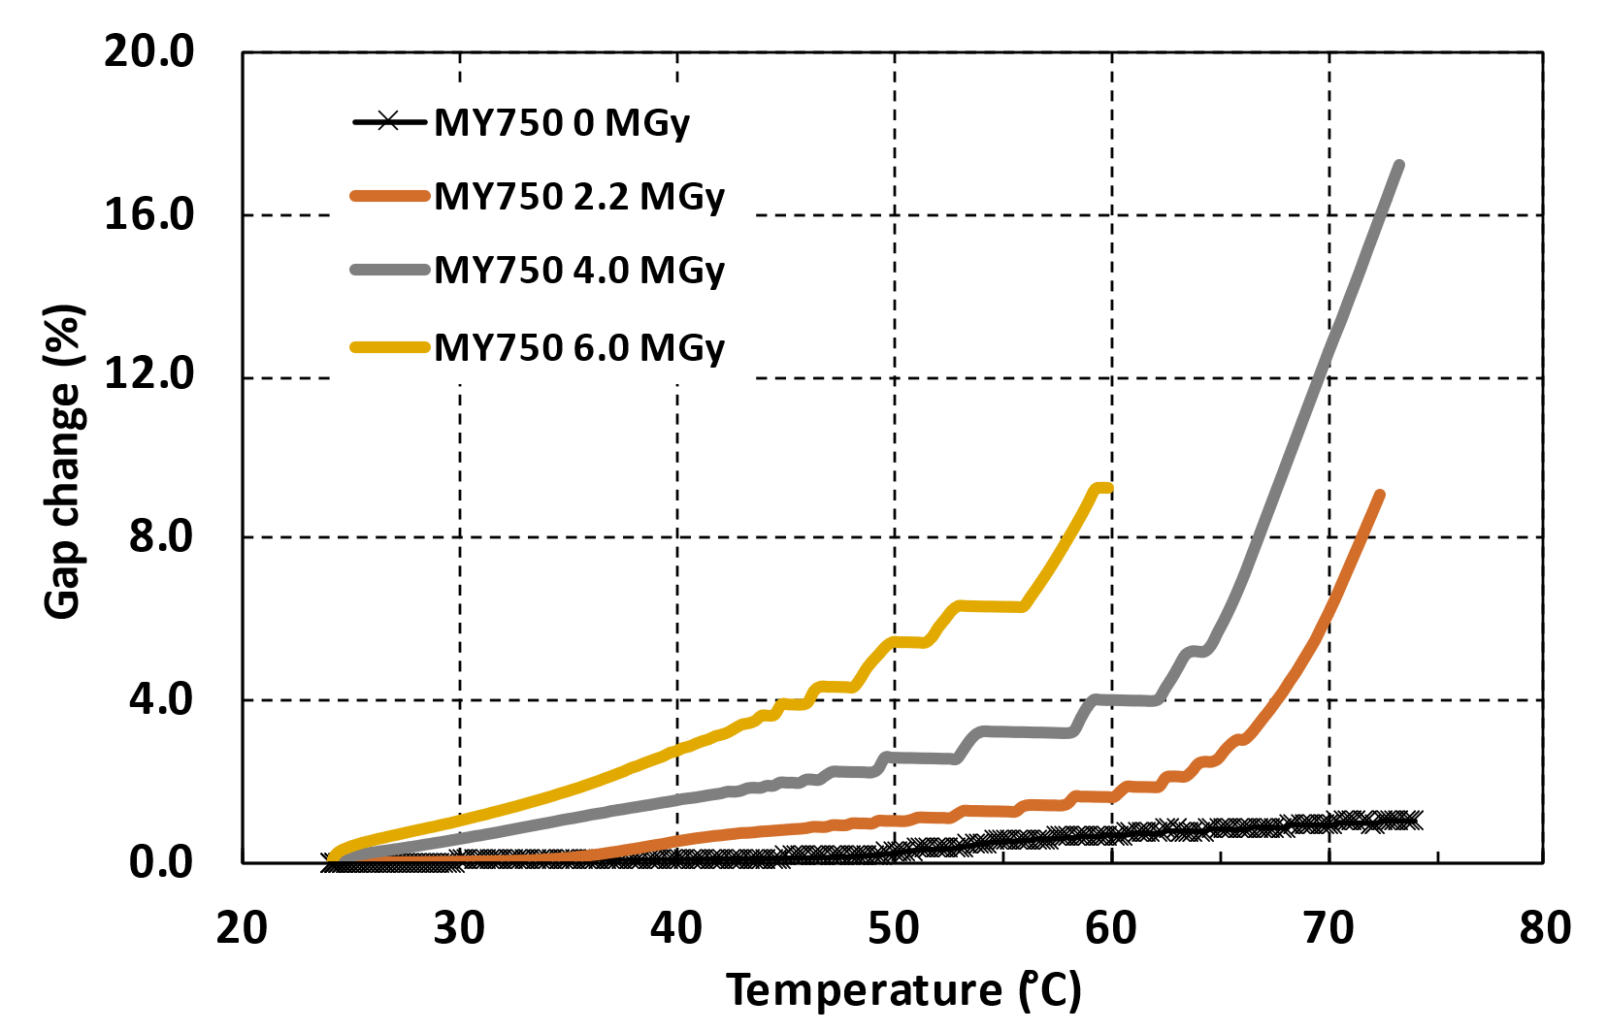
Different effect of ambient air gamma irradiation on G’(T) and thermal expansion of selected polymers
T_{g}
T_{g}
PEEK G’(T) and thermal expansion
CTD101K G’(T) and thermal expansion
MY750 G’(T) and thermal expansion
All DMA results are courtesy of D.M. Parragh, CERN polymerlab.

Slide 11
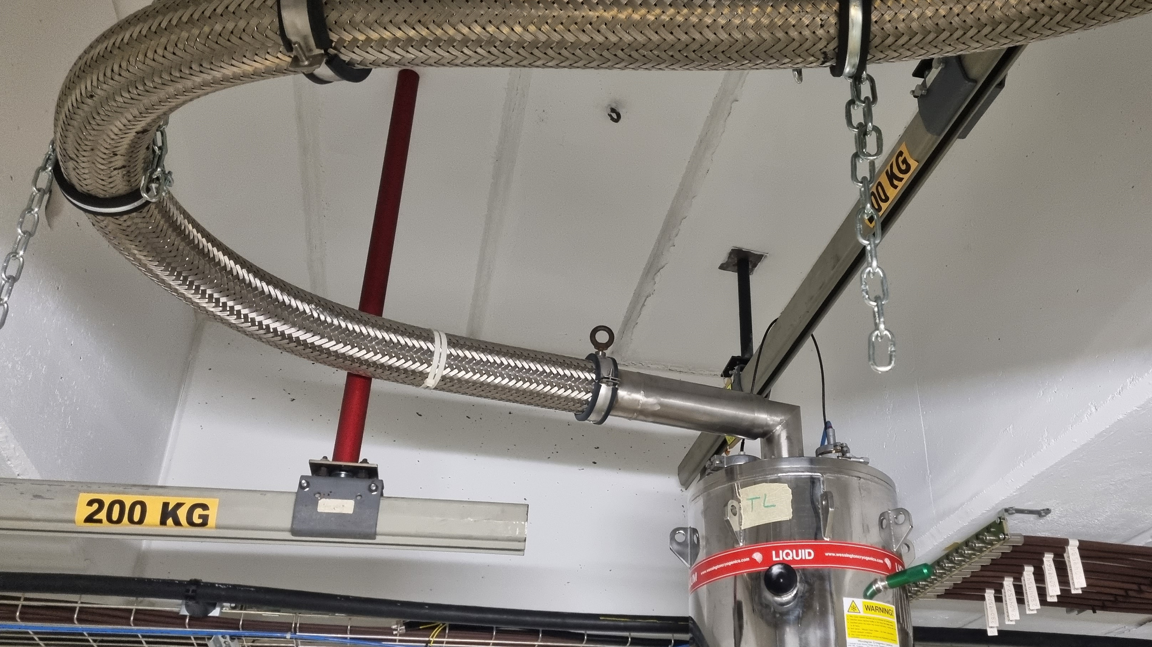
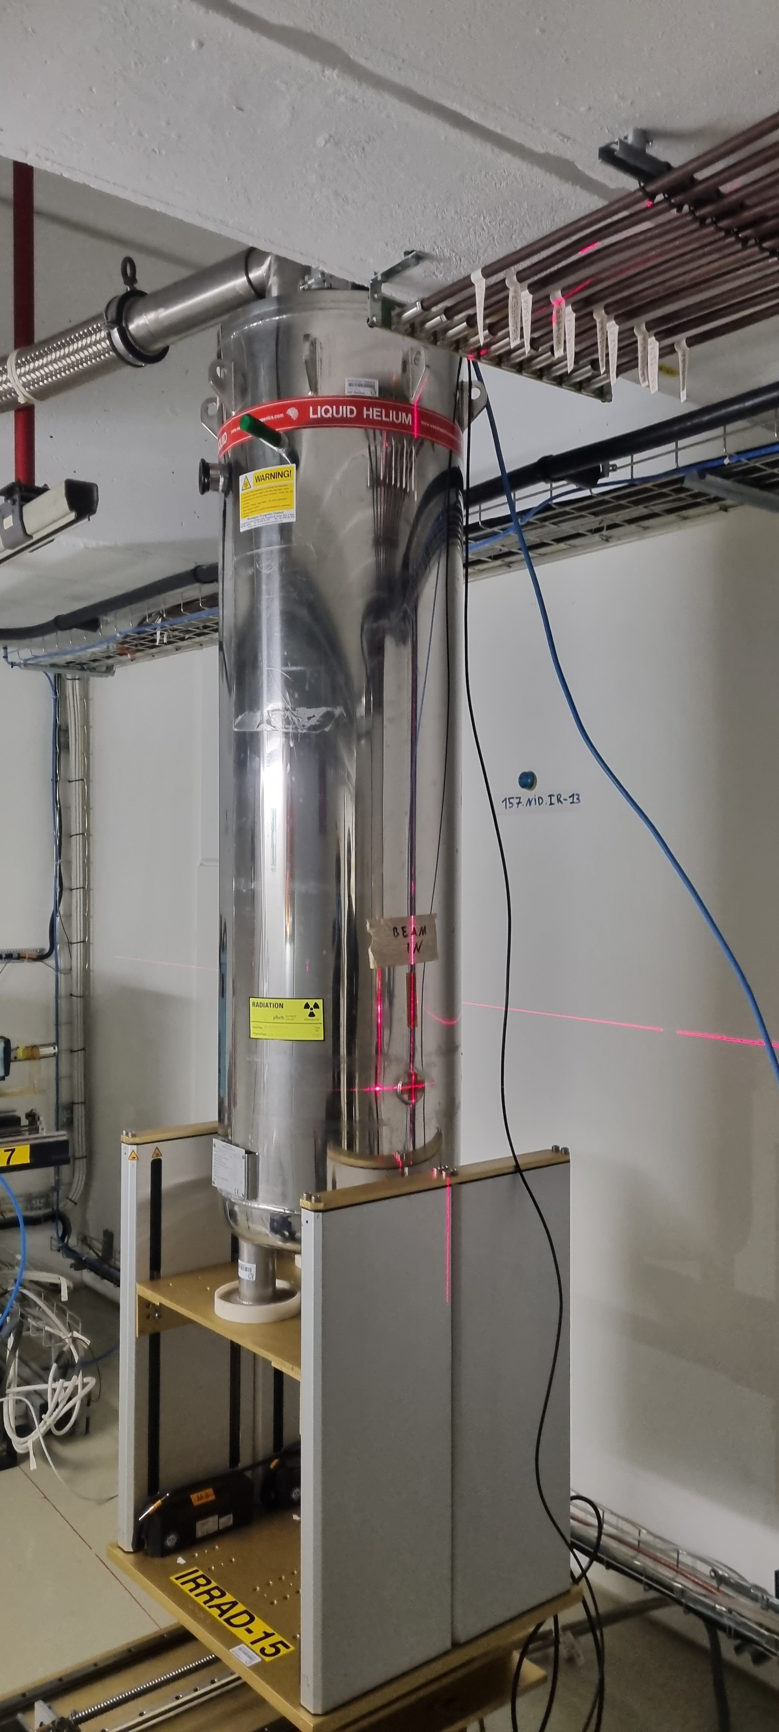
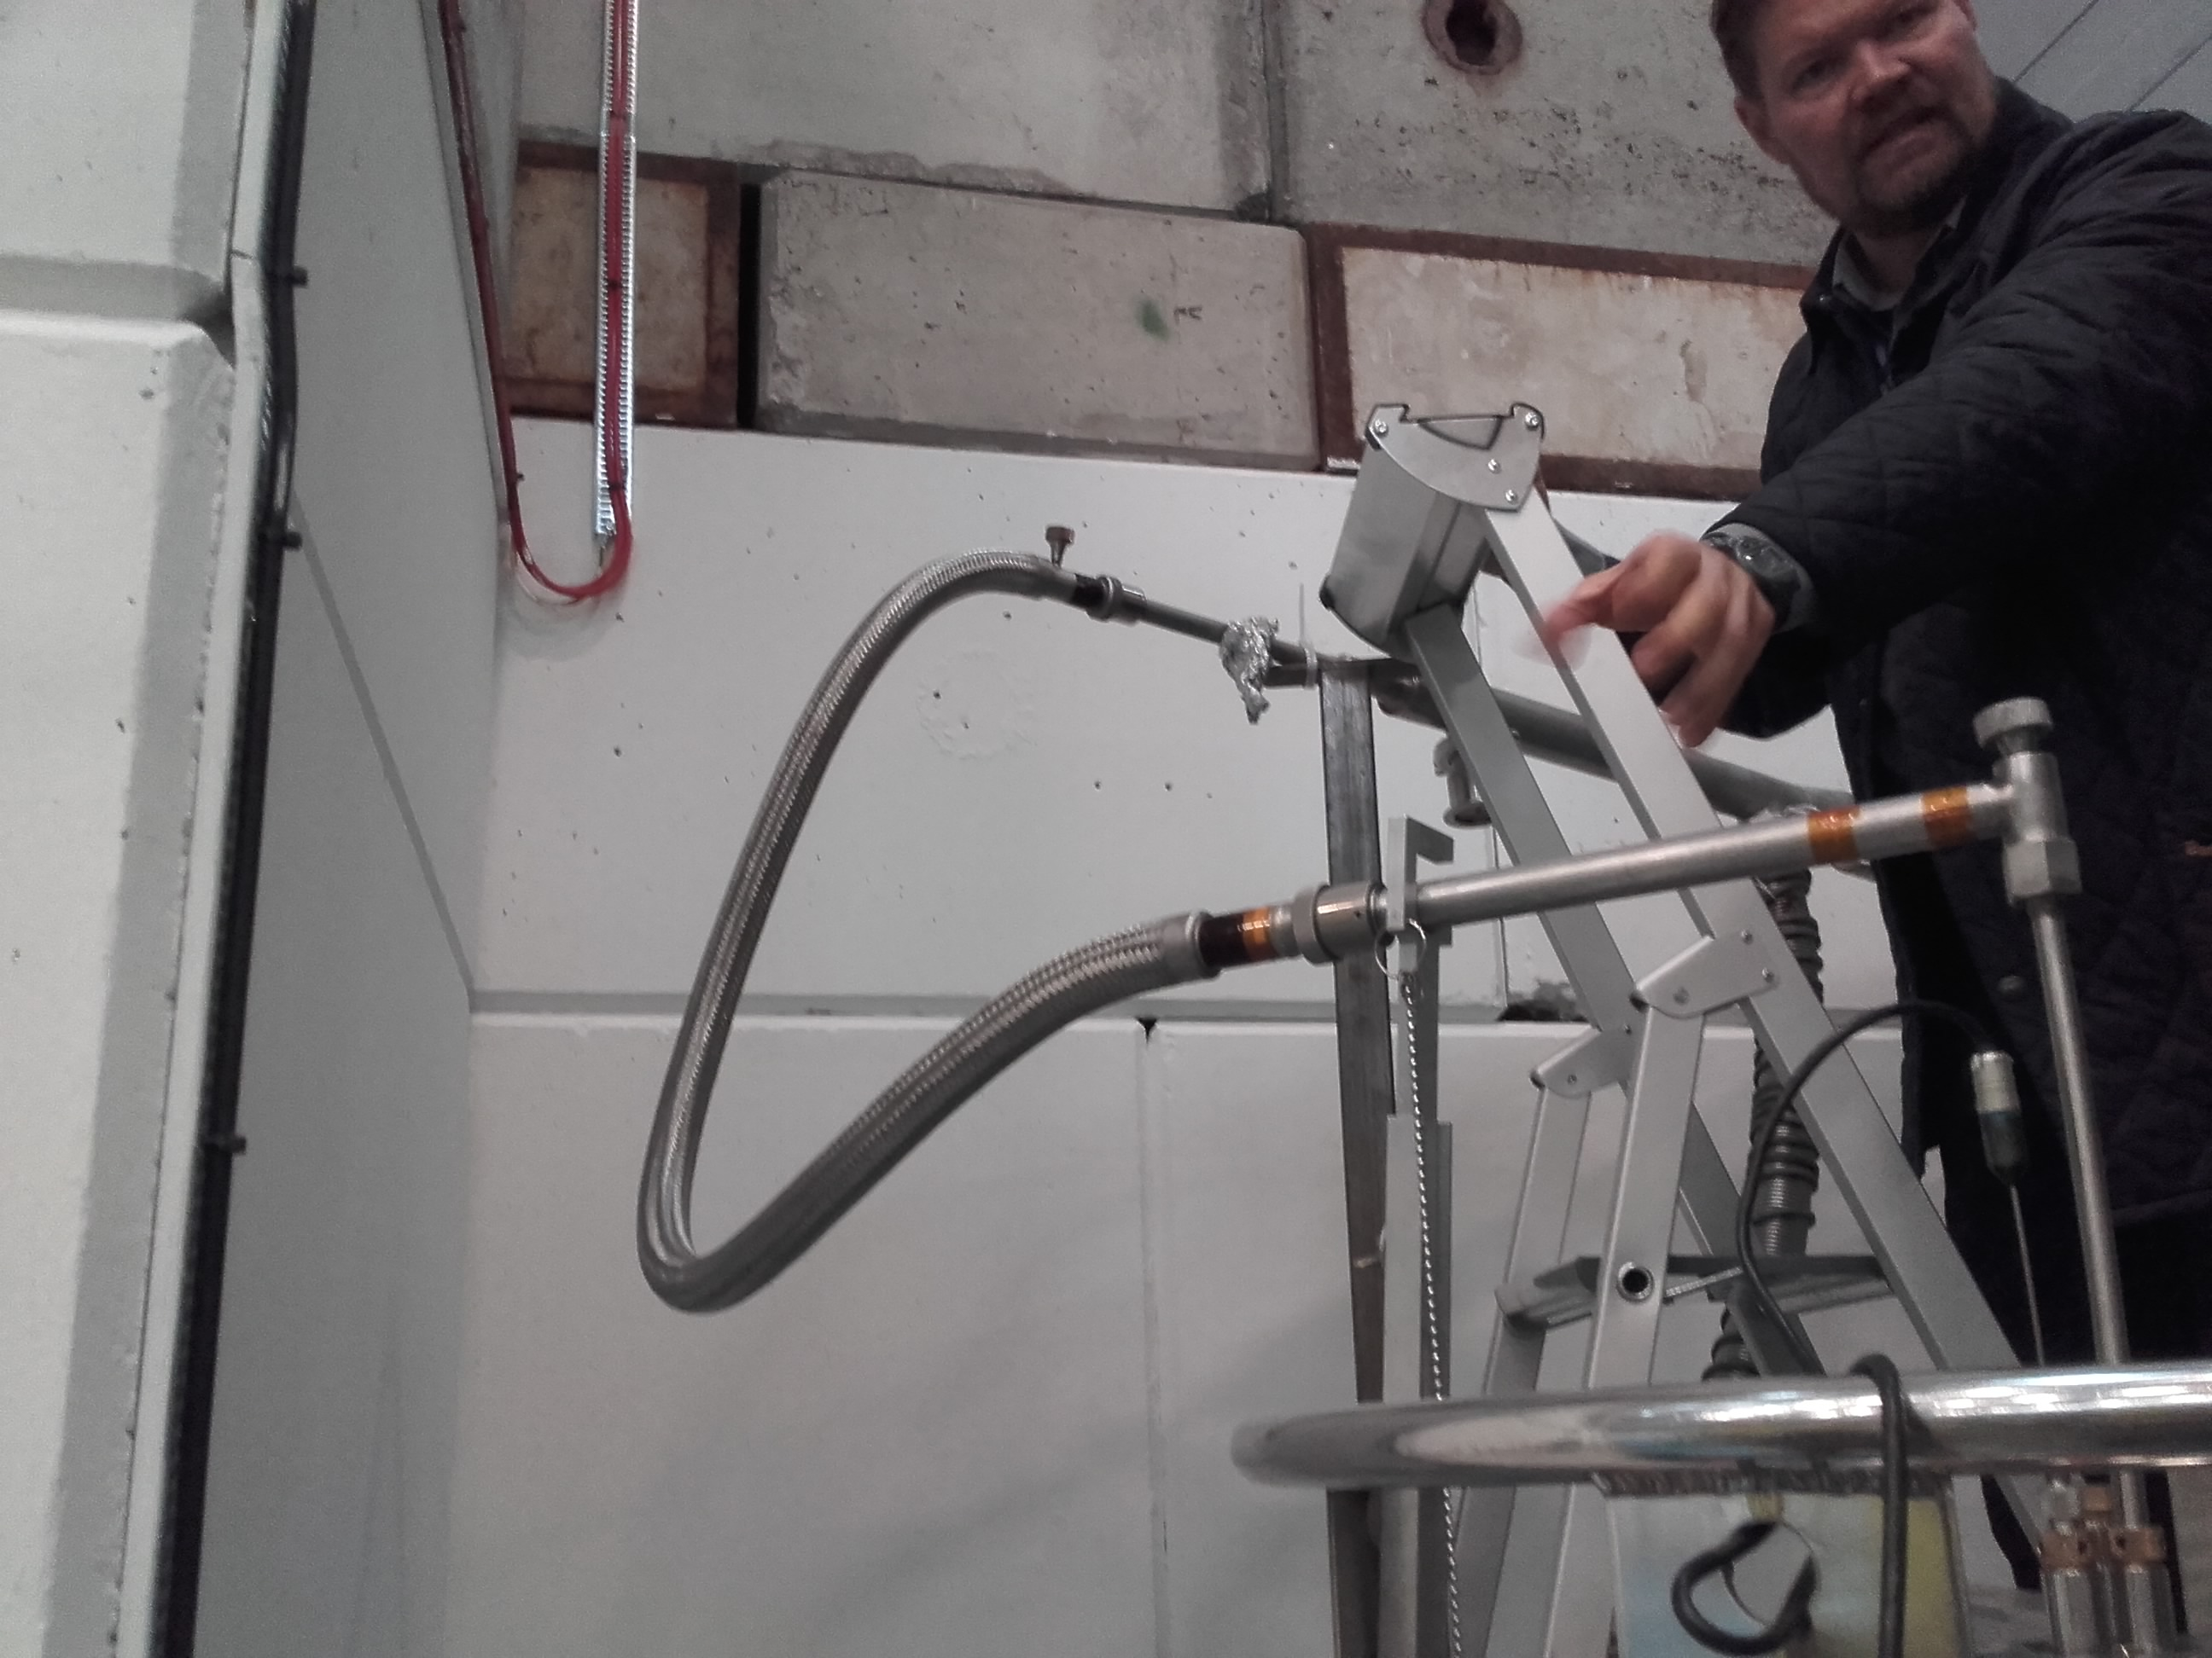
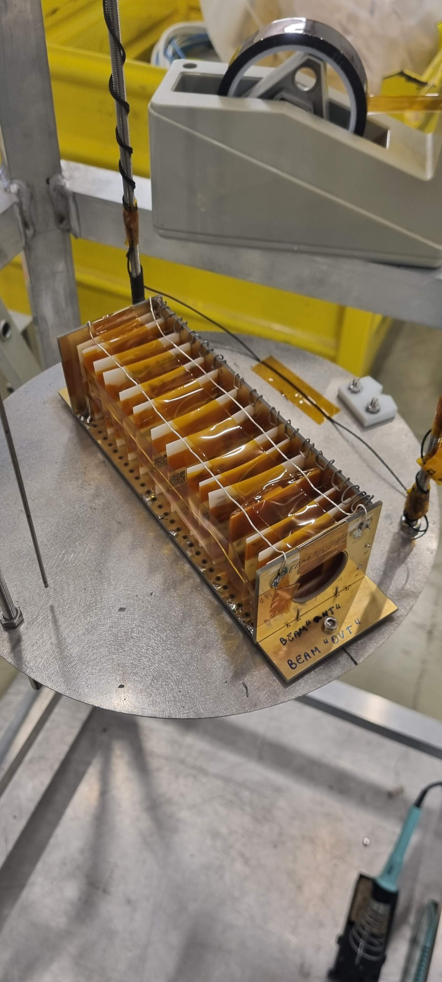
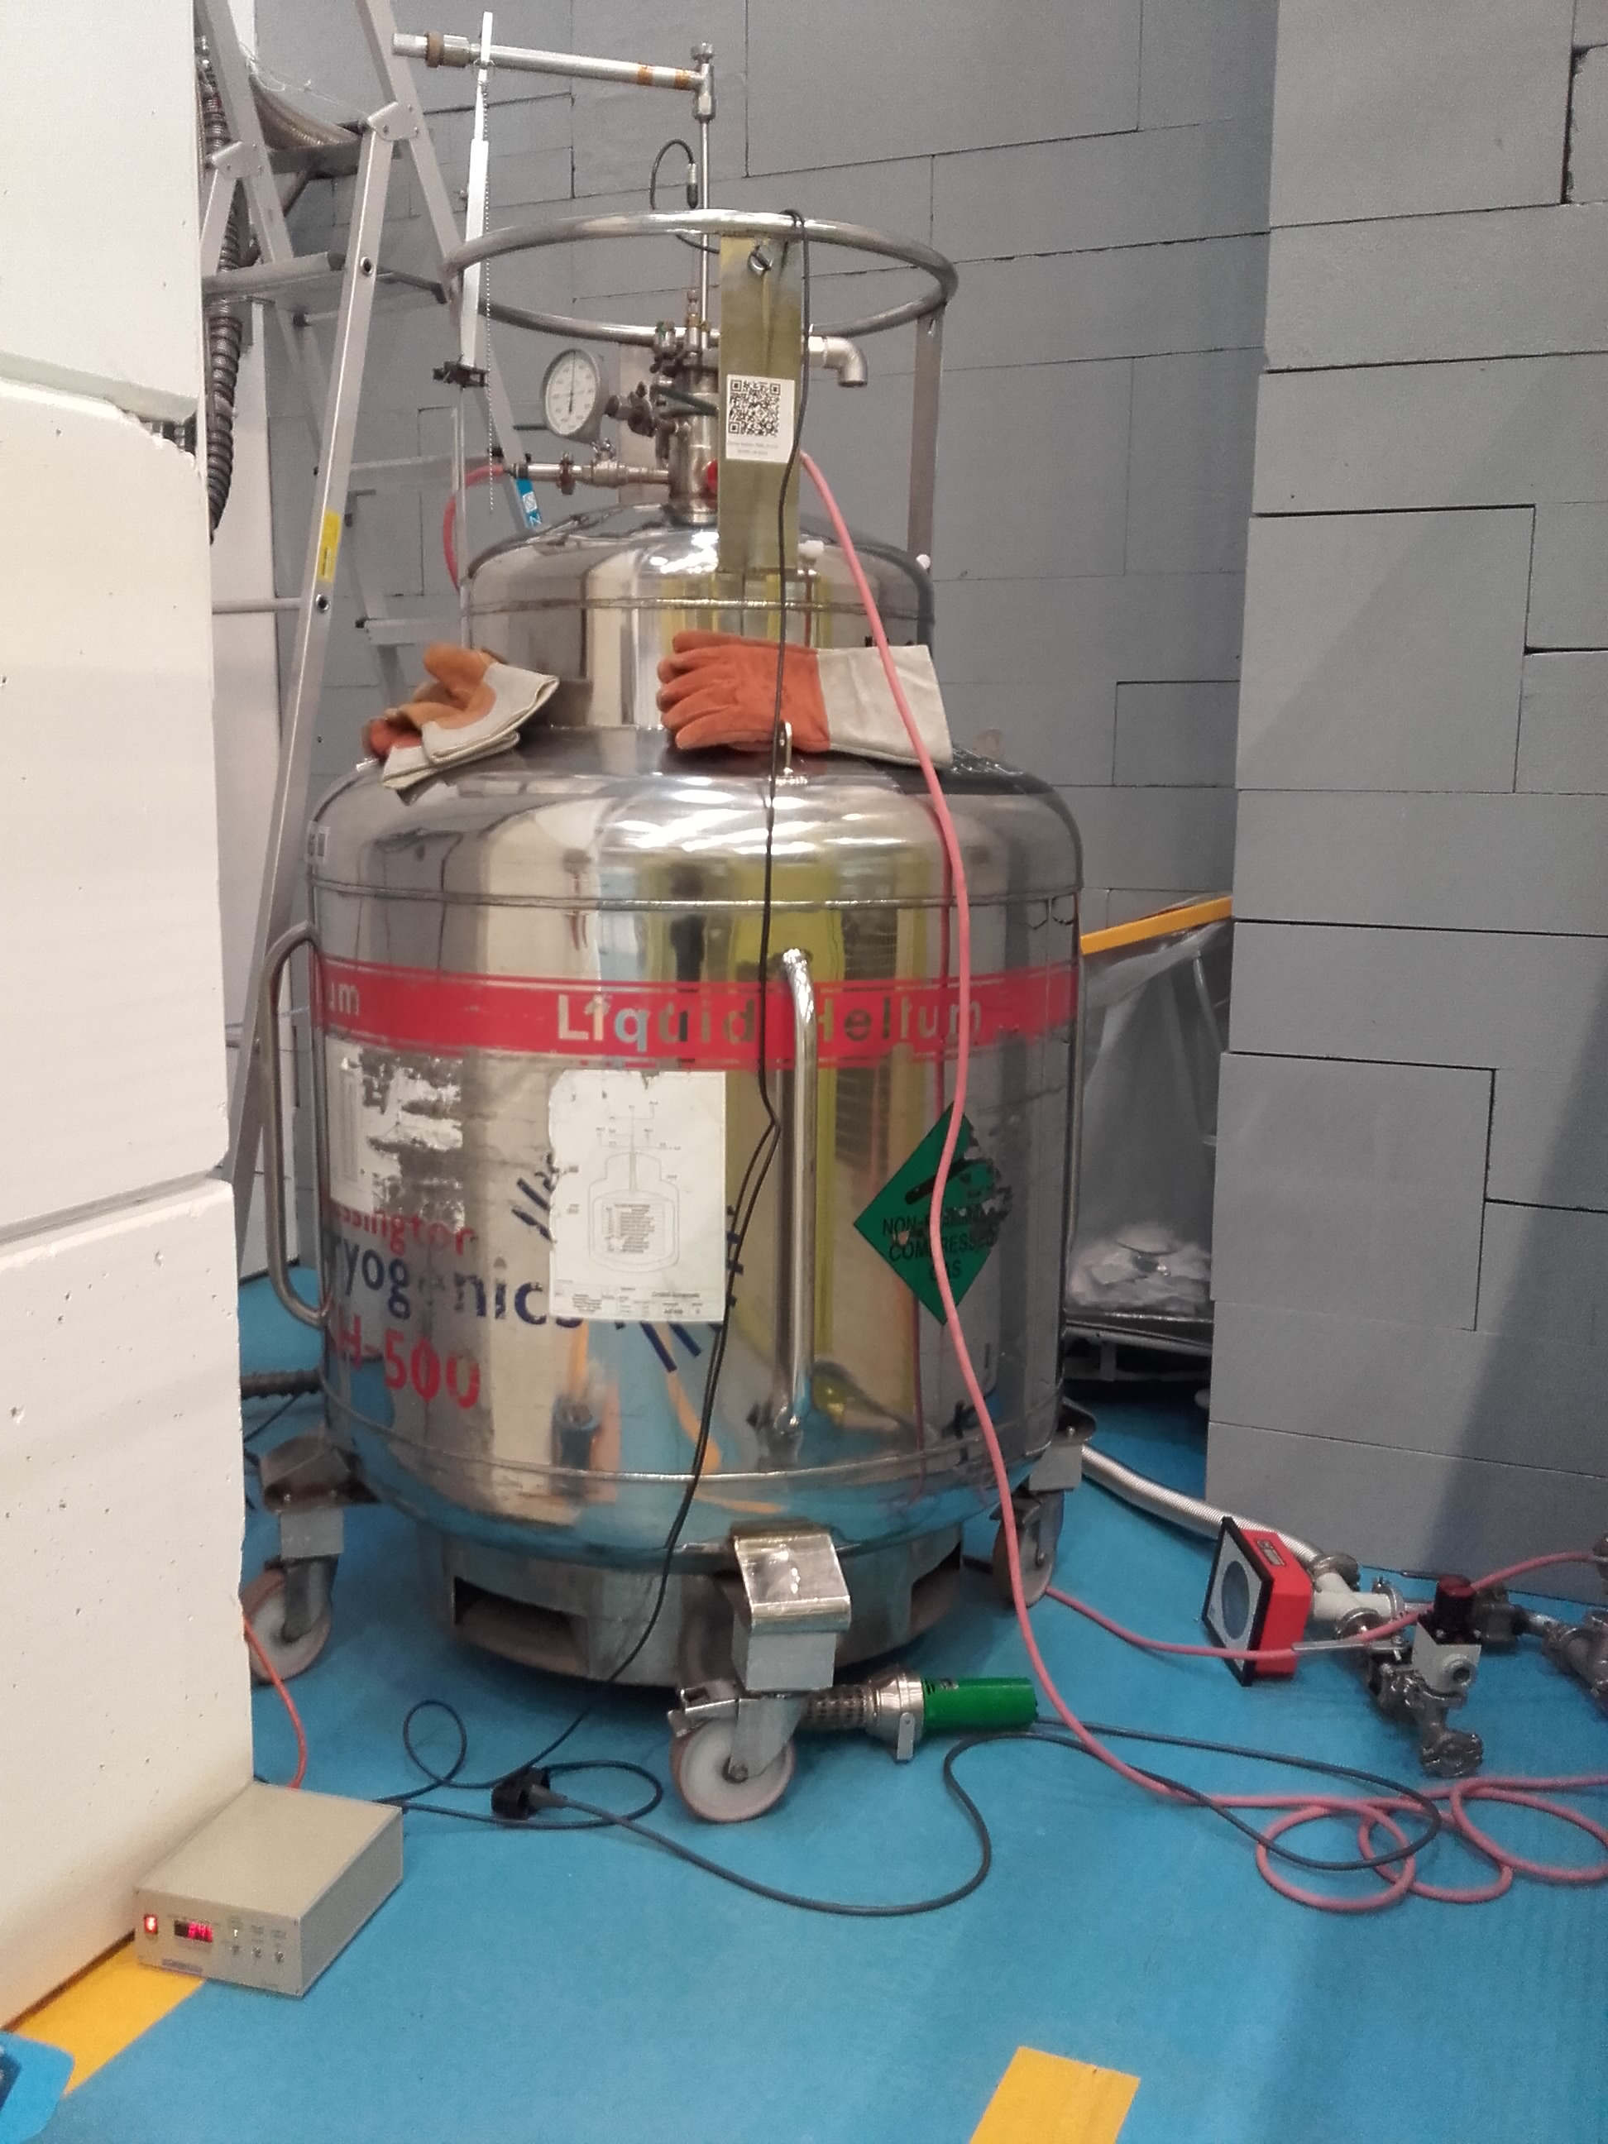
24 GeV proton irradiation in liquid helium
Irradiations were possible thanks to G. Pezzullo, F. Ravotti and IRRAD team, and T. Köttig and CERN cryolab team.
Two sets of identical samples were irradiated simultaneously
  Inside the cryostat immersed in liquid helium
  Outside the cryostat in ambient air
A proton fluence of about 1E16 p/cm² was achieved during 2 weeks of irradiation, which corresponds with about 3 MGy.

Slide 12
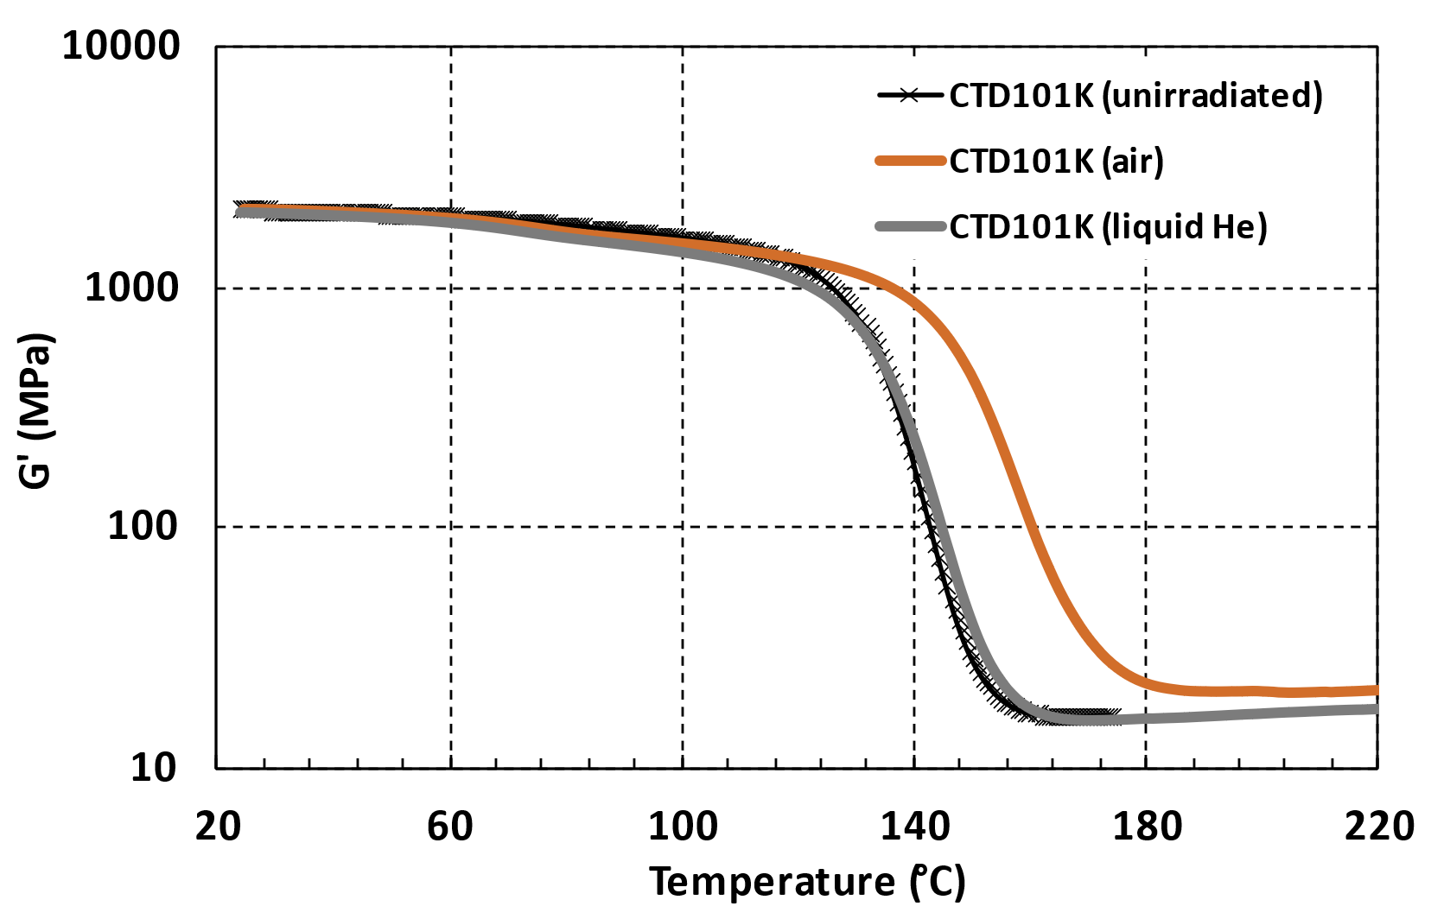
What is the influence of the irradiation environment?
Superconducting magnets are irradiated at cryogenic temperature in the absence of oxygen.
CTD101K epoxy resin, which is used for the impregnation of the HL-LHC superconducting magnets, was irradiated in liquid helium, and an initially identical sample was irradiated simultaneously in air behind the cryostat.
In liquid He irradiation has almost no effect, in air irradiation has a significant influence on G’(T).
A certain dose in liquid helium might cause much less degradation than the same dose in air.
G’(T) of CTD101K before and after irradiation in liquid He and in air to about 3 MGy.

Slide 13


