Slide 1
PLC Software Engineering workflows at SY-EPC
Jose Manuel de Paco Soto
SY-EPC-CCS
March 28th 2023, CTTB Industrial Controls Forum - #8

Slide 2
Introduction to PLCs @ EPC

Slide 3
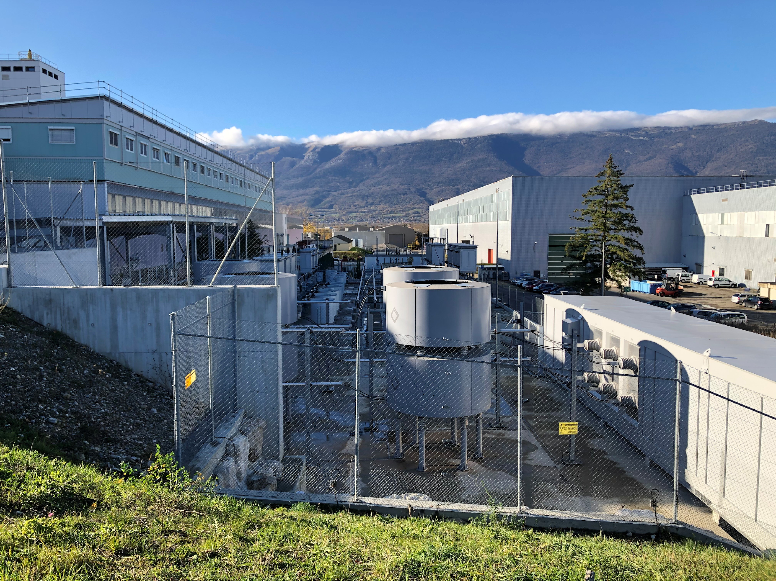
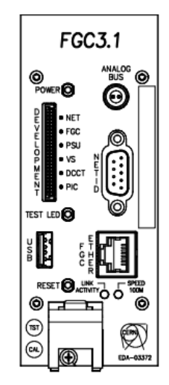
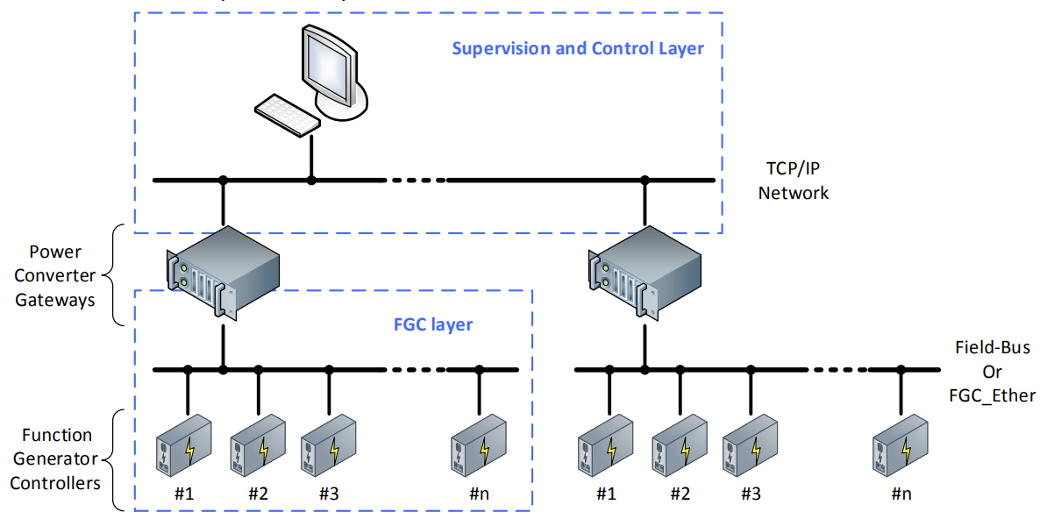
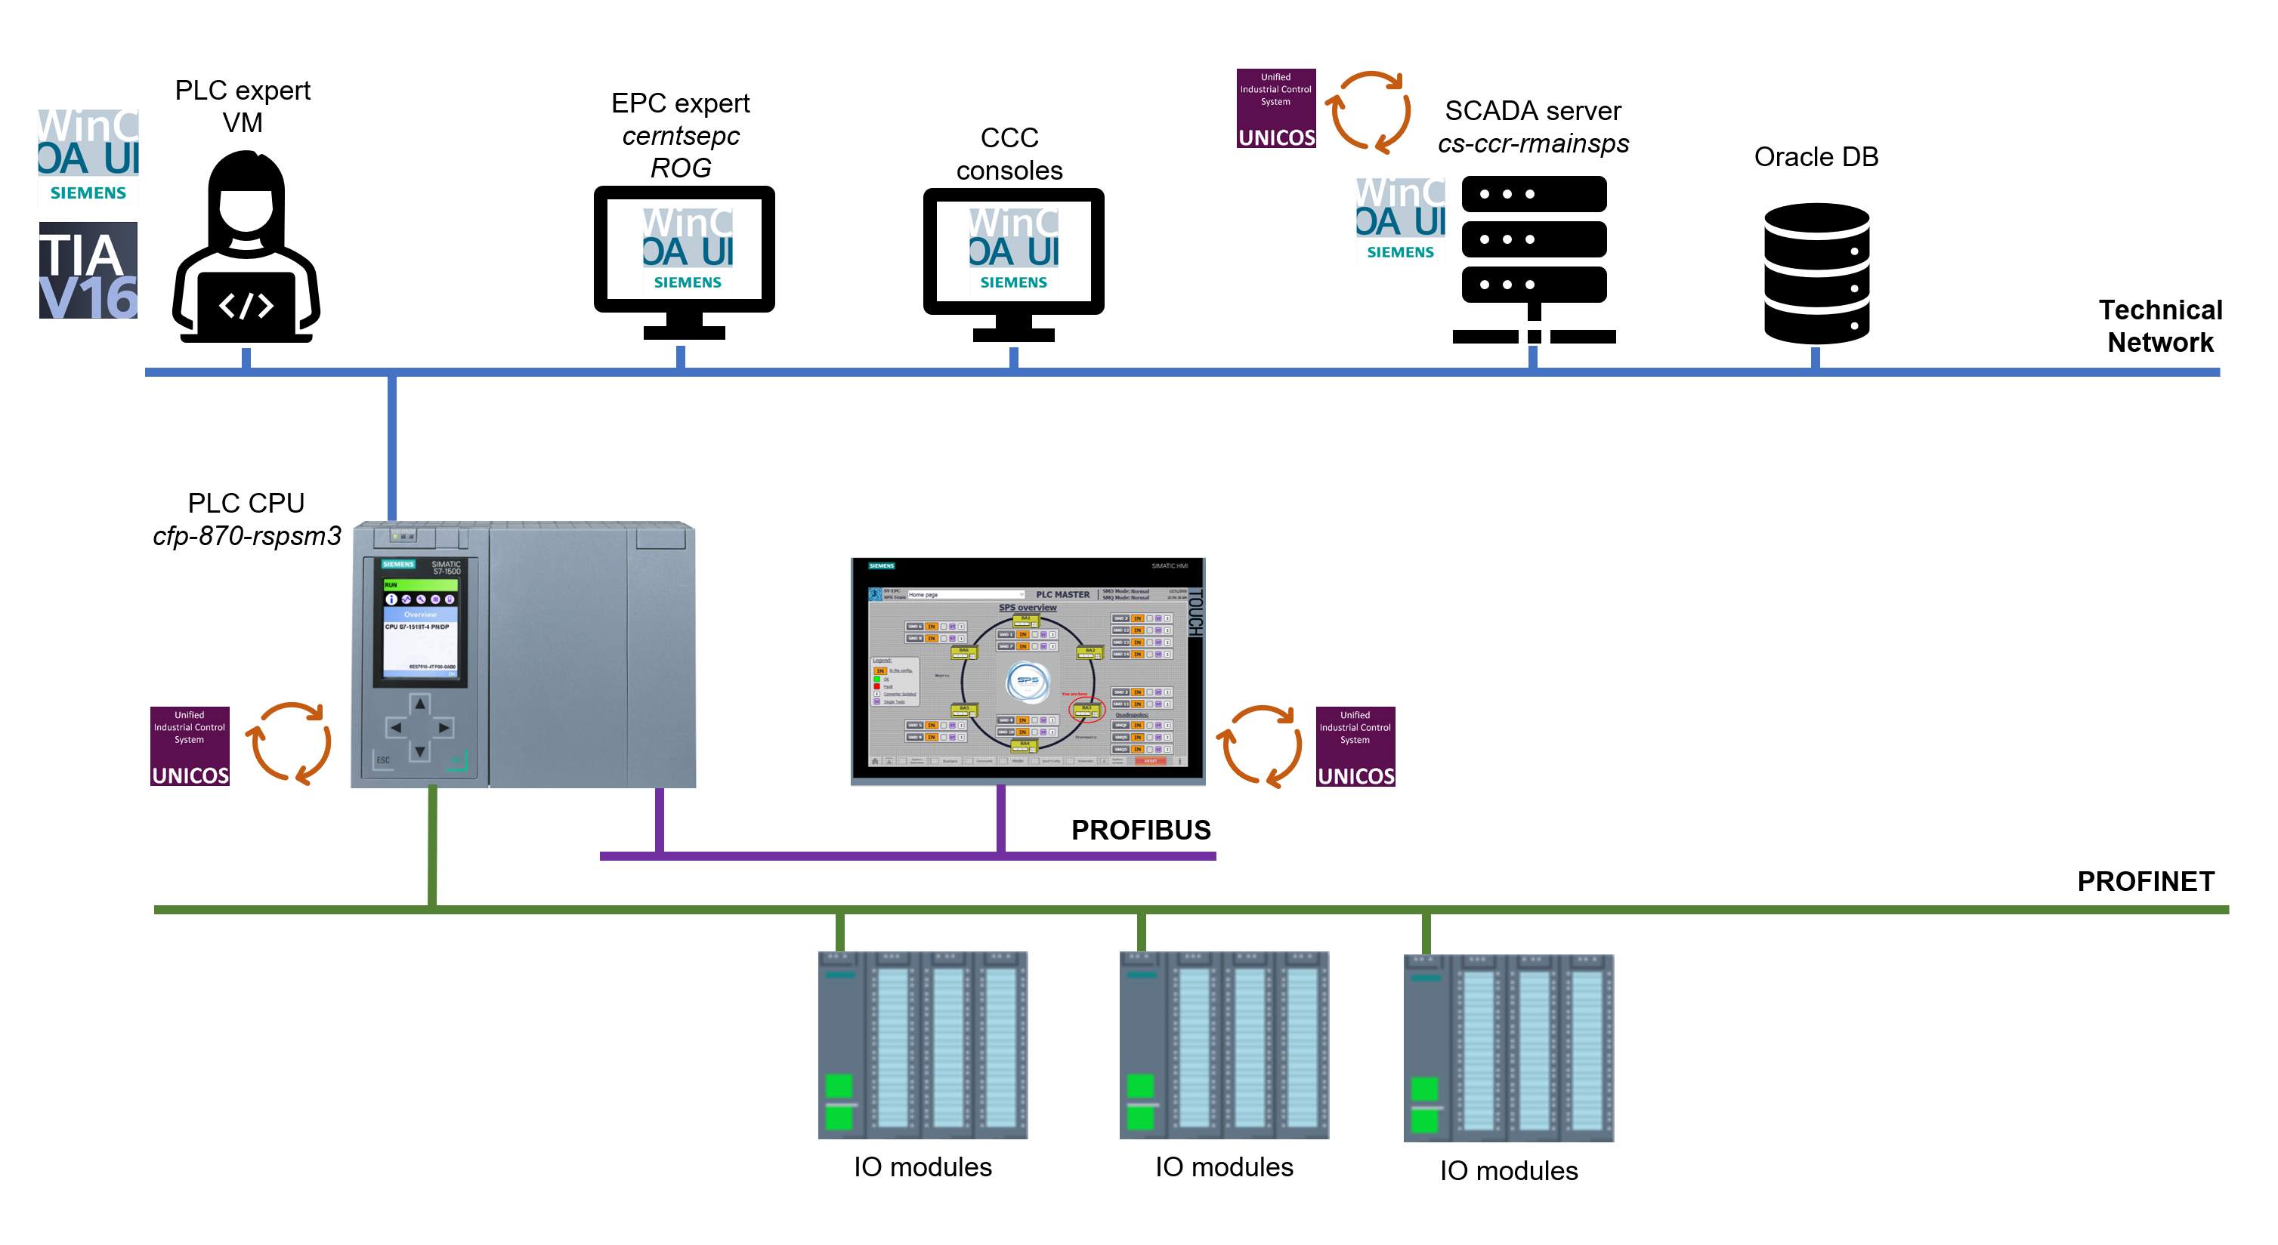
PLCs at EPC
  Several types of control systems in EPC:
    FGCD (FEC) - RegFGC
      Default controller. 1 RegFGC → 1 PC.
      Real-time regulation of voltage sources and magnet currents.
    FESA (FEC) – Fieldbus – commercial PS
      PowPLC – PLCs – Commercial PS.
    PLCs for high power systems – state machines and interlocks:
      Static Var Compensators (SVC)
      Powering of main magnets of PS, PSB, SPS.
  ~60 PLCs
    Developed or being migrated to UNICOS-CPC.
    Siemens S7-300, S7-400, S7-1500, TouchPanels.
  WinCC OA is used by EPC experts but also directly by accelerator operators for PS, PSB and SPS main power converters.

Slide 4
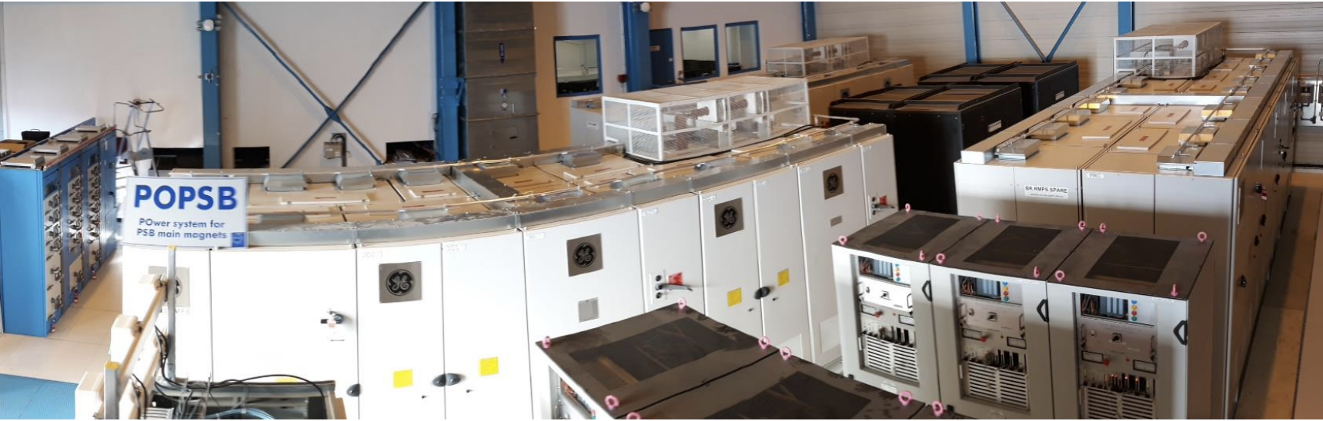
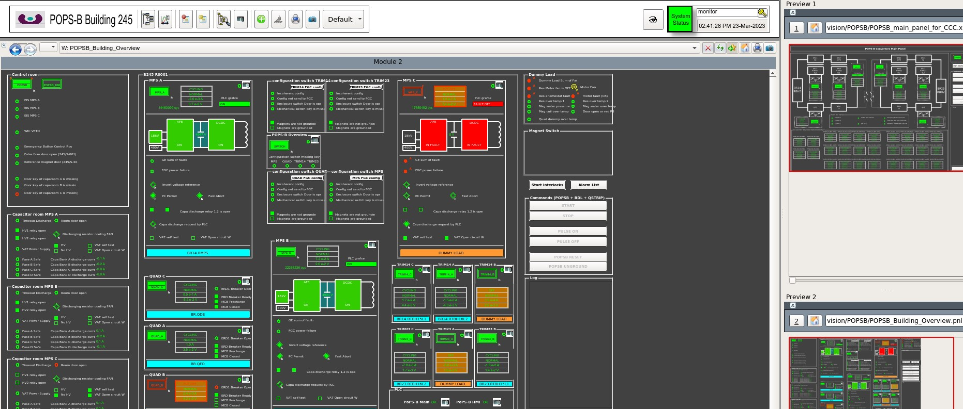
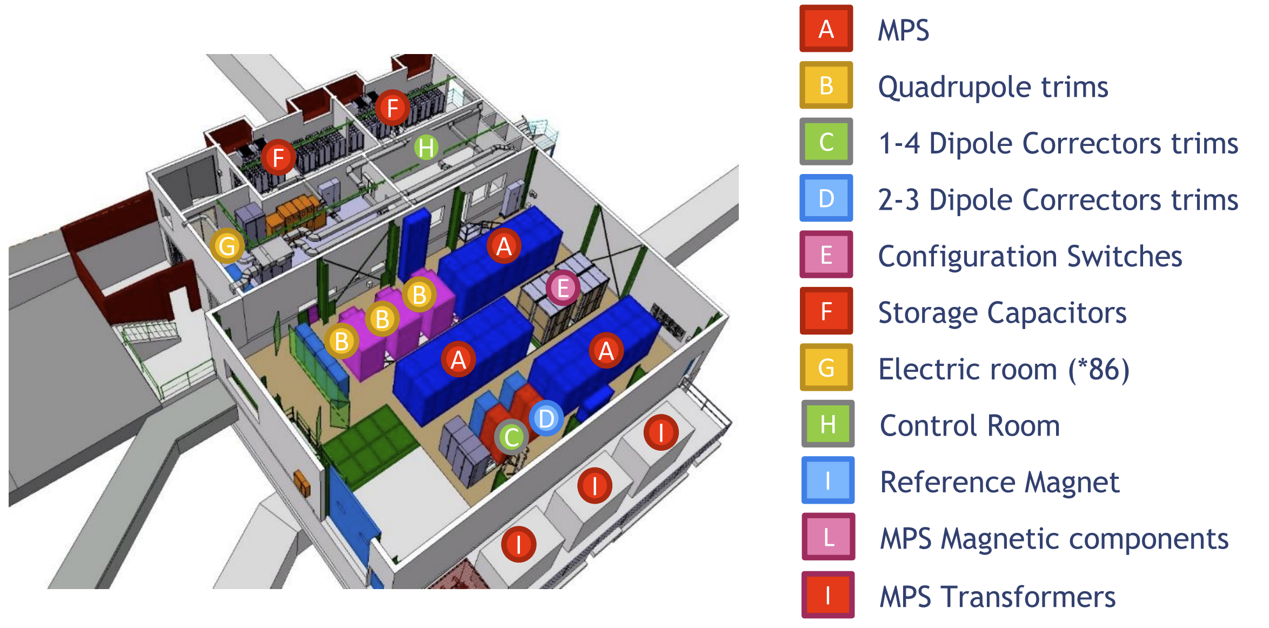
POPSB: Power system for PSB main magnets
2 GeV cycles, 18 MW
Converters for main dipoles, quadrupoles and trim magnets, with magnetic coupling.
Energy recovery system with capacitor banks.
One of the most complex power systems at CERN.
PLC system coordinates the machine.

Slide 5
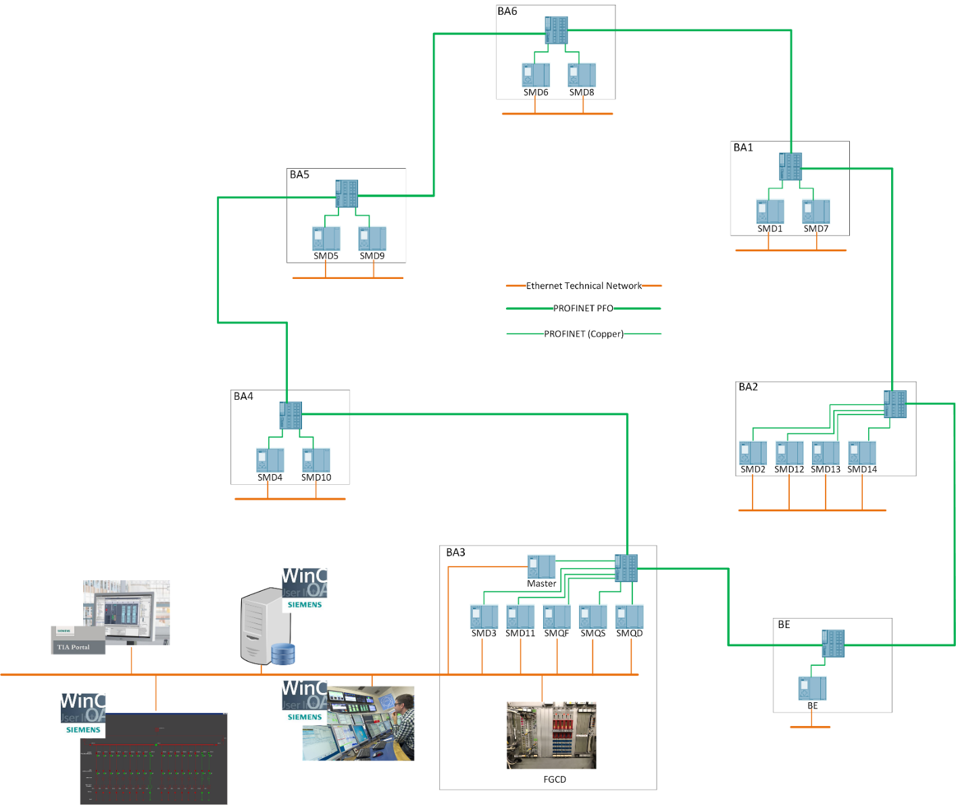

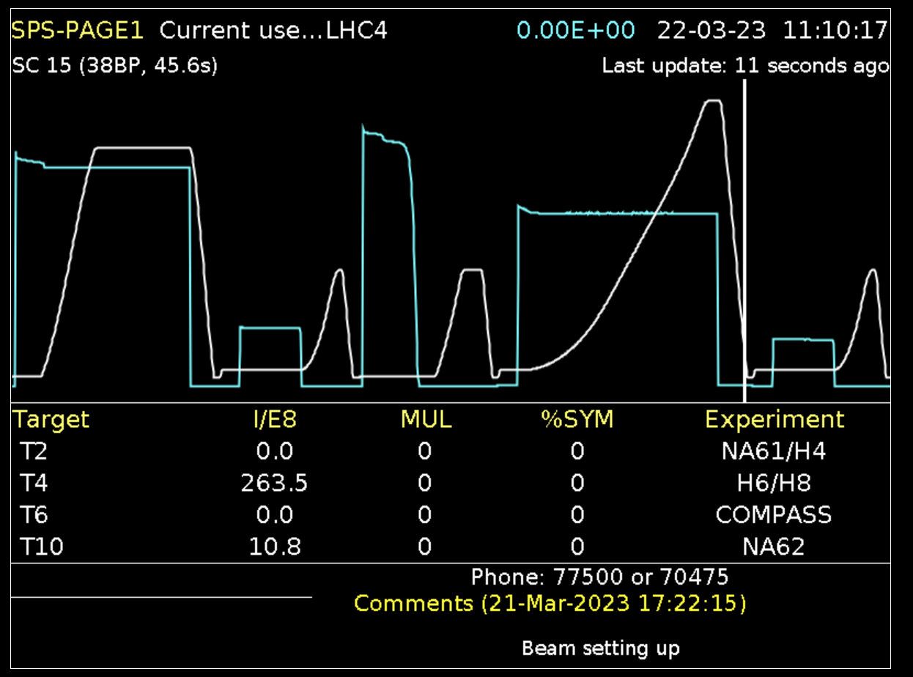
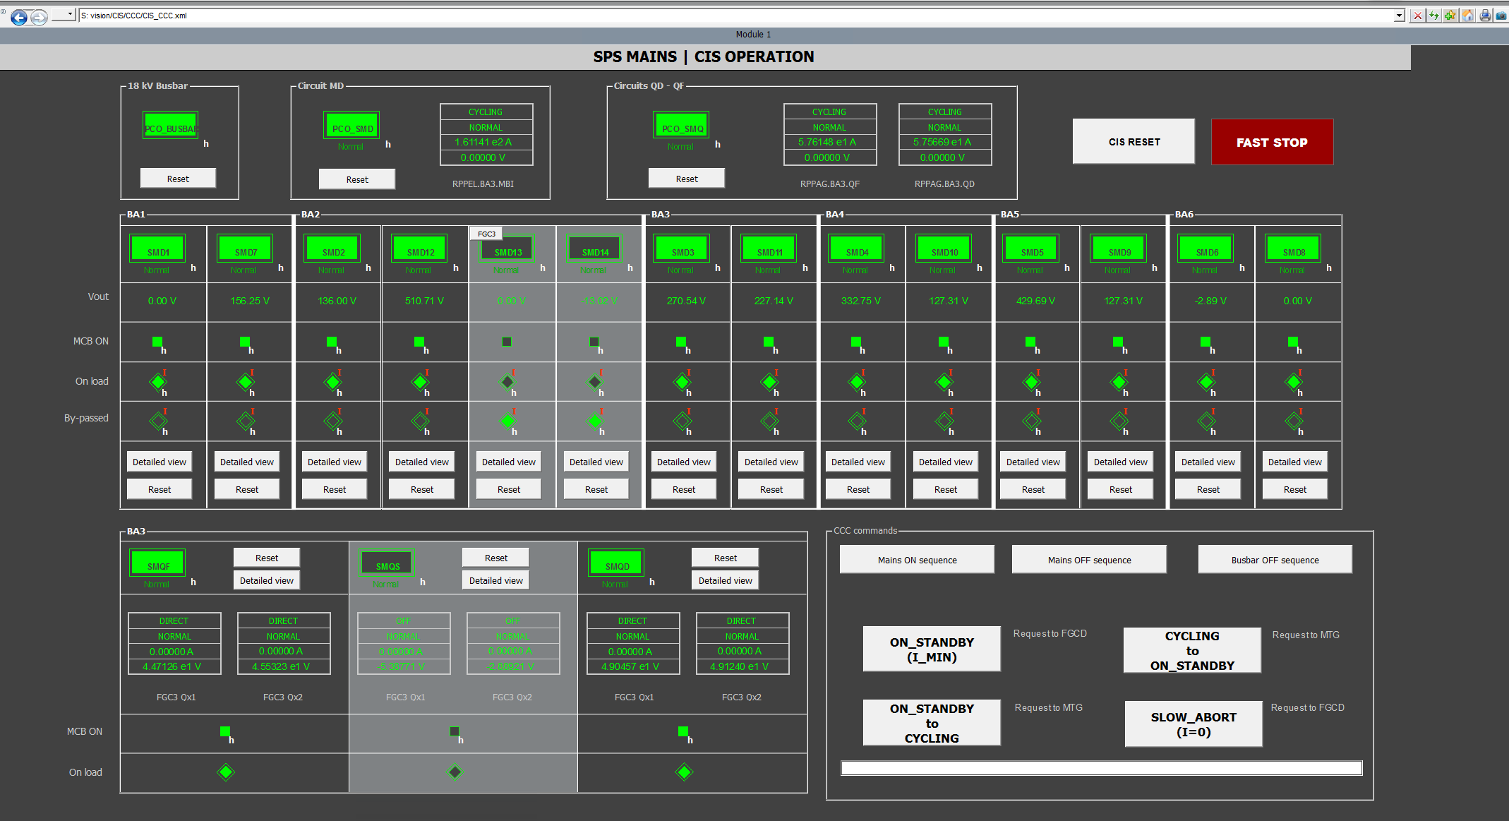
Control and Interlock System of the SPS main power converters
  Powering of SPS main magnets: 746 dipole and 214 quadrupole
  Dipole circuit is 144 MW (2000 V, 6000 A)
  19 functionally interconnected PLCs: ~ 3000 interlocks, ~ 5000 IO
5

Slide 6
Engineering Workflow PLC Software

Slide 7




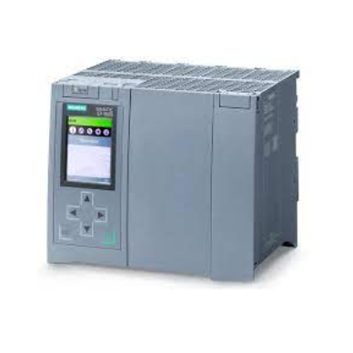





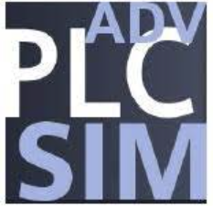




Engineering workflow for PLC software
Continuous modification requests for TS or YETS
Integration tests
Functional tests
Procedure
Functional Specification
Commissioning
Desktop computers
Virtual Machines
UAB Project
UNICOS spec
Templates
Sources
TIA Portal base
cfp-870-rspsm3
Automatic testing
Gitlab CI pipeline
Virtual PLC
Manual testing
TN Virtual Machines
Pypowerplc
Gitlab CI/CD files
Project specific test files
Virtual PLC
Dev WinCC OA
Development
Testing
Deployment & Diagnostics

Slide 8
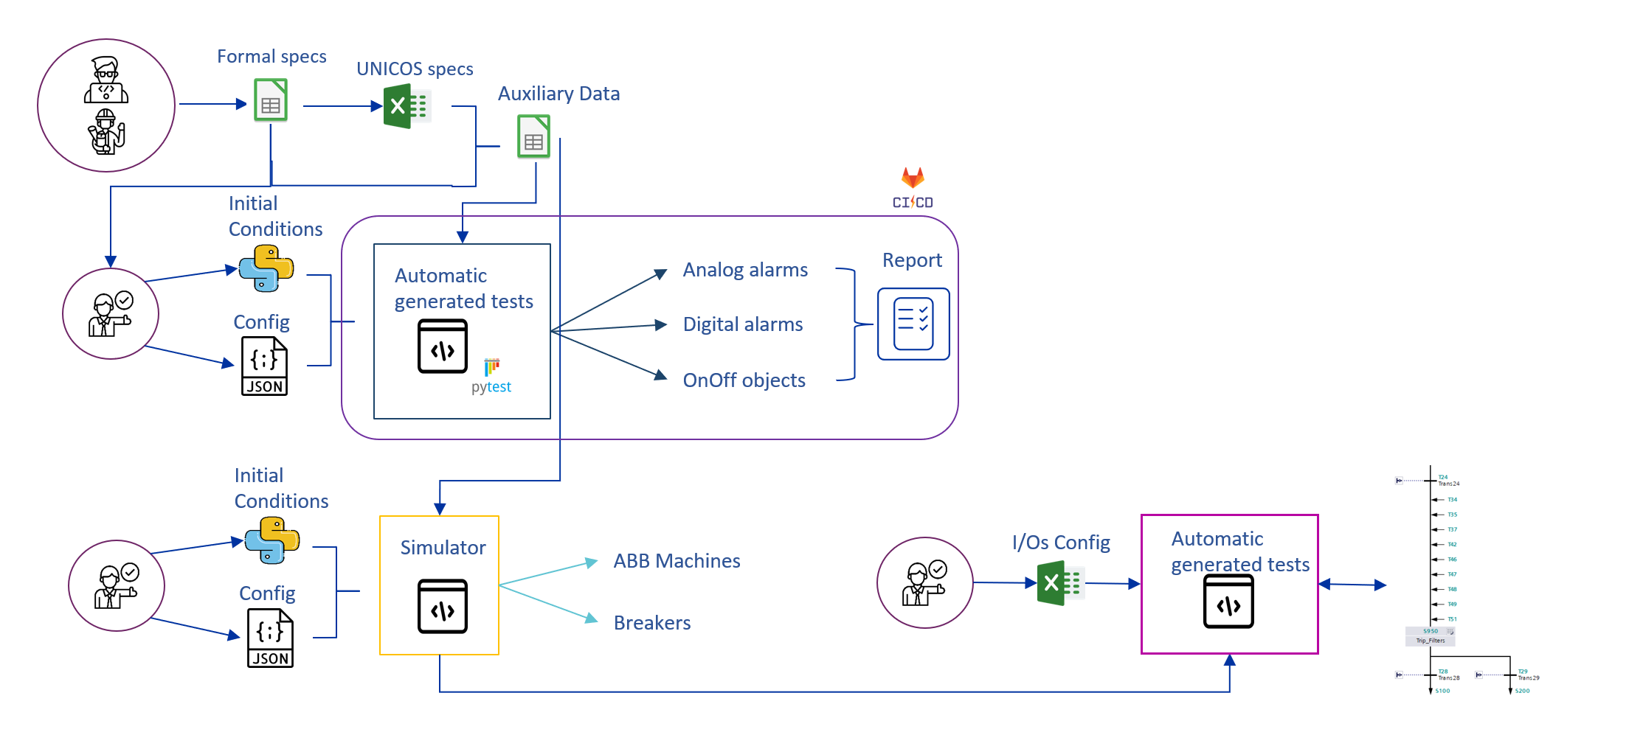
Continuous Integration and Automatic Testing
Pipeline in Gitlab CI: build, deploy and test.
Next steps
Formal specifications – Spec Manager UI
  Cause-Effect-Matrixes (CEM)
Formal verification – Integration of PLCVerif in pipelines
Releasing and versioning
Testing framework “pypowerplc” using BE-ICS’s “pyplctest”

Slide 9
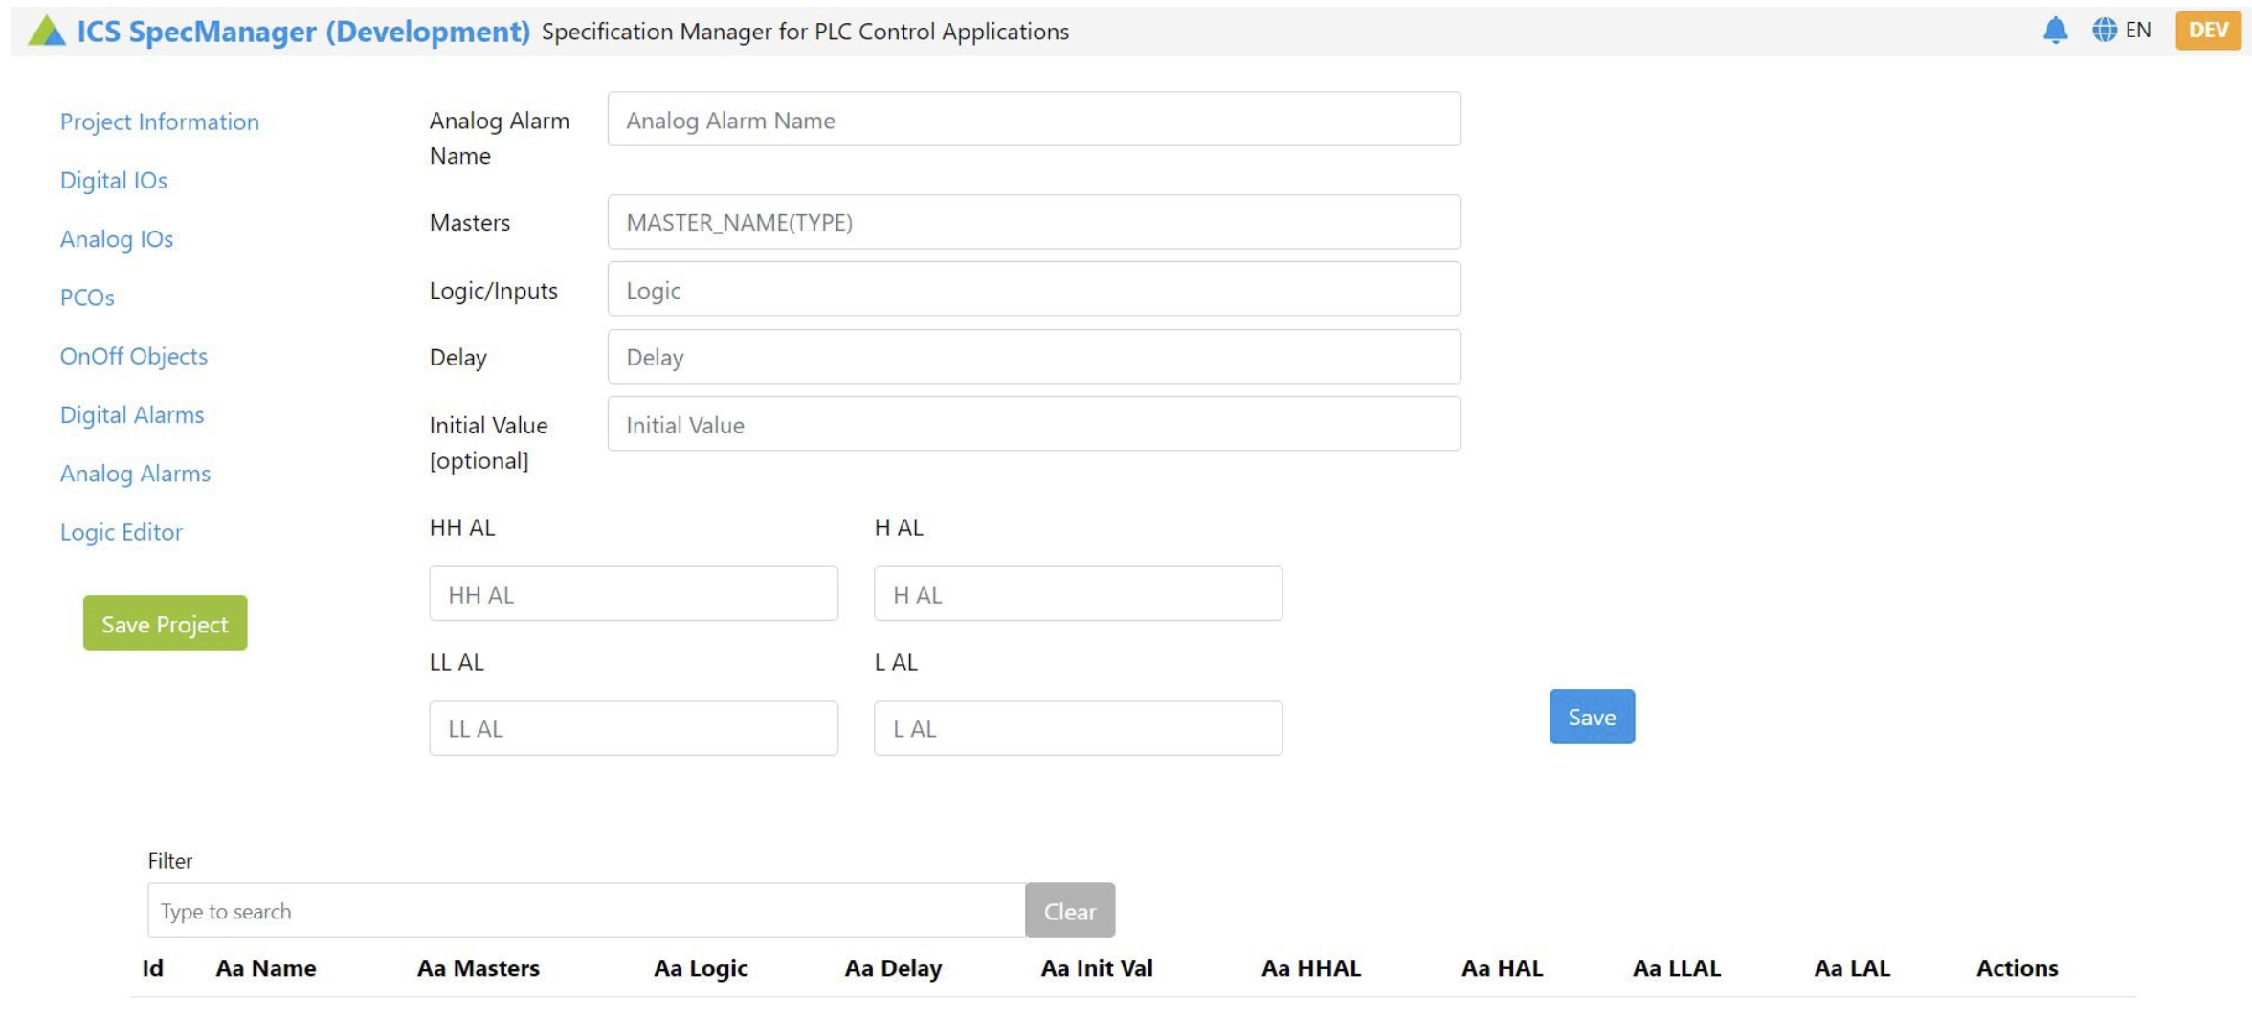
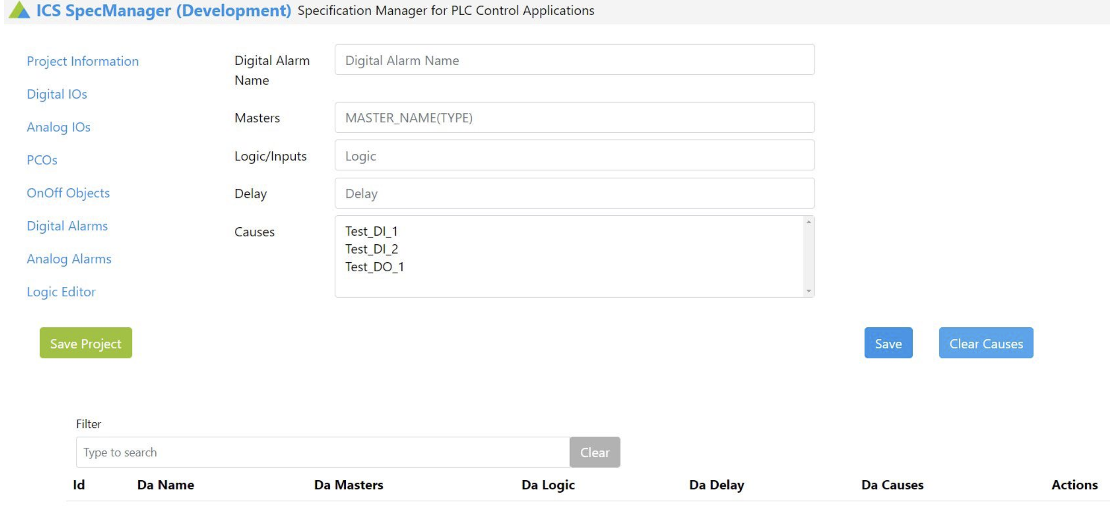
Spec Manager UI
Based on EPC-CCS toolkit (CCSTools.js) for Web UI (Vue3), back-end (Python) and databases.
Creation of inputs, outputs, actuators, alarms and their logical relations (CEM).
Benefits
  Formal specification
  Automatic generation of documentation (pdf)
  Versioning and traceability
    EDMS vX.y.z – Gitlab release vX.y.z – Vdog project vX.y.z
  Automatic creation of tests (pypowerplc)
Does not replace UNICOS spec file
  Not intended for automatic generation of UNICOS spec
Student’s prototype
Community interest?

Slide 10
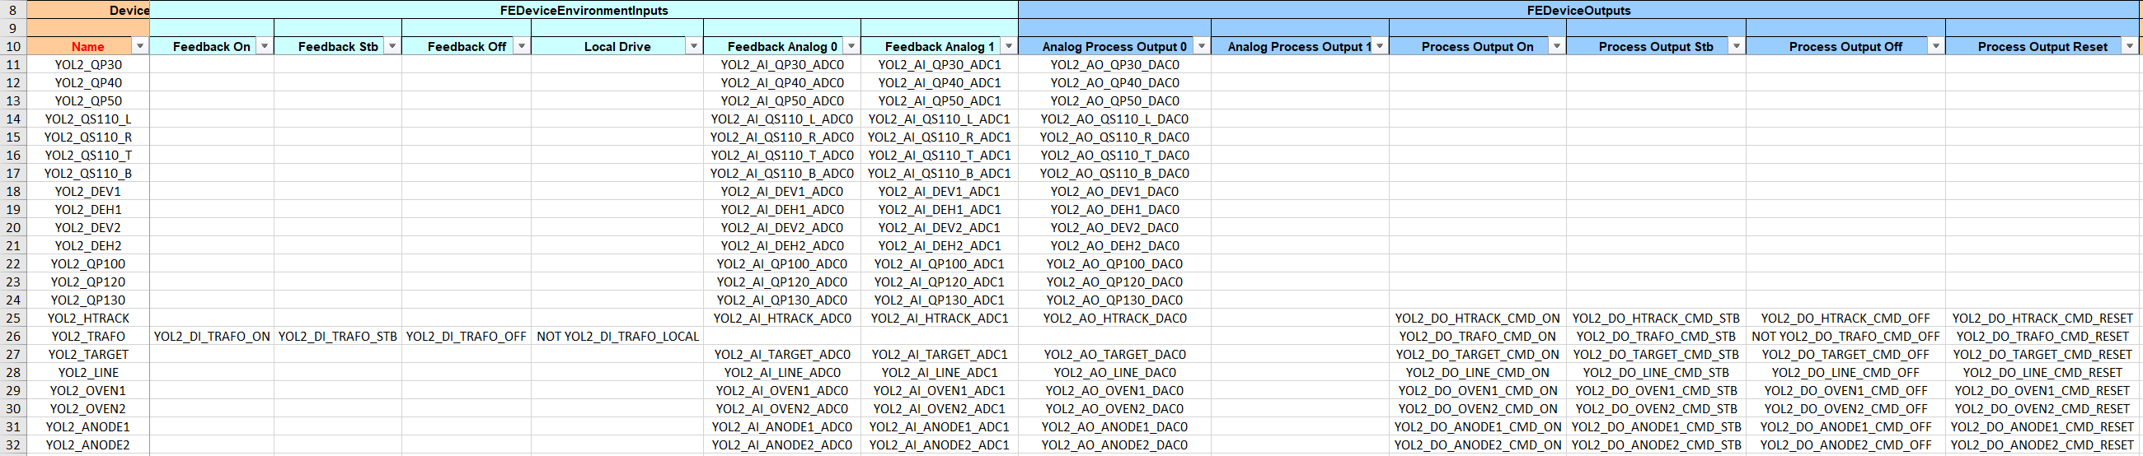
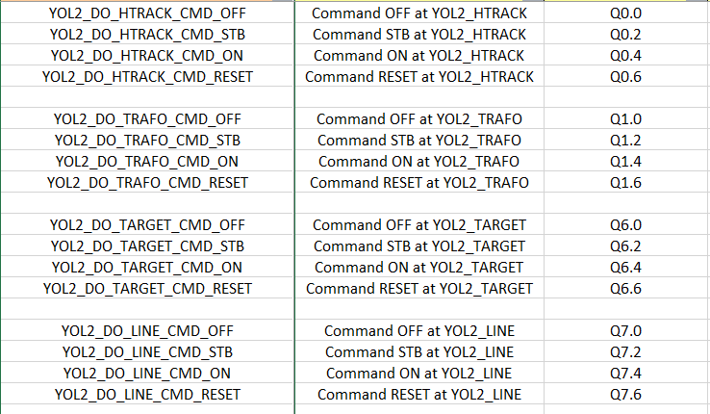
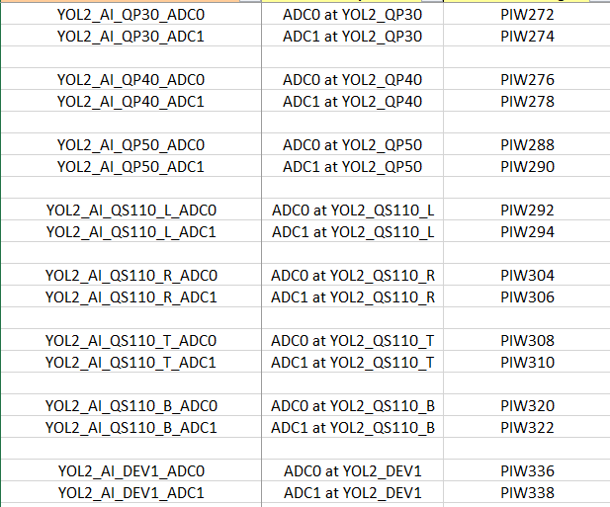
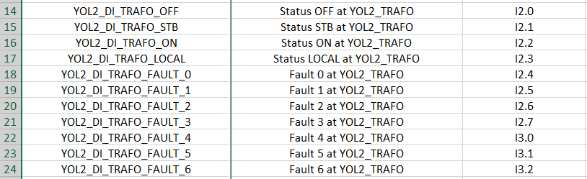
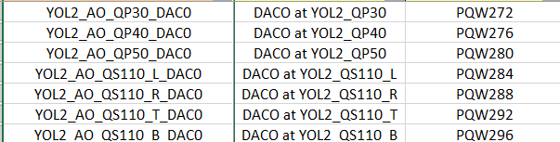
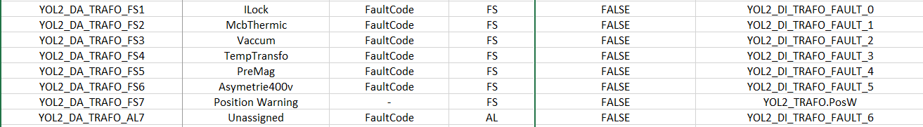
Engineering in UNICOS-CPC: PowPLC
UNICOS spec – Power Converter
Digital Outputs
Digital Inputs
Analog Outputs
Analog Inputs
Not maintainable by equipment responsible
> 650 converters
Digital Alarms

Slide 11

Web/database driven engineering for PowPLC?
Resources not available
Goal: LS3
Web UI “Device Manager”
Equipment responsible can:
  Create, remove and rename converter devices.
  Manage alarms and settings.
Creation of virtual FGC devices for and update of CCDB.
Parse
Build
Test
Release

