Slide 1
SCADA Configuration Workflow
EN-EL
A.Kiourkos – EN/EL/CBS
28/03/2023

Slide 2
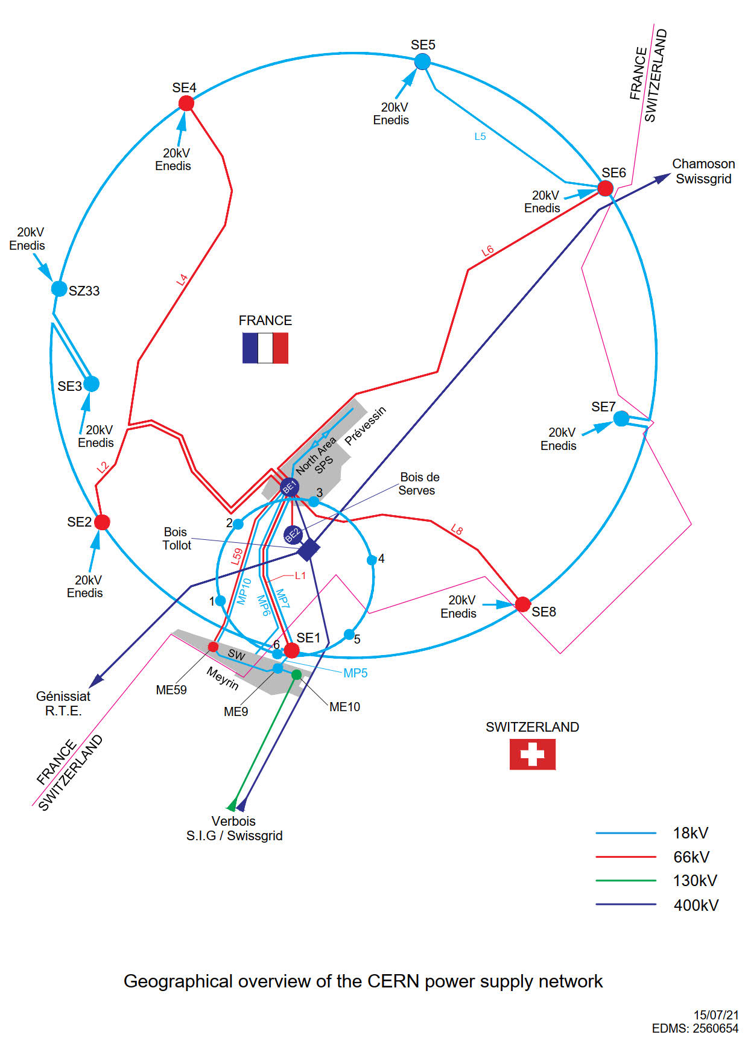
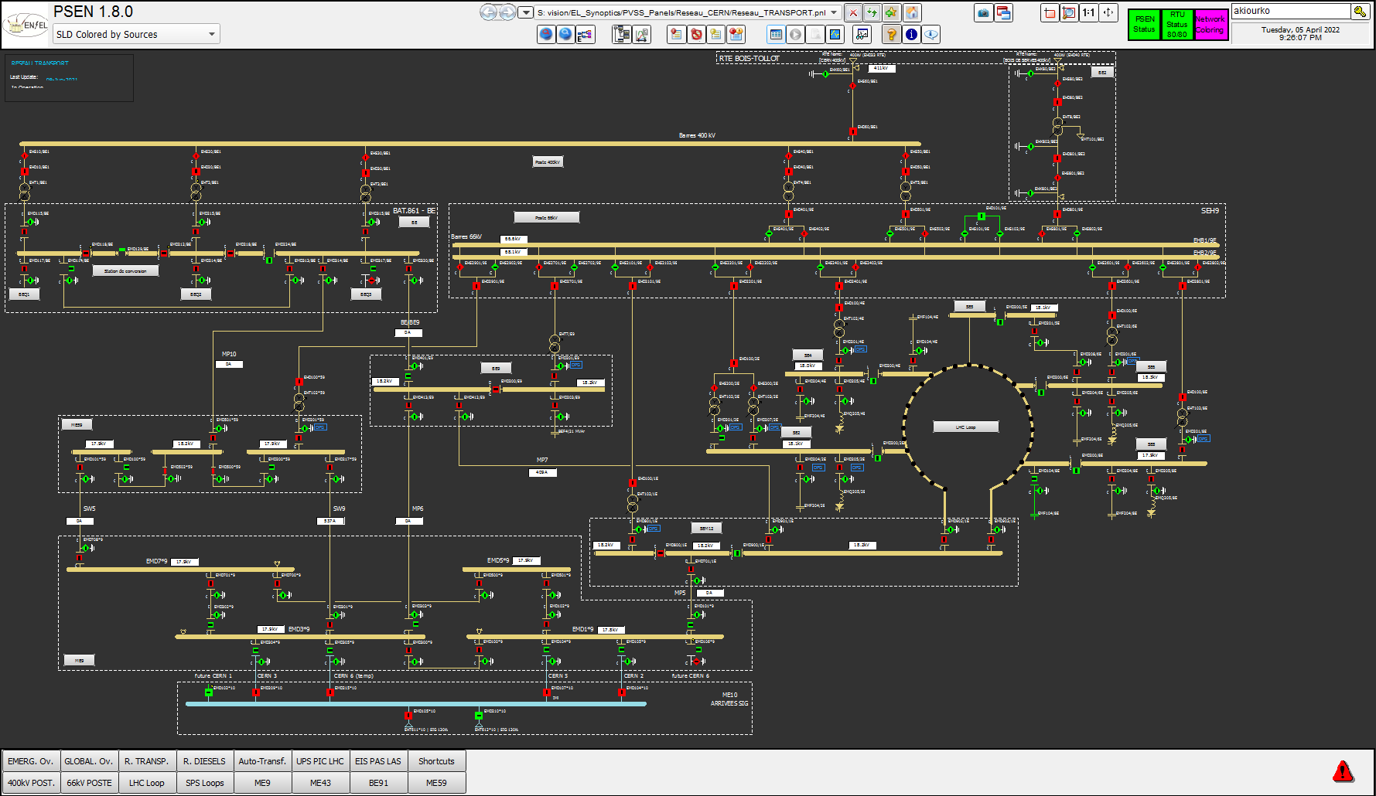
CERN’s Electrical Network

Slide 3
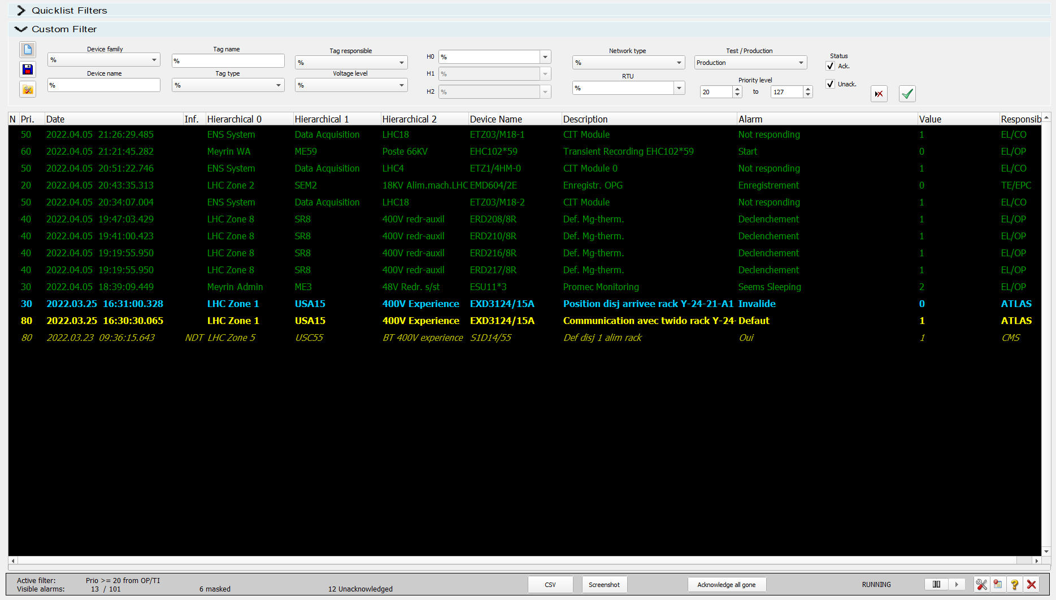
PSEN
WinCC OA based SCADA developed by BE/ICS
Monitoring CERN’s Electrical Network
320,000 data points
24,500 devices
125,000 alarm states

Slide 4
Goals & Principles
Achieve uniformity through standardization and harmonization
Boost efficiency and minimize effort
Reduce errors for dependable and accurate configuration
Avoid duplication
Balance reusable services with custom solutions, depending on needs

Slide 5

DIS - Demande d'Intervention SCADA
Where it all starts
User driven DIS submission
Utilize an online form for streamlined data input
Use data from the configuration system to ensure homogenization and uniformity
Identify dependencies to other systems
Automatically JIRA ticket generation
Monitoring progress through JIRA

Slide 6
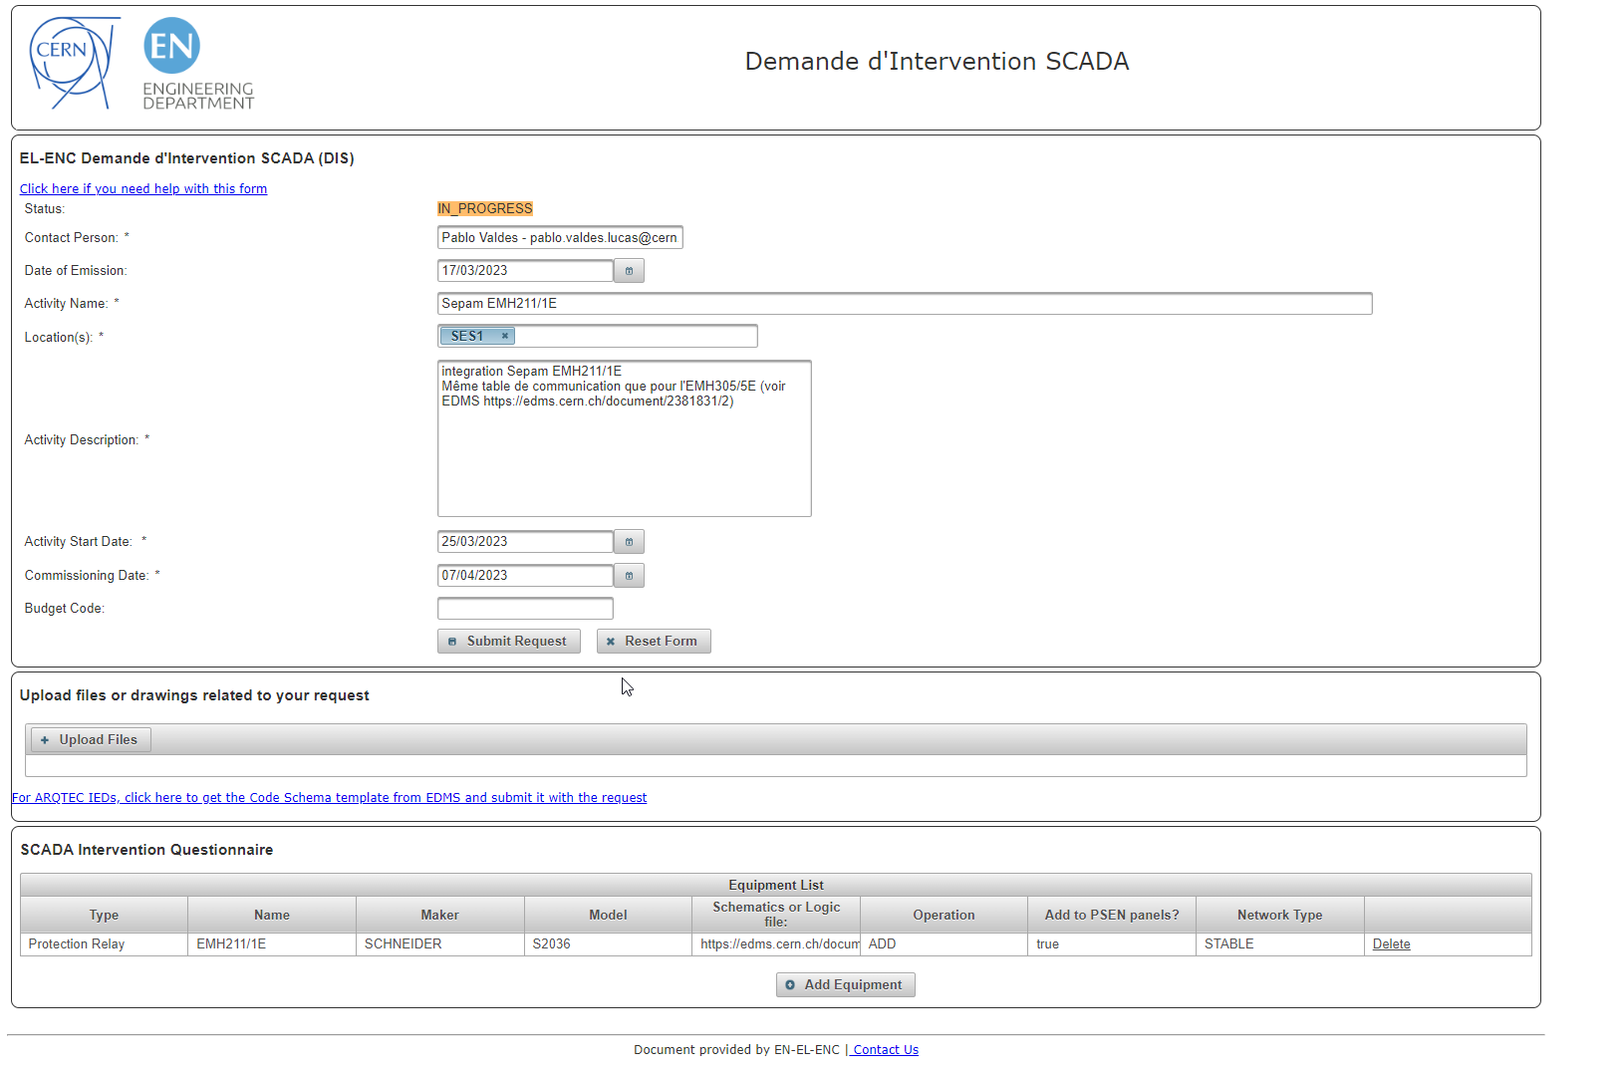
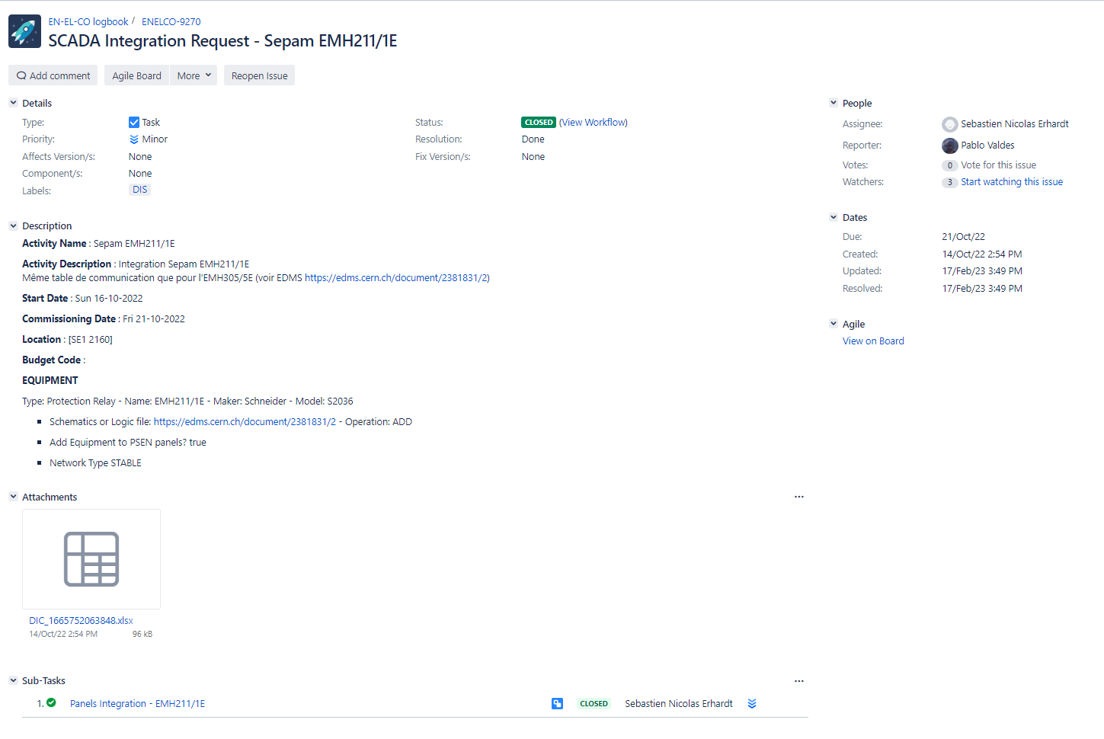
DIS

Slide 7
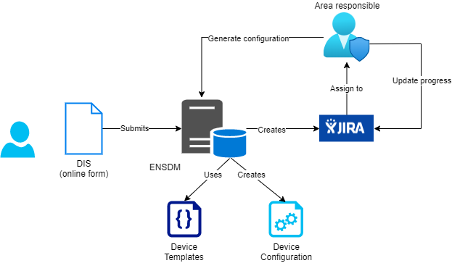
ENS Data Manager – Configuration System
Next step in the process
Ticket is assigned to the area responsible
JIRA is used for project management
The configuration system is used for generating configuration data
Device templates are used for the configuration
Operations that affect other systems (e.g. deletions):
      Affected systems identified and correcting actions triggered.
      Automatic generation of JIRA tickets and email notifications.

Slide 8
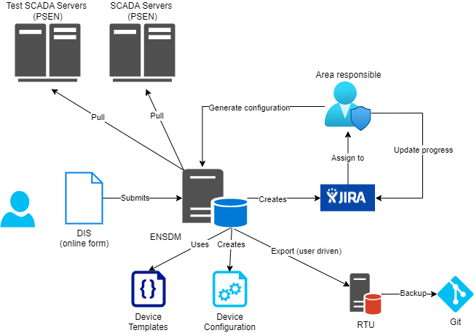
PSEN and RTU configuration
SCADA and Data concentrator config
ENSDM generates configuration data
Configuration is based on templates (Code Schema)
Devices are instances of the these templates
Allows to reuse and standardize
Apply system wide policies (e.g. alarm priorities)
Update external systems (EAM, MODESTI)
Provide audit trail

Slide 9
PSEN and RTU configuration
SCADA and Data concentrator config
Configuration of the RTUs is generated automatically by ENSDM
It needs to be exported and applied by the users
PSEN pulls the configuration from ENSDM once per week (weekly PSEN update)
New devices are put in test mode by default
RTU configuration is backed-up in Gitlab

Slide 10
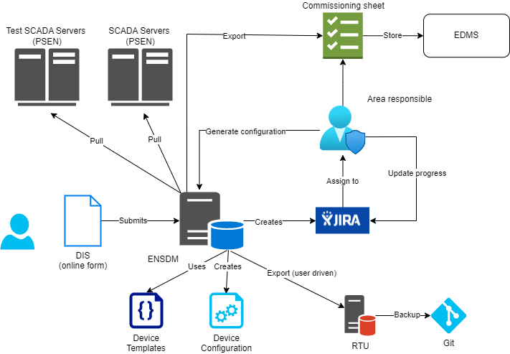
Commissioning
PSEN and RTU Commissioning
Commissioning sheets are generated by ENSDM ENSDM
Area responsible tests on RTU and PSEN
Fills in commissioning sheets and stores in EDMS
Updates JIRA
Takes devices out of test mode

Slide 11
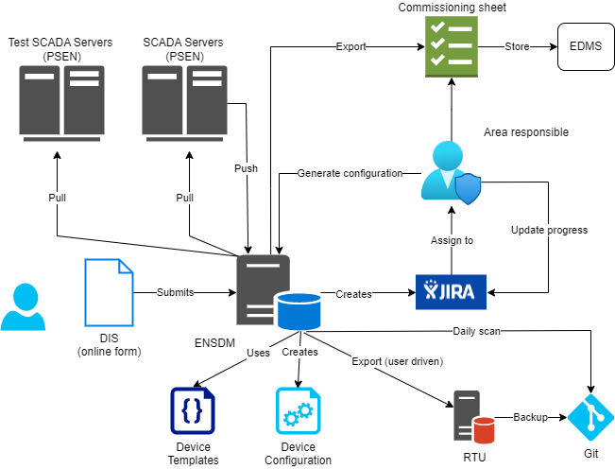
Ad-hoc modifications
Minor modifications
Minor modifications possible outside ENSDM
Directly in PSEN
Directly on the RTUs
Changes in PSEN are automatically propagated back to ENSDM
RTU changes are stored in Git and scanned daily by ENSDM

Slide 12

Future improvements
Automate deployment to the RTU
  Remove the manual export by the user
Streamline weekly PSEN update
  Automate parts of the process
  Reduce duration
Consolidate ENSDM UI
  Currently running 10+ years
  Refine, enhance and improve

