Slide 2
UNICOS-CPC Engineering workflow

Slide 3



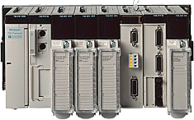
UNICOS-CPC
UNICOS Continuous Process Control (UNICOS-CPC) is a package of UNICOS to create PLC based process control applications.
Support for Siemens and Schneider PLCs only.
UCPC package
UNICOS
JCOP Framework
WinCC OA
PLCs CPC
Cryogenics
Gas
Collimators Interlocks
Cooling and Ventilation
Process Control applications

Slide 4
UNICOS-CPC provides
Libraries at the control and supervision layers
Well defined standard device objects that model most of the devices used in a controls system
A high performance PLC-SCADA communication mechanism (TSPP)
A formalised way to:
  Model control units of a process (based on ISA-88 and IEC 61512)
  Create system specifications
  Develop specific process logic
  Generate process control applications
  Operate a plant

Slide 5
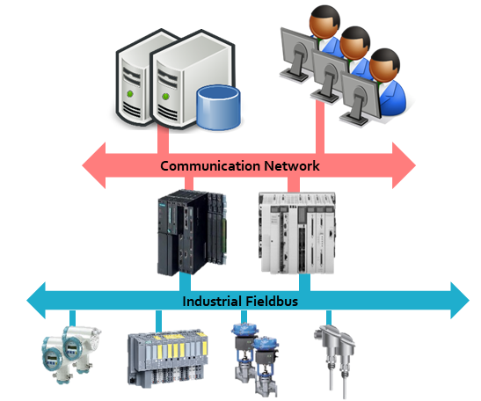
UNICOS-CPC technology
Supervision Layer: WinCC OA SCADA
Control Layer
    Siemens S7-300, S7-400, S7-1500.
    Schneider Premium, Quantum, M580, M340.
Local operation
    Simatic HMI (WinCC flexible, TIA portal)
    Schneider Magelis
Industrial communications: Profibus, Profinet, Ethernet/IP, Modbus TCP, OPC UA…

Slide 6
UNICOS-CPC engineering workflow
Process
Modelling
Specification
Specs
Logic templates
Deployment
Generation
(UAB)
P&ID
Process decomposition
Functional Units
Functional Analysis:
System requirements
Instrumentation
Electrical diagrams
UNICOS-CPC specs
Logic Templates
Expert templates (grafcets)
UAB CPC wizard
PLC Instances
PLC logic
HMI tags
WinCC OA object instances
Comm resources
SCADA set-up (synoptics)

Slide 7



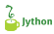





Generation with UAB
CPC Wizard
PLC sources:
Object instances
User logic
Comm
Device Types
Device Instantiation Templates
PID
Alarm
PLC: Instance and Logic Gennerator
HMI generator
SCADA generator
Analog
CPC
Spec file
User logic Files
Baselines
Process Logic
Templates
HMI configuration file
Touch Panel
SCADA
PLC
UAB
WinCC OA configuration file (Import file)
Reverse engineering

Slide 8
UAB CPC plugins
Siemens S7-300/400:
  S7 Instance Generator, S7 Logic Generator, S7 Project Generator
Siemens S7-1500:
  TIA Instance Generator, TIA Logic Generator, TIA Project Generator
Schneider:
  Unity Instance Generator, Unity Logic Generator, Unity Project Generator
SCADA: WinCC OA Generator
HMI: Touch Panel Generator
General Purpose: Expert User Generator

Slide 9
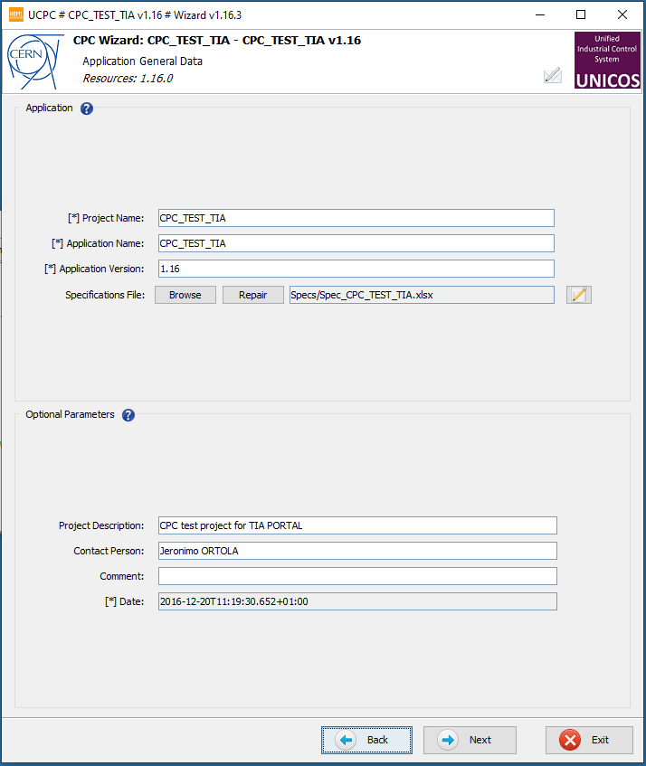
UAB CPC wizard

Slide 10
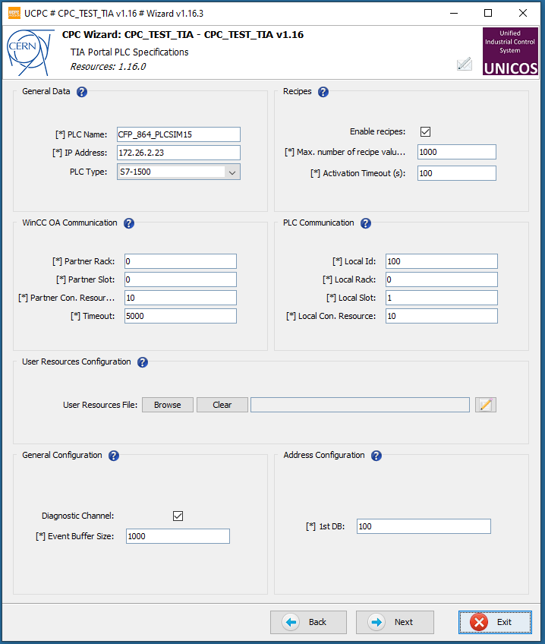
UAB CPC wizard

Slide 11
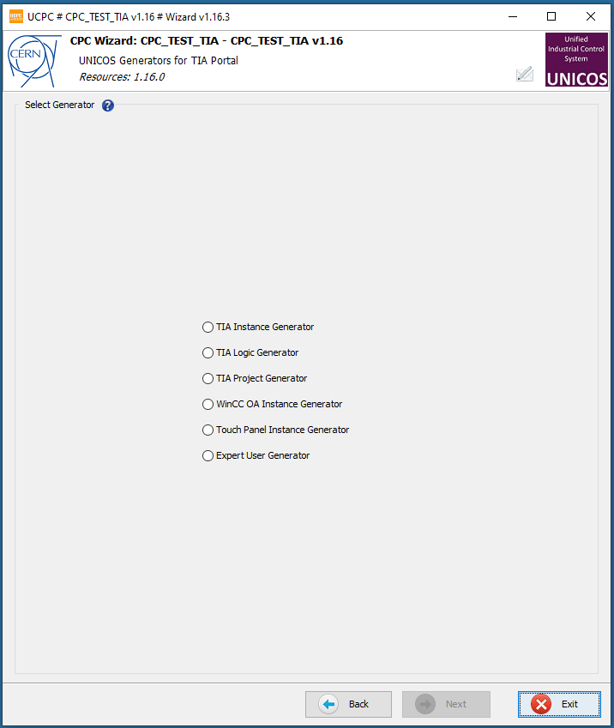
UAB CPC wizard

Slide 12
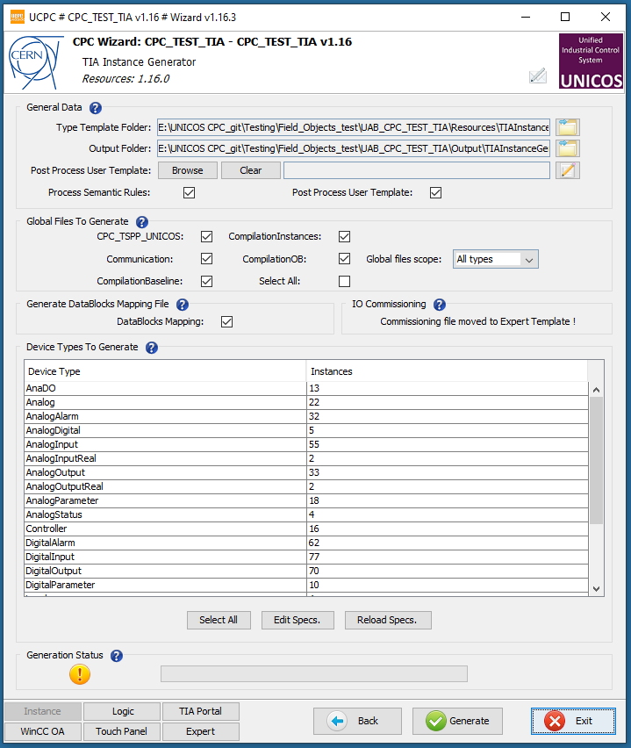
UAB CPC wizard

Slide 13
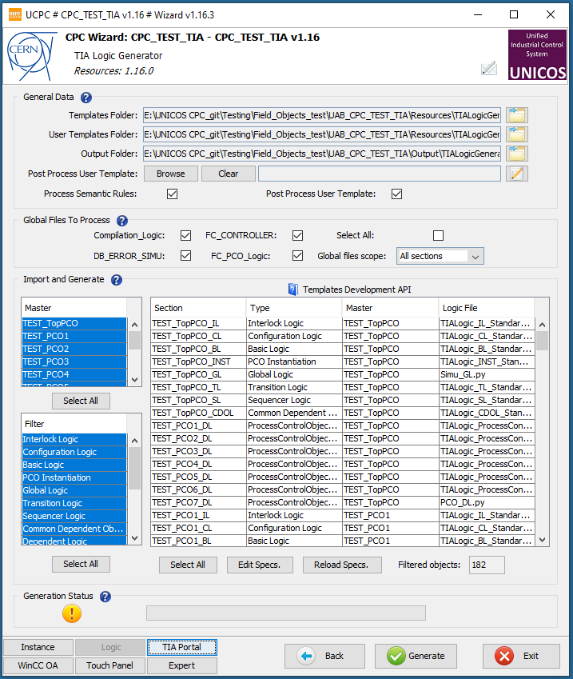
UAB CPC wizard

Slide 14
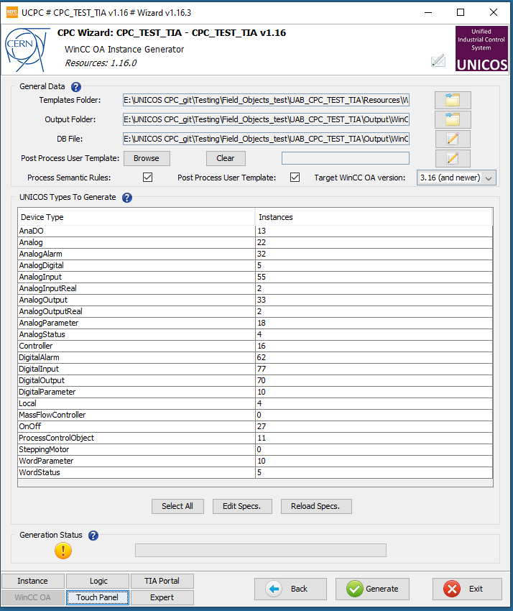
UAB CPC wizard

Slide 15
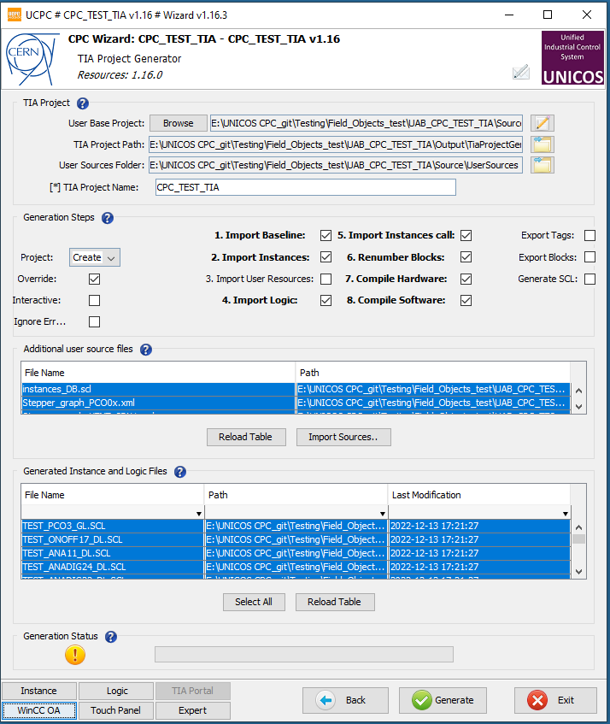
UAB CPC wizard

