Slide 1







The ⁷Be + d reaction in the context of the cosmological lithium problem
Dhruba Gupta
Department of Physics, Bose Institute
Sk M Ali, D Gupta, K Kundalia, S K Saha Bose Institute, India
O Tengblad, J D Ovejas, A Perea CSIC, Madrid, Spain
J Cederkall, J Park Lund University, Sweden
I Martel Bravo Universidad de Huelva, Huelva, Spain
S Swezc University of Jyväskylä, Finland
Bose Institute

Slide 2
Plan of talk
CLiP
Possible solutions: Nuclear Physics ?
Resonance excitations in ⁷Be + d channel
IS 554: ⁷Be + d @ 5 MeV/u
Results: ⁷Be(d,p)⁸Be*, ⁷Be(d,³He)⁶Li, second Li problem
Outlook

Slide 3
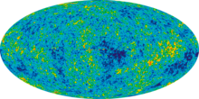
The standard Big Bang model of the Primordial Universe is very successful in accounting for the observed relative abundance of the light elements.
The only astrophysical input to the Big Bang Nucleosynthesis (BBN) calculation is the baryon density of the Universe, which is now known precisely.
However, BBN theory fails to predict correctly the observed abundance of ⁷Li.

Slide 4
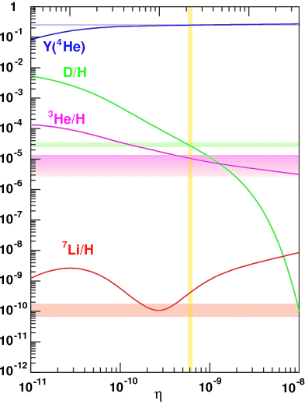


The Cosmological ⁷Li problem
BBN theory over predicts the abundance of ⁷Li by about a factor ~ 3 and up to five sigma deviation from observation. The theory uses the baryon-to-photon ratio η from measurements of cosmic microwave background (WMAP / PLANCK).
BBN theory using η:
Observationally extracted:
Serious discrepancy
Good agreement of BBN predicted abundances with observations for ²H, ⁴He.
Observed (predicted) values : bands (lines)
η = n_{B}/n_{γ} = 6.104 ± 0.058 × 10⁻¹⁰ baryon-to-photon ratio
For decades, one of the
important unresolved problems
Notes:
First, I explain what lithium 7 problem is.
It is a cosmological problem.
Light elements abundances synthesized at early universe are explained by Big Bang Nucleosynthesis called BBN.
Here, “early” means that the age of universe is between a few second and a few minutes.
This time region is sometimes called “The first three minutes”
BBN predicts light element abundances from a parameter, baryon to photon ratio.
This figure shows the predicted and observed abundances of the light element abundances.
In this figure the observed values are represented by these bands, and predicted values are represented by these lines.
At the observed value of baryon to photon ratio, observed values and predicted values are consistent, except for Lithium 7.
For lithium 7, predicted value is two or three times larger than observed value.
This inconsistency is called lithium 7 problem.
Since the predicted value exceed the observational value, we have to introduce a lithium 7 reducing process.

Slide 5
Possible Solutions
Astrophysical solutions tried to reconcile the difference on the basis of stellar processing of ⁷Li, it may be destroyed in metal-poor stars through diffusion and turbulent mixing. Improvements in observationally inferred primordial lithium abundance, found to be very difficult to justify enough destruction. Korn, Nature (2006); Ryan (1999)
Physics beyond standard BBN
Destruction of mass-7 nuclides through interaction with WIMP particles, unstable particles in the early universe that could have affected BBN. Existence of ⁸Be as a bound nuclide during BBN. Interpretations assumed nuclear reaction rates known accurately Goudelis (2016), Coc (2012), Fields (2011), Cyburt (2006)
Nuclear physics aspects of the primordial lithium problem
In the condition of BBN, ⁷Li is effectively destroyed through ⁷Li(p,α)⁴He, so that 95% of the primordial ⁷Li is the by-product of the electron capture β-decay of the primordial ⁷Be after the cessation of nucleosynthesis.
Nuclear aspects involve the reaction rates of ⁷Be production, mainly ³He(α,γ)⁷Be and its destruction through ⁷Be(n,p)⁷Li, ⁷Be(n,α)⁴He and ⁷Be(d,p)2α.
Notes:
First, I explain what lithium 7 problem is.
It is a cosmological problem.
Light elements abundances synthesized at early universe are explained by Big Bang Nucleosynthesis called BBN.
Here, “early” means that the age of universe is between a few second and a few minutes.
This time region is sometimes called “The first three minutes”
BBN predicts light element abundances from a parameter, baryon to photon ratio.
This figure shows the predicted and observed abundances of the light element abundances.
In this figure the observed values are represented by these bands, and predicted values are represented by these lines.
At the observed value of baryon to photon ratio, observed values and predicted values are consistent, except for Lithium 7.
For lithium 7, predicted value is two or three times larger than observed value.
This inconsistency is called lithium 7 problem.
Since the predicted value exceed the observational value, we have to introduce a lithium 7 reducing process.

Slide 6
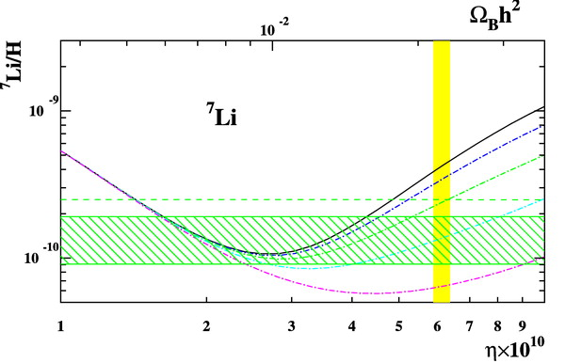
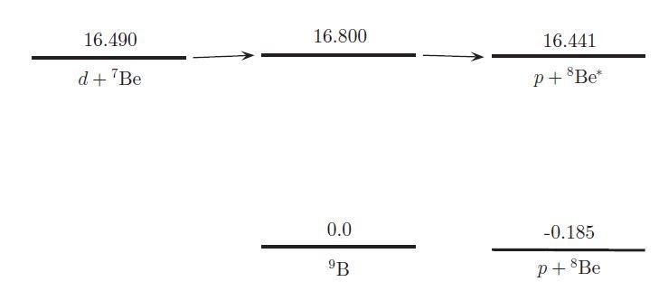
Incomplete nuclear physics input for BBN calculations ?
³He(α,γ)⁷Be has an uncertainty of < 5%
⁷Be(n,p)⁷Li, ⁷Be(n,α)⁴He have failed to solve the Li anomaly
Broggini JCAP(2012)
Damone PRL (2018) Barbagallo PRL (2016)
Increased mass-7 destruction via novel reaction pathways or by resonant enhancement of otherwise minor channels.
The ⁷Li discrepancy resolved, if the ⁷Be(d,p)⁸Be*(2α) Q = 16.674 MeV reaction rate larger by a factor ~ 100, Resonant enhancement in ⁷Be + d?
IJMPE (2012)
Coc APJ (2004)
Proposed ⁷Be destruction mechanism d + ⁷Be → ⁹B∗ → p + ⁸Be*
X 30
X 100
X 300
X 1000
Kirsebom PRC (2011)
The ⁷Be + d reaction leads to the 16.8 MeV state in ⁹B, which decays by proton emission to a highly excited state in ⁸Be, 16.626 MeV above the ground state, which subsequently breaks up into two α particles.

Slide 7
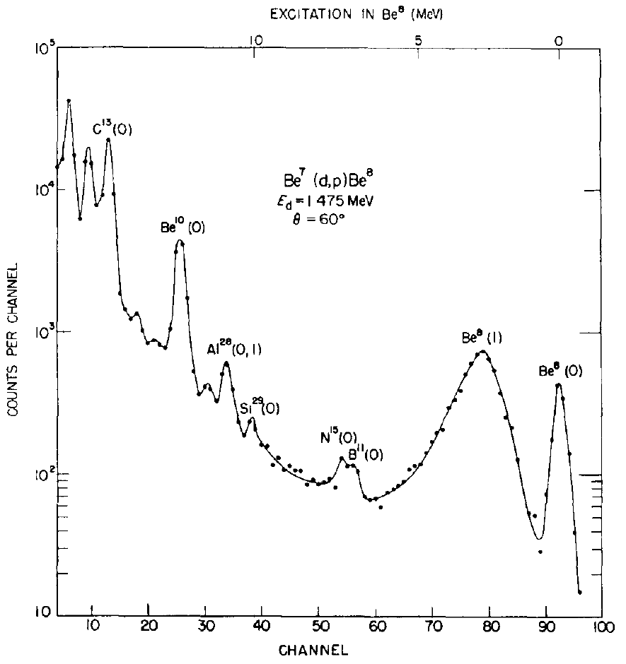
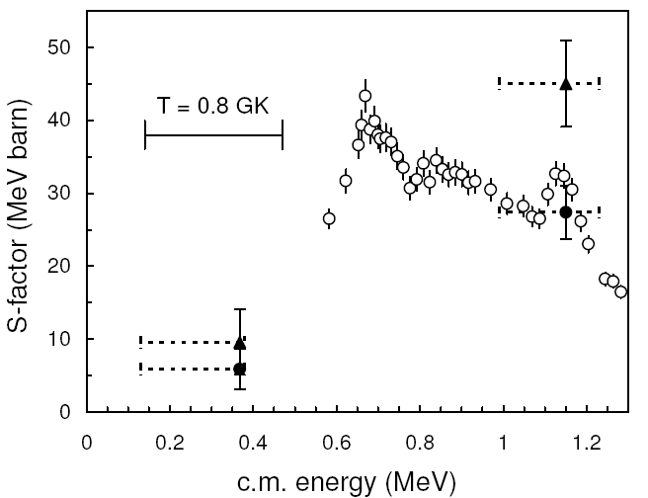
Caltech
E_{cm} = 0.6–1.3 MeV, up to E_{x} = 11 MeV in ⁸Be, protons detected for ⁸Be g.s(0⁺) and 3.03 MeV(2⁺)
Lacking complete angular distributions, data were converted to total cross section by multiplying by 4π and ~ 3 to take in to account contributions from higher excited states in ⁸Be. A constant S factor ~ 100 MeV b was adopted Parker (1972)
g.s (0⁺)
3.03 (2⁺)
⁸Be
Kavanagh NP (1960)
An experiment performed at lower energy found a significantly reduced cross-section in the BBN Gamow window compared to Parker’s estimate.
Angulo APJ (2005)
Louvain-la-Neuve
E_{cm} = 0.38, 1.23 MeV, up to E_{x} = 13.8 MeV in ⁸Be. Observed also 11.4 MeV(4⁺) higher energy level
Gamow window
Higher energy states not observed by Kavanagh contribute about 35% of total S factor. Reaction rate is smaller by a factor of ~2 at 1.0-1.23 MeV and by ~ 10 at energies relevant to BBN.
Kavanagh
Angulo g.s+3.03 MeV
Angulo Total S factor
The S factor at BBN energies was not underestimated by Parker but overestimated.

Slide 8
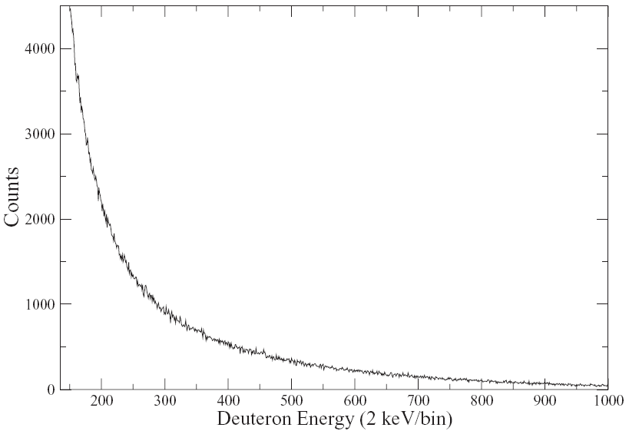
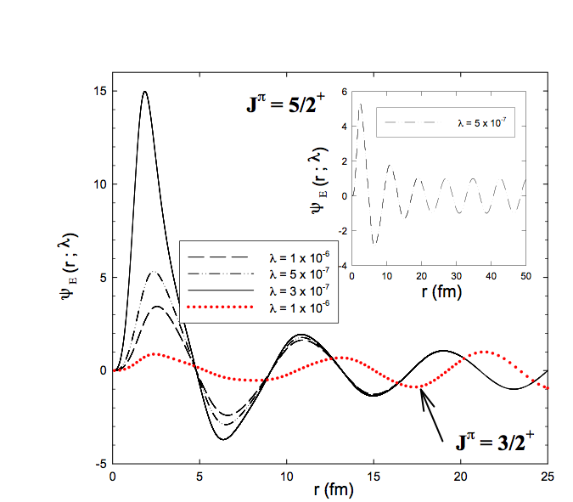
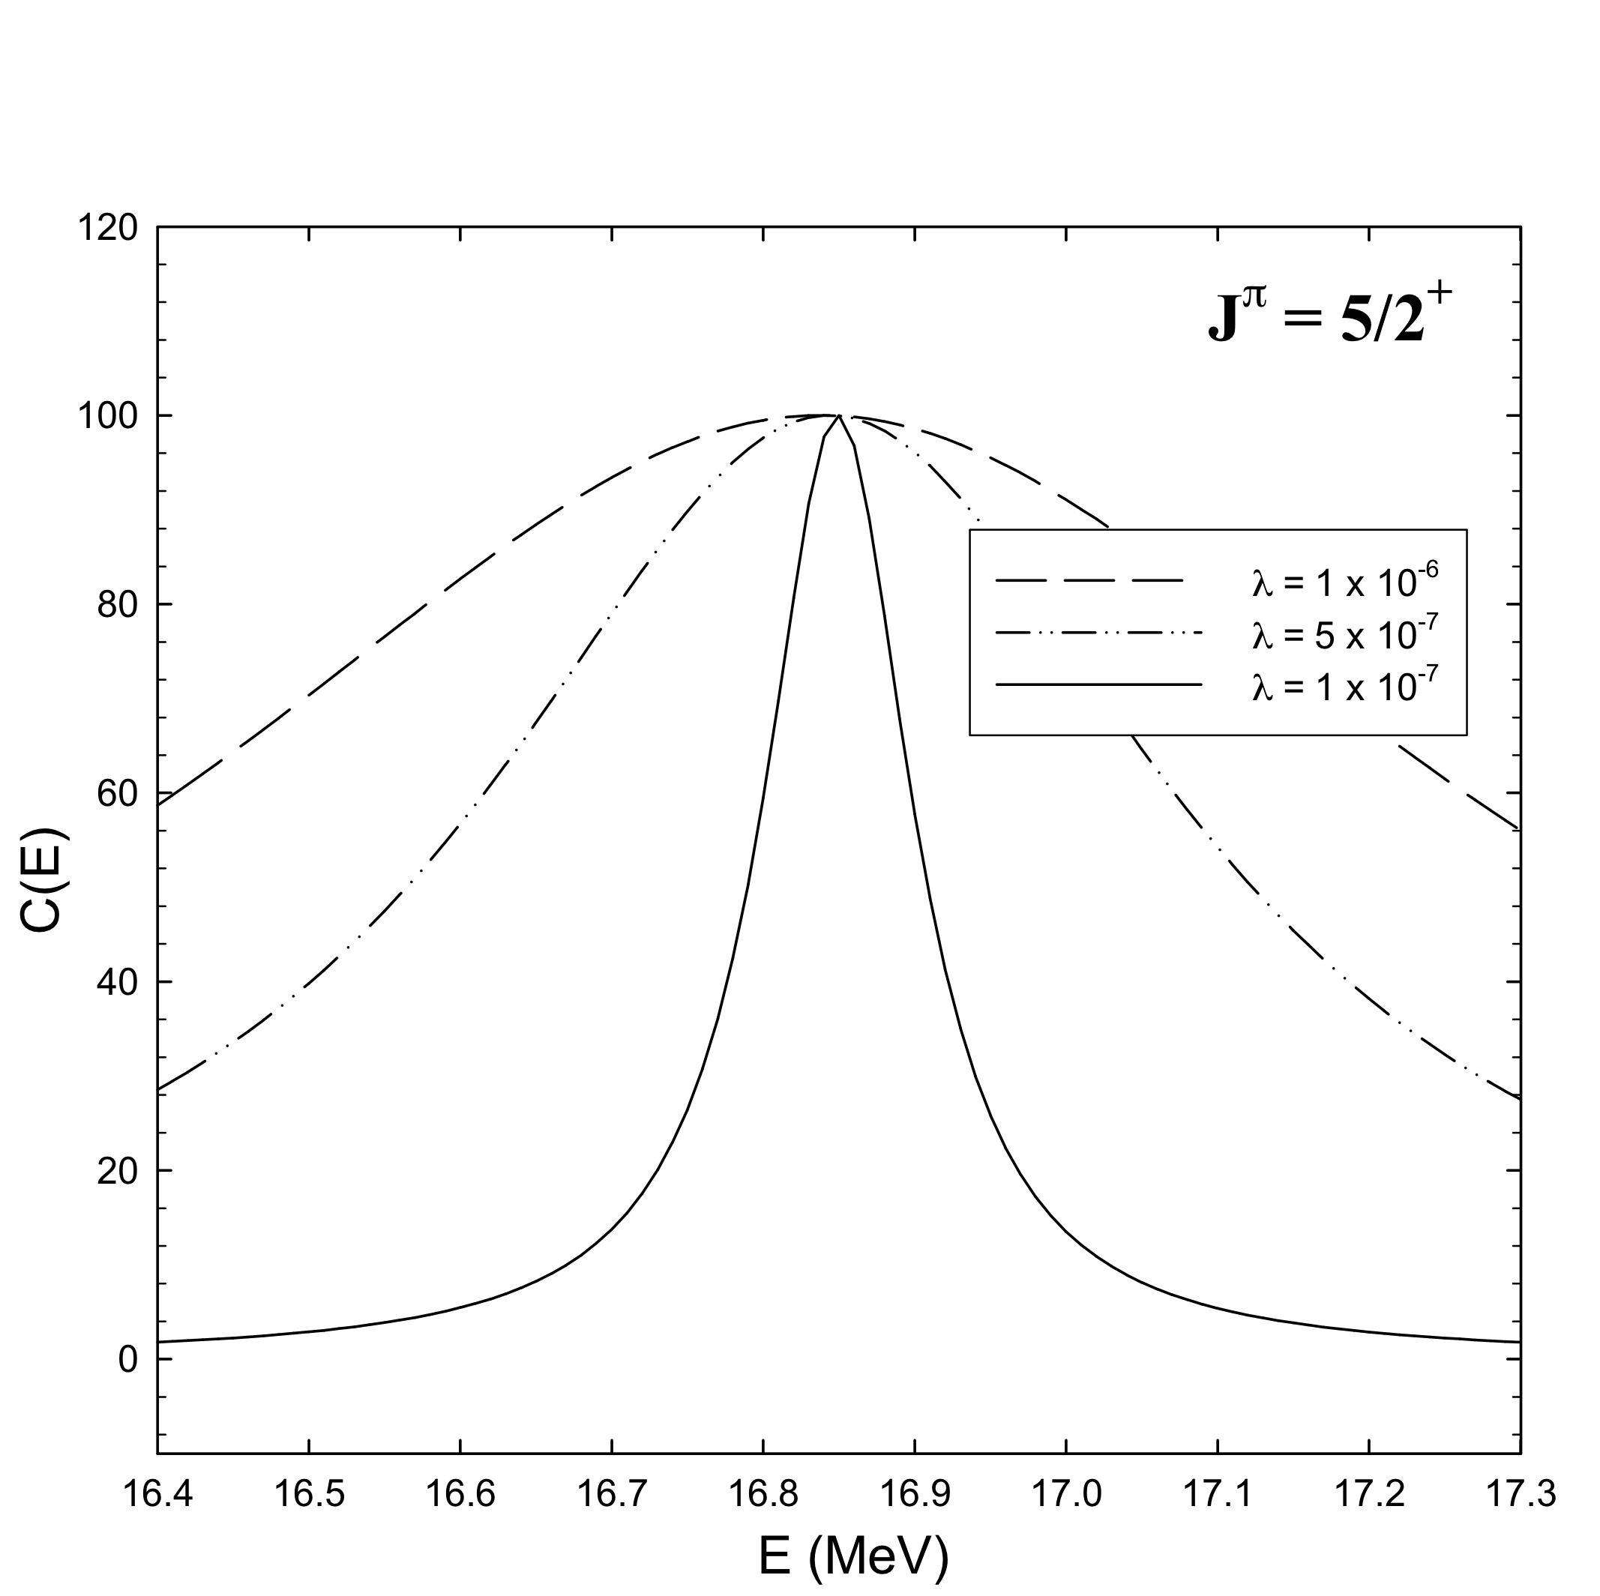
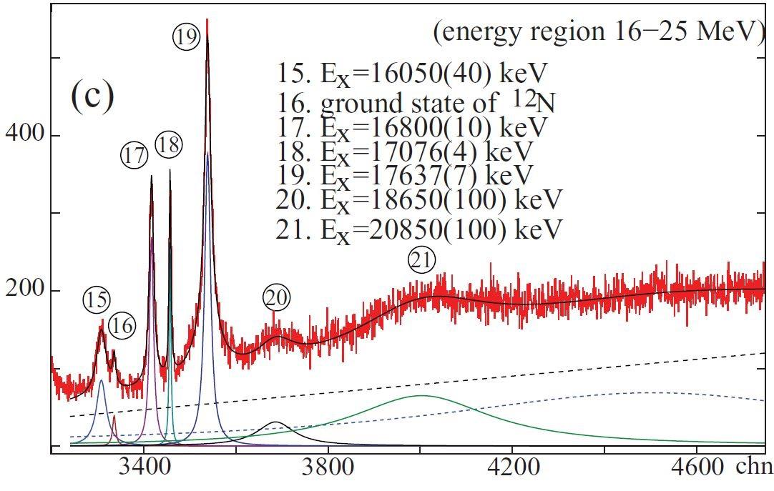
Other works suggested resonant enhancement through a high lying resonance state in ⁹B Cyburt (2005), Chakravorty (2011)
O’Malley PRC (2011)
Supersymmetric quantum mechanics to study the ⁹B resonance
⁷Be(d,d) E(⁷Be) = 10 MeV
Dutta arXiv (2020)
PLB (2018)
No evidence for a resonance
Oak Ridge
Scholl PRC (2011)
RCNP
Resonance energy E_{R}=16.84 MeV (5/2⁺)
Width Г = 69 keV
High resolution study of ⁹Be(³He,t)⁹B E= 140 MeV/A, the state is strongly excited.
Energy: 16.800(10) MeV (5/2⁺) , width: 81(5) keV

Slide 9
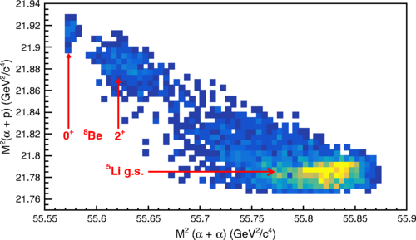
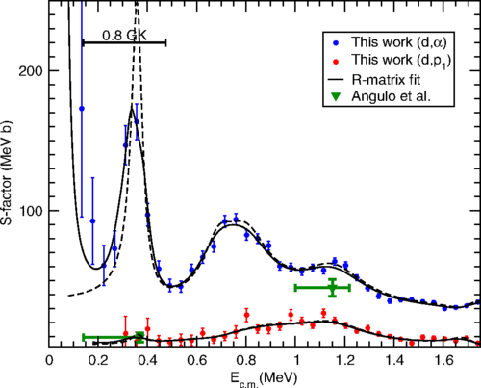
Recent work shows, d + ⁷Be → 2α + p may proceed through intermediate state in ⁸Be by ⁷Be(d,p)⁸Be(2α) or ⁵Li by ⁷Be(d,α)⁵Li(pα) sequence, or in a “democratic” three-particle decay of the ⁹B compound system.
Rijal PRL (2019)
FSU
E_{cm} ≈ 0.2–1.5 MeV, measured cross sections dominated by the (d,α) channel towards which prior experiments mostly insensitive.
A new resonance at 0.36(5) MeV observed, claiming to reduce predicted abundance of primordial ⁷Li.
R-matrix analysis: 16.849(5) MeV(5/2⁺) state in ⁹B? Speculation: ⁹B resonance at 16.80 MeV? Scholl (2011)
Additional experiments with improved statistics needed to reduce the uncertainty in the resonance energy.

Slide 10
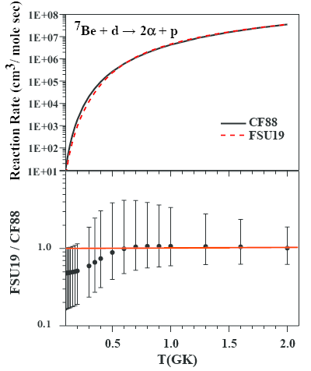
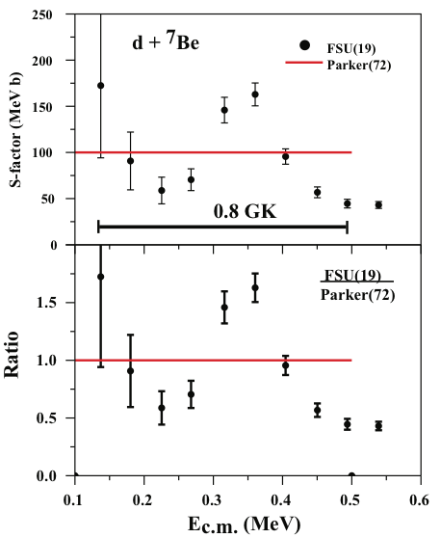
Gai Mem. S.A.It (2019)
FSU rate uncertain by a factor of 10, due to uncertainty of the resonance energy. Old BBN d + ⁷Be rate (CF88) and Rijal (FSU) rates are nearly identical.
Since no state is known in ⁹B at the proposed “new resonance” energy of 16.85 MeV, resolving such a major systematical uncertainty is required.
No reduction in ⁷Li abundance.
There are carefully measured cross-sections, but still ⁷Be destruction could be enhanced by unknown or poorly measured resonances. To determine fully the contribution of the ⁷Be(d,p)⁸Be reaction to the ⁷Li abundance, it needs to be measured for ⁸Be excitations around 16 MeV.

Slide 11
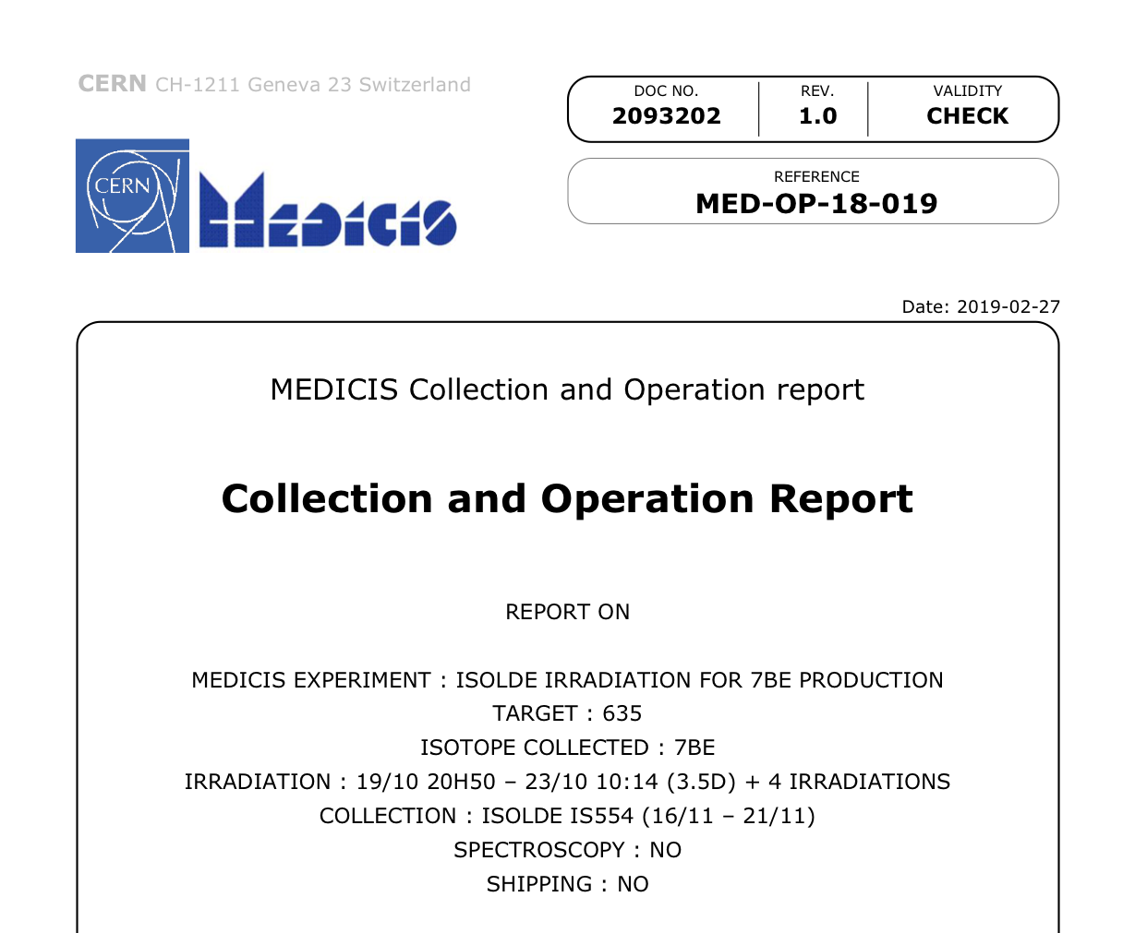
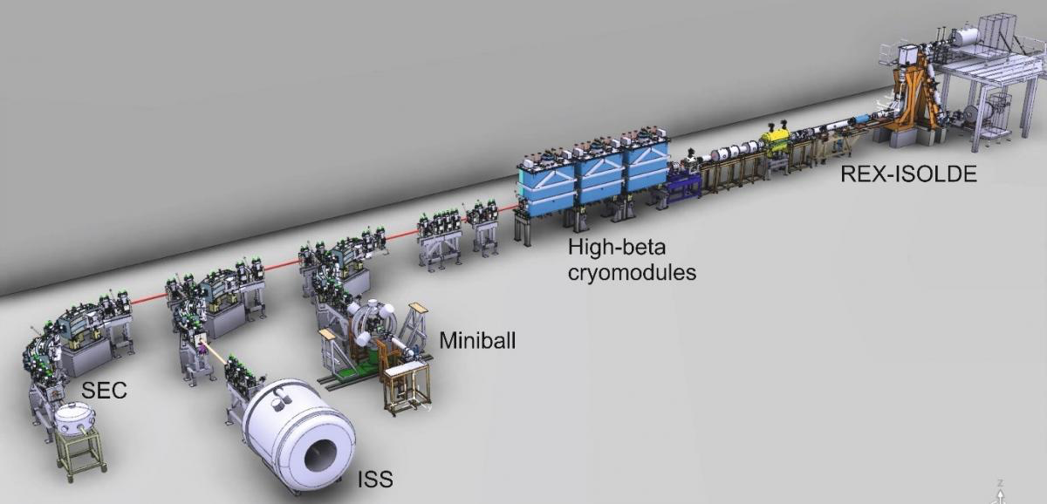
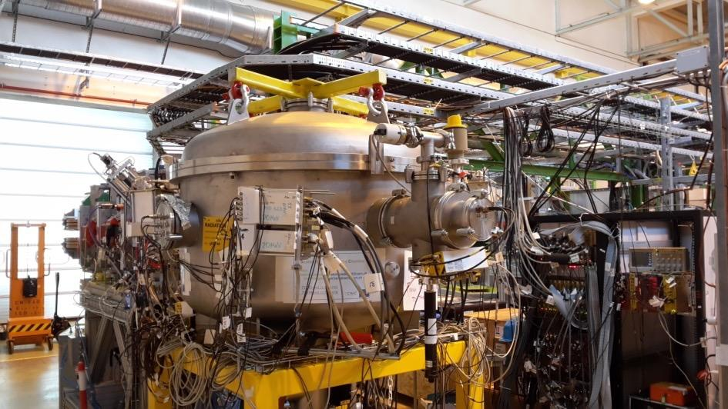
Experiment IS 554 @
⁷Be : E = 5 MeV/u , I ~ 5 x 10⁵ pps
Targets: CD₂ (15 μm), CH₂ (15 μm), ²⁰⁸Pb (1 mg/cm²)
Scattering Chamber (SEC)
The target (UCx) was irradiated with 0.37 μA of 1.4 GeV protons from the PS-booster offline during 3 days. The activated target was then mounted on the GPS target station, heated and the ⁷Be was extracted using the RILIS laser ion-source, and accelerated using the HIE-ISOLDE post accelerator. A stripping foil and a dipole before the experimental station was used to clean the beam to ⁷Be⁴⁺.

Slide 12
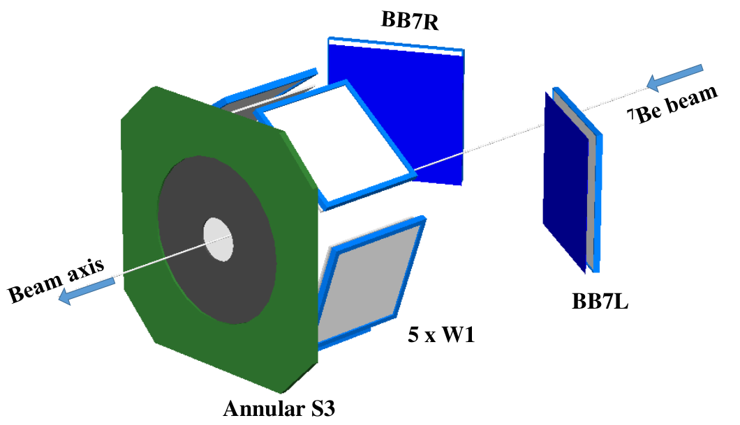
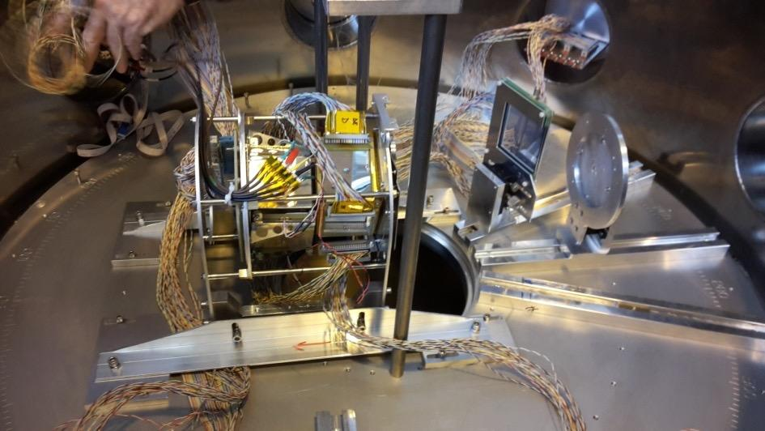
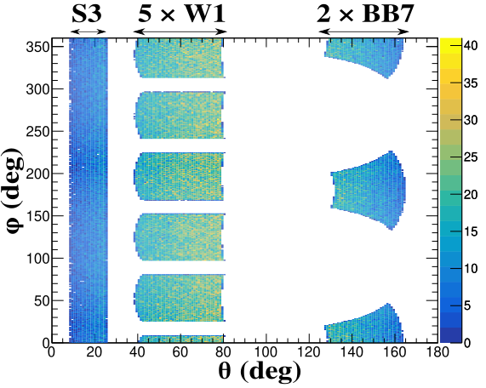
Experiment IS 554 @
The total solid angle coverage of the detectors is ∼32% of 4π.
Charge particle detector setup
1 x S3 annular DSSD (24 x 32 strips, 1000 μm) covering front angles 8º – 25º
5 x W1 DSSD (16 x 16 strips, 60 μm) in pentagon geometry covering angles 40º – 80º
2 x BB7 DSSD (32 x 32 strips, 60 μm and 140 μm) at backward angles 127º – 165º
The W1 and BB7 DSSDs are backed by 1500 μm thick unsegmented pads MSX25/MSX40

Slide 13
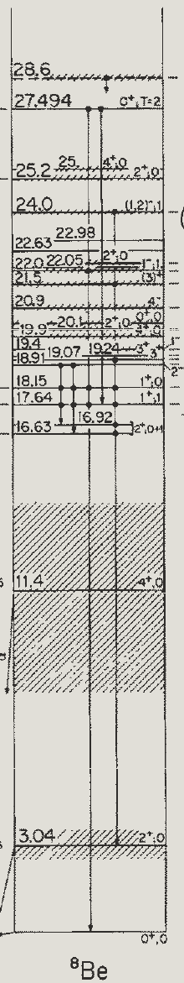
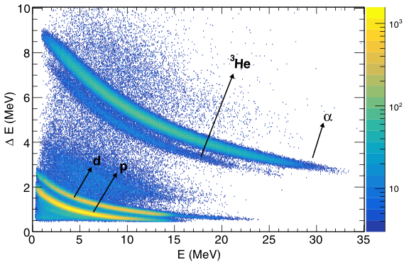
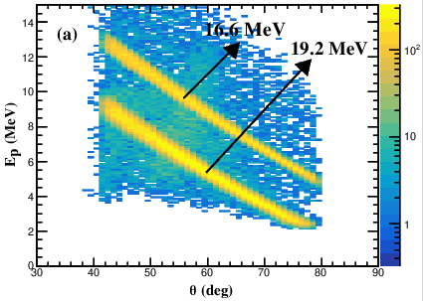
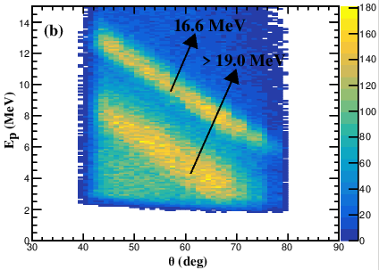
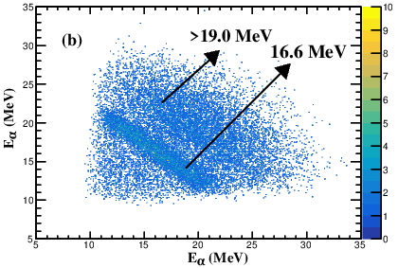
Experiment IS 554 @
Measured excitation energy of ⁸Be from 0-22 MeV in the ⁷Be(d,p)⁸Be* channel, events identified from E vs θ plot of protons detected in coincidence with α−particles.
Ali et al., PRL (2022)
Simulations
Data
Two distinct bands for higher excitations of ⁸Be, one corresponds to states 16.63 MeV and 16.922 MeV, other to states in 17-22 MeV. Earlier works suggest that 16.63 MeV state populated considerably more than 16.92 MeV. Hence, we refer to this doublet as 16.63 MeV.
ΔE-E spectrum of p, d, ³He, and α, detected at W1 + MSX25 telescopes
The ⁷Be(d,p)⁸Be* events for forward scattered protons to S3 were clearly identified from energy-energy correlations of two coincident α-particles at W1.

Slide 14
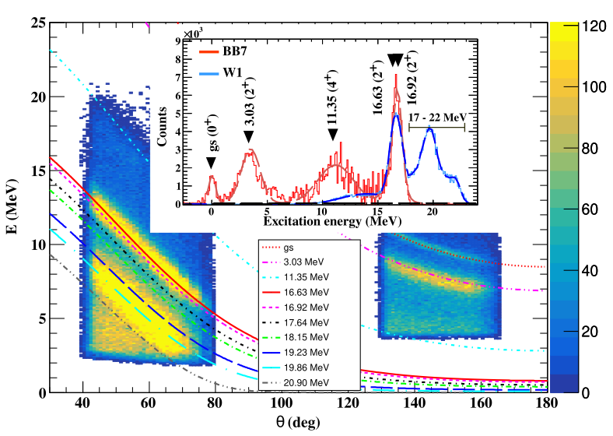
Experiment IS 554 @
Ali et al., PRL (2022)
BB7 counts x 2 for clarity.
E vs θ for protons at W1 and BB7. The kinematic lines for different excited states of ⁸Be are shown and the inset shows the excitation energy spectrum of ⁸Be from 0-22 MeV.
⁷Be(d,p)⁸Be*
The energy resolution ∼660 keV due to beam, target straggling and detectors, limits the separation of narrowly spaced high lying states at 16.63 and 16.92 MeV, and around 17–22 MeV. The errors in cross sections mainly arise from statistical uncertainties, systematic uncertainties in target thickness (∼10%) and beam intensity (∼10%).

Slide 15
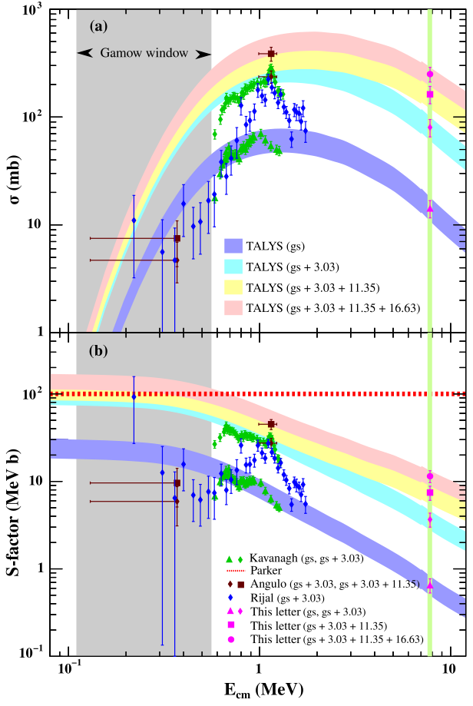
⁷Be(d,p)⁸Be*
Ali PRL (2022)
Excitation function of the different levels is calculated with the nuclear reaction code TALYS. The bands are TALYS calculations normalized to the measured cross section, giving an estimate of contributions of individual states of ⁸Be up to the 16.6 MeV state for the first time.
The existing data within Gamow window (T = 0.5–1 GK, E_{c.m.} = 0.11–0.56 MeV) has large error bars. Good agreement with data outside Gamow window.
The S factor due to contribution of gs+3.03+11.35 MeV state agrees with Parker’s estimate of 100 MeV b. Addition of the 16.63 MeV state leads to a maximum value of 167 MeV b but is not adequate to solve the Lithium anomaly. The Li abundance is reduced by < 1%.
Contribution of higher excited states in ⁷Be(d,p)⁸Be* do not solve the Cosmological lithium problem

Slide 16
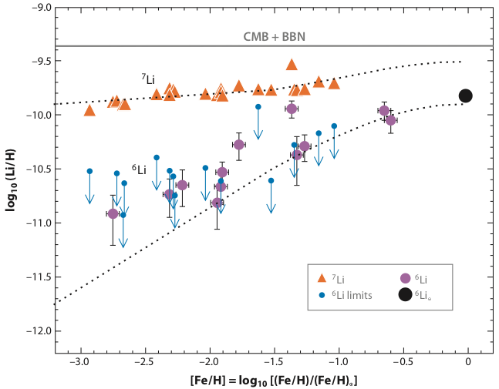
Second Li problem ?
Fields ARNPS (2011)
Lithium abundances in selected metal-poor Galactic halo stars. For each star, both lithium isotopes are plotted versus the star’s metallicity. The flatness of ⁷Li versus iron is known as the Spite plateau; it indicates that the bulk of the lithium is unrelated to Galactic nucleosynthesis processes and thus is primordial. The horizontal band gives the CMB+WMAP prediction.
Points below the Spite plateau show ⁶Li abundances; the apparent flatness of these points (suggesting a primordial origin) constitutes the ⁶Li problem. BBN predictions underestimate the observed abundance by a factor of ~1000. Curves show predictions of a Galactic cosmic-ray nucleosynthesis model.
⁶Li observations remain controversial and only for a few halo stars, ⁶Li detection is confirmed. How to explain the ⁶Li plateau, if it exists.
⁶Li production in standard BBN is very small: ⁶Li/H ≃ 10⁻¹⁴, ⁶Li/⁷Li 􏰄≲ 10⁻⁴, far below the ⁶Li plateau.
Are there novel reaction pathways or resonant enhancement of otherwise minor channels ?

Slide 17
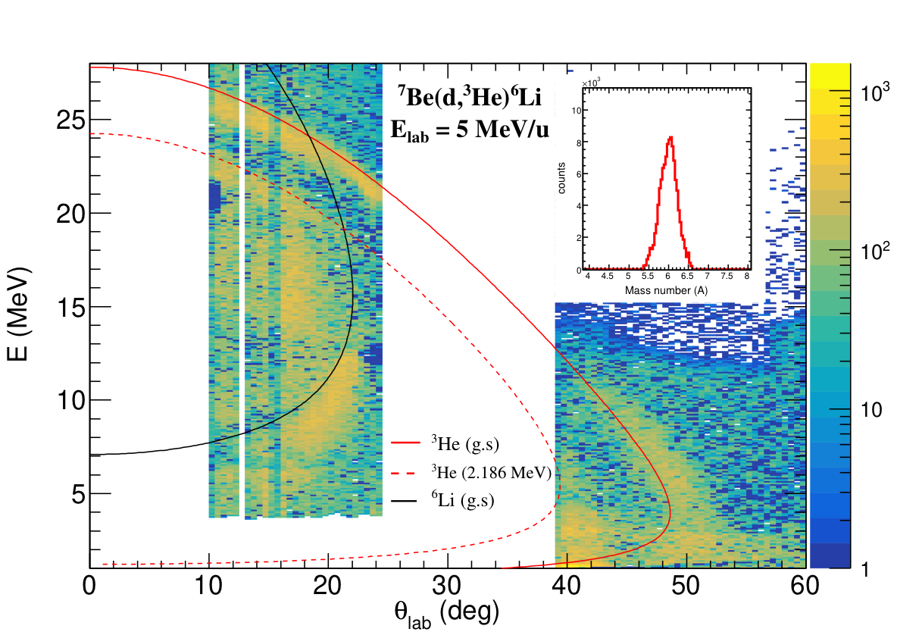
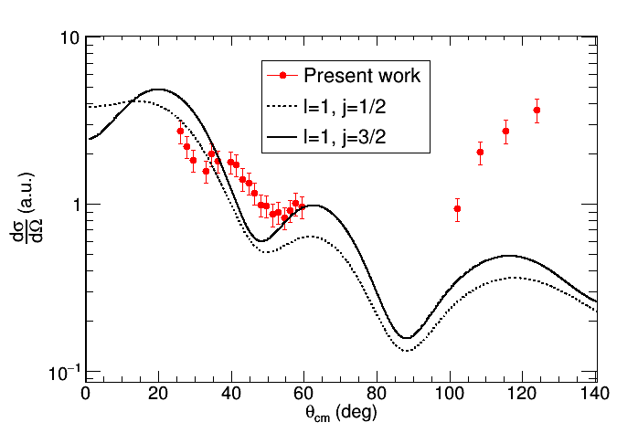
⁷Be(d,³He)⁶Li
This ⁷Be destruction reaction may impact both the lithium problems simultaneously. It produces ⁶Li and destroys ⁷Be, thereby decreasing ⁷Li abundance indirectly. If this reaction rate is artificially multiplied by 100, the BBN calculations result in a 45% decrease in abundance of ⁷Li and 47% increase in abundance of ⁶Li.
Existing measurement at E_{cm =} 4.0 and 6.7 MeV Li et al. (2018). No kinematical identification, relied on MC simulations. Statistical uncertainty ~ 10% - 67%.
IS554 data
The coincident detection of ³He and ⁶Li from ⁷Be(d, ³He)⁶Li. Clear kinematic signatures are observed from E-θ plot. Missing mass spectrum by gating events on ³He band.
In preparation
The p-transfer agree with forward angle data, 𝛼-transfer increases cross section at back angles, elastic-transfer effect in (d + ³He) may cause back angle rise.
In preparation
Angular distribution of ⁷Be(d, ³He)⁶Li at 5 MeV/u and DWBA calculations.

Slide 18
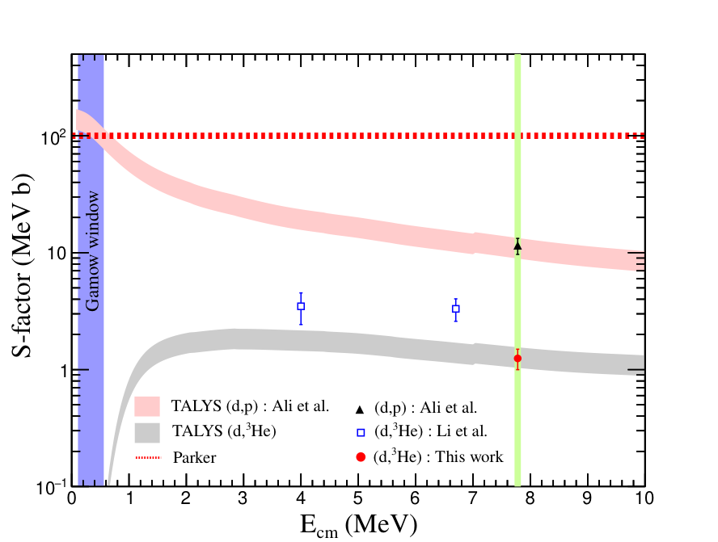
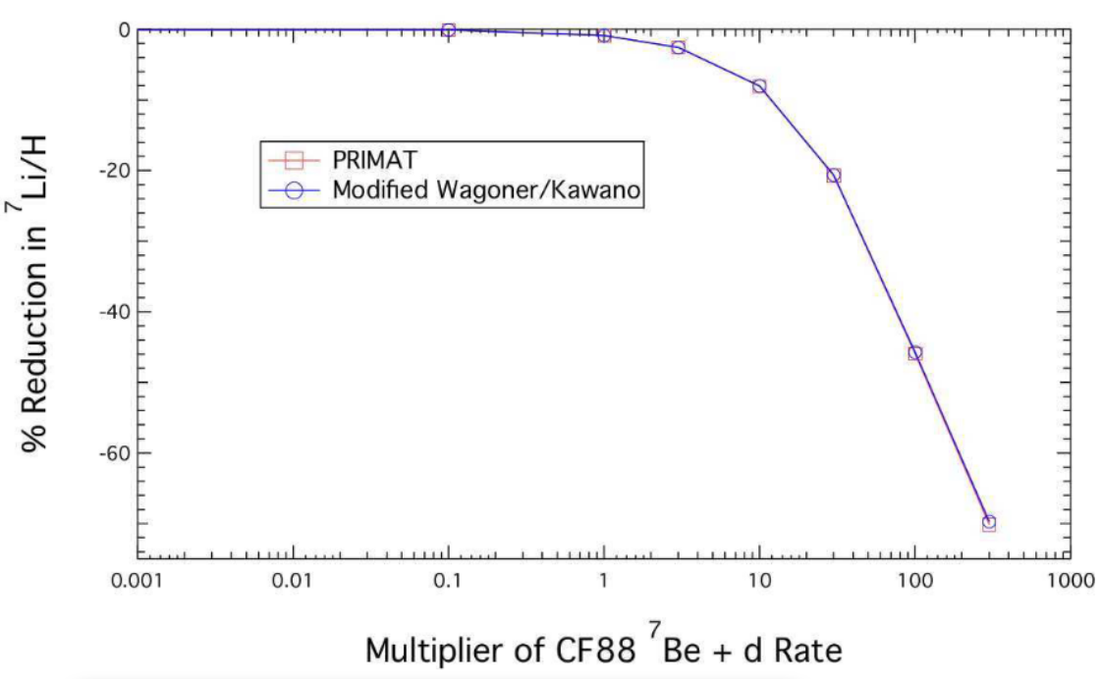
⁷Be(d,p)⁸Be* and ⁷Be(d,³He)⁶Li
In preparation
B. Davids (2020)
Excitation function calculated using TALYS by normalizing with present data at E_{c.m.} = 7.8 MeV. S factor of (d, ³He) is ~3 orders of magnitude less than (d,p) inside the Gamow window. It is almost 50% lower than Li et al data at nearby energies (may be due to lower statistics and contribution of other channels in Li et al data).
For (d,p), S factor of 167 MeV b, the ratio of reaction rate from the present work and CF88 at the relevant BBN energies is < 2 whereas for solving the Li problem this ratio ~ 100. The ⁷Be destruction by the (d, ³He) is negligible compared to (d,p). Both channels are not able to alleviate the Li anomalies.

Slide 19
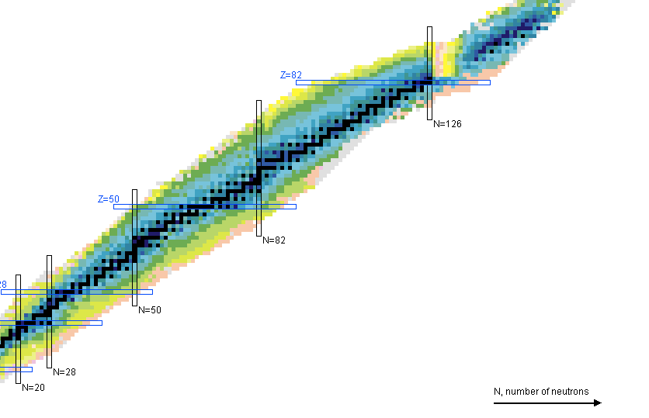
Outlook
Search for nuclear physics solution to the CLiP through the possible influence of resonances at higher excitation energies, that could enhance ⁷Be destruction
Destruction channels ⁷Be(n,p)⁷Li, ⁷Be(n, α)⁴He decrease lithium abundance but are insufficient. Damone (2018), Barbagallo (2016). ⁷Be(d,α)αp leads to speculation of a new resonance at E_{cm}= 0.36 MeV Rijal (2019) but no reduction of ⁷Li abundance Gai (2020).
Contribution of ⁸Be* higher excited states to the ⁷Be(d,p)⁸Be* cross section is reported for the first time. Including contribution of the measured 16.63 MeV state, the S factor is estimated to reach 167 MeV b inside Gamow window (60% higher than currently used 100 MeV b in BBN calculations). No substantial mitigation (< 1%) of the discrepancy. The ⁷Be destruction by (d, ³He) is negligible compared to (d,p).
The cosmological lithium problem persists!
Nuclear physics solutions are found to be inadequate. Solutions to ⁷Li and ⁶Li anomalies are difficult to find in reaction rates and may well require physics beyond the Standard Model, although deuterium and ⁴He must remain unperturbed.
It would be interesting in future to see if the lithium problems truly point to new fundamental physics.

Slide 20
References
R. W. Kavanagh, Nuclear Physics 18 (1960) 492
Angulo et al, Astrophys. Jour. 630 (2005) L105
C. Broggini et al JCAP 06, 30 (2012)
Damone Phys. Rev. Lett. 21, 042701 (2018),
Barbagallo Phys. Rev. Lett. 117, 152701 (2016)
Cyburt Int. Jour. of Mod. Phys. E (2012)
A. Coc et al., Astro. Phy. Jour., 600, 544 (2004)
O.S.Kirsebom et al., Phys. Rev. C 84, 058801 (2011)
O’Malley et al Phys. Rev. C 84, 042801( R) (2011)
Scholl et al Phys. Rev. C 84, 014308 (2011)
S. K. Dutta et al, arXiv:2004.09105 [nucl-th] (2020); Phys. Lett. B 776, 464 (2018)
Rijal et al Phys. Rev. Lett. 122 (2019) 182701
Moshe Gai Mem. S.A.It 75 (2019) 282
G. R. Caughlan, At. Data Nucl. Data Tables 40, 283 (1988)
Thierry Stora; CERNEDMSMEDI-CIS operation Report No. 2093202 (MED-OP-18-019)
Sk M Ali et. al. Phys. Rev. Lett. 128 (2022) 252701
B. D. Fields, Ann. Rev. Nucl. Part. Sci. 61, 47 (2011)
E. T. Li et al. Chinese Physics 42, 044001 (2018)
B. Davids, Mem. Soc. Astron. Ital. 91, 20 (2020)

Slide 21
IS 554 collaboration
Sk Mustak Ali, Dhruba Gupta, Kabita Kundalia, Swapan K Saha
Dept. of Physics, Bose Institute, Kolkata, India
Bose Institute
Olof Tengblad, Javier Diaz Ovejas, Angel Perea
Instituto de Estructura de la Materia, Madrid, Spain
Joakim Cederkall, Joochun Park
Lund University, Sweden
Ismael Martel Bravo
Universidad de Huelva, Huelva, Spain
Stuart Swezc
University of Jyväskylä, Finland

Slide 22




Thank You
Acknowledgements
ISOLDE engineers in charge, RILIS team, Target Group
Grant agreement no. 654002 (ENSAR2)
Grant ISRO/RES/2/378/15-16 (ISRO, Govt. of India)

