Slide 1
Tunnel Asset Management Short and long-term requirements – BE Robotics/SCE Collaboration
SCE-DOD-FS
John A. Osborne, Martin Cull, Vanessa Di Murro, Aohui Ouyang
08/03/2023
SCE
Site and Civil Engineering

Slide 2
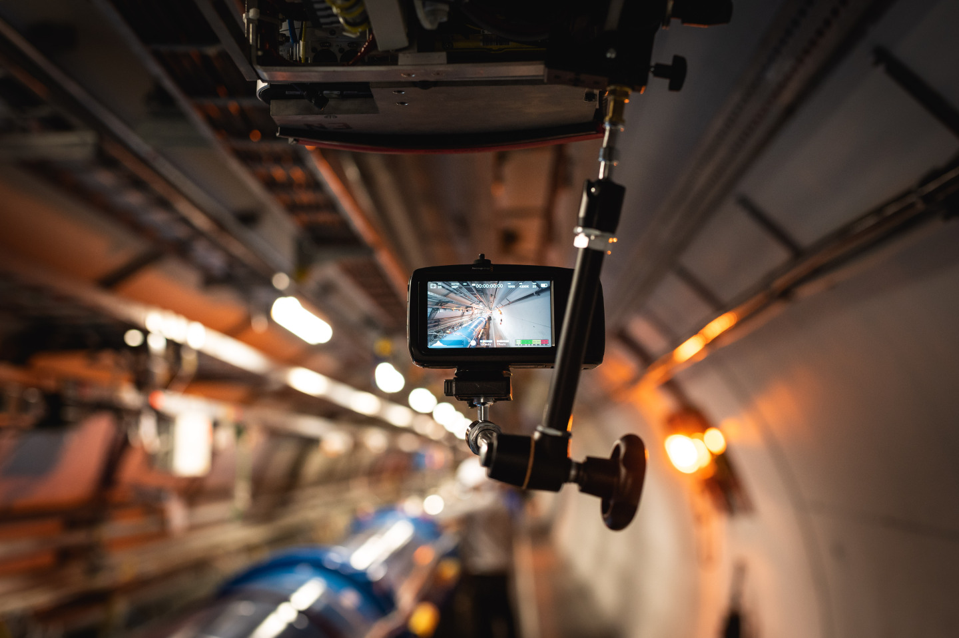
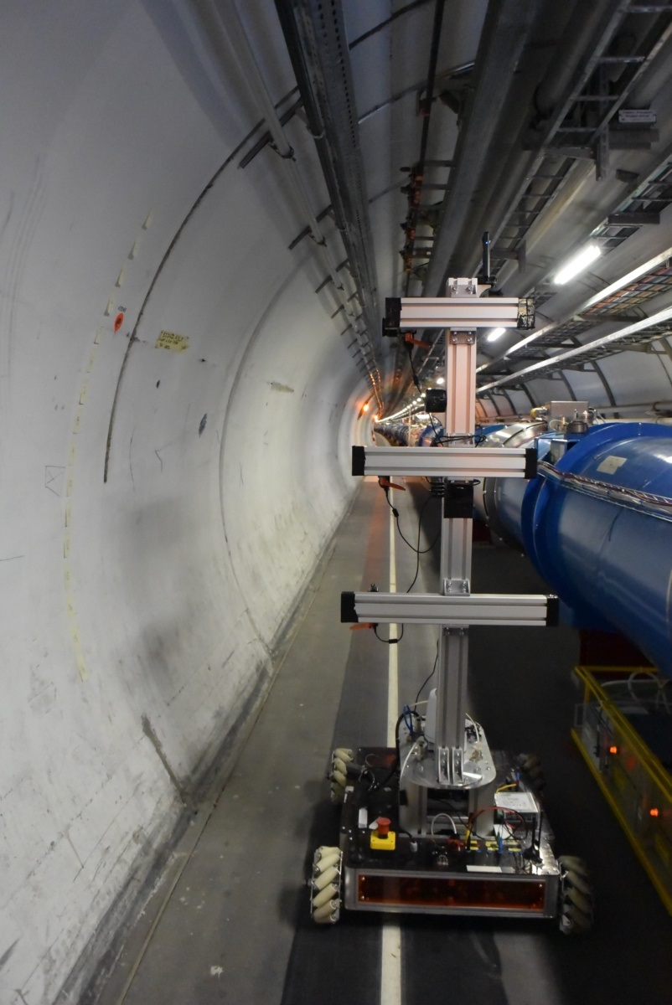
YETS 2023/2024 deliverables: LHC & SPS tunnels
Collaboration with the BE-CEM department aims to improve safety and efficacy of inspections by using advanced robotics solutions (CERNbot & TIM) for remote monitoring of CERN underground.
YETS 2023/2024 objectives
Video and/or images taken from TIM of LHC Sector 3-4 with high resolution camera for identifying critical tunnel sections (camera* to face the tunnel lining surface).
Video and/or images taken from CERNbot of SPS Sector 1-2 with high resolution camera for crack detection and classification (camera* to face the tunnel lining surface).
Thermal images data acquisition for water ingress and sediment detection (if thermal camera is available).
TIM – Tunnel Monorail
*Camera details to be defined in the Proposal document drafted by SCE-DOD-FS
CERNbot

Slide 3
Long-term deliverables: LHC & SPS tunnels
Long-term (after YETS 2023/2024)
Development of a monitoring system suitable for large-scale underground infrastructures ie. FCC
Regular monitoring activities of all LHC, SPS, PS and injection tunnels by using advanced robotics solutions to be carried out every year during the YETS/technical stop
For the inspection of the shafts further robotics development is required

Slide 4
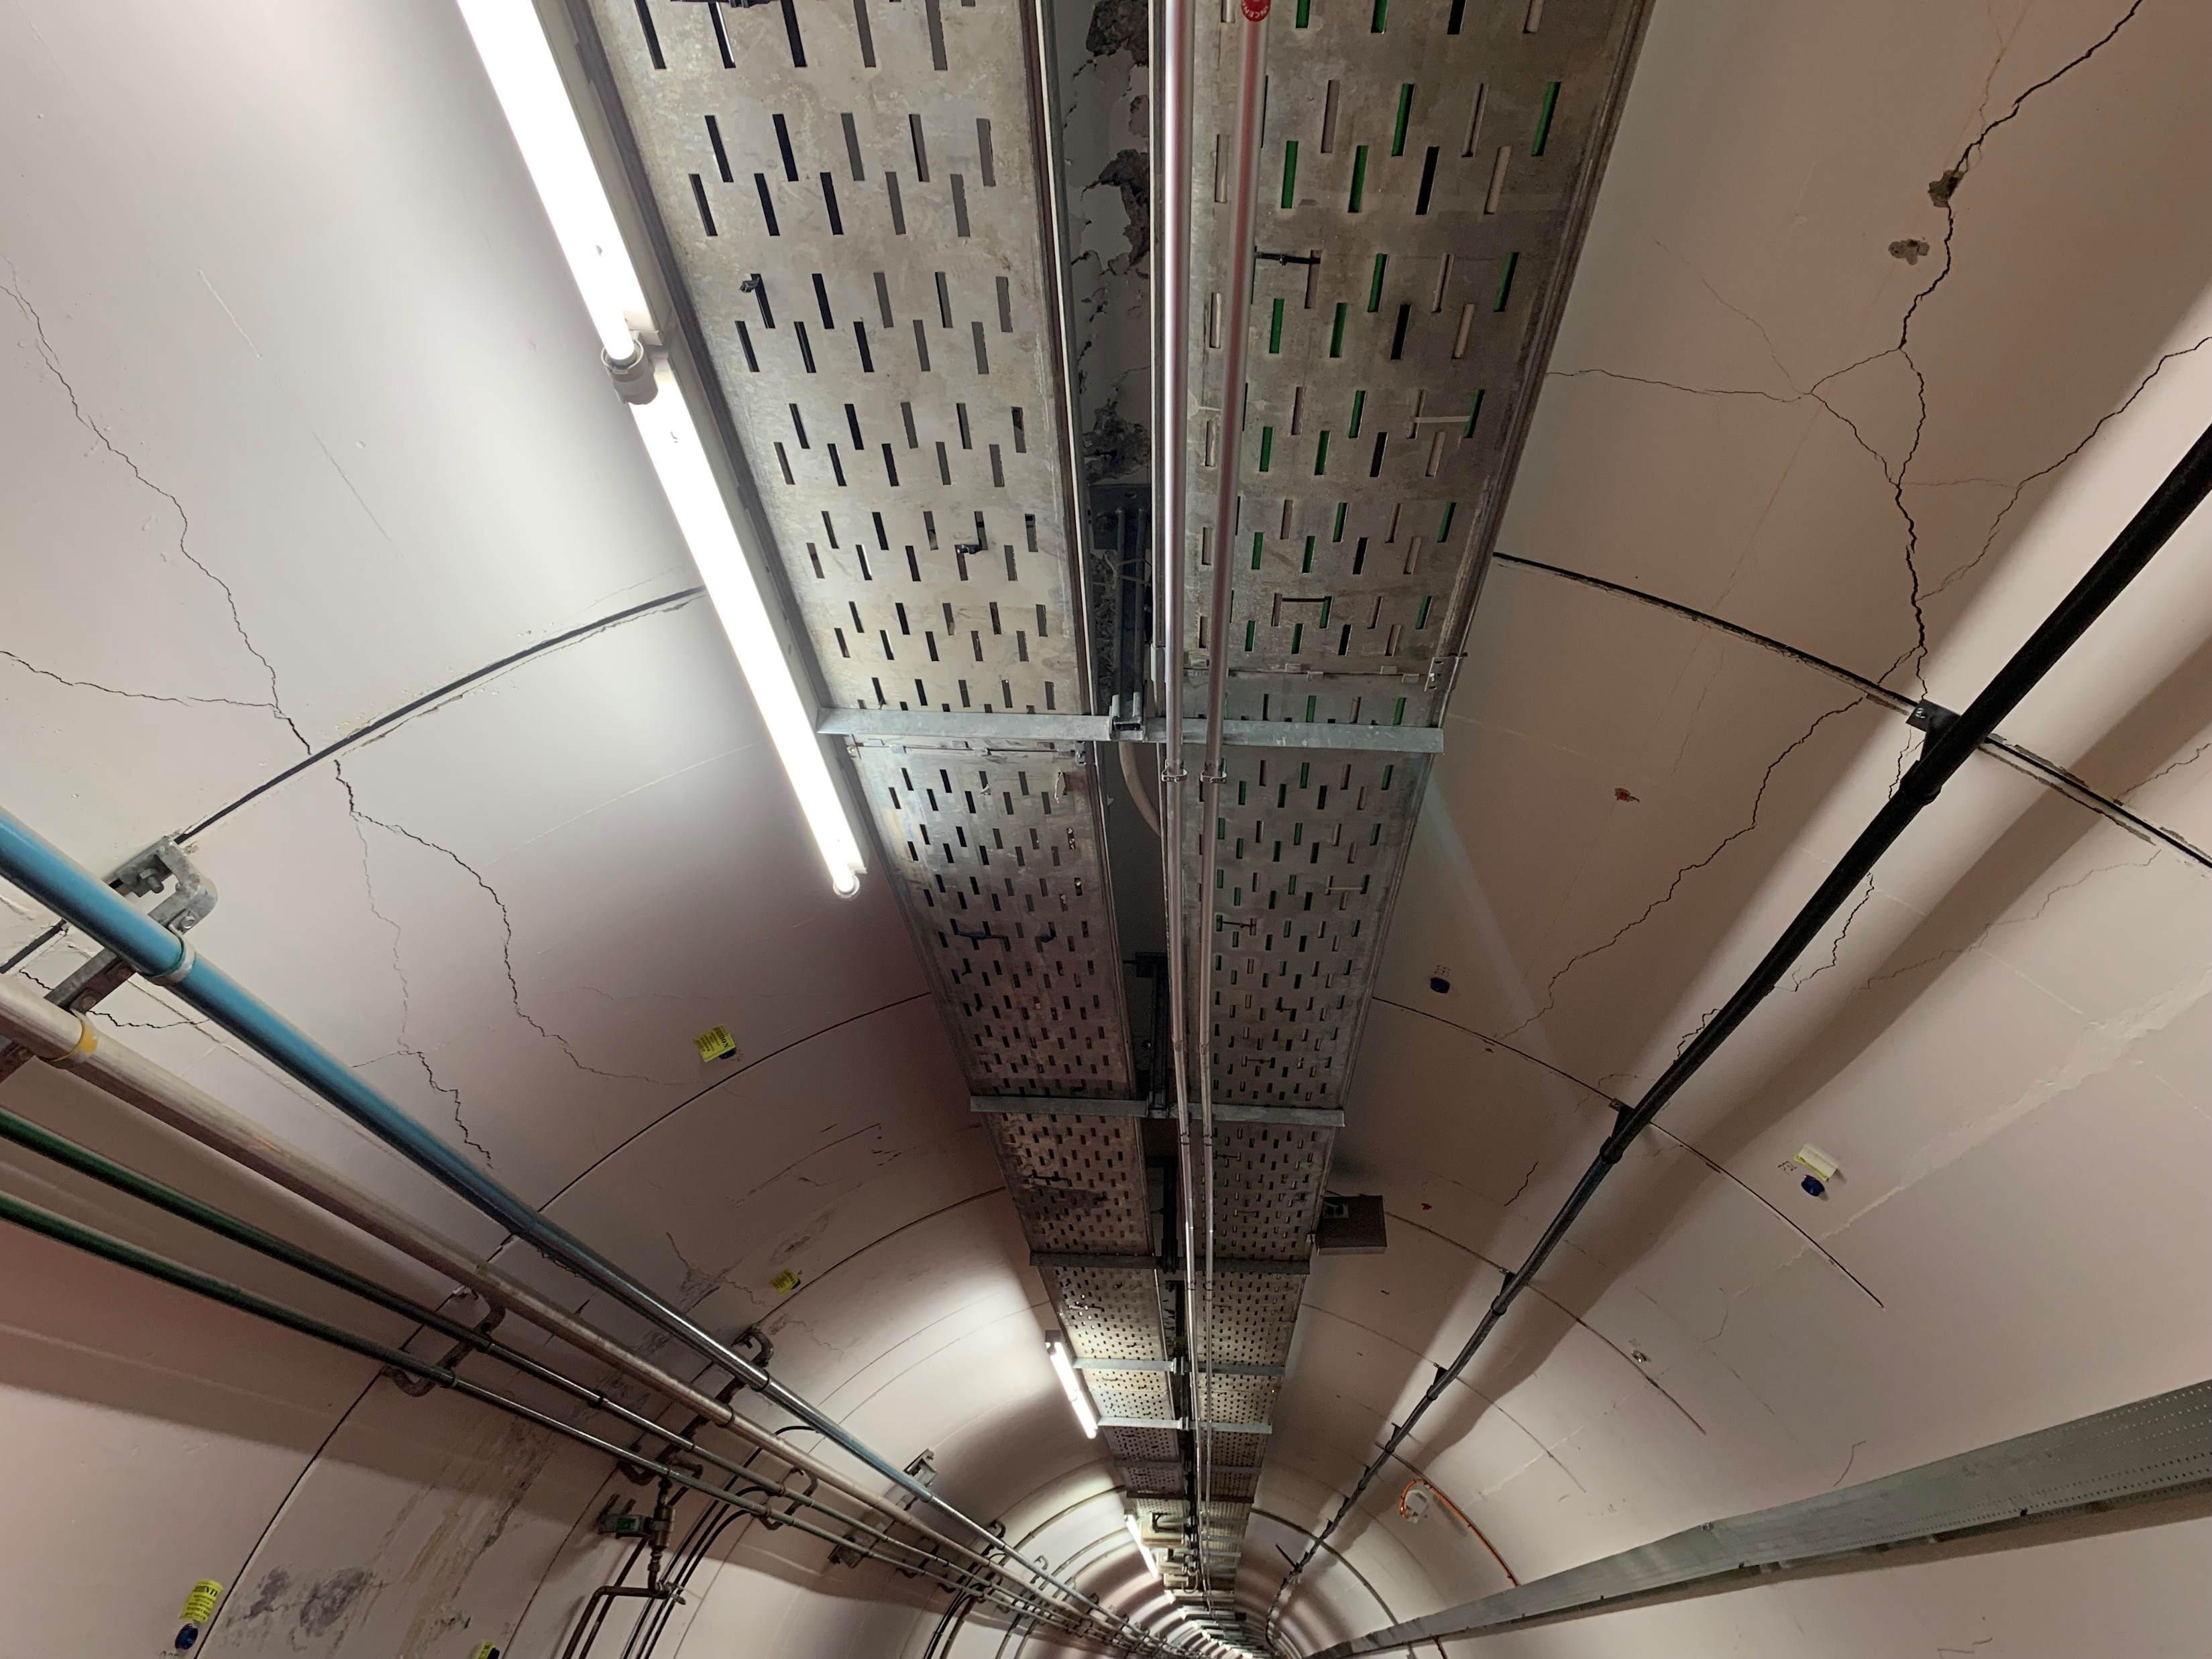
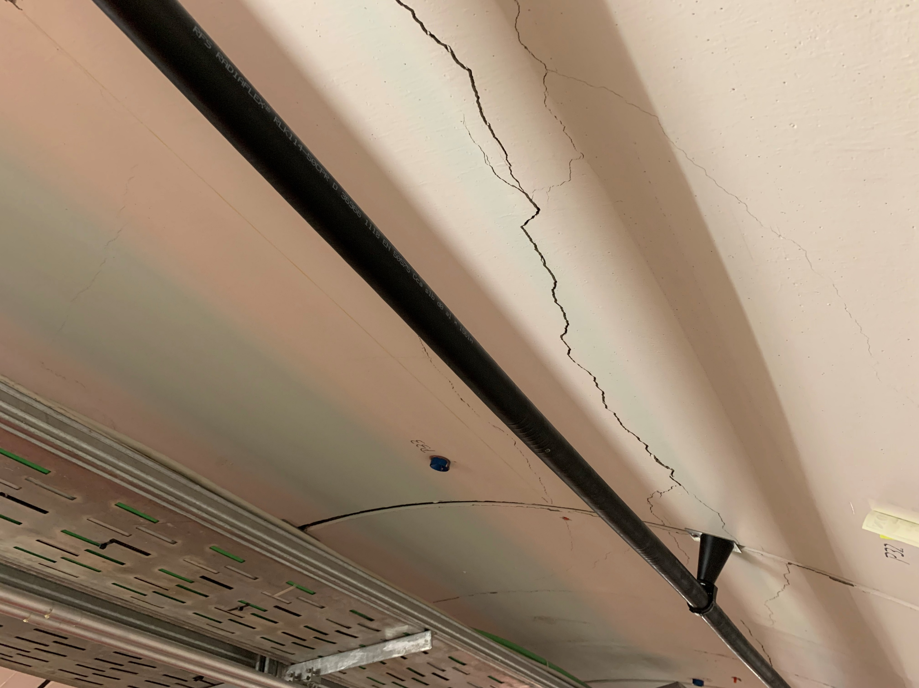
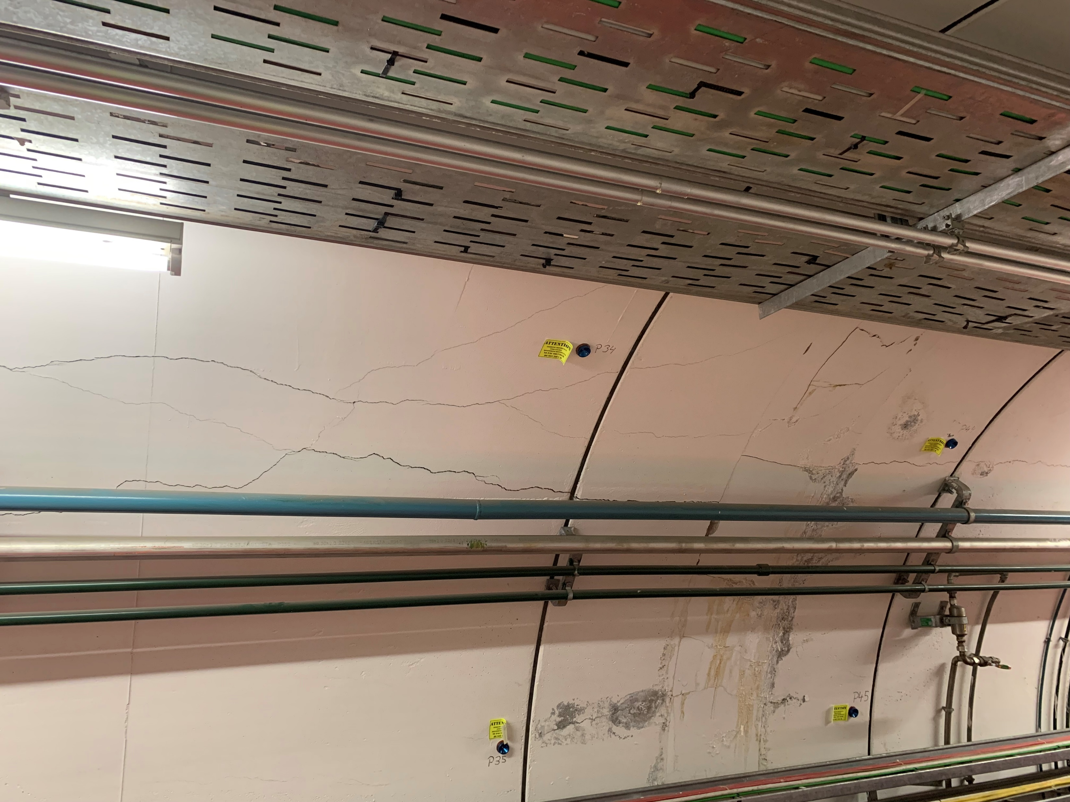
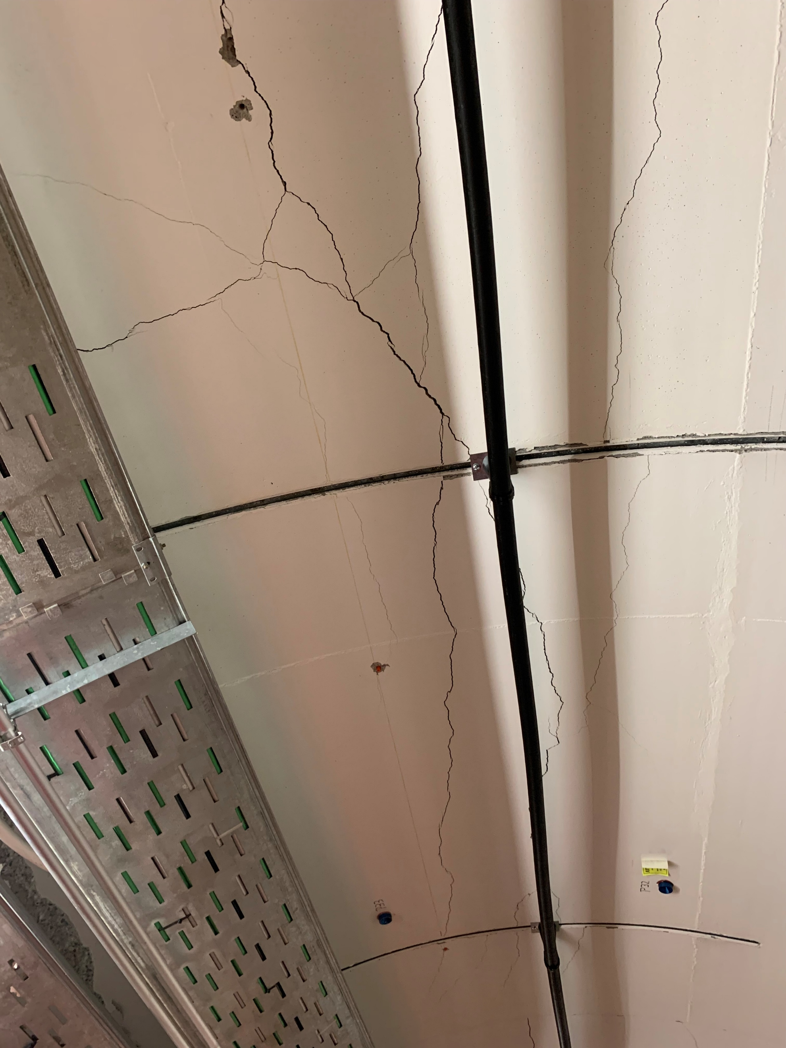
Defect in SPS TS16 Tunnel
As reported on the IEFC on the 17th February, large cracks are observed in the SPS TS16 tunnel, requiring urgent monitoring system in place
Longitudinal cracks
Crown spalling
Concrete flaking

Slide 5
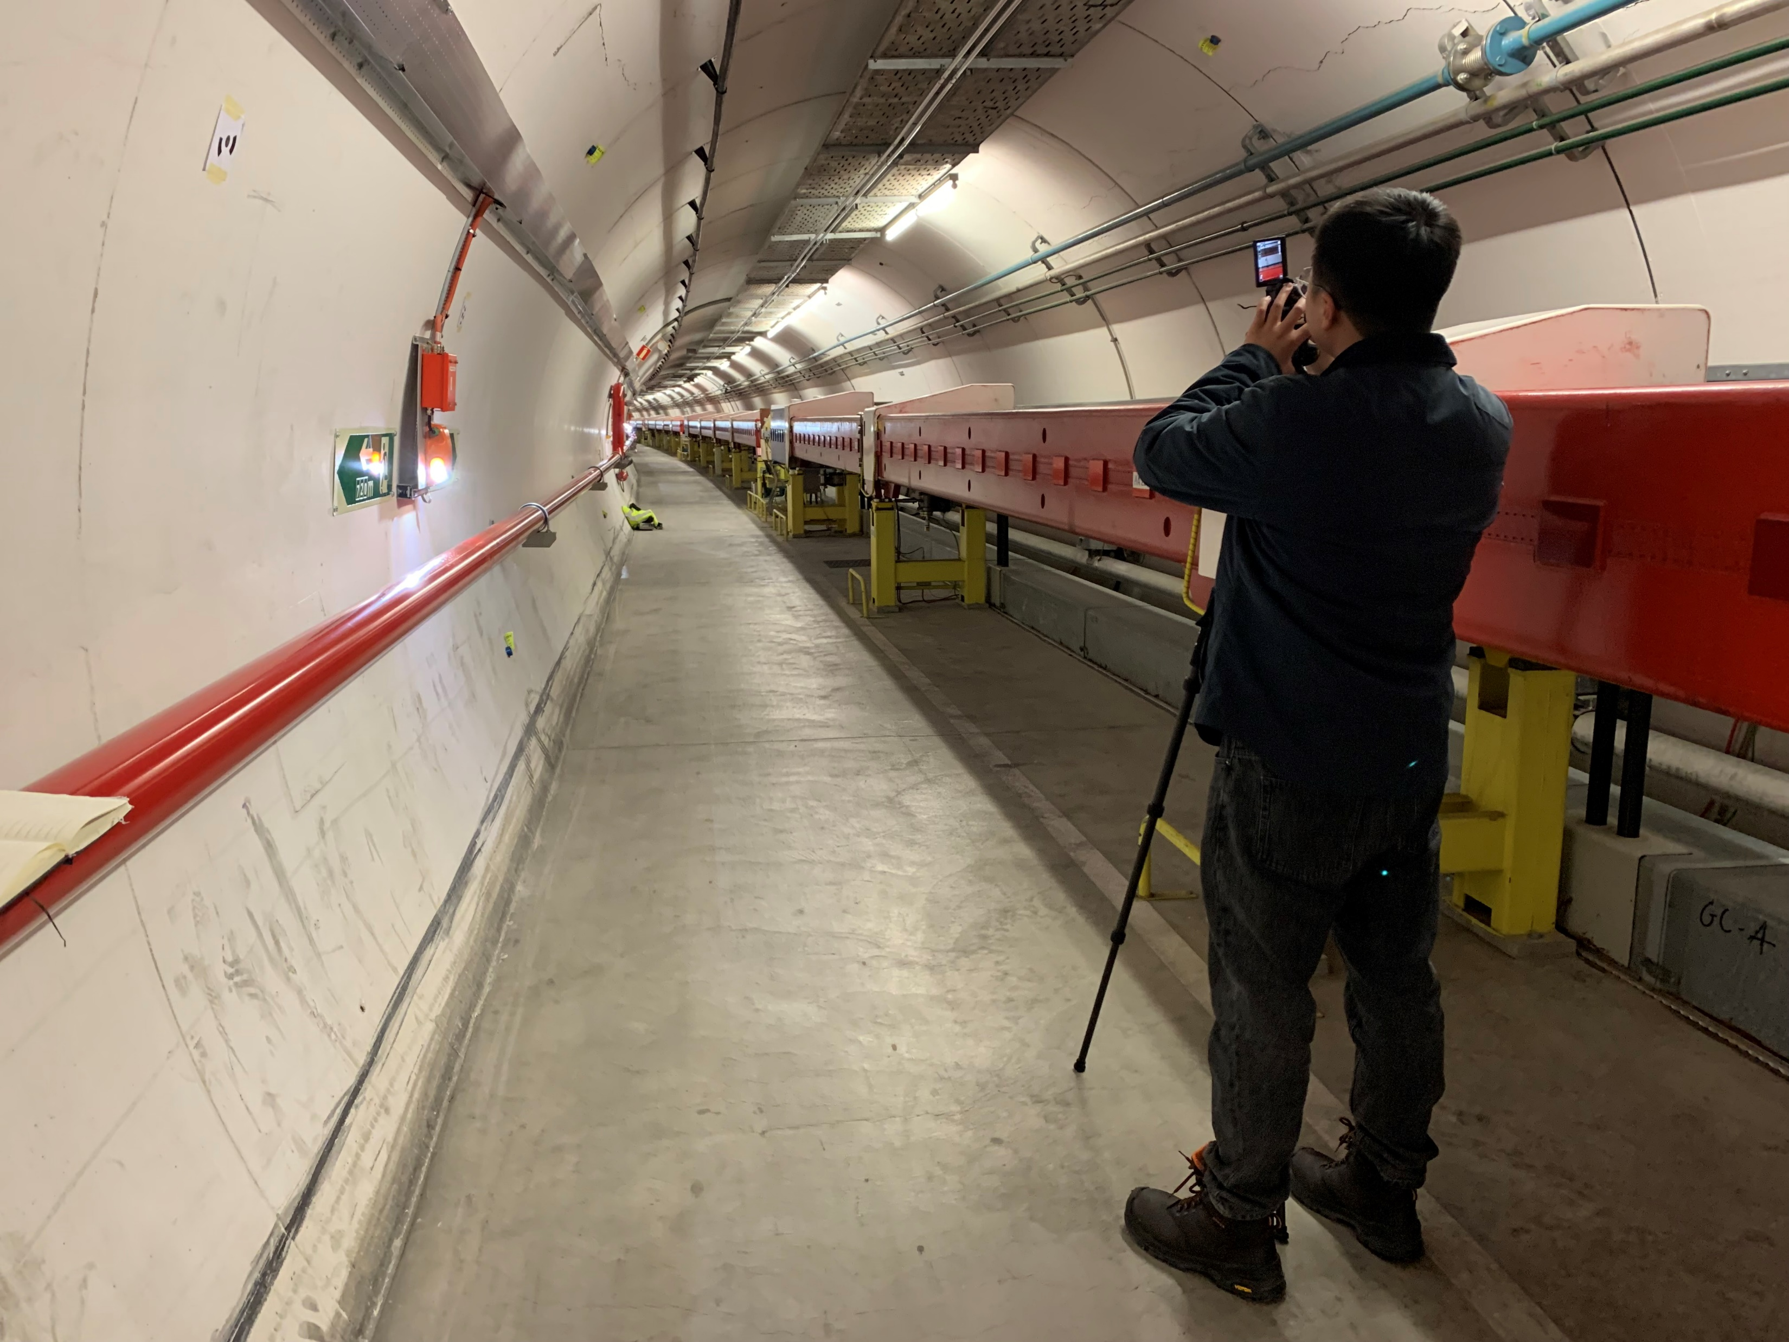
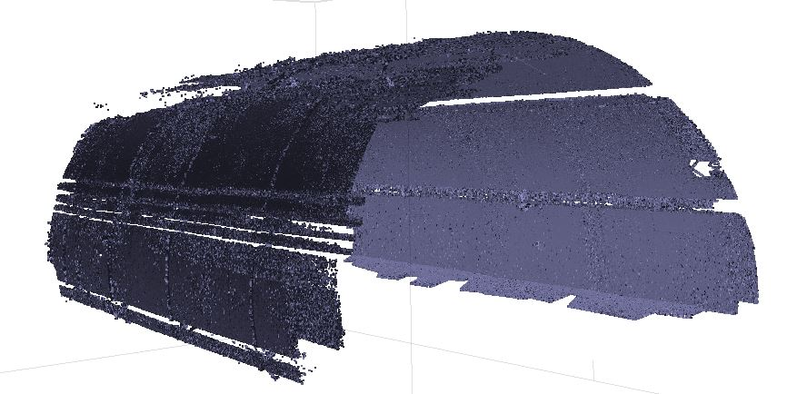
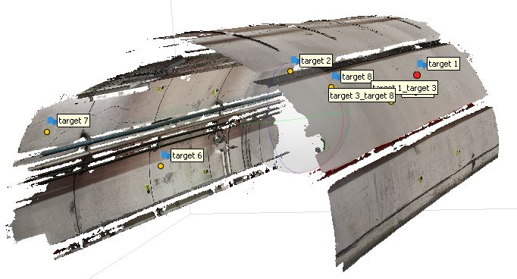
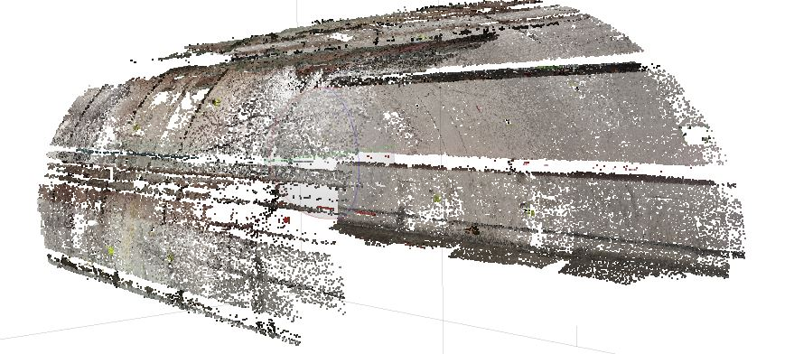
Current investigation
Collection of images for SPS tunnel section of max 30m obtained so far by using a tripod and a camera purchased by SCE
Refined photogrammetry analysis is applied to reconstruct a 3D model of the tunnel for defect quantification and severe damaged tunnel sections visualization
Sparse point cloud
Dense point cloud
Referenced Textured model
360deg camera (BE-CEM)

Slide 6

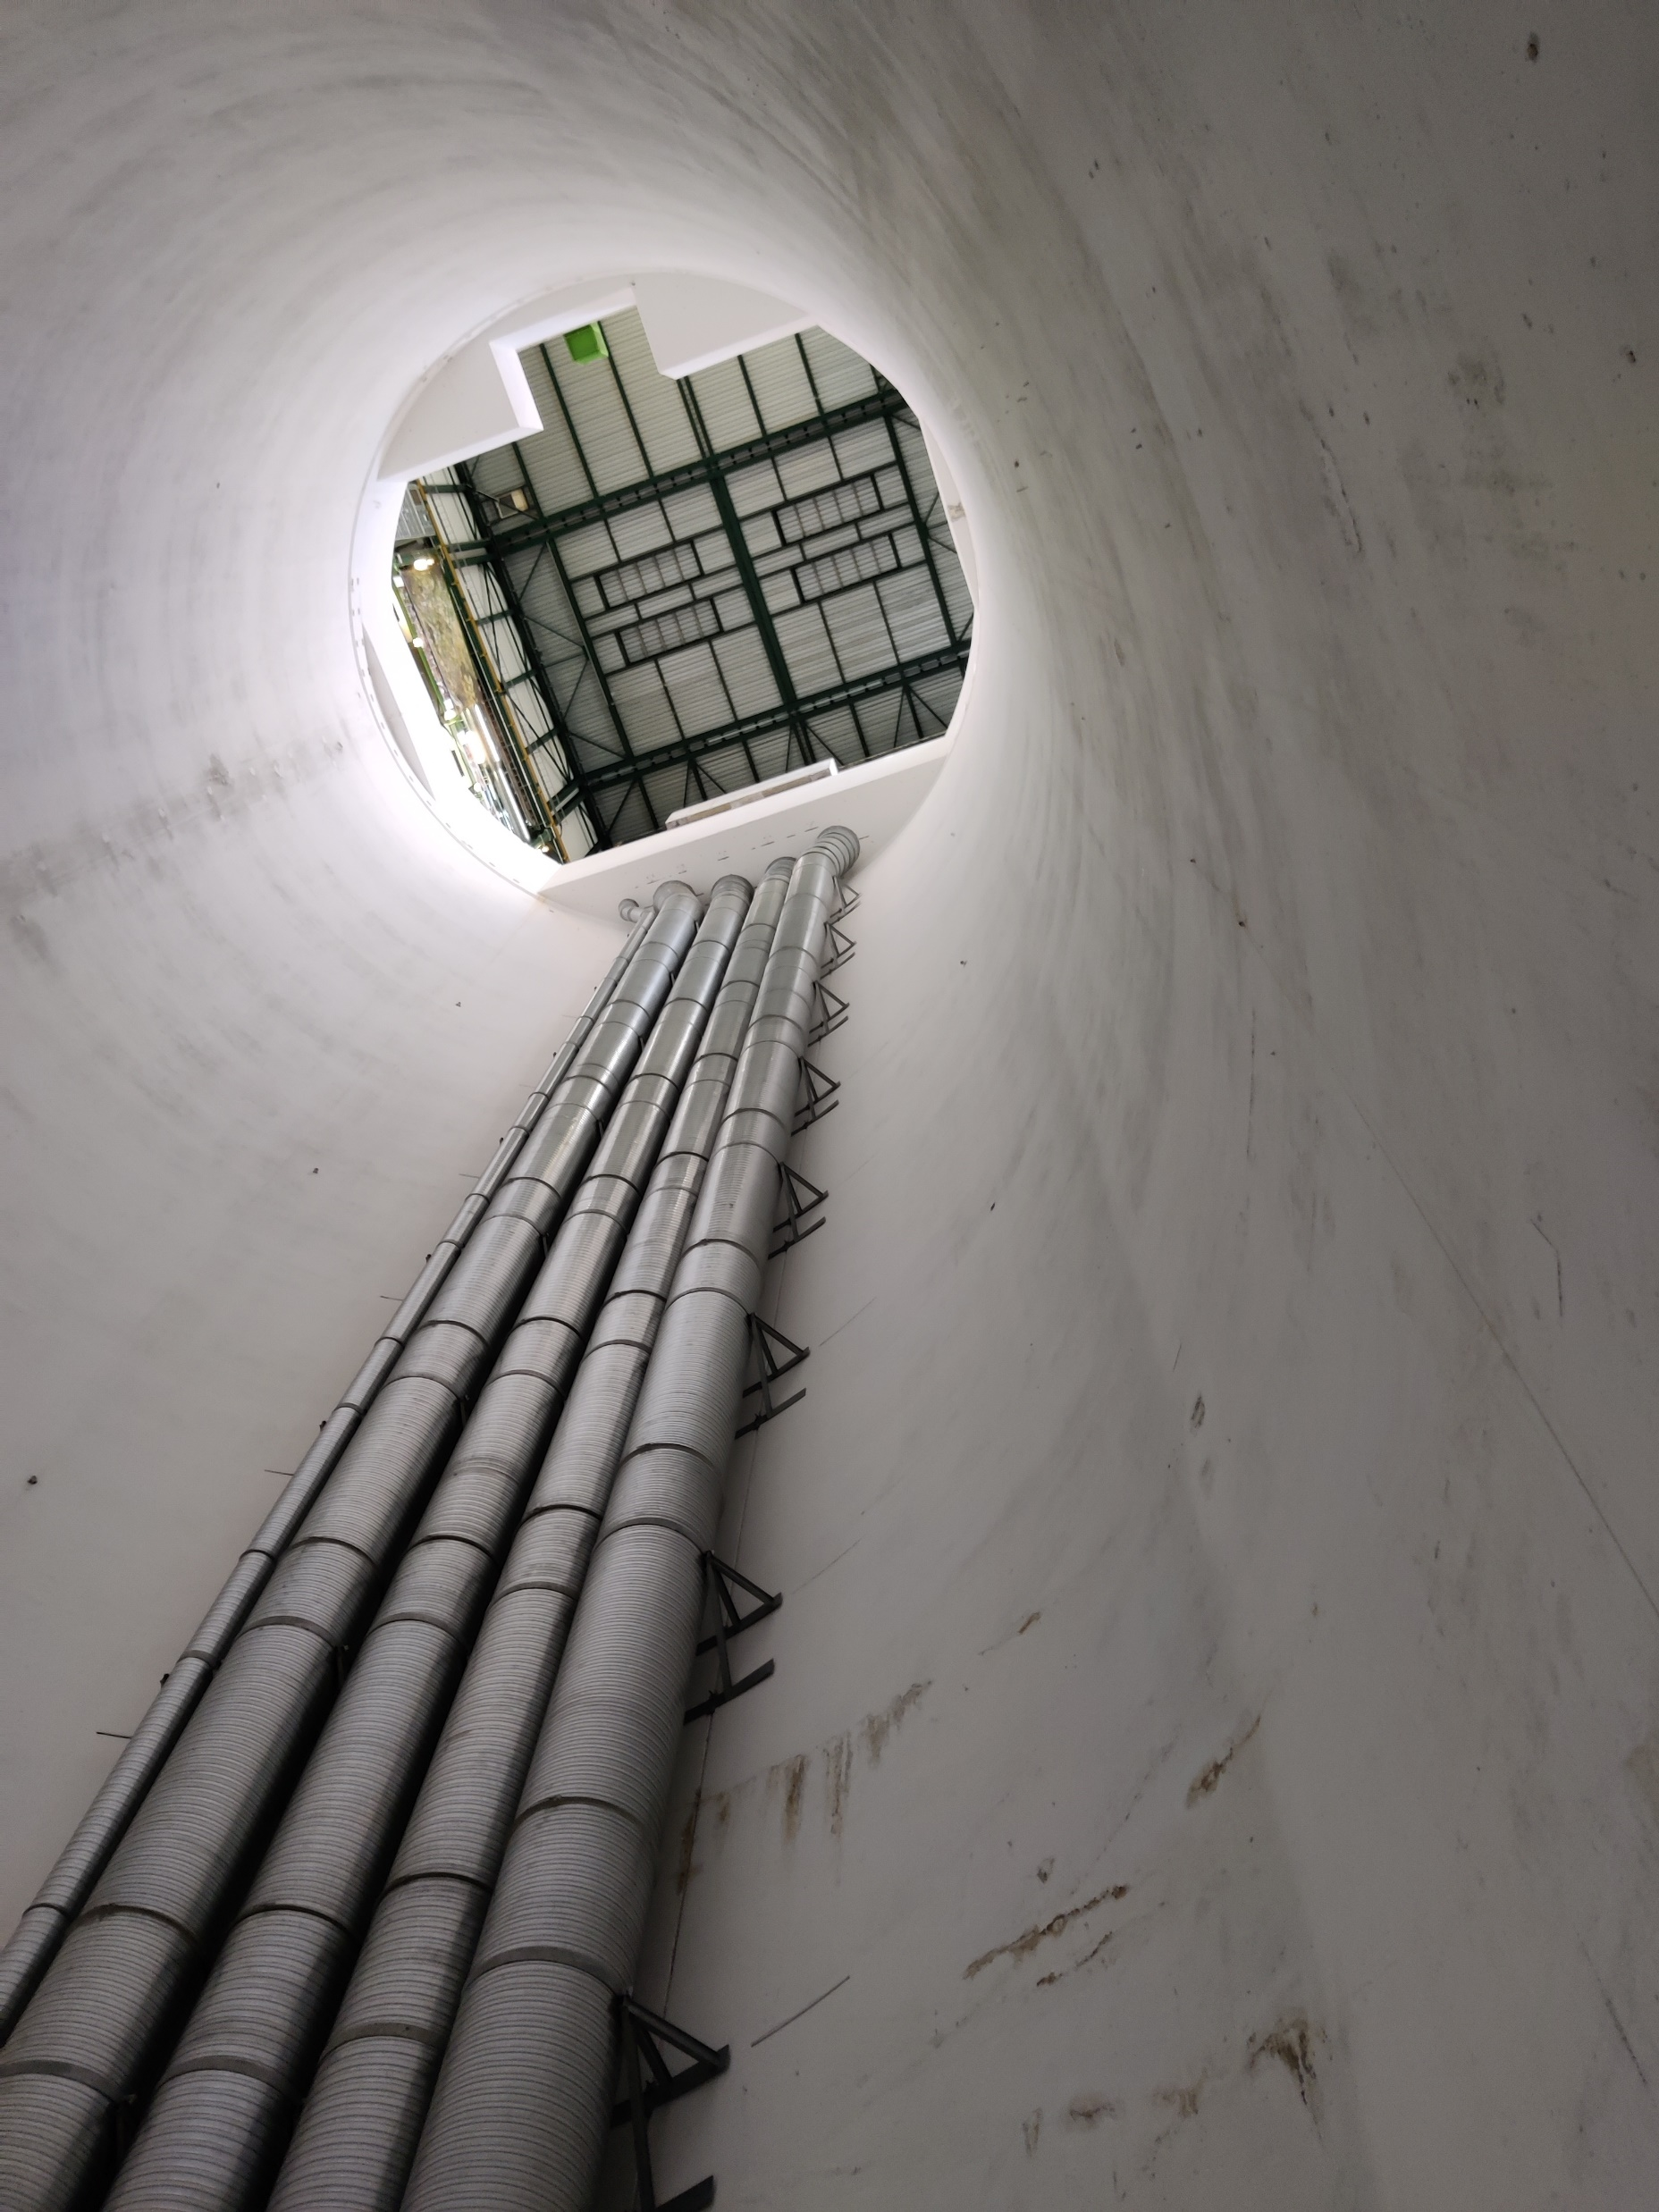
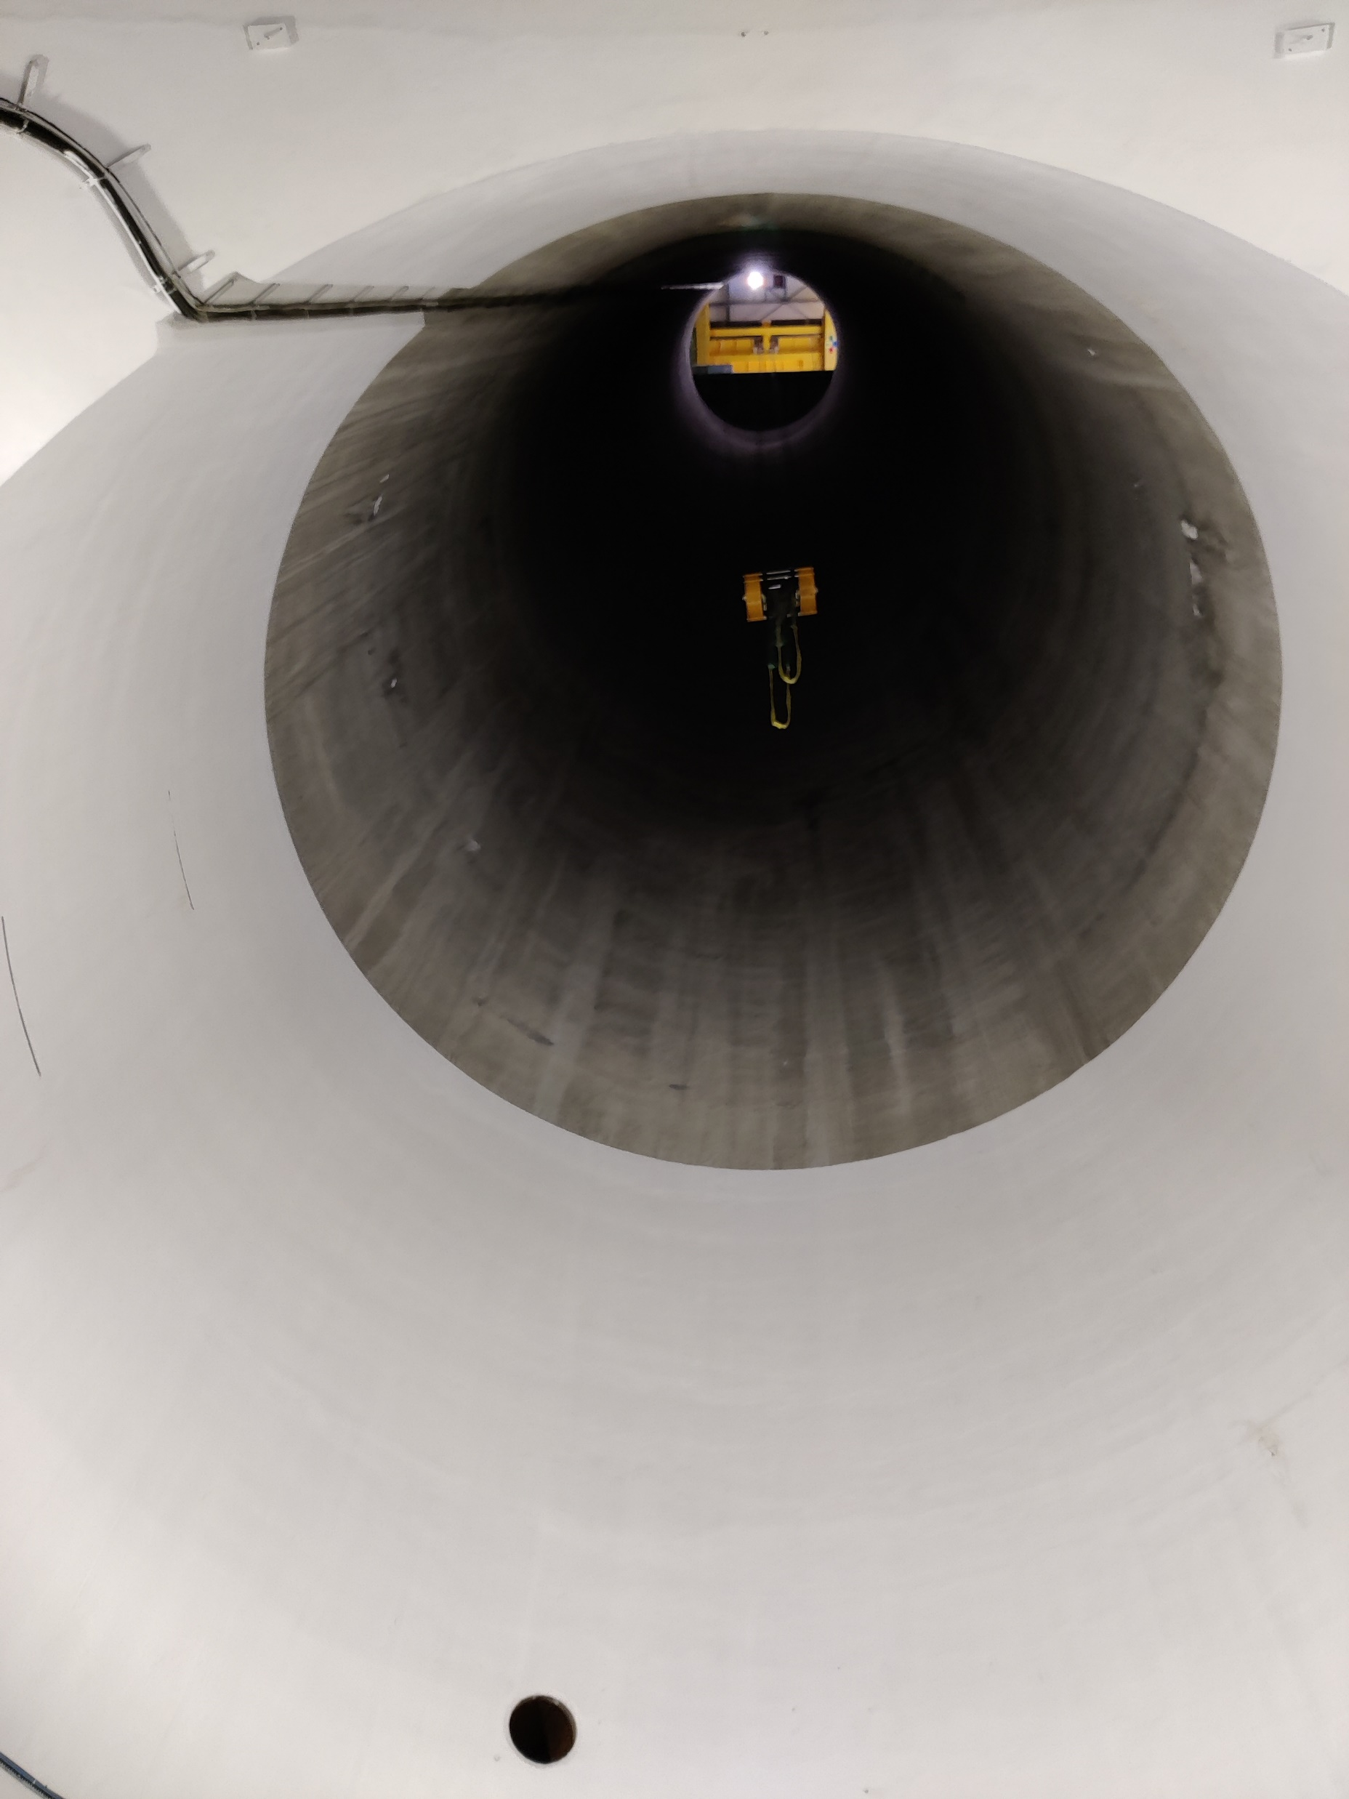
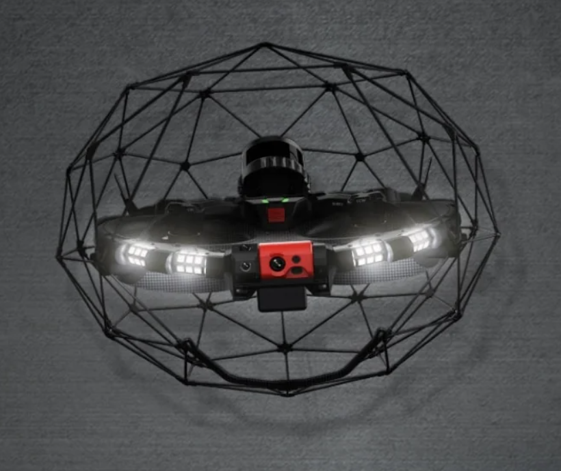
Drone trial
A trial of a drone is scheduled on the 8th March at the LHCb Shaft (PX84) and LHC mock-up tunnel in collaboration with BE-CEM to check its feasibility for crack and water leakage detection
Shaft – 10m Diameter & 100m deep
360deg camera (BE-CEM)

