Slide 1
NA-Operation 2023
Users Meeting – Installation
Michael Lazzaroni BE-EA-DC

Slide 2
Installation Organization in North Area
Users Installation Coordinator
Michael Lazzaroni
Installation of users in exp. areas
Sylvain Girod & Michael Lazzaroni
Moveable tables (i.e DESY) booking
Michael Lazzaroni
Control Rooms responsible
Nicolas Perez
I am your main technical contact for your installation

Slide 3
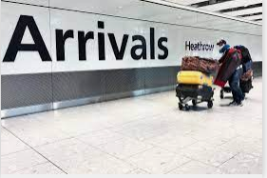
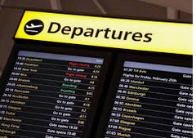

Installation Process
Preparation before your arrival
Your arrival in EHN1- Installation day
End of your beam time period
Technical meeting ~3-4 weeks prior the experiment installation to ensure an efficient installation.
(see details in the next slide)
- Please ensure that your equipment are ready to be moved in the PPE early in the morning (~9am).
- All late requests will be treated at the end of the day (to not disturb the installation planning).
- Priority of installation is given to main users.
De installation at the end of your beam time period:
- Please remove of all equipment in the EA and CR the Wednesday ASAP (8am).
- Checkout of the EA and CR together to be sure that all your equipment have been removed.

Slide 4
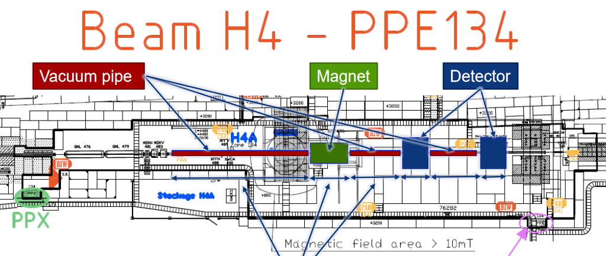
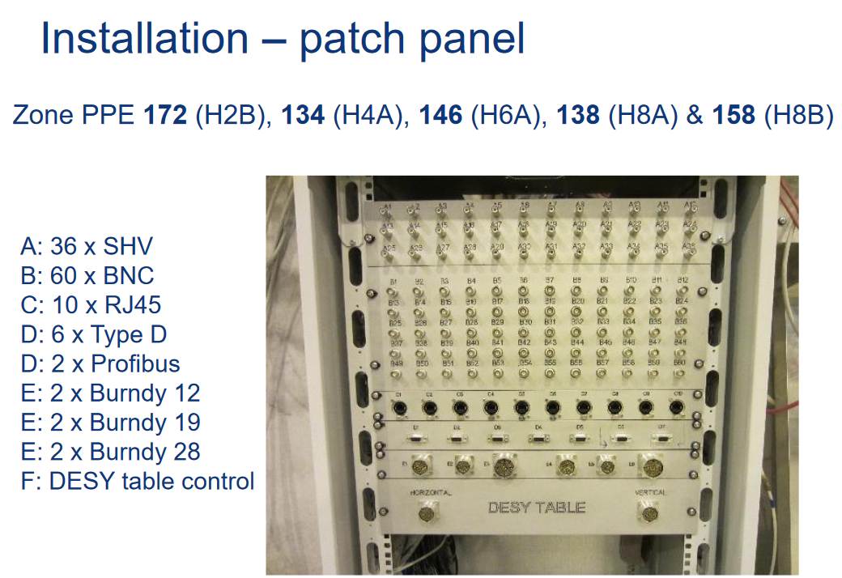
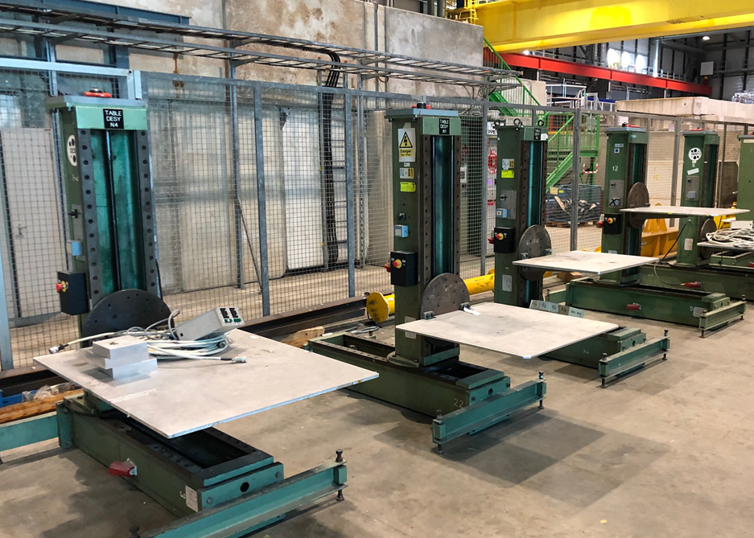
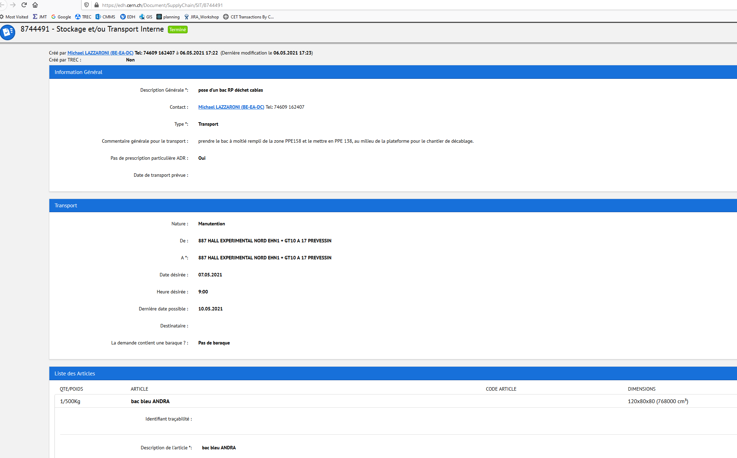
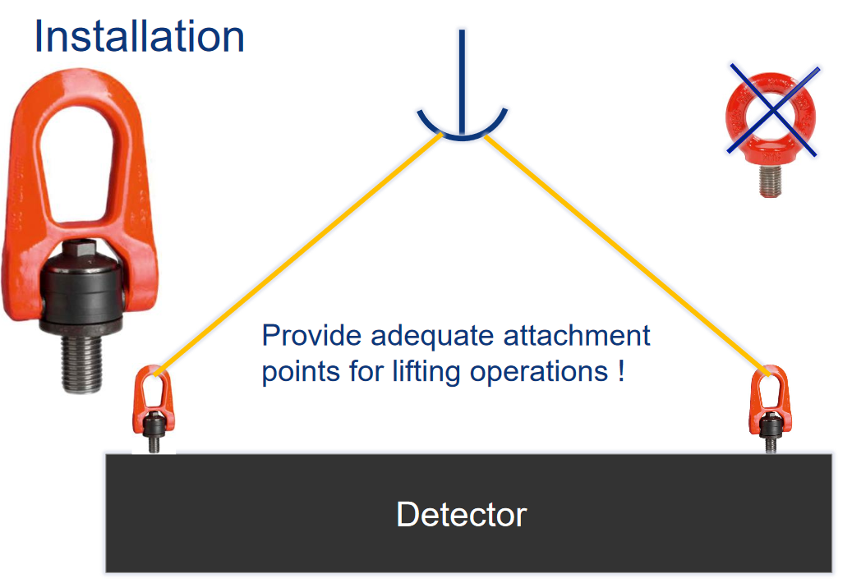
Technical meeting (3-4 weeks prior your installation)
Technical points to discuss concerning your installation:
  Preparation of the zone according your requirements, in term of:
    Beam line configuration (your detectors, vacuum pipes …)
    Cabling, patch panel needs
    Mechanical support for your set-up (DESY tables, concrete blocks…)
    General Services: electrical power needs…
    Gas (Reminder : make your gas request ASAP to David Jaillet)
  Preparation of your arrival:
    Quantity of material (storage place)
    How to prepare “transport request” via EDH to unload your material
    CERN requirements to handle your material safely
      In case of doubt please contact Caterina.Bertone@cern.ch

Slide 5
Services in BE-EA – Useful technical contacts
BE-EA provides technical services to users, in term of:
Cabling
Connectors, cables, cabling…
Gianluca.Canale@cern.ch
Celim.Benmehdi@cern.ch
Moveable tables
Workshop
Machining, installation…
Maintenance of Desy tables, XSCA…
Vincent.Marchand@cern.ch
Gas
be-dep-ea-gas@cern.ch (David Jaillet)
Supply of CO2, He, N2….

Slide 6
Thanks for your attention!
Questions?

