Slide 2
TREC in experimental areas
&
Radiation Monitoring System in experimental areas
F. Aberle, C. Ahdida, G. Dumont, R. Froeschl, J-F. Gruber
27/03/2023
EDMS 2579972

Slide 3
Content
TREC
  Guidelines
  Workflow
  Layout of the areas
  RP Contacts
  Reminders
Radiation monitoring
  Radiation monitoring system
  Possible sources of radiation alarms
  Recommended actions in case of radiation alarms
  Q&A

Slide 4
Guidelines
Every material leaving a beamline has to be traced in TREC and controlled by RP
Every material leaving a radiologically classified building has to be controlled by RP

Slide 5
Workflow
Identify the material (traceability stickers) before installing in the beamline. Trace reasonably (i.e. do not use one code per screw)
Do the request well in advance, with indication of the time when the material will be available for the measurement (measurement deadline). Use comments in TREC if needed
Deposit the material in the Buffer Zone, if possible. Otherwise, call the RP Officer (Meyrin: 72504, Prévessin: 75252)
Sign the EDH created by TREC, and wait for the RPO signature before leaving the building
Update the location of your equipment when it has been transported

Slide 6
Information for radiological clearance
To be able to accurately and efficiently classify your equipment, we need to know:
  The type of beam
    Particle type (e.g. protons, Pb ions, pions, muons, electrons, etc.)
    Maximum particle energy (e.g. 400 GeV)
    Maximum intensity (e.g. 5·10⁵ particles per spill)
    Duration of beam operation (e.g. 4 days)
    Target type (thin (~1cm) or thick (>> 1cm), if applicable)
  The type of material
    Material composition (e.g. steel, aluminum, copper, tungsten, PCB, etc.)
  The location of the material
    Approximate distance of beamline to equipment
    Presence of in-beam material (yes / no)

Slide 7
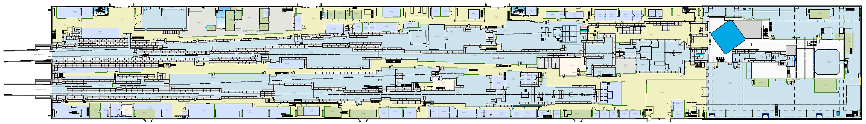
Layout of the areas – North Area
North Area
2 Buffer Zones available
TREC mandatory for equipment in beam lines*
* As depicted by red areas

Slide 8
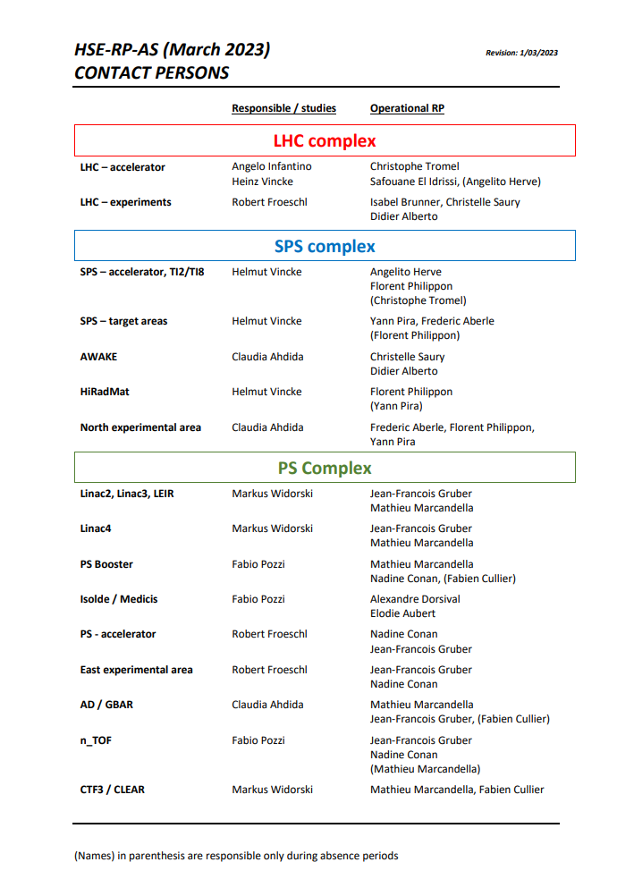
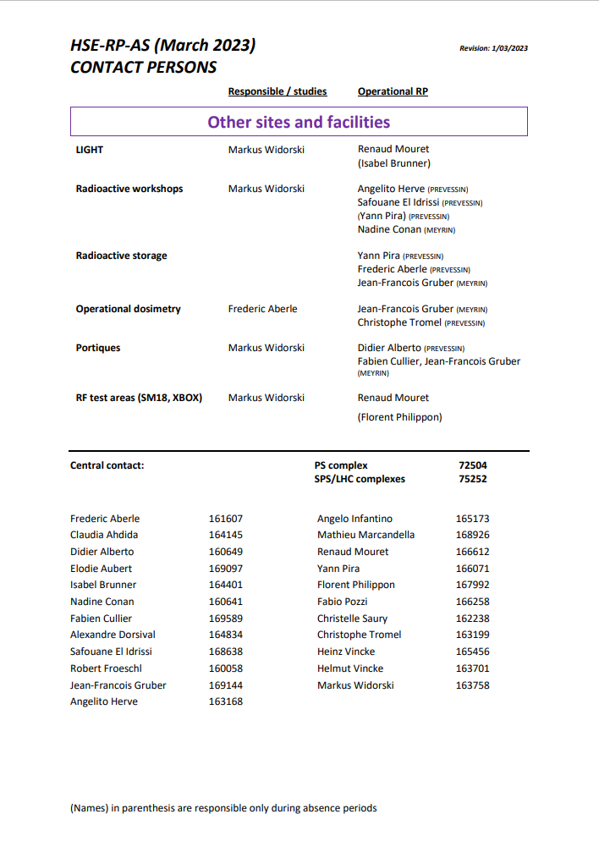
RP Contacts
RP contact available at: https://espace.cern.ch/RP-LHC/DivDocs/RP-AS-Contacts-LastUpdate.pdf
Do not hesitate to contact the RPO of the concerned area
Meyrin: +41227672504
Prévessin: +41227675252

Slide 9
Reminders (often forgotten)
The TREC code follows the equipment part until the end of his life
Record your request in TREC
Indicate a responsible person who is at CERN and available to sign in EDH
Sign your EDH
Wait until RPO signature before leaving
In case of urgency, contact the RPO
For specific cases, contact the RPO

Slide 10
Questions?

Slide 11
Content
TREC
  Guidelines
  Flow
  Layout of the areas
  RP Contacts
  Reminders
Radiation monitoring
  Radiation monitoring system
  Possible sources of radiation alarms
  Recommended actions in case of radiation alarms
  Q&A

Slide 12
Radiation monitoring system
Radiation monitoring system
  ensures that radiation levels are compliant with the Radiological Area Classification
  detect (and, if needed, terminate) degraded operation conditions
Ambient dose equivalent rate averaged over a predefined time window
  Typical time window length ≥ 90s (~2 PS super-cycles)
Two alarm thresholds
  Alert → visible and audible alert and sent to CCC
  Alarm → visible and audible alarm and sent to CCC + interlock beam
The actual alarm threshold settings are derived from the Radiological Area Classification Limits
  Supervised Radiation Area – Low Occupancy: 15/30 µSv/h
  Supervised Radiation Area – Permanent Workplace: 3/6 µSv/h

Slide 13
Radiation monitoring system in EHN1
In EHN1, the system primarily monitors prompt radiation
Alarm acts on the corresponding safety chain automatically
This removes the source of the prompt radiation
  Exception: radiation monitor on roof of H6-CERF (muons from upstream areas)
Radiation monitoring system in EHN1 has been upgraded from ARCON to CROME in LS2

Slide 14
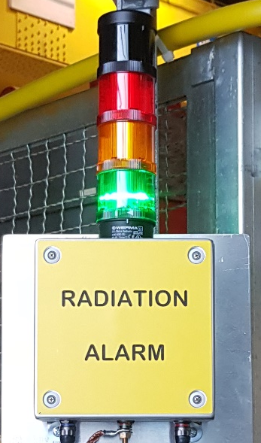
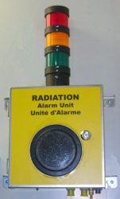
Radiation alarm displays
Flashing RED light + Audible ALARM
→ Leave the concerned area calmly
Flashing ORANGE light + WARNING SOUND
→ Limit your stay in the concerned area
Continuous green light = NORMAL situation
(low radiation levels, system OK)

Slide 15
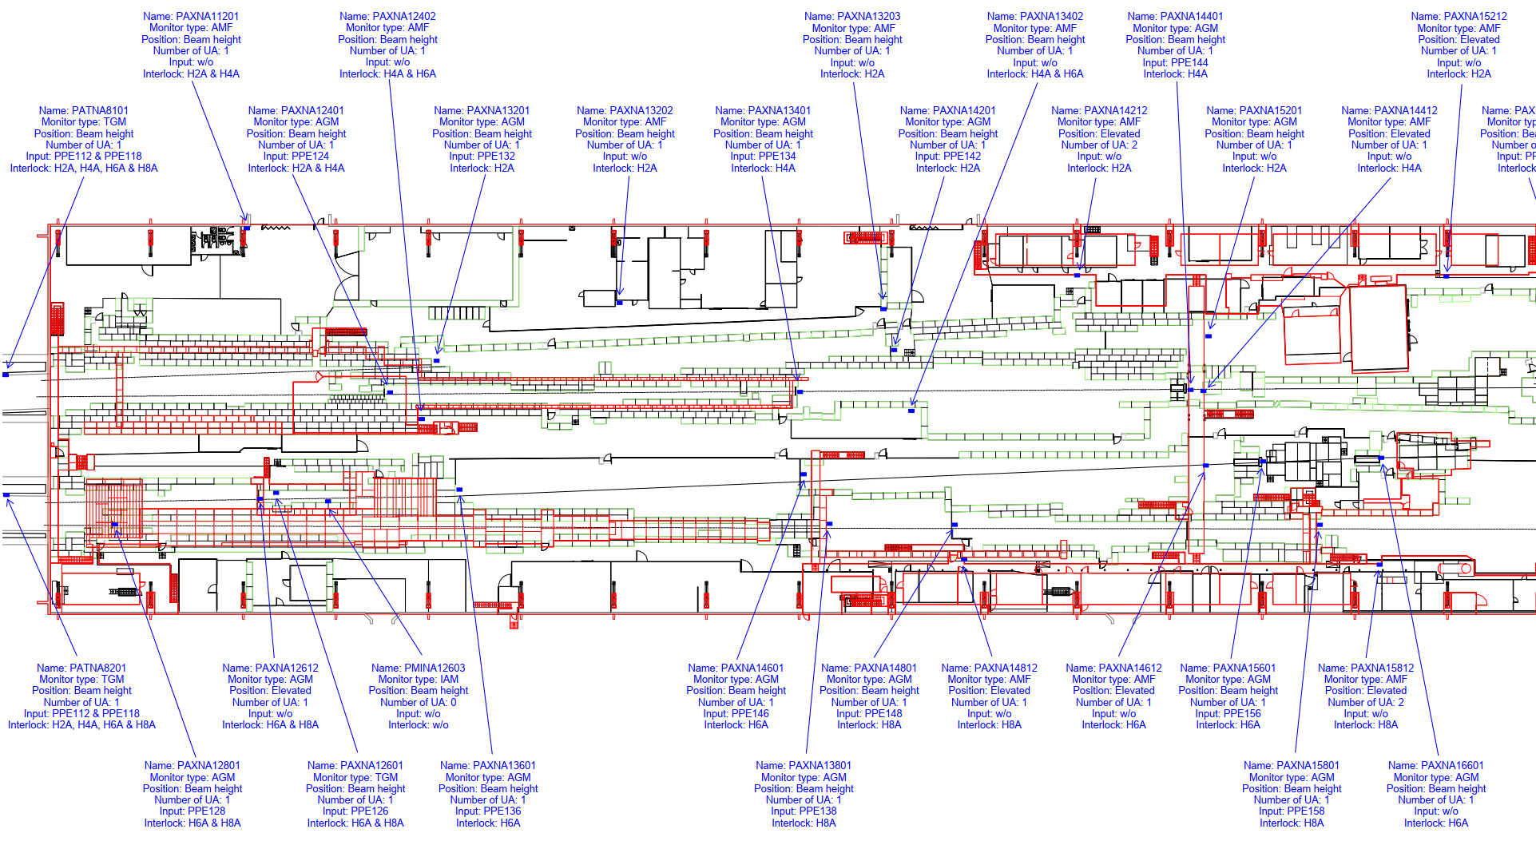
Radiation monitoring system in EHN1

Slide 16
Possible sources of EHN1 radiation alarms
Beam transport and steering
  In the NA Target area
  In the transfer lines upstream and around EHN1
  In the beam lines in EHN1
Beam intensity
  Collimator settings are a major source of alerts/alarms
Beam particle type
Status of beam intercepting devices
  Including their surrounding

Slide 17
Recommended actions in case of radiation alarms in EHN1
In case of any alarm in a zone under your responsibility
  Understand & remove the source of the alarm
  CCC, beam line physicists, radiation monitoring data
EHN1 is a very large building
  You can safely stay in EHN1 if there is no radiation alarm in your vicinity
  In case of doubt, please contact the responsible of the zone where the alarm occurs (via the CCC)

Slide 18
Questions?

Slide 19


Radiation at CERN
Accelerator in operation:
The interaction beam-matter generates stray radiaton
Accelerator stopped:
The interaction beam-matter has made the matter radioactive (activation)
Stray radiation
Residual radioactivity (resulting)
Stable matter
Radioactive matter
Beam
Stray radiation
No Beam

Slide 20

Ionising radiation in/around the accelerators
Experimental hall:
Accelerator in operation
Primary beam
Secondary beam
Beam tunnel:
Experimental area:

Slide 21

Ionising radiation in/around the accelerators
Experimental hall
Accelerator in shut down
Radioactive accelerator
Beam tunnel:
Experimental area:

Slide 22
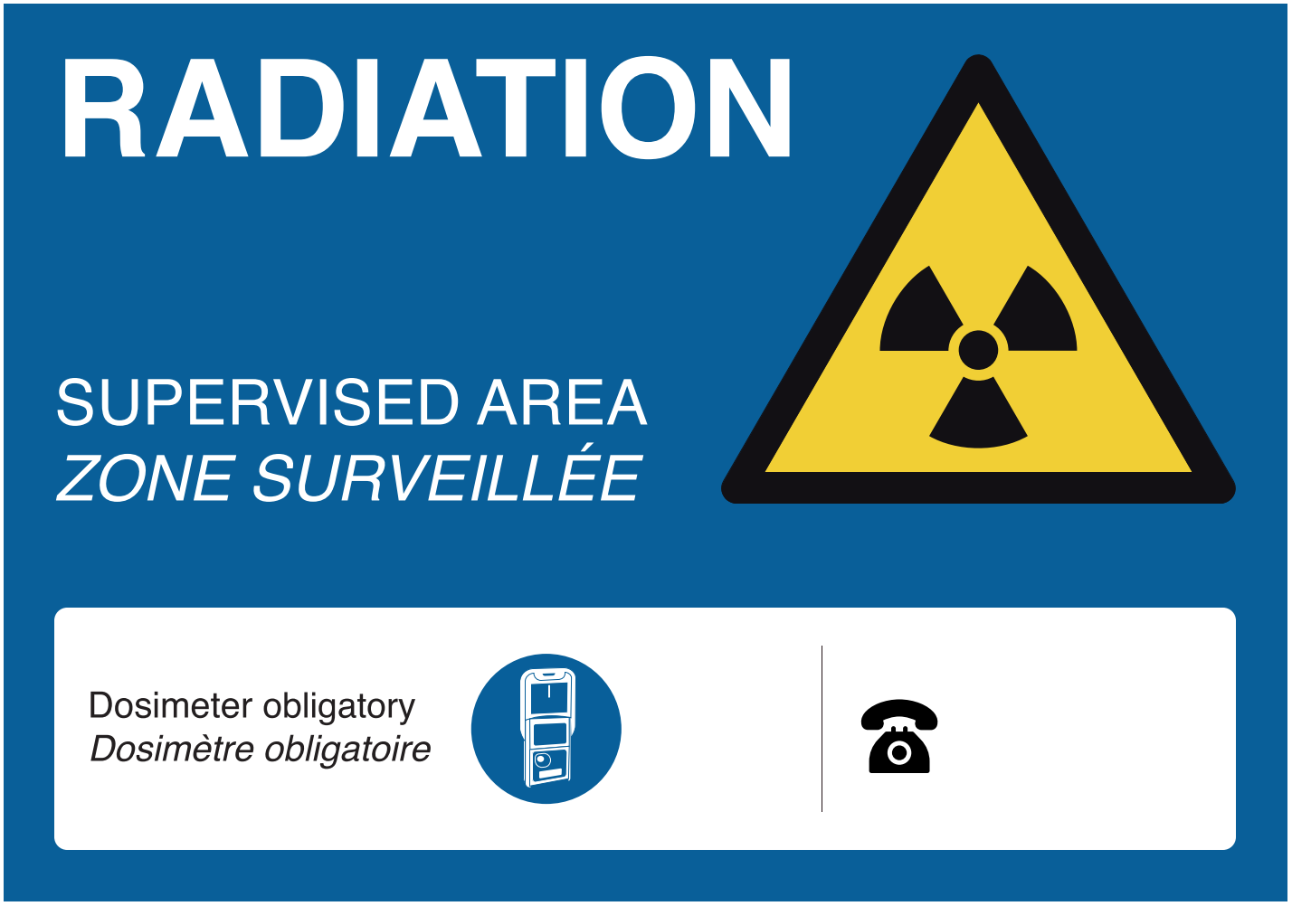
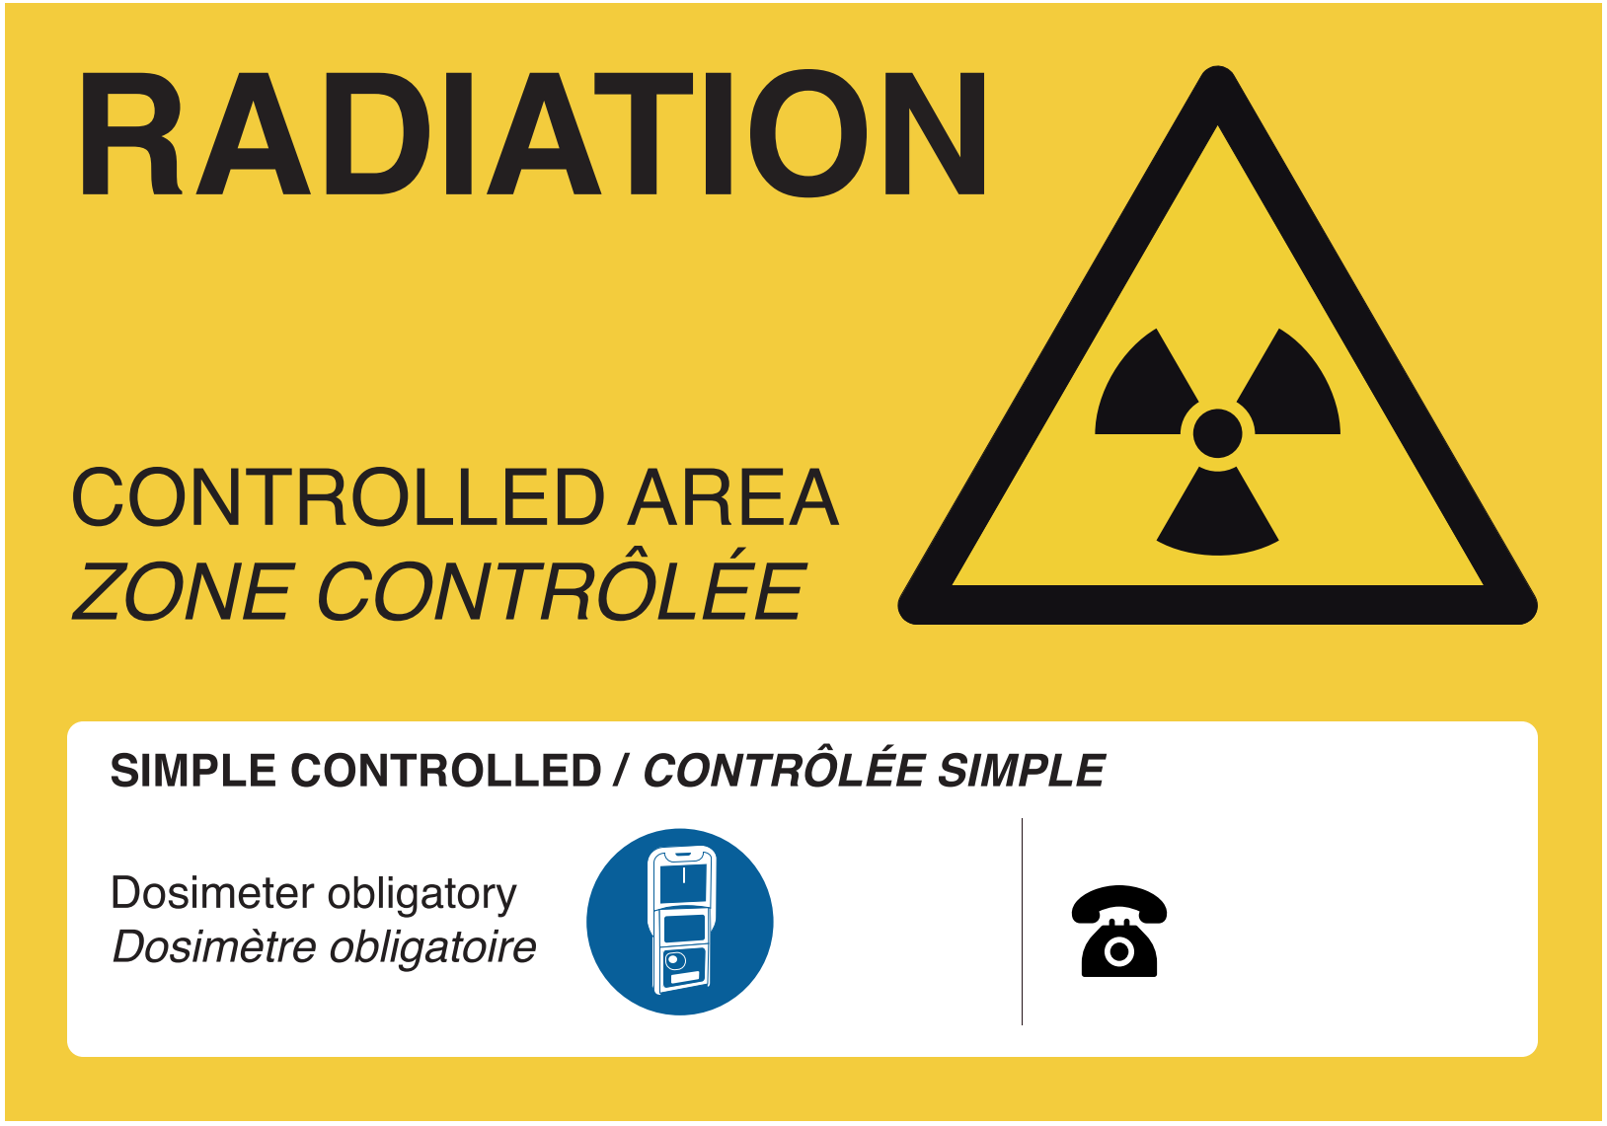
Radiation Areas at CERN
Areas with risks due to ionizing radiation are classified as "Radiation Areas". Radiation Areas at CERN are clearly marked with yellow panels. Corresponding to the risk level, Radiation Areas are subdivided into:
"Supervised Radiation Areas“
(<15 μSv/h - low risks)
"Controlled Radiation Areas“
(elevated risks)
EHN1 is generally a Supervised Radiation Area due to prompt radiation levels

Slide 23
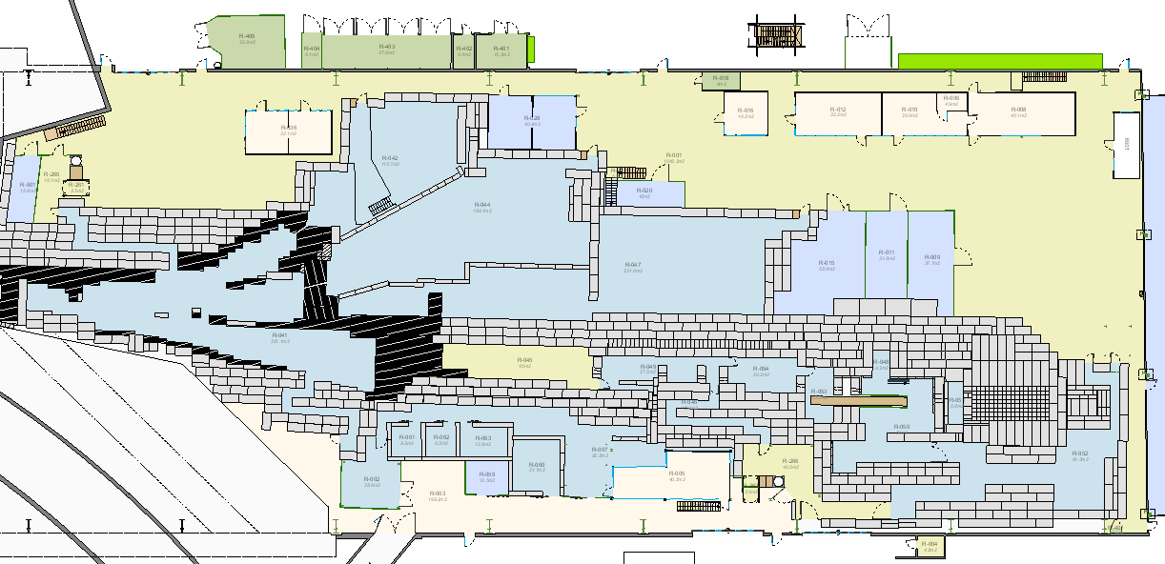
Layout of the areas – East Area
East Area
  1 Buffer Zone available
  TREC mandatory for
  equipment in beam lines*
CHARM/IRRAD
  1 Buffer Zone available
  TREC mandatory for
  equipment in beam lines*
* As depicted by red areas

Slide 24
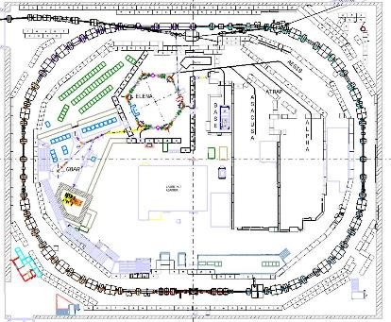
Layout of the areas – AD Hall
AD Hall
  2 Buffer Zones available
  TREC mandatory for equipment leaving AD ring*
  TREC mandatory for beam equipment and experimental setup*
  TREC not mandatory if 60 cm away from the beam line*. RP control still needed
* As depicted by red areas

