Slide 1
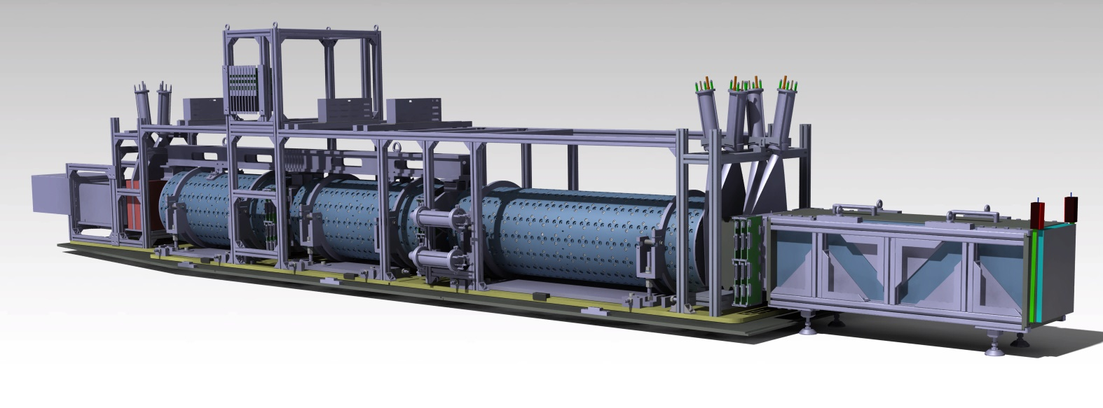
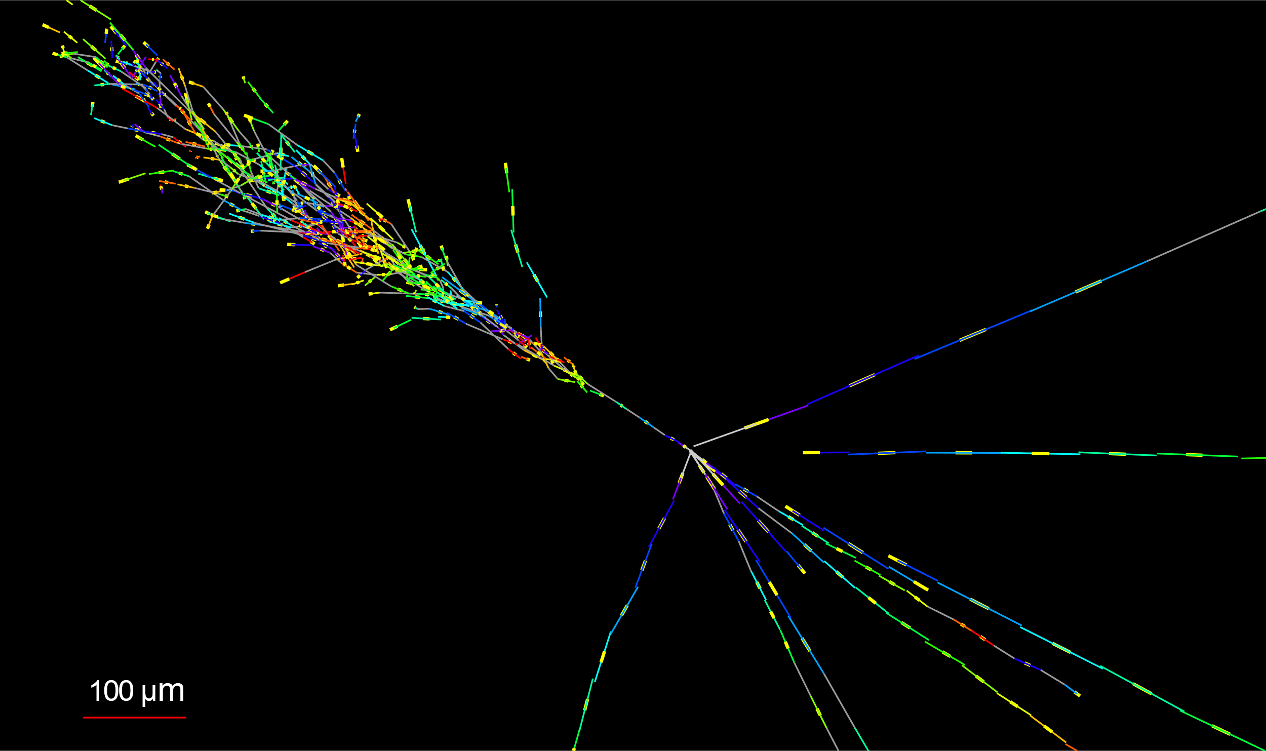




FASER$ν$ test beam
FASER$ν$ is a new experiment at the LHC, targeting TeV energy collider neutrinos
Emulsion/tungsten-based detector, we want to test
  EM shower calibration
  Momentum calibration
$ν_{e}$ candidate from 2022 run
FASER$ν$
Emulsion/tungsten neutrino target

Slide 2
Beam request
50, 100, 200, 400 GeV charged particles (muon or hadrons)
  10^3-104 particles per spill
  Large beam size
50, 100, 200 GeV electrons (electron-rich beam)
  Low intensity, ~10 particles per spill
  Large beam size

Slide 3
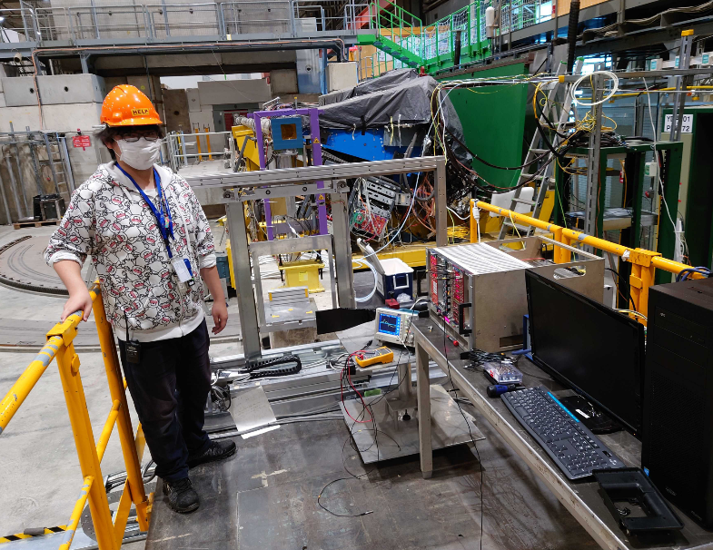
Setup (for NA65, will be shared)
Requirements for infrastructure is the same as NA65
Beam monitor
Target mover
Scintillation counter
Emulsion detector
2021 NA65 setup
NA65 target mover
~200 kg
XWDC
Vacuum pipe
Detector
Counter
Target mover
Emul-sion
XDWC
Movable table

Slide 4
backup

Slide 5


Module for momentum measurement test
Mom reconstruction by multiple Coulomb scattering
Emulsion / tungsten x 100 layers x 1 module
  Film size 12.5 cm x 10 cm
Different beams in different angular space
$$θ_{x}$$
50-400 GeV
Mu+ or Hadron+
50 GeV
400 GeV
$$θ_{x}$$
200 GeV
100 GeV
50 mrad

Slide 6


Module for electromagnetic shower
Emulsion / tungsten x 60 layers x 3 modules
  Size 12.5 cm x 10 cm
Different beam in modules
  50, 100, 200 GeV
50-200 GeV $e^{−}$
17 $X_{0}$

Slide 7
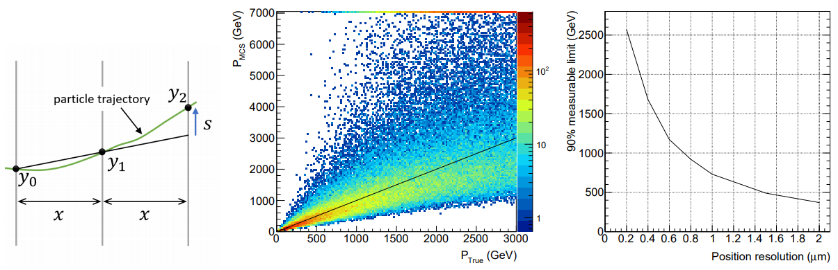


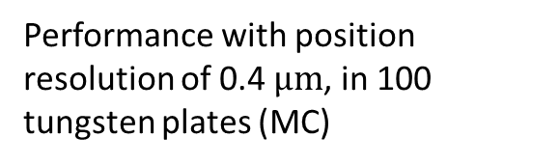
Particle momentum measurement by multiple Coulomb scattering (MCS)
Backup slides for LHCC 2019 Sep
Sub-micron precision alignment thanks to muons.
  Our experience = 0.4 $μm$ (in DsTau)
This allow to measure particle momenta by the MCS, even above 1 TeV.
Performance with position resolution of 0.4 $μm$, in 100 tungsten plates (MC)
Measurable energy vs position resolution

Slide 8
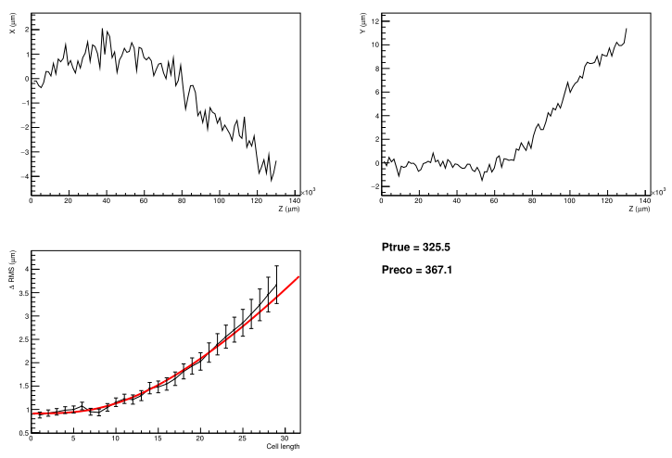

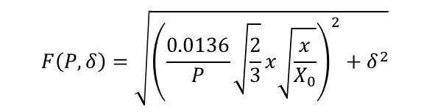
Example of MCS and fit
Backup slides for LHCC 2019 Sep
track in 100 layers of tungsten x 1 mm
Trajectory in Y
Trajectory in X
smeared with position resolution
RMS of scattering as a function of cell length
Fitting result
$$F\left(P,δ\right)=\sqrt{{\left(\frac{0.0136}{P}\sqrt{\frac{2}{3}}x\sqrt{\frac{x}{X_{0}}}\right)}^{2}+δ^{2}}$$
position resolution = 0.4 $μm$

