Slide 1










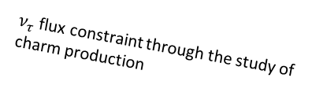



The NA65/DsTau experiment at the CERN SPS
Study of ν_{τ} production for future tau neutrino experiments.
Measurement of $D_{s}$ double differential production cross section
Reduce uncertainty of $ν_{τ}$ flux from >50% to 10% → Fundamental input for future ν_{τ} experiment: SHiP, and indirectly FASER
Forward charm physics, charm/gluon PDF
Principle of the experiment
Detection of “double-kink + charm decay” topology within 10 mm.
$4.6×{10}^{9}$ protons, $2.3×{10}^{8}$ proton interactions in target, ${10}^{5}$ charm pairs, $1000 D_{s}→τ→X$ detected events.
$ν$ oscillation experiments
DONuT
Re-evaluation of $ν_{τ}$ cross-section (2020)
-2008
Small kink at D_{s} → τ
400 GeV
proton
ν_{τ}
Ds
Tau
$ν_{τ}$ flux estimation
D_{s}
X
Precise $ν_{τ}$ cross-section.
New physics searches in neutrino scattering
τ
2027?-
D⁺
ν_{τ}
$ν_{τ}$ flux constraint through the study of charm production
X'
Astrophysical $ν_{τ}$ observations
~5 mm
2022-

Slide 2
Beam requirement
Beam: 400 GeV proton
Beam size/shape: 2 cm x 2 cm.
Gaussian-like shape is better than square-like profile.
A sigma of distribution ~10 mm (not RMS)
2022 beam shape at H4 is good, 2021 H2 was better
No beam divergence = No Q-magnet working nearer than 100 m
Beam intensity: a few x 10⁵/spill
Spill time structure: flatter is better

Slide 3
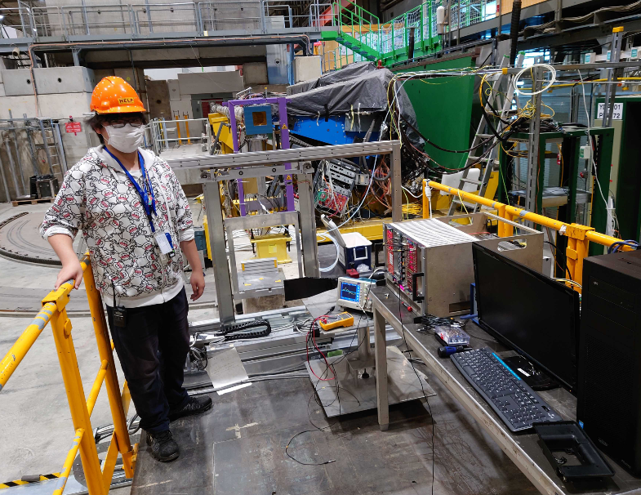
Requirements for infrastructure
Movable table (Nikhef table or equivalent)
Beam profile monitor
XDWC in front of NA65 detector (longer cable is needed)
Vacuum pipe to transport proton beam
Storage of the target mover (1m x 2 m + some carton boxes)
2021 setup
DsTau target mover
~200 kg
XWDC
Vacuum pipe
Detector
Counter
Target mover
Emul-sion
XDWC
Movable table

