Slide 1

Status of MPE-MI Systems in the LHC
234rd Machine Protection Panel Meeting
Raffaello Secondo
on behalf of TE-MPE-MI
24rd March 2023

Slide 2
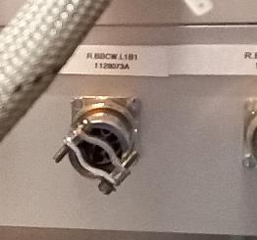
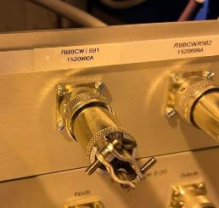
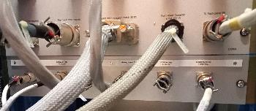
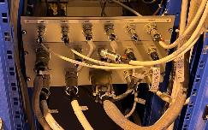
WIC
All 8 WIC systems operational
No changes done on the WIC side
except in P1 and P5 because of BBCW not repairable
The interlock cables of the power converters below were disconnected and replaced by a bridge:
R.BBCW.L1B1 in P1
R.BBCW.L5B1 in P5
In order to have a permanent “PC_Status” at TRUE (bridge on pair 1-2) to give in turn a “User_Permit” at TRUE to the BIS
Remaining “B2” BBCW in P1 and P5 are protected by the WIC (No changes)
WIC rear patch panel in P1
WIC rear patch panel in P5

Slide 3
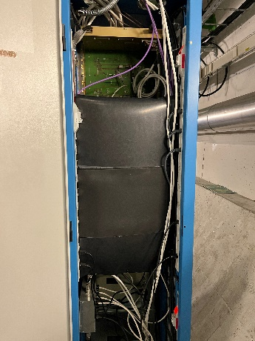
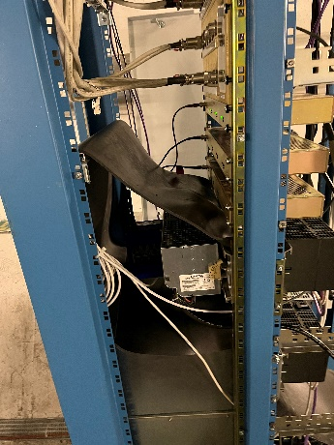
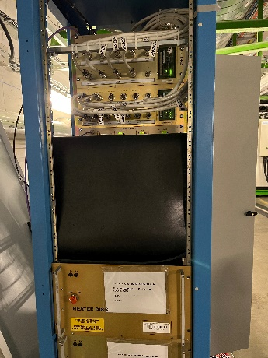
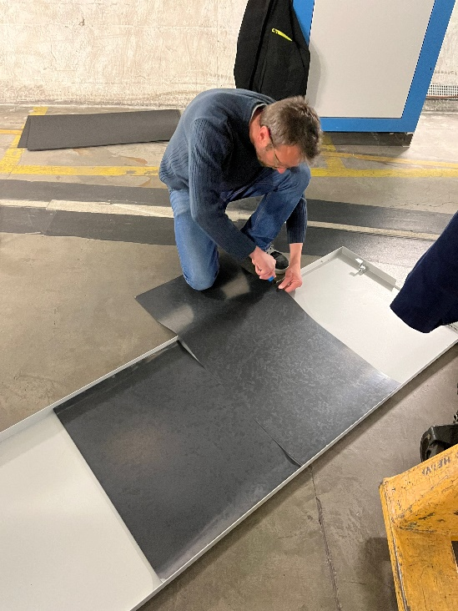
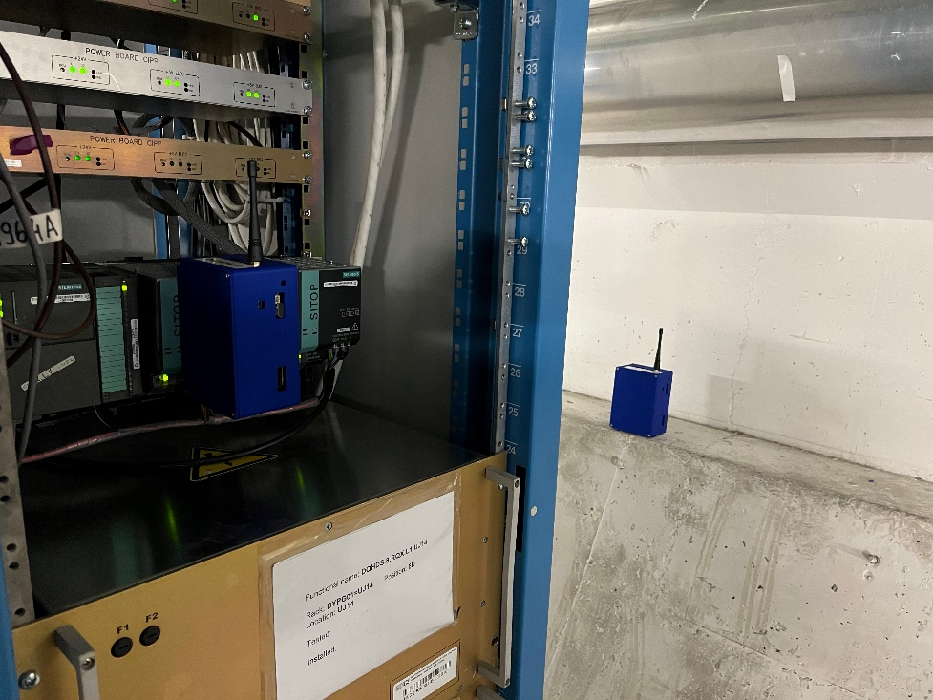
PIC - FMCM
PIC Hardware Commissioning:
  All powering PIC tests done in Acc testing.
  PIC_TO_BIC tests ongoing.
  AUG connection to PIC tests to be analysed
FMCM - Waiting operation for LHC and SPS transfer line tests.
Boron Carbide (B4C) shielding installation around PIC @point 1 (UL14, UL16) during YETS 22/23:
  Increasing PLC CPU failures occuring only at point 1 since 2017. #2 failures in 2022 requiring access.
  High energy hadrons and thermal neutrons fluences measured in 2018 and 2022. Neutron fluence suggests large impact on failure rate.
  Decision to install a 4pi B4C shielding, to reduce ThN induced SEEs
  4x BATMONs installed to monitor fluences.
  A thermal study was carried out to evaluate the impact of potential overheating in the crates → No risk of PLCs malfunctioning (low temperature increase).

Slide 4
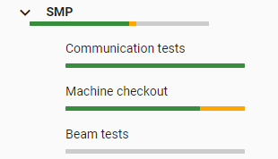
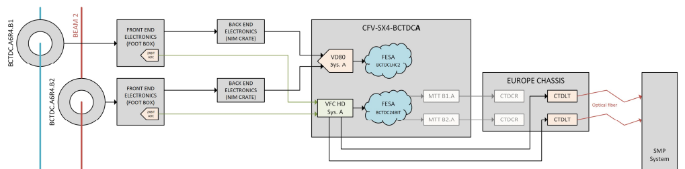
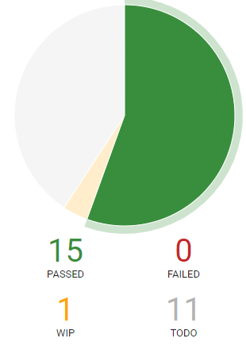
SMP
Tests of the DC-BCT1 and DC-BCT2
  Modification of 24-bit acquisition, (ECR 2802395).
  Test received intensity levels, including negative values.
SIS/Sequencer tests not repeated
Moveable Devices Allowed In, Stable Beams Flag tests passed
SPS Flags – PBF/SBF/TBF tested
  Validation of SPS BCT5 connection(ECR 2822146)
TED Beam Flag logic with TEDs in DUMP position passed
Interface with timing and CRC tested
Beam Tests to be performed

Slide 5
BIS
BIS Connections
  BCCM A + B, Beam 1 & Beam 2 in UA47 disabled on input 9
BIS Input Channels Jumpers
  Removed Jumpers on Injection BIS – 21st March
  New jumpers placed on LHC TZ76 Channel 1 – 22nd March (vacuum B1 & B2)
BIS Local Loop
  Local loop removed from point 6 – 21st March
IST tests status
  Injection BIS IST - passed on 23rd March
  LHC Ring IST passed on all points, IST on point 7 to be repeated after removal of jumpers
  Jumpers on TZ76 possibly to be removed next Wednesday or Friday
Setup Beam Flag on LHC Injection BIS (SR2 and SR8)
  Moved from LHC-SBF to SPS-SBF – 15th March
  According to specifications, reduced redundancy of connections

Slide 6
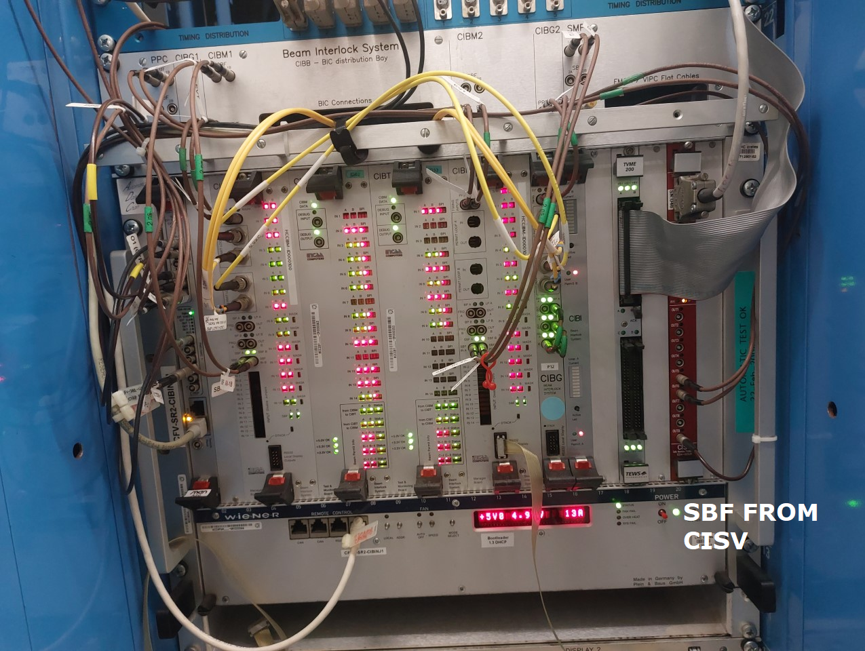
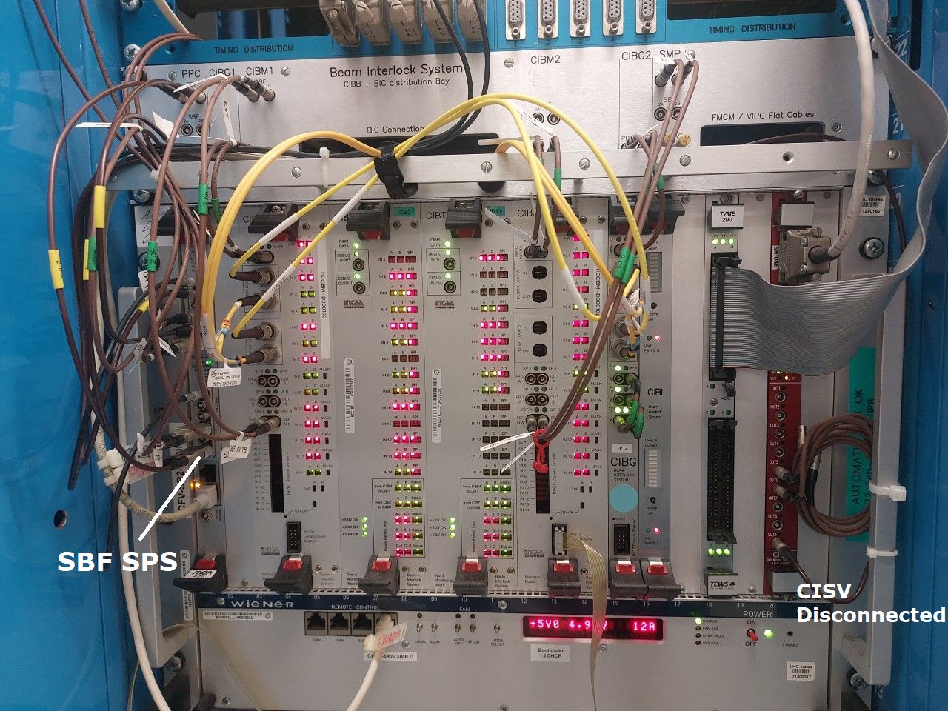
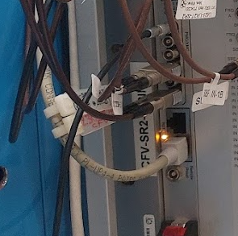
SBF for LHC Injection BIS
Masking with
LHC Setup Beam Flag
Masking with
SPS Setup Beam Flag

