Slide 1
LHC BLM
System Readiness
Summary of YETS 22-23 Changes
234th Machine Protection Panel
Mathieu Saccani (SY-BI-BL) on behalf of the BLM team

Slide 2
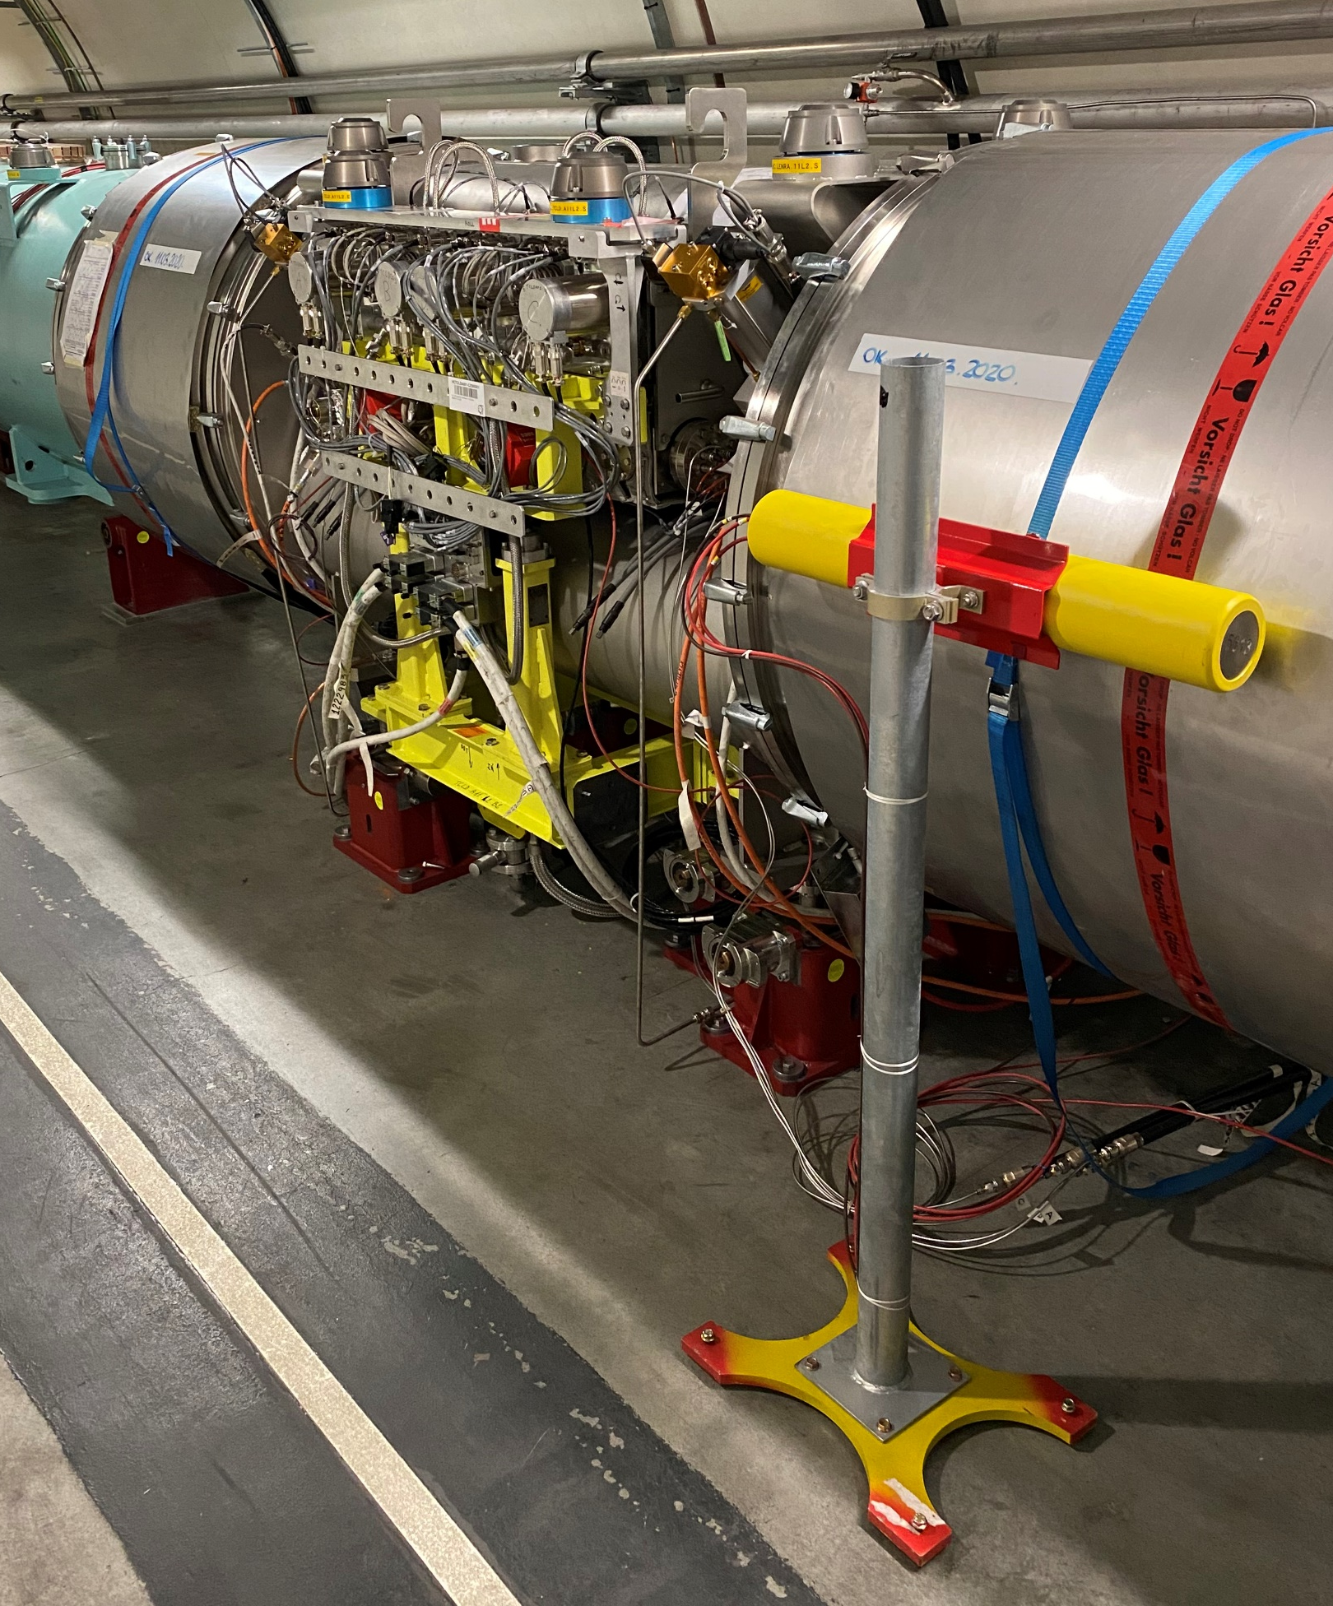
Changes during YETS 22-23
Monitors ➔ minor changes
Installation of 2 temporary detectors at 11L/R2 TCLD collimators: JIRA-BIBML-2560 EDMS-ECR-2859726
Installation of 2 detectors on the CryoBLM sCVD in SR5 and SR7 (research subject): JIRA-BIBML-2630
Hardware ➔ mostly preventive maintenance
Acquisition electronics: 3 replaced & 27 repaired BLECF (HV resistor, GOH, …)
Processing electronics: 2 replaced & 6 repaired BLETC (optical receiver, fibre clean-up)
Survey electronics: 1 replaced BLECS (SRAM memory)
Repaired of a few WorldFIP failing links (remote reset)
A11L2 new monitor

Slide 3
Changes during YETS 22-23 (cont’d)
Firmware ➔ major changes
BLETC (Threshold Comparator) firmware update to solve the RS12 Ch6/14 8MSb swap JIRA-BIBML-2548
BLECS (Combiner & Survey) firmware update:
  to solve the VME incompatibility with MEN-A25 (FPGA was responding too slowly)
  to improve the VME throughput and stability (block transfer added, and should solve the sanity check to randomly fail)
  minor processing improvements (remove offset in connectivity check, add access to all SRAMs, …)
Software and Databases ➔ major changes
CPU migration from MEN-A20 to A25 (advanced from LS3 to now):
  avoid losing CTIM events (missing XPOC/PM): JIRA-TIMING-4011 & JIRA-TIMING-4027
  give more processing time margin for real-time actions
LHC data concentrator new release: JIRA-BIBML-2507
Changes in FESA:
  Clean-up unused properties/fields
  Probes inserted in RT actions
  Remove some “VME retries” as the bus is now stable
Update of GUIs: BLMLHC_expert, InternalParameters, Thresholds, …

Slide 4
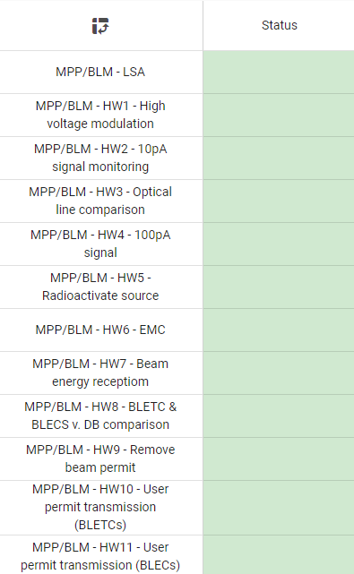
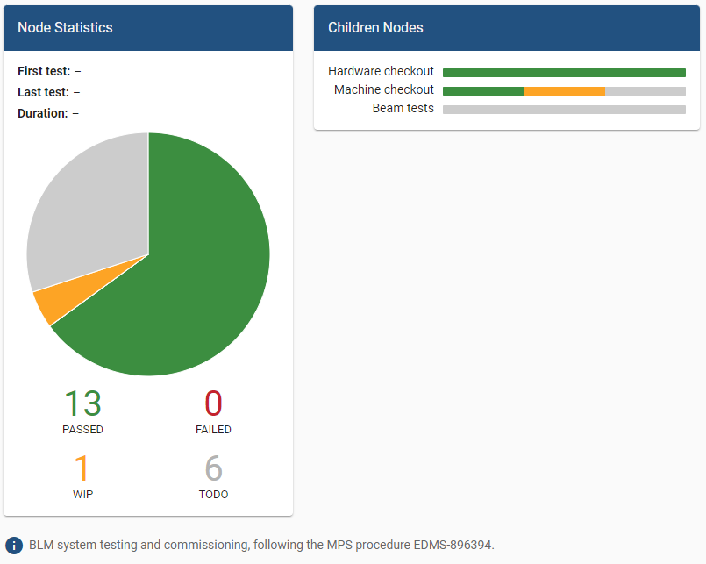
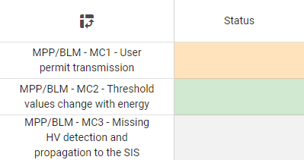
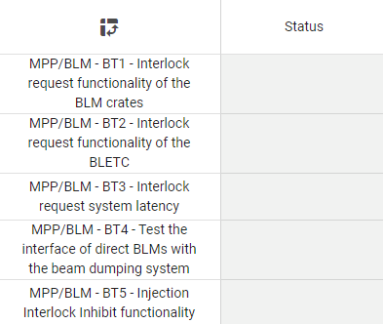
BLM LHC System readiness
Hardware Checkout
Completed 20th Mar 23
Done by BI experts.
BLM MPS Checklist
Only after LS2.
Could be greyed in the checklist.
Also verified with BIS team. Issue in SR5 solved.
Machine Checkout (“IST”)
Tests with Beam
Scheduled 3rd Apr 23
(delayed?)
Scheduled 3rd Apr 23
(delayed?)
1 block of tests
in CCC
To be done from the CCC.
Last year issue in SR5 is solved.
No need
No change on Direct Dump (neither on BLM nor LBDS)
Already tested after LS2.
Checklist - MPS - BLM
MPS_BLM_Commisisoning-EDMS-896394
Needed?
Injection Inhibit test to be tested with beam by ABT & BI.

Slide 5
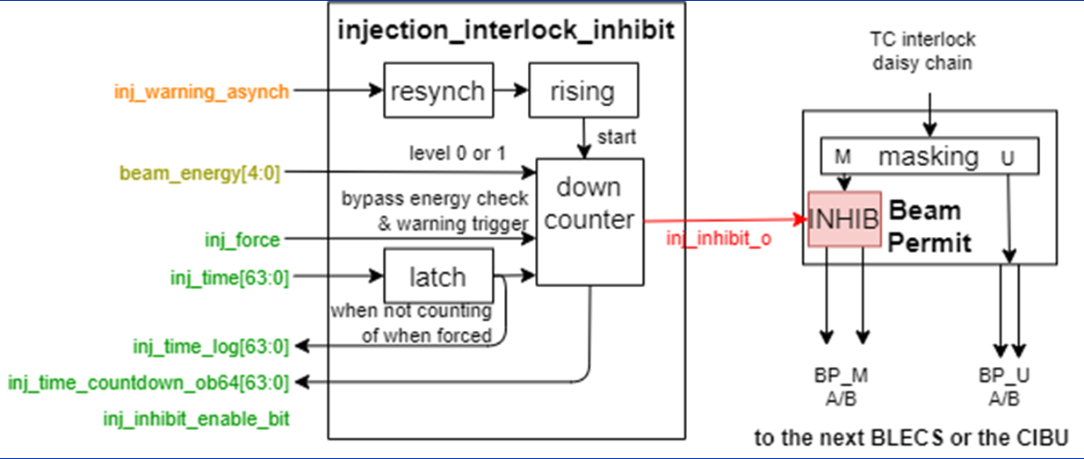
Limitations
Blindable channels inhibit at injection never tested with beam
Feature present in all crates, not only SR2-Inj & SR8-Inj
By default, it is disabled
Triggered by injection warning (from BST) with programable timer per crate
Acts only on maskable channels
Inhibits the interlock output to BIC only (all running sums still active, and dump requests logged)
This feature must be commissioned:
  Dedicate ~3h to ABT+BI in the CCC
  Test with beam
  and measure the blind time needed
  Double-check the set of maskable
  channels to blind (+adjust monitor factors)
Injection Interlock Inhibit FW Implementation

