Slide 1
DRD4 - Photodetectors and Particle ID
»First small meeting»
P. Krizan and C. Joram
08 March 2023.
Agenda
Round table (≤1 minute per participant)
Detector R&D Collaborations in the context of the ECFA Roadmap
We like the bottom-up approach ➔Purpose of the meeting:
  taking the temperature of the community
  What do you expect from such a collaboration ?
  Where do you see potential ? Where are the risks ?
  First ideas: what are topics for joint R&D ?
The next steps
Disclaimer: the invitation list aimed to cover the major experiments with PID and major labs/groups with photodetector developments. P.K. and C.J. take the blame for possible bias and incompleteness of the list.
Not being invited to today’s meeting doesn’t exclude anyone from participating to DRD4.

Slide 2
Material and Links
The Roadmap (248 p)
https://cds.cern.ch/record/2784893?ln=en
ECFA Detector R&D Roadmap Symposium of Task Force 4 Photon Detectors and Particle Identification Detectors
Thursday 6 May 2021
https://indico.cern.ch/event/999817/
Implementation of the ECFA Detector R&D Roadmap
https://indico.cern.ch/event/957057/page/27294-implementation-of-the-ecfa-detector-rd-roadmap
➔ DRD4. News, dates, …

Slide 3
Detector R&D Collaborations in the context of the ECFA Roadmap
The Roadmap has identified detector technologies¹⁾ that need to be developed for the next generations of particle physics experiments.
To address those needs in a coordinated and efficient way, Detector R&D Collaborations are being formed.
Some similarity to the CERN R&D collaborations before the construction of LHC (still alive RD50, RD51…)
Collaborations shall form, define their work programme, define and organise their funding, define their management, report once per year to a DRD Committee at CERN.
Joint R&D should increase efficiencey (avoid duplication, form partnerships) and lead to synergies (share equipment, samples, know-how).
The label ECFA Roadmap should enhance chances for extra funding from Funding Agencies. The participating groups (nationally clustered?) request funds from their FAs.
¹⁾ IMPORTANT: we are talking about technolgical (strategic) detector R&D in the fields photodetectors and Particle ID. This is different from experiment-specific developments and optimisations (adaptation of geometry, full-size prototype, industrialisation of production process, …). The latter R&D shall remain fully under the responsibility of the experiments.

Slide 4
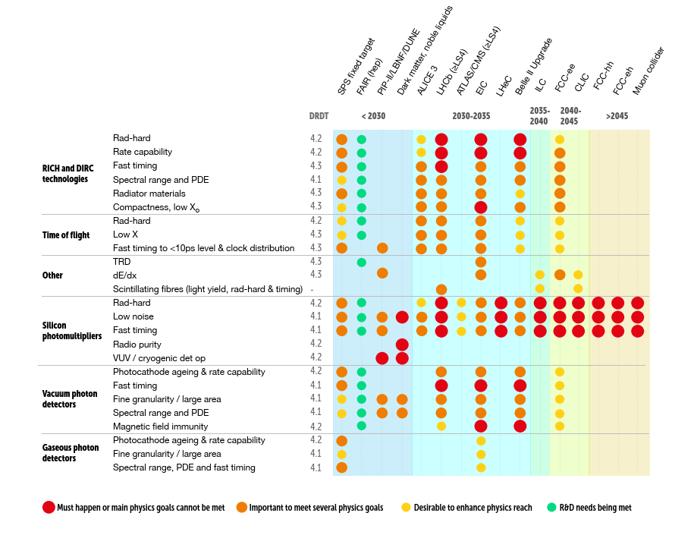
Current Roadmap plan
ECFA bible p. 89
PID - Technologies
Not covered in this table:
Specific FE electronics
Simulation and Analysis-software
… should be discussed!
Photodetector Technologies

Slide 5
Main recommendations
DRDT 4.1 - Enhance the timing resolution and spectral range of photon detectors.
DRDT 4.2 - Develop photosensors for extreme environments.
DRDT 4.3 - Develop RICH and imaging detectors with low mass and high resolution timing.
DRDT 4.4 - Develop compact high performance time-of-ﬂight detectors.
Further recommendations
It is recommended that several “blue-sky” R&D activities be pursued.
The development of solid state photon detectors from novel materials is an important future line of research, as is the development of cryogenic superconducting photosensors for accelerator-based experiments.
Regarding advances in PID techniques, gaseous photon detectors for visible light should be advanced.
Meta-materials such as photonic crystals should be developed, giving tune-able refractive indices for PID at high momentum.
Finally, for TRD imaging detectors, the detection of transition radiation with silicon sensors is an important line of future research.

Slide 6
Next steps
Establish mailing list of wider community. We have a list with more than 100 people expressing interest. This will be the starting point.
Invite for community meeting
  Where, when, how long, agenda ? Mix of scientific and organisational parts
  Volunteers (organisation, individuals).
  Fallback venue: CERN
Questionnaire. Online via Indico. Comes with the invitation.
  Will explore interests, plans, infrastructure, special equipment

Slide 7
DRD4 tentative timeline
(has to fit in ECFA global plan)
31.07.2023
Official deadline for
proposal submission
today
Feb Mar Apr Mai June Jul Aug Sep Oct Nov Dec Jan 2024
Low efficiency !
Many people absent!
We’ll ask for a few weeks extra, if needed.
24/02 Send invitation =>
Community meeting =>
Proposal completed =>
Start of activities =>
Send out questionnaire =>
Constitution meeting =>
questionnaire returned =>
Start proposal writing=>
08/03 Small zoom meeting =>
6 weeks!
20 pages expected.
‘Bible’ helps, but we have to find groups that commit to do the work.

