Slide 1
Towards the detector requirement report:
di-lepton and di-photons cross-sections at the Z peak
Blondel, M. Dam, (also discussions with P. Janot, C. Paus, E. Perez etc)
Work in progress for discussions
Motivation
What is involved
(not included in this talk: ECM, theoretical calculations)
Final state selections, leading to detector requirements
in 15 minutes + 5 minutes for questions

Slide 2
In the process towards feasibility study, an high priority output is:
the publication of a set of detector requirements for the FCC-ee detector systems
-- part of the contents of the mid-term review report
Essential also towards the (ECFA) EU-wide detector R&D plans and process, and the associated funding requests, which will orient soon the detector R&D efforts of the community.
Emphasize that the FCC-ee has very specific aspects, in particular at the Z pole.
3. Essential to guide the development of detector concepts.
The precision measurements at the Z pole and WW threshold are particularly important tools of
search for nex physics via loops or mixing in a context where
1. the SM is complete (except perhaps RH neutrinos)
2. its predictions well defined (up to parametric and calculation uncertainties)
3. We know that new physics exists but we do not know what/mass scale/couplings to SM particles
Improve precision ➔ improve discovery potential (see next three slides)
In my presentation in Krakow, I emphasized the measurement of the e+e- →‾qq (hadrons) rate which requires that the angle of detection be as low as possible. This governed the requirement that the low angle limit of the machine elements be contained in a cone of 100mrad around the detector axis.
Today we discuss further the low angle region which governs the processes
e+e- → lepton pairs and e+e- → γγ

Slide 3
« The Standard Model is complete »
This statement is correct in the following sense, which allows to separate ‘SM’ from ‘BSM’
we should distinguish
A. ‘Theory of particle physics’
based on Quantum Field Theory, relativity, quantum mechanics, principles of Gauge invariance etc... using in particular the SU(3)_color ⊗ SU(2)_L ⊗ U(1) gauge groups or extensions thereof.
In itself it is not necessarily predictive, but provides a wide toolset to include further discoveries.
** definitely not complete**, but completeness is not the
and
B. « the Standard Model » which is one possible model witihin the above, with a specific set of constituants (fermions and gauge bosons), their couplings, chiralities and their masses, which are all extracted from experiment
It was created (and named in ~1976) after the discovery of the Neutral Currents (1973), Charm (74/76) and the tau and ν_{τ} (75-77)
With the discovery of the Higgs boson, the Standard Model is complete and forms a predictive and quantitative tool.
-- assumes neutrinos are massless
-- comprises 3 families of quarks and leptons and a single, elementary Higgs boson, and as such
contains no free parameter (only parametric uncertainties) ANY DEVIATION from SM is BSM DISCOVERY
-- does not explain in a unique way the neutrino masses or the Baryon Asymetry of the Universe, does not comprise a candidate DM particle, etc... for which we know for sure that BSM is needed.

Slide 4
Motivation for the precision measurements *and* precision calculations
1. Given that the minimal SM is complete with the Higgs discovery, how do we find out:
-- if the Higgs boson is exactly what is foreseen by the standard model? (→ Higgs Factory)
-- where/what are the new physics phenomena that must be present to explain:
baryon asymmetry
dark matter,
neutrino masses (and other mysteries we don’t understand) (→ EW/top factory)
2. A powerful and broadly efficient method is to perform precision EW measurements
-- many observables contain sensitivity to new phenomena, either by loops, direct long distance propagator effects, or mixing with SM coupled particles.
➔ are there any more weakly coupled particles?
The top quark effect at LEP was 10σ! (➔ there is *not* another t-b quark system)
any custodial SU(2)-violating effect appears regardless of mass scale
-- is there mixing ? in particular active-sterile neutrino mixing
-- high mass SM-coupled and custodial SU(2)-respecting → (ex: Z’ or degenerate Su-Sy)
Emphasis on different observables depending on the question asked.
Δρ =ΔT/α=
α/π . (m²_{top}-m²_{b})/m²_{W}
«T»
not to forget:
QCD
Lepton-quark
lepton and quark family
Universality
«ν»
«S»

Slide 5
Overview of loop correction relationships and examples of new physics effects
Z scan
WW at and above threshold
α_{QED}, m_{Z}, G_{F}
Δα_{QED}
m_{top}
S,T, NP
m_{top}
m_{top}
α_{s}
S,T,ν, NP
sin²θ^{eff}_{W}
m_{W}
ν
T,ν, NP
asymmetries
from Parity violating couplings
A_{FB}^{f}
P(τ), A_{FB}^{pol(f)}
(initial of final state)
A_{LR}
α_{s}
σ_{had} (m_{Z})
Γ_{Z}
α_{s}
δ_{vb}
τ
(mass)
BR,
lifetime
ratios of partial Z widths
R_{lept (e,μ,τ)}
R_{b}
R_{c}
Γ_{W}
_{part. widths}
partial widths, (g_{A}² +g_{V}²)(f), N_{v}
(g_{V}/g_{A})(f)
bottom line: FCCee provides both the SM inputs and the SM measurements → unprecedented exploration of BSM!

Slide 6
The fundamental reference
Basic papers of the 4 LEP experiments
Reference: https://inspirehep.net/literature/691576
Phys.Rept. 427 (2006) 257-454

Slide 7
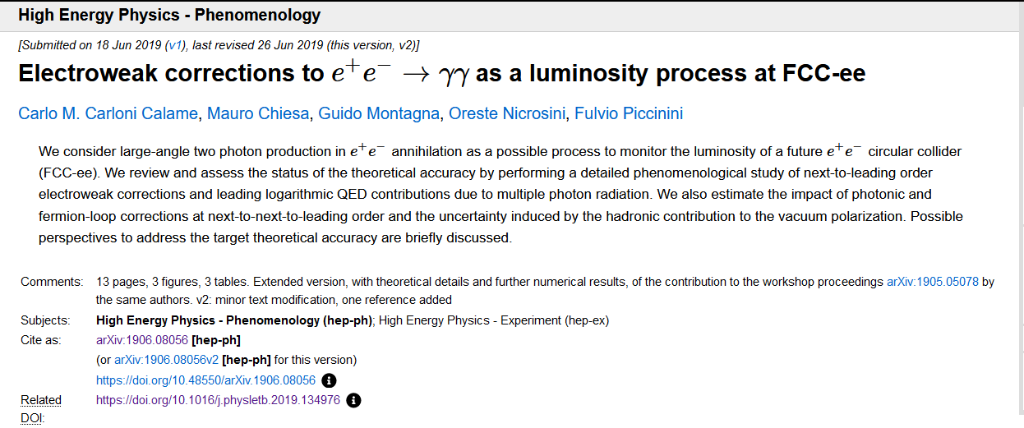
A very useful reference

Slide 8
A great reference!

Slide 10
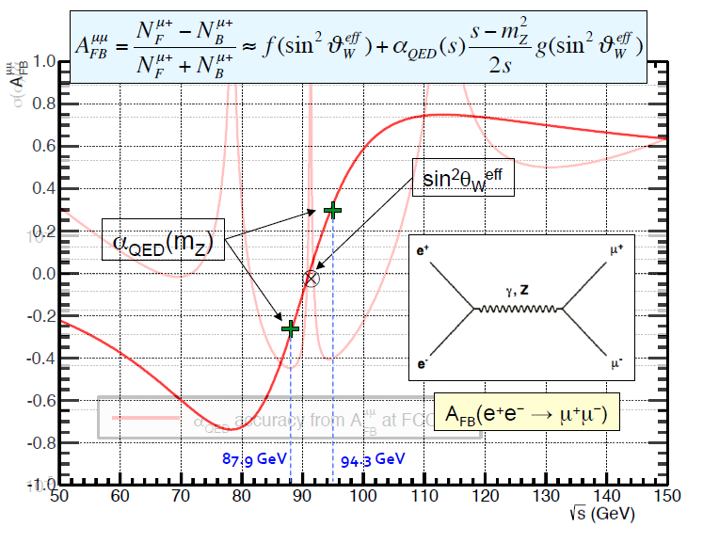
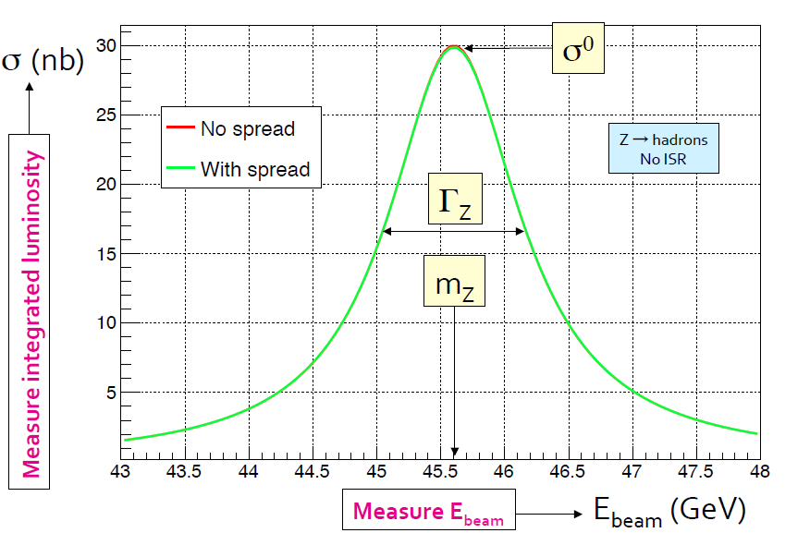
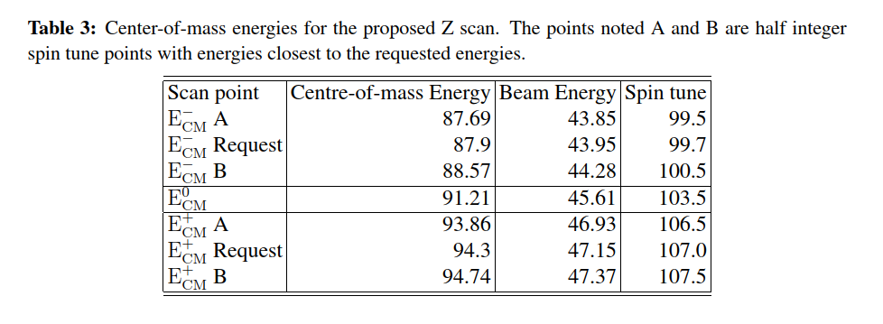
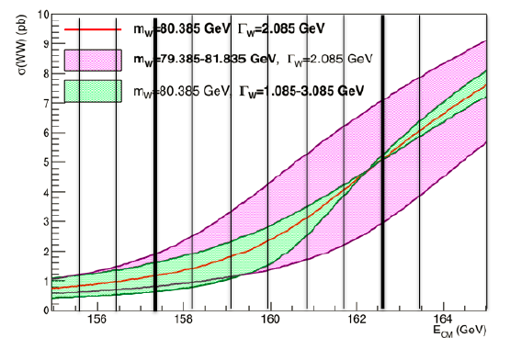
FCC scan points for m_{Z} and m_{W}
from arXiv:1909.12245 – 2 exp
30 ab-1
90 ab-1
30 ab-1

Slide 11
s-channel: Z→ ee = Z→μμ = Z→ ττ
ee → γγ
t-channel: ee → ee

Slide 12
Systematic precision target ≤ statistical error
45 ab-1 in one experiment at the Z pole
Z→ lepton pairs = 3x1.4nb x 45 ab-1= 1.9 10¹¹ evts
relative statistical precision: 2.3 10⁻⁶
Z → hadrons = 31.4 nb x 45 ab-1 = 1.4 10¹² evts
rel. statistical precision 8.5 10⁻⁷
e+e- → γγ (20pb for 20 deg. cut ) =0.9 10⁹ events
rel stat. precision 3.3 10⁻⁵ for a 20 degrees cut (0.94)
Physics interest
hadronic cross-section → N_{v} (L-R neutrino mixing)
ratio of hadrons to leptons R_{l} → α_{s} (m_{Z})+ l-q univ.
Z width → rho/T parameter
Z mass (and W mass) and their ratios
Bhabha ee → ee and ee → γγ are precious to
determine the absolute and relative luminosity.
ee → γγ offers good hope to improve the absolute
luminosity uncertainty wrt Bhabha. FCC-ee specific
s-channel: Z→ ee = Z→μμ = Z→ ττ
t-channel: ee → ee
ee → γγ
0.98
NB at the Z pole s(imaginary) and t(real) channels do not interfere

Slide 13
Leptonic event selection
for each experiment
-- statistics 6.8 10¹⁰ events in each channel ➔ 1.9 10¹¹ leptonic events provide 1/√N = 2.3 10⁻⁶
Paradoxically leptonic event selection is much more prone to systematics than the hadronic selection
The main reason is that it is much easier to lose one track than a whole jet.
For instance if two tracks are required the loss of efficiency is twice the track reconstruction inefficiency ε(θ)
selection might start with single track selection, second track to be used to ensure both
-- high efficiency
-- measurement of efficiency (2 tracks vs 1 track)
Also low angle definition is essential, as it is not compensated by the wider ‘jet’ structure
Similarly to luminosity measaurement, it is useful to select one track with tight cut and the other with looser cut
and switching the “tight side” from one side to the other event by event.
this eliminates effectively the issues of misalignment of the beam axis wrt detector axis (old trick by G. Barbielini)
the main question is the solid angle under which the limit of the tight cut is seen from the vertex.
That solid angle refers to the angle wrt the nominal direction of the exiting beams (not the detector axis!)

Slide 14
requested comment on angle determinations using large angle dimuon events.
The acceptance cut above is expressed as a solid angle. This cannot be extracted from a fit to large angle events.
See « Absolute angle determination » section in the EPOL paper arXiv:1909.12245v1, which is great!
where the angles of the beam collision plane vs detector ref frame are determined and considered to be ‘absolute’.
– however the detector dimensions cannot be determined that way. Also the detector is not a rigid body.
-- As complement, it was noted that the combination of the beamstrahlung monitor x crossing point measurement
can also in principle determine the beam collision plane.

Slide 15
Typical dilepton selection
-- define a inclusive dilepton selection (goal to measure number of leptons pairs with highest precision)
-- within this sample evaluate ee/ mumu/ tautau fractions
-- e/mu/tau separation requires dedicated tau analysis
-- ee channel comprises both Z decays, t-channel (Bhabha scattering, non resonant) and their interference
required dedicated treatment of e+e- channel
must impose a low angle limit of selection (necessary because of low angle bhabha scattering)
sensitivity to low angle cut
-- a cut such as |cosθ|<0.95 has a typical efficiency of 0.9 for a process with angular distribution (1 + cos²θ)
-- what is the precision required on this angle to ensure a overall precision matched with the statistical precision?
-- this cut is correlated between channels and must be considered globally.
-- as for luminosity measurement one could consider a tight-lose method (switch on event by event basis)
requirement applies to tight cut.
Answer: at an angle of 20 degrees, a 2mrad change of polar angle → 10⁻³ change of acceptance.
a precision of 1.4 10⁻⁶ will require a (hardware or alignment) with precision of 3 μrad (i.e. 6 microns at 2m)
For an angle of 10 degrees the precision required is relaxed by 2 – 6 μrad or 12 microns at 2m
This question is synergetic with the luminosity measurement from e+e- → γγ events

Slide 16
s-channel: Z→ ee = Z→μμ = Z→ ττ
Larger cut angle
tighter tolerance
10 degrees gives tolerance of 14 microns at 2.5 m
20 degrees gives 8 microns

Slide 17
ee → γγ
Larger cut angle
→ less statistics and less precision
looser tolerance
10 degrees gives tolerance of 25 microns at 2.5 m
20 degrees gives 38 microns
Lower angle cut gives higher cross-section, but angle cut tolerance becomes tighter.
The precision is never as good as the statistical error of the large angle lepton samples
but for a 10 degrees cut the required tolerance is not as tight.
The angular tolerance is accompanied with a z position requirement which is typically
5-10 times looser.

Slide 18
Detector considerations
1. It is essential to place a tracker in front of the calorimeter in order to separate electron from photon.
2. The least material between the IP and the first sensitive element the better.
3. the critical number if ‘how many 45 GeV electrons give no track’ (catastrophic bremsstrahlung)
4. presence of two sides per event will be of great help.
whenever possible tracking elements should be perpendicular to the beam axis
The main background for the diphoton channel
is the t-channel Bhabha scattering.
0.98

Slide 19
status and outlook
for the t-channel Bhabha, Z leptonic decays, and two gamma channel, a dominant and straightforward systematic uncertainty arises from the definition of the low angle cut, which defines a solid angle in space.
Examples and curves have been produced.
A question arises : are the two sides of a detector independent or fully correlated?
indepenance losens tolerance by sqrt(2)
The systematic has been considered to be independent between detectors
(precision improves with number of detectors) this will lead to higher precision by factor 2 for four detectors vs. one.
Detector design for the low angle region of the endcaps is truly critical. Impact beam pipe etc...
Time to write a note on the topic.

