Slide 1
Towards an R&D collaboration for PD and PID (DRD4)
Peter Krizan & Christian Joram
JSI Ljubljana CERN
Community Meeting
16 and 17 May 2023
Many thanks to Neville Harnew for quite a few slides.

Slide 2
Welcome at CERN
Community meeting of groups and individuals active in the field of photodectors and Particle ID (+ SciFi trackers)
Towards an R&D collaboration (DRD4) as outlined in the ECFA Roadmap process.
DRD4 shall bundle and boost R&D avtivities in the above fields, in order to achieve the performance needed for the next generation of high energy physics experiments and upgrades.
Common R&D may accelerate progress, avoid duplication, give access to infrastructure, train people, lower the cost...

Slide 3
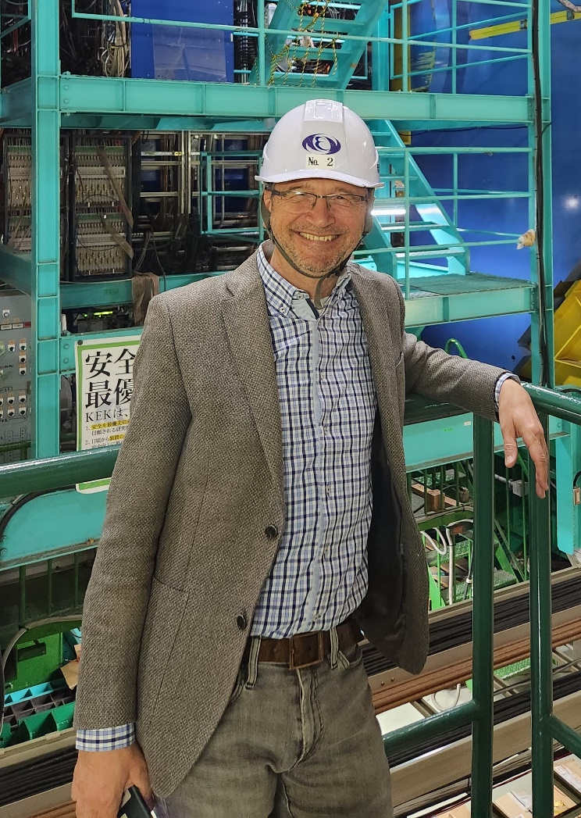
Peter Križan
University of Ljubljana and J. Stefan Institute
Flavour physics and detectors
  ARGUS @DESY
  HERA-B @DESY: RICH with MaPMTs and C₄F₁₀
  Belle @KEK: silicon strip vertex detector
  Belle II: spoke, technical coordinator, Cherenkov detectors ARICH and TOP
  Applications in medical imaging: Cherenkov based TOF-PET
Photon detectors
  MaPMTs, MCP-PMT, HAPD, SiPM
Editor NIMA (2010-2022)
Why am I here?
ECFA Roadmap, co-convener of TF4 (together with Neville Harnew).
With Christian given the mandate to launch a D(etector)RD Collaboration on Photodetector and PID
Co-coordinator of the Photodector working group of the 2019 US DOE HEP-Instrumentation BRN effort
Technical coordinator of Belle II (2015-2020)

Slide 4
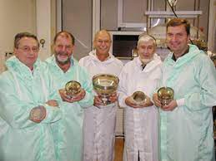

Christian Joram
CERN, since 1994
Detector physicist
  DELPHI RICH
  LHCb, RICH R&D
  ATLAS ALFA, Scint. Fibre tracker
  LHCb SciFi, Scint. Fibre tracker
  AXIAL PET
Photodetectors
  HPD, MAPMT, SIPM, also digital
Why am I here?
ECFA Roadmap, expert in TF4
Peter and I were given the mandate to launch this Detector R&D (DRD) Collaboration
Helped to launch RD50 and RD51 collaborations
Coordinator of EU MC network MC-PAD
Coordinator of CERN Detector R&D Programme
Editor of NIM A

Slide 5
Tentative Programme for Community Meeting
Tue, 16/05, morning, 0.5h
Introduction, the Roadmap, purpose of the meeting, timeline, results of survey
Session Photodetection,
SiPM, SPAD, PMT, MCP 12 talks
Session Technologies
Materials
Software
Session Particle ID
RICH/DIRC
TOF/TORCH
Social dinner
Wed, 17/05
Session ‘blue sky’, special, etc.
Session Organisation 1
Introduction to Organisation
Presentation of groups and their interests
Session Organisation 2
Structure of DRD4
Which WPs? Scopes ?
Financial
Common projects
Session Organisation 3
Proposal, content, timeline, signatories
Contributors
3 talks
3 talks
6 talks

Slide 6
DRD4: timeline
DRD4 Timeline
31.07.2023
Official deadline for
proposal submission
TODAY =>
Feb Mar Apr May Jun Jul Aug Sep Oct Nov Dec Jan/2024
Low efficiency !
Many people absent!
We’ll ask for a few weeks extra, if needed.
Proposal completed =>
Start of activities =>
Constitution meeting =>
24/02 Send invitation =>
Community meeting =>
questionnaire returned =>
Start proposal writing=>
Send out questionnaire =>
08/03 Small zoom meeting =>

Slide 7
Community meeting and survey schedule
8 March 2023 Small meeting (zoom) with representatives of major experiments and groups (~20 participants)
            https://indico.cern.ch/event/1263718/
April 2023 Survey conducted : 40 groups and 43 individuals
            Many small groups, many experiments
16 – 17 May 2023 TF-4 community meeting
            https://indico.cern.ch/event/1263731/
            91 registrations so far (55 present)
            24 abstracts
            40 partipants to dinner
31 July 2023 Ultimate deadline for submission of proposal
            20 pages, based on Roadmap ‘book’

Slide 8
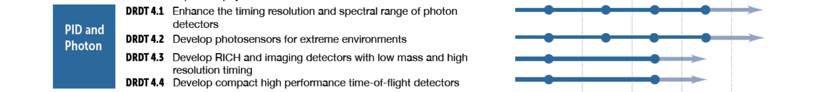
DRD4 - Detector Research and Development Themes
Required for fast timing in Cerenkov and time of flight detectors, for operation with high particle fluxes and pile-up, and in extending the wavelength coverage of scintillation photons from noble gases and Cerenkov photons.
Essential for operation in the high-radiation environments at the HL-LHC, Belle II Upgrade, EIC and FCC-hh; and similarly for cryogenic operation.
Required for particle identication at HL-LHC, Belle II upgrade, EIC, and FCC-ee.
As a complementary approach for particle identification at HL-LHC, EIC and FCC-ee.

Slide 9
RICH, DIRC and TOF detector technologies

Slide 10
RICH technologies : key R&D areas
RICH geometries
  The HL-LHC has possibly the most demanding requirements for next generation of RICH detectors eg. LHCb.
  Hermetic experiments (eg FCC-ee, EIC) need RICH detectors with a total length shorter than a meter. Possibility of pressurizing noble gases to several bars
  The use of lightweight mirrors (CF technology), light collection systems, concentrators – smart optics design
  Radiator materials
  Gas radiators : to develop green gases as an alternative to fluorocarbons (C₄F₁₀ or CF₄).
  Solid, crystal & aerogel radiators (tunable refractive index, larger tiles, higher photon yield).
  Meta-materials, photonic crystals, capable to match refractive indices at low and high momentum.
  Photon detectors and readout
  Need large-area single-photon detectors capable of sustaining high counting rates (few MHz/cm²), improved photon detection efficiency, a total ionizing dose up to a few Mrad, timing resolution of the order of few tens of ps. Granularities of mm-level pixel size.
  Need to develop SiPMs and MCP-PMTs, solid photocathodes in micro-pattern gaseous detectors (MPGDs)
  Timing absolutely crucial to the new generation of RICHes (<50 ps precision) for background rejection and vertex association.

Slide 11
DIRC and TOP detectors key R&D areas
Applications are for flavour and heavy-ion physics, where PID is essential. e.g. Panda, Belle-II, EIC, Gluex drive the performance needs of DIRC detectors.
  DIRC detectors need to extend to 3 sigma pi/K separation @ 7-8 GeV/c (with TOP correction)
  R&D to make DIRC readout more compact, expand momentum reach, develop for endcap operation. Improvements in focusing designs, emphasizing spatial resolution.
  Develop quartz technology, surface quality is essential ((sub)-nm surface roughness) is a major cost driver, lower price.
  Photon detection - fast timing performance is essential (ps level). SiPMs, MCP-PMTs. Improved photon detector granularity; radiation tolerance, lifetime, low noise, photon sensitivity.

Slide 12
TOF technologies key R&D areas
TOF provides complimentary PID for high energy machines. Future applications, e.g. Panda/CBM, Na62/TauLV, ALICE, LHCb, ATLAS/CMS, EIC, FCC ...
  ToF methods
  Scintillators to ~50ps. Gaseous detectors: multigap RPCs to <50ps with micro pattern gas detectors (MPGDs).
  Silicon detectors : Low gain avalanche diodes (LGADs) important to the GPDs, FCC-hh etc, timing to10 ps.
  Large area MCPs (to 15ps): LAPPDs. Instrumenting large area surfaces.
  Cherenkov (DIRC)-based detectors eg. TORCH detector (LHCb, TauFV, kaon) with 3 sigma pi/K separation to 10 GeV/c at 10m.
  Future R&D challenges
  Quartz technology (as for DIRC)
  Photon detection - fast timing performance essential (~10 ps level). SiPMs, MCP-PMTs LGADs.
  R&D essential for timing (clock) distribution.

Slide 13
Photon
Detector
Technologies
Focus on MCP-PMTs and SiPMs for PID (and calorimetry)
Requirement for other vacuum devices and gaseous photon detectors in backup slides

Slide 14
Microchannel plate PMTs
MCP-PMTs proposed extensively for RICH detectors and TOF
  Several suppliers : eg. LAPPD (large area) and Photonis/ Hamamatsu/ Photek (compact, tunable granularity)
  State of the art currently ~20ps timing resolution
R&D requirements
  Large area coverage, cheaper cost for tiling large areas (LAPPD)
  Customised granularity (for DIRC-type detectors, TOF) -128 pixels over 2-inch tube size
  Rate limitation around 10⁵/cm² - need to improve rate capabilities (>MHz)
  Improved integrated charge capabilities (several factors above current state of the art ~20 C/cm²)
  Operating gain currently 10⁶ – 10⁷. Electronics to facilitate operation at a ~few x 10⁵ operation to reduce integrated charge
  Improvements in QE, CCE need to come.

Slide 15
Radiation hard SiPMs : a key technology
SiPMs are photosensors of choice for many applications – HL-LHC & FCC-hh mainly drive the HEP technology limits
Important features are their compactness, low operation voltage, robustness to magnetic fields and reasonable price
Timing, radiation tolerance, low backgrounds are key :
  Wide applications for scintillating fibres, calorimeters, neutrinos and DM experiments (pulse shape discrimination), noble liquid detectors (eg MEG-II with LXe), gamma ray astronomy
  SiPMs now becoming the detector of choice for RICH and DIRC-type detectors (LHCb, ALICE, EIC, FCC-ee etc). And also calorimetry.
    High QE around 50-60% in the visible (350-600 nm)
    However high dark count rates 10-100 kHz mm⁻² at room temperature need to improve towards 1 Hz mm⁻²
    Rad hardness : lose sensitivity to single photons at around 1x10¹¹ n cm⁻² eq. need to improve (1x10¹⁴ n cm⁻² eq @ CMS ; 10¹⁷-10¹⁸@ FCC-hh !)
    Fast timing response – significantly below 100 ps (aspire to 10 ps or below for time resolution)
    Small cell sizes which are tuneable – integration of large systems (cooling etc) important
    Note requirements for single photon detection and calorimeters (with many photons) could be conflicting

Slide 16
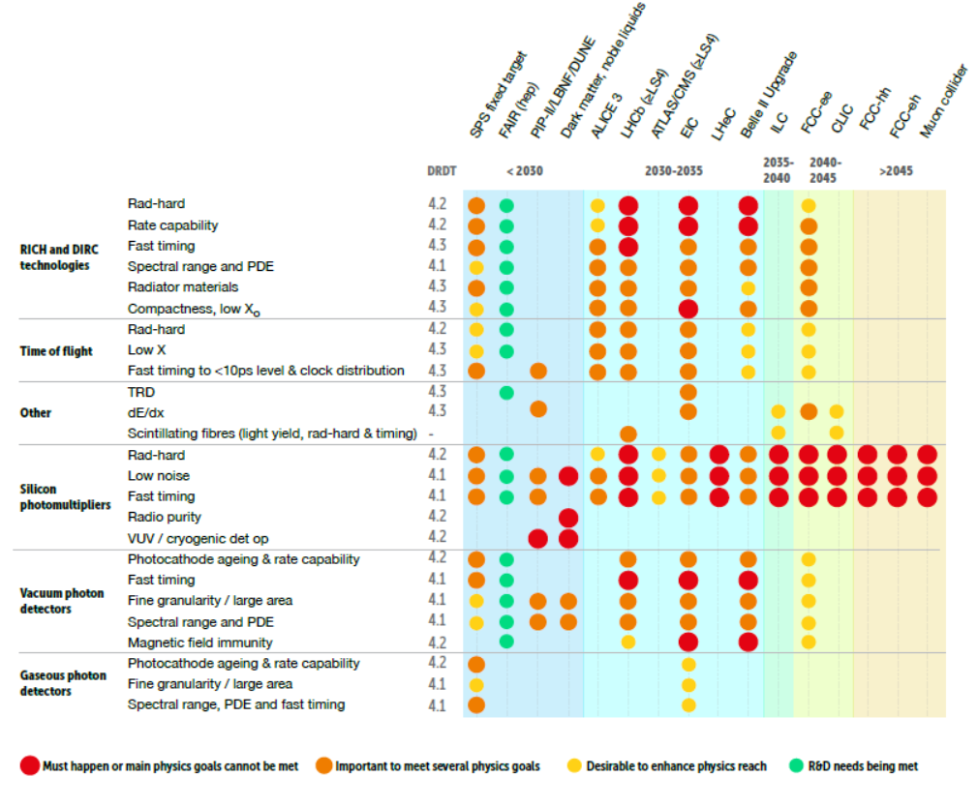
Summary of requirements
A chart was produced showing the timeline of categories of experiments employing PID and photon detectors together with R&D tasks.
The colour coding is linked to the potential impact on the physics programme of the experiment.
  Red, largest dot : Must happen or main physics goals cannot be met;
  Orange, large dot : Important to meet several physics goals;
  Yellow, medium dot : desirable to enhance physics reach;
  Green, small dot : R&D needs are being met;
  Blank : no further R&D required or not applicable.

Slide 17
Summary of recommendations
DRDT 4.1 : Enhance the timing resolution and spectral range of photon detectors
  Next 5 years : Advances in SiPMs for fast timing, uv sensitivity and rad hardness. Light collection systems
  MCP-PMTs improved QE & collection efficiencies, granularity and large areas.
  Next 10 years : Incremental improvements to gaseous photon detectors, granularity and fast timing.
DRDT 4.2 : Develop photosensors for extreme environments
  Next 5 years : Improve radiation tolerance of SiPMs. Radiation pure for cryo systems.
  MCP-PMTs improve detector ageing and high-rate performance
  Improve photocathode ageing and rate capability for gaseous detectors
  Next 20 years : Further advances in SiPMT rad hadness a couple of orders of magnitude beyond 1 x 10¹⁴ n_{eq}/cm²
DRDT 4.3 : Develop RICH and imaging detectors with low mass and high timing resolution
  Next 5 years : Picosecond timing, greenhouse-friendly radiator gases, cheaper quartz amd transparent aerogels
  Next 10 years : Compact RICH systems with low X₀ (pressurised systems).
DRDT 4.4 : Develop compact high performance time-of-flight detectors
  Picosecond timimg, high granularity photosensors with long lifetime and high-rate capabilities
Pursue “blue sky” R&D activities
  Solid state photon detectors from novel materials
  Cryogenic superconducting photosensors
  Gaseous photon detectors for visible light
  Metamaterials to give tune-able refractive indices

Slide 18
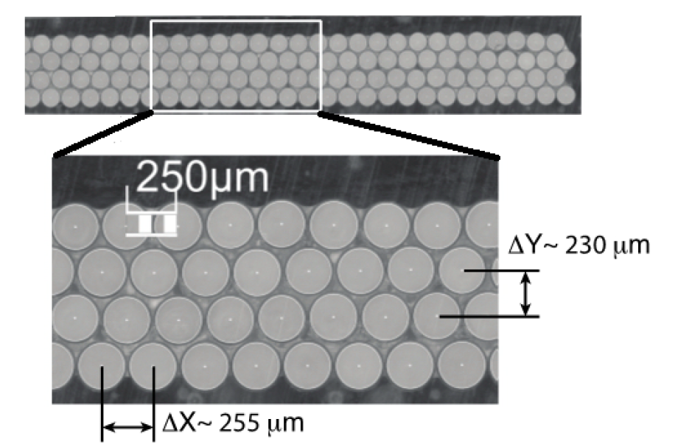
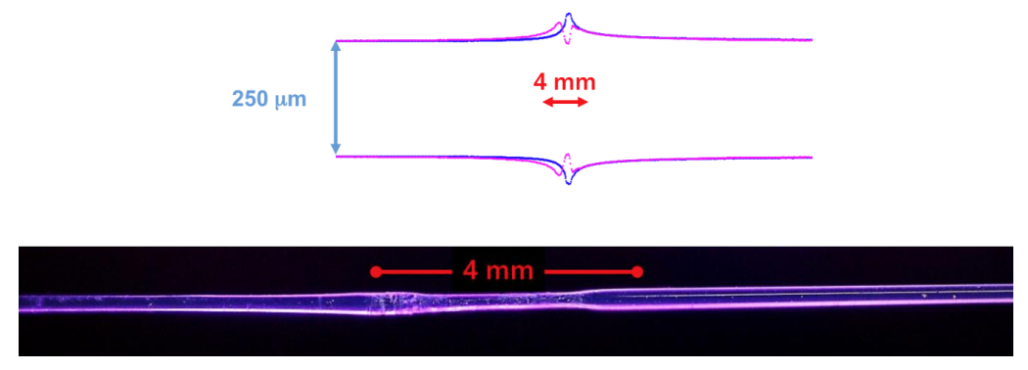
Scintillating fibre trackers
Decision by ECFA Roadmap officials : DRD4 shall include Scintillating Fibre (SciFi) trackers
We weren’t aware.
Recent examples: LHCb SciFi, Mu3e
Possible R&D goals
  Higher light yield
  Longer attenuation length
  More radiation hardness
  Better geometrical parameters (no bumps)
  Effective mat production technology

Slide 19
Quick analysis of returned surveys

Slide 20
ECFA TF-4 Survey : 40 groups replying

Slide 21
Replying Groups (40)
INFN Rome 1 and CREF
Bergische Universität Wuppertal
INFN Padova
GSI Helmholtzzentrum fuer Schwerionenforschung GmbH, Darmstadt, Germany
Georgia State University
infn
School of Physics and Astronomy, Monash University
Seoul National University
University of Warwick
IRFU, CEA
INFN Bari
INFN Bari
European Space Agency (ESA/ESTEC)
STFC - RAL
Institute of Plasma Physics and Laser Microfusion
CERN
IFIN-HH
IJCLab
INFN Milano Bicocca
Particle Therapy Research Center, University Medical Center Groningen
LHCb TORCH R&D project
A. I. Alikhanyan National Science Laboratory (Yerevan Physics Institute) AANL
ICCUB // University of Barcelona
DESY, Hamburg
University Giessen, Germany
CERN
Institut des 2 infinis de Lyon
INFN
KM3NeT Collaboration
AstroCeNT / Nicolaus Copernicus Astronomical Center of the Polish Academy of Sciences
ISTITUTO NAZIONALE DI FISICA NUCLEARE, Division of Ferrara
DESY
Fondazione Bruno Kessler
University of Oxford
The Catholic University of America
Queen Mary University of London
Aix-Marseille Univ, CNRS/IN2P3, CPPM, imXgam research team
Innsbruck University, NRNU MEPhI Moscow
Belle II, ARICH at KEK
CERN

Slide 22
Involved experiments (double countings not removed)
ePIC at EIC
RICH - CBM (Compressed Baryonic Matter)
PANDA/FAIR, GlueX/JLab, ePIC/BNL
fairtel
HERD R&D
Belle II
LHCb Upgrade II (TORCH)
ALICE-TOF, CALICE-SDHCAL, AIDAinnova
CALIPSO group, ClearMind project
N/A
LHCb / TORCH, also photon detectors for other applications relevant to DRD1 and DRD2
Space radiation environments and effects
LHCb
RF Timer
Future e+e- Higgs Factory
LHCb
LHCb, CTA, HERD, PETVISION
DUNE, Solar, LEGEND-200, LEGEND-1000
Real-time in vivo verification of proton therapy (RIVER)
TORCH
CBM RICH (with Univ. Wuppertal, GSI)
KM3NeT
PICMIC
CMS and CALICE
ALICE3
Detector developmet for high luminosity experiments (LHCb and 4DPHOTON projects)
ILD
LHCb and TORCH and ARC
ClearMind (French ANR), TEMPORAL (French PIA), TIARA (French PCSI)
Ongoing contacts / projects / discussions are related to CMS, LHCb and ALICE.
DarkSide-20k, DarkSide-LowMass, ARGO, 3DPi
ATLAS/TRT (main resposibility)
Electron Ion Collider/ hpDIRC
Belle II, ARICH
DUNE, ATLAS, MoEDAL
lhcb

Slide 23
Degree of interest in a DRD4 collaboration
Thanks!

Slide 24
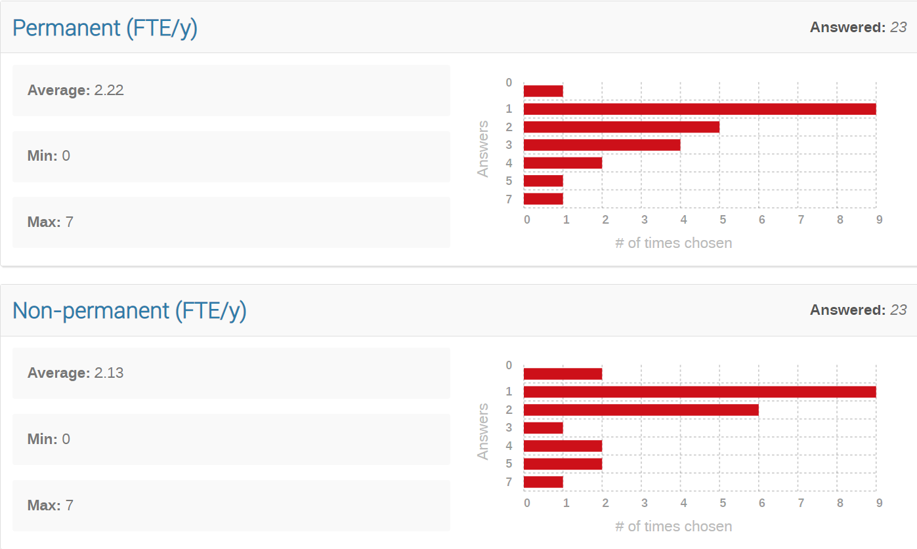
ECFA TF-4 Survey. Personnel resources. Groups replying (23)
Optimistic picture. Interface didn’t allow to enter 0.x FTE. And only half groups answered.

Slide 25
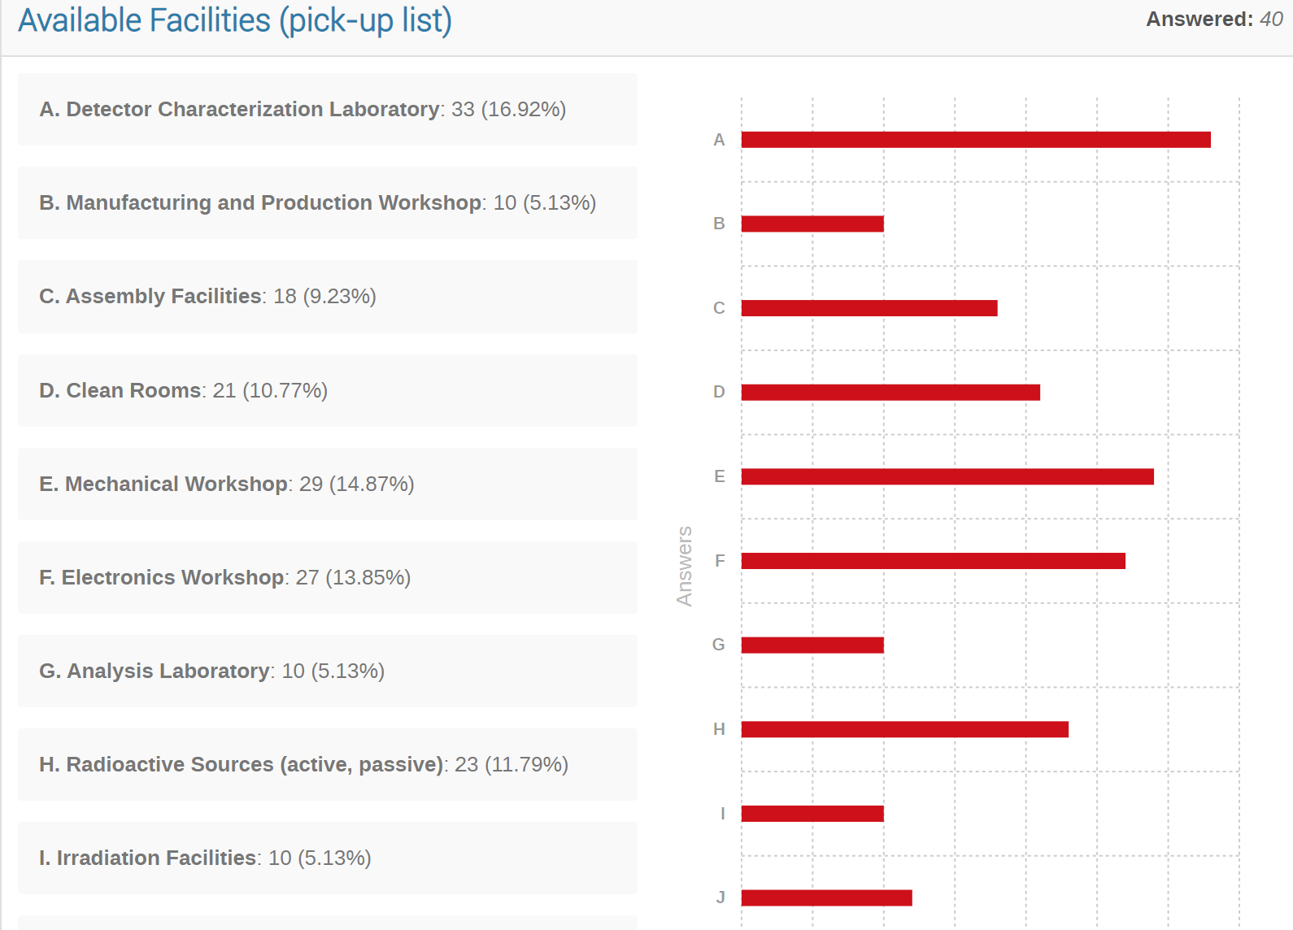
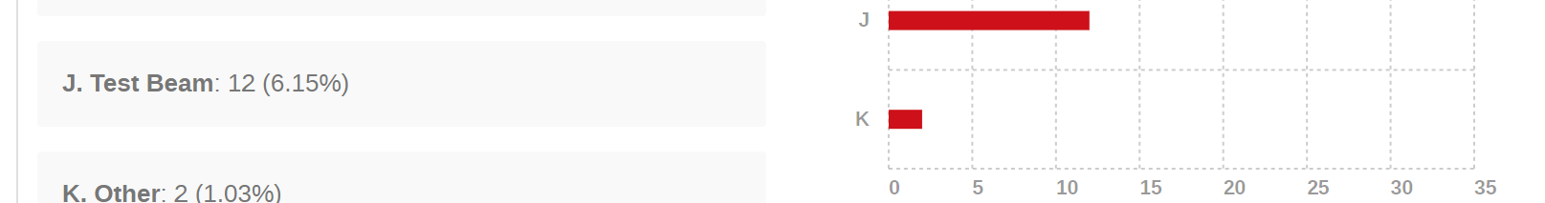
Available Facilities

Slide 26
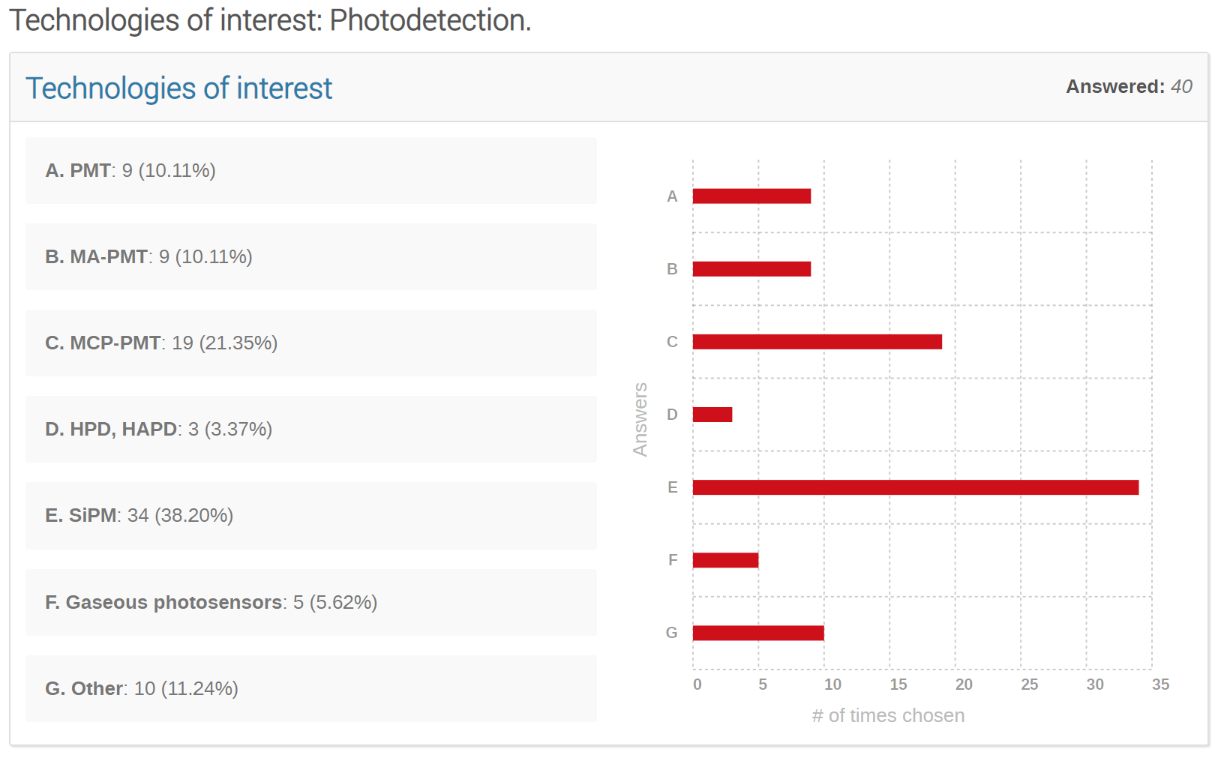
Technologies of Interest (Photodetection)

Slide 27
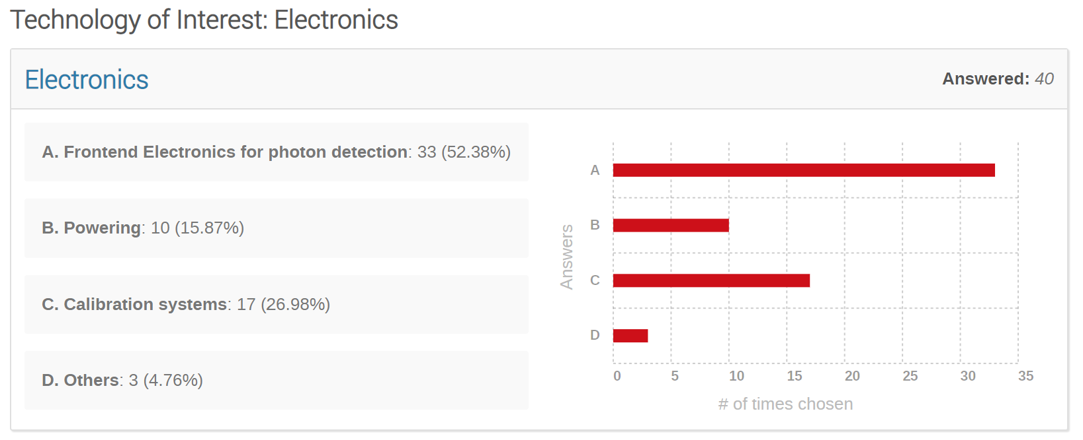
Technology of Interest: Electronics

Slide 28
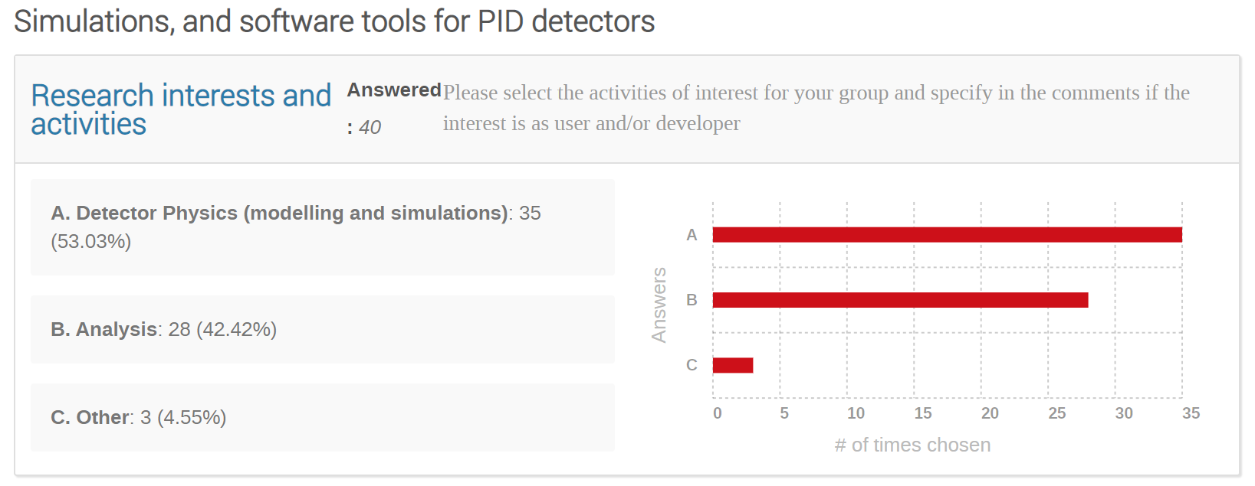
Simulation and software tools

Slide 29
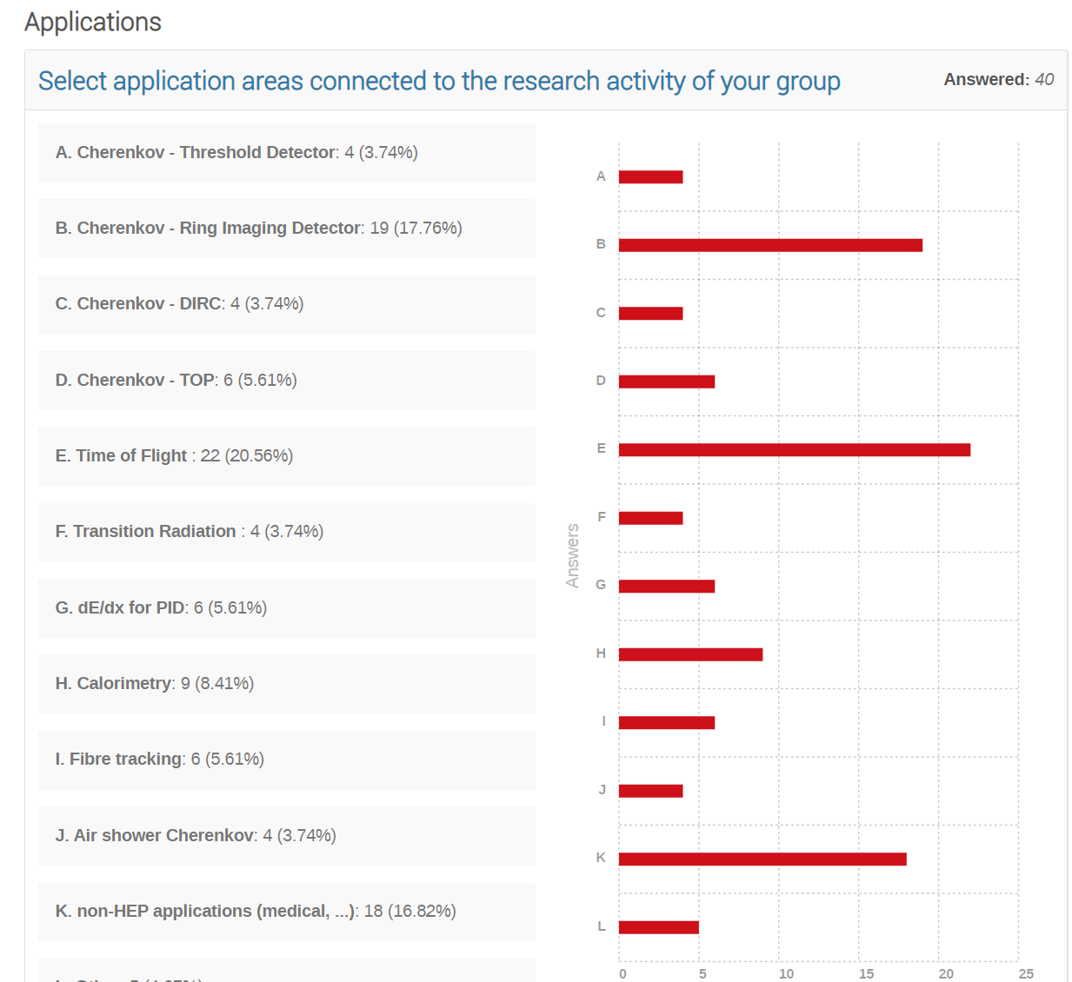
Applications

Slide 30
Tentative Programme for Community Meeting
Tue, 16/05, morning, 0.5h
Introduction, the Roadmap, purpose of the meeting, timeline, results of survey
Session Photodetection,
SiPM, SPAD, PMT, MCP 12 talks
Session Technologies
Materials
Software
Session Particle ID
RICH/DIRC
TOF/TORCH
Social dinner
Wed, 17/05
Session ‘blue sky’, special, etc.
Session Organisation 1
Introduction to Organisation
Presentation of groups and their interests
Session Organisation 2
Structure of DRD4
Which WPs? Scopes ?
Financial
Common projects
Session Organisation 3
Proposal, content, timeline, signatories
Contributors
3 talks
3 talks
6 talks

Slide 31
SPARE SLIDES

Slide 32
Draft structure of DRD4
(For discussion only)
Coordinator
JP leaders
WG leaders
Joint projects
DRDT 4.1
DRDT 4.2
DRDT 4.3
DRDT 4.4
Enhance the timing resolution and spectral range of photon detectors
Develop photosensors for extreme environments
Develop RICH and imaging detectors with low mass and high timing resolution
Develop compact high performance time-of-flight detectors
Other JP
…
Working Groups
Photodetector R&D
Solid state
Gaseous
Vacuum
Particle ID
RICH
DIRC
TOP
TORCH
TOF
Technologies
Radiators
Optical elements
Readout
Cooling
software
Future
ideas,
concepts,
blue sky
…
Other WG
…

Slide 33
Organisation of Detector R&D Roadmap
https://indico.cern.ch/e/ECFADetectorRDRoadmap

Slide 34
Facility requirements : Particle Identification
Projects | Timescale | RICH (high and low momentum PID) | Time of flight and DIRC | RPC technologies | TRD & dE/dx
Panda/CBM (Fair/GSI) | 2025 | ✓ | ✓ | ✓
NA62/KLEVER/TauFV | 2025 | ✓ | ✓
ALICE | 2026-27 (LS3) – 2031 (LS4) | ✓ | ✓ | ✓ | ✓
Belle-II | 2026 | ✓ | ✓
Neutrino long baseline | 2027
LHCb | 2031 (LS4) | ✓ | ✓
ATLAS-CMS | 2031 (LS4) - 2035 (LS5)
Non accelerator & particle astro | --
EIC | 2031 | ✓ | ✓
ILC | 2035
CLIC | 2035
FCC-ee | 2040 | ✓ | ✓ |  | ✓
Muon-collider | > 2045
FCC-hh | > 2050

Slide 35
Facility requirements : Photon Detectors
Projects | Timescale | SiPM technology | MCP-PMT technology | Large diameter PMT technology | Scintillating fibres & new scintillating materials | CCDs & superconducting devices
Panda/CBM (Fair/GSI) | 2025 | ✓ | ✓
NA62/KLEVER/TauFV | 2025 | ✓ | ✓
ALICE | 2026-27 (LS3) – 2031 (LS4) | ✓ | ✓
Belle-II | 2026 |  | ✓
Neutrino long baseline | 2027 | ✓ |  | ✓ | ✓
LHCb | 2031 (LS4) | ✓ | ✓ |  | ✓
ATLAS-CMS | 2031 (LS4) - 2035 (LS5) | ✓
Non accelerator & particle astro | -- | ✓ |  | ✓ | ✓ | ✓
EIC | 2031 | ✓ | ✓ |  | ✓
ILC | 2035 | ✓ |  |  | ✓
CLIC | 2035 | ✓ |  |  | ✓
FCC-ee | 2040 | ✓ | ✓ |  | ✓
Muon-collider | > 2045 | ✓
FCC-hh | > 2050 | ✓

Slide 36
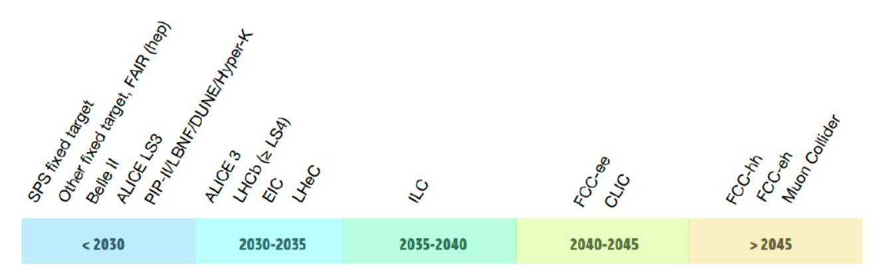
Large accelerator-based facility/experiment earliest feasible start dates

Slide 37
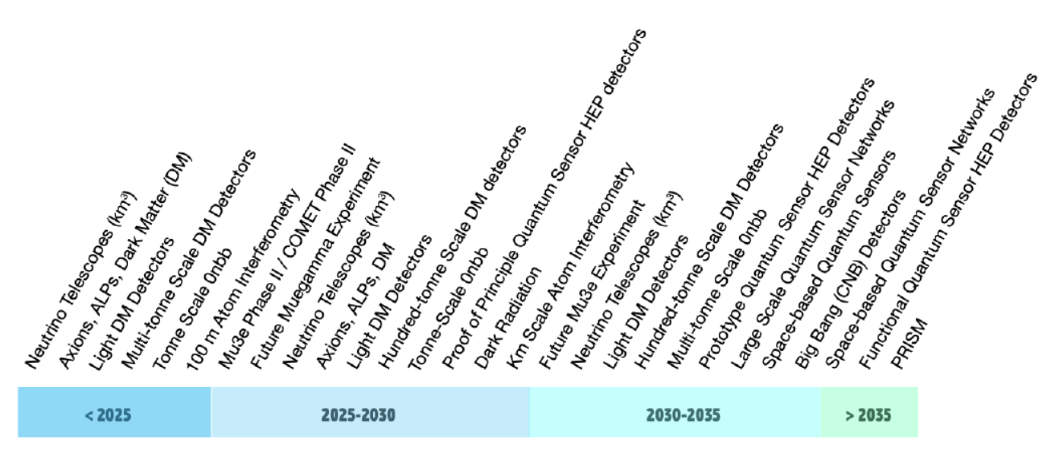
Smaller accelerator and non-accelerator-based experiments start dates

Slide 38
Family of vacuum-based photodetectors
A number of photon detector types have evolved from the classic photomultiplier concept :
Micro-channel plate detectors (MCP-PMTs)
  Several suppliers : eg. LAPPD (large area) and Photonis/ Hamamatsu/ Photek (compact, tunable granularity) – see next slide
  Photo-multipliers (including large areas)
  Improvements needed to increase radio-purity (factor 5-10), UV response & QE
  Multianode (MaPMTs)
  Hybrid avalanche photon detectors (HAPDs)
  Hybrid HPDs, V-SiPMT …. etc

Slide 39
Gas-based photodetectors
Gaseous Photon Detectors (GPDs) represent an effective solution for instrumenting large imaging surfaces (up to several square metres) in high magnetic felds.
Need to develop GPDs based on Micro Pattern Gaseous Detector (MPGD) structures which allow photon conversions at few 10’s of micron level.
  Further R&D to improve the photocathode lifetime (GHz rates for EIC), the PDE, radiation hardness and time resolution in the few ps range (PICOSEC-Micromegas Detector Development); challenging extension to the visible spectral range.
Search for UV-sensitive materials more radiation-hard and chemically inert than CsI.
  Carbon based photocathodes
  Develop compact GPD systems with integrated electronics for imaging applications
  InGrid - Micromegas integrated in a Timepix
  R&D for alternative hydrocarbon-free gas mixtures
  GPDs for cryogenic applications
  Detection of both scintillator light and ionization

Slide 40
SiPMs : R&D technology requirements
A non-exhaustive list – different applications, different requirements:
  Improved radiation hardness (1x10¹⁴ n cm⁻² eq @ CMS ; 10¹⁷-10¹⁸@ FCC-hh !)
  Improved dark count rates towards 1 Hz mm⁻² (driven by low light-level experiments) and reduced after pulsing
  Improved timing characteristics (aspire to 10 ps or below for time resolution)
  Increasing photon detection efficiency for single-photons : fill factor and spectral range into the UV & IR
  Cryogenic operation of SiPMs : improved cooling systems (to reduce dark noise), @ -50 °C
  Optimised SiPM systems - large-area integration with cooling
  Optimised optical couplings. development of micro-lenses/filters.
  New materials for SiPMTs (eg SiC, GaN, InGaN, AlGaN)
  Improved dynamic range (driven by calorimetry)
  Improved cross talk
  Cheaper solutions for SiPMs (eg CMOS) for large area applications and high pixel density. Analogue vs. Digital
  Improving pulse shape discrimination (neutrinos and non-accelerator); development of corresponding r/o electronics
  High radioactive-purity for underground experiments, better than a few Bq/kg depending on material
  Cell size, dynamic range, fill factor.

Slide 41
PID with dE/dx, TRD
dE/dx resolution around 5% is routinely reached, in excellent conditions and with accurate calibration. Possible improvements
  dE/dx resolution ~ 5.4% (LP)^{-0.37} with L length in m, P pressure in bar; the interest in the P term is renewed where excellent PID is needed together with a large mass of the gas (TPC-as-a-target). R&D topics: suitable gas mixtures for high-P operation, light pressure-containment vessels.
  Cluster counting: dN_{cl}/dx resolution is potentially better than dE/dx (by a factor of 2). Cluster counting requires fast electronics and sophisticated counting algorithms, or alternative readout methods. It has the potential of being less dependent on other parameters. Cluster counting in time, cluster counting in space; R&D topics: wave-form sampling FEE with FPGA processing, 2D micropattern read-out.
TRD: employed in several experiments, ATLAS, ALICE, AMS, CBM, EIC
  Gas TRDs a mature instrument for PID at high energies. Due to the overlapping of the TR signal with the ionization, a precise knowledge (and simulation) of dE/dx is a must.
  GEMs are making their way in the technique
  An attempt has been made to improve cluster counting by means of a GridPix. Some improvement is possible, although not drastic. Potential improvement may be reached by differentiating the response to X-ray photons and to particle ionization→ Extensive R&D required!
  TRD imaging (e.g., with Timepix3)? (for hadron PID at very high energies)

Slide 42
Superconducting photodetectors
  Single photon detection technologies with superconductors
  Superconducting detectors for UV-midIR photons
    TES: Transition Edge Sensor
    SNSPD: Superconducting Nanowire Single Photon Detector
    MKID: Microwave Kinetic Inductance Detector
  Example: nanowire detectors for dark matter detection; dark photons
  Work in progress relevant to HEP applications

Slide 43
Novel optical materials for fiber trackers
Scintillating fibres:
  A cost-effective way of instrumenting large areas for charged particle tracking at relatively low material budget. With the availability of small-pitch SiPM arrays, high resolutions are possible (LHCb SciFi tracker upgrade)
Further advances in the technology, e.g. for a second upgrade of the tracker envisaged for the High-Luminosity LHC:
  Optimize photo-sensor and optical fibers need to be optimised for a higher light yield, allowing for smaller diameters and thus higher precision and improved radiation tolerance.
Open issues:
  Radiation tolerance, speed, emission spectrum
Innovative materials: Nanostructured-Organo-silicon-Luminophores (NOL) scintillators:
  Exhibit stronger and faster light output than presently achieved.
  Decay time: NOL fibres are almost a factor 2 (6) faster than the best blue (green) standard fibres, which makes them very interesting for time critical applications
  Radiation hardness (X-rays to a dose of 1 kGy): damage is as expected on a level comparable to reference fibres

